Slide 1
WINGS of Hope: evaluating effects of integrating a brief gender-based violence prevention intervention with HIV counseling and testing among women who use drugs in Kyrgyzstan
Tatiana Musagalieva

Slide 2
WINGS of Hope Team’s acknowledgement for the HIV/AIDS research community:
I want to begin my presentation by thanking the people living with HIV who have generously shared their time, experiences, and bodies for the purposes of this research. Much of the fight against HIV and AIDS relies upon people living with HIV continuing to put themselves forward and this research and our fight against HIV and AIDS is indebted to those past and present.

Slide 3
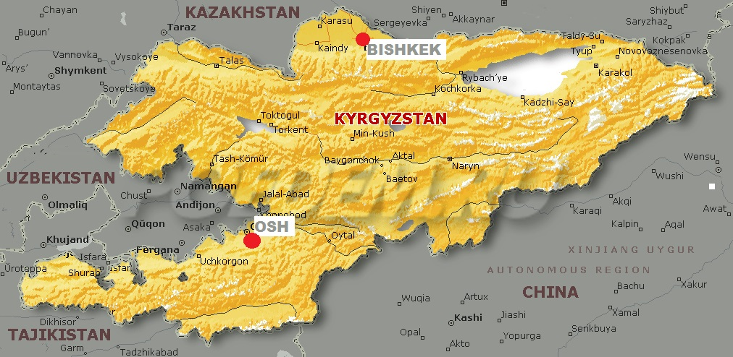
Goals of WINGS of Hope
Conduct a pilot trial to evaluate the effectiveness of WINGS integrated with gender-specific HCT recommended by WHO in (1) identifying and addressing IPV and GBV and (2) increasing HIV testing
Adapt WINGS – an IPV screening, brief intervention, and referral to treatment/service model (SBIRT) to identify and address GBV among women who use drugs in Kyrgyzstan
&
&
Collect secure electronic data on frequency of all types of IPV and GBV among women who use drugs

Slide 4
WINGS of Hope Participants’ Eligibility Criteria
A woman was eligible if she:
+
… and agreed to participate
… was 18 or older
… OR reported binge drinking (4 or more drinks in a 6-hour period) in the past 90 days with a history of drug use
… spoke Russian
… reported using illicit drugs in the past 3 months
+
… OR was in drug treatment (methadone, detox, NA, etc) while participating in the project
… OR reported accepting money, goods, food, drugs, or other things from a man or a woman, or offering housing or protection in exchange for vaginal, oral or anal sex, with a history of binge drinking or drug use

Slide 5
Socio-demographics Background Characteristics of WINGS of Hope women participants (consolidated 2013-2016 data, n=213): Part One
Age (mean, SD) | 39.9, 8.9
Ethnicity
Russian | 127 (59.6%)
Tartar | 26 (12.2%)
Kyrgyz | 25 (11.7%)
Uzbek | 13 (6.1%)
Other | 22 (10.3%)
Religion
Muslim | 62 (29,1%)
Christian | 137 (64,3%)
Do not have religion preferences | 14 (6,6%)
Marital Status
Married | 34 (16%)
Common law marriage | 69 (32,4%)
Divorced | 47 (22,1%)
Separated | 19 (8,9%)
Widow | 22 (10,3%)
Single, never married | 15 (7%)

Slide 6
Socio-demographics Background Characteristics of WINGS of Hope women participants (consolidated 2013-2016 data, n=213): Part Two
Education
No formal schooling | 4 (1,9%)
Primary school (grade 1-4) | 3 (1.4%)
Secondary school (grade 5-9) | 48 (22.5%)
High school (grade 10 through grade 11) | 87 (40.8%)
Vocational education | 50 (23.5%)
Incomplete higher education | 6 (2.8%)
Higher education | 15 (7%)
Employment
Employed full-time | 27 (12.7%)
Employed part-time | 38 (17.8%)
Temporary work | 90 (42.3%)
Get seniority pension | 1 (0.5%)
Get incapacity benefit | 2 (0.9%)
Other sources of income | 47 (22.1%)
Have children | 153 (72%)
Place to sleep every night, past 90 days | 192 (92%)
Sex trading, ever | 108 (51%)

Slide 7
WINGS of Hope key activities framework:

Slide 8
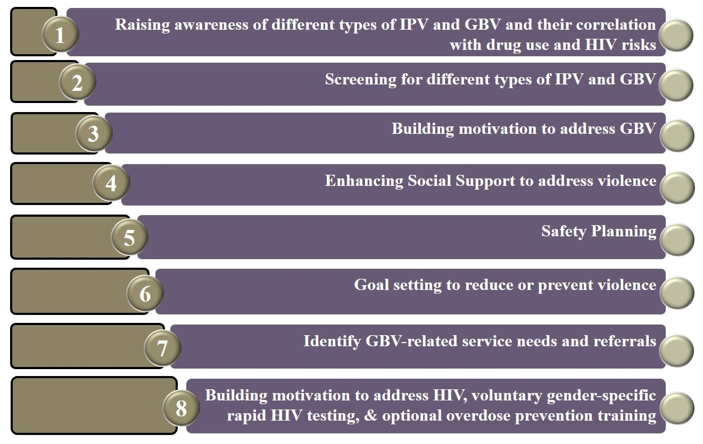
WINGS of Hope key components:

Slide 9
WINGS of Hope 2013-2016 NGO partnership network in Osh and Bishkek, Kyrgyzstan:
ASTERIA
(n=88)
Chance Crisis Center (n=8)
SOTSIUM (n=7)
Positive Dialogue
(n=7)
Plus Center (n=8)
Podruga Foundation
(n=95)

Slide 10
Overdose experience reported by the WINGS of Hope participants (“in the past 3 months”, 2013-2016 data)

Slide 11
Drug Use rates reported by the WINGS of Hope participants (“in the past 3 months”, 2013-2016 data)

Slide 12
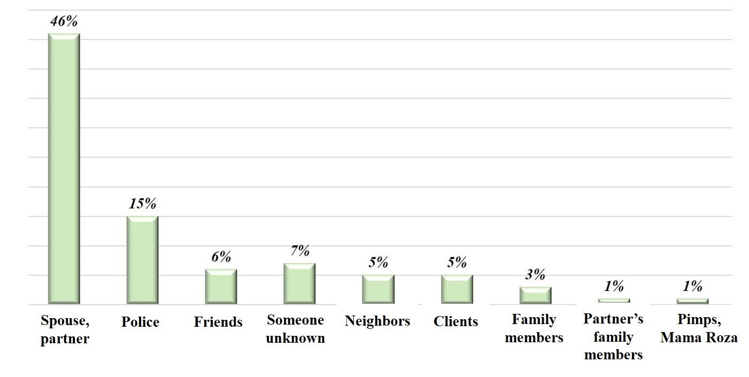
Perpetrators’ consolidated profile (2013-2016 data, n=213):

Slide 13
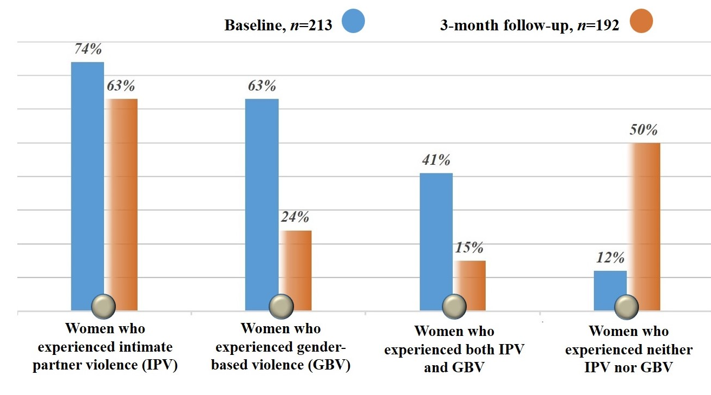
Prevalence of IPV and GBV in the WINGS of Hope participants “in the past 3 months” at baseline and 3-month follow-up assessment (2013-2016 consolidated data):

Slide 14
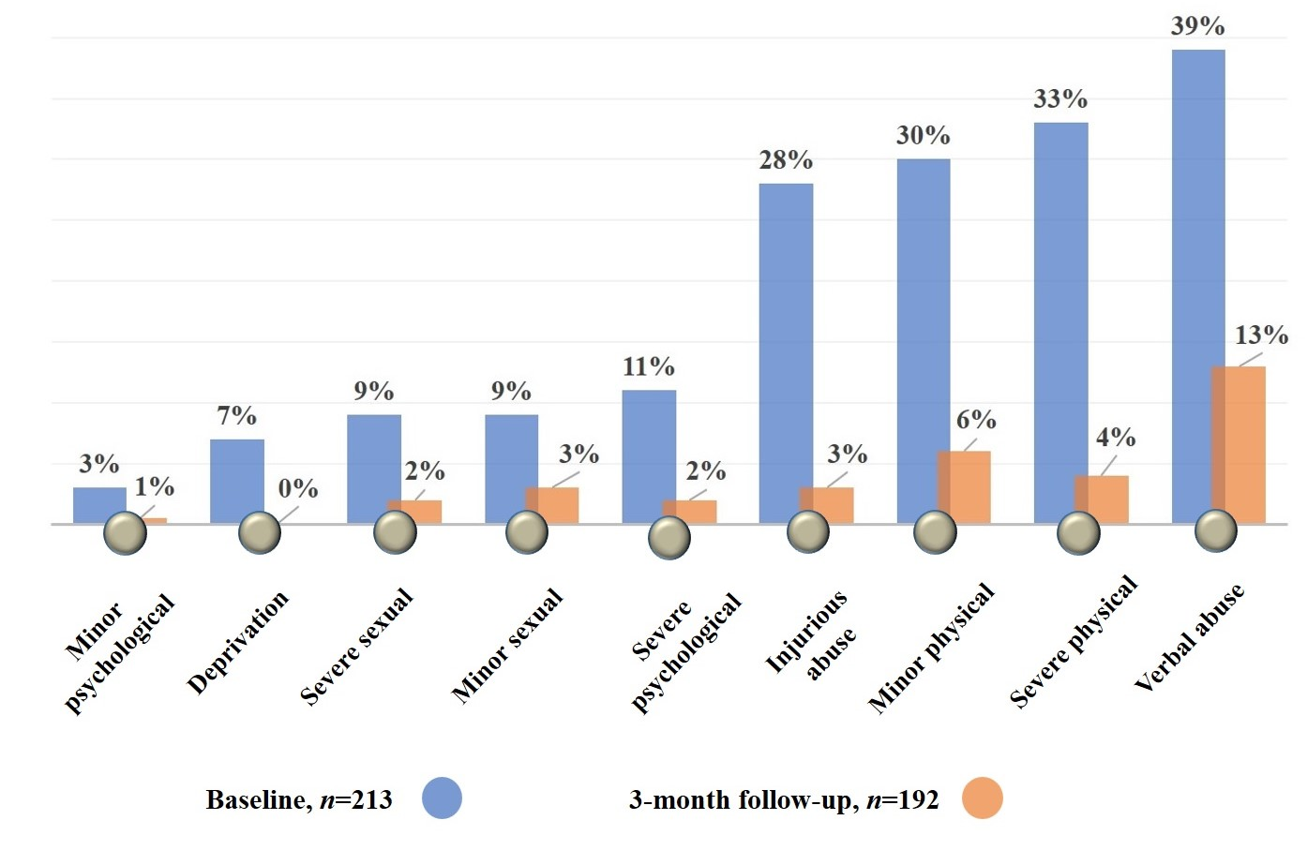
Prevalence of GBV in WINGS of Hope participants (2013-2016 consolidated data):

Slide 15
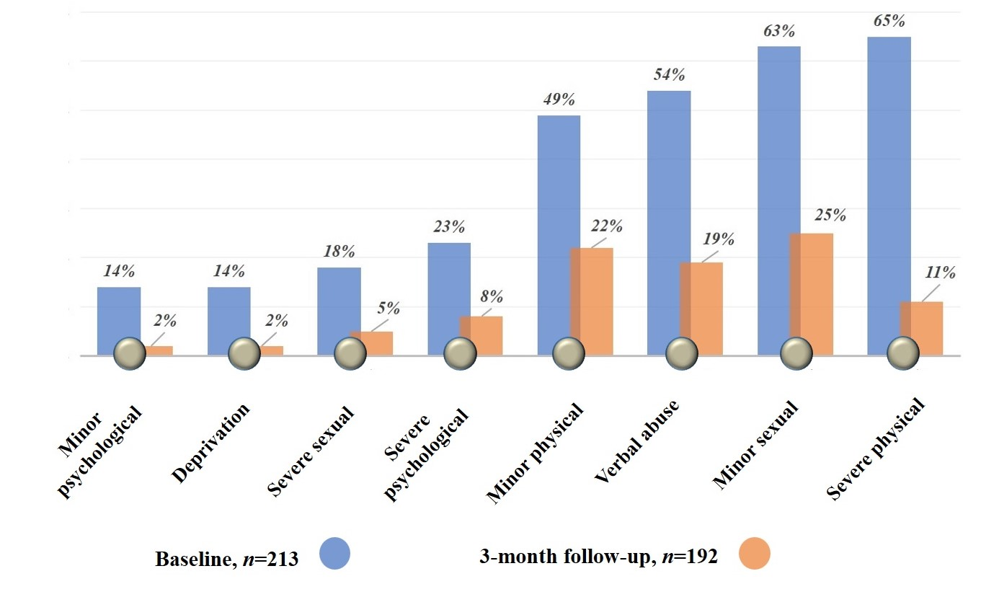
Prevalence of IPV in WINGS of Hope participants (2013-2016 consolidated data):

Slide 16
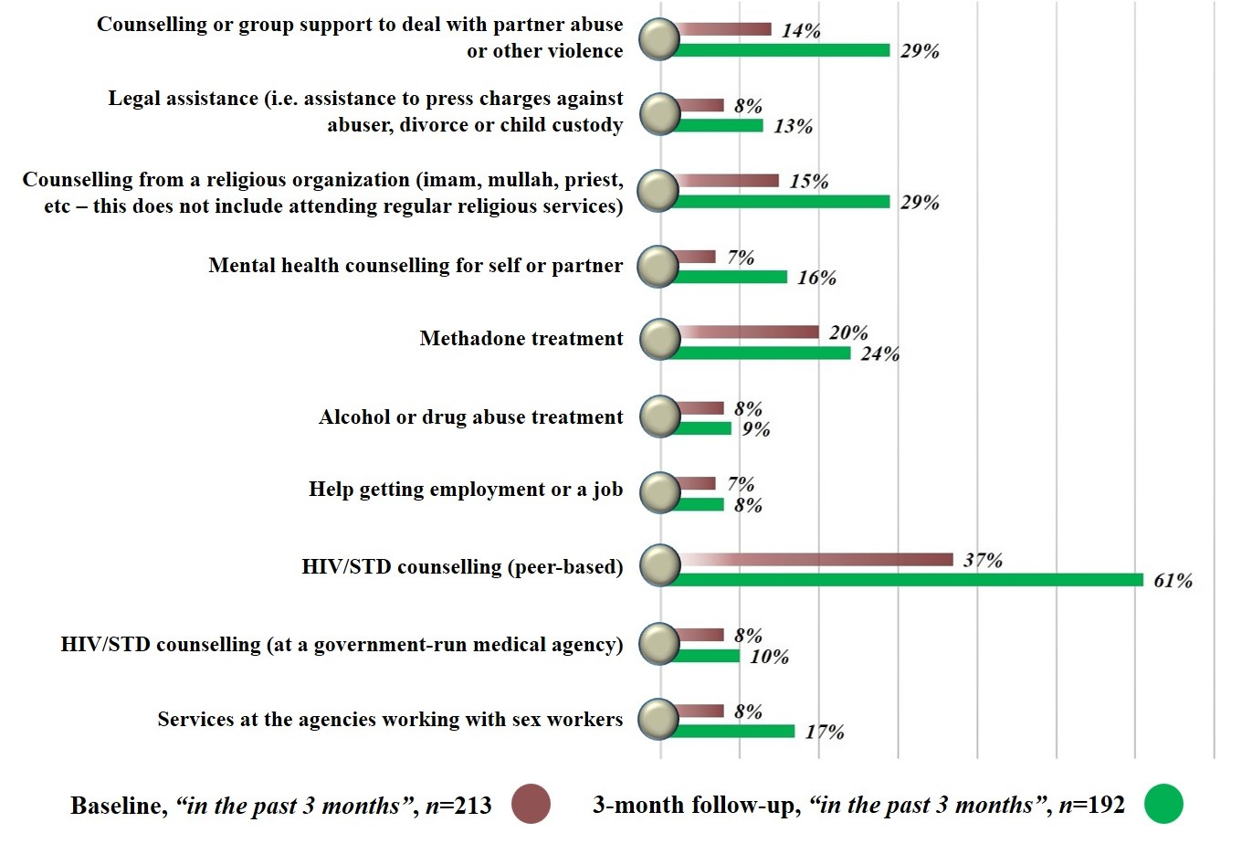
Service utilization rates (2013-2016 consolidated data):

Slide 17
WINGS Resources for committed implementers
Website in English and Russian with the WINGS Resource Center (www.glori.kg)
Page on Facebook with direct links to the Foundation’s website
Website in English at Columbia University server (www.projectwings.org)

Slide 18
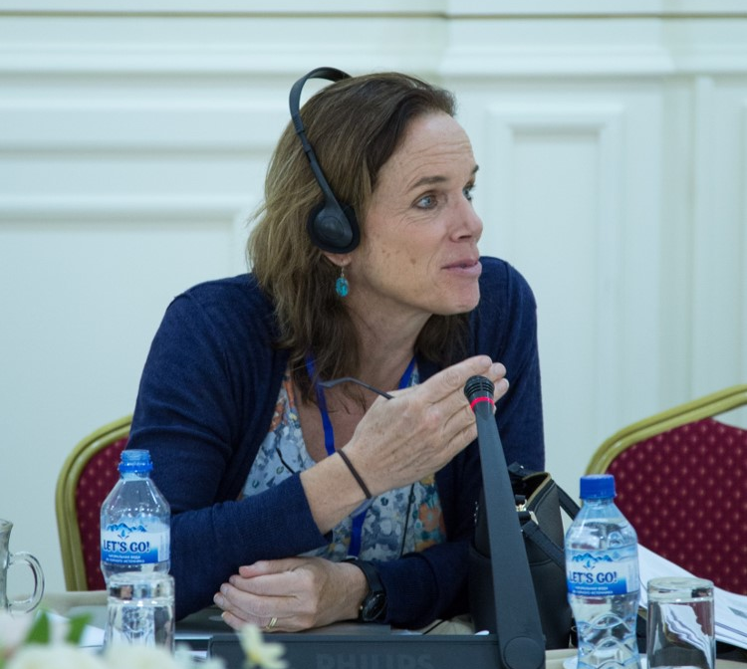
WINGS of Hope: Feedback from Renowned Researchers
“… The report represents an incredible amount of work with incredible partners in Kyrgyzstan over the past three years. It made just absolutely huge difference in reducing violence among women… I miss our partners there, I can’t wait to work with them in the future, and I just thank them so much from the bottom of my heart”.
Dr Louisa Gilbert, Columbia University Social Intervention Group

Slide 19
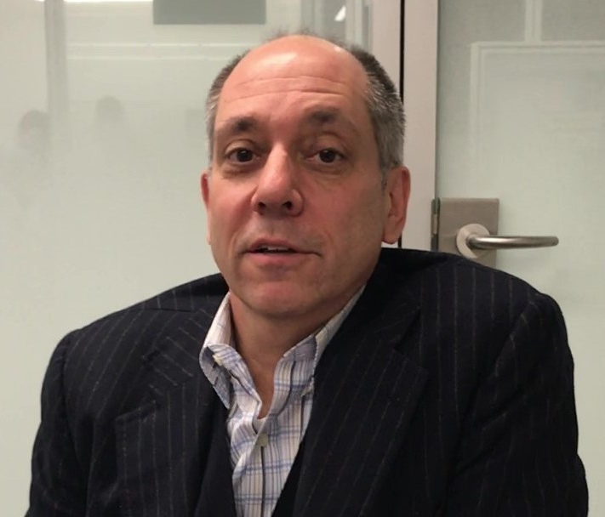
WINGS of Hope: Feedback from Renowned Researchers
“… This project is important to the world for two reasons: first, it is highlighting not only a problem of gender-based violence but what people can do about it when are left by themselves to cope Second, it represents collaboration between civil society organizations, a leading research university on the world, and an NGO that is working to bridge the gap between those two other groups”.
Daniel Wolfe, Director, IHRD Program, Open Society Foundations

Slide 20
Acknowledgement
The project was designed and implemented with involvement of all members of NOVIC (No Violence Coalition), community-based social activists, partners and international consultants who provided valuable contributions (in alphabetical order): Muhayo Abduraupova, Mahabat Akmatova, Marina Atabekova, Akim Barakov, Renata Bayazitova, Irena Ermolaeva, Batma Estebesova, Louisa Gilbert, Timothy Hunt, Chinara Imankulova, Tina Jiwatram-Negron, Ravshan Mazhitov, Aibek Mukambetov, Tatiana Musagalieva, Sahira Nazarova, Danil Nikitin, Aleksandr Pugachev, Olga Rychkova, Ilim Sadykov, Nadejda Sharonova, Olga Sheptiy, Natalya Shumskaya, and Elena Tkacheva.
The GLORI Foundation's team, including Danil Nikitin and Aleksandr Pugachev, took a lead role in coordinating, administering and facilitating all training-specific activities. GLORI Foundation appreciates people on this list for their significant support throughout the project.
Thank You!!

