Slide 1
HIV infection is an independent risk factor for liver steatosis: A study in HIV mono-infected patients compared to uninfected paired controls and associated risk factors
Antonio Pacheco, Hugo Perazzo, Sandra Cardoso, Maria-de-Jesus Fonseca, Rosane Griep, Paulo Lotufo, Isabela Bensenor, Jose Mill, Rodrigo Moreira, Ronaldo Moreira, Ruth Friedman, Marilia Santini-Oliveira, Valdilea G Veloso, Dora Chor, Beatriz Grinsztejn
Oswaldo Cruz Foundation (FIOCRUZ), Rio de Janeiro
University of São Paulo (USP)
Federal University of Espírito Santo (UFES)
Abstract number: THAB0205
Session title: HIV and the liver
July 26h, 2018

Slide 2
Disclosures
The authors have nothing to disclosure

Slide 3
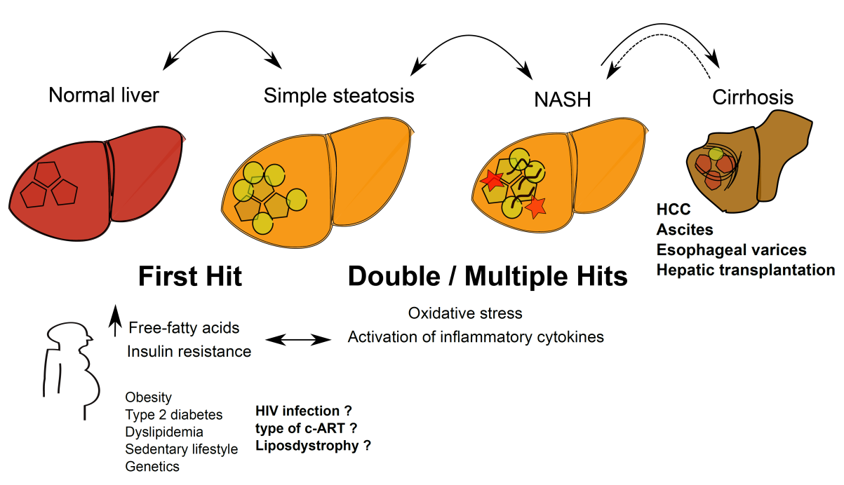
Background
Evolution of non-alcoholic fatty liver disease
Çç
l

Slide 4
The burden of liver steatosis
in HIV-infected patients
Authors | Country | N | Gold standard | Prevalence | Factors
Morse et al CID 2015 | USA | 62 | Liver biopsy | 73% | -
Mohr et al Medicine 2015 | Germany | 341 | - | - | -
Lombardi et al Dig Liver Dis 2016 | UK | 125 | US | 55% | Male sex, age, HOMA-IR, GGT
Liu et al AP&T 2016 | China | 80 | MRI | 29% | Triglycerides
Macias et al HIV Med 2016 | Spain | 326 | CAP | 37% | -
Sebastiani et al J Hepatol 2017 | Canada | 538 | CAP | 36% | BMI, triglycerides
Lemoine et al AIDS 2017 | France | 405 | - | - | -
Perazzo et al IAS 2017 | Brazil | 395 | CAP | 35% | MS, cumulative use of D-drugs
Impact of HIV infection for development of steatosis ?

Slide 5
Aims
To evaluate the prevalence and factors associated with liver steatosis in HIV mono-infected patients compared to uninfected subjects paired for confounding factors

Slide 6
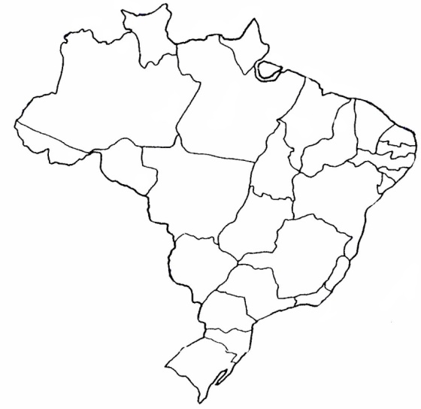
Methods
Cohort of HIV patients: HIV-ELSA
649 HIV mono-infected patients who have been followed at INI/FIOCRUZ - Rio de Janeiro - Brazil
Cohort of non-HIV subjects: ELSA-Brasil study
15,105 individuals included in a longitudinal multricentric Brazilian study (6 centers)
Brazilian Longitudinal Study of Adult Health

Slide 7
Methods
Clinical evaluation: anthropometric measures, alcohol intake, co-morbidities and co-medication use, history of HIV infection and c-ART treatment (for HIV-infected patients)
Blood tests: analyzed in a centralized laboratory
Liver steatosis was defined by Fatty Liver Index (FLI) ≥ 60
Serological biomarker for detection of steatosis
Parameters: GGT, BMI, waist circumference and triglycerides
Diagnostic value - AUROC = 0.84 [0.81-0.87] - FLI ≥ 60 – Sp=87%
FLI = (e0.953*ln(triglycerides, mg/dl)+0.139*BMI + 0.718*ln(GGT) + 0.053*ln(WC) - 15.745) x 100
1 + (e0.953*ln(triglycerides, mg/dl)+0.139*BMI + 0.718*ln(GGT) + 0.053*ln(WC) - 15.745)
Bedogni BMC Gastroenterology 2006
 | China | Finland | Thailand | The Netherlands | USA | Brazil
 | N=3,548 | N=572 | N=29,797 | N=2,652 | N=5,869 | N=6,571
FLI - AUROCs | 0.76 [0.74-0.77] | 0.72 [0.66-0.77] | 0.827 [0.822-0.831] | 0.813 [0.797-0.830] | 0.780 [0.740-0.810] | 0.762 [0.745-0.779]

Slide 8
Method for matching
The variables used for the matching were selected through a genetic algorithm that searched for the best model fit
A propensity score was calculated for HIV-infected patients (HIV-ELSA) and non-HIV subjects (ELSA-Brasil study)
A nearest neighbor propensity score matching with a caliper of 0.05 was used to select cases (HIV-patients) and controls (non-HIV subjects)
Notes:
The variables used for the matching were selected through a genetic algorithm that searched for the best model fit
A propensity score were calculated for cases (HIV-infected patients from the INI-ELSA cohort) and controls (uninfected individuals from the ELSA Brasil study)
The methodology of the nearest neighbor propensity score with a caliper of 0.05 – selection of cases and controls
Standardized mean difference < 0.25

Slide 9
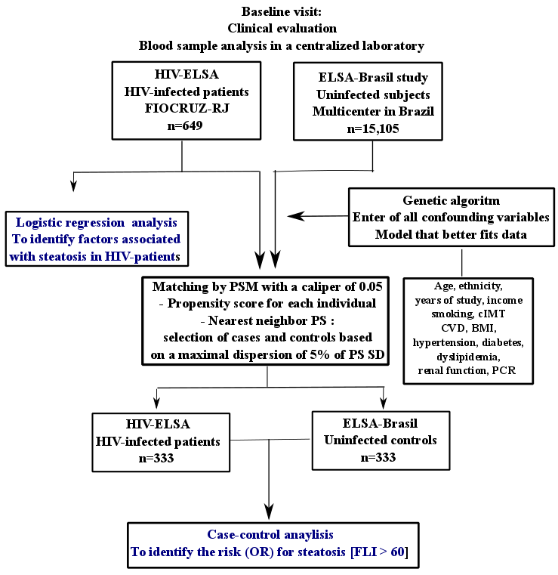
Flow-chart of the study

Slide 10
Characteristics of patients
 | ELSA-Brasil cohort Uninfected subjects (n=15,105) | HIV-ELSA cohort HIV-infected subjects (n=649) | p value
Demographic characteristics
Female sex | 8211 (54%) | 273 (42%) | < 0.001
Age, years | 51 (45 - 58) | 44 (36 - 51) | < 0.001
Black/Pardo ethnicity | 6591 (44%) | 149 (23%) | < 0.001
Education level > 8 years of study | 13167 (87%) | 339 (52%) | < 0.001
Metabolic features
BMI, Kg/m² | 26.5 (23.9 - 29.8) | 24.4 (21.9 - 27.5) | < 0.001
Waist circumference, cm | 87 (78 - 94) | 90 (82 - 99) | < 0.001
Type-2 diabetes | 2762 (18%) | 167 (26%) | < 0.001
Dyslipidemia | 8784 (58%) | 235 (37%) | < 0.001
Hypertension | 5717 (38%) | 202 (31%) | < 0.001
Metabolic syndrome | 6800 (45%) | 212 (33%) | < 0.001
Biochemistry
GGT, IU/L | 27 (18 - 42) | 52 (36 - 81) | < 0.001
Triglycerides, mg/dL | 115 (82 - 166) | 120 (85 - 185) | 0.007
LDL-cholesterol, mg/dL | 129 (107 - 152) | 106 (87 - 133) | < 0.001
HDL-cholesterol, mg/dL | 54 (46 - 65) | 42 (35 - 51.8) | < 0.001
Data expressed as n (%) or median [IQR]

Slide 11
Factors associated with liver steatosis in HIV-infected patients (n=649)
Prevalence of steatosis = 35%
 | No steatosis FLI < 60 (n=418) | Steatosis FLI >=60 (n=231) | p value
Female sex | 180 (43%) | 93 (40%) | 0.542
Age, years | 42 (34 - 50) | 46 (40 - 52) | < 0.001
Black/Pardo ethnicity | 105 (25%) | 44 (19%) | 0.096
Education level > 8 years of study | 225 (54%) | 114 (49%) | 0.312
Metabolic features
BMI, Kg/m² | 22.8 (20.9 - 24.9) | 28.4 (25.7 - 31.9) | < 0.001
Waist circumference, cm | 81 (76 - 87) | 97 (92 - 105) | < 0.001
Type-2 diabetes | 73 (18%) | 94 (41%) | < 0.001
Dyslipidemia | 133 (32%) | 102 (46%) | < 0.001
Hypertension | 97 (23%) | 105 (46%) | < 0.001
Metabolic syndrome | 56 (13%) | 156 (68%) | < 0.001
Poor clinical management | 162 (39%) | 123 (54%) | < 0.001
HIV history
CD4 count, cells | 529 (352 - 708) | 586 (408 - 830) | < 0.001
Undetectable HIV viral load (< 50copies/mm3) | 257 (70%) | 164 (77%) | 0.057
Nadir CD4 count | 226 (104 - 317) | 194 (85 - 305) | 0.142
c-ART | 369 (88%) | 207 (90%) | 0.700
Duration of c-ART, years | 3.3 (0.5 - 9.8) | 4.8 (1.7 - 11) | < 0.001
Current NNRTI treatment | 265 (63%) | 159 (69%) | 0.191
Current PI treatment | 208 (50%) | 132 (57%) | 0.085
Data expressed as n (%) or median [IQR]

Slide 12
Factors indepentently associated with liver steatosis in the multivariate analysis in HIV-infected patients (n=649)
 | OR (95% CI) | p value
Male sex, [yes vs no] | 5.36 (2.41-11.94) | < 0.001
Black/Pardo ethnicity, [yes vs no] | 0.22 (0.09-0.55) | < 0.001
BMI, [per Kg/m²] | 1.91 (1.67-2.18) | < 0.001
Type-2 diabetes, [yes vs no] | 5.79 (2.58-13.00) | < 0.001
Dyslipidemia, [yes vs no] | 2.57 (1.27-5.21) | 0.01
Hypertension, [yes vs no] | 2.56 (1.25-5.26) | 0.01
Poor clinical management, [yes vs no] | 0.36 (0.17-0.79) | 0.01
CD4 count, [per 100 cells/mm3] | 1.13 (1.01-1.27) | 0.04
Cumulative HIV viral load [per 10 log *year] | 1.25 (1.02-1.54) | 0.03

Slide 13
Presence of steatosis in HIV and non-HIV individuals paired by the nearest neighbor propensity score with a caliper of 0.05
 | OR (95% CI) | p value
HIV infection | 2.1 (1.49-2.95) | < 0.001
Logistic regression-based scores were used for matching and balance between groups was checked with usual procedures

Slide 14
Limitations
Strenghts
Multicenter study for controls (non-HIV subjects)
Blood sample analysis were performed in a centralized laboratory
Matching methodology (PSM) lead to very similar cases and controls based on a genetic algorithm
Lack of liver biopsy or imaging methods as a gold-standard for liver steatosis and fibrosis assessment

Slide 15
Conclusions
Traditional and HIV-specific risk factors were independently associated with liver steatosis in people living with HIV
HIV-infected individuals had 2-fold higher odds for presence of steatosis compared to uninfected paired controls

Slide 16
Acknowledgement
Participants:
ELSA-Brasil study and the HIV-ELSA cohort
Co-authors and colleagues:
FIOCRUZ [INI-LAPCLIN-AIDS / PROCC / ENSP]
University of São Paulo / University of Espirito Santo
Funding support
Thank you for your attention
hugo.perazzo@ini.fiocruz.br

