Slide 1
Residual HIV transcription on ART: implications for latency elimination
Steven Yukl
UCSF and San Francisco VA

Slide 2
Disclosures
I have no financial relationships with commercial entities.

Slide 3
Unclear what mechanisms govern latent HIV infection in vivo
Multiple mechanisms have been implicated in HIV latency:
Most published studies have relied on in vitro models
Most studies have investigated only one mechanism at a time
Blocks to initiation of transcription:
Integration into transcriptionally-silent regions
Epigenetic modification
Lack of host cell transcription factors
Lack of viral transcription factors (Tat)
Transcriptional interference
Blocks to elongation of transcription:
Lack of host cell elongation factors
Lack of Tat
Nucleosome positioning
Post-transcriptional factors:
Lack of Rev
Blocks to nuclear export
RNA interference

Slide 4
Objectives
Simultaneously apply a panel of HIV RNA assays to cells from ART-treated patients in order to:
Determine the degree to which different mechanisms inhibit HIV transcription in vivo
Measure the degree to which each mechanism is reversed by T cell activation
Hypothesis: Latency is primarily due to lack of HIV transcriptional initiation

Slide 5
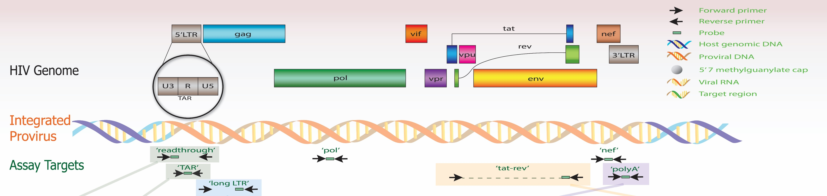
“Transcription profiling” to investigate the mechanisms that regulate HIV transcription in vivo
Read-through
Suggests transcriptional interference
TAR
Found in
all HIV transcripts;
initiation of transcription
LONG LTR
Proximal elongation (past 5’ LTR)
NEF
Distal transcription
(3’ end)
POLY A
Completion of transcription; surrogate for HIV protein
TAT-REV
Completion of splicing; surrogate for productive infection
Bullen et al., 2014 Nat. Med.; Kaiser et al., 2017 J. Virol. Methods; Lenasi et al., 2008 Cell Host Microbe

Slide 6
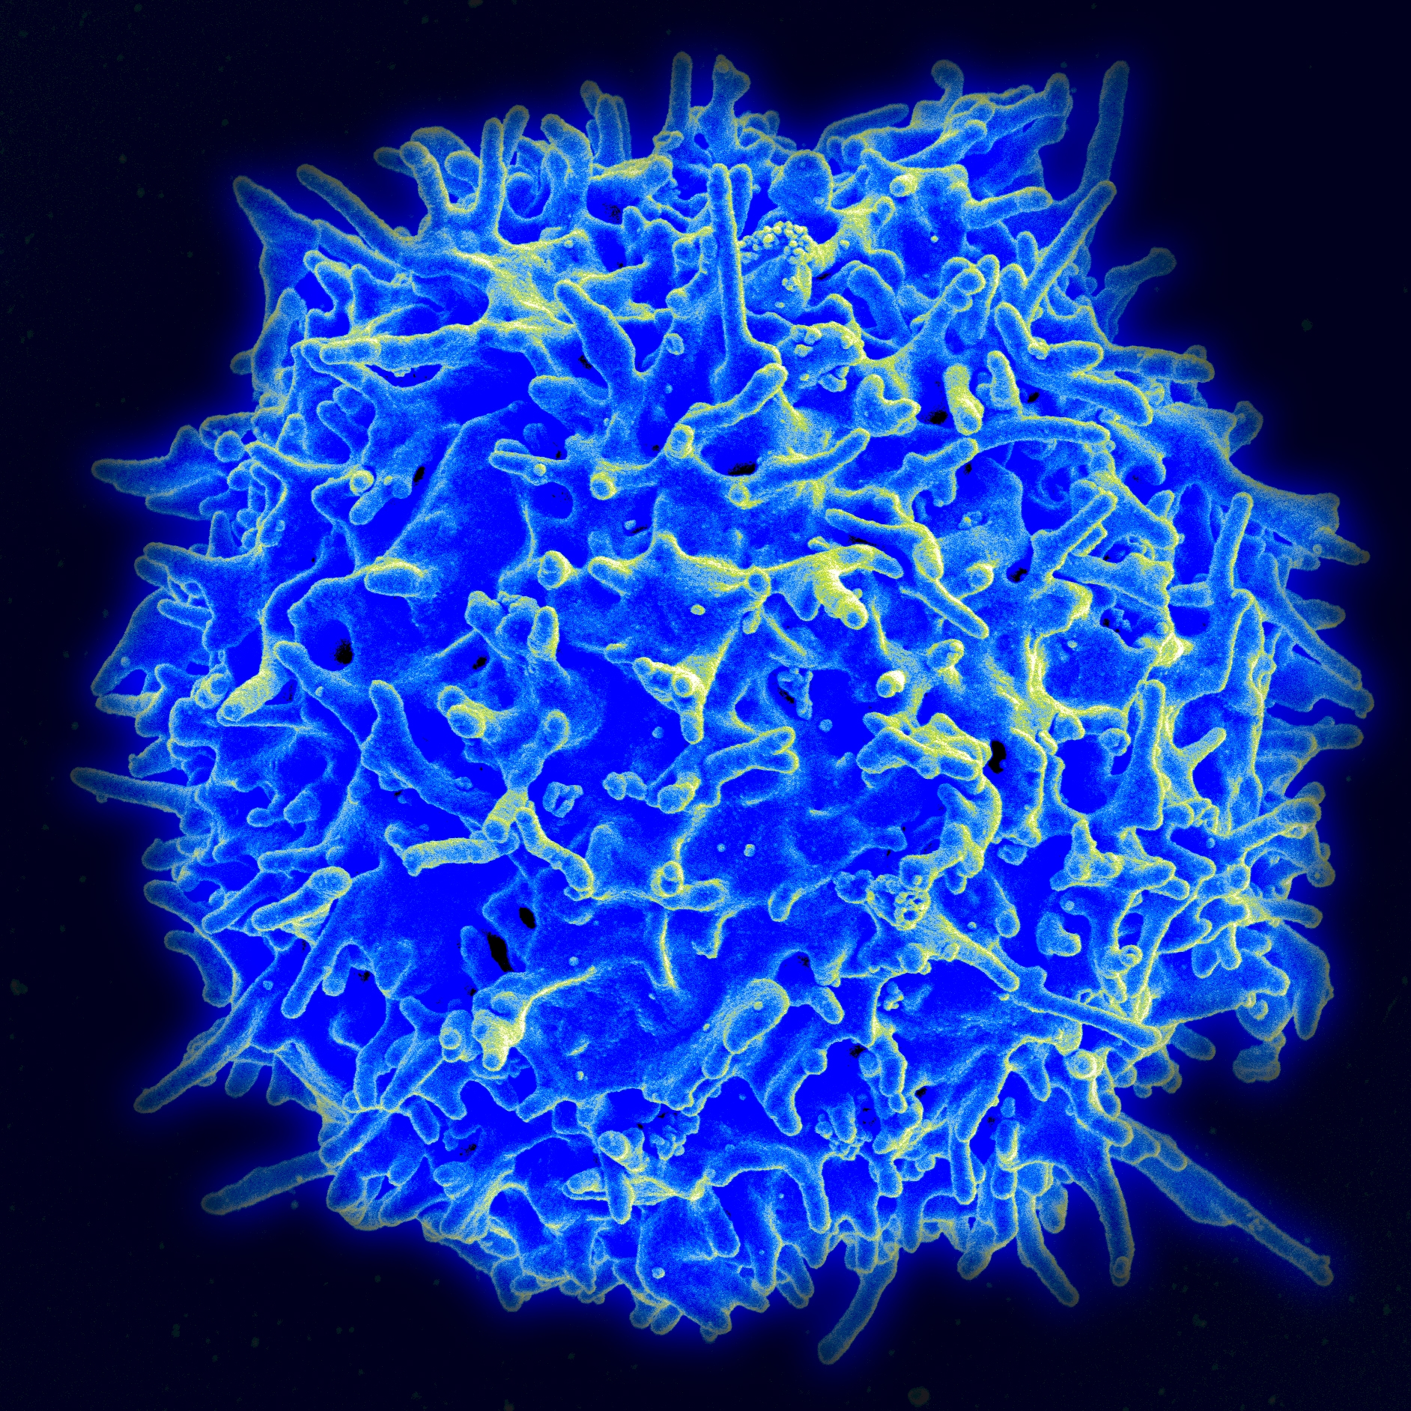
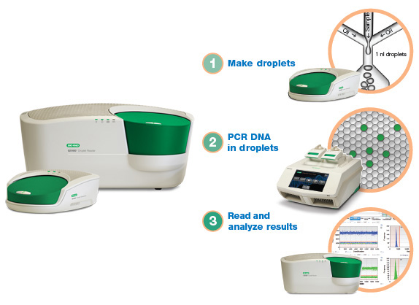
Methods
Neg selection using
Ab-bound beads
Blood from
HIV+ adults
on ART
VL<40 c/ml
-80C (day 0, untouched)
Extract total
RNA and DNA
CD4+T cells
Activate for 1 and 2 days
Aliquots of cells
6-10 x 10⁶
+ nevirapine + indinavir
+/- antiCD3/28 and IL-2
Trireagent
Measure
concentration
NanoDrop
Aliquot RNA
1ug
5ug
Poly-A tailing
PolyA polymerase
Reverse transcription
Reverse
transcription
Poly(dT) +
Random hexamers
Poly(dT) +
Random hexamers
Aliquot for
ddPCR
Aliquot for ddPCR
TAR
Read-through
Long LTR
Pol
Nef
PolyA
Tat-Rev
Yukl et al, Science Trans Med, 2018

Slide 7
Transcription profile in blood CD4+T indicates blocks to elongation, completion, and splicing
Yukl et al, Science Trans Med, 2018
1) Low levels of read-through transcripts; 2) High levels of transcriptional initiation (TAR); 3) Strong blocks to elongation, completion, and multiple splicing

Slide 8
Block to completion represents blocks to distal transcription +/- polyadenylation
Yukl et al, Science Trans Med, 2018
A gradient was observed from the 5’LTR to Pol to Nef to the 3’LTR-polyA
Suggests blocks to distal elongation and a possible block to polyadenylation

Slide 9
Differences in HIV RNAs can’t be explained by proviral mutations in primer/probe regions
Yukl et al, Science Trans Med, 2018
1. Differences between levels of HIV RNAs were preserved even after normalization to the corresponding HIV DNA levels
2. Differences in HIV RNA levels can’t be explained by mutations in HIV DNA at primer/probe regions

Slide 10
Differences in HIV RNA levels can’t be explained by differences in stability

Slide 11
Activation selectively increases elongated, polyadenylated, and spliced transcripts
Yukl et al, Science Trans Med, 2018
Median (day2/day0) = 0.75
Median (d2/d0) = 0.87
Median d2/d0 = 1.64
Median d2/d0 = 10.9
Median d2/d0 = 26
The main reversible blocks to HIV transcription are not transcriptional interference or lack of initiation, but blocks to elongation, completion, and splicing

Slide 12
Activation partially reverses blocks to elongation, completion, and splicing
Yukl et al, Science Trans Med, 2018
Activation reverses baseline blocks to elongation, completion, and splicing
The block to completion is the one most reversed by activation

Slide 13
The cellular distribution of each HIV RNA follows the same pattern as the levels/10⁶ cells
Yukl et al, Science Trans Med, 2018
The relative order of cell frequencies positive for each HIV RNA mirrors the levels/10⁶ cells
Almost all HIV-infected cells contain TAR transcripts
The observed transcriptional blocks operate in most HIV-infected cells

Slide 14
Blocks to elongation, completion, and splicing found in most HIV-infected cells
Yukl et al, Science Trans Med, 2018

Slide 15
LRAs exert differential effects on the different blocks
Yukl et al, Science Trans Med, 2018
The mechanisms underlying the blocks to completion and splicing may differ from those that mediate the blocks to initiation and elongation

Slide 16
Different mechanisms govern HIV transcription in the rectum
>10-fold lower HIV transcriptional initiation (TAR RNA/HIV DNA) in rectal CD4+ T
Little or no block to elongation in rectal CD4+ T
Blocks to completion and splicing observed in rectal CD4+ T

Slide 17
Blood and gut differ in HIV transcriptional blocks underlying latency

Slide 18
Conclusions
The main reversible blocks to HIV expression in circulating CD4+ T cells are not transcriptional interference or lack of initiation, but rather inhibition of elongation, completion, and multiple splicing
These blocks to HIV transcription operate in most HIV-infected cells, and are likely the mechanisms of latency in the blood
Blocks to HIV transcriptional initiation (as well as completion and splicing) may be important for latency in the gut

Slide 19
Implications
The TAR loop may serve as marker and target for HIV-infected cells in the blood
Latency reversal may require agents or combinations that reverse all blocks
Different therapies may be required to reactivate HIV-infected cells in the tissues
There are multiple different steps at which HIV transcription can be silenced
Gut cells that are activated but don’t express virus may serve as a model for silencing HIV

Slide 20

Acknowledgments
San Francisco VA and UCSF:
Philipp Kaiser
Peggy Kim
Sushama Telwatte
Tsui-Hua Chen
Sunil Joshi
Harry Lampiris
Joseph Wong
San Francisco VA ID Clinic:
Mai Vu
UCSF/ZSFGH:
Ma Somsouk
Chris Baker
Sulggi Lee
Teri Liegler
Mike McCune
Jeffrey Milush
Peter Hunt
Steve Deeks
Baylor:
Hongbing Liu
Andrew Rice
University of Zürich
Huldrych Günthard
Marek Fischer
Funding:
Dept. of Veterans Affairs
NIH
amfAR
The study participants!

Slide 21
Differences in HIV RNAs are not explained by differences in assay performance
Yukl et al, Science Trans Med, 2018

Slide 22
Differences in HIV RNAs can’t be explained by mutations in proviruses
Yukl et al, Science Trans Med, 2018
Differences between read-through, TAR, long LTR, Pol, Nef, and polyA RNA were preserved even after normalization to the corresponding HIV DNA

Slide 23
Limitations to Study Methods
We are unable to tell how much RNA comes from cells with infectious proviruses. However:
  It is difficult to demonstrate both inducibility and infectivity without T cell activation, which precludes analysis of the basal transcription patterns.
  Much regulation of HIV transcription may depend on cellular factors that are independent of viral sequence.
  Noninfectivity may be a consequence of sequence changes throughout the provirus, but only those that create functional defects in the LTRs or Tat/Rev would affect transcription
  Cell dilution experiments suggest that the blocks to elongation, completion, and splicing operate in most HIV-infected cells.

