Slide 1
HIV transmission: Virus, host and microbiome
Setting the scene
Professor Gilda Tachedjian
Burnet Institute

Slide 2
Disclosure of Speaker’s Interests
No (potential) conflict of interests

Slide 3
Globally almost 2 million new HIV Infections in 2017
16% decline since 2010 among adults
High burden of new HIV infections in sub-Saharan Africa representing 65% of global infections
Every week 7000 adolescent girls and young women become infected with HIV
Early events in transmission sets the course of HIV infection: need to understand this process to inform antiviral prevention, vaccine and cure strategies
UNAIDS 2018
Piot et al 2015 The Lancet
Mathur et al 2016 Lancet HIV

Slide 4
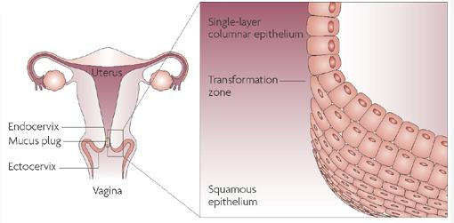
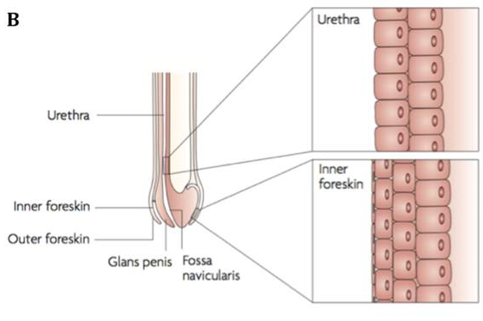
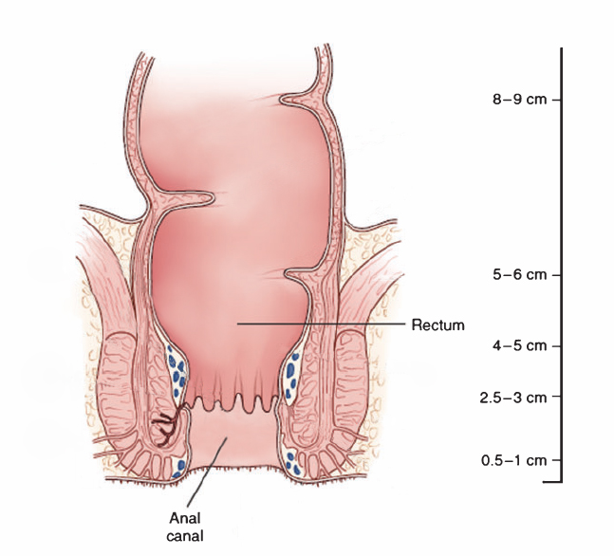
Majority of HIV Infections are Sexually Transmitted via the Genital and Rectal Mucosa
Risk of Transmission
/Exposure
Female Genital Tract (M-F)
- Vagina squamous
Ectocervix squamous
Endocervix columnar (single)
0.04; 0.38%*
Male Genital Tract (F-M)
- Inner foreskin (squamous)
- Penile urethra columnar (stratified)
0.08; 0.30%*
Intestinal Tract (RAI)
Rectum columnar (single)
1.7%*
*High income; low income countries
Early phase of HIV infection 9.2x higher risk
Variability of HIV transmission at each mucosal site due to the virus, host, and environmental factors
Hladik and McElrath 2008 Nat Reviews Immunol 8:447
Hladik and Hope 2009 Current HIV/AIDS Reports 6: 20
Boily et al 2009 Lancet Infect Dis 9:118

Slide 5
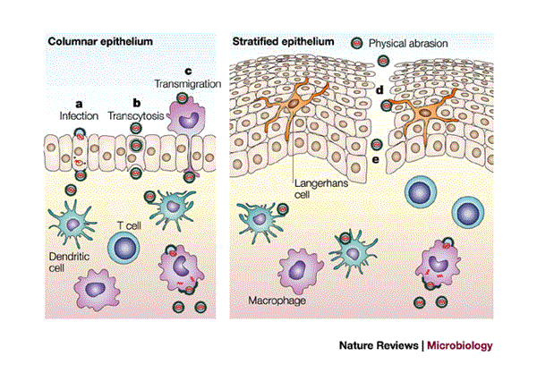
Physical and Biological Defense Mechanisms Against
HIV Transmission in the Lower FGT
Physical Barriers
Mucous
Ciliary clearance
Epithelial cells
Immune Defense
Innate and adaptive immunity
Soluble factors (e.g. AMPs)
Immune cells (including epithelial cells respond to) MAMPs/PAMPs: immune mediators: antiviral and pro-inflammatory (paradoxically promote HIV infection in women)
Microbiota Communities of bacteria (along with fungi and viruses)
Competition, bacteriocins, organic acid metabolites (i.e. lactic acid –produced by vaginal lactobacilli associated with HIV protection)
Endocervix
Ectocervix and Vagina
Shattock and Moore 2003 Nat Rev Microbiol 1:25 ; Carias et al 2013 J Virol 87: 11388
Wira et al 2011 Am J Rep Immunol 65:196
Stieh et al 2014 Plos Path 10:e1004440
Hearps et al 2017 Mucosal Immunol 10:1480; Burgener et al 2015 Curr Opin Immunol 36:22
Aldunate et al 2013 J Antimicrob Chemother 68:2015; Tachedjian et al 2017 Res Microbiol 168:782; Tyssen et al 2018 mSphere 3(4); Nunn et al 2015 Mbio 6:e01084;
Gosmann et al 2017 Immunity 46:1;

Slide 6
Highly Diverse Vaginal Microbiota (e.g. Bacterial Vaginosis) Increase HIV Risk in Young Women in South Africa
Increase risk of HIV
1.6 - 4.4x vs women
with protective
Lactobacillus spp.
BV associated with
increased risk of
other STIs
Genital inflammation
Cohen 2016 Science 353:6297; Masson et al 2015 Clin Infect Dis 61: 260; Anahtar et al 2015 Immunity 42: 965; Gosmann et al 2017 Immunity 46:1;
McClelland et al 2018 Lancet Infect Dis 18:554; Atashili et al 2008 AIDS 22:1493; van de Wijgert et al 2008 J Acquir Immune Defic Syndr 48:203;

Slide 7
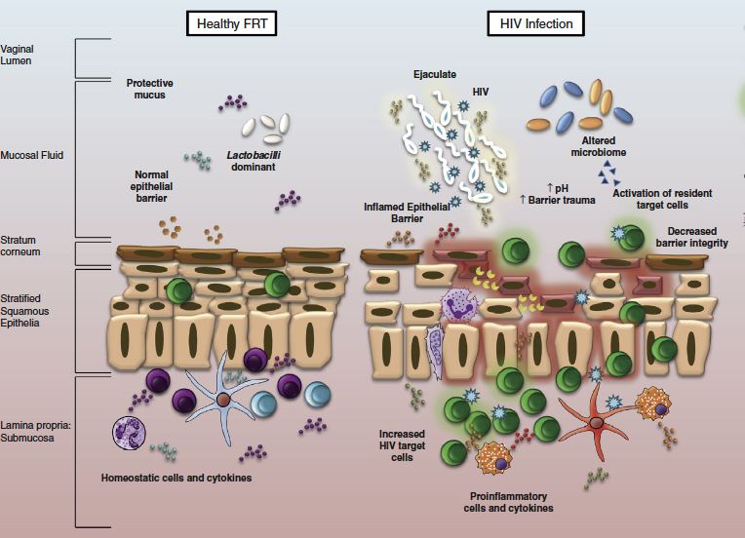
Highly Diverse Vaginal Bacteria and STIs
Pro-inflammatory Mucosal Environment
Lactobacillus-dominated
Highly Diverse Microbiota (BV)
PrEP
(topical)
PrEP
(topical)
HIV
Can we use Antibiotics and/or Probiotic Strategies to Shift
Diverse Microbiota to Lactobacillus-dominated?
HIV
Burgener et al 2015 Curr Opin Immunol 36:22; Masson et al 2015 Clin Infect Dis 61: 260; Anahtar et al 2015 Immunity 42: 965; Gosmann et al 2017 Immunity 46:1;
McClelland et al 2018 Lancet Infect Dis 18:554; Aldunate et al 2015 Frontiers in Physiol 6:164; Tachedjian et al 2017 Res Microbiol 168:782; McKinnon et al 2018 Nat Med 24: 491; Klatt et al 2017 Science 356: 938

Slide 8
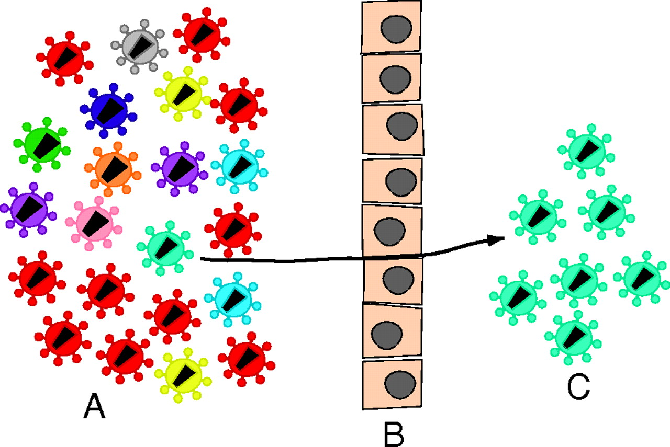
HIV Transmission at Mucosa: Systemic Infection Usually Established by a Single Genetic Variant from the Donor
Stochastic and Selective Forces
Bias for selection of more fit (consensus) variants
Bias reduced by genital inflammation (STIs or BV)
Evolutionary pressure on HIV in vivo (acute) by HLA restricted immune responses: T/F?
Donor quasispecies
bottleneck
Transmitted/
Founder
Implications of the T/F that wins on virus evolution, clinical outcomes and vaccine design
Boeras et al 2011 PNAS 108: 18589; Salazar-Gonzalez et al 2009 JEM 206:1273; Keele et al 2008 PNAS 105:7552; Goonetilleke et al 2009 J Exp Med 206:1253;
Iyer et al 2017 PNAS 114:E590; Claiborne et al 2015 PNAS 112: E1480; Carlson et al 2014 Science 345:6193; Carlson et al 2016 Nature Med 22: 606; Joseph et al 2015 Nature Rev Micro 13: 414; Carlson et al 2015 Trends in Microbiology 23:212

Slide 9
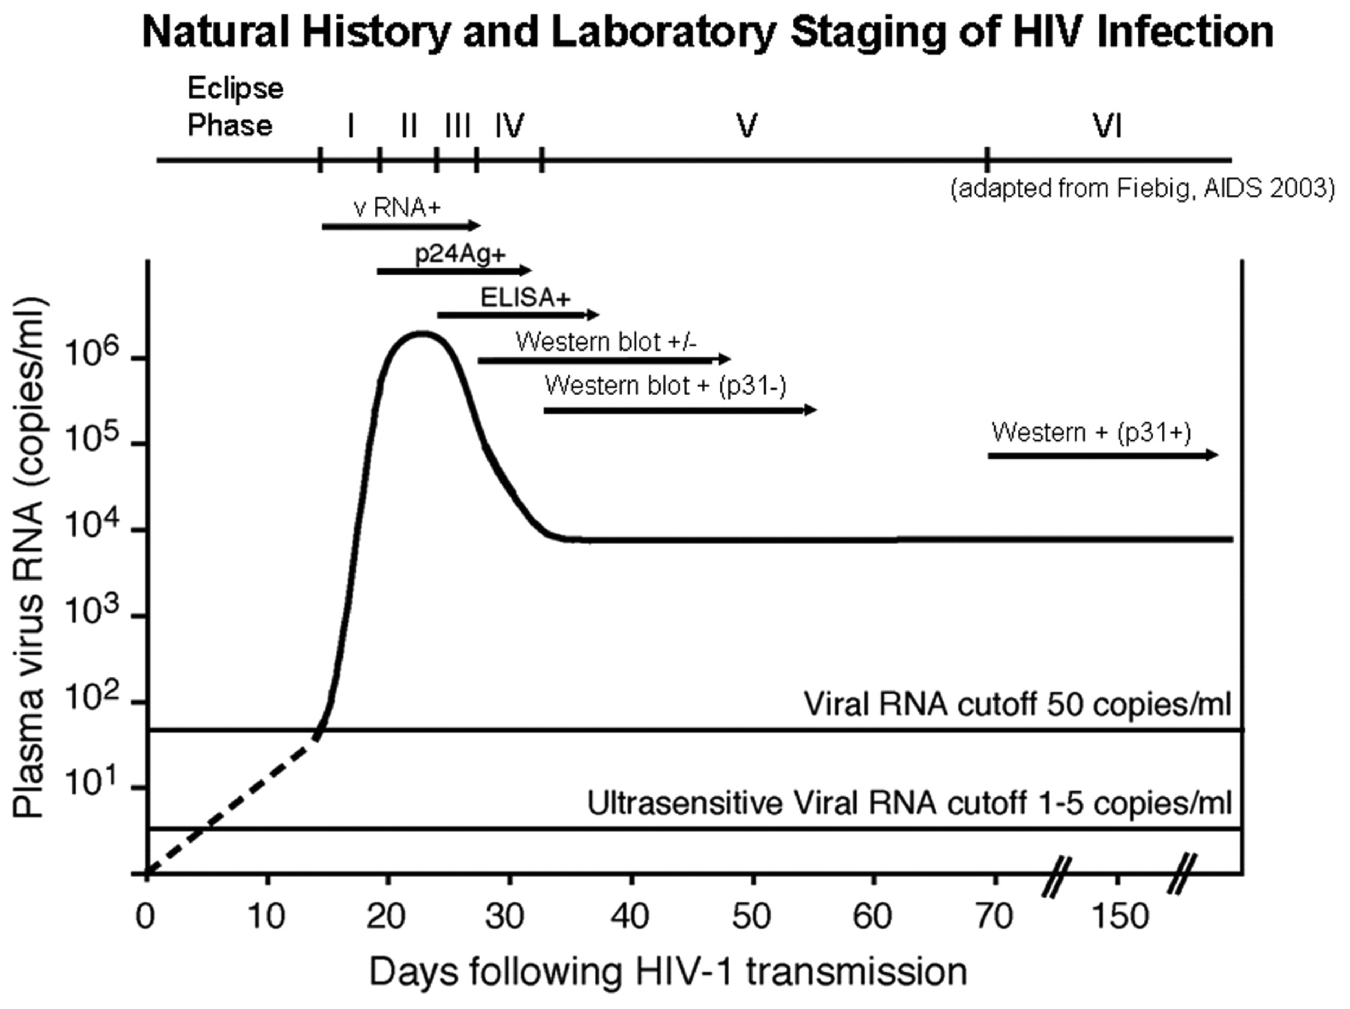
HIV Reservoir Seeded During the Eclipse Phase Prior to Detectable Viremia: Implications for HIV Cure
Suppressive HIV treatment of acute HIV infection (Feibig 1) – results in viral rebound after ART interruption – reservoir seeding
SIV infected macaques -
viral reservoir seeded during the eclipse phase (undetectable plasma vRNA)
HIV-1 DNA reservoir is genetically stable on suppressive ART – PBMCs
Suggests latent reservoir should represent the early genetic archive and any subsequent within-host evolution (viral blips)
Plasma vRNA
What are the Implications of the Genetic Archive for Kick and Kill Strategies to Purge the HIV Reservoir?
Cohen et al 2010 JID 202:S270; Whitney et al 2014 Nature 512: 74; Colby et al 2018 Nature Med 24:923; Brodin et al 2016 eLife 5:e18889

