Slide 1
Why the transmitted virus wins
Jonathan Carlson, Ph.D.
Microsoft Healthcare

Slide 2
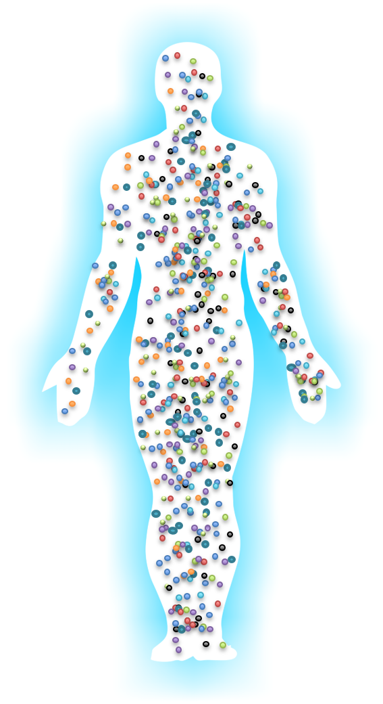
250 Million

Slide 3

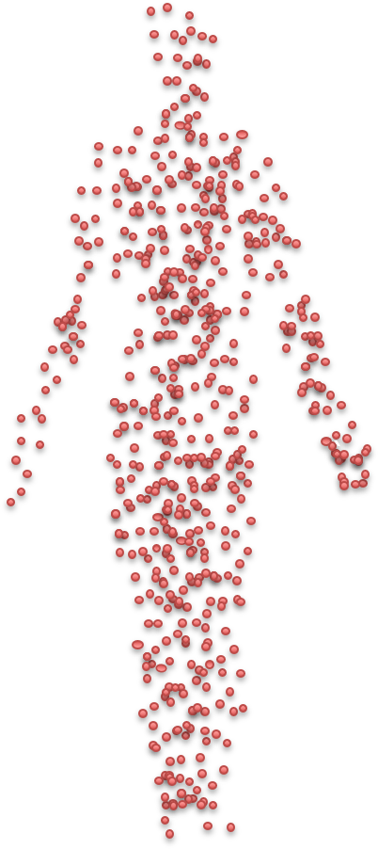
What’s so special about the Founder Virus?

Slide 4
Should we be surprised there’s only one?

Slide 5
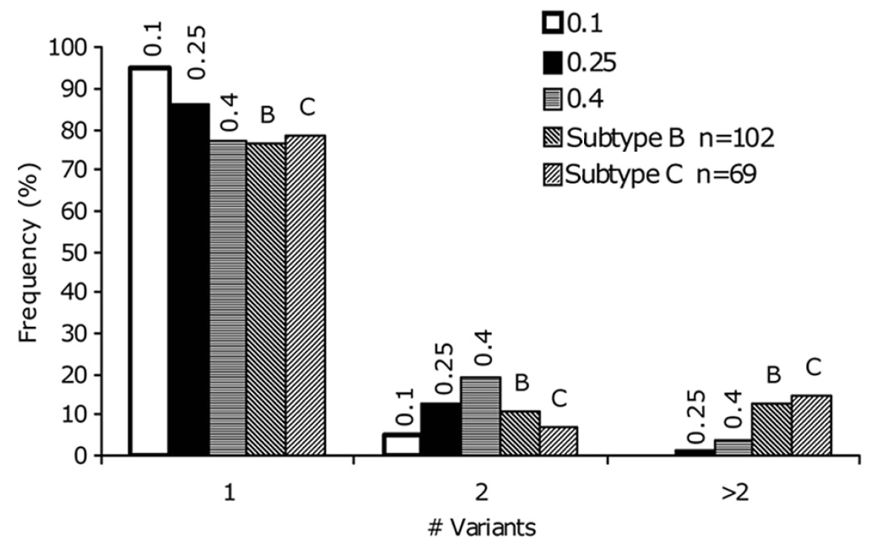
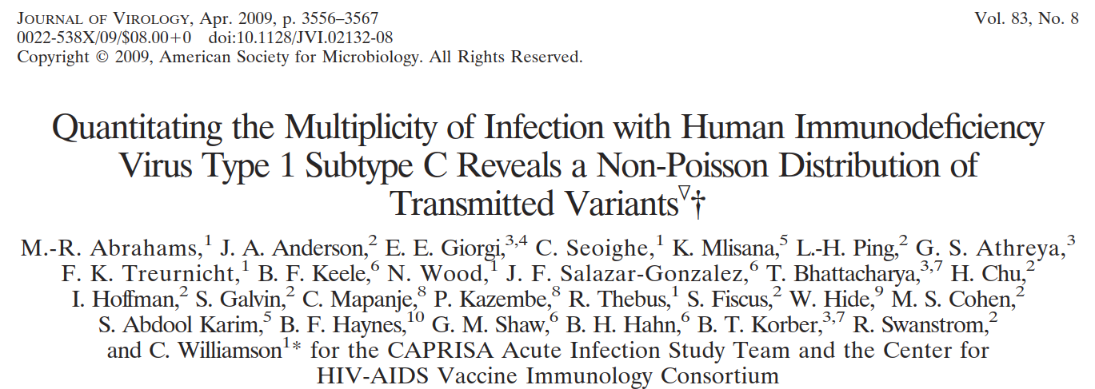
Way too many!

Slide 6
A SIMPLE MODEL
# Transmitted Variants
~ Binomial(N, p)
99% no transmission
`

Slide 7
A SIMPLE MODEL
0.8
0.2
Keele, PNAS, 2008
Kijak, PLoS Pathogens, 2017

Slide 8
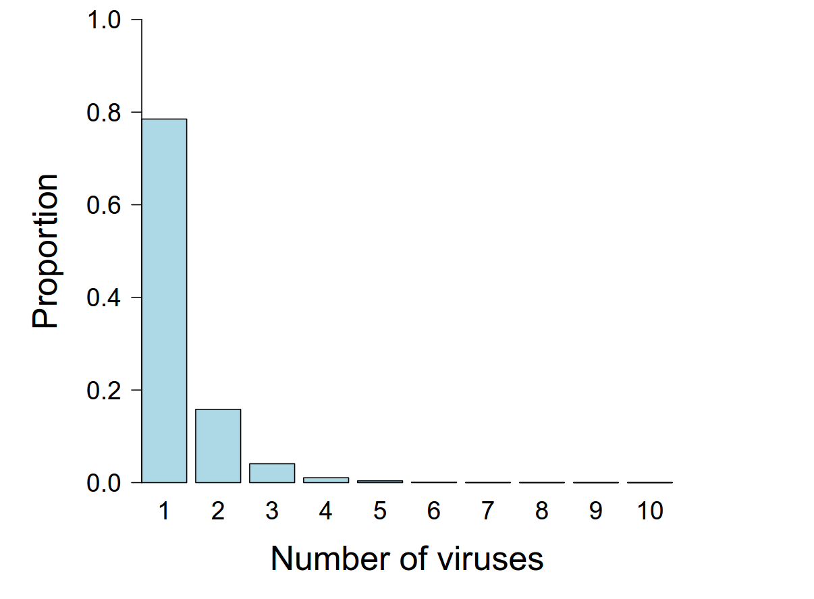
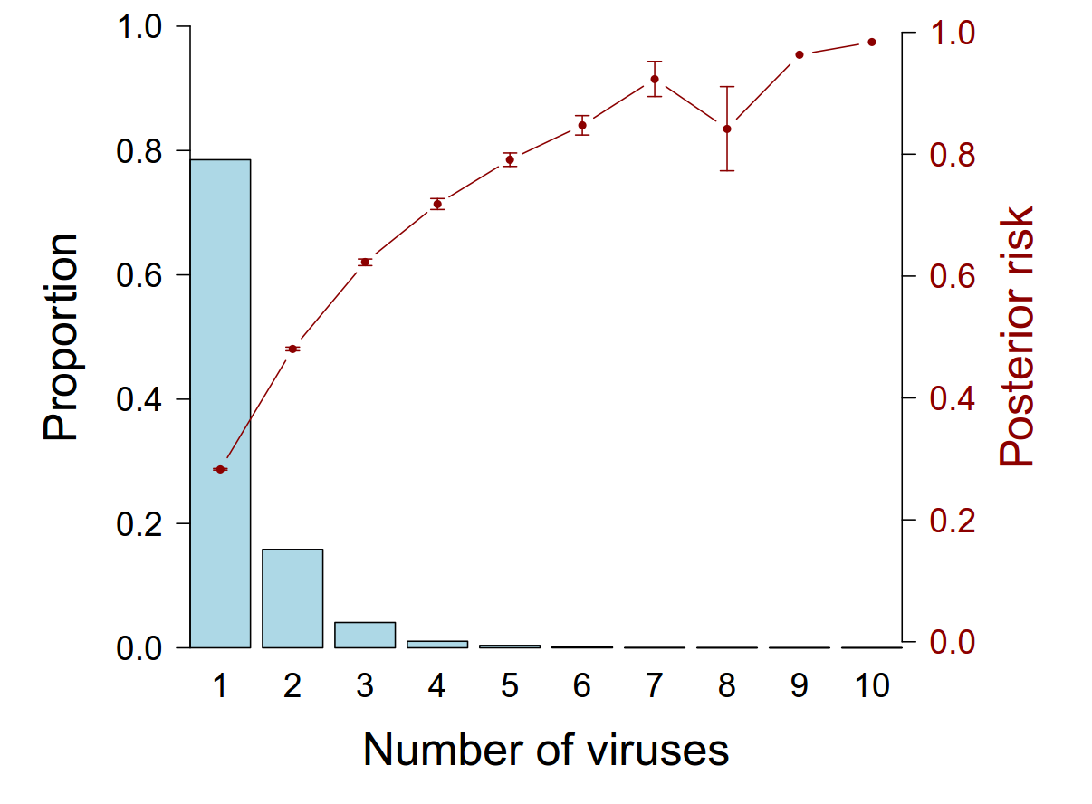
A SIMPLE SOLUTION
Multiple founders mostly among high risk exposures
Some exposures are FAR HIGHER risk (>200x)
Mean risk among multivariant infections: 52.3%
Mean risk among non-infections: 0.01%
0

Slide 9
A SIMPLE SOLUTION
Step
RV144
Multiple founders mostly among high risk exposures
Transmitter Viral Load (Liu, J Virol, 2010)
Genital inflammation (Haaland, PLoS Path, 2009)
IDU (Greenier, J Virol, 2001; Bar, J Virol, 2010)
MSM (Li, PLoS Path, 2010; Chaillon, Virus Evolution, 2016)
Or virions don’t act independently
Local recruitment of CD4+ target cells (Li, Nature, 2009)
Does it matter clinically?

Slide 10
So we shouldn’t be surprised that there’s a single founder virus
What’s so special about that one Founder Virus?
Are there evolutionary pressures at the site of transmission?

Slide 11
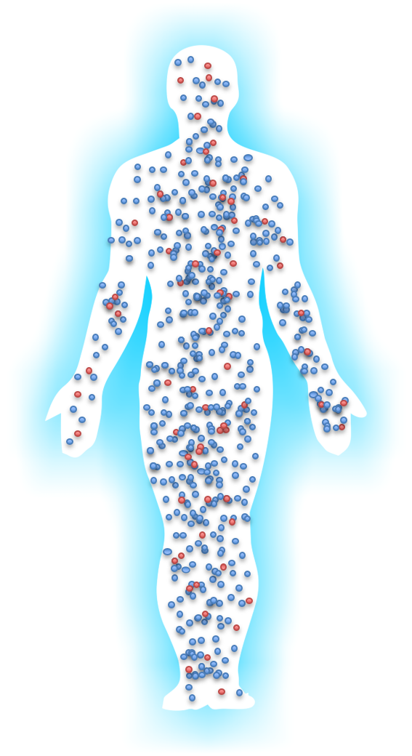

Slide 12
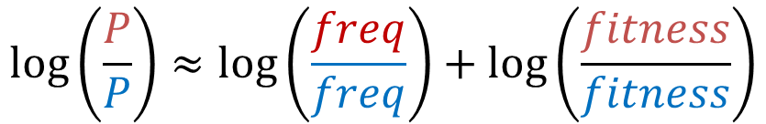
What are the odds the founder virus is red?
$$\log\left(\frac{P}{P}\right)≈\log\left(\frac{freq}{freq}\right)+\log\left(\frac{fitness}{fitness}\right)$$

Slide 13
$$\log\left(\frac{P}{P}\right)≈\log\left(\frac{freq}{freq}\right)+\log\left(\frac{fitness}{fitness}\right)$$
Carlson, Science, 2014
Consensus variants are favored
(Herbeck 2006, Sagar 2009, Carlson 2014)

Slide 14
Higher Ab neutralization sensitivity
CCR5 tropic; High CD4 concentration
Derdeyn, Science, 2004
Ping, J Virol, 2013.
Higher replication, particle release,
and IFN-1 resistance
Higher infectivity and Env Content
Parrish, PNAS, 2013
Iyer, PNAS, 2017

Slide 15
SELECTION
Taken together, founder viruses may be
More likely to infect the first cell
More likely sustain propagation to next cells
With some interesting implications…
Opportunity to block systemic spread (Li, Nature, 2009)
Local mucosal infections?

Slide 16
So there appears to be evolutionary pressure favoring some variants
Is this changed by infection risk?

Slide 17
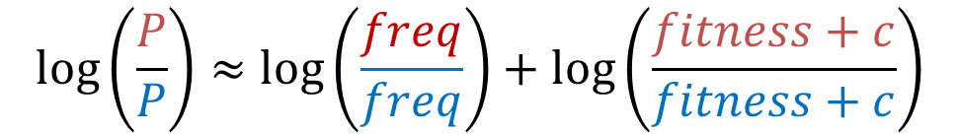
Increased risk is like a constant increase in fitness
There is less selection pressure in the context of high risk exposure
$$\log\left(\frac{P}{P}\right)≈\log\left(\frac{freq}{freq}\right)+\log\left(\frac{fitness+c}{fitness+c}\right)$$

Slide 18
Founder viruses closer to consensus when risk is low
Proportion donor AA transmitted
Carlson, Science, 2014

Slide 19
Is there an impact on disease?
Heterosexual males vs MSM
Women in CAPRISA 002 TFV vs Placebo arm
Tully, PLoS Path, 2016
Ngandu, JAIDS, 2017
Infectivity LOWER in TFV arm
No difference in RC
Lower infectivity with genital inflammation
Selhorst, Clin Infect Dis, 2017
Selhorst, J Virol, 2017
Chopera, PLoS One, 2013

Slide 20
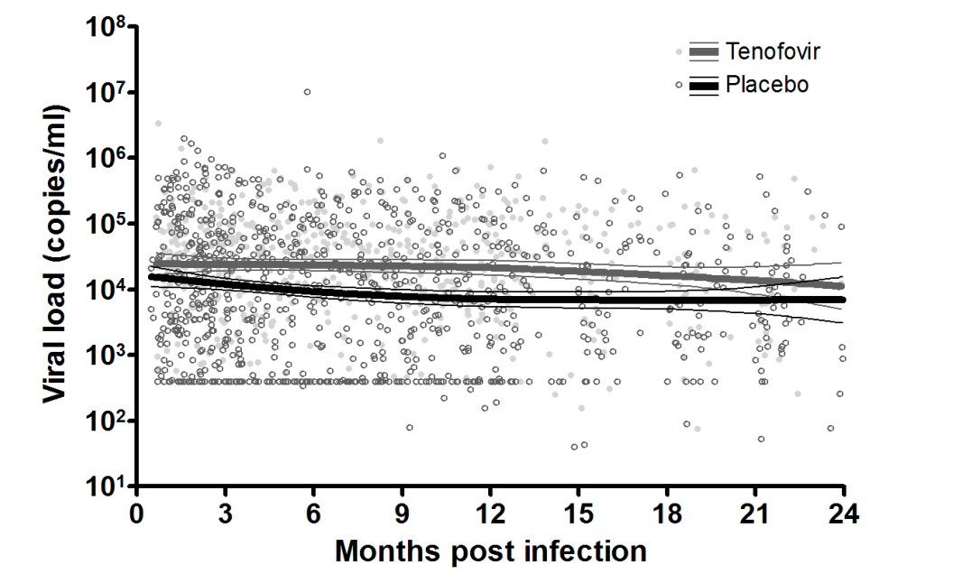
A transient increase in VL
Caprisa 002
p=0.01
Garrett, JAIDS, 2014

Slide 21
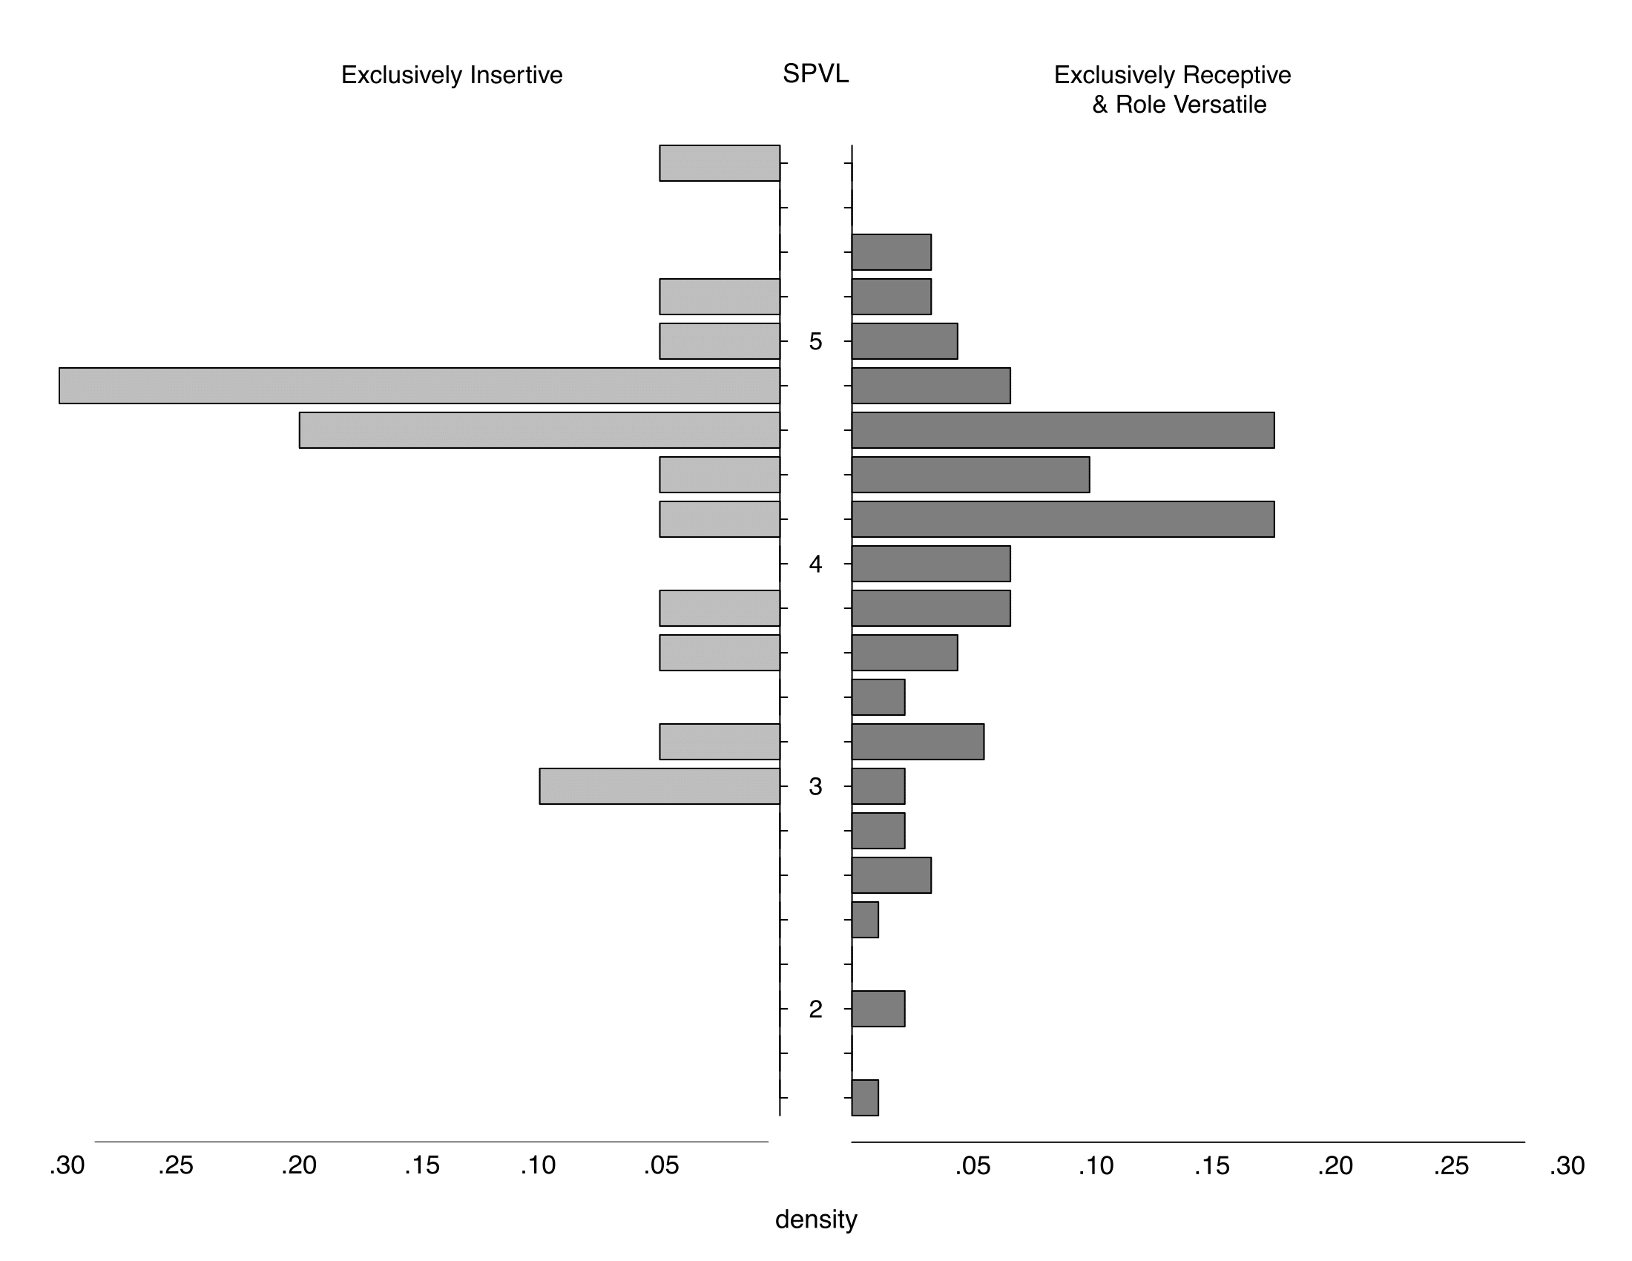
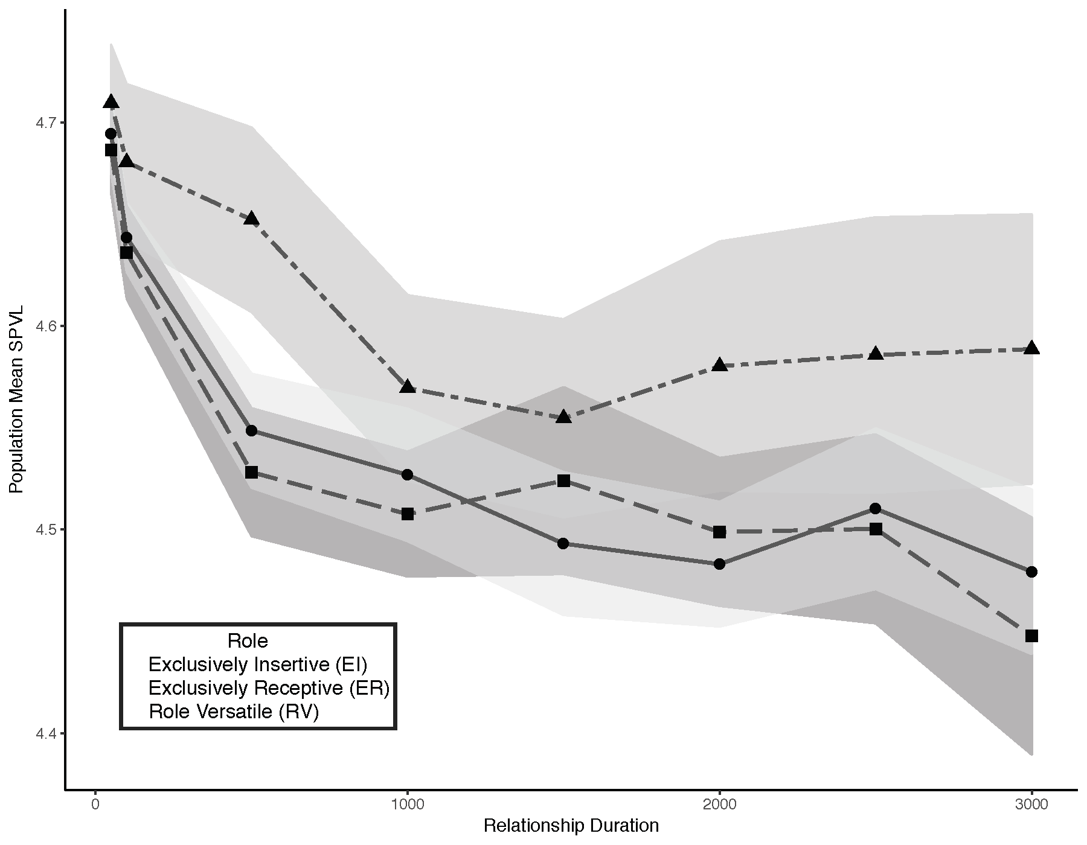
VL by role among MSM
But only among longer duration partnerships
0.3 log higher VL among exclusively insertive men (P<0.05)
Stansfield, HIV Dyn & Evol, 2018
MS in review
Fig courtesy of Josh Herbeck

Slide 22
CONCLUSIONS
A single founder virus
80% single founder is shockingly low
Multiple founders are associated with higher VL
Transmission selection bias
Selection for virions closer to consensus, with higher infectivity and IFN-1 resistance, and lower NAb resistance
Infection risk
Increases risk of multiple founders
Decreases selection pressure
May be associated with lower VL
Notes:
Increasing barriers to infection may be critical in reducing transmission risk, but may have the unfortunate side effect of increasing the average virulence of breakthrough infections.

Slide 23
The fitness landscape changes
What happens when we intervene with a vaccine?

Slide 24
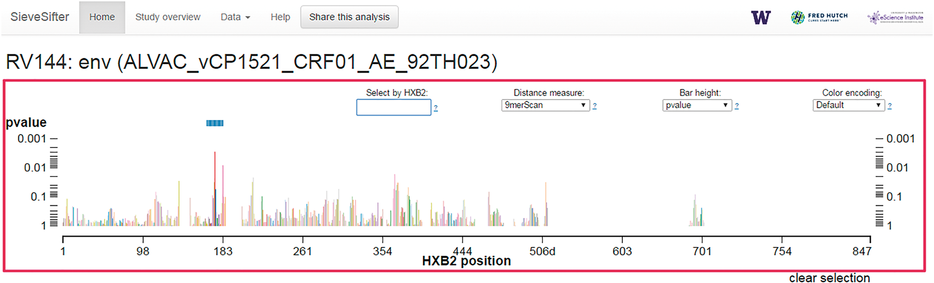
SIEVE ANALYSIS
Founder virus divergence between vaccine and placebo
Fiore-Gartland, Bioinformatics, 2017

Slide 25
Vaccine efficacy
Sieve effects
Step Study
RV144
Buchbinder, Lancet, 2008
Duerr, J Infec Dis, 2012
Rerks-Ngarm, NEJM, 2009
Rolland, Nature Med, 2011
Rolland, Edlefsen, Nature 2012

Slide 26
Sieve effects
RV144
Improved efficacy against certain variants
Rolland, Edlefsen, Nature 2012

Slide 27
Vaccine efficacy will wane
Herbeck, Vaccine, 2017

Slide 28
CONCLUSIONS
A single founder virus
80% single founder is shockingly low
Multiple founders are associated with higher VL
Transmission selection bias
Selection for virions closer to consensus, with higher infectivity and IFN-1 resistance, and lower NAb resistance
Infection risk
Increases risk of multiple founders
Decreases selection pressure
May be associated with lower VL
Vaccines reshape fitness landscape

Slide 29
Thank you to all the people living with HIV who have so generously participated in the many research projects we were able to discuss today.

