Slide 1








HIV incidence trends among the general population in Eastern and Southern Africa 2005-2016
Emma Slaymaker, Jim Todd, Mark Urassa, Kobus Herbst, Nuala McGrath, Rob Newton, Dorean Nabukalu, Tom Lutalo, Amelia Crampin, Simon Gregson, Keith Tomlin, Kathryn Risher, Georges Reniers, Milly Marston, Choziwadziwa Kabudula, Basia Zaba
Disclosures: no disclosures

Slide 2
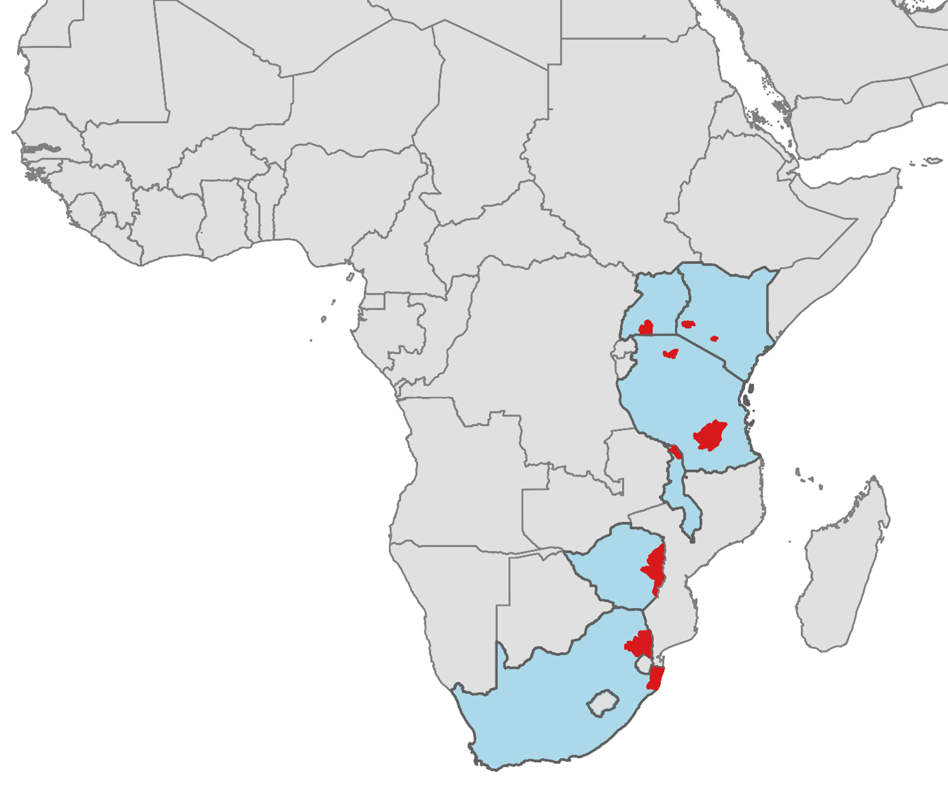
The ALPHA Network
Network for Analysing Longitudinal Population-based HIV/AIDS data on Africa
Kenya
  Kisumu: CDC/KEMRI (Gem)
  Nairobi: APHRC
Uganda
  Rakai: Rakai Community Cohort study
  Masaka: Kyamulibwa GPC
Tanzania
  Kisesa: Kisesa Cohort study
  Ifakara: Ifakara urban DSS
Malawi
  Karonga: Karonga DSS
Zimbabwe
  Manicaland: Manicaland GPC
South Africa
  Agincourt: Agincourt HDSS
  uMkhanyakude: Population Intervention Platform, AHRI
GPC: General Population Cohort
(H)DSS: (Health and) Demographic Surveillance Study

Slide 3
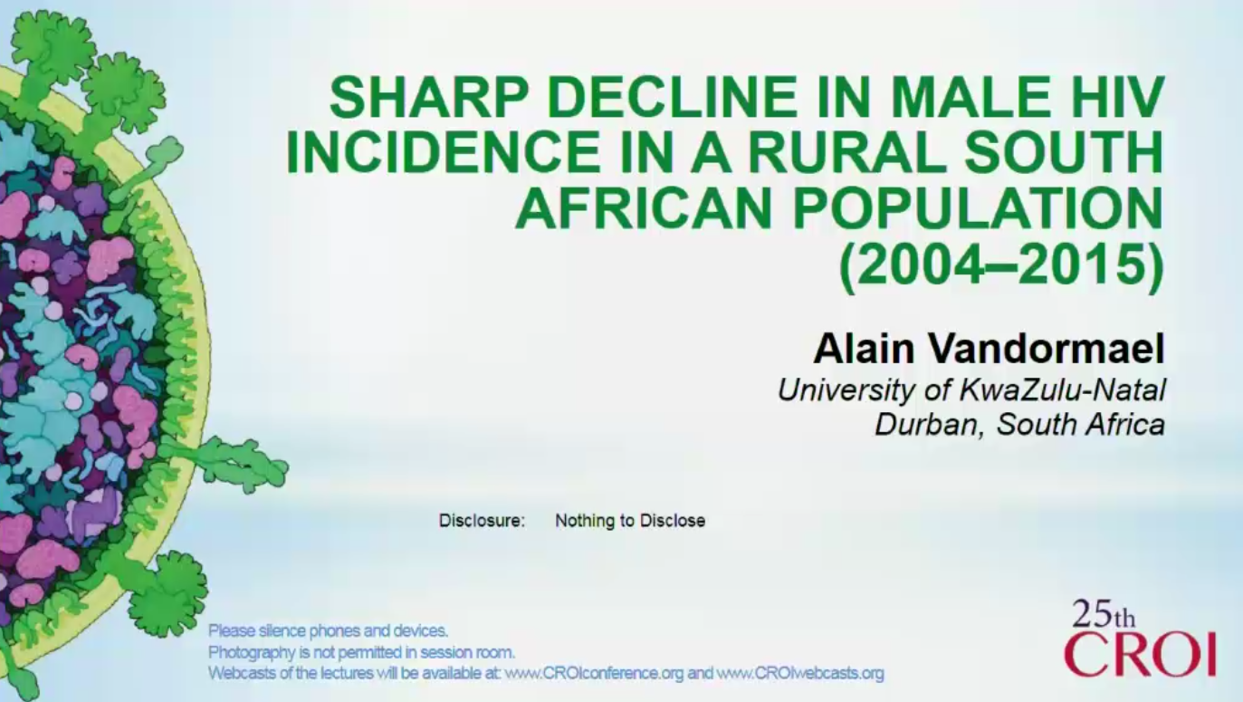
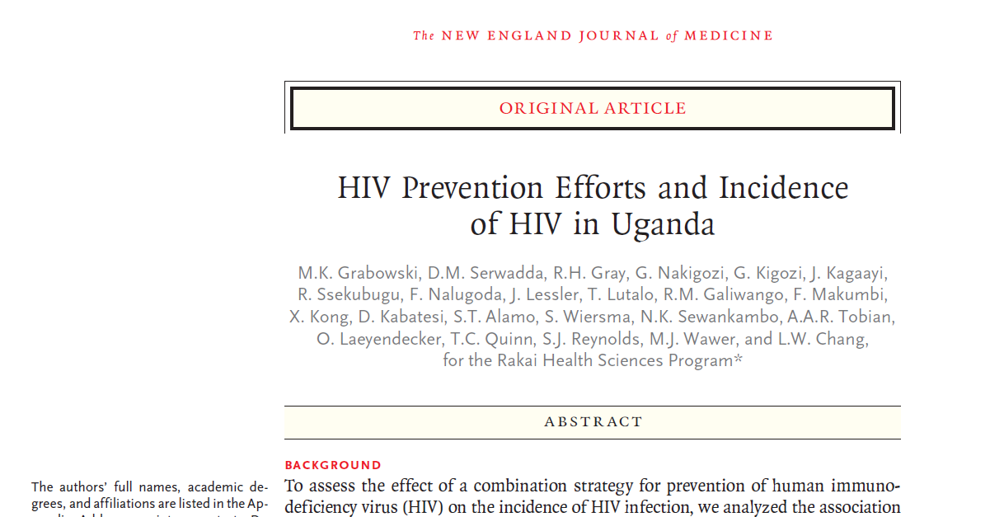
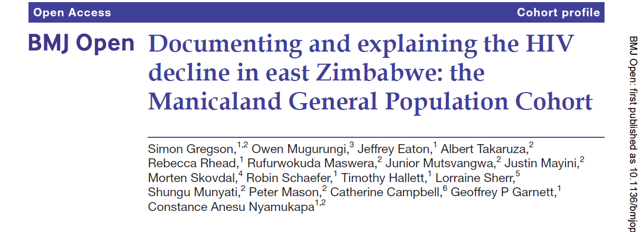
Analysis objectives
3 studies have recently described incidence declines
Aims:
Describe changes over time:
  For six studies
  For men and women
  Using pooled data from all studies
Evaluate the role of:
  Treatment
  Male circumcision
  Changes in participation
Ethics approval from LSHTM
Funding from Bill and Melinda Gates Foundation

Slide 4
Methods for incidence analysis (1)
HIV tests conducted at regular intervals on all residents (1- 3 years apart)
Observation starts at first HIV negative test recorded while resident in study area
Participants were followed until study exit or testing HIV positive.
  Study exit was at: out-migration from study area
            death
            administrative censoring at most recent study round (last HIV test)

Slide 5
Methods for incidence analysis (2)
Seroconversion date imputed between last negative and first positive date. We:
  ran 70 imputations
  used a uniform distribution for seroconversion dates
  used all seroconversion intervals, regardless of length
  Excluded gaps in residency from denominator, excluded non-resident seroconversions and discarded subsequent negative person time

Slide 6
Covariates for incidence analysis:
1) HIV and treatment status among potential partners
Do not know: the HIV status of sexual partners
Can estimate: the HIV prevalence and treatment coverage in the group of people who are potential sexual partners.
Estimation of person-time spent untreated
  linked clinical records and self-report used to identify PLHIV receiving treatment
  PLHIV person-time classified as untreated prior to date of ART initiation or first observed treatment episode (doi: 10.12688/gatesopenres.12753.1)
Estimation of HIV prevalence in potential sexual partners
  reported ages of sexual partners used to define age-mixing matrix
  HIV prevalence estimated for men and women in each cell of the matrix
Estimation of untreated HIV prevalence in potential opposite sex partners
  HIV prevalence combined with proportion untreated to estimate untreated prevalence
  Each individual assigned the untreated prevalence estimate for the opposite sex in the age range of potential sexual partners.

Slide 7
Covariates for incidence analysis:
2) circumcision and 3) participation
Estimation of circumcision status:
  Male circumcision was self reported during surveys
  Circumcision status of individuals at survey assigned based on self-report and carried forwards until any subsequent survey
Estimation of participation levels:
  Survival analysis of time from a study HIV test to the next study HIV test
  For each survey round, estimated the percentage of people who had previously tested negative and were still eligible for the survey who were successfully tested for HIV.
Untreated prevalence, circumcision status (men only) and participation probability all explored as time-varying covariates

Slide 8
Incidence cohort sizes- 2005 onwards
Study name & years data are available | Sex | Number of people | Number of person years | Number of seroconversions
Karonga | Men | 4,574 | 10,951 | 30
(2006-2012) | Women | 5,813 | 14,356 | 59
Kisesa | Men | 3243 | 15,060 | 82
(2005-2015) | Women | 4284 | 21,530 | 155
Manicaland | Men | 4,479 | 16,627 | 150
(2005-2013) | Women | 6,512 | 25,462 | 305
Masaka | Men | 4,881 | 21,049 | 85
(2005-2016) | Women | 5,994 | 25,873 | 139
Rakai | Men | 7,126 | 30,491 | 234
(2005-2016) | Women | 8,352 | 38,136 | 354
uMkhanyakude | Men | 8,670 | 32,613 | 712
(2005-2017)

Slide 9
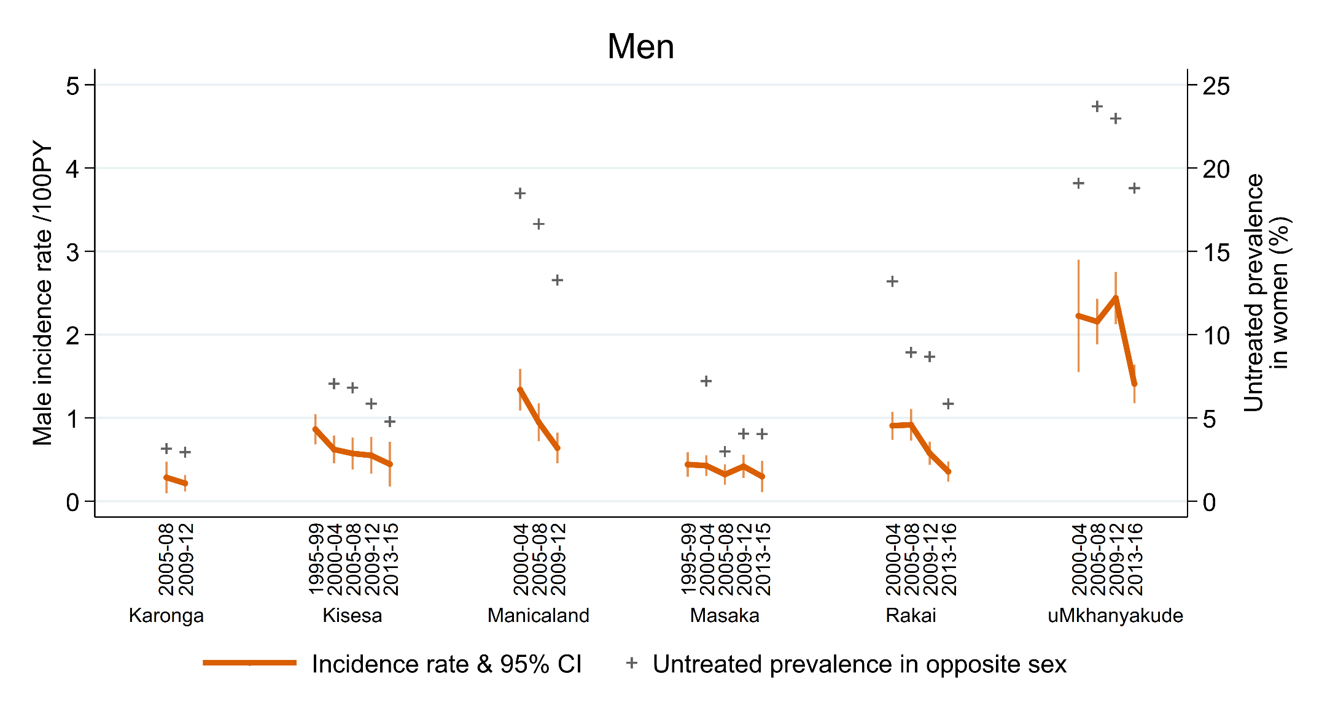
Crude Incidence trends by study- men 15-49

Slide 10
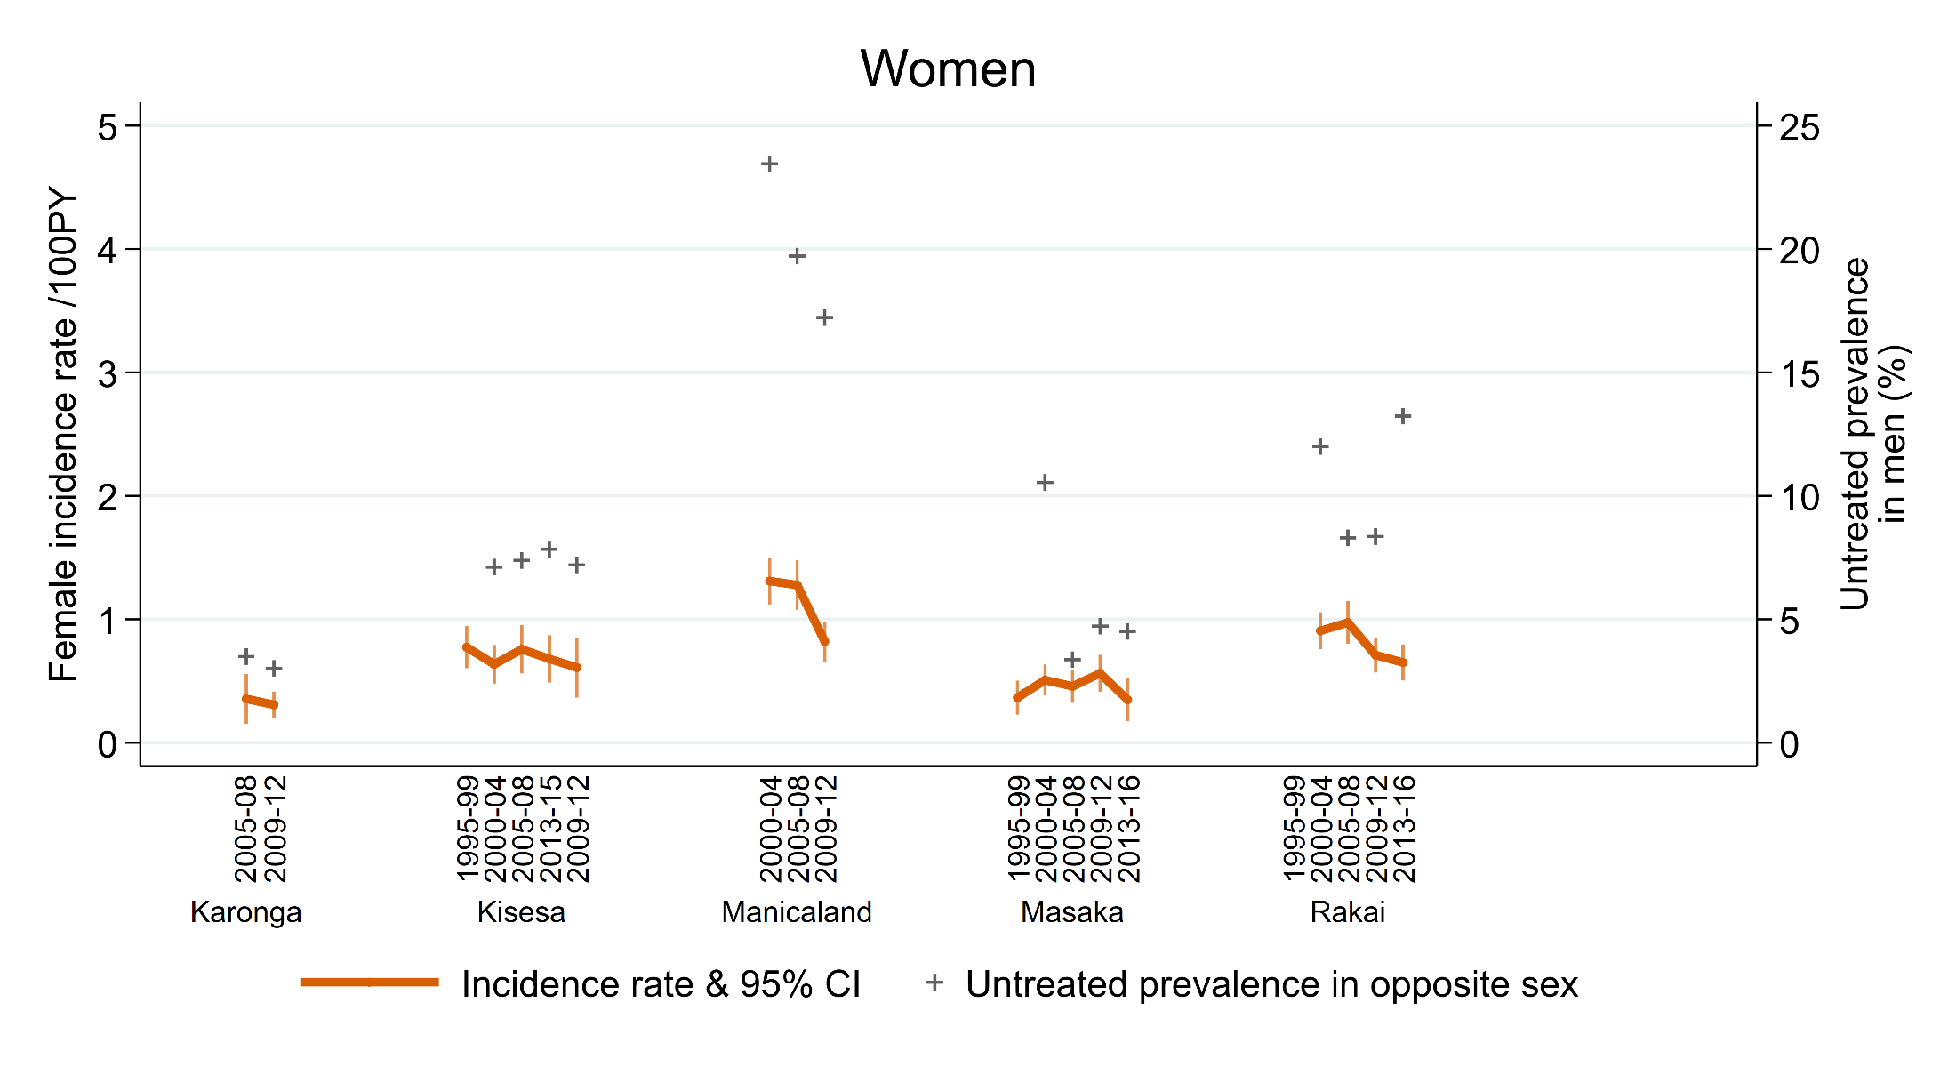
Crude Incidence trends by study- women 15-49

Slide 11
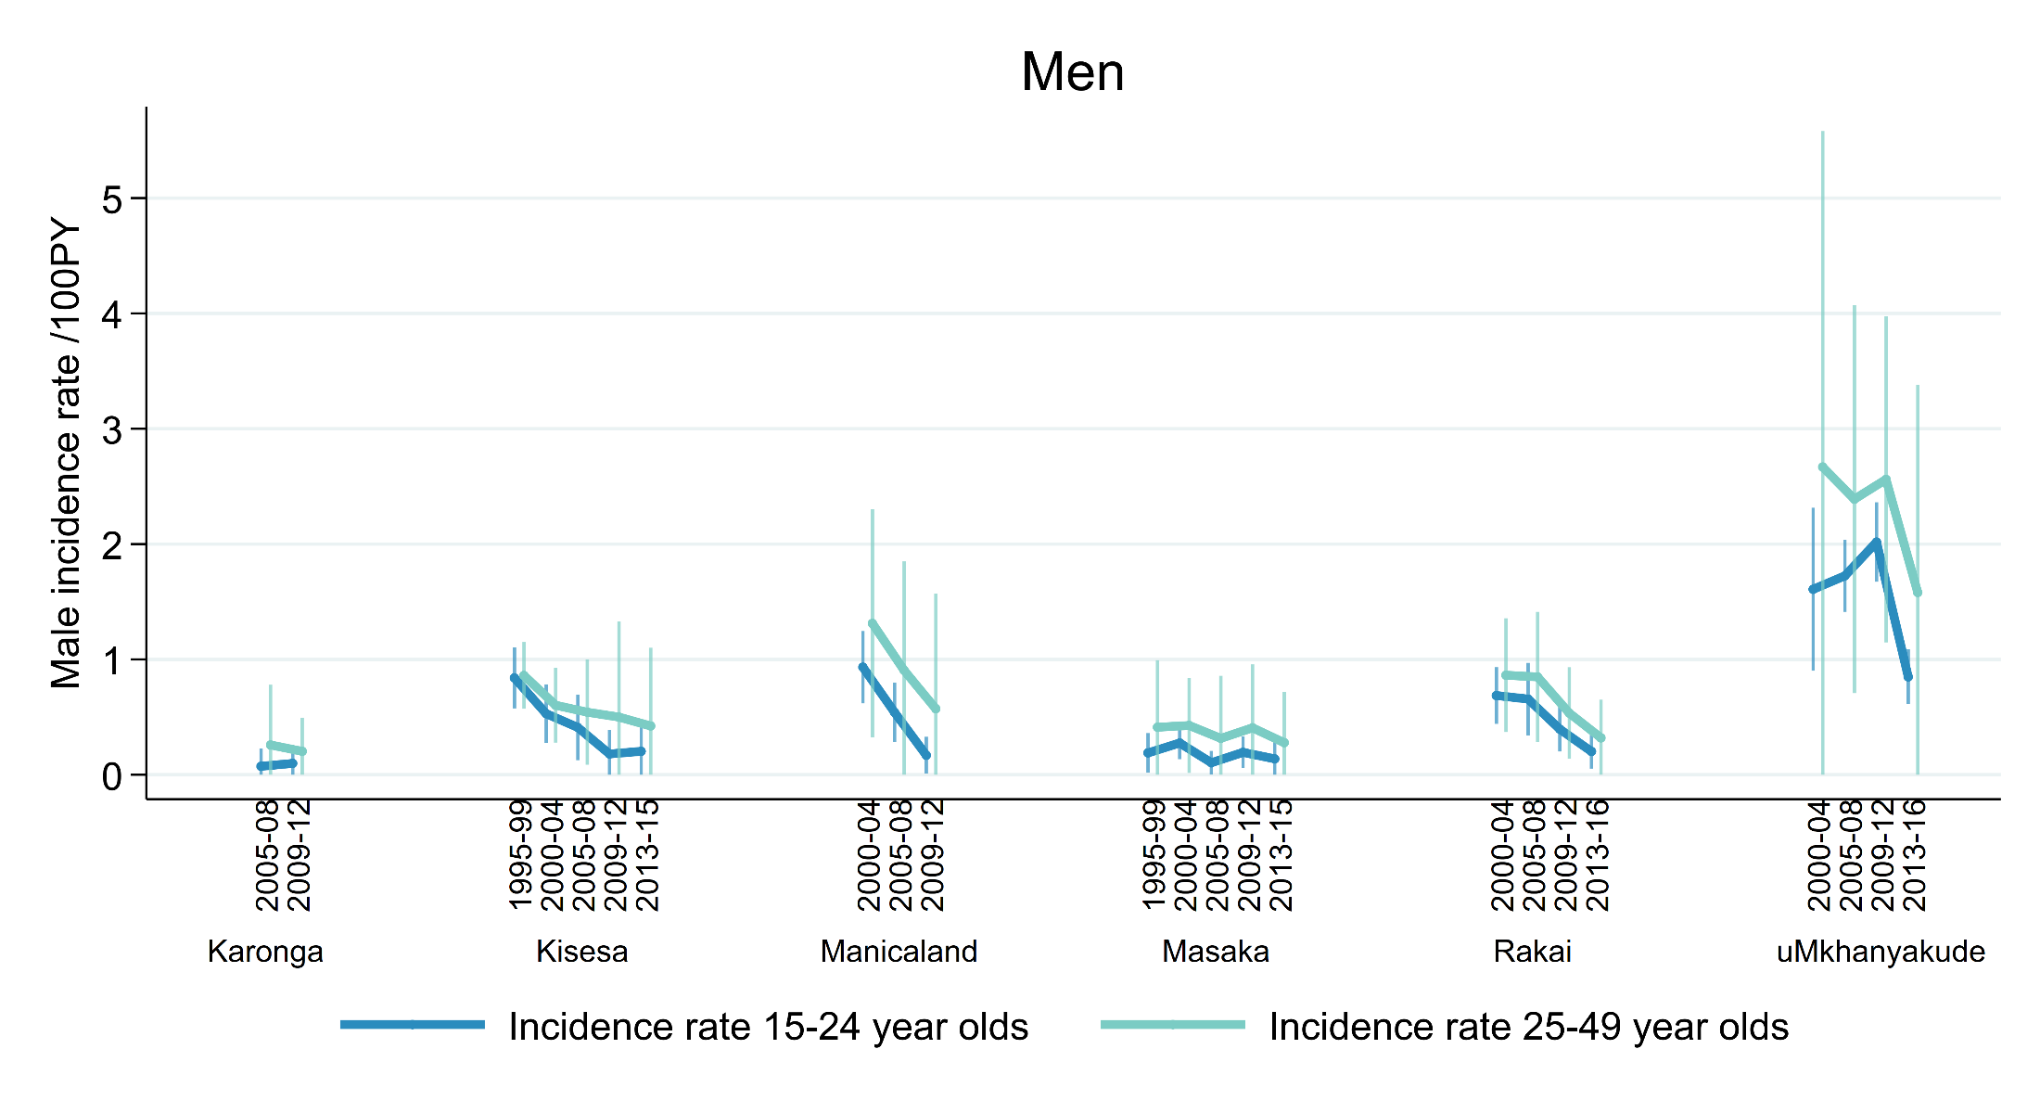
Trends among 15-24 and 25-49 year olds

Slide 12
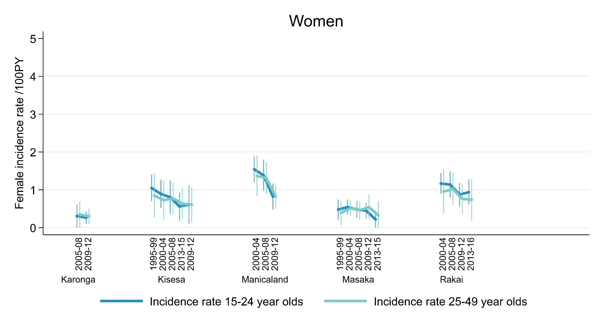
Trends among 15-24 and 25-49 year olds

Slide 13
Pooled age-stratified analysis of trends: men
Incidence rate ratios (IRR) for calendar time from piecewise exponential survival models
p<0.1; ** p<0.05; *** p<0.01
†Adjusted models include calendar year group, study, circumcision, untreated prevalence in the opposite sex and probability of retesting.

Slide 14
Pooled age-stratified analysis of trends: women
Incidence rate ratios (IRR) for calendar time from piecewise exponential survival models
p<0.1; ** p<0.05; *** p<0.01
†Adjusted models: calendar year group, study, , untreated prevalence in the opposite sex and probability of retesting.

Slide 15
Conclusion
Male incidence has declined
No evidence for female incidence decline apart from Rakai and Manicaland
Where declines are seen:
Among young people decline can be explained by change in the prevalence of infectious opposite sex partners.
Among older people change over time not entirely explained by changes in untreated prevalence, circumcision or participation-
  Epidemic dynamics and heterogeneity?
  Behaviour change?
  Untreated prevalence measure performs poorly for older people

Slide 16

In memory of Basia Zaba (1949-2018)

