Slide 1
"We´re going to leave you for last because of how you are" Transgender Women's Experiences of GBV in Health Care, Education, and Police Encounters in Latin America and the Caribbean
International AIDS Conference July 24, 2018
Michele Lanham
FHI 360
mlanham@fhi360.org

Slide 2
Methods
Partnership among UNDP, LINKAGES, University of the West Indies, and local organizations in Barbados, Trinidad & Tobago, Haiti, El Salvador
74 qualitative interviews with transgender women
Experiences of GBV in:
Education
Health care
Police encounters
Other state institutions

Slide 3
Results
Emotional abuse was most common across all settings; also experienced physical, sexual, and economic GBV, and other human rights violations
Education (85%)
Physical violence/threats
Sent home
Failing grades
Suspended/expelled
Harassed in restrooms
Health care (83%)
Blamed
Lower priority
Denied services
Substandard care
Lack of confidentiality
Police (80%)
Refused help, blamed
Physical violence/threats
Blackmail
Intimidation
Arrested or detained
Other state institutions (66%)
Forced to alter appearance to get identity card or passport
Denied services

Slide 4
Recommendations
Anti-discrimination and gender-identity laws and policies
Allow trans women to self-determine the name and gender that appear on official documents
Anti-bullying policies in schools
Anti-profiling and anti-bias policies for police and security forces
Train HIV and other health service providers to:
Provide nondiscriminatory, gender-affirming services
Detect GBV and provide first-line support
Train police on trans women’s human rights and the need for stigma-free police services.
Connect GBV victims with trans peer educators, who can accompany them to police, health, and legal services.
Manuscript coming soon in Violence and Gender

Slide 5
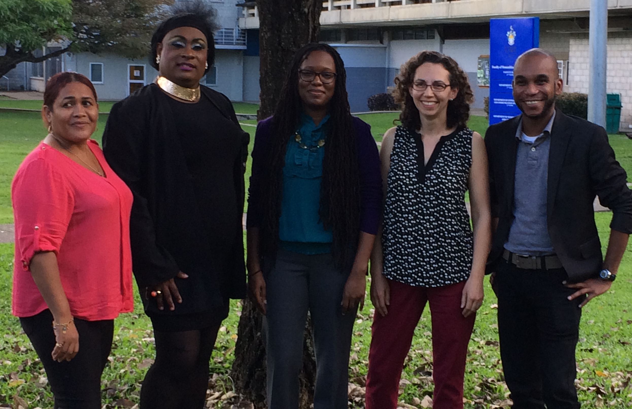
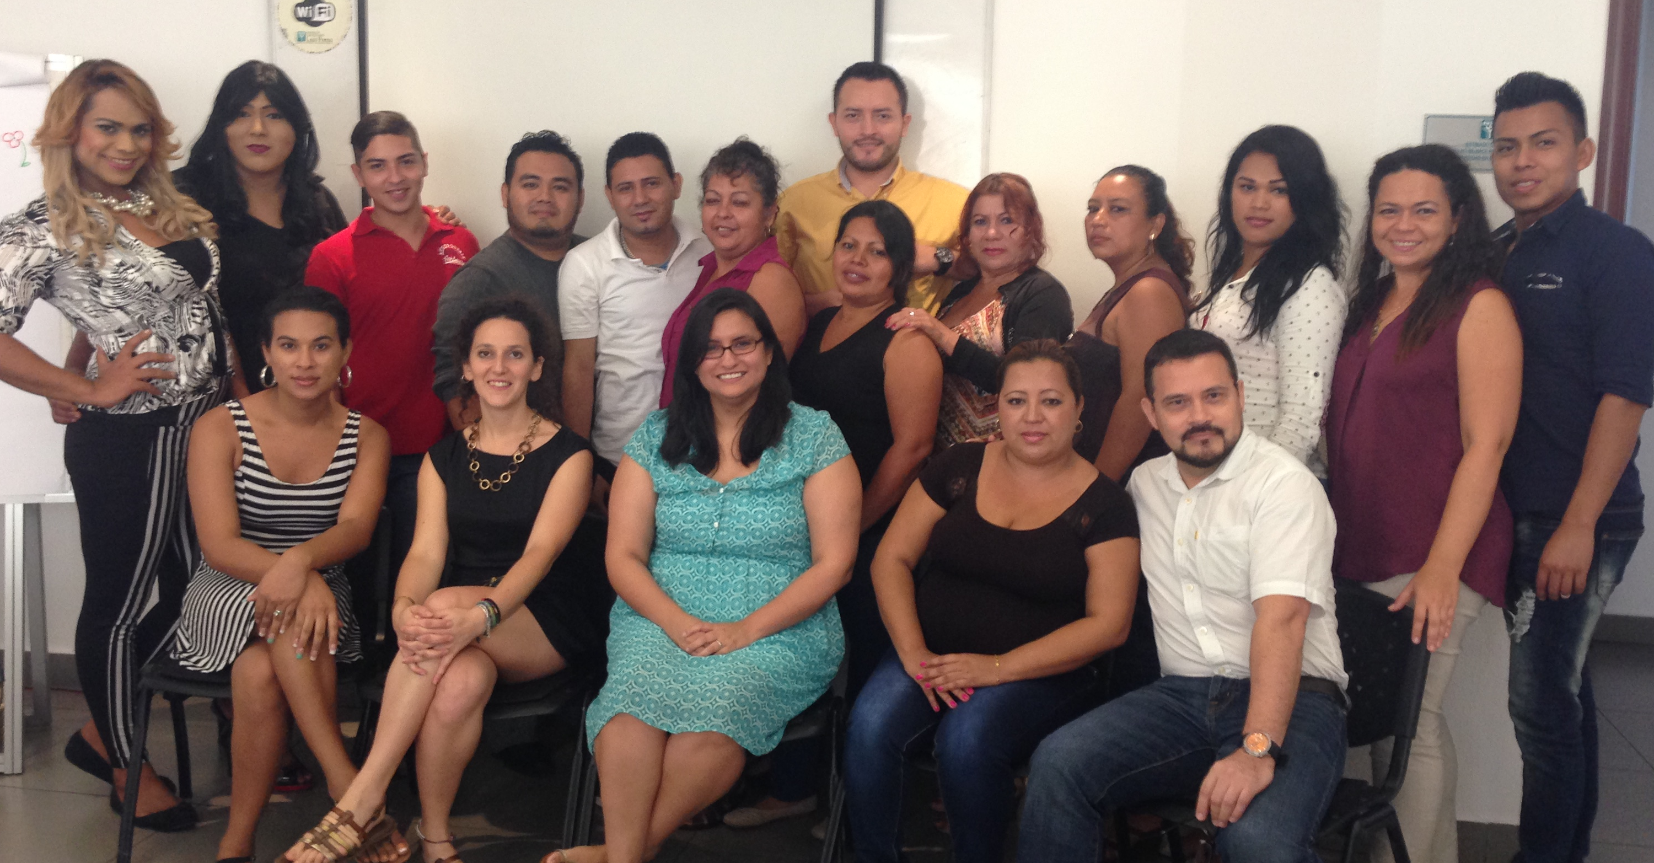
Thank You
Civil Society Organizations
Trinidad & Tobago: Friends for Life, CARe, Family Planning Association of Trinidad and Tobago
Barbados: Community Education Empowerment & Development, EQUALS, Jabez House, B-Glad
El Salvador: Asociación Diké de Personas Transgénero y LGBTI+, ASPIDH Arcoíris, COMCAVIS-TRANS
Haiti: Arc en Ciel, ANAPFEH, Facdis, FEBS, FOSREF, GHESKIO, Gran Lakou, Kouraj, ORAH, Serovie
The Innovative Response Globally for Trans Women and HIV
Peer data collectors
Trinidad & Tobago: Brandy Rodriguez
Barbados: Dadrina Emmanuel
El Salvador: Britany M. Castillo, Camila Vargas, Nissa Kahory Sánchez
Haiti: Wilfrid Junior Moril, Palemon Wikenson, Veillard Reginald, Caimitte Jn Elie, Clifford Cherisier
Contact: Michele Lanham, mlanham@fhi360.org

Slide 6
Stay Connected with LINKAGES
Follow LINKAGES on Twitter: www.twitter.com/LINKAGESproject
Like the project on Facebook: www.facebook.com/LINKAGESproject
Subscribe to the LINKAGES blog www.linkagesproject.wordpress.com
Subscribe to The LINK, LINKAGES’s quarterly project e-newsletter
Check out LINKAGES’s quarterly research digest

