Slide 1
Adolescent and young people’s participation and representation in clinical trials: lessons from a community-wide HIV testing and treatment study, the HPTN 071 (PopART) study
Musonda Simwinga, Joseph Mwate, Tisankhe Ng’ombe, Steve Belemu, Nozizwe Makola, Constance Mubekapi-Musadaidzwa, Graeme Hoddinott, Rhonda White, Kwame Shanaube, Virginia Bond

Slide 2
PopART for Youth P-ART-Y Study
Nested within HPTN 071 trial
Evaluated the acceptability & uptake HIV prevention package among young people aged 10-19 years in Zambia and South Africa.
The study’s primary outcome was uptake of HCT in the previous 12 months among adolescents aged 15-19.

Slide 3
Participation Avenues
AYP were engaged through:
  Adolescent Community Advisory Board (aCAB) Meetings
  Future spaces
  Social media: Facebook and WhatsApp
  Youth friendly health services
  Community health events
  Regular meetings with researchers
  Designing and reviewing study material

Slide 4
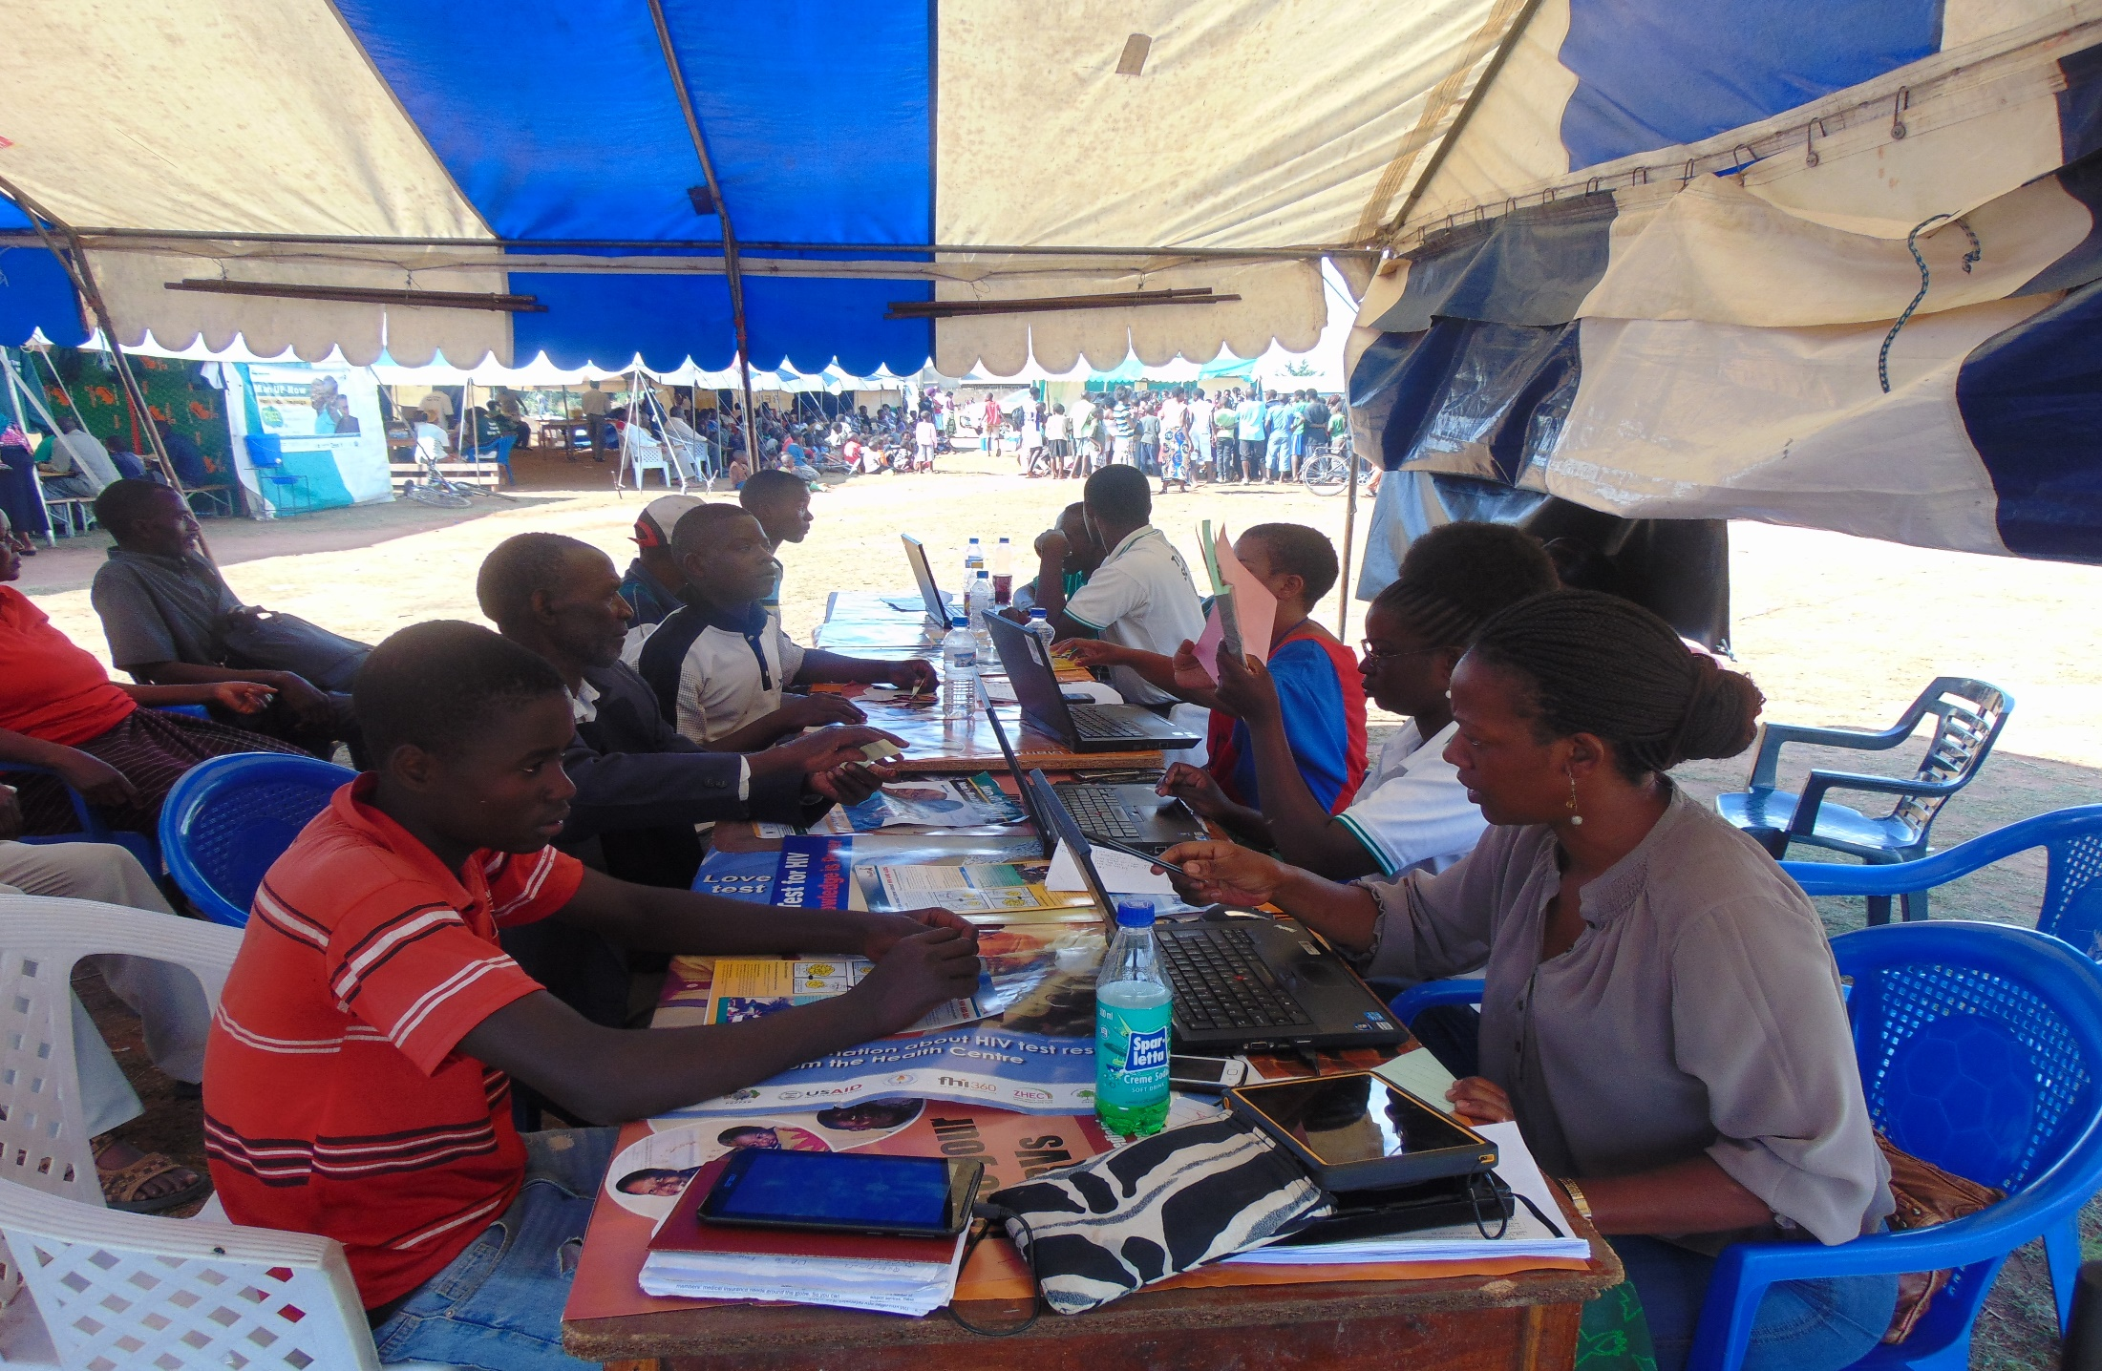
A young person being enrolled on the study during a community health event

Slide 5
Factors Facilitating Participation in the Study
Training skills building & use of new technologies
Financial and non-financial incentives
Acknowledgement of the role AYP play
Constant engagement; AYP are very active and want ‘presence and action’ all the time
Supportive parents and guardians
Timing of meetings
Fun and use of participatory methods

Slide 6
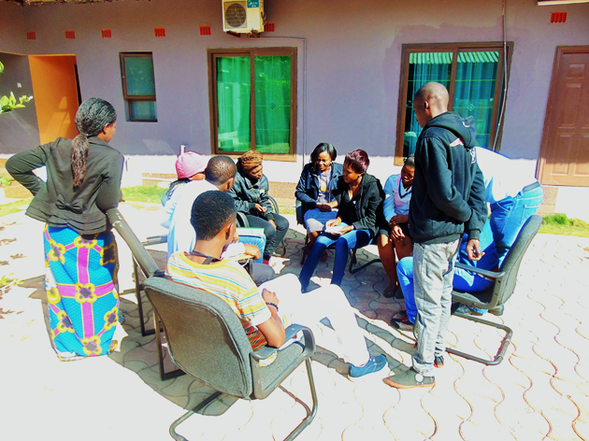
aCAB members having a group discussion during a meeting

Slide 7
Factors Constraining Participation in the Study
Lack of monetary incentives; wasting time
“We know that this is voluntary but even a little help will go a long way. This is why people are leaving and going to look for other means of earning money. They have no motivation to stay.
Alcohol and substance abuse
“….we ……found a group of adolescents sniffing, smoking and drinking at the same time. And so the question is how can such a person decide to go for testing and even if they go for testing how are they going to accept their results in case they are HIV positive”
Safety concerns when conducting study activities

Slide 8
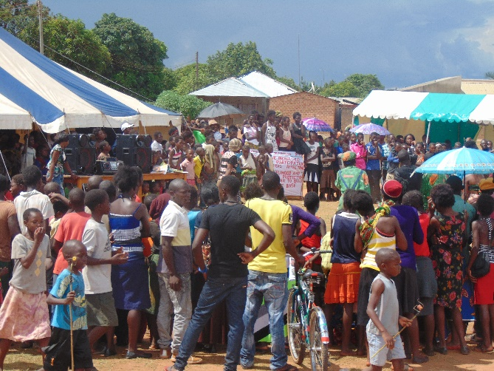
A community health event in progress

Slide 9
Conclusion
AYP in Africa are capable of participating meaningfully in research that directly impacts their lives.
While challenges to participation in research exist, researchers should be encouraged to invest in meaningful partnerships with AYP. CABs with only AYP representatives are one such strategy.

Slide 10
Thank You

Slide 11
acknowledgements
Sponsored by the National Institute of Allergy and Infectious Diseases (NIAID) under Cooperative Agreements # UM1 AI068619, UM1-AI068617, and UM1-AI068613
Funded by:
  The U.S. President's Emergency Plan for AIDS Relief (PEPFAR)
  The International Initiative for Impact Evaluation (3ie) with support from the Bill & Melinda Gates Foundation
  NIAID, the National Institute of Mental Health (NIMH), and the National Institute on Drug Abuse (NIDA) all part of the U.S. National Institutes of Health (NIH)

Slide 12
















The HPTN 071 Study Team, led by:
Dr. Richard Hayes
Dr. Sarah Fidler
Dr. Helen Ayles
Dr. Nulda Beyers
Dr. Peter Bock
Government Agencies:
PEPFAR Implementing Partners:

Slide 13

With thanks to:
All research participants and their families
The 21 research communities and their religious, traditional, secular and civil leadership structures
Volunteers in the community advisory board structures

