Slide 1
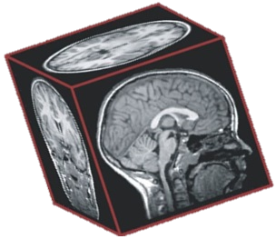
Neuroimaging findings in children from the CHER (Children with HIV early antiretroviral therapy trial) cohort
Emmanuel Nwosu and Farai Mberi
University of Cape Town, South Africa
University of Cape Town
Martha J. Holmes
Franscesca Little
Frances Robertson
Marcin Jankiewicz
Ernesta M. Meintjes
Stellenbosch University
Els Dobbels
Barbara Laughton
Mark Cotton
Massachusetts General Hospital
Andre van der Kouwe
Related poster numbers:
TUPDB0103 – 5 yr morphometry (Nwosu)
TUPDB0104 – 9 yr diffusion tensor imaging (Mberi)
THPEB134 – 7 yr tractography (Madzime)
THPEB145 – 5 yr imaging-neuropsych associations (Ibrahim)

Slide 2
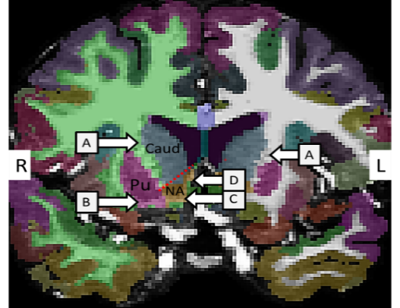
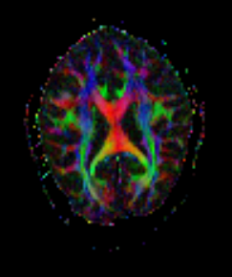
Study participants
Multimodal Longitudinal neuroimaging study
(5, 7, 9, 11 yrs)
From interlinked vaccine trial in the same community in Cape Town
Xhosa & Cape Coloured
Children
Structural MRI
From randomized CHER trial
HIV Infected (HIV+)
90
Uninfected controls
62
Effects of ART interruption on Morphometry (5 years)
Interrupted ART (CD4 guided)
Planned ATI @ 48/96 wks;
Median ATI age ± IQR =49±36 wks; Interruption duration =44±54 wks
Continuous
ART
Diffusion Tensor Imaging
HIV-exposed (HEU)
HIV-unexposed
(HU)
Followed from birth
All HIV+ children received Zidovudine. Lamivudine, Lopinavir/ritonavir
Viral load suppressed in 96% of children by age 2 years
Effects of Infection/Exposure on white matter integrity (9 years)

Slide 3
Cortical differences at age 5 years in HIV+ children with ART interruption (N=21) compared to continuous therapy (N=25)
Localised cortical thinning
Regional cortical folding reductions
-0.30 -0.12 0.07 0.25
-0.26 -0.11 0.03 0.18
ART interruption alters brain morphometry at age 5 years.
Neuropsychological testing necessary to establish whether observed morphometric differences affect outcomes in long term
Notes:
Thinner cortex in the lateral occipital region of left hemisphere.
Lower cortical folding (gyrification) in bilateral superior parietal region.

Slide 4
Ongoing white matter alterations at 9 years despite early ART
HIV+ (N=51) compared to Uninfected Controls (N=36)
HEU (N=22) vs. HU (N=14)
Lower fractional anisotropy
Higher mean diffusivity
Lower mean diffusivity
White matter alterations in the inferior fronto-occipital fasciculus, bilateral corticospinal tract, inferior longitudinal fasciculus, and anterior thalamic radiation seen in HIV+ children at younger ages persist.
Additional damage observed in corpus callosum at 9 yrs.
Differences in the corticospinal tract persist.
In addition, observe alterations in inferior fronto-occipital fasciculus at 9 yrs.

