Slide 1
Public health implications of acute HIV infection diagnostic strategies in low- & middle-income countries
Sarah E. Rutstein, MD, PhD
University of North Carolina at Chapel Hill

Slide 2
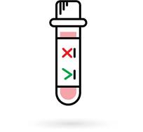
What is acute HIV – a public health-centric definition
Why is it worth the effort?
transmission
cluster identification/intervention
PrEP
early treatment (not discussed here)
How do we diagnose AHI?
How do we miss AHI?

Slide 3
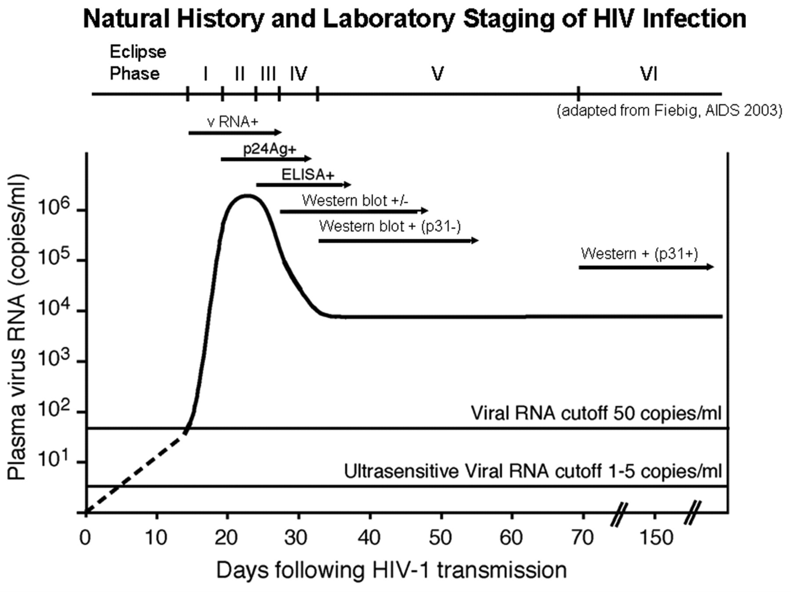
Acute HIV infection: Fiebig Stages
Fiebig Stages:
From: The Detection of Acute HIV Infection
J Infect Dis. 2010;202(Supplement_2):S270-S277. doi:10.1086/655651
J Infect Dis | © 2010 by the Infectious Diseases Society of America

Slide 4
Defining acute HIV infection
HIV-RNA+

Slide 5
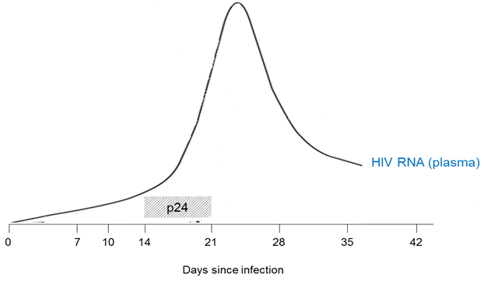
Defining acute HIV infection
HIV-RNA+ and/or p24 Ag

Slide 6
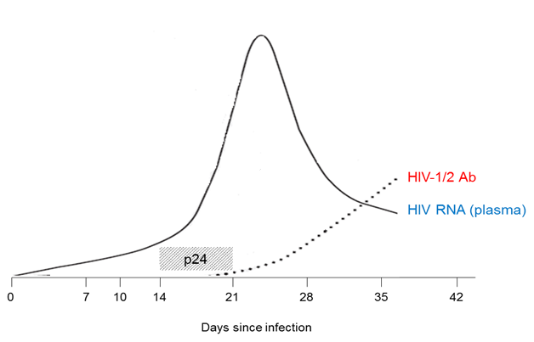
Defining acute HIV infection
HIV-RNA+ and/or p24 Ag
Undetectable anti-HIV Ab

Slide 7
Defining acute HIV infection
HIV-RNA+ and/or p24 Ag
Undetectable anti-HIV Ab
Public health implications

Slide 8
What is acute HIV – a public health-centric definition
Why is it worth the effort?
transmission
cluster identification/intervention
PrEP
early treatment (not discussed here)
How do we diagnose AHI?
How do we miss AHI?

Slide 9
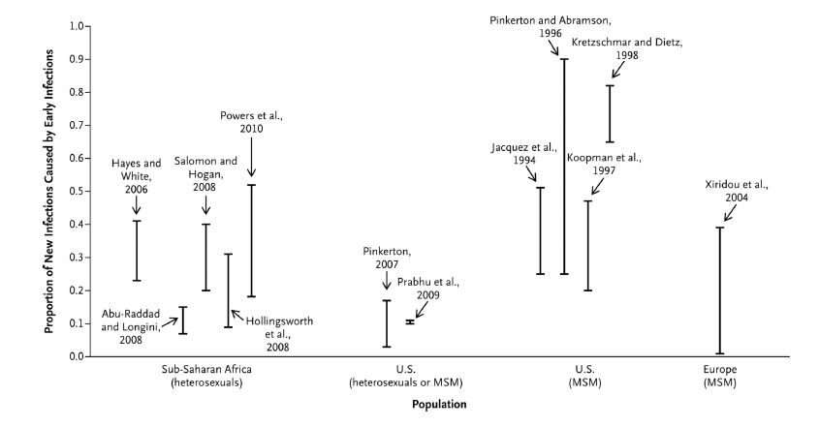
→ Efficient transmission
Proportion of New Infections Caused by Early Infections
Volz et al., 2013

Slide 10
→ Efficient transmission
Phylogenetic estimates and mathematical models highly variable →
AHI accounts for 10-50% of all transmissions

Slide 11
AHI: Canary in a coal mine

Slide 12
AHI: Canary in a coal mine

Slide 13
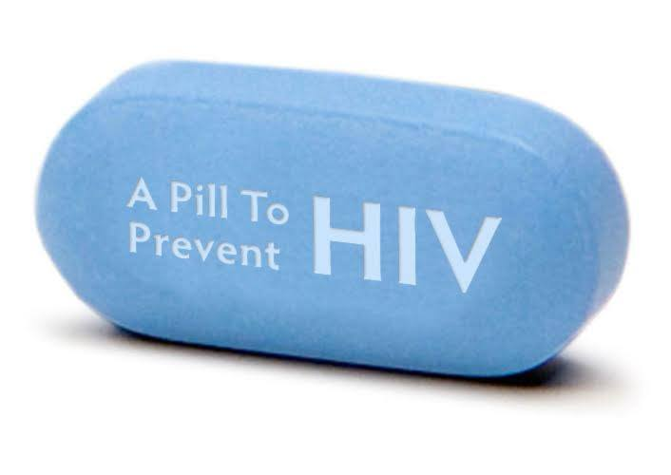
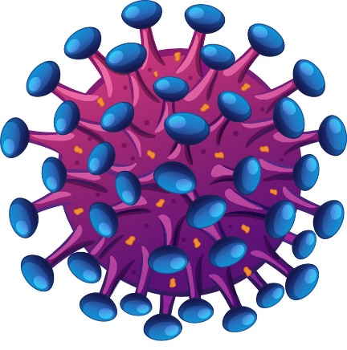
PrEP: can we confirm HIV negative status without AHI screening?
?

Slide 14
What is acute HIV – a public health-centric definition
Why is it worth the effort?
transmission
cluster identification/intervention
PrEP
early treatment (not discussed here)
How do we diagnose AHI?
How do we miss AHI?

Slide 15
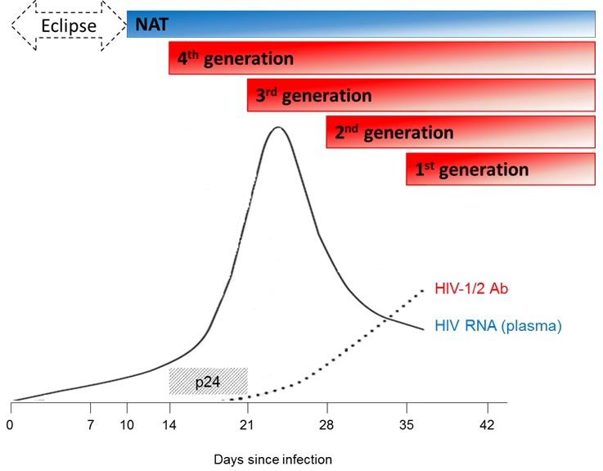
Diagnosing AHI

Slide 16
Diagnosing AHI

Slide 17
3rd vs 4th generation testing/NAT
WHEN
<20 minutes
Day(s)
WHERE
Field (anywhere)
Access to lab/electricity/platform
WHAT
Fingerstick
Venipuncture/whole blood
WHO
Lay health-worker
Skilled laboratory technician
3rd generation
(POC)
4th generation/NAT
(not POC)

Slide 18
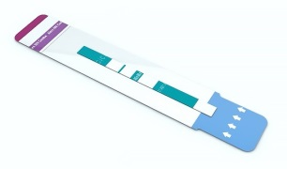
Diagnostic pipeline
Alere Determine Ag/Ab Combo

Slide 19
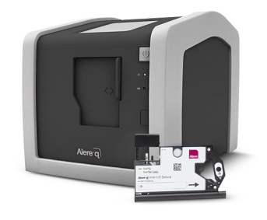
Diagnostic pipeline
Alere Determine Ag/Ab Combo
POC Alere q HIV-1/2

Slide 20
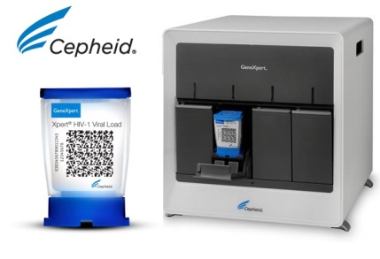
Diagnostic pipeline
Alere Determine Ag/Ab Combo
POC Alere q HIV-1/2
GeneXpert HIV-1 Viral load

Slide 21
What is acute HIV – a public health-centric definition
Why is it worth the effort?
transmission
cluster identification/intervention
PrEP
early treatment (not discussed here)
How do we diagnose AHI?
How do we miss AHI?

Slide 22
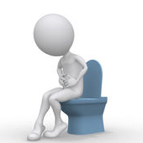
How we miss acute infection…
Fever
Fatigue
Body pains
Sore throat
AHI
Genital ulcer disease
Diarrhea

Slide 23
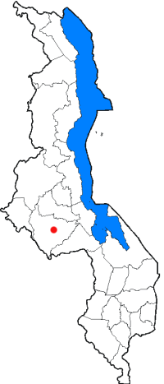
AHI: more common than you’d think
Pilcher, et al., AIDS, 2004
Fiscus, et al., JID, 2007
Rutstein, et al., JAIDS, 2016
iKnow study (ongoing)

Slide 24
AHI: more common than you’d think
Seronegatives (n):
508
862
4255
9949

Slide 25
Focusing screening efforts
HIV Testing Centers vs Sexually Transmitted Infection Clinic
(Lilongwe, Malawi, 2012-2014)

Slide 26
Beyond diagnostics: screening for AHI
Symptom-driven care seeking
Many seek care during symptomatic phase
Symptom- and risk behavior-derived risk scores concentrate scarce testing resources
Screening <50% of patients can identify >80% of persons with AHI
AHI risk score
Score <2
Score ≥2
Offer HTC, consider alternative diagnoses
HTC with rapid antibody
Negative/discordant
Positive
AHI screening
Link to care/start ART
No RNA/p24 available
HIV RNA*/p24
Repeat HIV rapid antibody in 2-3 weeks
Adapted from: E. Sanders

Slide 27
…but perhaps the most critical component to AHI diagnosis is going to be standardized, global policy regarding, who, when, and how to test
…worth the effort given significant public health implications regarding transmission, case-finding, and safety of PrEP initiation.
Multiple barriers to diagnosis, including need for accurate POC screening tools…
Brief period characterized by unfettered viral replication…

