Slide 1

Impact of HIV Combination Prevention in Men who have Sex with Men, Bangkok, Thailand
Pattanasin S ¹, Cadwell B³, Smith DK³, Sukwicha W ¹, Mock PA ¹, Wimonsate W ¹, Ungsedhapand C ¹, Sirivongrangson P ², Thigpen MC ^{1,3}, Dunne EF ^{1,3}
¹ Thailand Ministry of Public Health – U.S. Centers for Disease Control and Prevention
Collaboration, Nonthaburi, Thailand
² Department of Disease Control, Ministry of Public Health, Nonthaburi, Thailand
³ Division of HIV/AIDS Prevention, U.S. Centers for Disease Control and Prevention
Georgia, U.S.
22nd International AIDS Conference, Amsterdam, Netherlands, 23-27 July, 2018

Slide 2
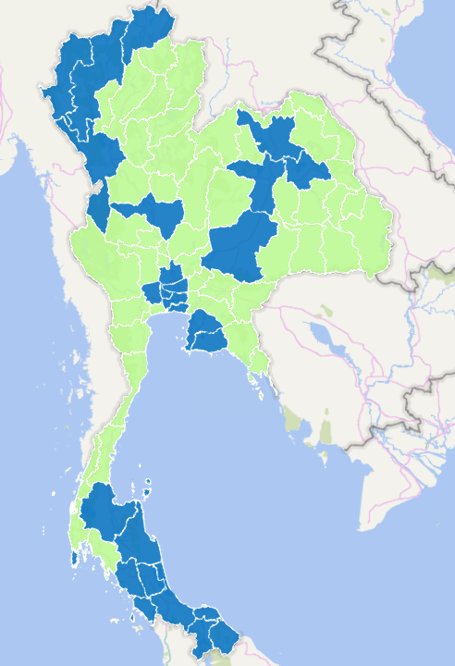
PrEP in Thailand
Chiang Mai
2014
  Thai National Guidelines for HIV/AIDS recommend PrEP for HIV prevention
  Thai Government Pharmaceutical Organization produced TENO-EM, a locally made TDF/FTC combination pill at a low price ~ 20 USD per 30 pills
2017
  National strategies to end the AIDS epidemic by 2030 launched
  Target to reduce new HIV infection to < 1000 infections/year
2018
  Ministry of Public Health launched PrEP projects for Men who have Sex with men (MSM), Transgender Women (TGW), and Person Who Inject Drug in many provinces
Planned
  MSM and TGW, and discordant partner access to PrEP under Universal Insurance Coverage in 2019
Bangkok
Pattaya
Phuket

Slide 3
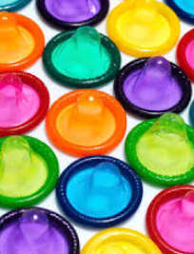
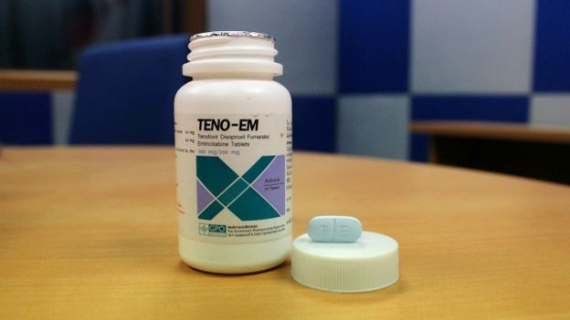
Objective
To assess the impact of PrEP and condom use in Thailand by describing the estimated number of HIV infections among Thai MSM in Bangkok using different attributes of adherence and stratified by risk behaviors

Slide 4
Methods
Statistical analysis
Deterministic model
Previously presented by Smith DK, 2015
Parameters
3 parameters from published data
  PrEP effectiveness based on self-reported medication adherence and pills counts (iPrEX)¹
  Condom effectiveness based on self-reported use during anal sex among MSM reporting ≥ 1 HIV-positive partner in 2 HIV prevention trials ²
  HIV incidence among Bangkok MSM Cohort Study (BMCS) ³
  ¹ Grant RM,2010 ² Smith DK, Herbst JH and Rose CE, 2015 ³ van Griensven F, 2013

Slide 5
PrEP effectiveness (iPrEX)
Subgroup | Hazard Ratio | 95% CI
Pill use
≥90% Pill use vs. placebo | 0.27 | 0.12, 0.59
As treated
<50% Pill use vs. placebo | 0.68 | 0.33, 1.41
Grant RM, 2010.

Slide 6
Condom effectiveness (Combined EXPLORE and VAX 004)
Receptive + insertive anal intercourse | Hazard Ratio | 95% CI
Always vs. never | 0.29 | 0.21, 0.42
Sometimes vs. never | 0.92 | 0.68, 1.25
Smith DK, 2015.

Slide 7
HIV incidence among MSM in BMCS, Thailand, 2006-2012
Characteristics |  | Rate per 100 PY | CI
Overall |  | 5.9 | 5.2, 6.8
Age | 18-21 years | 8.8 | 6.6, 11.6
 | 22-29 years | 6.4 | 5.3, 7.6
 | ≥30 years | 3.7 | 2.6, 5.0
Drug use for sexual pleasure |  | 16.2 | 11.0, 29.0
Group sex |  | 10.0 | 7.5, 13.0
Receptive anal intercourse (RAI) |  | 7.2 | 6.2, 8.4
Living with | Partner | 6.0 | 4.1, 8.5
 | Roommate/alone | 7.3 | 6.0, 8.7
van Griensven F, 2013.

Slide 8
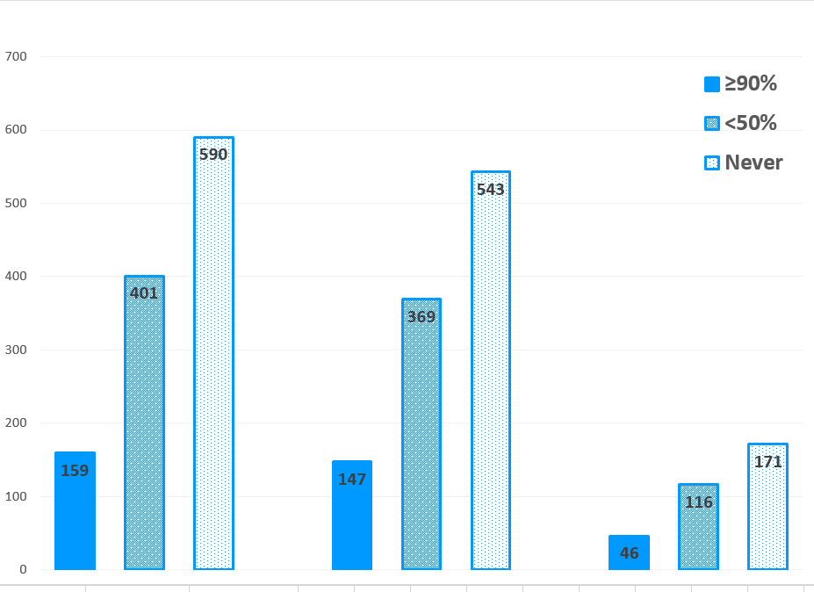
Results:
HIV infection per 10000 sexually active Bangkok MSM by level of PrEP adherence
never condom
sometimes condom
always condom
Number of infections
PrEP use self-report: A= Always ≥90%, <50% = 1-49%, Never = 0%
Condom self-report: Always = 100%, Sometimes =1-99%, Never = 0%

Slide 9
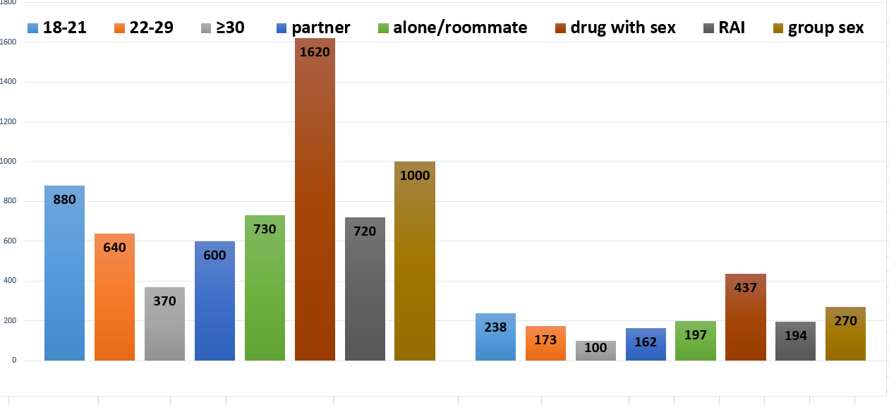
HIV infection per 10000 sexually active Bangkok MSM
Number of infections
Overall baseline HIV rate from BMCS
never PrEP & never condom
PrEP ≥90% & never condom

Slide 10
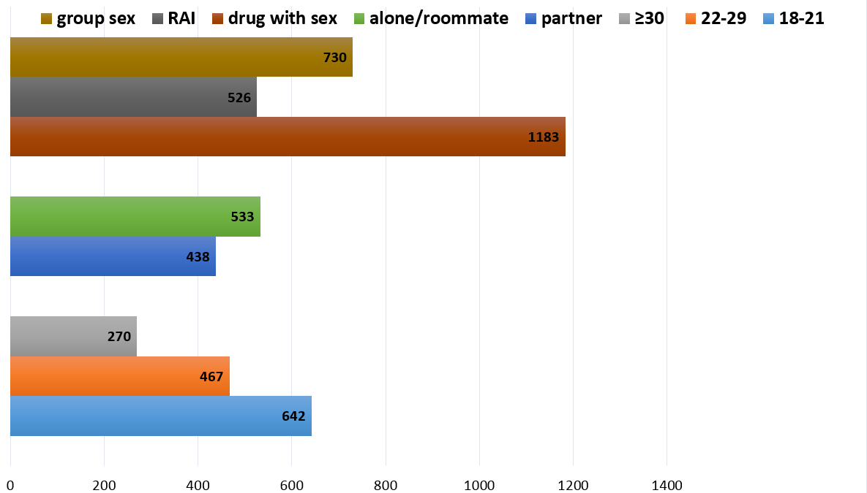
Averted HIV infection per 10000 sexually active Bangkok MSM
PrEP ≥90% & never condom
Number of infections

Slide 11
Limitations
We did not include impact of treatment as prevention in the model
Our model had independent assumptions of PrEP and condom use
Baseline incidence rate of 5.9 per 100 PY from BMCS may be an underestimate as some participants in BMCS may have been condom users
Calculations of reduction in HIV infection had high variability

Slide 12
Summary
Our results show the impact of PrEP and condoms on reductions in HIV infection
  Adherence for prevention strategies is critical
We demonstrate particular risk groups among MSM that would most benefit from these combination prevention strategies

Slide 13









Acknowledgements
Participants of the BMCS, iPrEX, EXPLORE, and VAX 004 studies
Supaporn Chaikummao RA Patrick J. Flaherty MBA, MPP

Slide 14
vpv6@cdc.gov

Slide 15
Definition
Drug use for sexual pleasure
Cannabis, 3,4-methylenedioxy-N-methylamphetamine (ecstasy), amphetamine, methamphetamine, ketamine, cocaine, and gamma hydroxyl butyrate (GHB)
Group sex
Ever had group sex in past 4 months? “Seks moo” in Thai colloquial language.

Slide 16
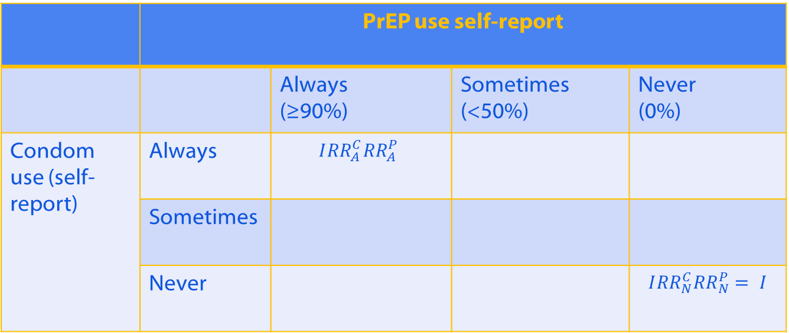

Incidence matrix (independent assumption)
 | PrEP use self-report
 |  | Always (≥90%) | Sometimes (<50%) | Never (0%)
Condom use (self-report) | Always | $$I{RR}_{A}^{C}{RR}_{A}^{P}$$
 | Sometimes
 | Never |  |  | $I{RR}_{N}^{C}{RR}_{N}^{P}$ $= I$
(5.9/100)*(0.29*0.27)*10000
$$I_{ij}=I{RR}_{i}^{C}{RR}_{j}^{P}$$

Slide 17
Estimated number of annual HIV infections among 10,000 sexually active MSM, Bangkok, Thailand
Results
Overall | PrEP use self-report
 |  | Always (95% CI) | Sometimes (95% CI) | Never (95% CI)
Condom use (self-report) | Always | 46 (19-110) | 116 (52-260) | 171 (121-242)
 | Sometimes | 147 (62-344) | 369 (168-811) | 543 (400-736)
 | Never | 159 (72-353) | 401 (194-829) | 590 (520-680)
PrEP use self-report = Always ≥90%, Sometimes 1-49%, Never 0%
Condom self-report = Always 100%, Sometimes 1-99%, Never 0%

Slide 18
iPrEX note
Background: Multinational efficacy study of FTC/TDF in MSM in Peru, Ecuador, SA, Brazil and Thailand.
As-treated: Time dependent covariate indication as to whether the subject was known to fall below the pre-specified level of study-drug compliance (50%) on any of the following: records of study-drug dispensation, pill count and self-report.
Pill use: The rate (%) of self-report pill use. The rate of pill use decreased during the first year, from 90% to 91%, a trend that contrasted with pill counts and self-report, which indicated an increased rate of use.

Slide 19
Combination VAX004 & EXPLORE (Smith DK, 2015)
Background: Condom effectiveness in heterosexual discordant partner = 80%, how about MSM?
Objectives: 1) To calculate condom effectiveness in MSM, 2) To compare with existing data from Cochrane review
Methods: Combined trial longitudinal data sets, calculate effectiveness from PY and HR [100*(1-HR)], risk per sex act, condom were grouped as always/sometimes/never.
Results: Overall condom effective among MSM = 70% (Always/never). No significant different with Cochrane review.
Limitations: Unknown treatment VL status, multiple sex partners not accounted for.

Slide 20
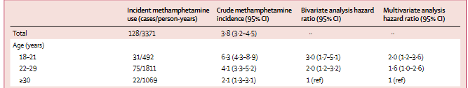
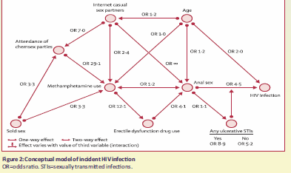
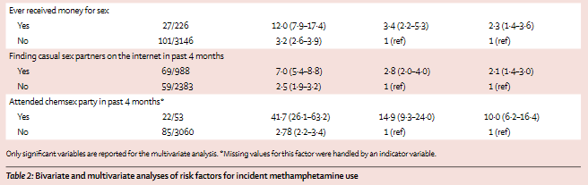
TUPEC315
Piyaraj P et al.,

