Slide 1
Association between syndemics (of alcohol and drug use, and violence) and HIV-related sexual risk among MSM in India: Findings from a large-scale national bio-behavioural survey Venkatesan Chakrapani^{a*} PVM Lakshmiª, Pradeep Kumar^{b}, Venkatesh Srinivas^{b} ªPostgraduate Institute of Medical Education and Research (PGIMER), India ^{b}National AIDS Control Organisation (NACO), India Oral Poster: WEPDC02. July 25, 2018. Session Room: G102-103

Slide 2
HIV prevalence among MSM in India - 4.3% to 7%
Consistent condom use (male partners): 48% to 55% (IBBS, 2015)
SYNergistic epiDEMICS (Singer, 1996 & 2013):
1. Co-occurrence of psychosocial conditions
2. Synergy in increasing a negative outcome (e.g., sexual risk or HIV)
3. Social forces (e.g., Stigma) lead to syndemic conditions
Objective:
Whether psychosocial health conditions co-occur?
Whether they synergistically increase sexual risk?

Slide 3
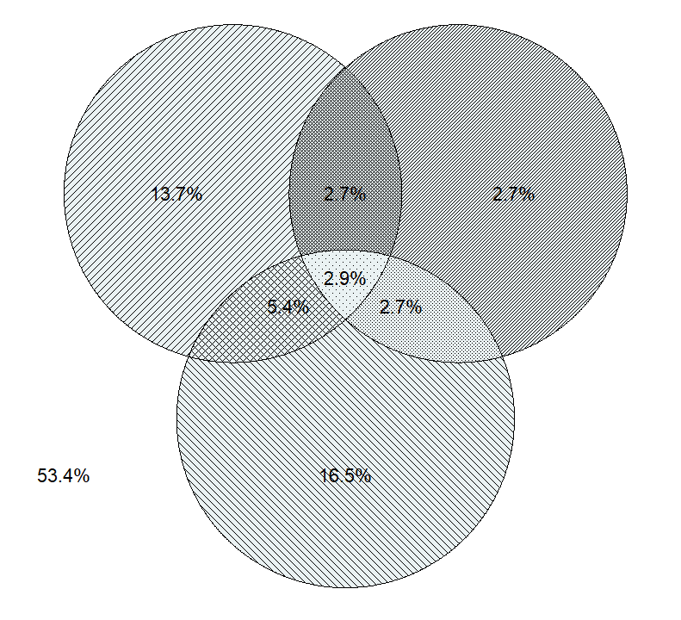
Co-occurrence of three psychosocial health conditions
(N=22,297 HIV-neg MSM)
V
D
V = 24%
A = 27%
D = 11%
A

Slide 4
As the number of conditions increases, sexual risk increases
Inconsistent condom use
with male partners

Slide 5
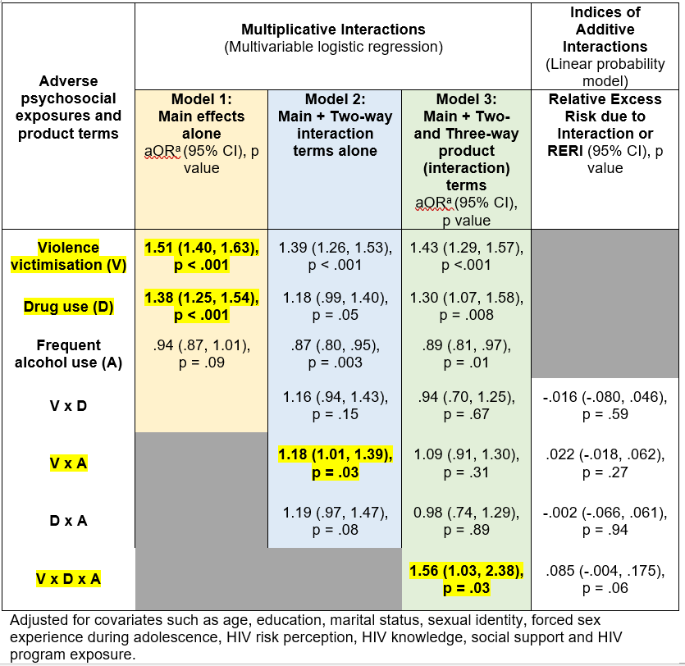
Effect of psychosocial conditions on
inconsistent condom use (male partners)

Slide 6
ASSOCIATIONS WITH SEXUAL RISK
Independent effects: V (aOR=1.51, p < .001); D (aOR=1.38, p < .001)
Evidence for Synergy
Significant three-way interaction: V x D x A (aOR = 1.56, p=.03)
Significant two-way interaction: V x A (aOR = 1.18, p=.03).

Slide 7
IMPLICATIONS
Need to address Violence victimisation, and alcohol and drug use to substantially reduce HIV risk among MSM
What can be done?
Screen and manage syndemic conditions
Prevent syndemics (e.g., Stigma reduction programmes)
Future: 1) Identify other syndemic conditions; 2) Test and evaluate syndemically oriented HIV interventions

