Slide 1
Unstable housing associated with injection risk behaviors among PWID in Ukraine
Alyona Mazhnaya, Jill Owczarzak
Department of Health, Behavior, and Society, Johns Hopkins School of Public Health, Baltimore, MD 21205, USA
amazhna1@jhmi.edu
Notes:
Good afternoon,
I am thankful to be able to present results of the study that has focused on the association between unstable housing and injection risk behaviors among people who inject drugs in Ukraine.
This study was motivated by the understanding that in other settings homelessness and housing instability were among the structural vulnerabilities that expose people who use drugs to HIV and HCV risk.

Slide 2
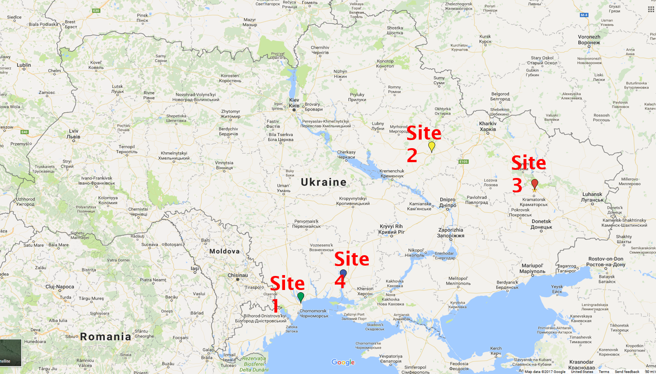
Setting and sample
Survey of N=684 PWID
4 sites
Injection risk:
using needles/syringes after someone/ sharing injecting equipment within last 30 days
Unstable housing:
living on the street, in abandoned or vacant building, staying in shelter or multiple places
Notes:
Setting and sample
Data for the current study comes from a baseline survey of N=684 participants who were recruited from 4 sites as part of a study to develop and assess the effectiveness of HIV prevention interventions for PWID in Ukraine
The assessment instrument was based on the Risk Behavior Assessment (RBA) and included basic sociodemographic characteristics (age, sex, education, marital status, income, housing situation), health history, drug use, injection and sex-related risk behaviors. The instrument was self-administered in Russian through the web-based online platform Qualtrics at the agency venue in a private environment.
Study protocol and materials were reviewed and approved by the Institutional Review Board at the Johns Hopkins Bloomberg School of Public Health and the ethics committee of the Sociological Association of Ukraine.
Measures
The outcome measure is HIV/HCV injection risk behaviors defined as reporting using needles/syringes after someone or sharing injecting equipment (cooker, cotton, water) within last 30 days.
The main exposure of interest is, unstable housing defined as living on the street, in abandoned or vacant building, staying in shelter or multiple places vs. stable housing defined as living with family, sex partner, with acquaintances or in own apartment.
ADDDITIONAL INFORMATION :
In Ukraine, a country of 42 million people 1.1% of adult population are estimated to inject drugs. Among PWID in Ukraine, HIV prevalence is estimated to range from 21% to 42%, while HCV prevalence estimated to be as high as 60%.
Previously injection risk behavior has been addressed through increasing coverage of harm reduction programs such as:
- needle/syringe distribution programs
- consultations, peer-based behavior change interventions ,and
- group-level interventions
Despite the fact that Ukrainian response to HIV/AIDS is often set as an example, few interventions address issues related to the role that structural determinants play in the production of risk.
Therefore, this study aimed to address this gap by exploring the association between unstable housing and injection risk behaviors

Slide 3
Main results
Probabilities adjusted for education, sex, site, type of primary drug using Poisson regression with robust variance estimate
Notes:
Statistical analysis
We used multivariable regression to examine independent associations with injection risk behavior. The final model was selected based on the best subset variable selection according to the Akaike information criterion (AIC).
We used the results of crude and adjusted regressions to calculate probabilities of injection risk behavior by stable vs unstable housing
We found that unstable housing is independently associated with the increased prevalence of risky behavior, as figure on the slide shows the prevalence of risky behavior among unstably housed is two times the prevalence of risk behavior among those who reported stable housing.
These results is adjusted for education, sex, site, type of primary drug

Slide 4
Takeaway
Unstable housing contributes to HIV/HCV vulnerability among PWID in Ukraine.
Assistance with obtaining stable housing and additional psychosocial support.
Need to address structural determinants of health in HIV and HCV prevention programs in Ukraine and EECA.
Notes:
Housing situation is part of the risk environment concept widely discussed in the literature. People who report being homeless are likely to represent one of the most marginalized population whose vulnerability to HIV and HCV risk are substantially higher.
Therefore, this study highlights that among population of PWID there are important sub-groups that have increased prevention needs which include assistance with obtaining stable housing and additional psychosocial support.
Despite abundant evidence on the role of socioeconomic precarity for health outcomes, this avenue of research has not been fully explored with regard to HIV/HCV risk in EECA. Therefore, our findings bring attention to the importance of socio-economic factors in addressing HIV and HCV risk in Ukraine and EECA by addressing structural determinants of health in programming and implementation.

Slide 5
Acknowledgements
We thank the members of the MICT research team who are key contributors to the parent project:
Ruzanna Aleksanyan, Polina Alpatova, Tetyana Zub, and Olga Filippova, Sarah D. Philips at Indiana University, Bloomington.
We also extend our gratitude to the staff in agencies participating in the project whose input in data collection was vital.
Funding for this study was provided by the National Institute on Drug Abuse (R01DA033644).

