Slide 1
HIV prevention in a Fast Track City
Trends in time-dependent HIV cascade indicators among gay and bisexual men attending high HIV caseload testing services in Melbourne, Australia.
Mark Stoove, Jason Asselin, Carol- El Hayek, Sharon Lewin, Brent Allan, Jenny Hoy, Edwina Wright, Simon Ruth, John Mills, Christopher Carter, Michael West, John Mainwaring, Andrea Fischer, Anna Wilkinson, Rebecca Guy, Basil Donovan, Denton Calendar, Nasra Higgins, Peter Locke, Norm Roth, BK Tee, Jeff Wilcox, Long Nguyen, Kathleen Ryan, Margaret Hellard

Slide 2
Overview
HIV epidemiology
Australia and Melbourne/Victoria
Local cascade of care and measurement challenges
Methods – extraction and analysis of HIV testing data for gay and bisexual men (GBM) attending specialist sexual health clinics in Melbourne
Results – annual trends in:
HIV cascade-related indicators (diagnostic and viral load testing):
HIV incidence
Conclusions and implications

Slide 3
HIV Epidemiology in Australia
Diagnose ~1000 cases of HIV annually
Australian population prevalence = 0.13%
Concentrated epidemic:
Prevalence among GBM ~7.3%
Prevalence among People who inject drugs ~1.4%

Slide 4
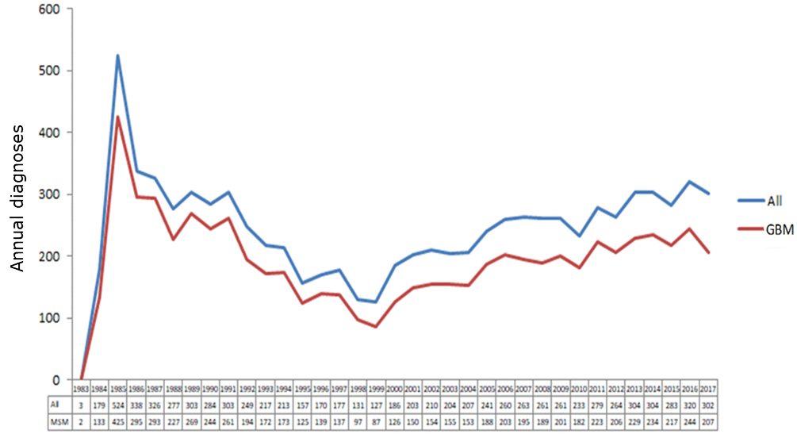
HIV Epidemiology in Melbourne, Victoria
2017 HIV diagnoses in Victoria = 302
Approximately 75% of HIV diagnoses occur among GBM

Slide 5
HIV Epidemiology in Melbourne, Victoria
HIV diagnoses collated at state-level
85% of HIV cases diagnosed in Victoria resided in Melbourne at the time of diagnosis
HIV both socially and geographically concentrated

Slide 6
HIV Epidemiology in Melbourne, Victoria
Cascade of care 2012 - 2016
Undiagnosed HIV remained unchanged at 12%

Slide 7
HIV Epidemiology in Melbourne, Victoria
Cascade of care 2012 - 2016
PLHIV receiving treatment increased from 82% to 95%

Slide 8
HIV Epidemiology in Melbourne, Victoria
Cascade of care 2012 - 2016
Viral suppression among PLHIV receiving treatment increased from 88% to 94%

Slide 9
Measuring the HIV cascade of care
Cascade of care - 2016
Progress and achievement of UNAIDS targets
Sensitive to change?

Slide 10
Measuring the HIV cascade of care
HIV cascade as a prevention metric is about measuring community HIV viremia
How many people are viremic?

Slide 11
Measuring the HIV cascade of care
HIV cascade as a prevention metric is about measuring community HIV viremia
How many people are viremic?
How long are people are viremic?
TIME

Slide 12
Measuring the HIV cascade of care
The key metric becomes
cumulative time people are viremic (cumulative time for onward transmission risk)
TIME

Slide 13
Measuring the HIV cascade of care
Sentinel surveillance system that links individuals’ episodes of care over time
Testing services
HIV care services
Laboratories
GRHANITE™ software anonymously links data using encrypted and non-reversible hash codes
Able to accurately monitor the timing of individuals movement through the cascade following diagnosis.
http://accessproject.org.au/
http://www.grhanite.com

Slide 14
Methods
ACCESS data for HIV diagnostic and viral load monitoring tests among GBM were extracted between 2012 and 2017
4 sexual health specialist clinics (3 GP clinics; 1 peer-led HIV/STI testing service) that see high caseloads of GBM
Settings diagnose ~25% of all HIV in Victoria

Slide 15
Methods
Calculated annualised trends:
Rate of return testing (testing frequency) – diagnostic tests occurring within 3, 6 and 12-months of a previous negative test;
Proportion of HIV tests returning positive results;
Time to viral suppression:
Proportion achieving undetectable viral load (<200 copies/ml) ≤12 months of diagnosis
Median time to undetectable viral load
HIV incidence (≥2 tests)

Slide 16
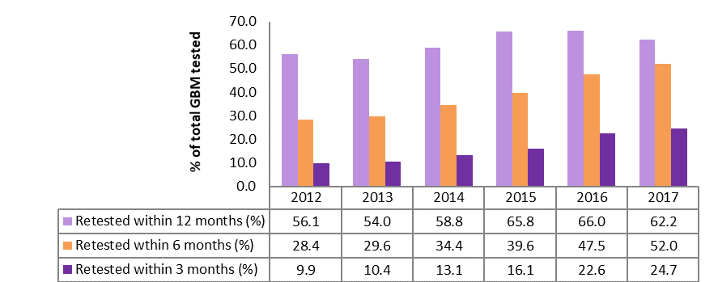
Results [1]
3, 6 and 12-month return testing
Proportion of GBM retesting HIV re-testing among MSM

Slide 17
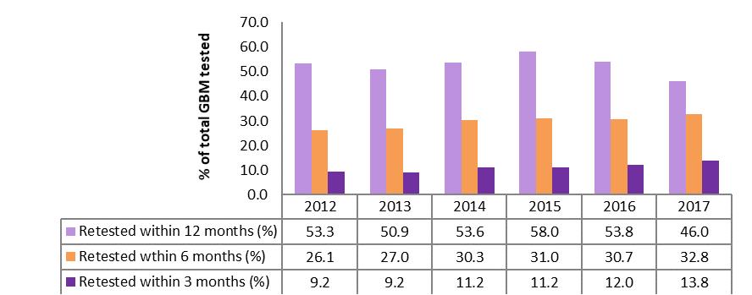
Results [1]
3, 6 and 12-month return testing
Proportion of GBM retesting HIV re-testing among MSM not on PrEP

Slide 18
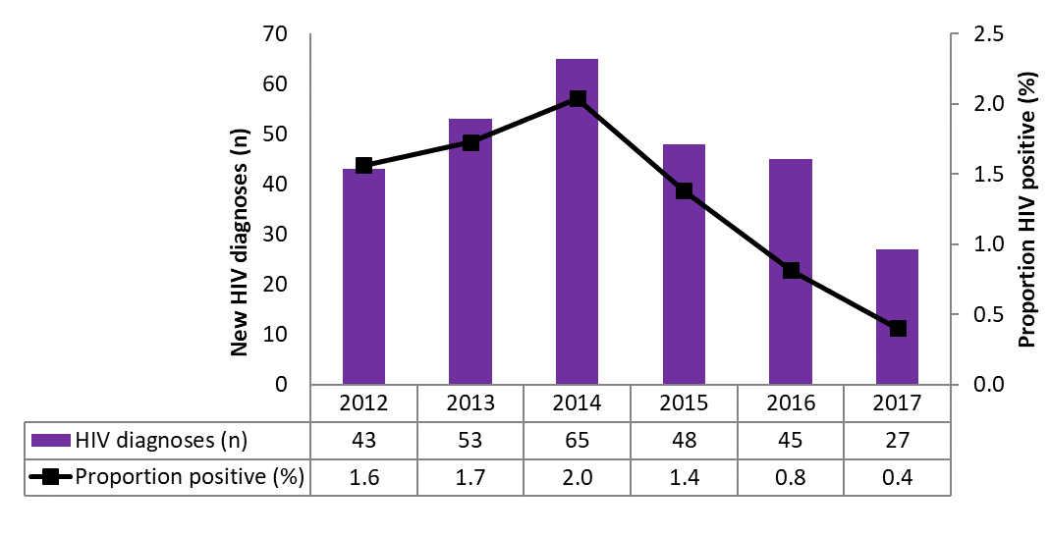
Results [2]
HIV tests proportion positive
Number of HIV diagnoses and proportion positive tests

Slide 19
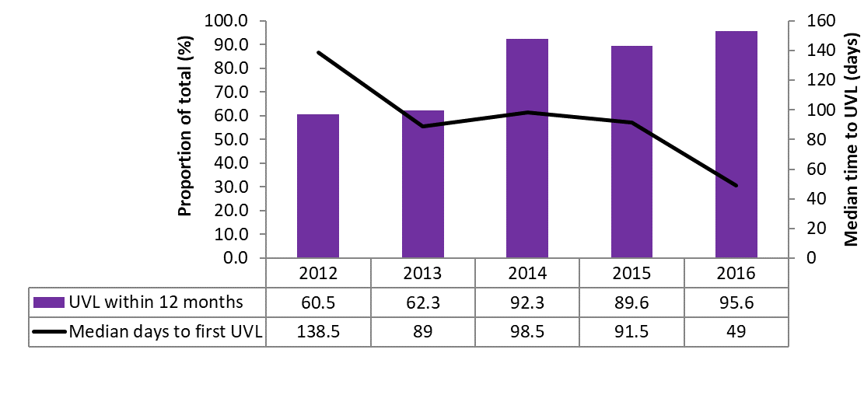
Results [3]
Proportion UVL ≤12 months of diagnosis & median time to UVL
Proportion UVL within 12 months & time to UVL

Slide 20
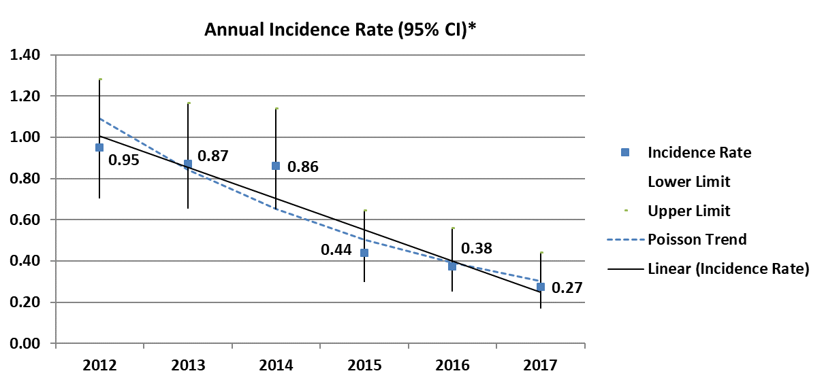
Results [4]
HIV incidence
* Random Point estimate (uniform distribution) with Linear and Poisson trend

Slide 21
Conclusion [1]
Substantial declines in HIV incidence among GBM attending specialist HIV testing services
Coincided with declines in time between diagnosis and viral suppression
Data linked at the patient level generates cascade indicators that are more sensitive to change
Greater utility in evaluating biomedical HIV prevention programs and inform strategic priorities

Slide 22
Conclusion [2]
Victoria’s local strategic priorities:
DIANOSTIC TESTING!
Specialist clinics at capacity
Specialist limited geographic and risk population reach
Need to increase capacity in low case clinical settings
Need to develop and support models for HIV self-testing

Slide 23
Acknowledgements
Co-authors
International Association of Providers of AIDS Care (IAPAC)
ACCESS surveillance team
Clinical and laboratory services that participate in ACCESS
Michael Traeger (Burnet Institute)
Dr Richard Gray (Kirby Institute)
Victorian Department of Health and Human Services
Commonwealth Department of Health
Community Partners - Thorne Harbour Health (formerly Victorian AIDS Council) and Living Positive Victoria
People living with HIV

Slide 24
Isaac Stoové
b. 17 Sept 1944 – d. 20 June 1996

