Slide 1
Forecasting the Cost of Financing ART in Sub-Saharan Africa under Differential Funding Scenarios
Tahvi Frank and Austin Carter
July 25, 2018

Slide 2
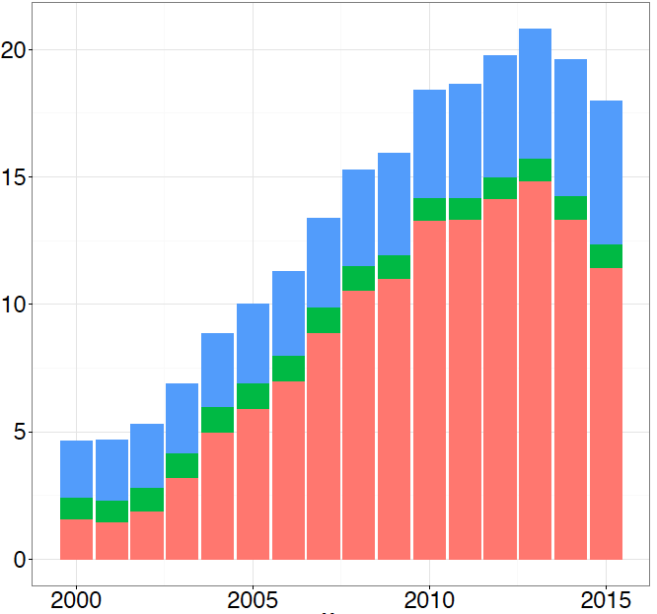
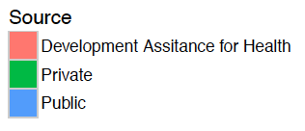
Context
HIV Financing in Sub-Saharan Africa
Stagnating government health expenditure and decreasing development assistance to health
Current funding levels do not meet treatment needs
2017 Purchasing Power Parity (Billions)
Year
Spending on health and HIV/AIDS: domestic health spending and development assistance in 188 countries, 1995–2015
Dieleman, Joseph L et al. The Lancet , Volume 391 , Issue 10132 , 1799 - 1829

Slide 3
Predicting Future ART Cost
Predicting cost of financing ART 2017 – 2040
Estimate future ART coverage under better, worse, and reference scenario
Price of ART
Health spending
Model the HIV epidemic for each scenario
ART Price
ART Coverage
Population Projection
Health Expenditure
(better, worse, reference)

Slide 4
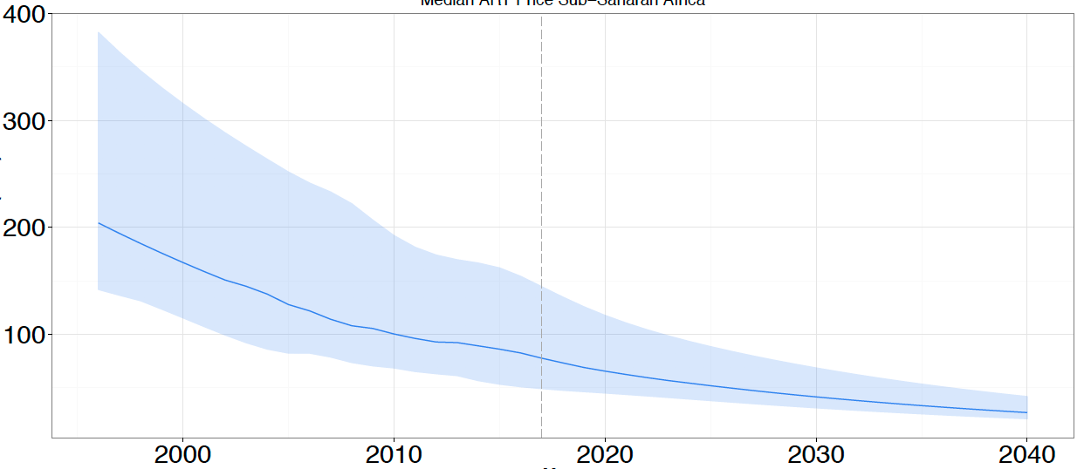
Forecasting ART Price
Data on average cost of ART per person per year from Global Price Reporting Mechanism spanning 2004-2016
Stochastic frontier analysis bounds future minimum cost
Gaussian process regression used to complete time series and extend to 2040 for each country
Range of Annual ART Price SSA
Annual ART Price per Person (US$)
Year

Slide 5
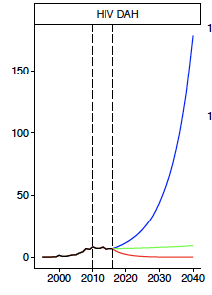
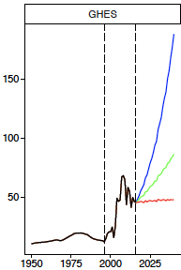
Projected Health Expenditure
Calculated annualized rate of change of per capita health expenditure in each country
Development assistance for health (DAH) for HIV
Government health expenditure as source (GHES)
15th (worse), 50th (reference), and 85th (better) percentile rate of change across countries used to project future funding
Per Capita Spending (US$)
Year

Slide 6
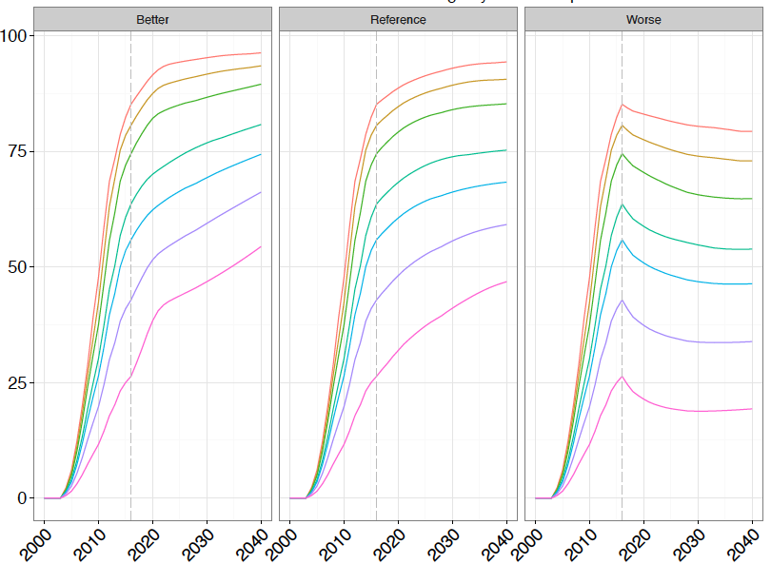
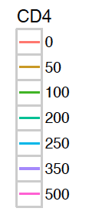
Predicted ART Coverage
Malawi Scenario – Specific ART Coverage
Percent Covered
Year

Slide 7
Predicted Incidence
Counterfactual trend in incidence forecasted using 15th, 50th, and 85th percentile rate of change approach
Final projected incidence decreases with improvements in ART coverage along with changes in the secular trend in counterfactual incidence
Predicted at country-, age-, sex-, year-, draw-level

Slide 8
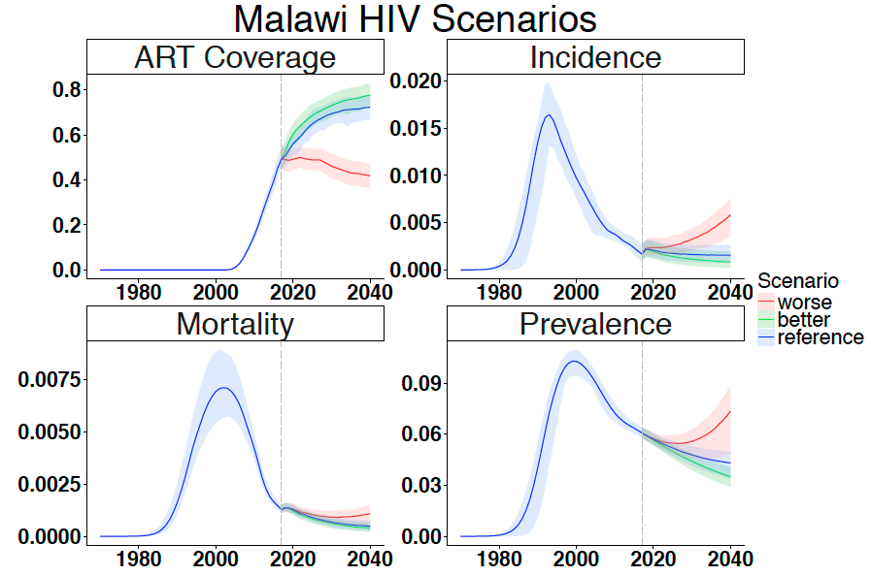
Spectrum
Rate (per 1)

Slide 9
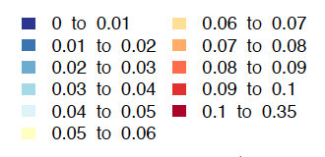
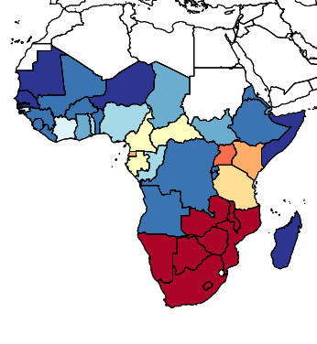
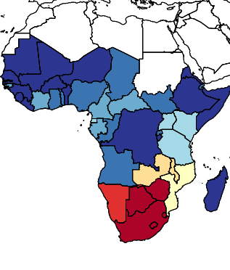
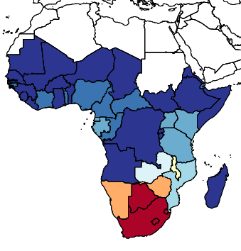
HIV Prevalence
Rate (per 1)
Predicted HIV Prevalence Rate, 2040
Worse
Reference
Better

Slide 10
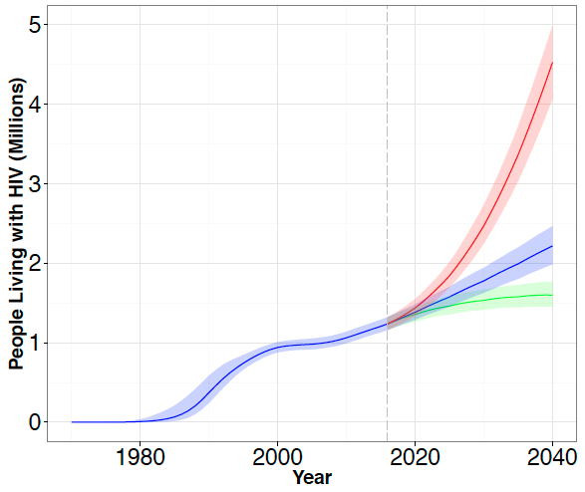
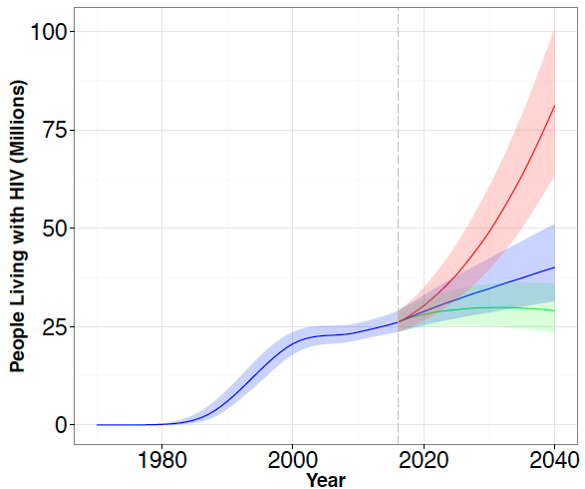
People Living With HIV
Malawi
Sub-Saharan Africa

Slide 11
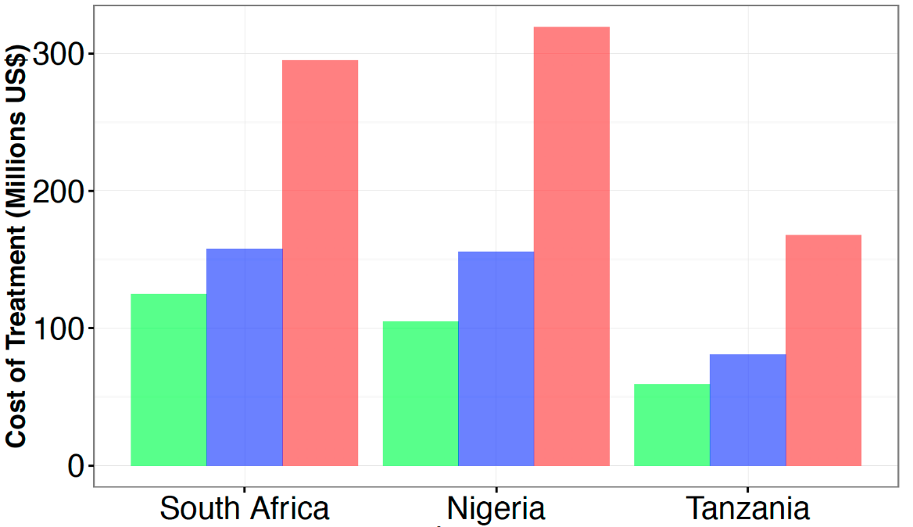
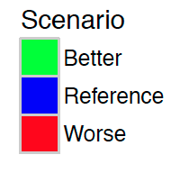
Cost of Treatment
People Living with HIV (millions)
Location | 2016 | 2040
 |  | Worse | Reference | Better
Sub-Saharan Africa | 26.1 | 81.2 | 40.1 | 29.1
South Africa | 6.4 | 14.1 | 7.5 | 5.9
Nigeria | 3.3 | 11.2 | 5.4 | 3.7
Tanzania | 1.6 | 6.3 | 3.1 | 2.2
Cost of ART for all PLHIV, 2040

Slide 12
Conclusions
Despite projected declines in incidence rate, the number of people living with HIV is predicted to increase
Driven by demographic changes and longer lifespans for PLHIV
Highlights need for increased funding
Though the number of PLHIV is projected to increase across all three scenarios, worse scenario reveals dramatic consequences of reducing funding into the future
Triple the number of PLHIV compared to 2016
Better scenario evidences potential for sustained increases in funding to lead to decreased prevalence and future savings on treatment
Limitations
Prediction of price of drug rather than comprehensive cost of care
Lack of data on government health expenditure specific to HIV
Analysis focuses on relationship between funding and ART coverage
Does not include PrEP, male circumcision, and other highly effective interventions

Slide 13
Forecasting the Cost of Financing ART in Sub-Saharan Africa under Differential Funding Scenarios
Tahvi Frank and Austin Carter
tahvif@uw.edu
aucarter@uw.edu

