Slide 1
Taking human rights programs to scale in the HIV response
Ralf Jurgens
The Global Fund to Fight AIDS, TB and Malaria

Slide 2
Acknowledgements
Hyeyoung Lim¹, Alexandrina Iovita¹, Gayane Arustamyan¹, Joanne Csete², Susan Timberlake³, D. Burrows⁴, R. Armstrong⁵, A. Stangl⁶, S. Gruskin⁷, L. Ferguson⁷, S. Baral⁸, C. Lyons⁸, N. Poku⁶, C. Schutte⁵
¹The Global Fund to Fight AIDS, TB and Malaria
²Columbia University, Mailman School of Public Health, NY
³Independent consultant
⁴APMG Health, Sydney
⁵HEARD, Johannesburg
⁶ICRW, Washington DC
⁷USC, Institute for Global Health, Los Angeles
⁸Johns Hopkins University, Bloomberg School of Public Health, Baltimore

Slide 3
Acknowledgements
Open Society Foundations
Ford Foundation
American Jewish World Services

Slide 4
Investing for Impact 2012-2016: Human Rights
Already Global Fund Strategy 2012-2016 had a strategic objective (SO4) on human rights, with three sub-objectives:
Integrate human rights considerations throughout the grant cycle
Increase investment in programs that address human rights barriers to accessing health services
Ensure the Global Fund does not support programs that infringe human rights
1
2
3
Notes:
The Global Fund’s commitment to human rights was already reflected in its 2012-2016 Strategy: Investing for Impact.
The Strategic Objective 4 committed the Fund to: 1) Integrate human rights throughout the grant cycle; 2) Increase investments on human rights programs in HIV, TB and malaria grants; and 3) make sure that programs financed by the Global Fund do not violate human rights.

Slide 5
Progress made from 2014-2016
Significant progress was made on SO 4.1 (integrating HR into the grant cycle) and SO4.3 (ensure no violations)
GMD focal points trained
HR barriers question included in concept notes
123 country profiles made available to CTs and TRP
Minimum human rights standards in grant agreements
SIIC decision on compulsory treatment
OIG Human Rights Complaints Procedure
For SO4.2 (investment in programs to reduce HR-related barriers), progress was limited
Most applications included some analysis of human rights barriers to HIV and, to a lesser extent, TB and malaria services
However, investment in concrete programs to address these barriers remained very low, at 0.7% of overall budgets for HIV, and far less for TB and malaria

Slide 6
Human Rights Cascade (from concept note to grant)
Notes:
Global Fund Human Rights Investments Cascade
This graph shows (in light blue) the total number of concept notes (the 218 that were submitted to GAC 1) submitted for each of the diseases (including joint HIV/TB concept notes) and health system strengthening in the 2014-2016 funding cycle; the number of concept notes that included an analysis of human rights-related barriers to services (in darker blue); the number of signed grants that includes any programs to reduce human rights-related barriers (in dark blue); and the number of signed grants with programs to reduce human rights-related barriers that have a traceable budget (in green).
It clearly shows how a great number of applications included some analysis if human rights barriers to HIV and, to a lesser extent, TB and malaria services.
However, investment in concrete programs to address these barriers remained very low, as shown in the next slide.

Slide 7
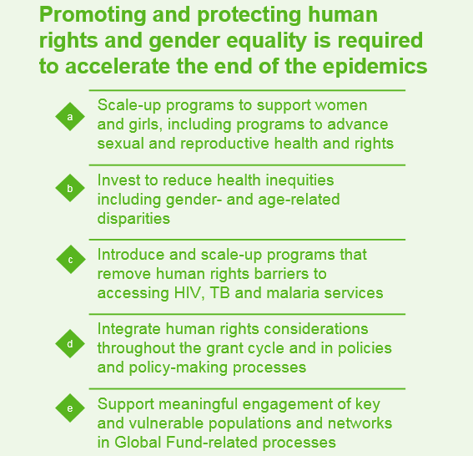
Global Fund Strategy 2017-2022“Investing to End Epidemics”
MAXIMIZE IMPACT AGAINST HIV, TB AND MALARIA
BUILD RESILIENT & SUSTAINABLE SYSTEMS FOR HEALTH
PROMOTE & PROTECT HUMAN RIGHTS AND GENDER EQUALITY
MOBILIZE INCREASED RESOURCES
STRATEGIC ENABLERS: Innovate and differentiate along the development continuum + Support mutually accountable partnerships
Notes:
The Global Fund’s commitment to gender equality, human rights, achieving impact by reaching the most marginalised and strengthening the role of communities appears throughout the 2017-22 strategy.
Next slide shows some specific details:

Slide 8
Background
“Success … requires moving from rhetoric to investing in the very practical programs that have been shown to reduce human rights barriers to access, increasing uptake of and retention in services, and ultimately increasing the efficiency of Global Fund investments.”
The Global Fund Strategy 2017-2022: Investing to End Epidemics

Slide 9
Increasing investment in programs to reduce human rights-related barriers to services
An intensive support effort in 20 countries, with $45 million in matching funds to catalyze investments: Global Fund Key Performance Indicator (KPI) 9a
Ensuring greater investment in middle-income countries: KPI 9b
A focused effort in upper middle income countries nearing transition, aimed at increasing investment from domestic resources: KPI 9C
KPI 9b
Vision: Increased programming for key populations and for programs to reduce HR-related barriers to services in MICs
Measure: % country allocation invested in programs targeting key populations and HR-related barriers to access in middle income countries
Human rights targets:
2.85% for HIV; 2% for TB (for HR, in all MICs)

Slide 10
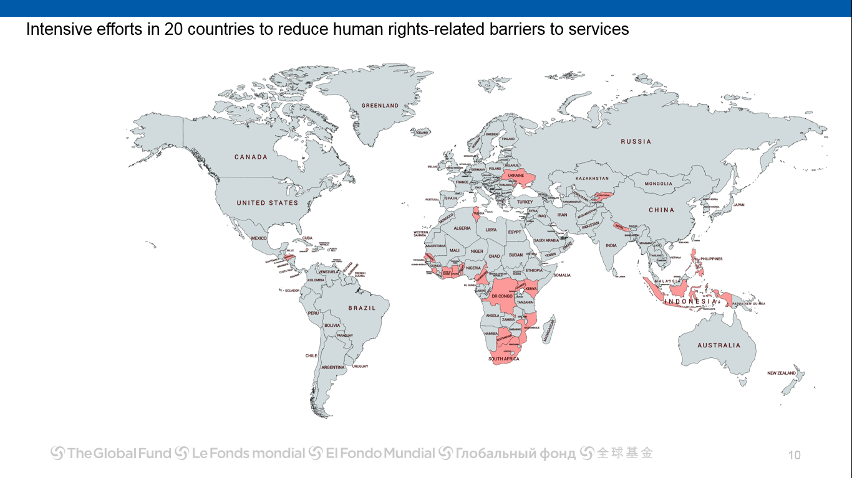
20 country intensive support initiative
Ukraine
KGZ
Tunisia
Indonesia
Philippines
Honduras
Jamaica
Nepal
Benin, Botswana, Cameroon, Cote d’Ivoire, DRC, Ghana, Kenya, Mozambique, Senegal, Sierra Leone, South Africa, Tunisia, Uganda

Slide 11
What is new / innovative?
A new approach
A pragmatic, programmatic and practical approach to human rights, focusing on where the Global Fund can make the biggest difference.
Moving from ad hoc, small scale investments to comprehensive programs
For the first time, baseline assessments of HR-related barriers to services are being undertaken in 20 countries.
Multi-stakeholder meetings will be held in each of the 20 countries and 5-year plans to reduce HR-related barriers developed.
The 5-year effort will be rigorously monitored and evaluated.

Slide 12
Progress to date: 20 country effort
19 baseline assessments of HR-related barriers to services completed; Kenya is starting.
9 reports have already been shared widely with in-country partners: Ukraine, Kyrgyzstan, Nepal, Indonesia, Jamaica, Tunisia, Ghana, South Africa.
Others to follow in next months.
Ukraine and Nepal multi-stakeholder meetings held.
Support provided to Global Fund country teams on human rights component of applications and matching fund requests.
Technical assistance for development of matching fund applications and engagement of community in that process.

Slide 13
Baseline assessments – findings
Overall
Baseline assessments are identifying barriers, existing programs, what a comprehensive response would look like and cost
Programs to reduce barriers exist only at small scale, in few settings.
There are even fewer programs to reduce HR-related barriers to TB services
Stigma and discrimination
Particularly in health-care settings, S&D remain major barriers to uptake of and retention in services; few evidence-based programs are being implemented.
Laws versus practice
Countries may have good laws, but police violence & lack of access to justice, among others, may nevertheless prevent access to services.

Slide 14
Laws versus practice
Kyrgyzstan: the most significant barrier identified by key and vulnerable populations and the people who work with them included illegal police practices involving harassment, extortion, arbitrary arrest and detention and violence, including rape. These practices drive these populations underground and erode their trust in government and health services.
Mozambique: despite the recent changes in the laws to decriminalise same sex relations and sex work, there is continuation of the harassment, stigmatisation, discrimination and violence, including from the law enforcement officers, against men who have sex with men and sex workers.
DRC: while the law does not criminalise same sex relations or sex work, deeply rooted stigma and discrimination against men who have sex with men and sex workers fuels discrimination, stigmatisation and violence, including from the police security forces, are committed with impunity.

Slide 15
Progress to date: investments to reduce human-rights related barriers
Investments in programs to reduce human rights-related barriers to services across 14 of the 20 intensive support countries in the 2017-19 allocation period is $56,2 million. This is an increase of almost $50 million (32 million of which from matching funds), from $6,23 million in the 2014-16 strategy period.
Assessments of progress made towards targets set in KPI 9b must be viewed cautiously, but appear to be on track for HIV, but not TB
Increase in investments from $6m to $56m between strategy periods.
During the 2014-16 allocation period a total of $6,23 million was allocated to programs to reduce human rights-related barriers to services in the first 14 countries of the 20 country cohort that had matching fund proposals approved by the TRP. This increased to $23,9 million from within the allocation for 2017-19, plus $32,3 million in matching funds. The total amount of investments in programs to reduce human rights-related barriers to services in these 14 countries will thus total $56,2 million in the 2017-19 allocation period, compared to $6,23 million in 2014-16.
Previous investment level tracked at grant-making: on-going efforts to track data in signed grants.

Slide 16
Progress to date: Tracking investments in programs to reduce human-rights related barriers in MICs
Measure | End-2017 Result ** | Key takeaways
Percentage of HIV, HIV/TB, and TB grants invested in programs targeting key populations and human rights barriers to access in middle income countries | HRts HIV: 2.06% | HRts TB: 0.50% KP HIV: 19.03%
 | 2019 Target
 | HRts HIV: 2.85% | HRts TB: 2.00% KP HIV: 39.00%
Due to small sample size (35% of cohort for HIV Human Rights & Key Populations assessed; 46% of cohort for TB Human Rights), all assessments of progress against targets should be viewed cautiously; further review required as more results become available
Human Rights HIV: Based on performance in sub-set of cohort, results appear to be on track against target (greatest progress in LMICs)
34% of the increased percentage in investments over baseline can be attributed to matching funds (in 2 LMICs in High Impact Africa and High Impact Asia)
Human Rights TB: Based on sub-set of cohort (see following slide), underperformance is likely
Secretariat has taken steps to increase investments in countries in next review windows and will investigate opportunities for reprogramming
Human Rights HIV
Overall: HRts HIV
Matching Funds
Breakdown by income bracket*
% of grant funds
6
6
6
Target: 5.45%
UMIC Concentrated
34%
LMIC Concentrated
4
4
4
LMIC Generalised
Target: 2.85%
Target: 2.54%
Target: 2.51%
2
2
2.06%
66%
2
1.62%
2.82%
3.30%
2.29%
2.06%
1.78%
0.25%
0
0.74%
0
0.74%
0
0.58%
2014-16 Baseline
End-2017 Results
2014-16 Baseline
End-2017
Results
End-2017
Results
2014-16 Baseline
End-2017 Results
2014-16 Baseline
End-2017 Results
2014-16 Baseline
End-2017 Results
35% of cohort reporting
Incl. matching funds
35% of cohort reporting
Excl. matching funds
* No results for UMIC Generalised. ** Current results include assumptions relating to program management, M&E, and research costs, to allow comparison between investments in KPs and HRts

Slide 17
What more can the Global Fund do?
Move from incentives for some countries to strong policy levers to ensure countries invest in programs to reduce human rights-related barriers to services for key and vulnerable populations
Move from ad-hoc trainings to development & implementation of a multi-year plan to increase capacity at the Secretariat so it can better support countries to increase programming to reduce HR-related barriers
Move to broader ownership of the human rights elements of the Strategy, to ensure they are seen as Secretariat, not only CRG priorities
Move from informal collaboration/coordination with key partners beyond UNAIDS to formal agreements with other partners
Move from ad-hoc TA provision to development and implementation of a plan to increase capacity at country level to implement programs

