Slide 1


CHIDAMIDE DISRUPTS AND REDUCES HIV-1 LATENCY IN PATIENTS ON SUPPRESSIVE ANTIRETROVIRAL THERAPY
Y. Sun, J. Li, J. Ma, C. Wang, F. Bai, K. Zhao, Z. Yu, W. Kang,
Y. Zhuang, N. Yao, Q. Liu, B. Dang, B. Wang, Q. Wei, Z. Liu,
L. Wang, W. Kang, L. Wang, J. Xia, T. Wang, T. Zhu
Tangdu Hospital of the Fourth Military Medical University
Xi’an, China

Slide 2
01
Part One
INTRODUCTION

Slide 3



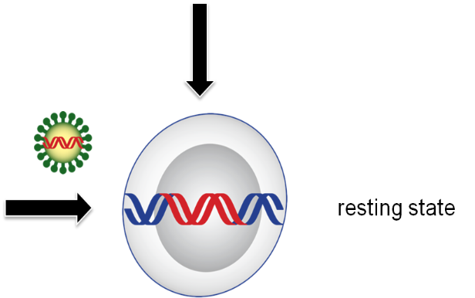
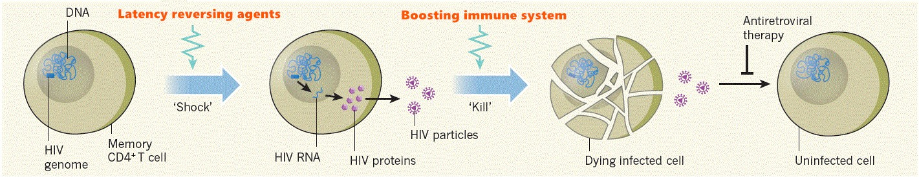
HIV Latency VS. “Shock and Kill”
Latent reservoir cells are unrecognizable to the immune system and unresponsive to ART
cell death
HAART
immune system
The “shock and kill” strategy is proposed to disrupt this latency
(Latency)
Archin. Nature 2012
3

Slide 4
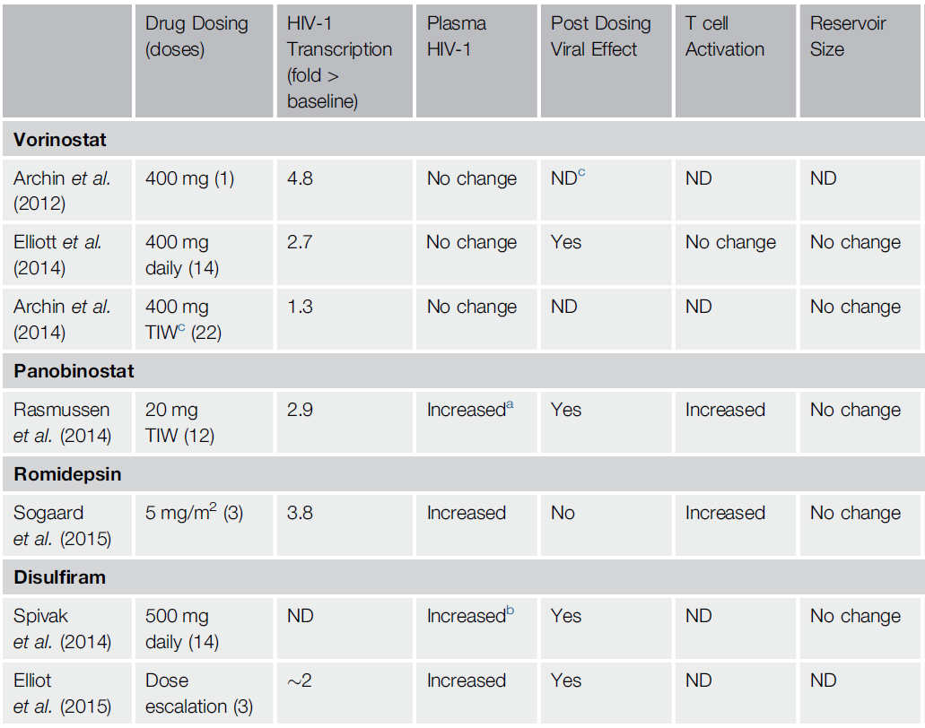
Clinical Trials of Latency-Reversing Agents
Rasmussen. Trends in Microbiology 2015.
4

Slide 5
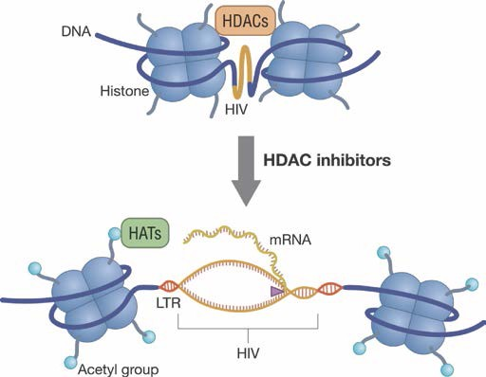
HDAC Inhibitors
Induce HIV mRNA transcription in latently infected resting CD4 cells in vivo
Considerable variability in potency between HDACis
Induce virion release to allow for immune-mediated killing of infected cells
Archin. Nature 2012; Lewin. CROI 2013; Rasmussen. HVIT 2013
5

Slide 6
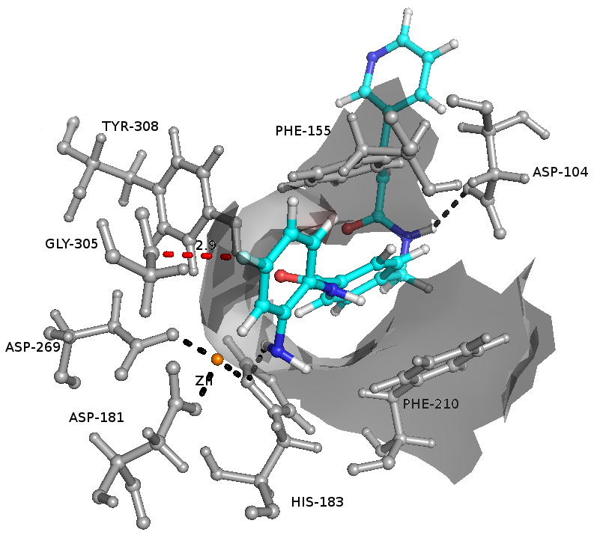
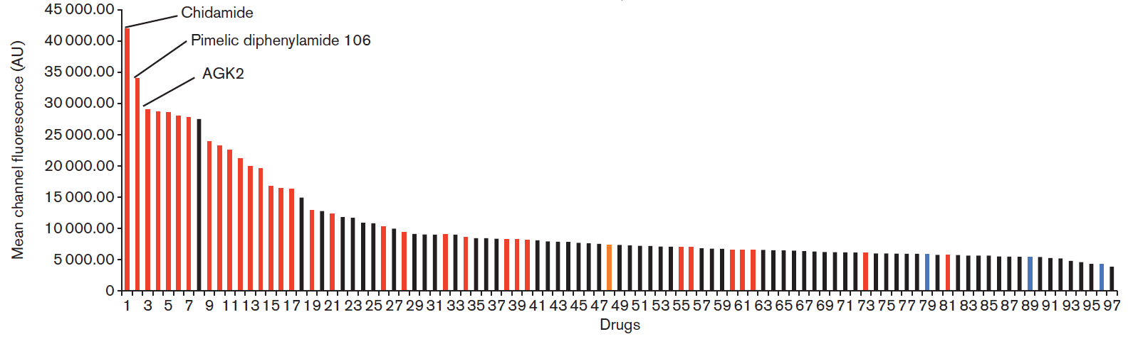
Chidamide
Discovered in China for treatment of peripheral T cell lymphoma
A low nanomolar inhibitor of HDAC 1, 2, 3, and 10
The most active LRA in a primary cell screening model
Pan Med Chem Comm 2014; Kobayashi. J Gen Virol 2017
6

Slide 7
AIMS
A phase 1b/2a clinical trial to evaluate the safety and efficacy of chidamide in combination with cART in HIV-infected adults with suppressed viral load to reverse HIV-1 latency.
7

Slide 8
02
Part Two
TRIAL DESIGN

Slide 9
Non-randomized interventional trial
Chidamide (10 mg) twice a week (Tuesday/Friday) for 4 weeks （totally eight oral doses ）
HIV-1 patients on suppressive cART ≥ 18 months
(HIV RNA < 50 copies/mL ≥12 months and CD4⁺ T cell > 350 cells/μL)
ClinicalTrials.gov (NCT02513901)
9

Slide 10
03
Part Three
RESULTS

Slide 11
Baseline Characteristics
All 7 participants (6 male, 1 female) completed eight oral doses of chidamide
ID | Gender | Age (years) | Months since HIV diagnosis | Months on ART | Months with HIV-1 RNA < 50 copies/mL | ART regimen | Baseline CD4 count (cells/μL)
004 | Male | 43 | 24 | 24 | 21 | TDF, 3TC, EFV | 191
005 | Male | 33 | 68 | 36 | 19 | TDF, 3TC, Lop/r | 352
006 | Female | 40 | 84 | 84 | 77 | TDF, 3TC, EFV | 355
008 | Male | 34 | 114 | 114 | 50 | TDF, 3TC, Lop/r | 352
013 | Male | 46 | 33 | 31 | 28 | TDF, 3TC, EFV | 282
014 | Male | 42 | 51 | 47 | 15 | AZT, 3TC, Lop/r | 473
023 | Male | 57 | 21 | 21 | 18 | TDF, 3TC, EFV | 637
Median (range) | - | 42 (33-57) | 51 (21-114) | 36 (21-114) | 21 (15-78) | - | 352 (191-637)
11

Slide 12
Safety of Chidamide
Rash (1/7), fatigue and somnolence (1/7)
Complete blood cell count had a slight decrease especially for red blood cell count and hemoglobin, but all did not reach grade 1 and recovered to baseline levels at day 56 post-chidamide.
CD4 T cell count was stable during study period.
No significant adverse events were reported.
12

Slide 13
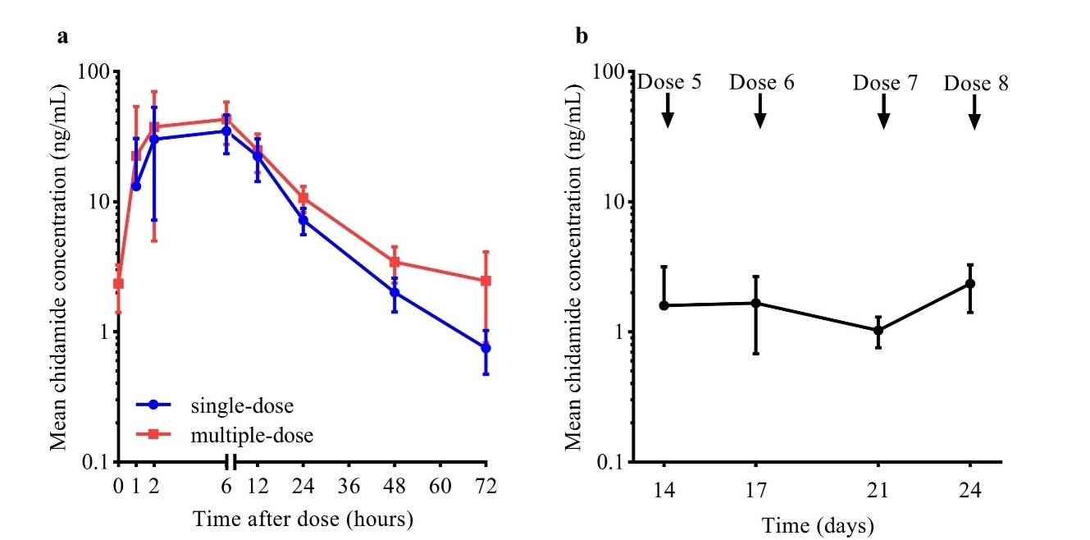
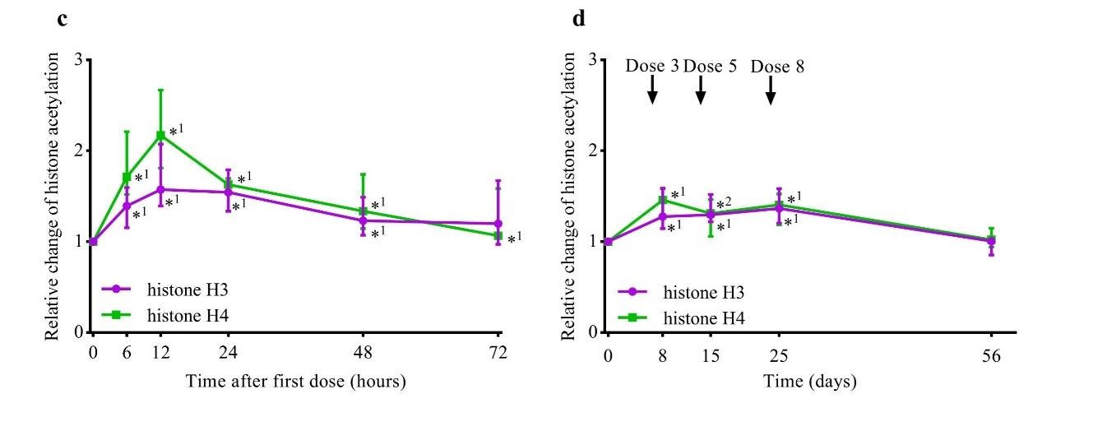
Chidamide Showed a Favorable PK&PD Profile
PK profile
(plasma conc.)
01
PD profile
(histone acetylation)
02
13

Slide 14
Chidamide Showed a Favorable PK&PD Profile
 | T_{max} | C_{max} | AUC_{0-72 h} | t_{1/2}
 | h | ng/mL | ng·h/mL | h
Single-dose | 5.4 ± 1.5 | 40.3 ± 20.3 | 625 ± 178 | 11.5 ± 2.6
Multiple-dose | 5.7 ± 3.4 | 48.8 ± 26.6 | 842 ± 252 | 15.5 ± 4.2
No evident drug accumulation effects were observed after multiple doses.
14

Slide 15
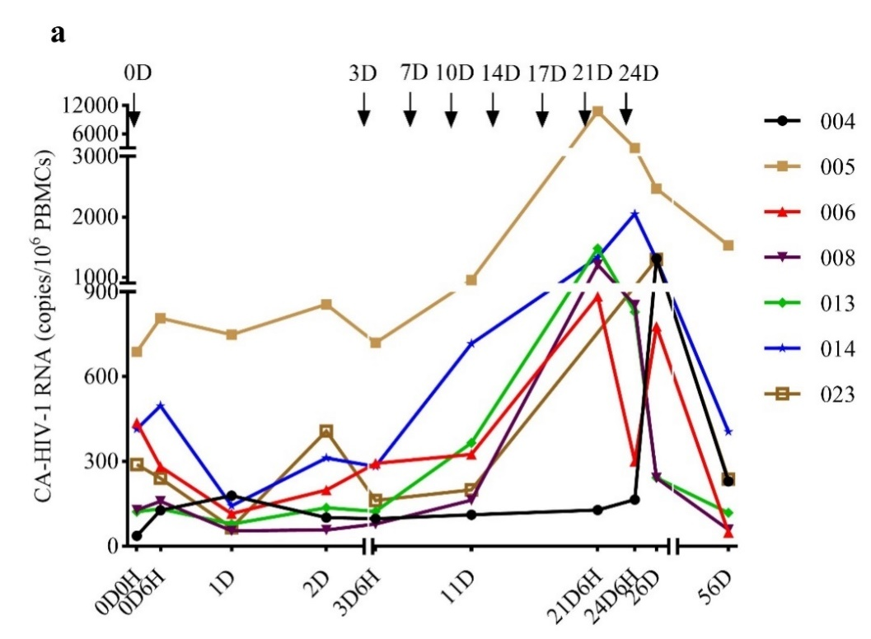
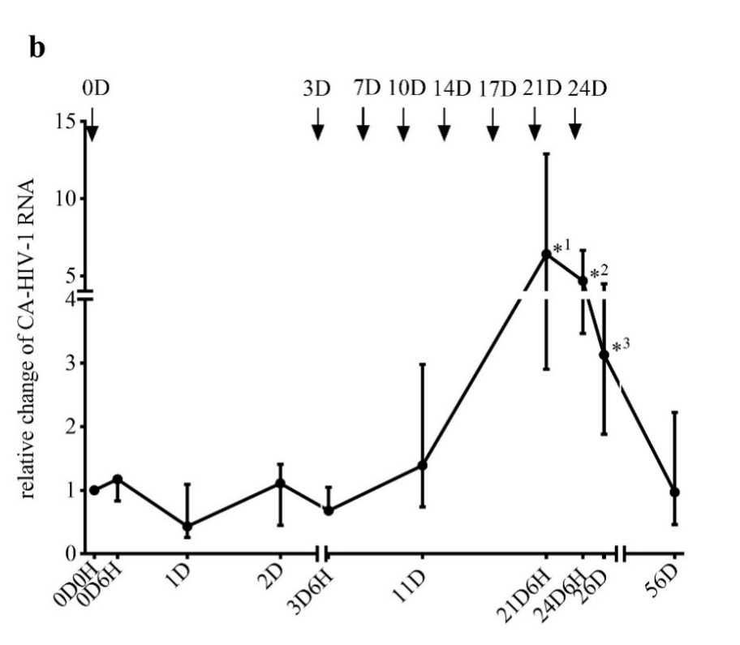
Chidamide Induced HIV Transcription
HIV transcription (cell-associated HIV-1 RNA)
Relative changes of CA-HIV-1 RNA
15

Slide 16
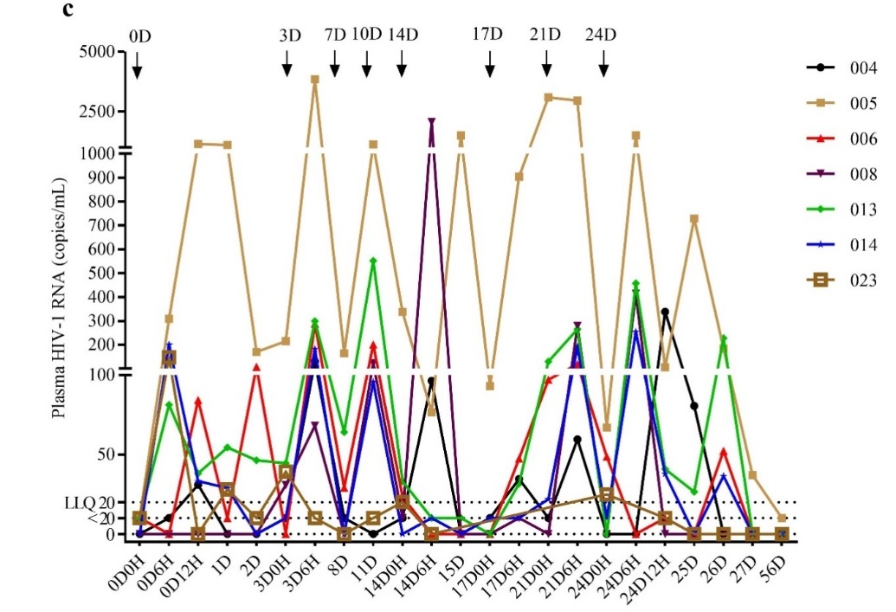
Chidamide Induced HIV Cyclic Viremia
16

Slide 17
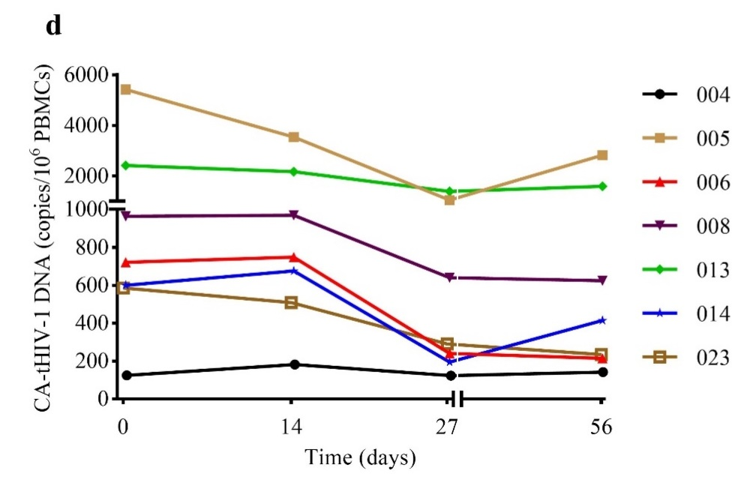
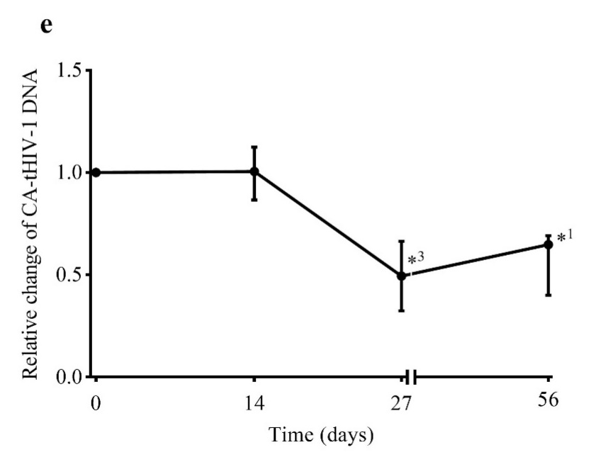
Chidamide Induced a Reduction of Total HIV-1 DNA
A decrease in cell-associated total HIV-1 DNA (CA-tHIV-1 DNA)
Relative changes of CA-tHIV-1 DNA
48.9%
37.7%
Last dosing of Chidamide at D24
24
17

Slide 18
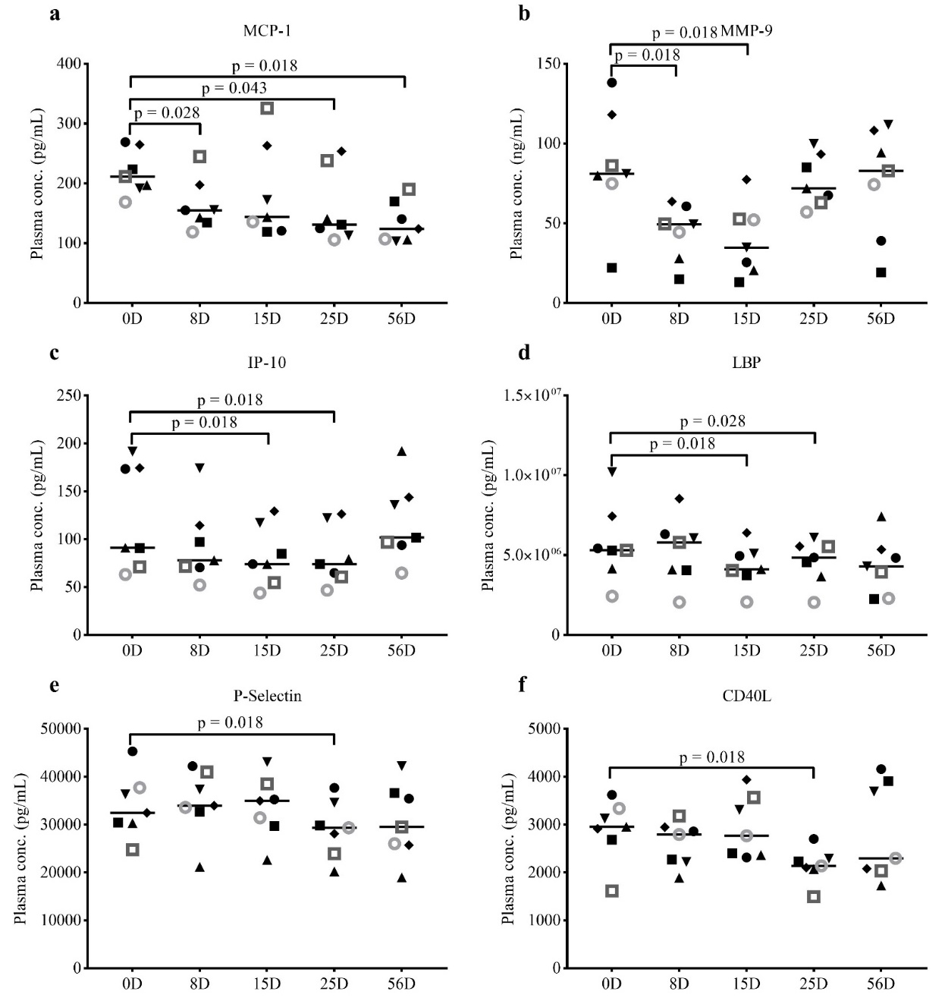
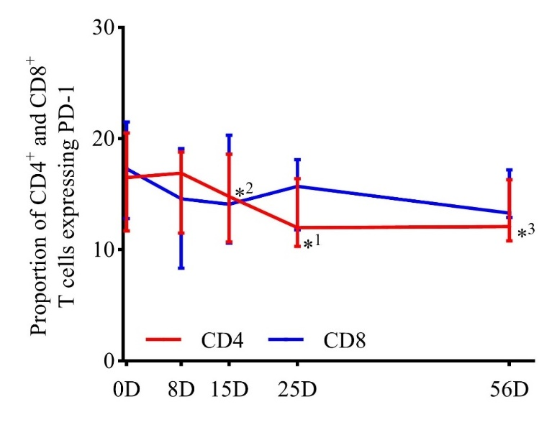
Chidamide Exhibited Immune Modulatory Effects
Inhibition of pro-inflammatory cytokines and decrease of PD-1 expression on CD4+ T cells
18

Slide 19
04
Part Four
CONCLUSION

Slide 20
CONCLUSION
CONCLUSION
Chidamide can safely disrupt HIV-1 latency resulting in cyclic plasma viremia and further reduction of viral reservoir.
LIMITATION
The participants was limited.
No control group was set up in the trial.
PROSPECTIVE
To validate these findings, a multi-center, randomized, placebo-controlled, and double-blinded clinical trial incorporating 60 participants is ongoing.
20

Slide 21
ACKNOWLEDGMENTS
We thank all study participants for their dedication to this study.
We thank Chipscreen Ltd. for providing study chidamide tablets.
We thank Guangzhou SUPBIO Bio-technology and Science Co. Ltd. for their assistance in determining CA-HIV-1 RNA and CA-tHIV-1 DNA.
This work was supported by National Science and Technology Major Project 2014ZX10001002 and 2017ZX10202102.
21

Slide 22
