Slide 1
Community monitoring in HIV prevention programs with sex workers in Kyrgyzstan
Svetlana Radchenko, Outreach worker, Tais Plus, presenting author
Aida Myrzabekova, Outreach worker, Tais Plus, co-author
AIDS2018 Amsterdam

Slide 2
Tais plus (kyrgyzstan)
Sex workers-led organization
Mission is to strengthen the sex workers community to achieve more decent working and living conditions of sex workers
1997: Initiative group
March 3, 2000: Official registration:
The 3d of March is the future International Sex workers’ Rights Day which has been started to celebrate since 2001 after the Indian Sex workers’ Festival

Slide 3
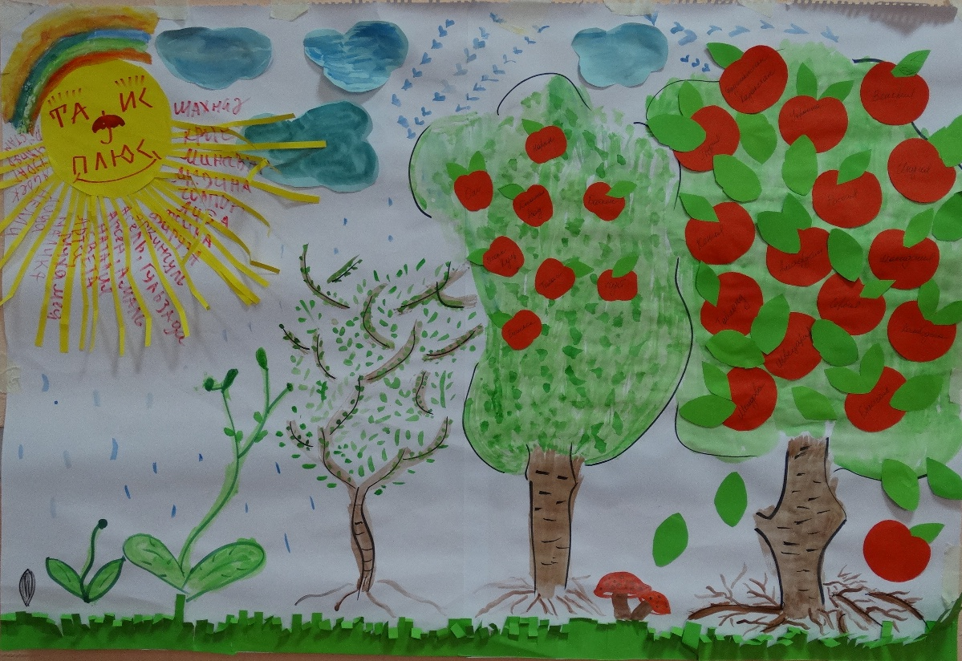
Tais plus by the team eyes (Summer 2017)

Slide 4
monitoring by the community
Period: 2016-2017
Geography: all oblasts over the country where HIV prevention programs with sex workers are implemented
Support:
UNDP, the Global Fund Project, component “Community System Strengthening” and “Removal Legal Barriers” (CSS&RLB).
SWAN, Robert Carr Fund-supported Project

Slide 5
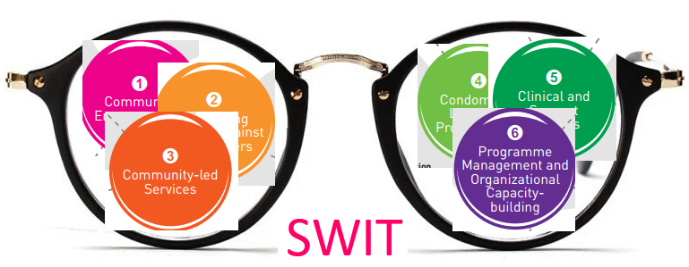
Monitoring through SWIT “glasses”
Planning, implementing and monitoring of HIV/STI programs with sex workers should be based on SWIT

Slide 6
The goal of the monitoring by the community
The goal is to regularly monitor the quality of services and legal barriers that prevent sex workers from participating in HIV programs, including monitoring:
Sex workers are clients or partners of our programs?
The gap between what our programs are offering to sex workers and sex workers' needs?
To what extent state facilities are friendly to sex workers?
Meaningful participation of the sex workers community in HIV and human rights programs?
Monitoring is accompanied with the technical support to NGO.

Slide 7
monitoring tools
A number of questionnaires was developed to assess and monitor:
NGO opportunities to expand sex workers participation in HIV programs and to work on removing legal barriers (CSS&RLB)
VCT quality
STI service quality

Slide 8
Technical support
Focus on the Community Strengthening
SWIT Section 1 “Community Empowerment” was adapted to train NGOs’ staff
Purpose: How to include in daily NGO work the Community Empowerment Approach
Analysis of day-to-day communication with sex workers:
We come to tell you about safer sex
Or
How do you think is it important to practice safer sex and why?
We were trying to find together answer to the question: “What should we change in our work in order sex workers become and feel themselves partners of our programs”

Slide 9
Monitoring process
Quarterly in 2016-2017
Participants are staff of 6 NGO working with sex workers
Documents developed on each visit:
Visit plan
Team Terms of Reference
Monitoring tools
Training materials to provide technical support
Report template

Slide 10
Each visit
Focus group discussions with NGO staff
Technical support: SWIT with focus on Section 1 “Community Empowerment”
Meeting with sex workers to discuss daily problems, opinions on NGO work as well as barriers and opportunities of sex workers to actively participate in HIV and rights programs
Conclusions and recommendations were being agreed with visited NGOs and then sent to key donors supporting HIV and human rights programs

Slide 11
Summary
10 Tais Plus staff took part in monitoring visits within 2 years, 8 out of 10 did it as volunteers
5 visits per two years in each of six NGO in average
47 staff members of 6 NGO took part, including focus group discussions and on-the-job trainings

Slide 12
findings
VCT
Rights
Need in training modules helping to talk with sex workers on human rights and how sex workers could protect on their own
Information&Communication
Almost nobody reads printed materials. Need in new formats – video, phone applications
Community Empowerment
Sex workers are mainly perceived as only program's clients who need services.
Quality of pretest counseling should be improved

Slide 13
Changes
VCT
Rights
Information&Communication
Community Empowerment
Pretest counseling is already taking 20-30 min
Counselors feel less fear if they should announce HIV-positive test result
First module has been published how to hold meetings with sex workers and discuss topics: Human Rights, Interaction with the police, Self-support
First video "We know our rights"
Sex workers NGO staff wish to participate in the monitoring by the community

Slide 14
Conclusions
Significant increasing capacity of Tais Plus staff: new skills – monitoring, training and transfer of own practical experience to others
NGO Partnership strengthening - more mutual understanding. In the very beginning our visits were perceived as control. It took time to overcome it.
Monitoring by the community should be an integral part of HIV programs, and its results are to be used in planning and adjustment programs
Necessary to train sex workers NGO staff in monitoring and then form mixed monitoring teams

Slide 15
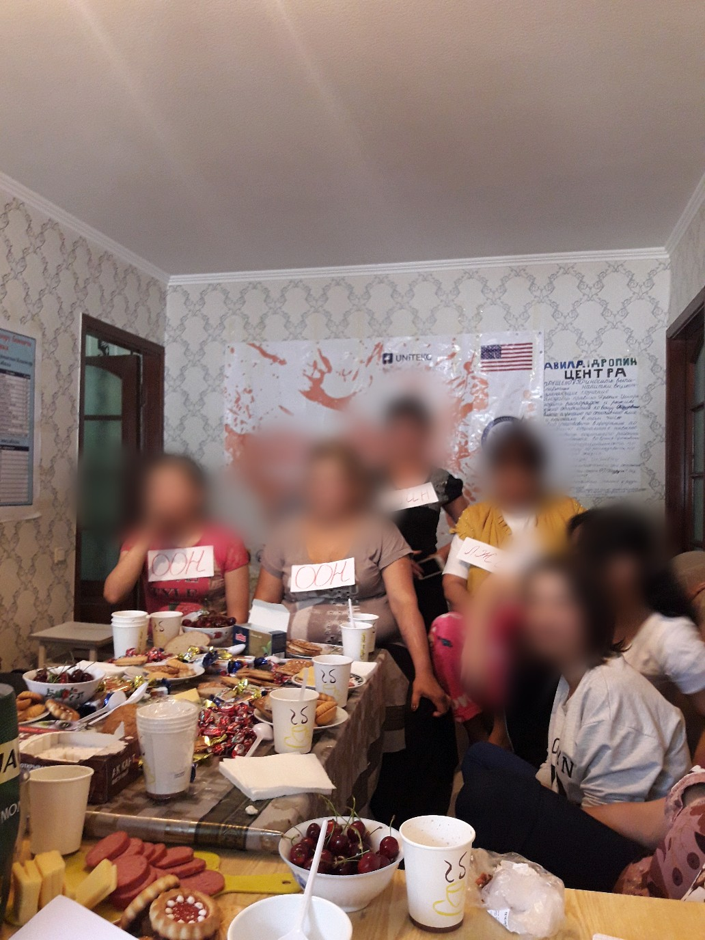
June 2018 visit

Slide 16
Thank you!

