Slide 1
Online census of drug consumption rooms as a setting to address HCV:
current practice and future capacity.
International Network of Drug Consumption Rooms ¹Uniting Sydney Medically Supervised Injecting Centre (MSIC) Sydney, Australia ²Correlation Network, De Regenboog Group. Amsterdam, The Netherlands.
Vendula Belackova¹ Allison Salmon¹ Eberhard Schatz² Marianne Jauncey¹
William Wood¹

Slide 2
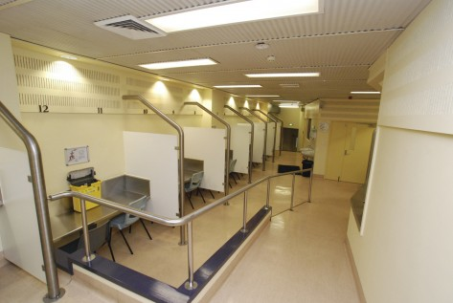
Uniting
MSCI Sydney
Uniting’s Sydney Medically Supervised Injecting Centre (MSIC)
is the first supervised injecting facility in the Southern hemisphere
and the English speaking world that opened in 2001.
MSIC is a service where people who inject drugs (PWID) do
so legally under health professional supervision.
MSIC aims to reduce death and injury from drug overdose
and reduce harm associated with injecting drug use.
To date, over 1 million visits were made to the service by a total
of 16,000 registered clients.
Nearly 13,000 referrals to health and social services were
made by MSIC the staff and almost 7,500 overdoses
were managed onsite.
- At present, around 150 visits to the service are recorded every day.

Slide 3
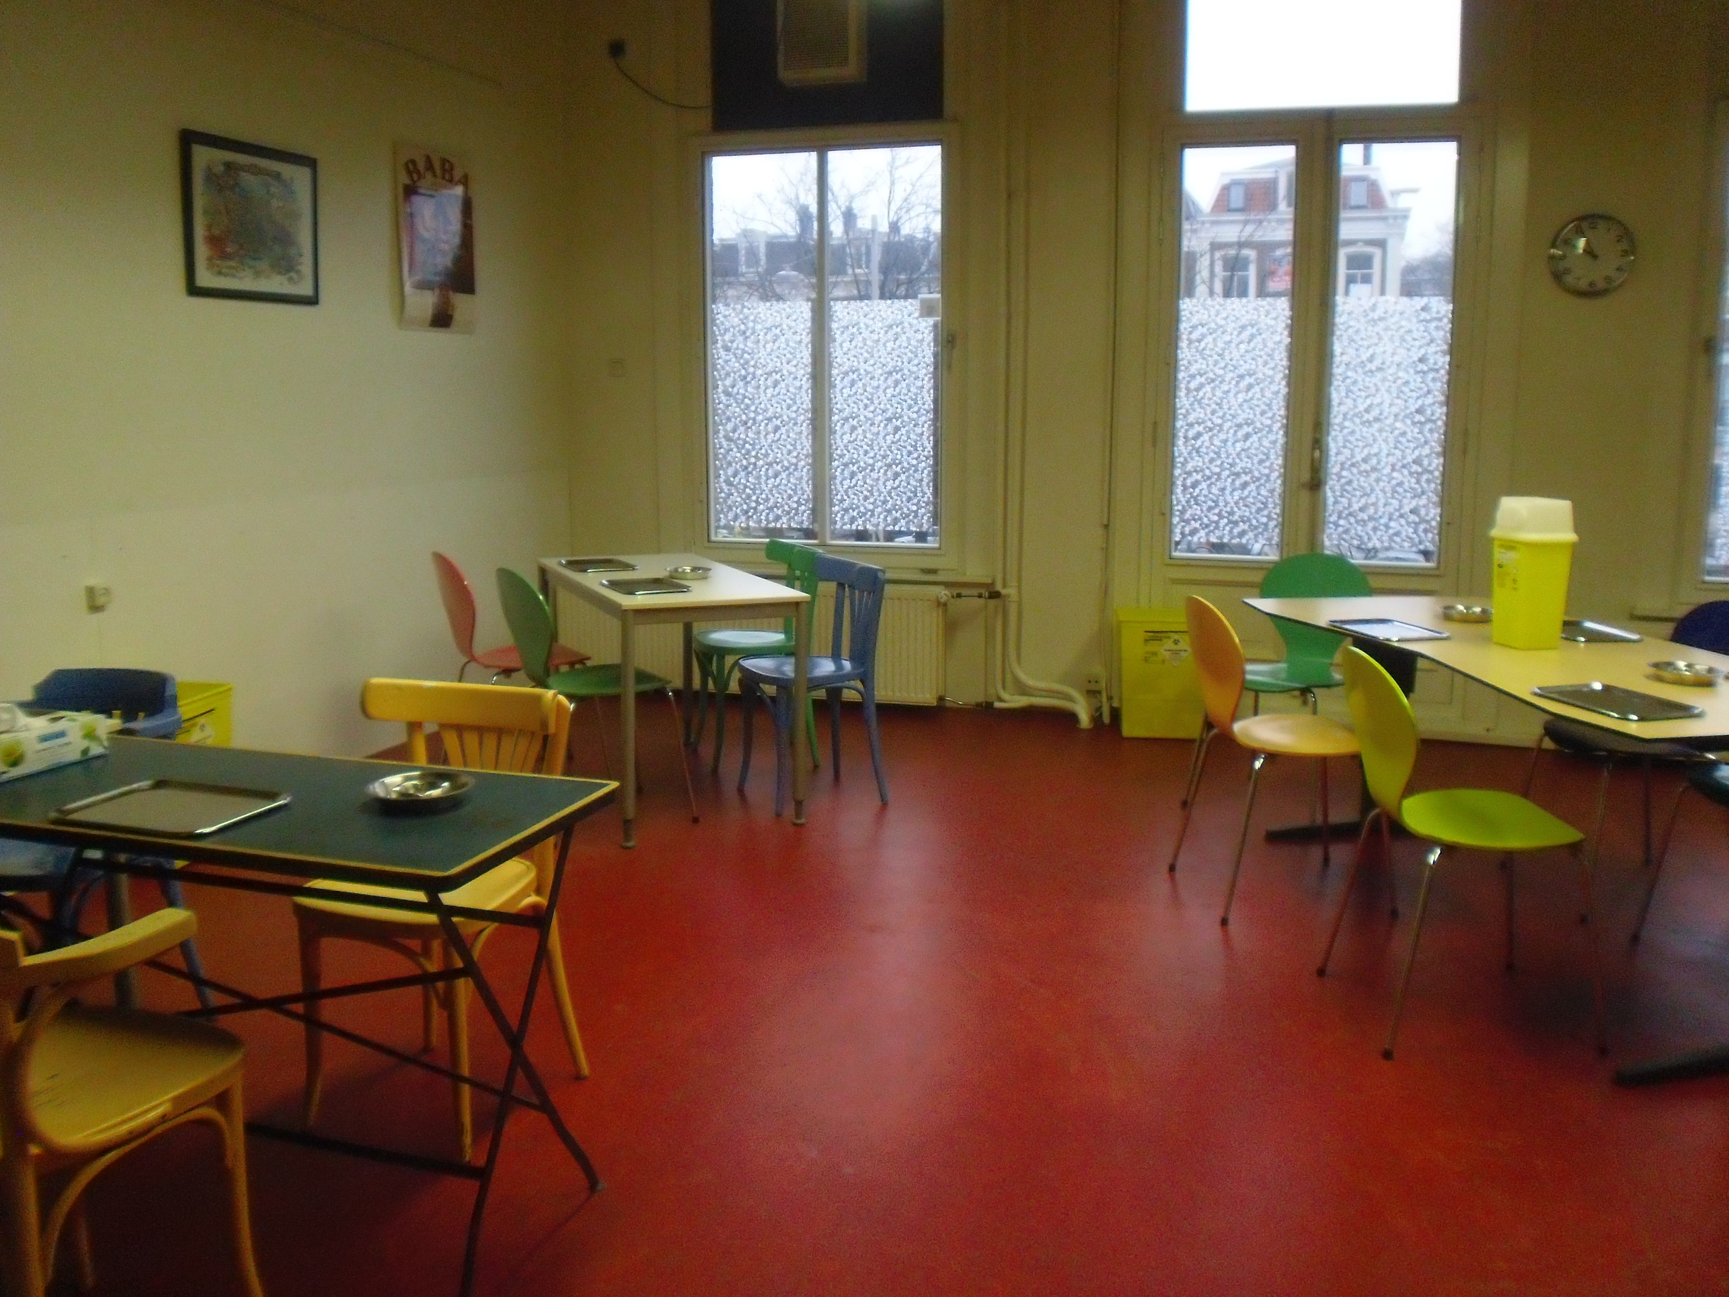
Correlation
European Harm Reduction Network
Launched in 2004.
Newly reformed in 2018.
4 pillars:
Network.
Monitoring.
Capacity Building.
Advocacy.
Current Priorities:
Civil Society Involvement in drug policy.
Hepatitis C
Overdose Prevention
Drug Consumption Rooms
New drug trends

Slide 4
International Network
of Drug Consumption Rooms
Creating partnerships between organisations, cities, associations, politicians, police, community (drug users and residents) with the objective of developing consumption rooms as a tool for risk reduction wherever necessary.
Sharing of best practices in the field of managing and maintaining a DCR from professional and user perspective.
Providing guidelines and common quality standard for existing and new DCR.
Providing and sharing knowledge through exchange of information, visits and on-site trainings (running a DCR, health prevention in a DCR…).
Assist in and contribute to evidence-based research, which is supporting the cause of DCR’s.

Slide 5
Drug Consumption Rooms
Safe Injecting Facilities
(de Vel-Palumbo, Matthew-Simmons, Shanahan, & Ritter, 2013; D. Hedrich & Hartnoll, 2015; Dagmar Hedrich, Kerr, & Dubois-Arber, 2010; Kennedy, Karamouzian, & Kerr, 2017; Kerr, Kimber, DeBeck, & Wood, 2007; Kerr, Mitra, Kennedy, & McNeil, 2017; J. Kimber, Dolan, Van Beek, Hedrich, & Zurhold, 2003; Jo Kimber et al., 2010; Milloy & Wood, 2009; Monico, 2015; Potier, Laprévote, Dubois-Arber, Cottencin, & Rolland, 2014; Semaan et al., 2011)
Are services that provide hygienic environments in which
people can inject illegal drugs under the supervision
of qualified staff.
Demonstrated to:
attract the most vulnerable people who inject drugs (PWID)
manage overdose
enhance safe injecting practice
increase access to drug treatment and other health services
improve health outcomes and save cost
improve public amenity & not increase crime
Reduce other risky behaviour
Kennedy, M. C., Karamouzian, M., & Kerr, T. (2017). Public Health and Public Order Outcomes Associated with Supervised Drug Consumption Facilities: a Systematic Review. Current HIV/AIDS Reports, 14 (5), 161-183.
Belackova, V. and A. M. Salmon (2017). Overview of international literature – supervised injecting facilities & drug consumption rooms. Sydney, Uniting Medically Supervised Injecting Centre.

Slide 6
Drug Consumption Rooms
Safe Injecting Facilities
& HCV
HCV prevalence among DCR/SIF clients rather high: 63 % in Germany (Scherbaum et al., 2009) or 43 % in Spain (Bravo et al., 2009)
Prevent HIV & HCV infections and save cost (Bayoumi and Zaric, 2008).
Specific HCV prevention & treatment in DCR/SIFs haven’t been described.
At the same time:
New direct-acting antiviral agents (DAAs) treatment highly tolerable
‘Delivery of DAAs in a community setting as a successful example for patient-centred arrangements’ (Morris et al., 2017)
Bayoumi, A. M. & Zaric, G. S. 2008. The cost-effectiveness of Vancouver's supervised injection facility. Canadian Medical Association Journal, 179, 1143-1151.; Bravo, M. J., et al, 2009. Use of supervised injection facilities and injection risk behaviours among young drug injectors. Addiction, 104, 614-619.; Morris, L., et al. (2017). "Initial outcomes of integrated community-based hepatitis C treatment for people who inject drugs: Findings from the Queensland Injectors’ Health Network." International Journal of Drug Policy.

Slide 7
1.
SURVEY AIMS
& PARTICIPANTS

Slide 8
Online survey of DCRs/SIFs
Research questions:
What is the range of HCV services currently offered at DCRs?
What are their operational capacities of DCRs internationally (staff, services provided)?
What are the factors associated with HCV service provision in DCRs?
What are the needs and/or resource requirements needed to increase HCV awareness, prevention and treatment among DCRs?
Design:
To be filled in by DCR/SIF managers (reminder sent 3 times)
Took approximately 30 min to complete
No question obligatory
Excluded those where >50% of answers was missing

Slide 9
Online survey of DCRs/SIFs
 | No of DCRs operating (IX 2016) | No of DCRs participating in the study | Particip. rate
Netherlands | 20 | 8 | 40%
Switzerland | 18 | 7 | 39%
Germany | 26 | 17 | 65%
Spain | 15 | 9 | 60%
REMAINING COUNTRIES | 12 | 7 | 64%
Australia | 1 | 1 | 100%
Canada* | 1 | 1 | 100%
France | 2 | 2 | 100%
Denmark | 6 | 2 | 33%
Norway | 1 | 1 | 100%
Luxembourg | 1 | 1 | 100%
TOTAL | 91 | 49 | 54%
Exhaustive sampling: 91 DCRs operating in 8 European countries, Australia and Canada as of September 2016
NOTE: Health Canada has approved about 30 Supervised Consumption Services (SCSs) since.

Slide 10
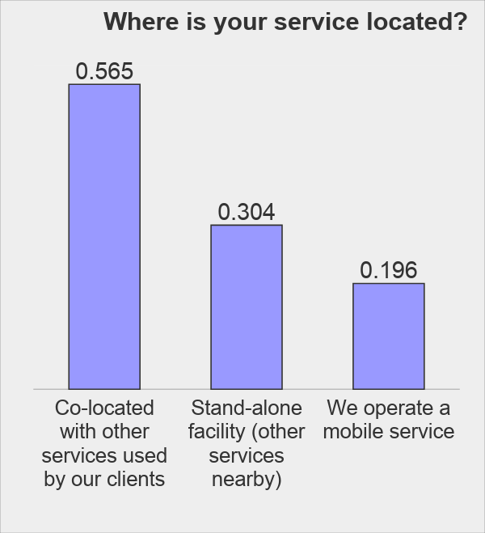
Survey participants
Response rate:
n=49 valid responses (54%)
each country represented
Organisations:
not-for profit (67%)
local or central government (40%)
private (7%)
church (n=1)
Funded from (multiple sources):
local/municipal (71%)
state / regional (36%)
national government (13%)

Slide 11
DCR/SIF capacity and operation
On average, 12 places for drug consumption in each DCR.
The maximum number of places was:
23 for injecting
40 for smoking
16 for inhaling
The average number of visits each day was 80
72 to inject
51 to smoke
12 visits to snort/inhale

Slide 12
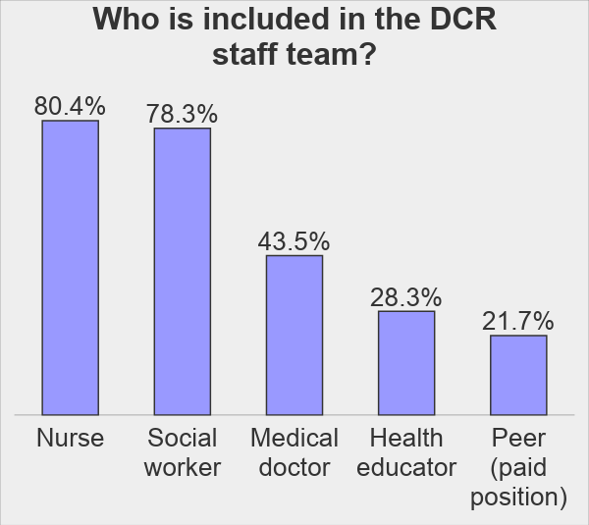
DCR/SIF capacity and operation
Mean 7 paid and 1 unpaid workers present onsite on average day of operation

Slide 13
Services provided beyond safe space for drug use
 | Onsite | Refer elsewhere
Referral to care/treatment facilities (e.g. drug treatment, health care) | 94% | n.a. | n.a.
Needle/syringe distribution (for take - away) | 94% | n.a. | n.a.
Condom provision | 89% | n.a. | n.a.
Overdose management onsite | 89% | 12 | 26%
HIV testing / screening | 54% | 54%
Out-patient counselling | 46% | 52%
Mental health care | 44% | 59%
take-home Naloxone provision | 37% | 28%
Opioid substitution therapy | 24% | 70%
Phone charging, cofee/tea | 91% | n.a.
Personal care (e.g. shower, washing clothes) | 78% | n.a.
answered question |  |  |  | 46
skipped question |  |  |  | 5

Slide 14
2.
HCV RELATED
SERVICES

Slide 15
HCV-RELATED
EDUCATION & TESTING
94 % DCRs / SIFs offered HCV-related education (transmission routes, testing, symptoms and treatment options)
brochures and pamphlets (89%)
individual client consultations (88%)
posters (70%)
digital resources (20%)
educational campaigns (20%)
group educational sessions (17%)
2/3 (65 %, n=31) DCRs/SIFs offered HCV testing onsite, as well as pre- and post-test counselling:
Blood sample from a vein (68%)
Saliva / oral fluid (39%)
Finger Prick test (32%)
Other (10%)
57 % referred for HCV testing elsewhere
Estimate: median 80 % clients tested, 60 % HCV positive

Slide 16
HCV
SUPPORT SERVICES
 | PROVIDE ONSITE | PLANNING TO EXPAND
Referral to other services for HCV treatment | 96% | 36%
Disease self-management support (e.g. healthy diet, obesity) | 50% | 15%
Liver health monitoring/assessments (e.g. Fibroscan, blood test) | 24% | 11%
No | 15% | 49%
answered question |  | 46
skipped question |  | 3
54% (n=25) of the DCRs/SIFs provided liver
monitoring or disease management support onsite.

Slide 17
HCV
TREATMENT
 | PROVIDE ONSITE | PLANNING TO EXPAND
New HCV treatments (DAAs) | 2 (4%) | 1 (3%)
Interferon-based treatment | 0% | 1 (3%)
Both treatment options from above | 2 (4%) | 0%
Other | - | 4 (10%)
Don`t know | 4 (8%) | -
No | 39 (83%) | 41 (85%)
answered question |  | 47
skipped question |  | 2
21 % (n=10) DCRs/SIFs provided HCV
treatment offsite or planned to proved it in the future

Slide 18
3.
FACTORS ASSOCIATED WITH
HCV SERVICE PROVISION
& NEEDS FOR IMPROVEMENT

Slide 19
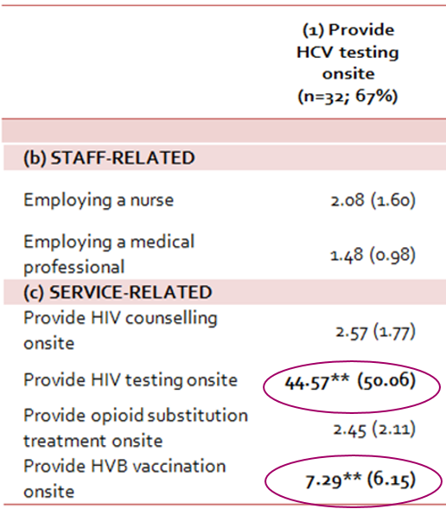
FACTORS ASSOCIATED WITH HCV TESTING ONSITE
DCRs that provided
HCV testing onsite were
significantly more likely
to also provide:
HIV testing
HVB vaccination

Slide 20
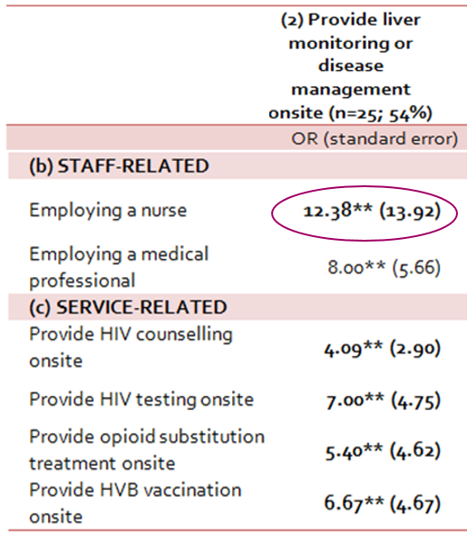
FACTORS ASSOCIATED WITH HCV DISEASE MANAGEMENT ONSITE
DCRs that provided HCV disease management onsite were significantly more likely to also employ a nurse.

Slide 21
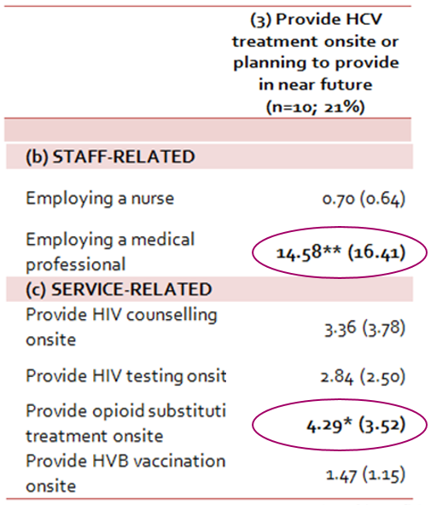
FACTORS ASSOCIATED WITH HCV DISEASE MANAGEMENT ONSITE
DCRs that provided HCV disease management onsite were significantly more likely to also provide:
employ a medical doctor
provide opioid substitution treatment onsite

Slide 22
INCREASING DCR/SIF CAPACITY IN HCV SERVICE PROVISION
How would you spend any additional HCV related funds (n=46):
employ additional medical staff (52%)
spend it on additional staff training (46%)
fund educational materials for clients (41%)
employ peer support workers (26%)
develop referral pathways to a specialist (24%)
Other:
purchase a fibroscan (n=1)
advocacy for the possibility of providing HCV treatment to “clandestine” persons (n=1)

Slide 23
CASE STUDY
HCV treatment at the Syden SIF. Close cooperation with a local health service.
- Australia has made a major investment in HCV treatment:
1 billion AUD investment in HCV treatment over 5 years.
anything over that cost given by the pharma industry for free .
added DAA treatments on the public benefit scheme in 03/2016, includes PWID.
- Sydney SIF (MSIC) sees 2000 PWID / year - “hard to reach” by other services
- “Opportunistic Engagement” - approx. 680 medical referrals since 03/2016.
Providing “Immediacy” – onsite clinics with doctors from local health service Kirketon Road Centre (KRC) 2h 3x week.
Using established “rapport” with the client to engage .
Using “holistic medical approach” – as per needs, HCV the most common issue.

Slide 24
CASE STUDY
HCV treatment at the Syden SIF. Close cooperation with a local health service.
Sydney SIF staff can administer or dispense limited medications (as per its Drug Authority), but Authority does not include HCV medications
HCV treatment is achieved by referring Sydney SIF clients for HCV treatment to Kirketon Road Centre (a local health service)
However some SIF clients never make it to other services, so dosing these hard to reach clients at the SIF seems a practical option by:
Storing DAA medication (a pharmacy-prepared “webster-pak”) for self-administration at the SIF
SIF staff reminding the client to self-administer DAA medication during their visits to SIF to inject drugs
Drug Authority needs amendment to keep up with pragmatic and practical interventions

Slide 25
CASE STUDY
HCV treatment at the Syden SIF. Close cooperation with a local health service.
Male in late 30s with long history of injecting and street-based homelessness
over 15 years HCV positive, never turned up to any appointment, difficult to engage, never attended KRC, history of medication non-adherance;
had uncontrolled epilepsy and frequent seizures (2-3 times per week, resulting in fractures, bleeding, memory issues and had frequent hospital admissions);
when the local services arranged accommodation, he left it in a week because of the fear that he would have seizures while alone;
the only service he has engaged with is MSIC and he attends it 2-3 times a day;
managed to get his epilepsy medication for him to self-administer via the “webster-pak” at MSIC – this intervention immediately reduced his seizures;
SIF also successfully linked him (after a number of attempts) to HCV testing
DAA treatment was included in the “webster pack” for self administration while at MSIC. His adherence improved to near optimal levels with regular reminders from SIF staff.
His HCV was cleared 3 months later and he is finally housed.
Difficult clients who are only willing to attend a SIF fall through the net, additional support at the SIF is essential for them.

Slide 26
CONCLUSIONS
DCRs/SIFs provide a broad range of social and health services in safe environment for PWID
DCRs/SIFs provide some HCV related services already (2/3 testing, ½ support services) or are interested to do so in the near future (1/5 treatment)
Provision of HCV treatment onsite at DCRs was linked to their overall capacity to provide clinical services, namely in relation to staff qualifications
additional financial resources for qualified staff and capacity building are essential to enhance the capacity for HCV services
DCRs/SIFs should be considered as a low-threshold HCV treatment provider for PWID on the community level; innovative arrangements should be sought

Slide 27
Thank you
for your attention
more information:
Eberhard Schatz
eschatz@correlation-net.org
Vendula Belackova
vbelackova@uniting.org
www.correlation-net.org www.drugconsumptionroom-international.org

