Slide 1
Assessing and overcoming human rights-related barriers to HIV in 20 countries
Ralf Jurgens
The Global Fund to Fight AIDS, TB and Malaria

Slide 2
Acknowledgements
H. Lim¹, A. Iovita¹, D. Burrows², R. Armstrong³, A. Stangl⁴, S. Gruskin⁵, L. Ferguson⁵, S. Baral⁶, C. Lyons⁶, N. Poku⁴, C. Schutte³
¹The Global Fund to Fight AIDS, TB and Malaria, Community, Rights and Gender Department, Geneva
²APMG Health, Sydney, Australia
³HEARD, Johannesburg, South Africa
⁴ICRW, Washington DC, United States
⁵University of Southern California, Institute for Global Health, Los Angeles, United States
⁶Johns Hopkins University, Bloomberg School of Public Health, Baltimore, United States

Slide 3
Acknowledgements
Open Society Foundations
Ford Foundation
American Jewish World Services

Slide 5
Background
Stigma and discrimination, gender inequality and other human rights-related barriers continue to impede access to HIV services
Programs to reduce these have nowhere been sufficiently scaled up.
A five-year initiative of the Global Fund to Fight AIDS, TB and Malaria aims to change this by:
assessing human rights-related barriers to HIV services
supporting and evaluating the scale-up of evidence-based programs to reduce those barriers.

Slide 6
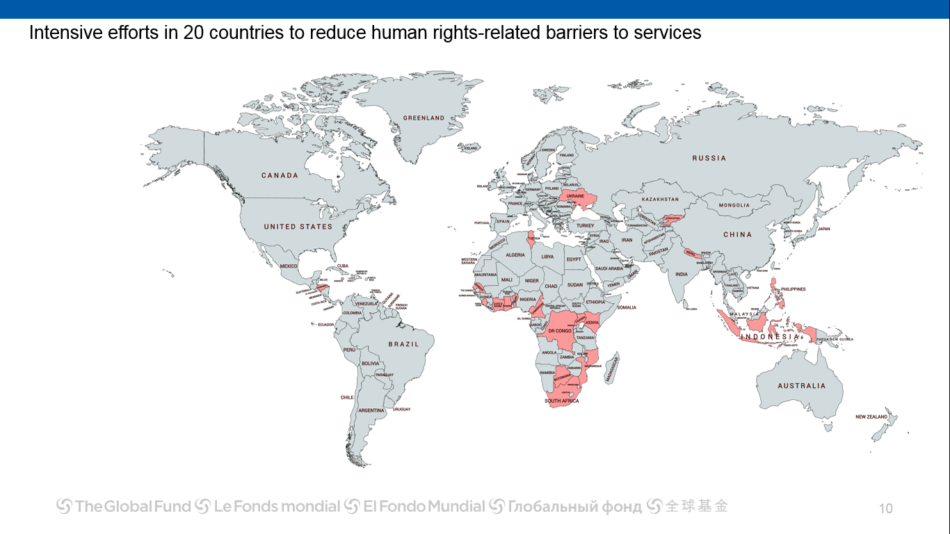
20 country intensive support initiative
Ukraine
KGZ
Tunisia
Indonesia
Philippines
Honduras
Jamaica
Nepal
Benin, Botswana, Cameroon, Cote d’Ivoire, DRC, Ghana, Kenya, Mozambique, Senegal, Sierra Leone, South Africa, Tunisia, Uganda

Slide 7
Description
In each country, research teams assessed:
Existing barriers to HIV services;
Existing programs to address them and their effectiveness;
What programs and interventions will be required over a five-year period to comprehensively address the barriers;
Retrospective costs of existing programs were estimated, as were prospective costs of the proposed comprehensive response.

Slide 8
Programs to reduce human rights barriers to HIV and TB services
Technical brief on HIV, gender and human rights | Technical brief on TB, gender and human rights
Stigma and discrimination reduction Sensitization of health care workers on medical ethics and human rights Training of law-makers and law enforcement officials Reducing discrimination against women in the context of HIV and TB Legal/rights literacy Legal services Monitoring and reforming policies, regulations and laws relating to HIV and TB | As for HIV, with the following in additions: 8. Ensuring confidentiality and privacy within TB services 9. Mobilizing and empowering patient and community groups 10. Rights and access to services in prisons and other closed settings
+
Notes:
EMPHASISE that for all of these programs, advocacy and accountability efforts are key interventions underpinning them.
These draw on recommendations from technical agencies
Technical briefs available at: Https://www.theglobalfund.org/en/applying/funding/resources/
There is evidence such programs work:
Thailand – evidence that programs to reduce stigma and discrimination in HCW, implemented jointly with CBOs, decrease share of late presenters https://www.ncbi.nlm.nih.gov/pmc/articles/PMC5337415/
Drug policy reform in Mexico (with decriminalization of possession of small amounts) did not yield results until police were trained on the law for its enforcement, on harm reduction and on human rights. Police professionalization found critical for furthering harm reduction goals https://harmreductionjournal.biomedcentral.com/articles/10.1186/s12954-017-0198-2
Strong prevention and treatment programs in prisons, and collaboration with civil society organizations, peer educators among inmates – precursors of success in drastically reducing TB in prisons in Moldova; Transnistria prisons where no interventions existed – still the same disastrous situation

Slide 9
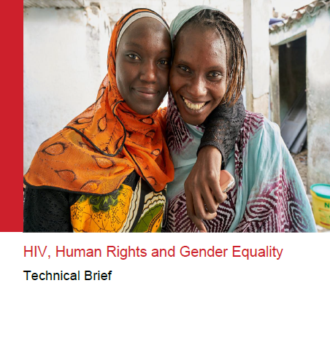
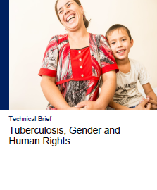

Slide 10
Definition of comprehensiveness
“Programs to remove human rights-related barriers to services are comprehensive when the right programs are implemented for the right people in the right combination at the right level of investment to remove human rights-related barriers and increase access to HIV and TB services.”

Slide 11
Results
In all 20 countries, human rights-related barriers continue to impede access to HIV services.
Stigma and discrimination at health care settings and in broader communities;
Gender inequality;
Punitive laws and policies and/or practices
Few effective programs are being funded to address these barriers.

Slide 12
Results: Stigma and discrimination in healthcare
All baseline assessments identify stigma and discrimination in healthcare as a key barrier to services
Denial of healthcare, poorer quality and delays in provision of care, breakdowns in confidentiality, intolerant attitudes and denigrating treatment among most frequent forms
S&D are insidious and interfering throughout the HIV cascade/TB and malaria continuum of care.
Where health services are not tailored to the specific needs of key and vulnerable populations, they are more likely to delay seeking healthcare until diseases are advanced, and positive treatment outcomes are less likely.

Slide 13
Responding to stigma and discrimination in healthcare
In all countries there are some efforts in place, but most are sporadic, and lack the funding to take them to scale.
Most often these take the form of one-off capacity building endeavours.
In all 18 countries, the comprehensive response envisages focus on reducing S&D in healthcare settings, including through
institutionalizing training in pre-service and in-service of healthcare workers
enhancing legal literacy of clients
enhancing access to legal services & redress mechanisms

Slide 14
Results
The failure to address human rights-related barriers to services reduces uptake of and retention in services, reducing the impact of Global Fund and other investments.

Slide 15
Results
Cote D’Ivoire 81%
Democratic Republic of the Congo 80%
Big gap between 2016 funding levels (small circle) and what is required
19%
20%
Mozambique 89%
Nepal 62%
38%
Philippines 83%
Ukraine 60%
11%
17%
Kyrgyzstan 45%
40%
55%
Notes:
The total estimated budget to implement a 5-year comprehensive response to remove human rights-related barriers to HIV services in 8 countries amounts to $87 mln. When compared to the current investment levels, we revealed 80% shortage of funding in our case study countries. The largest funding gap between 2016 level of funding and the annual resource needs required for programs to comprehensively address human rights-related barriers to services were observed in Mozambique and Cameroon .

Slide 16
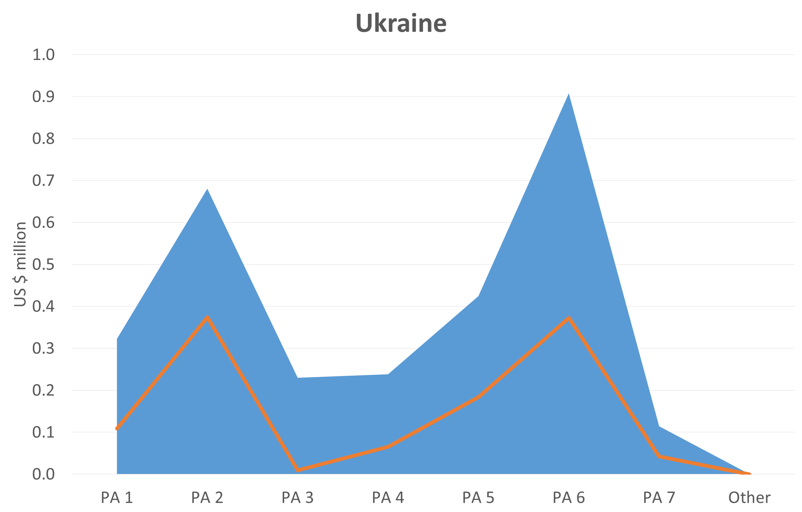
Country example: Ukraine
In 2016, about USD 1.15m was spent on interventions to reduce human rights-related barriers to HIV services. The total spending for the HIV response was about $52 million
Implementing a 5-year strategic plan to reduce human rights-related barriers requires $14,6 m ($ 2,9 m/year)

Slide 17
Results
In all countries, substantially larger investment in these programs will be needed over the next 5 years.
Global Fund investments are increasing, but will not be enough.

Slide 18
Progress to date: investments to reduce human-rights related barriers
Investments in programs to reduce human rights-related barriers across 14 of the 20 intensive support countries in the 2017-19 period is $56,2 million - an increase of almost $50 million (32 million from matching funds), from $6,23 million in the 2014-16 period.
Increase in investments from $6m to $56m between strategy periods.
Previous investment level tracked at grant-making: on-going efforts to track data in signed grants.

Slide 19
Conclusions/next steps
Multi-stakeholder consultations are being held in the countries that are part of this initiative.
Longer-term plans to scale up programs to reduce human rights-related barriers to HIV services will be developed in each country.
Mid- and end-term assessments will provide qualitative and quantitative information about how programs to reduce human rights-related barriers can best be scaled up, and the impact it has.

