Slide 1
Process as Product
Implementing Participatory, Rights-Based Research with Female Sex Workers, Men Who Have Sex with Men, and Transgender Women
Emily Evens, MPH, PhD
July 24, 2018
Notes:
Hi, I am Emily Evens and I would like to share results of a study conducted by the United Nations Development Programme and LINKAGES project, which is USAID and PEPFAR’s flagship project addressing HIV prevention, care and treatment among key populations,
I would like to begin by thanking the female sex workers, gay men and transgender women who participated in this study and courageously shared their experiences. We would also like to thank the peers who conducted the interviews, and the civil society organizations who supported this work.
This study was a partnership between LINKAGES, UNDP, The University of the West Indies HIV/AIDS Response Programme and over 20 global, national, and local key population-led organizations
We collaborated to conduct participatory, rights-based research on key population’s experiences of violence and its connection with HIV risk and service uptake in El Salvador, Trinidad and Tobago, Barbados and Haiti.

Slide 2
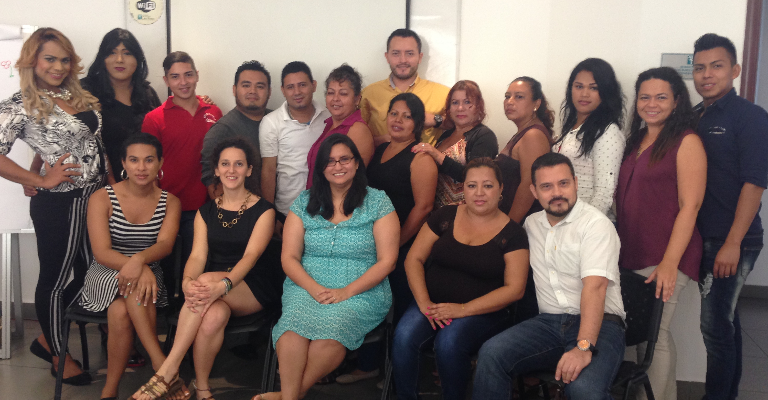
Background
Addressing the HIV-related needs of key
populations requires new approaches
What does meaningful engagement look like and how is it fostered?
Participatory and rights-based research
Notes:
Addressing the HIV-related needs of key populations requires new approaches to research.
Traditional approaches have triggered concerns about human rights violations, data ownership, and unacceptable study questions and methodologies.
Meaningful engagement of key populations in research design and implementation addresses these issues and produces high-quality, applicable findings, but what does meaningful engagement look like and how is it fostered? To answer this we used participatory and rights-based research:
Participatory research aims to involve those traditionally seen as subjects in generating, validating and using knowledge and creates a partnership between social groups and the scientific community to yield information that is more legitimate and useful for social change.
By “Rights-based research” we recognizes that MSM, transgender women and female sex workers have the right to the most attainable standard of health and equal protection under the law
We acknowledge and build on the strong tradition of participatory and rights-based work research, and value the support and visibility provided by the AIDS Conference

Slide 3
Methods
Key population data collectors actively engaged throughout the research process
Built-in collaboration with regional and national actors
Interpretation meetings
Notes:
So how did we do this?
Key population organizations provided input on study populations, interview topics, recruitment, participant safety, study instruments, analysis, and use of results.
All data collectors were key population members; they were supported by researchers in each country
Data collectors were trained in qualitative research, interviewing skills, speaking to victims of violence, study procedures, and research ethics
Study participants were recruited from key population focused civil society organizations. A total of 178 structured, qualitative interviews were conducted
To facilitate collaboration with regional and national actors and ensure that they were prepared to translate study results into action, the study team formed advisory groups to discuss the content and procedures for data collection.
After data collection and preliminary analysis, we held interpretation meetings to review the data, ensure accuracy in interpretation, prioritize results, and discuss the dissemination plans.

Slide 4
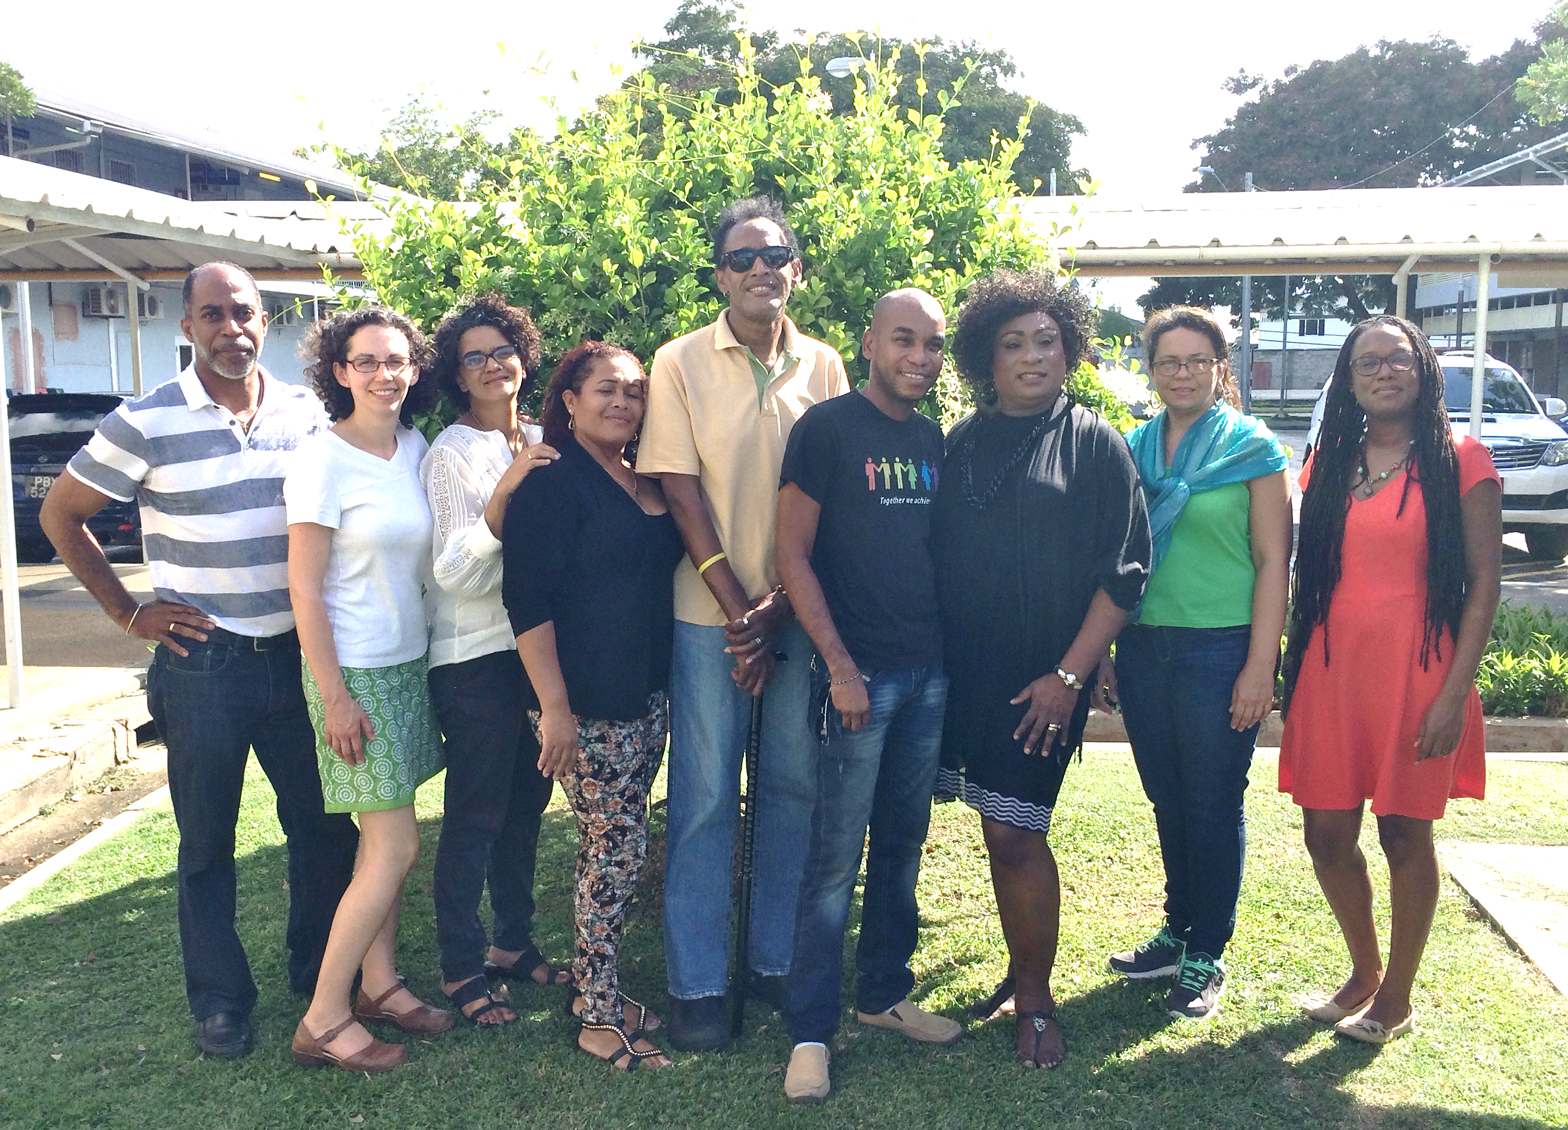
Selected Lessons Learned
Collaborate with KP members to define study population and reach participants
Support capacity-building to ensure that KPs have a strong voice in the process
Results provided guidance for collaborating with civil society, law enforcement, and health care programs
Results helped advocate for attention to GBV and promote evidence-based legislation and policy
Notes:
I would like to share a few strategies we identified as essential to the process:
•We collaborated with key population members to define and reach study populations
MSM advised increasing the sample size in each country to ensure that the sample reflected educational and occupational diversity of MSM in the region.
The study team worked with trans women in Haiti to ensure that the eligibility screening questionnaire appropriately identified trans women in areas where their gender expression is often censored due to violence. We used a two-stage question about sex assigned at birth and the gender the participant now identified with. Additionally, we worked with local key population organizations to ensure local terminology for trans was acceptable to trans women.
We supported capacity-building to ensure that key populations had a strong voice in the process
Training was adapted to allow for various literacy levels.
The study team supported data collectors in obtaining research ethics training certification that can be used for other research activities.
On-the-job mentoring of peer data collectors by experienced researchers allowed for high-quality research and skills-building for peers.
This work has led to several activities to prevent and respond to violence against key populations. LINKAGES has developed guidance for collaborating with civil society, law enforcement, and health care workers to create an environment in which KP members understand their rights and can seek support from police, peers, and health care workers.
UNDP has shared these results with key stakeholders including other UN agencies to advocate for attention to GBV against trans women. They have also advocated for evidence-based legislation and public policies to promote the rights and inclusion of LGBTI populations in Latin America and the Caribbean
This work would not have been possible without a participatory and rights-based approach. By adopting it we were able to recruit participants, get richer data and, most importantly, bring groups together to validate and interpret results that are being used to understand key populations’ experiences and improve their health and rights.
Thank you very much

Slide 5
Stay Connected with LINKAGES
Follow LINKAGES on Twitter: www.twitter.com/LINKAGESproject
Like the project on Facebook: www.facebook.com/LINKAGESproject
Subscribe to the LINKAGES blog www.linkagesproject.wordpress.com
Subscribe to The LINK, LINKAGES’s quarterly project e-newsletter
Check out LINKAGES’s quarterly research digest

