Slide 2
Should I Take PrEP? A Mental Models Assessment of Young African Women’s Motivations for and Barriers to PrEP Initiation and Adherence
Nichole Argo, PhD*
Carnegie Mellon University
Carnegie Mellon University
*Argo N, Krishnamurti T, Fischhoff B, Bekker L-G, Delany-Moretlwe S, Bukusi E, Myers L, Imrie J, Odoyo J, Celum C, and Baeten J for the POWER Study Team.

Slide 3
Background
Despite decreases in new infections the past two years, young women in sub-Saharan African still have one of the highest HIV incidence rates globally (UNAIDS, 2013; 2014; 2018)
Stigma, partner dynamics & economic context as factors limiting prevention options. (Kacadnek et al, 2013; Jewkes et al, 2010; Montgomery et al, 2012; Maticka-Tyndale et al, 2010, Stadler et al, 2008)
Need for an HIV prevention tool that does not require partner cooperation. However, in several large trials, low use of such biomedical HIV prevention tools (van Damme et al, 2012; Marrazzo et al, 2015; Baeten et al, 2016)
Consensus around the need to better understand and meet user demand
Behavioral interventions have also had limited results given their inability to address context of user lives (Celum et al, 2015)
PEPFAR: Identify user preferences for delivery of PrEP and microbicides, followed by demonstration projects to test and optimise uptake, adherence and delivery
Notes:
Stigma, social and econ context: Difficulties discussing HIV, negotiating partner HIV testing or condom use

Slide 4
Prevention Options for Women Evaluation Research - POWER
Purpose of the formative research:
Understand motivators and obstacles for women’s initiation of and adherence to PrEP, taking life context into account
How do women construe their HIV risk versus other risks in their lives?
What is the value proposition of PrEP (for young women)?

Slide 5
Our Approach: Decision science, the study of…
How people should make decisions
(normative analysis)
How people do make decisions
(descriptive research)
How to help people make better decisions
(prescriptive interventions)

Slide 6
REASONS WHY “SHOULD” AND “DO” ARE DIFFERENT, CONT.
Perspective taking failures:
not realizing situational factors in the decision
Communication failures
Experts assume their knowledge is intuitive to others, and thus are wrong about what to communicate, or how to communicate it (avian flu)
Over-informing (full-disclosure)…
Under-informing (numeracy)…
Applying a behavioral principle incorrectly (incorrect setting, or without attention to its interaction with other principles, e.g., loss frames & affect)
Biases & Heuristics

Slide 7
SOME BIASES AND HEURISTICS
Judgment | Choice
People are good at tracking what they see, but not detecting sample bias. | People consider the return on investment in making decisions.
People have limited ability to evaluate the extent of their own knowledge. | People dislike uncertainty, but can live with it.
People have difficulty imagining themselves in other visceral states. | People are insensitive to opportunity costs.
People have difficulty projecting non-linear trends. | People are prisoners to sunk costs, hate to recognize losses.
People confuse ignorance and stupidity. Affect: People evaluate a stimulus according to how they feel about it. | People may not know what they want, especially with novel questions.
People are present-biased.
Fischhoff, 2013.

Slide 8
What is mental models research?
Steps | Description
1. Expert Model & Interviews | Identify what people need to know to make more informed decisions.
2. Lay Model Interviews & Survey | Identify what people already know and how they make their decisions…in-depth interviews and follow-up surveys
3. Gap Analysis | Identify divergences between the mental models & the expert model.
4. Design (and evaluate) intervention | Inform and design interventions to facilitate making and implementing informed choices amongst various subpopulations.
Notes:
Themes are coded into directional links and built into a diagram representing a “mental model”

Slide 9
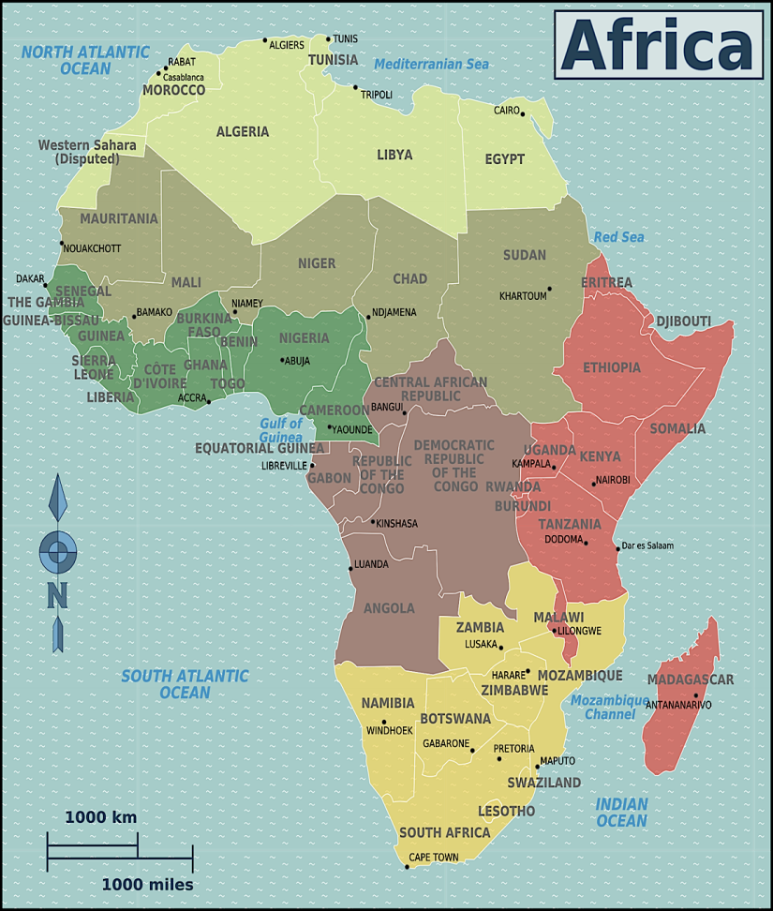
Field Research Conducted at 3 Sites
Desmond Tutu HIV Foundation
CAPE TOWN, SOUTH AFRICA
Wits Reproductive Health Institute
JOHANNESBURG, SOUTH AFRICA
The Kenya Medical Research Health Institute
KISUMU, KENYA
Notes:
Bullet #1 Note: MM method is to start with general questions to solicit participants’ own language and thinking, then become more detailed. Ending with quantitative risk elicitations, which we operationalized with spatial exercises in this sample.
Bullet #2 Note: Each site conducted at least 15 female and 15 male interviews, however due to time constraints we were able to code the first 8-10 males and females that came in from each site. The findings we report today will be based on this coded sample

Slide 10
Methods
Expert Model (March 2016)
Literature review, 6 phone interviews and 5 semi-structured surveys with HIV prevention experts
Lay Model (In-Depth Lay Interviews, May - August 2016)
Eligibility: Age 16-25, sexually active, HIV-, fluent in English or local language
n = 48 African women (age 16-25) and 45 African men (age 18-60)
2, 1-hr interviews per participant
Coded against the expert framework (new codes added), kappa >.80.
Follow-up Lay Survey (February - June 2017)
n = 444 (f 243; 87 at DTHF, 74 at Wits RHI, and 82 at KEMRI)
Goal: to establish prevalence of beliefs and attitudes identified in the interviews and identify demographic relationships to those beliefs and attitudes.

Slide 11
Results: Demographics of the Sample
Age
20 years (median)
16-17 Yrs (24%), 18-22 (46%), 23-25 (30%)
Education:
Primary (16%), Secondary (64%), University (17%), and Graduate (3%)
Marriage & Children:
Single (84%), Single living together (6%), Married (6%), Separated (4%)
68% = 0 children
Heard of PrEP? 44% yes
Know anyone using/has used PrEP? 5% Yes
Notes:
R/ First, AGE: since the selection process was driven by time rather than representativeness across participant attributes such as age, education, etc., thus this sample draws most strongly from the 18-22 age group.
R/ Education: Vast majority have completed high school but not college.
R/ Vast majority single, most women don’t have children.

Slide 12
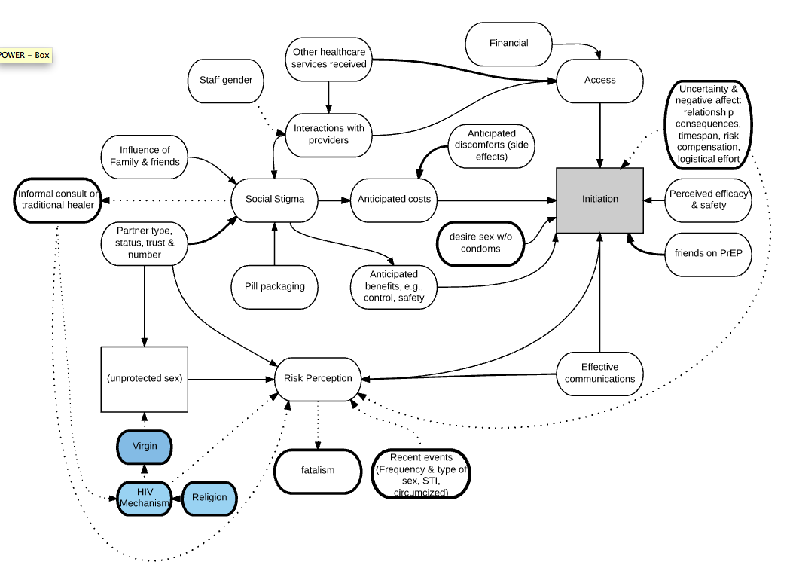
Results II: Integrated PrEP Initiation Model
Notes:
Blue = just men; Dots = participant pieces; Line thickness on shapes
Discuss:
Traditional expert themes: finance/access/interactions with providers/other healthcare services
NEW: Stigma into informal consult or traditional healer, staff gender
HIV mechanism into risk
Recent events: data they are very aware of, not always accurate
Uncertainty & negative affect around forecasting consequences…***emphasize

Slide 13
Results III: Gap Analysis - HIV Risk
Ps cared deeply about HIV risk
84% said HIV would be worse than getting pregnant. (Reason: social exclusion)
Ps overestimated their HIV risk
Single exposure estimates greatly overestimated: Objective risk is ~.38% for women (.3 for men), but they perceive 79% & 65%, respectively.
Ps understood some aspect of HIV/PrEP mechanism, but not deeply
Understanding HIV: circumcision, rough vs. not rough sex, STIs, etc.
Not understanding HIV/PrEP: that one’s ‘soldiers’ can fight HIV, interaction with immune system (efficacy concerns if one’s sick, empty stomach, other meds), missed doses, interpreting side effects
For a subsample, perceptions of high risk + shallow understanding lead to problematic “immunity,” “divinity” or mistrust stories to explain why they haven’t gotten HIV
For this subsample, HIV risk loses salience.

Slide 14
Results IV: Gap Analysis
Uncertainty & Negative Affect/ Present-Bias
Ps displayed a massive effort trying to anticipate risks to their self-image and relationships
relationship turbulence (introducing trust issues into their relationship, family)
work through moral reflections about risk compensation (what kind of person am I?),
forecast—often uncomfortably—how long their period of risk would be
Reactions to uncertainty around adherence issues
Empty stomach, side effects/immune, sick or other meds
Felt reactions to an issue occur automatically and subsequently influence the way in which we process and judge something (Zajonc, 1980; Slovic et al, 2005; Kahneman 2015).

Slide 15
“[Taking PrEP] would affect my relationship. Like I said, we are protecting ourselves and we are both HIV negative—or I assume that we are, right? (laughing)—so if I’m taking PrEP there would be questions about why. ‘Why are you taking PrEP? Are you sleeping around? What is it?’ Yes.”
- Johannesburg 2102.2
“I: Soon PrEP will be made available…however, to take PrEP you have to do a couple of things…How does that sound to you?
R: It sounds so challenging.
I: What is it that is challenging?
R: You have to take the pill for the rest of your life.”
- Johannesburg 2103.2

Slide 16
Results V: Benefits
Positive Affect / Present Bias: PrEP is…Control, Safety, Strength, & Conscientiousness
“I would not know when I would get raped or have unprotected sex so I would rather be on the safe side.” (Cape Town 1109.2)
“PrEP would affect my life in a lot of good ways because it would give me an opportunity to remind myself that there’s HIV out there, and now I am protecting myself from it…” (Joburg 2103.2)

Slide 17
Ps expressed strong interest in PrEP
After learning about PrEP’s efficacy, Ps were asked, ‘How interested are you in learning more?’
4.3/5 (between “very” and “totally”)
After being given information about daily administration of PrEP, regular follow-up visits, and the need to continue with condoms, they were asked how interested they would be in trying it
3.83/5 (between “somewhat” and “very”)
What predicts a woman’s interest in trying PrEP*
Living in Cape Town (+1.36, z=2.62, p=.01);
Previous knowledge of PrEP (+.89, z=2.44, p=.02);
Believing one’s self would use condoms less (+.83, z=2.25, p=.024);
Perceiving one can take PrEP daily (+1.84, z=4.14, p=.0.00);
Self-assessed 1-Yr HIV risk (+1.84, z=4.14, p=0.00)
Importantly: The following were not associated with interest when controlled for in the equation: age, frequency of sex or condom usage, having side partners or suspecting that one’s main partner has side partners.
LR chi2(13) = 109.04, Prob>chi2 = 0.00, R2 = .25.
Notes:
We asked about factors that would influence choice to take PrEP, such as: having to pay, side effects, travel far to get it/clinic visits, privacy, daily pill, partner not supportive, costs…
Few inputs are hard stops (except money/travel).
Ps who cite side effects as a game changer recant when informed they are short-term.

Slide 18
Summary
How do women construe their HIV risk versus other risks in their lives?
Some aspects of the initiation/adherence model were consistent with the expert model:
finance, stigma, access, interactions with providers
Those that were not:
Knowledge gap around perceived HIV Risks & HIV/PrEP mechanisms…HIV risk is salient for most.
The influence of non-HIV Risks: Relationships, self-image, forecasting the future, efficacy
What is the PrEP value proposition?
Most young women understand PrEP’s value
For some, it may be that affect is amplifying the felt weight of the costs of PrEP as much as hard stop factors such as cost/travel.

Slide 19
Implications: Communications
Marketing: Outreach / Branding
To counter uncertainty/negative affect in forecasting relationship/identity consequences…employ positive affective images/branding, e.g. empowerment, bravery, norms
Be aware of the affect heuristic, such feelings have particular application to the judging of risks and benefits: if one’s feelings towards a stimulus are positive, then people are more likely to judge the risks of it as low and the benefits high; on the other hand, if their feelings towards that stimulus are negative, they are more likely to perceive the risks as high and benefits low (Finucane et al, 2000).
Counseling Content:
Risk Framing – communicate cumulative or lifetime risk rather than single-exposure risk.
Emphasize that neither beauty nor character are useful indicators of HIV infection.
Clinical counseling: Incorporate a simple but clear illustration of HIV and PrEP mechanisms into counseling.

Slide 20
Implications: Decision Tool, Delivery
Create a Decision Tool
Uncertainty and negative affect seemed to pause the PrEP decision calculus for some Ps. A decision tool can guide/direct P’s attention to whether PrEP is right for her without activating relationship/identity/morality concerns.
PrEP Delivery
Overcome financial/logistical “hard-stops” by finding a way to bring PrEP (and services) to the people.
Create PrEP-friendly health services.
Train health care providers in perspective taking. Increase empathy, decrease judgment
Hire peer educators, youth community healthcare workers or PrEP ambassadors who mitigate the need for this training

Slide 21
Thank you…
To the interview and survey participants in South Africa and Kenya who generously shared their time and reflections.
To the Expert Model Coding & Diagram Creation Team, Spring 2016:
Francois Ban, Haley Behre, Regina Brecker, Jack Devine, Imane Fahli, Hannah McDonald, Melissa Hannequin, Syed Kaleem, Samantha Levinson, Peter Mann-King, Christian Murphy, Olufunmilola Oduyeru, Esosa Ohonba, Madeline Quasebarth, Robin Park, Anuradha Srikanth, Sinorti Stegman, Sandhya Subramanian, Katie Marie Whipkey, Anne Widom, and Ariana Zahedi.
To the Lay Model Coding & Diagram Creation, Summer 2016:’
Francois Ban, Yilun Bao, Sonia del Rivo, Jack Devine, Imane Fahli, Lydia Green, Melissa Hannequin, Ibrar Javed, Monica Jiang, Jennifer Kuflewski, Shannon Mance, Hannah McDonald, Madeline Quasebarth, Alecia Scheuermann, Xiaonan Shao, Anuradha Srikanth, Sandhya Subramanian, Emily Vokach-Brodsky, Jasper Wang, Annie Widom, and Ariana Zahedi.
To Rachel Johnson and Jennifer Morton at the University of Washington for their skillful guidance and support during the POWER Formative Work.

Slide 22
Questions & Discussion

Slide 23
Demographics
Participant Attributes | Caucasian/MSM (f= | m) |  | Black LGBTQ (f= | m=) |  | IDU (f=75 | m=76) |  | Total (f=244 | m=200)
Age (median): | 20 (16-26) | 22 (17-30) | 20 (16-25) | 26 (18-51) | 20 (16-25) | 22 (18-25) | 20 (16-26) | 22 (17-51)
Highest level of education: Primary School Secondary School University Degree Graduate Degree | 2 | 1 | 15 | 5 | 12 | 6 | 29 | 12
 | 66 | 40 | 50 | 32 | 53 | 59 | 169 | 131
 | 14 | 6 | 10 | 23 | 7 | 7 | 31 | 36
 | 2 | 4 | 4 | 11 | 3 | 4 | 9 | 19
Marital Status: Single Single but living together Married Separated | 75 | 46 | 60 | 37 | 69 | 69 | 204 | 152
 | 5 | 2 | 5 | 3 | 5 | 7 | 15 | 12
 | 2 | 1 | 13 | 32 | 0 | 0 | 15 | 33
 | 2 | 2 | 4 | 0 | 1 | 0 | 7 | 2
Know anyone using/has used PrEP: No Yes | 81 | 47 | 75 | 70 | 72 | 74 | 228 | 191
 | 5 | 3 | 6 | 2 | 3 | 2 | 14 | 7

Slide 24
Results II:
Women’s perceptions of relationships & sex
Sexual experience.
Avg first sexual experience age 16.5.
Avg sexual frequency = between once a week and once a month.
Condoms.
Women use condoms with main partners between “sometimes” and “usually” (3.33 out of 5, 1.35 SD).
Slightly more likely to use condoms with side partners, 3.88/5 (1.20 SD).
Side partner?
Most women reported not having a side (.24, .43 SD), but they thought most women have 2.54 (1.12 SD) partners at one time.
59% of men reported having a side (.49 SD). On avg, men thought that other men had 3.2 partners at a time (1.22 SD).
Norms. Of 10 couples in the community, how many monogamous? Women said 5.02 (2.59 SD); men said 5.01 (2.50 SD).
Notes:
Since perceptions about relationships and sex are foundational to the models, I’ll provide some background data from the sample.
Site differences can be seen in appendix, and will be sent to sites.

