Slide 1




Slide 2
Reducing Harm Caused by Drugs: HIV Prevention among People who Inject Drugs in South Africa
Edward Mbizo Sibanda, (MSc)
Right to Care

Slide 3
Introduction and Background
Right to Care supports partner organisations (Anova Health Institute & TB HIV Care) to deliver comprehensive prevention programmes for people who inject drugs (PWID)
Programme aims are to reduce the number of new HIV infections and further spread of HIV among PWID
  Provision of recommended comprehensive package of services as outlined by WHO, UNAIDS, UNODC
Modelling studies estimate that there are 67 000 PWID in SA (Petersen et al, 2013) existing in major metropolitan cities
In UNODC study with a sample of 450 found that half re-use needles, 1 in 5 living with HIV, ¼ share needles, ¼ engage in sex work and half used a condom the last time they had sex (Scheibe et al 2014).
HCV prevalence at 45% (THC et al, 2016)
Notes:
NB: Studies have revealed that drug use plays a major role in the growth of the South African HIV epidemic.
PWID are at higher risk of HIV infection and onward transmission compared to general population

Slide 4
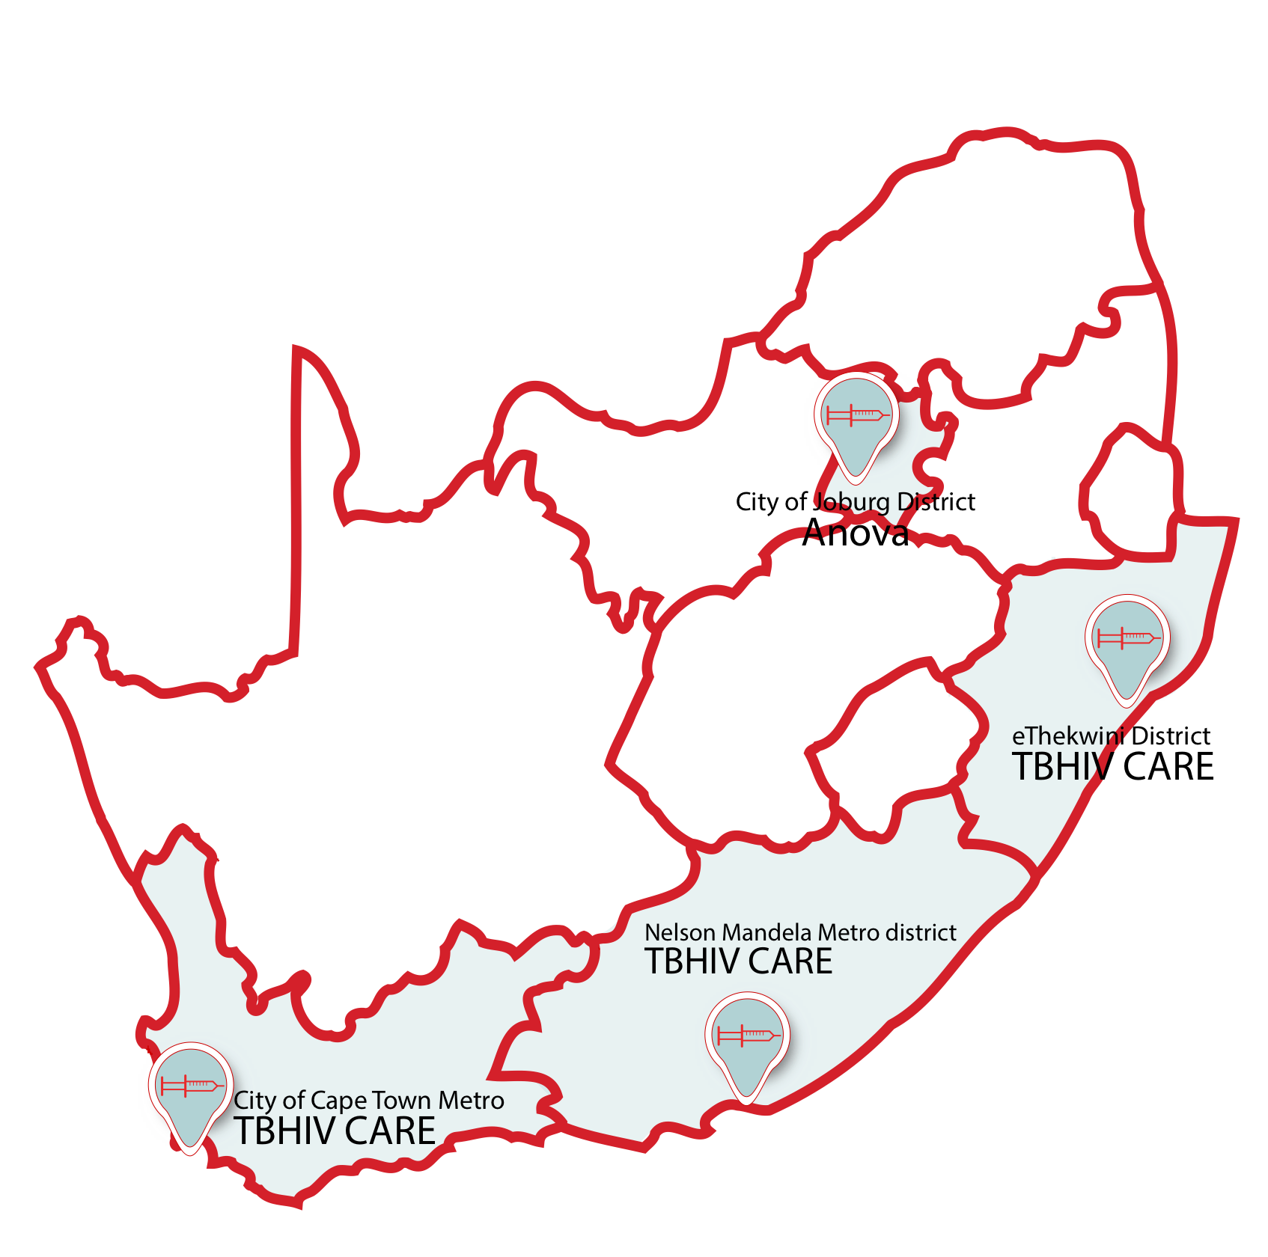
Location and implementing Partners

Slide 5
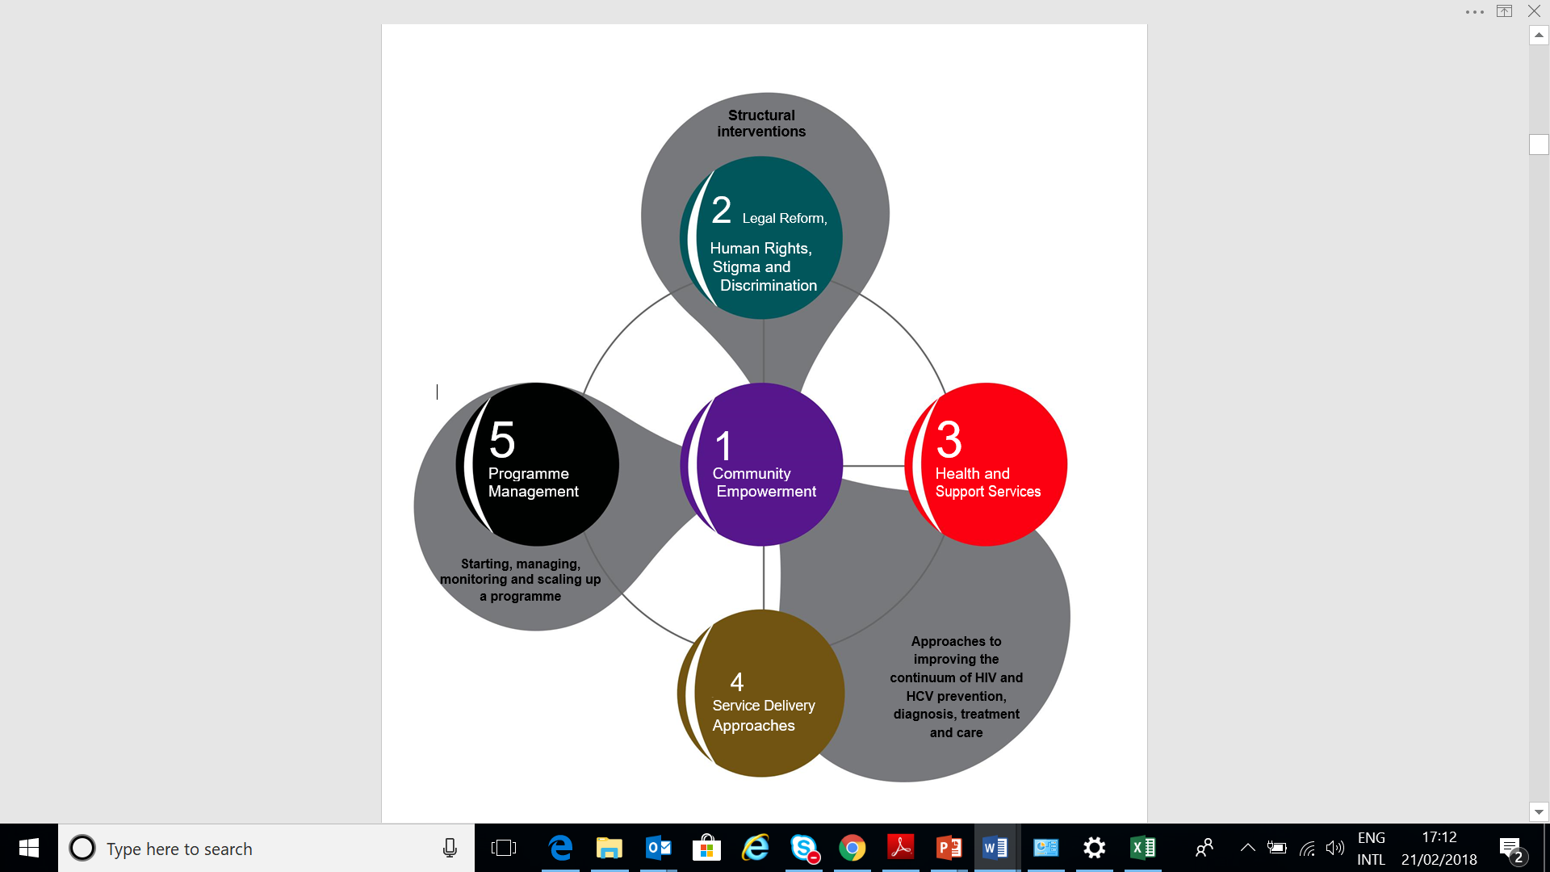
Designed Interventions
IDUT 2016

Slide 6
Key results
1 Oct 2016 – 30 May 2018
Notes:
622 HIV positive. 500 from CoJ; Dbn 500; WC 36 and EC 34. 8 known positives. NSP services stopped in Durban, plans underway to restart

Slide 7
HCT Yield per District
1 Oct 2016 – 30 May 2018
HIV positivity rate 19% overall

Slide 8
Overall OST Cascade
1 Oct 2017 – 30 May 2018

Slide 9
Lessons
  HIV positivity rate confirms previous studies results
  Use of peer outreach workers from target population helps in mapping areas and roll-out of interventions
  Need to bolster psychosocial intervention to address adherence to OST
  All HIV-positive clients were referred for onward management
  Need to include Hepatitis C in programmes for PWID as co-infection is very common

Slide 10
Conclusion
  Results show increased access to HIV prevention services and early enrolment in HIV care and treatment including medically assisted therapy (e.g., OST)
  Program has addressed some accessibility, applicability, appropriateness and availability challenges threatening health needs of PWID

Slide 11

Disclaimer
The views described herein are the views of this institution, and do not represent the views or opinions of the Global Fund to Fight AIDS, Tuberculosis and Malaria, nor is there any approval or authorization of this material, express or implied, by the Global Fund to Fight AIDS, Tuberculosis and Malaria

