Slide 1

How can programmes best support female sex workers to avoid HIV infection in Zimbabwe?
A prevention cascade analysis
Elizabeth Fearon, Andrew Phillips, Sibongile Mtetwa, Sungai T Chabata, Phillis Mushati, Valentina Cambiano, Joanna Busza, Sue Napierala, Bernadette Hensen, Stefan Baral, Sharon S Weir, Brian Rice, Frances M Cowan, James R Hargreaves
July 26, 2018
22nd International AIDS Conference, Amsterdam

Slide 2
Conflicts of Interest
None to declare.

Slide 3

HIV among female sex workers in Zimbabwe
High HIV prevalence: estimated 59%, rises steeply with age
High HIV incidence, estimate from programme repeat-testing: 10%
Require community-led combination HIV prevention
Sisters with a Voice Programme: since 2009 providing sexual and reproductive health services including HIV testing to FSW at 36 sites across Zimbabwe
How best to monitor HIV prevention and identify gaps in provision that allows us to target and improve HIV prevention programming?

Slide 4
HIV prevention cascades
For a given ‘prevention tool’:
‘Covered’ by prevention
HIV- negative
population at risk
Demand
Supply
Adherence
4

Slide 5
HIV prevention cascades
For a given ‘prevention tool’:
What factors lead to gaps in demand, supply, adherence?
What programmes are
needed?
‘Covered’ by prevention
HIV- negative
population at risk
Demand
Supply
Adherence
5

Slide 6
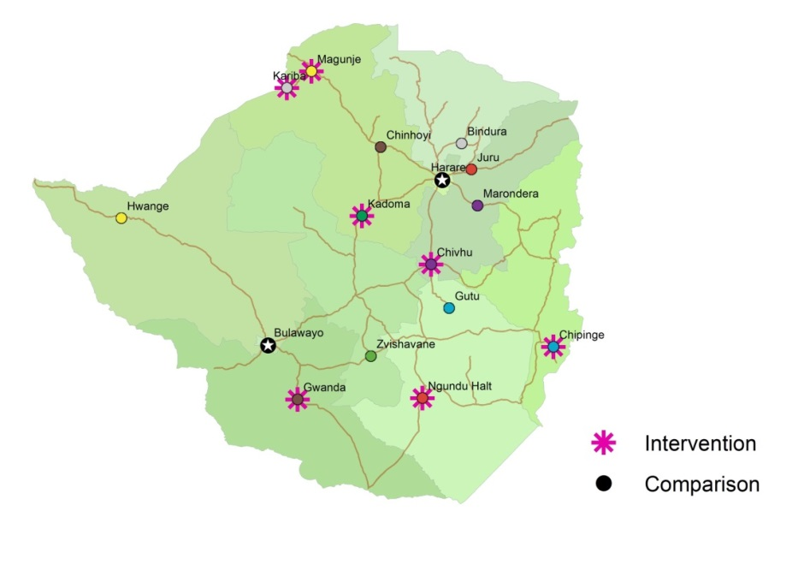
Data: SAPPH-IRe Trial
Cluster RCT 2014-2016
7 Comparison sites: community mobilisation, peer education, HTC, SRH services, STIs
7 Intervention sites: as above + ART and PrEP available onsite, adherence support
Endline cross-sectional RDS surveys, n~200 per site
Aged 18+ years
Resident at the site 6 months +
Exchanged sex for money in previous 30 days
611/1439 FSW were HIV-negative in intervention sites
Mean age 30 years;
Majority separated/divorced/widowed (78%);
Majority 1-5 (60%) and 6-9 clients per week (24%).

Slide 7
Operationalising the HIV Prevention Cascade
 | Condoms | PrEP
Demand | Aware that condoms can prevent HIV infection | Heard of PrEP
Supply | Reports condoms are “easily available” whenever needed | Ever offered PrEP
Adherence | No instance of condomless sex reported in the last month or at last sex with clients or steady partners* | Currently taking PrEP and Taking PrEP “every day”
*amongst steady partners not reported as known to be HIV-negative
Explanatory factors: sociodemographic, sex work characteristics, experience of stigma, experience of violence, relationships with other sex workers, alcohol consumption, where obtain condoms, adherence to the other prevention tool.

Slide 9
Operationalising the HIV Prevention Cascade
 | Condoms | PrEP
Demand | Aware that condoms can prevent HIV infection | Heard of PrEP
Supply | Reports condoms are “easily available” whenever needed | Ever offered PrEP
Adherence | No instance of condomless sex reported in the last month or at last sex with clients or steady partners* | Currently taking PrEP and Taking PrEP “every day”
*amongst steady partners not reported as known to be HIV-negative
Explanatory factors: sociodemographic, sex work characteristics, experience of stigma, experience of violence, relationships with other sex workers, alcohol consumption, where obtain condoms, adherence to the other prevention tool.

Slide 10
Prevention Cascade amongst n=611
HIV-negative FSW: condoms and PrEP
n=585
93.7%
n=581
93.9%
n=293
45.5%
n=343
54.7%
n=98
15.6%
n=188
28.8%
n=378
60.9%

Slide 11
Prevention Cascade amongst n=611
HIV-negative FSW: condoms and PrEP
n=585
93.7%
n=581
93.9%
n=293
45.5%
n=343
54.7%
n=98
15.6%
n=188
28.8%
n=378
60.9%

Slide 12
Prevention Cascade amongst n=611
HIV-negative FSW: condoms and PrEP
n=585
93.7%
n=581
93.9%
n=293
45.5%
n=343
54.7%
n=98
15.6%
n=188
28.8%
n=378
60.9%

Slide 13
Of the 343/618 HIV-negative FSW (54.7%) covered by HIV prevention:
N=50, 16.8%
N=245, 71.5%
N=48, 11.7%

Slide 14
Factors associated with condom adherence
 | n | Weighted % | Adjusted Odds Ratio | 95% CI
Overall condom adherence | 293/611 | 45.5
Age entered sex work |  |  | 1.05 | 1.00-1.11
Use condoms provided by clients | 99/218 | 39.0 | 0.48 | 0.30-0.78
Ever received condoms from a peer educator | 187/380 | 46.8 | 1.64 | 1.01-2.65
Frequency of alcohol consumption Never Once per month or less 2-4 times per month 2-3 occasions per week 4+ occasions per week | 139/262 26/44 39/77 50/112 38/115 | 50.9 61.7 49.2 38.8 28.9 | 1 1.43 0.89 0.50 0.34 | 0.61-3.33 0.42-1.86 0.26-0.94 0.16-0.69
Adjusted for age, education, marital status, food insecurity, number of clients and site.
Notes:
Ask Frances what alcohol programming have already

Slide 15
Factors associated with PrEP adherence
 | n | Weighted % | Adjusted Odds Ratio | 95% CI
Overall PrEP adherence | 98/611 | 15.8
Age at survey |  |  | 1.05 | 1.01-1.10
Age entered sex work |  |  | 0.94 | 0.89-0.99
Frequency of alcohol consumption Never Once per month or less 2-4 times per month 2-3 occasions per week 4+ occasions per week | 40/262 5/44 21/77 16/112 16/115 | 18.9 9.3 20.9 7.4 13.3 | 1 0.37 1.09 0.38 0.74 | 0.10-1.31 0.44-2.73 0.15-0.96 0.28-1.97
Adjusted for age, education, marital status, food insecurity, number of clients and site.

Slide 16
Association between PrEP adherence and condom adherence
 | n adherent to condoms/ N adherent to PrEP | Weighted % | aOR | 95% CI
Adherent to condoms (overall) | 48/98 | 40.8 | 0.90 | 0.47-1.71
Adherent to condoms with clients | 54/98 | 48.5 | 1.14 | 0.58-2.23
Adjusted for age, education, marital status, food insecurity, number of clients and site.

Slide 17
Discussion
Conclusions for sex work programming in Zimbabwe
High demand for and supply of condoms; difficulties in adherence (often not under FSWs’ control)
PrEP: new technology, need for demand strengthening as supply increases and support to adhere
Programming to assist HIV prevention in the context of alcohol consumption
Younger sex workers and those new to sex work likely need additional support
Limitations: secondary analysis, limited and self-reported measures, cross-sectional
Requirements for prevention cascades
Reflect combination prevention, different choices and circumstances
Account for changes in time at risk, and different partner circumstances
Address measurement challenges: concepts, biases in self-report

Slide 18






Thank you
Study participants of the SAPPH-IRe trial
The Bill and Melinda Gates Foundation via the MeSH Consortium (BMGF OPP1120138), funding of these analyses
Funders of the SAPPH-IRe trial: DFID, Swedish SIDA, and Irish Aid via Zimbabwe’s Integrated Support Programme, and UNFPA
MeSH Consortium Key Populations Working Group
London HIV Prevention Cascades Working Group
SAPPH-IRe study team

