Slide 1
What about hepatitis and TB/MDR-TB: Why are we also failing PWID?
Natasha Martin, DPhil
Associate Professor
Division of Infectious Diseases and Global Public Health
University of California San Diego
Javier Cepeda (UCSD), Peter Vickerman, Matthew Hickman, Jack Stone (University of Bristol)

Slide 2
DISCLOSURES
I have received unrestricted research grants and honoraria from Gilead and Merck.

Slide 3
HIV/HCV AMONG PWID

Slide 4
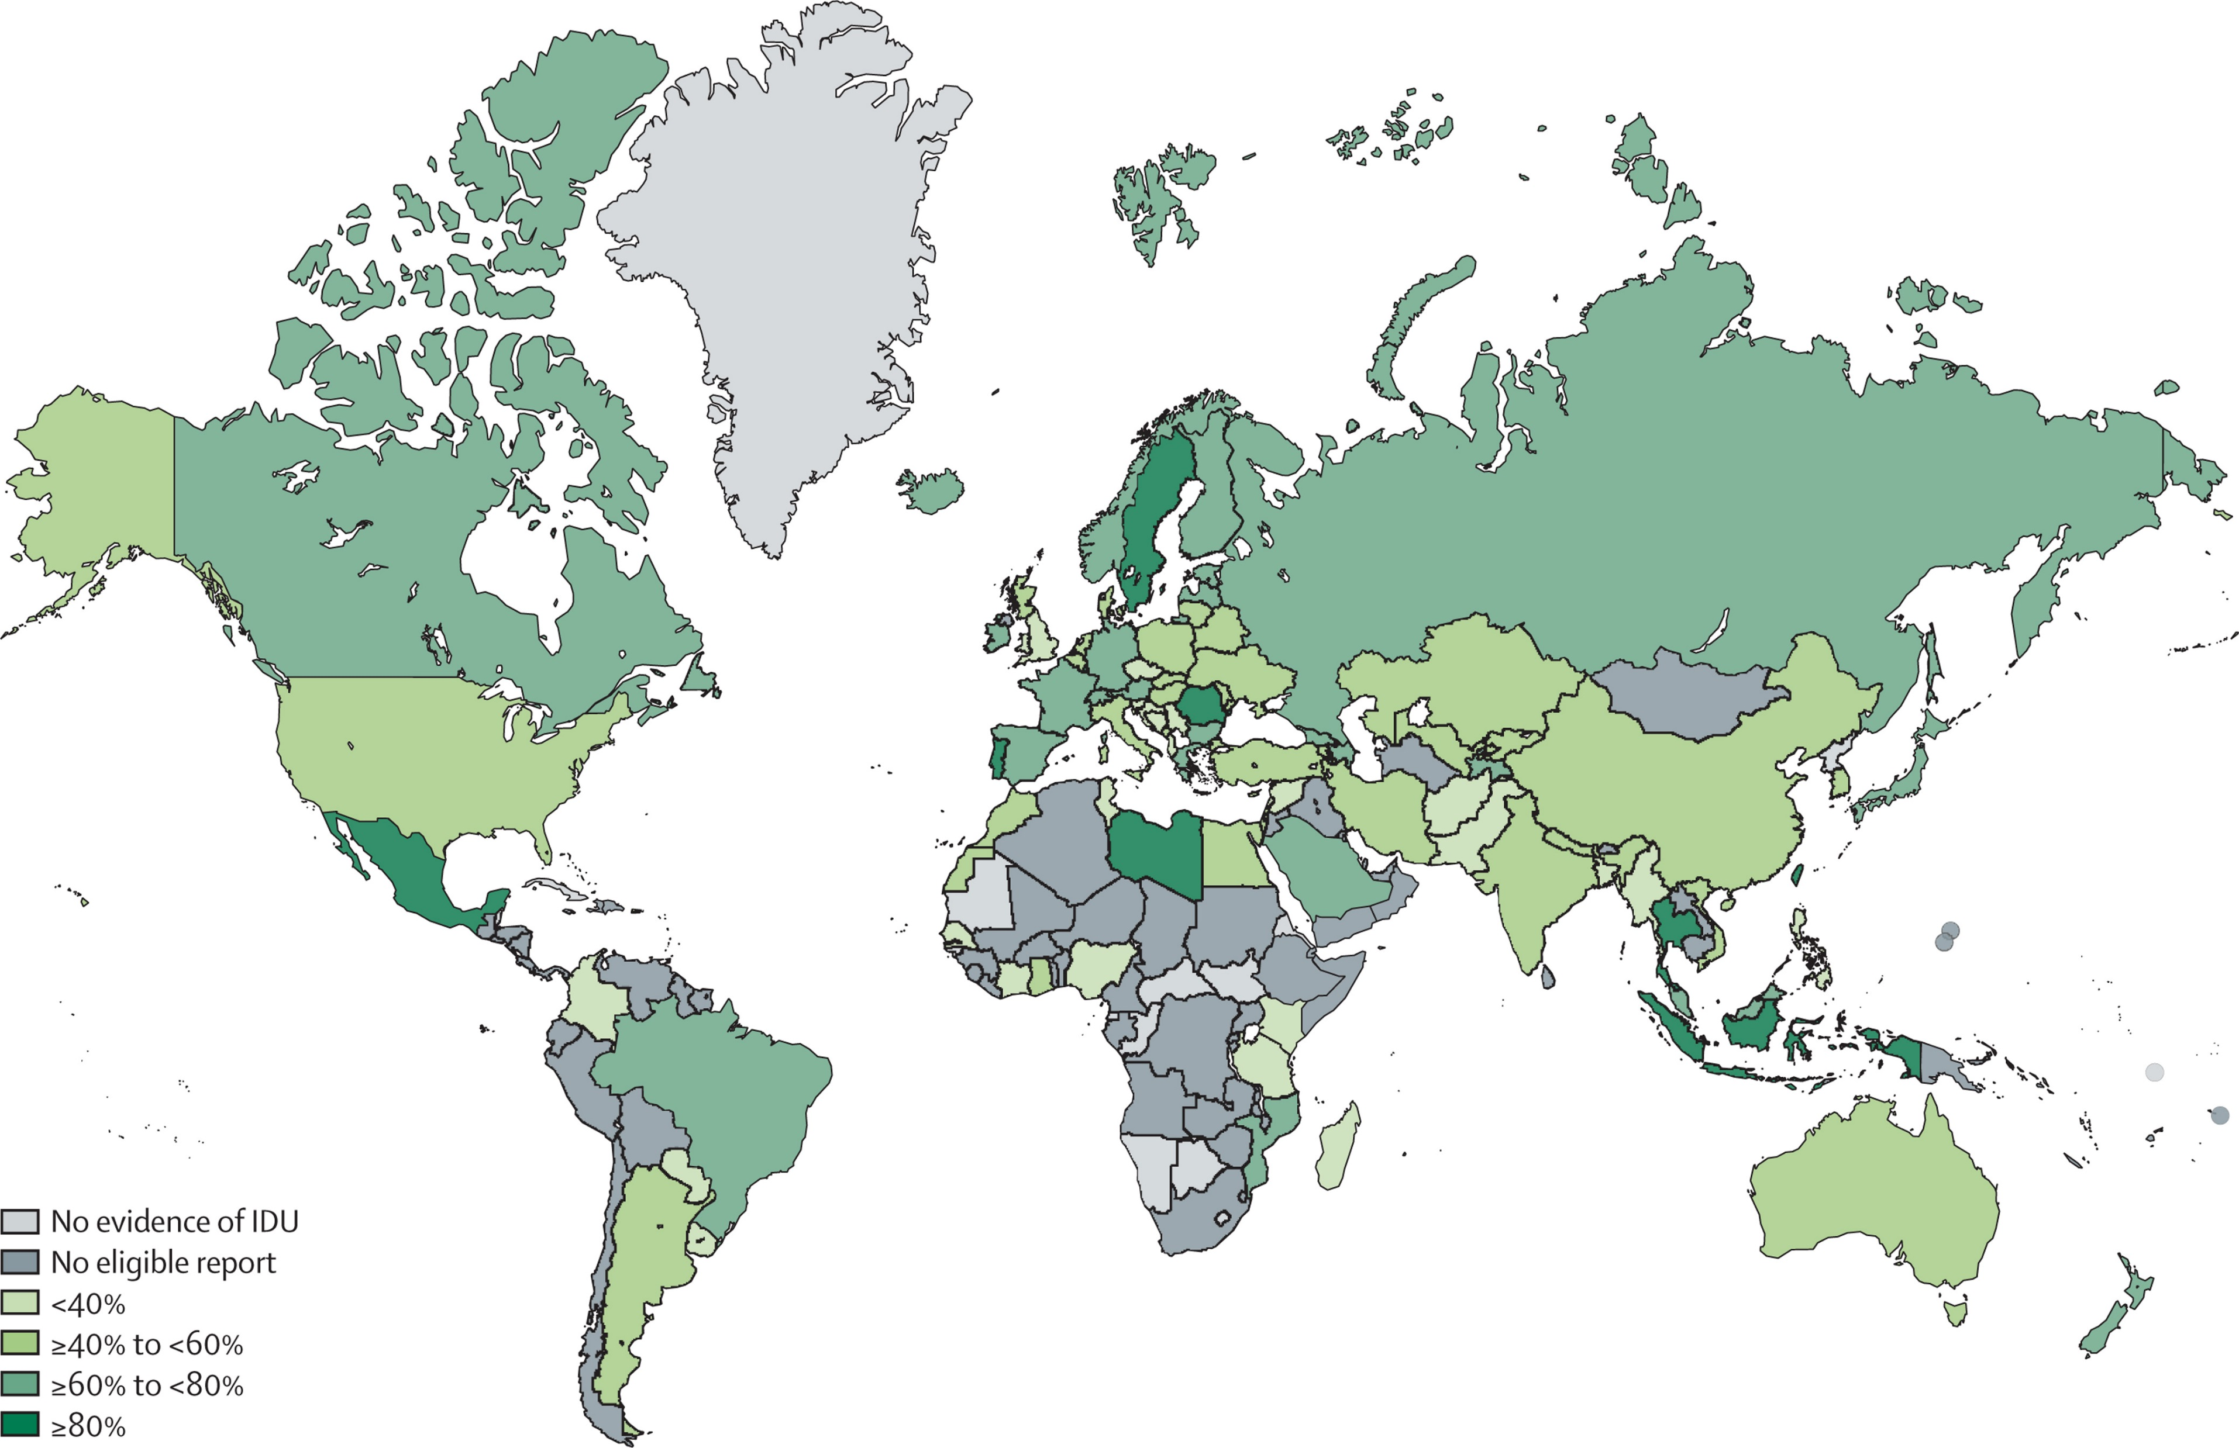
ANTI-HCV PREVALENCE AMONG PWID
Figure 4
Global: 52∙3% (42·4–62·1) HCV among PWID ~ 8∙2 million (4∙7–12∙4 million) people
The Lancet Global Health 2017 5, e1192-e1207DOI: (10.1016/S2214-109X(17)30375-3)
Degenhardt L et al. Lancet Glob Health 2017
Notes:
Globally, we estimate that 52∙3% (42·4–62·1) are HCV-antibody positive - equating to 8∙2 million (4∙7–12∙4 million)
people., and maybe same again among people with injecting history -
Globally,we estimate 82·9% (76·6–88·9) of PWID mainly inject opioids and 33∙0% (24∙3–42∙0) mainly inject stimulants. We
estimate that 27∙9% (20∙9–36∙8) of PWID globally are younger than 25 years, 21∙7% (15∙8–27∙9) had recently (within
the past year) experienced homelessness or unstable housing, and 57∙9% (50∙5–65∙2) had a history of incarceration.
Interpretation We identified evidence of IDU in more countries than in 2008, with the new countries largely consisting
of low-income and middle-income countries in Africa. Across all countries, a substantial number of PWID are living
with HIV and HCV and are exposed to multiple adverse risk environments that increase health harms.
Funding Australian National Dru

Slide 5
ANTI-HCV PREVALENCE AMONG HIV-INFECTED PWID
1.3M HIV-HCV coinfections among PWID, over half total global burden (2.3 M)
Platt L et al. Lancet ID 2016
Platt L et al. Lancet Infec Dis 2016
Notes:
2.3M HIV-HCV coinfections (IQR 1.3-4.4) among whom over half are PWID (1.3M).

Slide 6
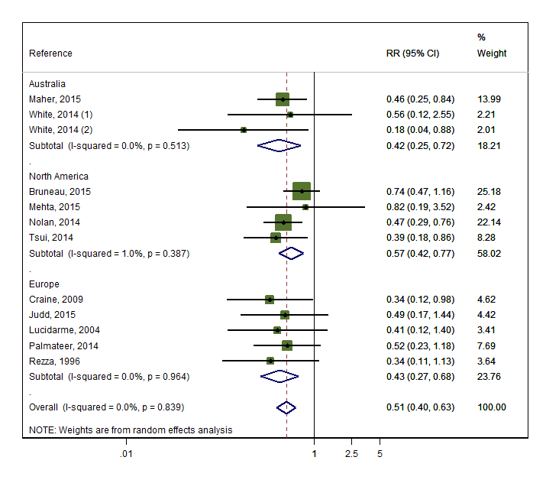
IMPACT OF OPIATE SUBSTITUTION THERAPY (OST) ON HCV INCIDENCE: COCHRANE REVIEW
OVERALL: 50% reduction in risk of HCV
Platt L et al. Cochrane Database Syst Rev 2017
Notes:
Here you see forest plot for opioid substitution treatment – from studies that adjusted for confounders. This includes twelve observational studies – including over 6300 participants and 1000 HCV incident events. Consistent evidence across geographical areas (Australia, North America, and Europe) – with little heterogeneity that OST reduces HCV transmission by 50%.
Because no trials (and there wont be any as would be unethical now) Cochrane rules say we have to grade the evidence as low quality – but strong good low quality evidence…

Slide 7
IMPACT OF HIGH COVERAGE NEEDLE/SYRINGE PROGRAMS (NSP) & OST ON HCV INCIDENCE: COCHRANE REVIEW
OVERALL: Reduced HCV incidence by 71%
Platt L et al. Cochrane Database Syst Rev 2017
Notes:
Four studies reported combined exposure to both NSPs and OST – the combination of high coverage NSP and OST reduced HCV by 71% - shown in top forest plot
3 studies also could assess combination of low NSP and OST – and suggested that impact of OST on HCV transmission was reduced in absence of high coverage NSP – shown in bottom.
We do need to strengthen the evidence base on the benefits of combining interventions.

Slide 8
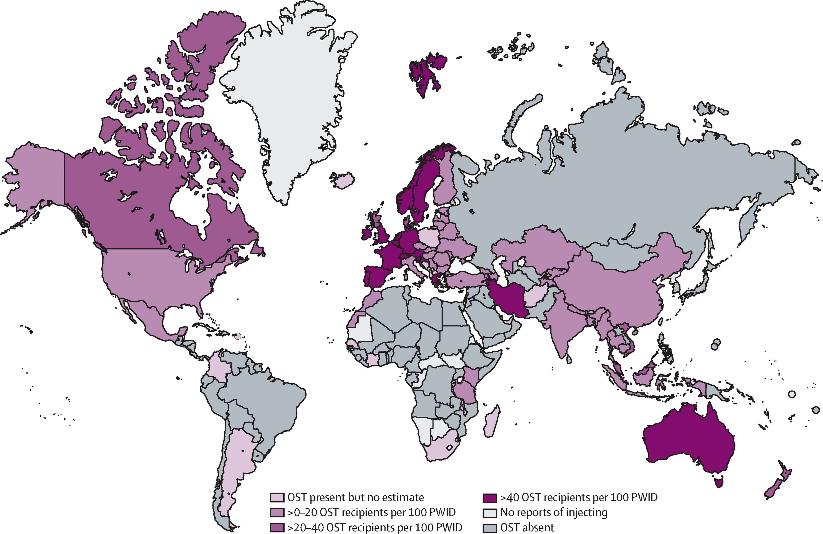
GLOBAL COVERAGE OF OST REMAINS POOR
Global: 16 (UI 10–24) OST recipients per 100 PWID
The Lancet Global Health 2017 5, e1208-e1220DOI: (10.1016/S2214-109X(17)30373-X)
Larney S et al. Lancet Glob Health 2017
Notes:
Coverage varied widely between countries, but was most often low according to WHO indicators (<100 needle-syringes distributed per PWID per year; <20 OST recipients per PWID per year). Globally, we estimate that there are 33 (uncertainty interval [UI] 21–50) needle-syringes distributed via NSP per PWID annually, and 16 (10–24) OST recipients per 100 PWID.
Less than 1% of PWID live in countries with high coverage of both NSP and OST (>200 needle-syringes distributed per PWID and >40 OST recipients per 100 PWID).
Coverage of HIV and HCV prevention interventions for PWID remains poor and is likely to be insufficient to effectively prevent HIV and HCV transmission. Scaling up of interventions for PWID remains a crucial priority for halting the HIV and HCV epidemics.

Slide 9
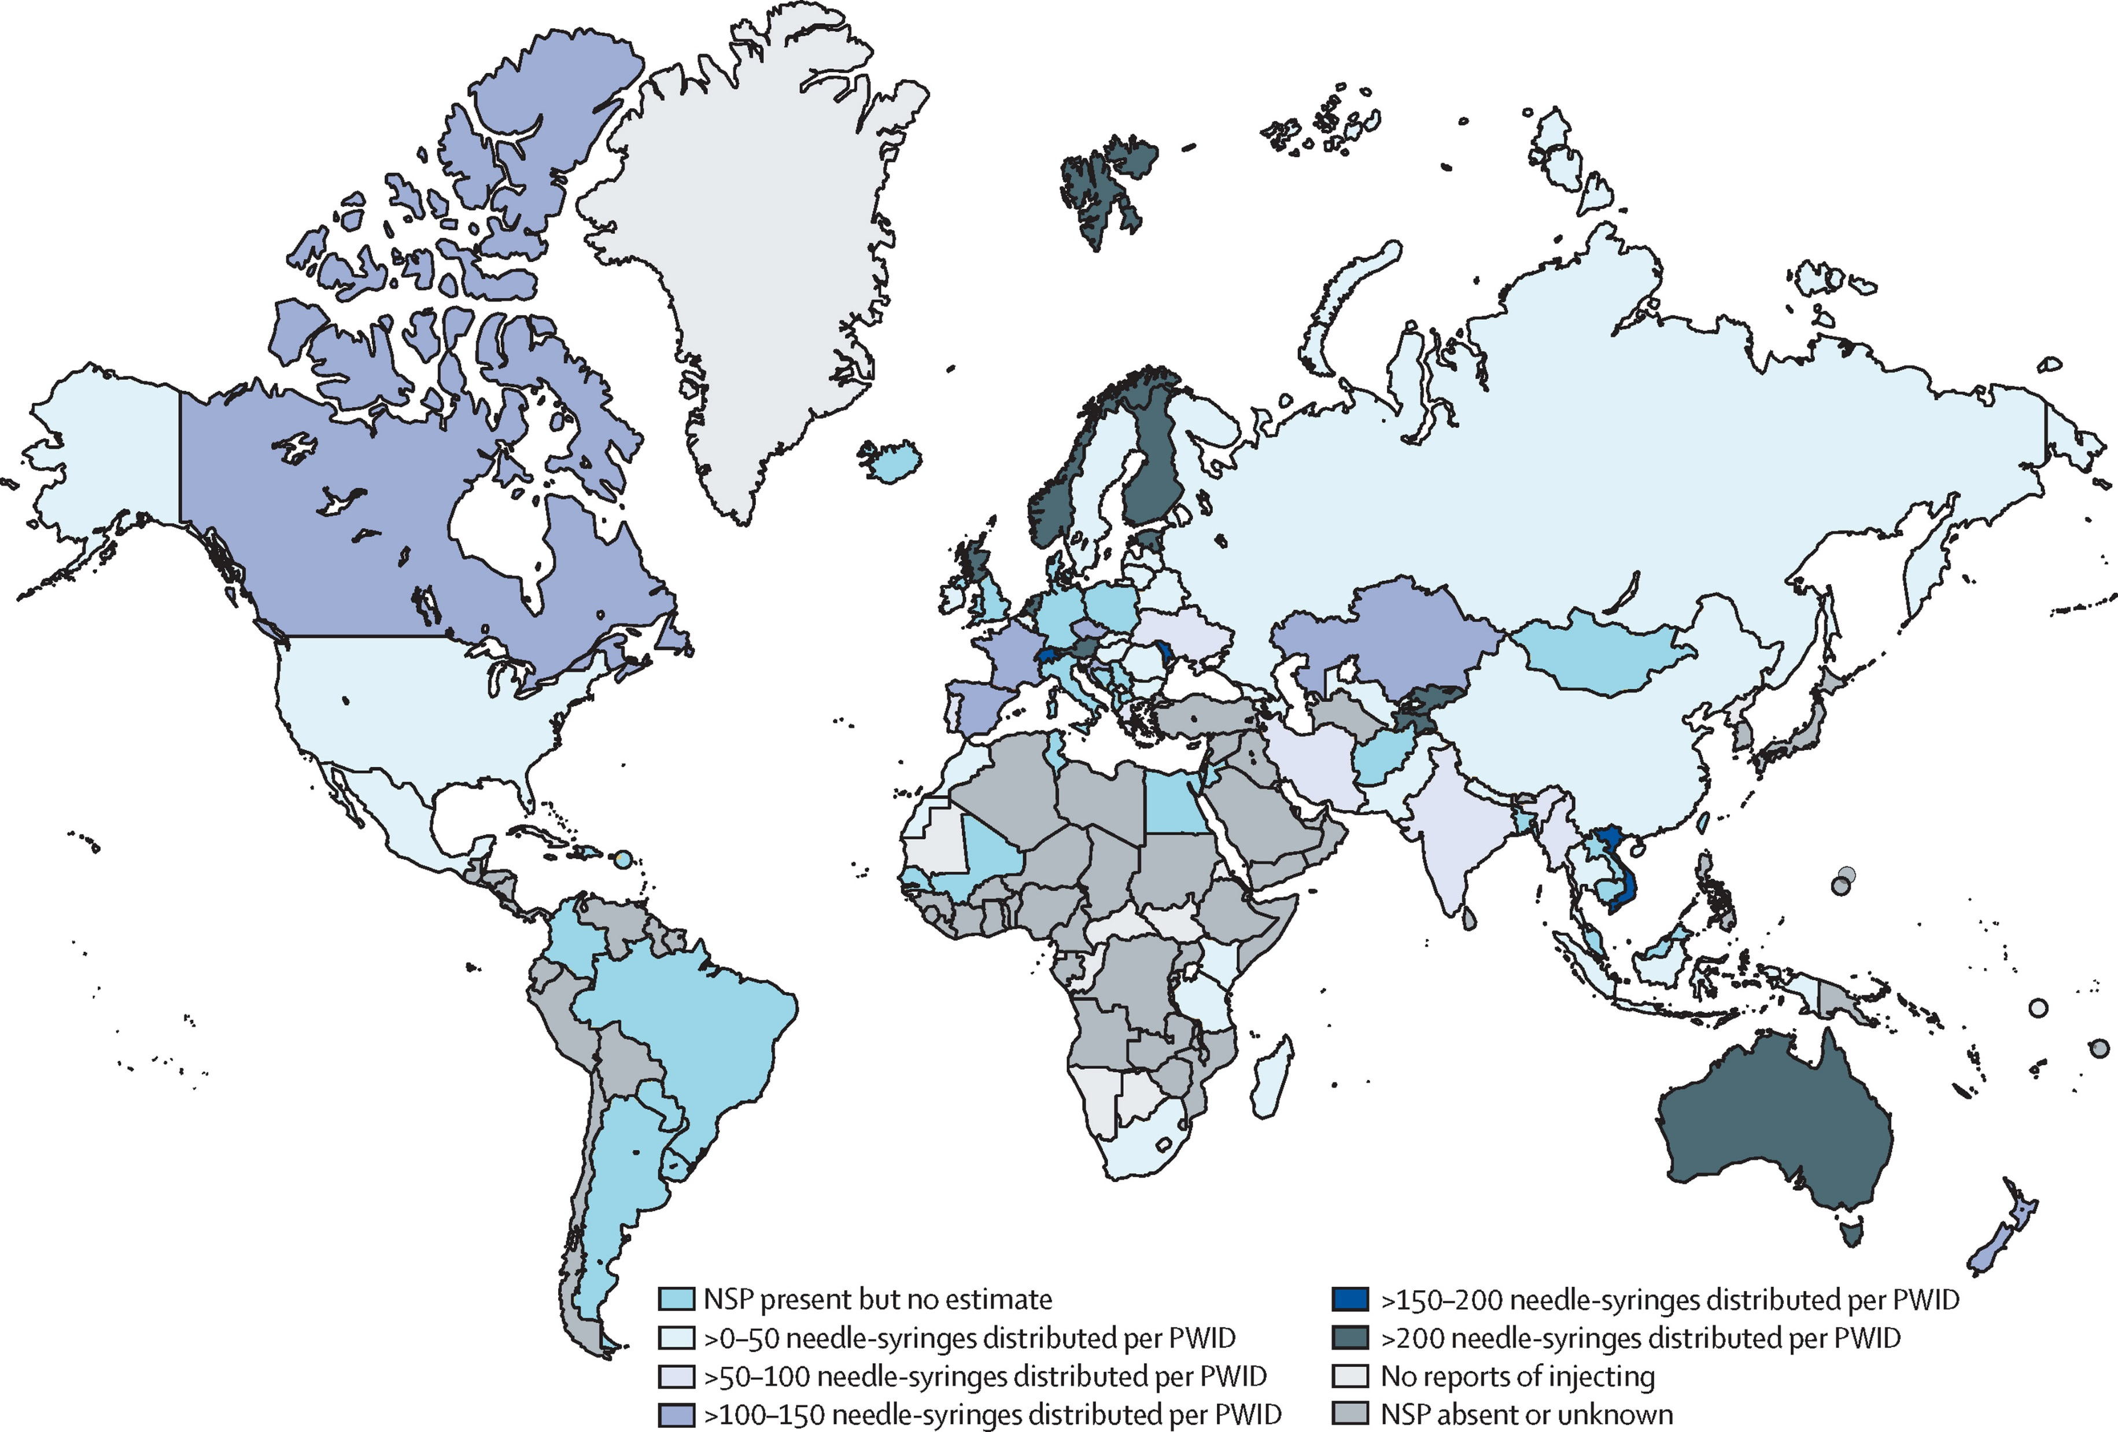
GLOBAL COVERAGE OF NSP ALSO POOR
Global: 33 (UI 21–50) needle-syringes distributed via NSP per PWID/yr
The Lancet Global Health 2017 5, e1208-e1220DOI: (10.1016/S2214-109X(17)30373-X)
Larney S et al. Lancet Glob Health 2017
Notes:
Coverage varied widely between countries, but was most often low according to WHO indicators (<100 needle-syringes distributed per PWID per year; <20 OST recipients per PWID per year). Globally, we estimate that there are 33 (uncertainty interval [UI] 21–50) needle-syringes distributed via NSP per PWID annually, and 16 (10–24) OST recipients per 100 PWID.
Less than 1% of PWID live in countries with high coverage of both NSP and OST (>200 needle-syringes distributed per PWID and >40 OST recipients per 100 PWID).
Coverage of HIV and HCV prevention interventions for PWID remains poor and is likely to be insufficient to effectively prevent HIV and HCV transmission. Scaling up of interventions for PWID remains a crucial priority for halting the HIV and HCV epidemics.

Slide 10
POOR GLOBAL ACCESS TO HARM REDUCTION
<1%
PWID live in countries with high coverage of both NSP and OST*
* >40% of PWID receiving OST, and >200 needle-syringes distributed per PWID/year
Larney S et al. Lancet Glob Health 2017

Slide 11
DAA treatment outcomes in PWID
HCV TREATMENT HIGHLY EFFECTIVE AMONG PWID
OST
No OST
current PWID
94%
Sustained viral response (%)
OBV/PTV/r +
DSV + RBV¹
SOF/LDV
+ RBV²
SOF/VEL³
SOF/VEL/VOX⁴
GZR/ELB^{5.6}
GLE/PIB⁷
SOF/VEL⁸
OST: Opiate substitution therapy
1) Grebely J, ILC 2017. 2) Grebely J, CID 2016. 3) Grebely J, CID 2016. 4) Grebely J, ILC 2017. 5) Zeuzem S, Ann Intern Med 2015. 6) Dore GJ, Ann Intern Med 2016. 7) Grebely J, INHSU 2017. 8) Grebely J, ILC 2017.
Slide courtesy of G Dore

Slide 12
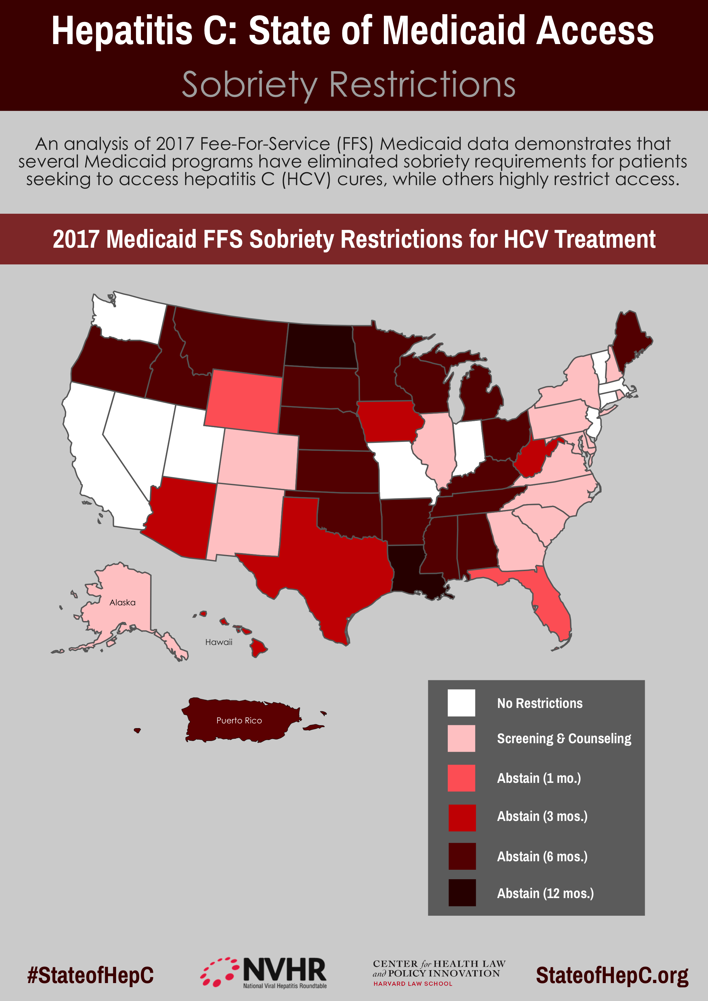
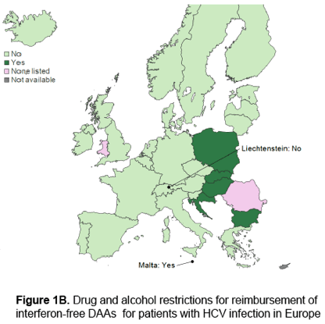
TREATMENT PRIORITIZATION AND RESTRICTIONS LIMITING SCALE-UP TO PWID EVEN IN RESOURCE RICH COUNTRIES
1. Marshall A. EASL 2017 2. stateofhepc.org
Notes:
majority of US states (34 states) require a period of abstinence from drugs and alcohol to quality for medicaid reimbrusement for HCV therapy, despite this countering the existing guidelines recommending access to treatment for people who inject drugs. As a result the treatment rates for PWID are very low.
Unfortunately, the high costs of HCV treatment has so far resulted in prioritization of HCV therapy even in developed countries. In these settings, patients with more advanced liver disease and those coinfected with HIV have been prioritized first. Although this type of strategy will be effective in preventing HCV-related morbidity and mortality among PWLH, it undermines elimination efforts as PLWH will remain at risk of being infected or reinfected with HCV from individuals who remain untreated and are at risk of transmitting. For example, PWID with a risk of transmission tend to be younger with less advanced liver disease, and therefore prioritization strategies targeting individuals with advanced liver disease may fail to prevent the substantial amount of transmission from this group[24]. This is despite economic assessments indicate that treatment scale-up among PWID at or below the level required for elimination is cost-effective in settings like Australia, the UK, and Netherlands[8, 24, 25],. Additionally, models indicate early treatment for PWID is cost-effective compared to delay until cirrhosis, and may be more cost-effective than early treatment for those with no ongoing risk in settings with low-moderate (20/40%) HCV prevalence among PWID due to substantial prevention benefits of early treatment of PWID[24].

Slide 13
RUSSIAN POLICY PROHIBITING OPIATE AGONIST THERAPY (OAT) AND LIMITED PROVISION OF NSP AND ART FUELS HIV AND OVERDOSE
White boxes: Omsk
Grey boxes: Ekaterinburg
Scale-up of NSP+OAT to 50% combined with ART scale-up (to 65% coverage by 2028) could avert:
53% and 36% of HIV infections among PWID in Omsk and Ekaterinburg, respectively, by 2028
~30% of fatal overdoses by 2028
53%
48%
35%
HIV cases averted among PWID, 2018-2028 (%)
33%
NSP + OAT (50%)
NSP + OAT (50%)
Integrated ART
(3x recruitment from 2018)
Cepeda JA & Martin NK et al. Lancet HIV 2018
Bekker LG, Baral SD, Cepeda J, Martin NK et al. The Lancet 2018

Slide 14
POTENTIAL DUAL BENEFITS OF HARM REDUCTION AND HIV/HCV TREATMENT ON HIV & HCV TRANSMISSION IN E.EUROPE AND C. ASIA
NSP (60%) & OST (20%) could prevent >35% of HCV and HIV infections over 20 years among PWID across a variety of settings
Particularly effective if combined with HIV and HCV treatment
% reduction HCV among PWID
% reduction HIV among PWID
Mabileau G Open Forum ID 2018

Slide 15
HIV/TB AMONG PWID

Slide 16
HIV AND TB AMONG PWID
Among HIV-infected individuals in Spain, PWID at higher risk of TB compared to other risk groups¹
Among HIV/TB coinfected individuals in Eastern Europe, MDR-TB significantly associated with injecting drug use²
Martin V J Epidemiol 2011
Post FA J Infect 2014

Slide 17
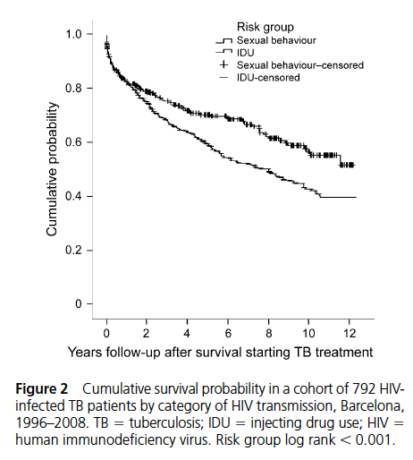
HIV/TB COINFECTED PWID HAVE LOWER SURVIVAL COMPARED TO OTHER RISK GROUPS
In part due to marginalization, delayed diagnosis of TB and HIV, poorer adherence to TB and HIV treatment²⁻⁵
1. Catala L. et al. Int J Tuberc Lung Dis 2011 2. Garcia de Ollala JAIDS 2002 3. Cayla Respir Res 2009 4. Diez M Eru J Publi Health 2004 5. Sobrino-Vegas P Curr HIV Res 2009
Notes:
Barcelona 1996-2006.

Slide 18
WHO-EUROPE: CONCERNING SETTING WHERE TB INCIDENCE AND MORTALITY AMONG HIV+ RISING
TB INCIDENCE
TB MORTALITY
TOTAL
Rate per 100 000 population per year
TOTAL
HIV+
HIV+
19% of new cases and 55% of previously treated cases with MDR-TB/RR-TB – integrated HIV&TB services urgently needed
WHO 2017
Notes:
Integreated HIV and TB services urgently needed

Slide 19
DRUG USE, INCARCERATION, AND HIV/HCV/TB SYNDEMICS

Slide 20
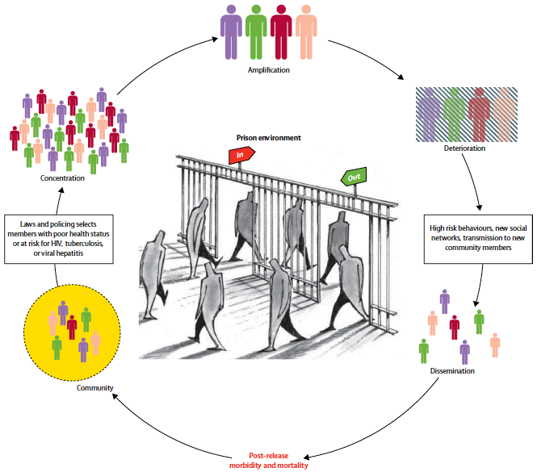
INCARCERATION AS A DRIVER OF HIV/HCV/TB
Amplification
Globally, ~58% PWID had a history of incarceration²
Concentration
Deterioration
Community
Dissemination
1. Kamarulzaman A et al. Lancet 2016 2. Degenhardt L et al. Lancet Glob Health 2017

Slide 21
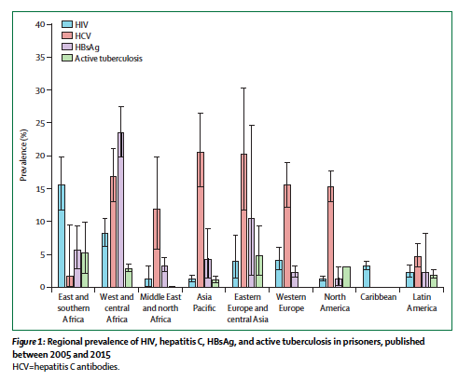
HIGH BURDEN OF HIV, HCV, HBV AND TB AMONG PRISONERS
Higher prevalence of HIV, HCV, HBV, and TB in prisoners than general populations.
Especially in incarcerated PWID.
Dolan K et al. Lancet 2016

Slide 22
INCARCERATION INCREASES RISK OF HIV AND HCV INCIDENCE AMONG PWID
Systematic review and meta-analysis found that recent incarceration significantly increases risk of acquiring HIV (by 81%) and HCV (by 62%) among PWID compared to non-recent incarceration
This risk persists post release (RR 1.25 ever incarcerated compared to never incarcerated for both HIV and HCV)
PRISON TREATMENT
Stone J, Martin NK, Vickerman P et al. Lancet ID in press
Notes:
Assumes much higher uptake rate of testing in opt out scenario – 90% - based on HIV opt-out screening in prisons.
Only prisoners with > 12 months remaining eligible for treatment.
1-y Risk: 1-time risk-based screening of prisoners and entrants with history of IDU for 1 year
1,5,10-y All: 1-time opt-out screening of prisoners and entrants for 1,5, or 10 years
Only prisoners with > 12 months remaining eligible for treatment.

Slide 23
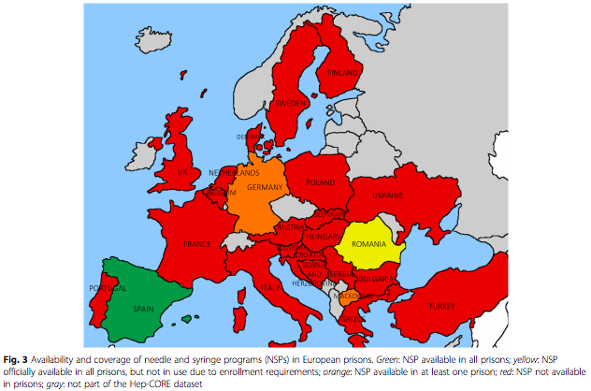
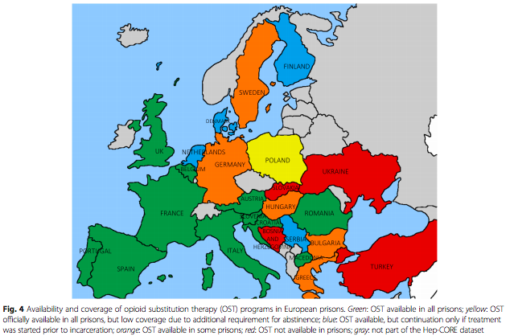
LIMITED HARM REDUCTION IN PRISON
NSP
OST
Green: available
Yellow: officially available but low coverage or not in use
Blue: available only if started prior to incarceration
Orange: some prisons
Red: not available
1. Bielen Harm Reduction Journal 2018
2. Kamarulzaman et al. The Lancet 2016
Notes:
Information, education and communication.
Counselling and testing

Slide 24
ESTIMATING CONTRIBUTION OF INCARCERATION AND PRISON INTERVENTIONS TO HIV, HCV, AND TB AMONG PWID IN UKRAINE
HIV:
Incarceration could contribute 28-55% of new HIV infections among PWID in 15 years¹
Prison OAT at 50% with retention on release could avert 20% new HIV infections in 15 yrs¹
HCV:
OAT in prison and removal of post-prison risk could reduce HCV incidence by >25% among PWID in a setting like Ukraine²
TB:
Incarceration results in 75% and 86% of all incident TB cases among HIV-infected and HIV-negative PWID, respectively, in Ukraine¹
Altice F et al. The Lancet 2016
Csete J et al. The Lancet 2016
Notes:
Ukraine- middle-income, 45 million peoople, highest prevalence of HIV in adults among EECA countries (1.2%) with Tb/MDR-tb contributing most to HIV mortality. 2.7% PWID on OAT, 20% on ART. 52% PWID ever incarcerated, on average 5 times, each a year in duration.

Slide 25
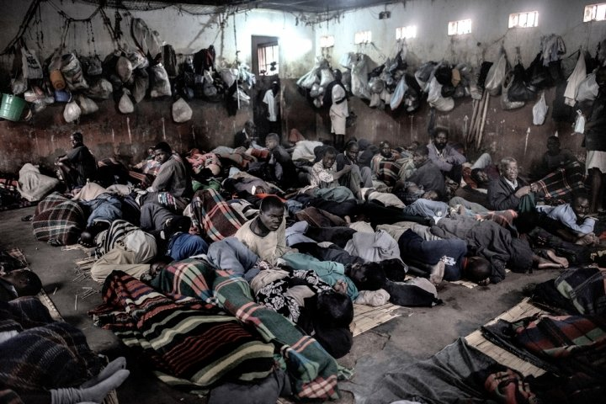
HCV AND TB: WHY ARE WE FAILING PWID?
Criminalization and mass incarceration
<1%
PWID live in countries with high coverage of both NSP and OST
Image credit: MSF
Low coverage of HIV and HCV treatment

Slide 26
HCV AND TB AMONG HIV-INFECTED PWID: WHAT IS NEEDED
Substantial global scale-up of harm reduction (NSP and OST) that is high-quality, evidence based, and affordable
Integrated services for PWID providing harm reduction combined with HIV/HCV/TB testing and treatment without restrictions or stigma
Reform of justice systems: decriminalization of drug use, diversion programs, and access to health services for incarcerated PWID in prison and continuity of care on release

Slide 27
FUNDING ACKNOWLEDGEMENTS
National Institute for Drug Abuse R01 DA037773
UCSD Center for AIDS Research (P30 AI036214)
Elton John AIDS Foundation
UK EPSRC
UK National Institute for Health Research Health Protection Research Unit (NIHR HPRU) in Evaluation of Interventions at University of Bristol.
The views expressed are those of the authors and not necessarily those of the UK NHS, UK NIHR, UK Department of Health.
Notes:
Add NSW and germans

