Slide 1
Setting the stage: HIV and mental health what do we know so far?
Robert H. Remien, Ph.D.
HIV Center for Clinical and Behavioral Studies
NY State Psychiatric Institute and
Columbia University
New York, NY, USA
Notes:
Thank you, Dr. Spudich for the very kind introduction and thank you to the conference organizers for choosing to feature the topic of mental health and for inviting me to deliver this plenary – it is an honor.
CLICK

Slide 2
Disclosure
No conflicts to report
Notes:
My only disclosure to this audience at this moment is to confess that while indeed it is an honor to be here, it is also a bit intimidating to speak before such a distinguished audience. So, I thought I would start by giving you all a view from the podium – and show you what I am seeing right now when I look out upon you the audience.
CLICK

Slide 3
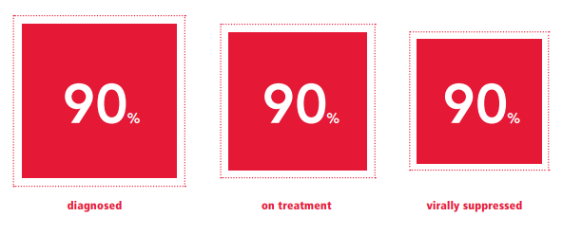
Why focus on mental health in the context of HIV prevention and care?
Significant gaps along HIV care continuum
Mental health problems and disorders influence every step
People at risk for – and those living with HIV - have significantly higher rates of mental health symptoms and disorders
If we do not address mental health, unlikely to achieve “90-90-90” goals or end the HIV epidemic
The human right to health means that everyone has the right to the highest attainable standard of physical AND mental health
Notes:
Why focus on mental health in the context of HIV prevention and care?
Despite all of our medical advances, we have not yet fully achieved the global success many had hoped for
Significant gaps remain along the HIV care continuum
Mental illness influences every step of our HIV prevention and care continua
PLWH have significantly higher rates of mental health disorders than that of the general population
I would posit that if we do not address mental health we are very unlikely to be able to achieve our current “90-90-90” goals – at least not in a sustainable way, nor will we be able to bring an end to the HIV epidemic
And finally, the right to health must include mental health – not just physical health – the mind and the body are one!

Slide 4
Global burden of mental, neurological, and substance use disorders [Disability Adjusted Life Years (DALYs) by Age]
Notice the similarity in age burden relative to the
age burden for HIV
Among adolescents and young adults living with HIV:
>60% have some type of mental health disorder
Excess deaths among persons with MNS disorders
Life span often 15 to 20 years shorter
Source: Whiteford et al, Lancet, 2016
Notes:
This Figure shows disability adjusted life years (DALYs) attributable to Mental, Neurological, and Substance Use Disorders, by Age
CLICK
These disorders contribute to reduced life span and excess deaths
CLICK
Note how the burden of these conditions rises rapidly in adolescence and peaks in young adulthood – similar to the HIV age bulge we are witnessing – which speaks to the intersection of mental health and HIV risk.
CLICK
I’ll be talking more about this in a minute, but to point out here the very high prevalence of mental health disorders among adolescents and young adults - >60% which is higher than what we see for adults.

Slide 5
Mental Health and HIV Prevention
Notes:
Let’s now take a look at Mental Health and HIV Prevention

Slide 6
Mental illness is a risk factor for HIV acquisition
Mental illness contributes 4 to 10X increased risk for acquiring HIV
HIV prevalence in US people with SMI: 2% - 6%
HIV prevalence in US general population: ~0.5%
Co-morbidities: Mood disorders + alcohol/substance use + other conditions contribute even higher risk
Source: CDC, 2016; Hughes et al , Lancet Psychiatry, 2016; Hobkirk et al, Current HIV/AIDS Report 2015
Notes:
Mental illness indeed is a risk factor for HIV acquisition. As you see for example the considerably higher HIV incidence among people with SMI compared to the general population in the United States.
And when you have comorbid disorders and other conditions there is a synergistic effect on HIV outcomes.
CLICK

Slide 7
Syndemic
A set of linked health problems involving two or more afflictions, interacting synergistically, and contributing to excess burden of disease in a population
Syndemic research focuses on communities experiencing co-occurring epidemics that additively increase negative health consequences.

Slide 8
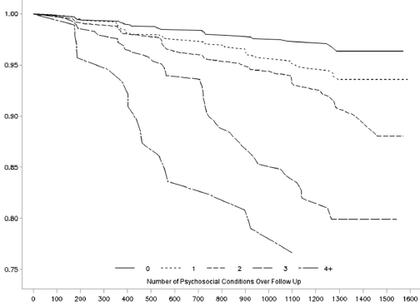
Syndemic Example: Multiple co-occurring conditions magnify HIV risk
4295 MSM from 6 US cities
Co-occurring conditions
Depressive symptoms
Heavy alcohol use
Stimulant use
Poly drug use
Childhood sexual abuse
Probability of staying HIV negative goes down as number of conditions increases
0 conditions
1 condition
Probability of remaining HIV seronegative
2 conditions
3 conditions
4+ conditions
Days from study initiation
Source: Mimiaga et al. JAIDS, 2015
Notes:
For example, among over 4,000 MSM across 6 US cities when there are co-occurring conditions such as mood disorders, substance use, and prior experience of childhood sexual abuse, the probability of staying HIV negative goes down significantly as number of conditions increases
CLICK

Slide 9
Depression influence on sexual risk behaviors and PrEP adherence
Men who have sex with men (MSM) and transgender women (TGW) at risk for HIV infection in iPrEx and iPrEx OLE
Conclusions:
Higher depression scores were associated with:
lower (PrEP) drug-detection
condomless receptive anal intercourse
Thus, depression screening/treatment may key to maximizing PrEP efficacy
Source: Mehrotra et al, AIDS and Behavior, 2016; Defechereux et al. AIDS and Behavior 2016
Notes:
We are beginning to see that in the context of PrEP scale-up, depression is associated with higher sexual risk behavior and poorer adherence. Thus, indicating that screening and treatment for mental health problems may be important to maximize PrEP efficacy.
CLICK

Slide 10
People Living with HIV/AIDS
Notes:
Now to focus on PLWH

Slide 11
Rates of selected psychiatric disorders:
United States general population vs PLWHA
7-67%
22-64%
30-64%
General population – lower estimate
23-56%
General population – upper estimate
PLWH – lower estimate
Percent of the US Population
PLWH – upper estimate
14-24%
In South Africa, 26 to 38% of PLWHA
have a mental disorder vs. 13% in
the general population
Jonsson et al., S Afr J HIV Med 2013;
14(4):155-165
2-19%
5-10%
3-12%
6-12%
6-10%
8%
2-4%
Even higher rates for adolescents
and young adults
Source: Extensive literature review by colleagues in the Northeast/Caribbean AETC
Notes:
*Here you see that the rates of each of these disorders are considerably higher among PLWH compared to the general population – drawing your attention to the largest disparities for Lifetime Alcohol or other Substance Use Disorder, Lifetime PTSD, and Current Depression
CLICK
Without showing all of the data, know that these prevalence rates are relatively comparable across the globe.
For example, in South Africa, 26 to 38% of PLWH have a mental health disorder compared to 13% in the general population
CLICK
And as I mentioned earlier, we see even higher rates among adolescents and young adults.
CLICK

Slide 12
Why the high burden of mental health in HIV?
Mental Disorder
HIV
SES
Income
Education
Housing and Food: Security/Insecurity
Demographic
Age
Gender Sexual Orientation
Ethnicity
Environmental
Natural Disasters
War/Conflict
Climate / Water
Migration
Biological
Chronic immune activation and HPA dysregulation Other Infections (e.g., HCV)
Intersecting Stigmas
Mental Illness
HIV
Gender / Sexual Minority
Substance Use
Sex Work
Racial/Ethnic minority
Psycho-social
Social Support
Loss / Bereavement
Trauma
Gender-based violence
Fear of illness
Community
Density
Safety / Violence
Cohesion
Notes:
So, why the high burden of mental health problems in the HIV context?
As most of you know, the populations we work with who are coping with HIV are affected by other conditions that can increase stress and distress.
All of these factors can influence HIV and Mental Health Co-Morbidities – including Demographic, Biological, Community, Environmental, and Psychosocial Factors.
I’d like to particularly point out the Intersecting Stigmas that many people face – While the HIV stigma may not be as blatant and overt as in the early days, Harold Jaffe reminded us in yesterday’s Plenary, but it remains strong today, and in some ways more insidious in its covertness. On top of that there is Mental Illness stigma, along with other often stigmatizing identities, such as gender or sexual minority status – or being a person who uses substances or engages in sex work.
And I’d like to add that even in the absence of diagnosable mental disorders, there can be a great deal of stress and distress associated with these factors, particularly stigma.
CLICK

Slide 13
Depression and mortality among PLWHA
Among 1487 women followed for 24 months in Tanzania, mortality was 6.6% among women with depressive symptoms vs 3.7% without
Among 765 HIV+ women at 4 US sites followed for up to 7 years, women with chronic depressive symptoms were twice as likely to die as women with limited or no depressive symptoms, even after adjusting for predictors of mortality (CD4 count, ART duration, age)
In the US WIHS prospective cohort (study N=858), chronic depressive symptoms was associated >3 times the hazard of mortality (women on ART) and >7 times the hazard of mortality (women not on ART) compared to women on ART with no depression
Sources: Sudfield et al., 2017, AIDS; Ickovics JR et al, 2001, JAMA; Todd et al., 2016, American Journal of Epidemiology;
Notes:
Depression is associated with increased mortality
Among these relatively large cohorts of women followed over time, depression is associated with 2 to 3 times the risk of mortality compared to women without depressive symptoms, when on ART – and as much as seven times the hazard of mortality, in the absence of ART. Thus, while ART is most certainly protective – even when controlling for duration of ART use, CD4 count, and age – depression doubles the risk of mortality.
CLICK

Slide 14
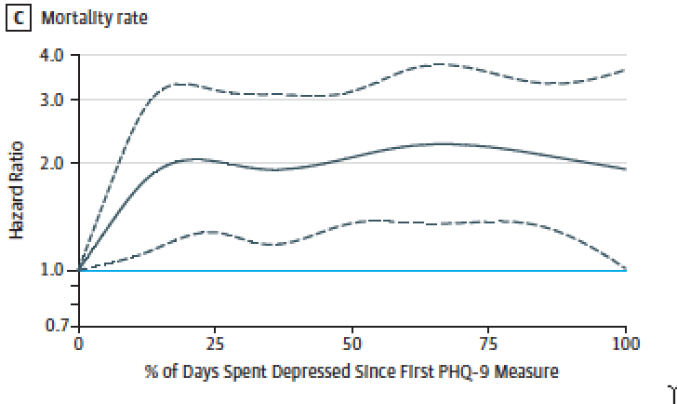
Longer depression yields worse HIV care outcomes
Dose-response relationship between depression length and HIV outcomes
5927 US individuals living with HIV
Each 25% ↑ in days with depression
19% ↑ risk of mortality
Source: Pence et al, JAMA Psychiatry, Feb 21 2018
Notes:
And here we see how - in a cohort of nearly 6,000 individuals, the length of time suffering from depression increases the risk of mortality, in a dose-response fashion.
CLICK

Slide 15
What are the potential pathways between mental illness and HIV health outcomes?
Potential biological mechanisms
Direct effects of depression → immune system
Chronic immune activation, HPA dysregulation
HIV crosses the blood brain barrier → immune activation in the brain and the CNS
Inflammatory proteins → oxidative stress and neuronal injury
Chronic inflammatory response to HIV infection
Elevation in the level of cytokines can lead to a cascade that increases neurotoxicity associated with depression, suicide, and anxiety
Source: Fu et al, Journal of Neuroinflammation, 2011; Lawson et al, Brain, Behavior, and Immunity, 2011; Capuron et al, Biological Psychiatry, 2011; Castillo-Mancilla et al, Clinical Infections Diseases, 2016; Hunt, Clinical Infections Diseases, 2017; Wada et al, AIDS, 2015; Dantzer, Current Topics in Behavioral Neurosciences, 2016; Martinez et al, JAIDS, 2014
Notes:
Potential biological mechanisms
•Direct effects of depression on the immune system with Chronic immune activation and HPA dysregulation
CLICK
•We know that HIV crosses the blood brain barrier leading to immune activation in the brain and the CNS
And inflammatory proteins contribute to oxidative stress and neuronal injury
CLICK
•Chronic inflammatory response includes:
-Elevation in the level of cytokines and TNF-Alpha triggering a chain reaction involving Tryptophan depletion through the activation of IDO enzyme
-And Tryptophan depletion reduces serotonin levels and increases Kynurenine (Kyn) and its metabolites – and some are neurotoxic and associated with depression, suicide, and anxiety.
Now this is not my area of expertise – but I do think this is a very exciting are of inquiry, currently without clear answers – I know that there are several experts in this topic area here at CROI and there are several abstracts and presentations being presented – so I encourage those who are interested to seek these out.
CLICK

Slide 16
The behavioral pathway is clear
Mental health impairment contributes to:
Increased risk behaviors
Delayed (or lack of) HIV testing and care initiation
Poor retention in care
Delayed (or lack of) ART initiation
Poor ART adherence
All lead to non-optimal HIV treatment and thus, poorer health outcomes (for self and for others)
Whatever the pathway, it is clear that we need to address mental health problems if we want to improve health outcomes along the HIV prevention and HIV care continua
Source: Bemelmans M et al, J Int AIDS Soc, 2016; Gonzalez JS et al, JAIDS 2011; Uthman et al, Curr HIV/AIDS Rep, 2014; Mayston et al, AIDS, 2012; Krumme et al, J Epidemiol Community Health, 2014; Musisi et al, Int J STD AIDS, 2014; Antelman et al, JAIDS, 2007; Remien et al, AIDS and Behavior, 2007
Notes:
I can say that the Behavioral pathway between mental illness and HIV health outcomes is pretty clear, in that mental health impairment does contribute to:
CLICK THROUGH (7x): increased risk behaviors, delayed HIV testing and care initiation, poor retention in care, delayed ART initiation, and poor adherence
CLICK
All lead to non-optimal HIV treatment and thus, poorer health outcomes
CLICK
Whatever the pathway, it is clear that we need to address mental health problems if we want to improve health outcomes along the HIV prevention and HIV care continua
CLICK

Slide 17
Benefits of integrating mental health screening and treatment into HIV care
First critical step!
Reduced HIV Risk Behavior
Reduction in HIV Transmission
MH care integration
Improvements in Mediators:
Mental Health Symptoms
Substance Use
Stress and Coping
Treating depression, PTSD & SUD improves adherence
Mental Health Screening
Mental Health Treatment
Improved Adherence to HIV Care and Treatment
Reduced Viral Load
Improved Linkage and Retention
Source: Shim et al, Psychiatric Services, 2012; Sikkema et al, AIDS and Behavior, 2010; Tucker et al, EBioMedicine, 2017; Safren et al, Lancet HIV, 2009
Notes:
Here is another way of picturing a model of care and the benefits of integrating mental health screening and treatment into HIV care
CLICK 3 TIMES
Essentially to say, that if we reduce stress, distress and mental health symptomatology, reduce substance use and sexual risk behaviors, and improve coping – we can improve adherence to care and treatment, thus increasing viral suppression to improve health outcomes for the infected individual and reduce ongoing HIV transmission.
CLICK

Slide 18
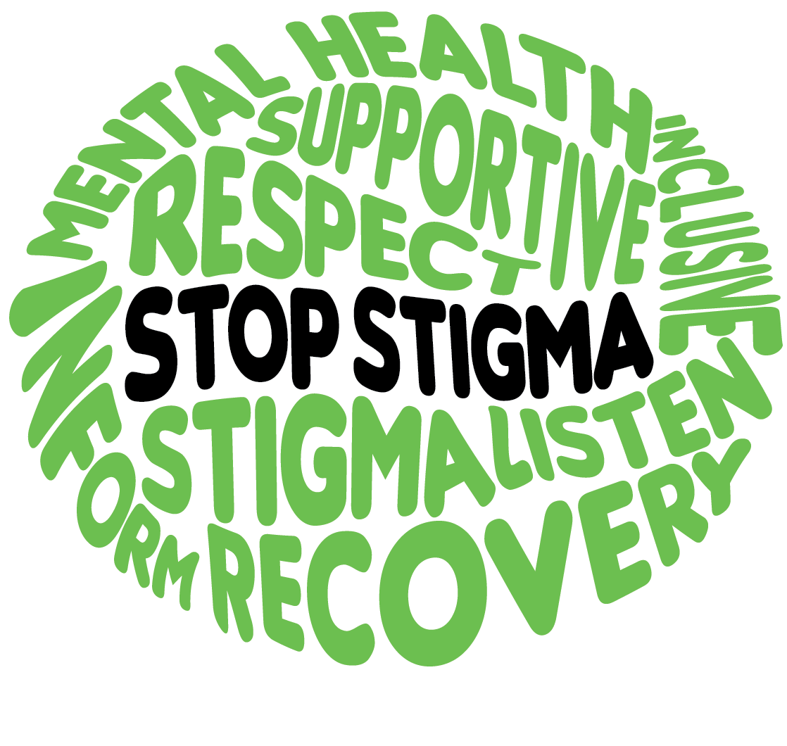
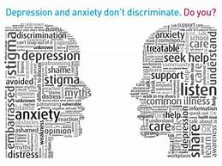
The Reality: mental health treatment gap
The majority of people (70-85%) with mental health problems – across all country settings - do not receive care
Contributors: Human resource shortages, fragmented service delivery models, and lack of capacity for implementation and policy change
Unfortunately, the stigma of mental illness exists at all levels: patients, health care workers, and policy makers
Source: Demyttenaere K et al, JAMA, 2004; Wainberg et al, Current Psychiatry Reports, 2017
Notes:
So, the reality is that we have a significant mental health treatment gap across the globe – with the majority of people not receiving mental health care. We are dealing with the lack of resources and good policy, as well as mental health stigma at all levels.
CLICK

Slide 19
The Challenge of Short vs Long Interventions
There is an increased focus on – and demand for – brief interventions; and there is evidence for success with certain brief interventions
Manualized and able to be administered by a wider range of staff
However, there is also evidence for longer and multi-level interventions generally having greater and longer-lasting benefits
Level of intervention intensity needs to vary depending on the severity of the problem(s) and the level of need for the patient
van Luenen et al, AIDS and Behavior, 2018; Sikkema et al, Global Mental Health, 2015; Sherr et al, Psychology, Health, and Medicine, 2011,
Notes:
CLICK
Because, there is an increased demand for brief interventions; and we do have evidence for success with certain brief interventions. However, there is also evidence for longer and multi-level interventions generally having greater and longer-lasting benefits. Are we willing to invest in adequate mental health treatment?! I think that we all need to recognize that mental health treatment can be complex and the intensity need does vary depending on the severity of the problem(s) and the level of need for the patient.
CLICK

Slide 20
Given the “resource reality,” how do we meet the challenge of addressing the MH need in the context of expanding ART scale-up?
It will look different in different regions, depending on political will, advocacy, and local policy
There is a spectrum of MH impairment and level of need in our populations
Most need minimal intervention; while some need greater intensity of intervention
We need more evidence-based “stepped interventions” with algorithms and tools for determining level of need.
**Cultural sensitivity of the care setting & the service provision**
Notes:
Given the “resource reality,” how do we meet the challenge of addressing the MH need in the context of expanding ART scale-up?
•It will look different in different regions, depending on political will, advocacy, and local policy
•There is a spectrum of MH impairment and level of need in our populations
-Most need minimal intervention; while some need greater intensity of intervention
•We need more algorithms and tools for determining level of need.
CLICK

Slide 21
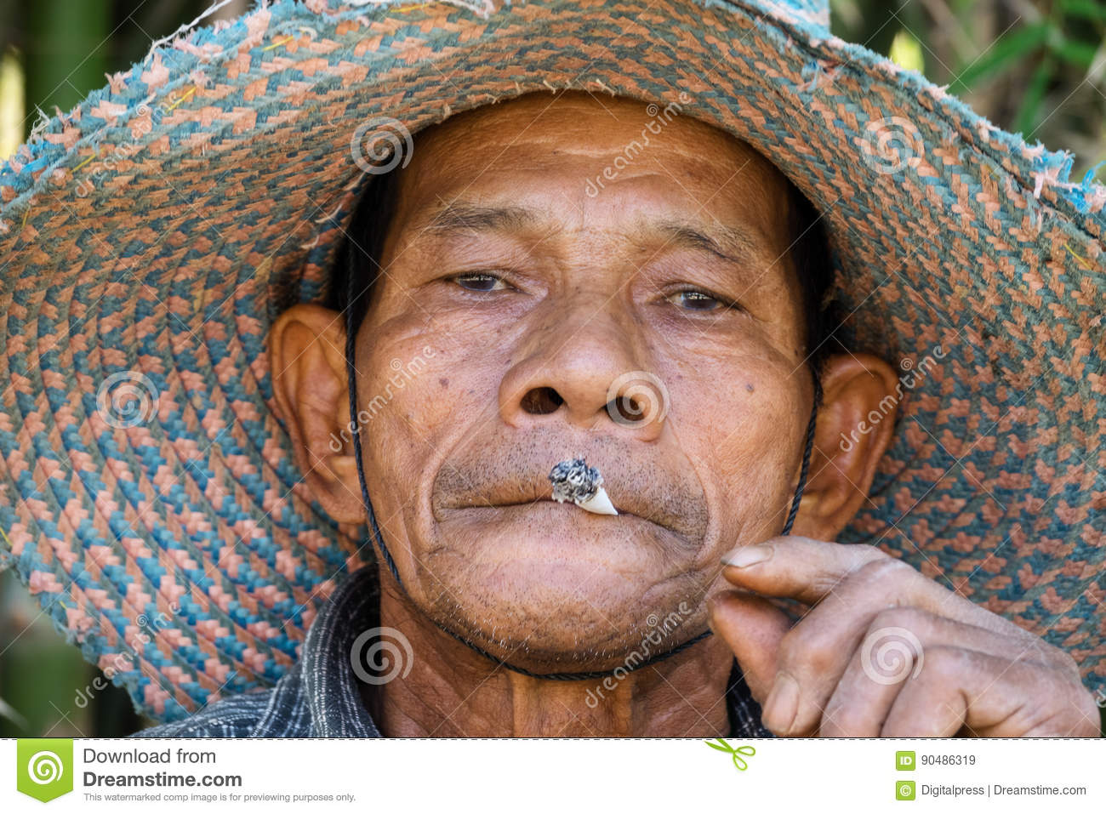
Diversity and Tailoring
An HIV+ mother of 3 in SSA,
suffering from PTSD
A young HIV- Black man in the
southern US kicked out of his
home due to his homosexual orientation, suffering from depression
A 40-year old transgender woman
recently diagnosed with HIV,
suffering from an acute anxiety
disorder
A 28-year old heterosexual man in
Central Asia, coping with opiod addiction
(of unknown HIV status)
Notes:
We need diversity and tailoring of our assessments and our interventions. Whether it be for youth – women – or men. And let’s face it –
CLICK
what is needed for an HIV+ mother of 3 in SSA, suffering from PTSD – will be different from
CLICK
A young HIV- Black man in the southern US kicked out of his home due to his homosexual orientation, suffering from depression
CLICK
Or a 40-year old transgender woman recently diagnosed with HIV, suffering from an acute anxiety disorder
CLICK
Or a 28-year old man of unknown HIV status, in central Asia, coping with opiod addiction
CLICK

Slide 22
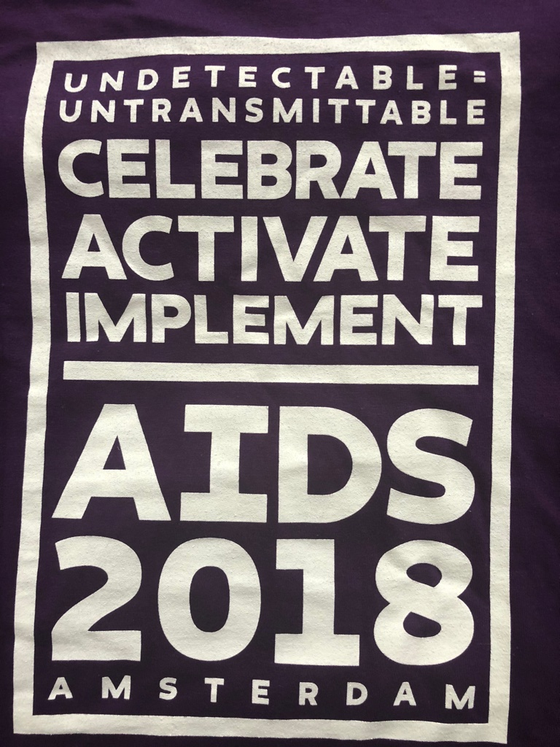
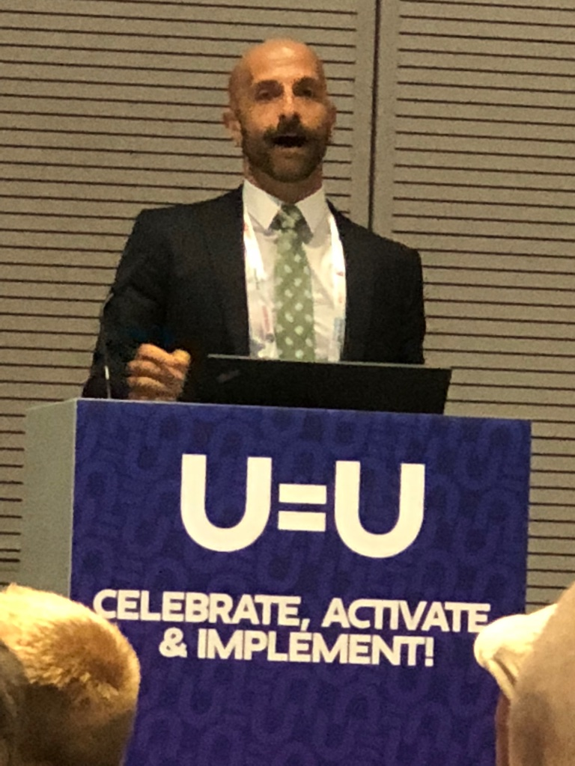
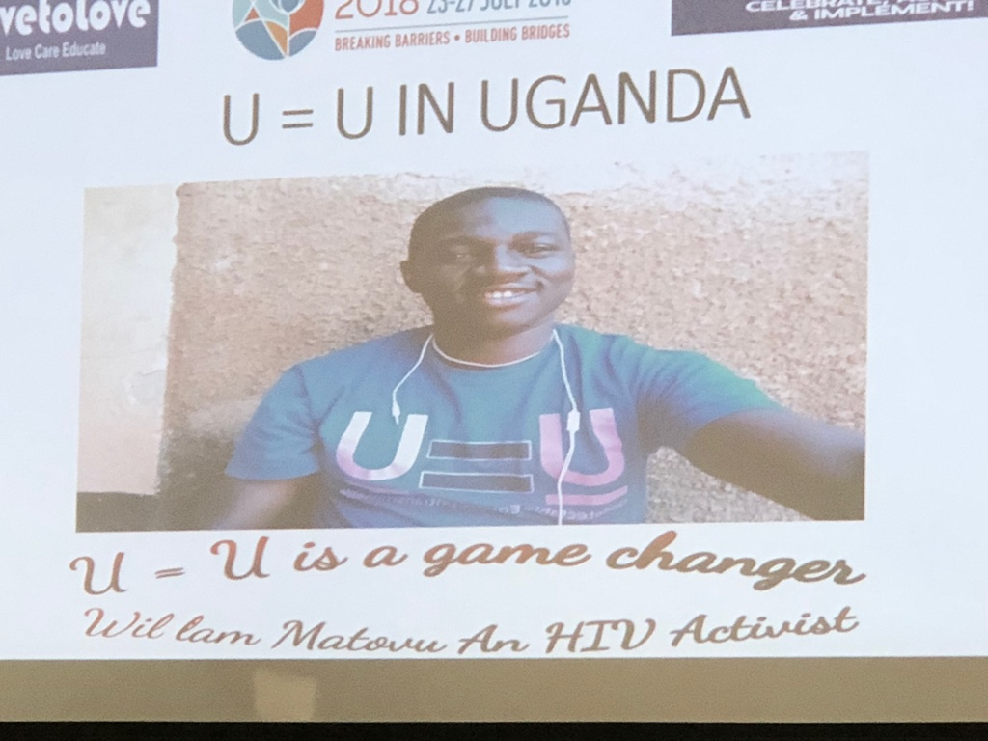
“HIV made me feel unattractive and made me afraid to have sex with my husband, who is HIV
negative. Since I learned about U=U, I have lost 20 pounds, I feel sexy, and my husband and
I are making up for all the times we missed.”
RESILIENCE
“It was only when I learned about U=U that I realized that I have
been living for all these years carrying this heavy weight.
Because I took my meds, I kept on living. But inside I felt like I
was dying. And that made me afraid to get close to anyone else.
The night I heard about U=U, I couldn’t stop crying. It was like
that burden I didn’t even realize I was carrying just fell away.”
“When I learned I was HIV+, I became isolated and depressed.
I went on medication, but knowing I had the virus made me
feel dirty and ashamed. I stayed that way for seven years,
stigmatizing myself. U=U has given me my life back. Knowing
that I can’t infect anyone else has allowed me to forgive myself.”
Notes:
And now for something from a somewhat different perspective. I would propose that the active and growing U=U messaging campaign – which is supported by our science – and emanates from the community is worthy of our attention. Part of the hope and expectation of the campaign is the Building of Hope and the Elimination of HIV Stigma. It seems to me that while not necessarily an intervention to address clinical mental health disorders or serious mental illness – I think that this community-based intervention campaign carries promise for reducing psychological distress.
Here are just a few quotes from people in the community living with HIV, after finding out about U=U:
CLICK – “HIV made me feel unattractive and made me afraid to have sex with my husband, who is HIV negative. Since I learned about U=U, I have lost 20 pounds, I feel sexy, and my husband and I are making up for all the times we missed.”
CLICK – When I learned I was HIV+, I became isolated and depressed…U=U has given me my life back
CLICK – “It was only when I learned about U=U that I realized that I have been living for all these years carrying this heavy weight. Because I took my meds, I kept on living. But inside I felt like I was dying. And that made me afraid to get close to anyone else. The night I heard about U=U, I couldn’t stop crying. It was like that burden I didn’t even realize I was carrying just fell away.”
I think there is some needed research around the potential effectiveness of this campaign for improving treatment initiation and adherence, reducing psychological distress and stigma, as well as improving psychological well-being and functioning.
CLICK

