Slide 1
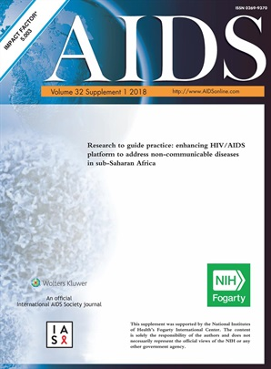
​​​​Research to guide practice: enhancing HIV/AIDS platform to address non-communicable diseases in sub-Saharan Africa
Supplement Launch!
July 1, 2018 - Volume 32 - Supplement 1

Slide 2
Building on the HIV platform: tackling the challenge of noncommunicable diseases among persons living with HIV
Wafaa El-Sadr
Professor of Epidemiology and Professor of Medicine, College of Physicians and Surgeons, Mailman School of Public Health, Columbia University, US
Eric Goosby, Professor, University of California, San Francisco, US

Slide 3
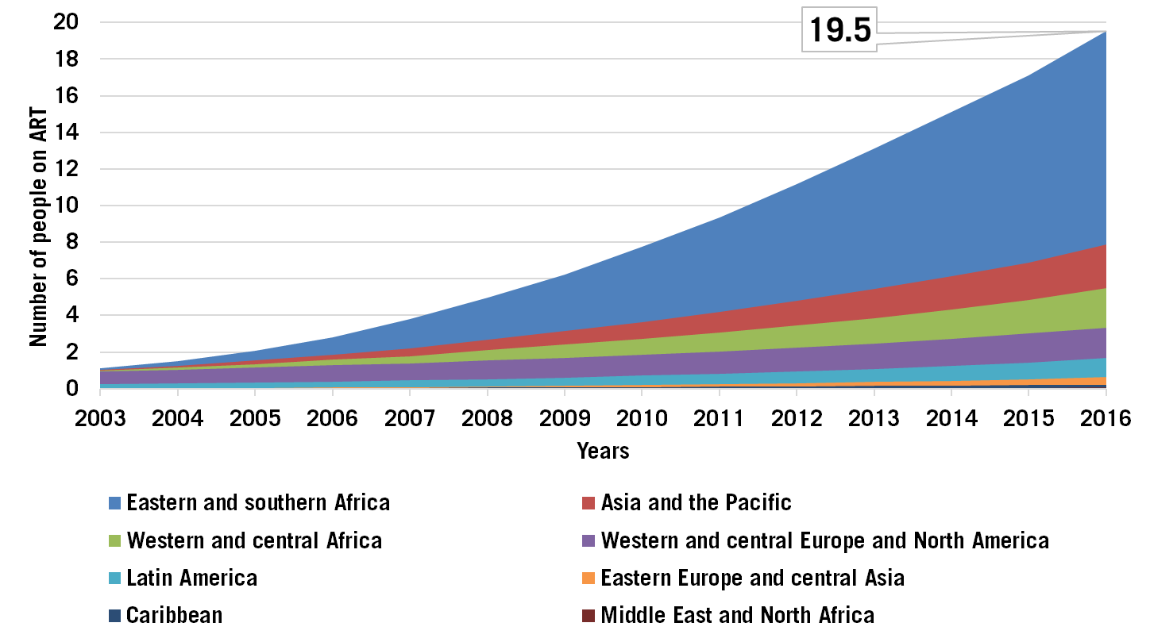
Scale-up of HIV Treatment
20.9
UNAIDS, 2017

Slide 4
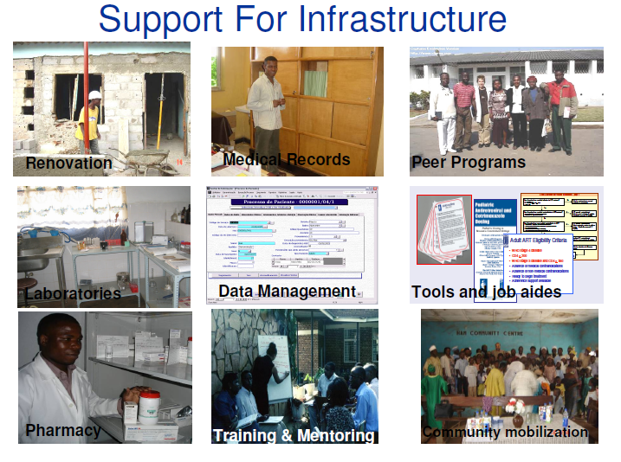
Support for Health Systems

Slide 5
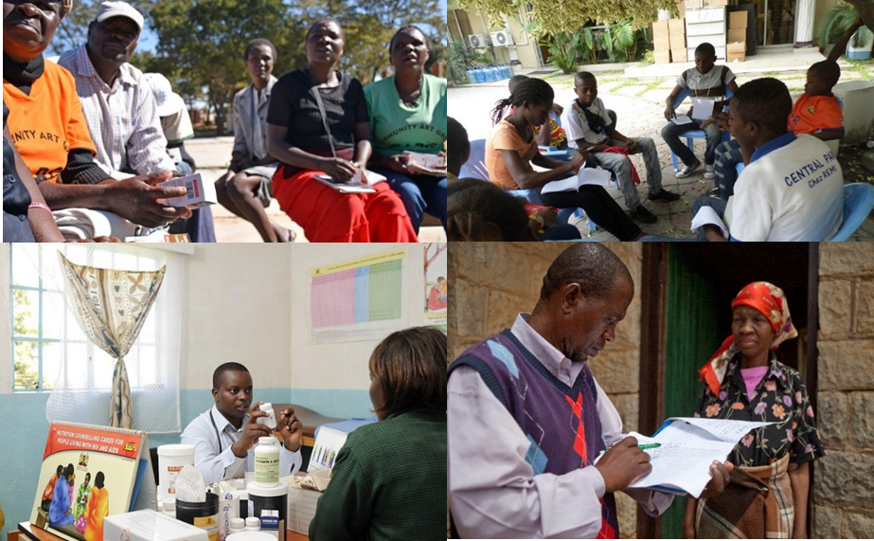
Diverse Models of Care

Slide 6
Global NCD Threat
NCDs responsible for 41 million death each year
  71% of all deaths globally
Each year, 15 million people between 30-69 years of age die from an NCD
  over 85% of these "premature" deaths occur in LMIC
Four conditions account for over 80% of all premature NCD deaths
Disease | Annual Number of Deaths
CVD | 17.9 million
Cancers | 9 million
Respiratory diseases | 3.9 million
Diabetes | 1.6 million
WHO 2018
Notes:
WHO -
Noncommunicable diseases (NCDs) kill 41 million people each year, equivalent to 71% of all deaths globally.
Each year, 15 million people die from a NCD between the ages of 30 and 69 years; over 85% of these "premature" deaths occur in low- and middle-income countries.
Cardiovascular diseases account for most NCD deaths, or 17.9 million people annually, followed by cancers (9.0 million), respiratory diseases (3.9million), and diabetes (1.6 million).
These 4 groups of diseases account for over 80% of all premature NCD deaths.
Tobacco use, physical inactivity, the harmful use of alcohol and unhealthy diets all increase the risk of dying from a NCD.
Detection, screening and treatment of NCDs, as well as palliative care, are key components of the response to NCDs.

Slide 7
Deaths due to NCDs by Region
Global Status Report on Noncommunicable Diseases 2014
Notes:
AFR=African Region, AMR=Region of the Americas, SEAR =South-East Asia Region, EUR=European Region,
EMR=Eastern Mediterranean Region, WPR=Western Pacific Region

Slide 8
PLHIV are at Increased Risk for NCDs
At risk due to prevalence of traditional NCD risk factors^{1,2}
Increased risk of NCDs associated with certain antiretrovirals³
HIV infection associated with increase in inflammatory markers⁴
¹ Rabkin et al. AIDS 2012
² Dalal et al. Int J Epidemiol 2011
³ Deeks et al. Lancet 2013
⁴ Neuhaus et al. J Infect Dis 2010

Slide 9
Common Challenges Faced Across Health Threats
 | HIV/AIDS | Diabetes | CVD | Chronic Lung Disease | Cancers | Mental Health
Demand-side barriers | + | + | + | + | + | +
Inequitable availability | + | + | + | + | + | +
Health worker shortages | ++ | ++ | ++ | ++ | ++ | ++
Lack of adherence support | ++ | ++ | + | + | + | +
Inadequate infrastructure and equipment | + | + | ++ | ++ | ++ | +
Inconstant supplies of drugs and diagnostics | + | + | + | + | + | +
Missing linkage and referral systems | + | + | + | + | + | +
Need for client and community engagement | + | + | + | + | + | +
Stigma and discrimination | ++ | + |  |  | + | ++
Adapted from Rabkin and El-Sadr, Global Public Health, 2011

Slide 10
Leveraging the Lessons of HIV
Diagnosis and enrollment | Identification of risk factors, early diagnosis, opportunistic case-finding, point-of-service diagnostics , standardized diagnostic protocols
Retention and adherence | Appointment systems, defaulter tracking, patient counseling, expert patients, secure medication supply chains, pharmacy support
Multidisciplinary family-focused care | A multidisciplinary team of healthcare providers and community members delivers care in partnership with the patient
Longitudinal monitoring | Health information systems have standardized and easily retrievable data
Linkages and referrals | Links within the health facility (to lab, pharmacy, others), between facilities, and between facility & community
Self management | An informed, motivated patient is an effective manager of his/her own health
Community linkages and partnerships | Need functional partnerships between health facility-based providers and community-based groups that facilitate access to services across the care continuum

Slide 11
Investments in HIV Response Lay Foundation for Quality HIV-NCD Integrated Care
El-Sadr, Goosby, AIDS, 2018

Slide 12
​​​​Research to guide practice: enhancing HIV/AIDS platform to address non-communicable diseases in sub-Saharan Africa
Journal Supplement
AIDS
July 1, 2018 Volume 32 - Supplement 1

Slide 13


Thank you

Slide 14
Panel 1 – HIV/NCD Integration of the Health System
Building on the HIV platform: Tackling the challenge of non-communicable diseases among persons living with HIV Wafaa El-Sadr, Professor of Epidemiology and Professor of Medicine, College of Physicians and Surgeons, Mailman School of Public Health, Columbia University, United States
Models of integration of HIV and non-communicable disease care in Sub-Saharan Africa: Lessons learned and evidence gaps Sonak Pastikia, Perdu University, AMPATH, Indiana, United States
Integrating cardiovascular disease risk factor screening into HIV services in Swaziland: Lessons from an implementation science study Miriam Rabkin, Columbia University, Mailman School of Public Health, United States
Integrating lessons learned from HIV to build reliable supply chain systems for non-communicable disease commodities Robert Ferris, USAID, United States
Opportunities and challenges for evidence-informed HIV/NCD integrated care policies and programs: Lessons from Malawi, South Africa, Swaziland, and Kenya Beatrice Matanje Mwagomba, Kamuzu Central Hospital, Lighthouse, Malawi
Costs and cost-effectiveness of HIV/NCD integration in Africa: From theory to practice Ruanne Barnabas, Associate Professor of Global Health and Medicine at the University of Washington
Moderated Discussion - Wafaa El Sadr Moderator - Panel 1 Speakers

Slide 15
Models of integration of HIV and noncommunicable disease care in sub-Saharan Africa: lessons learned and evidence gaps
Sonak Pastakia
Purdue University, AMPATH, Kenya/US
Njuguna, Benson; Vorkoper, Susan; Patel, Pragna; Reid, Mike J.A.; Vedanthan, Rajesh; Pfaff, Colin; Park, Paul H.; Fischer, Lydia; Laktabai, Jeremiah;

Slide 16
Recurrent Themes
Leveraging Human Resources
Patient Centered Delivery Design
Decentralized Service Provision
Streamlining Service Delivery
Public Private Partnerships

Slide 17
Purpose and Methodology
Purpose
Provide an overview of different peer- reviewed approaches for HIV and NCD integration
Methodology
Structured pubmed search
Interviews with lead authors of selected case studies
Description of representative case studies of integration across the continuum of HIV care

Slide 18
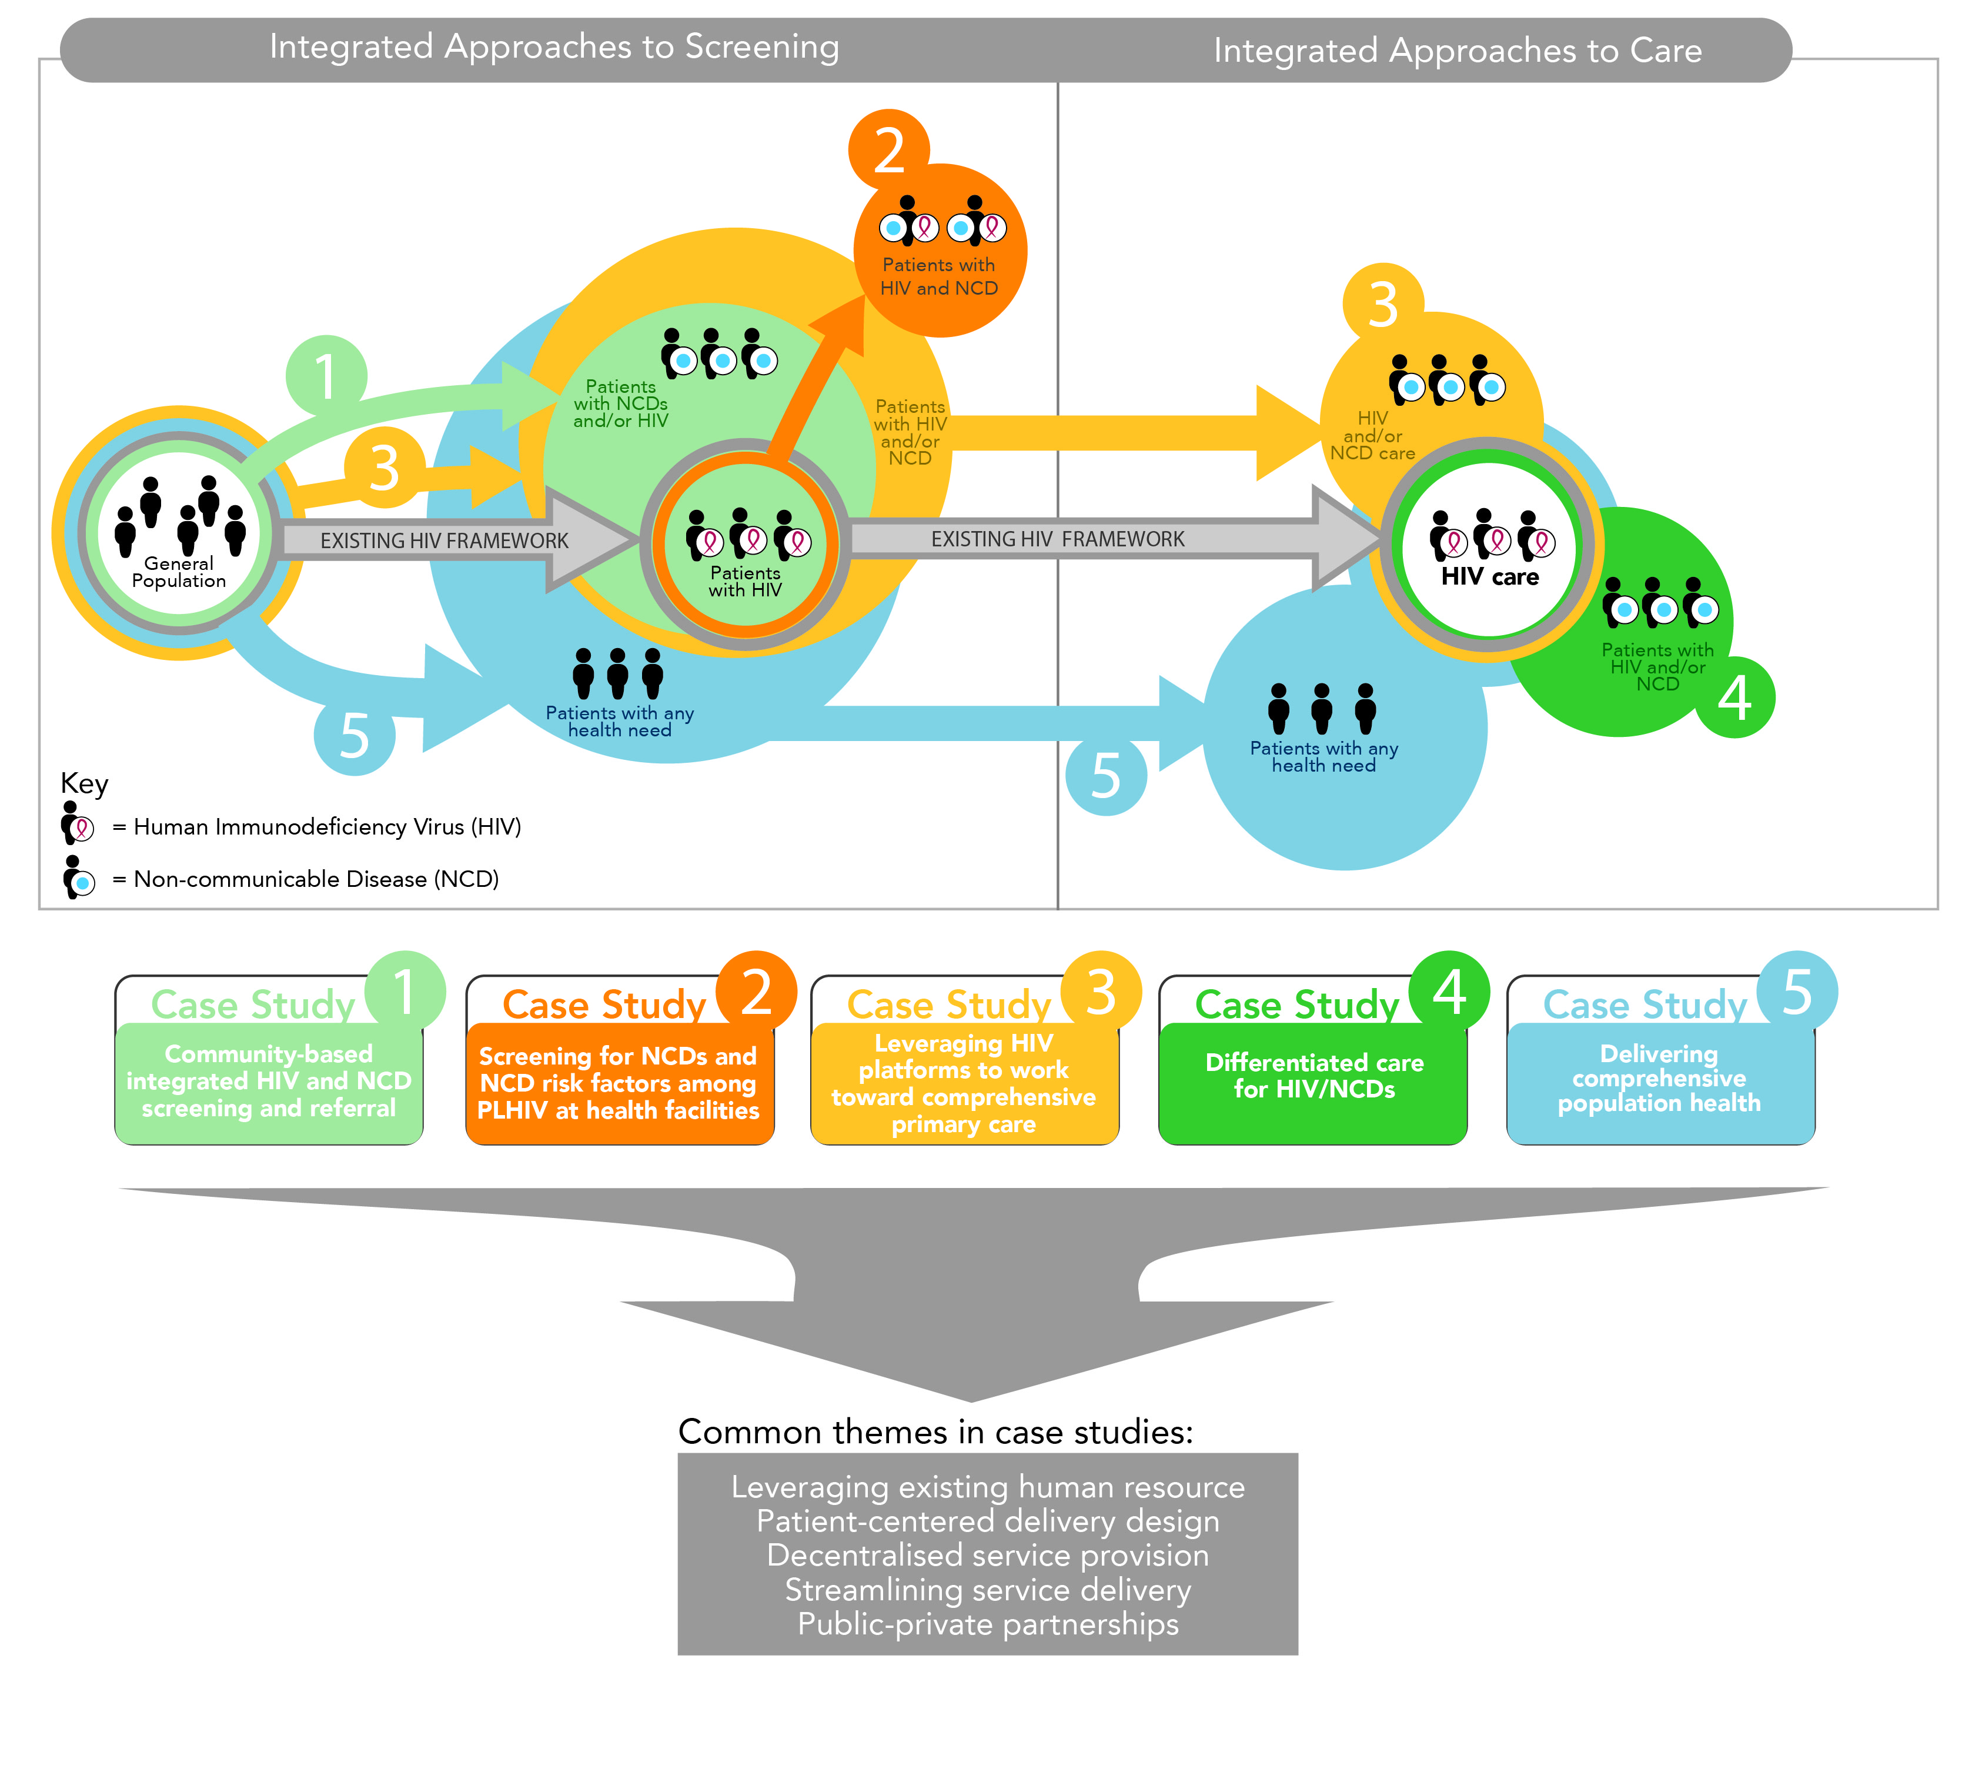
Progressive Iterations of Integrated Care
Continuum of Care

Slide 19
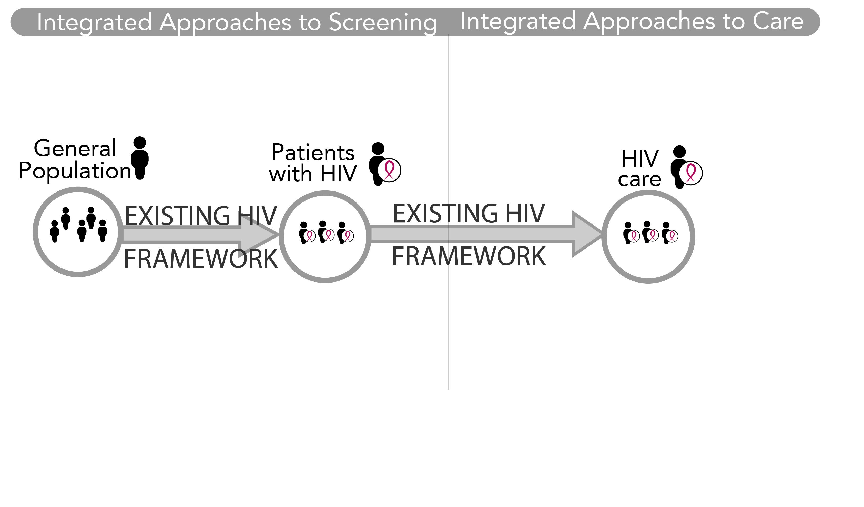
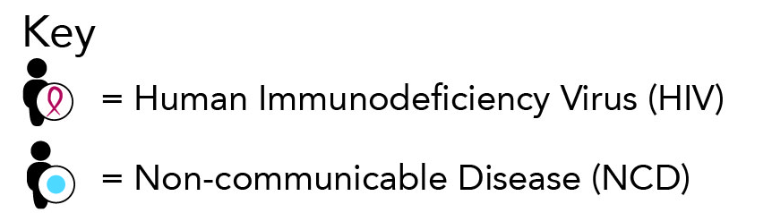

Slide 20
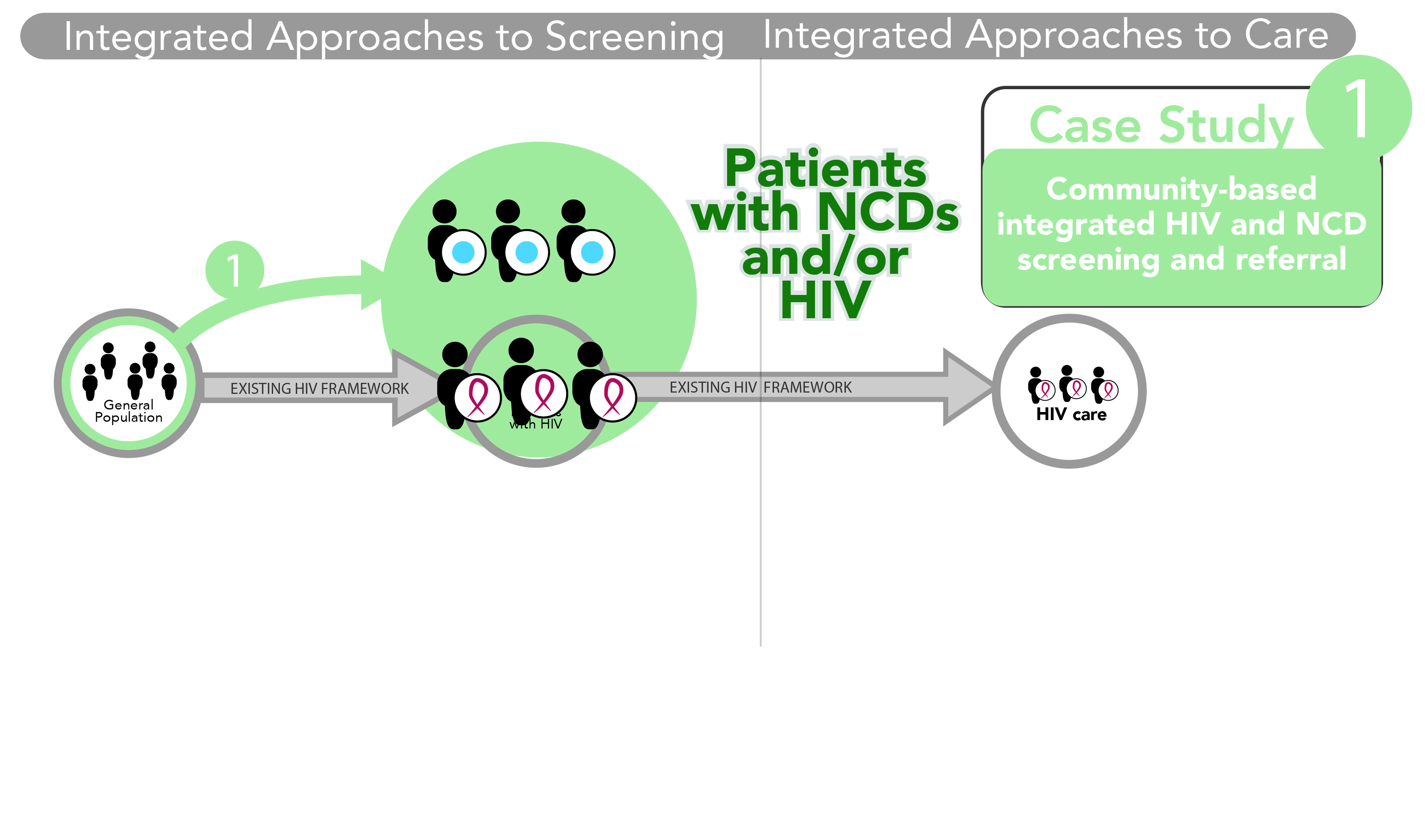

Slide 21
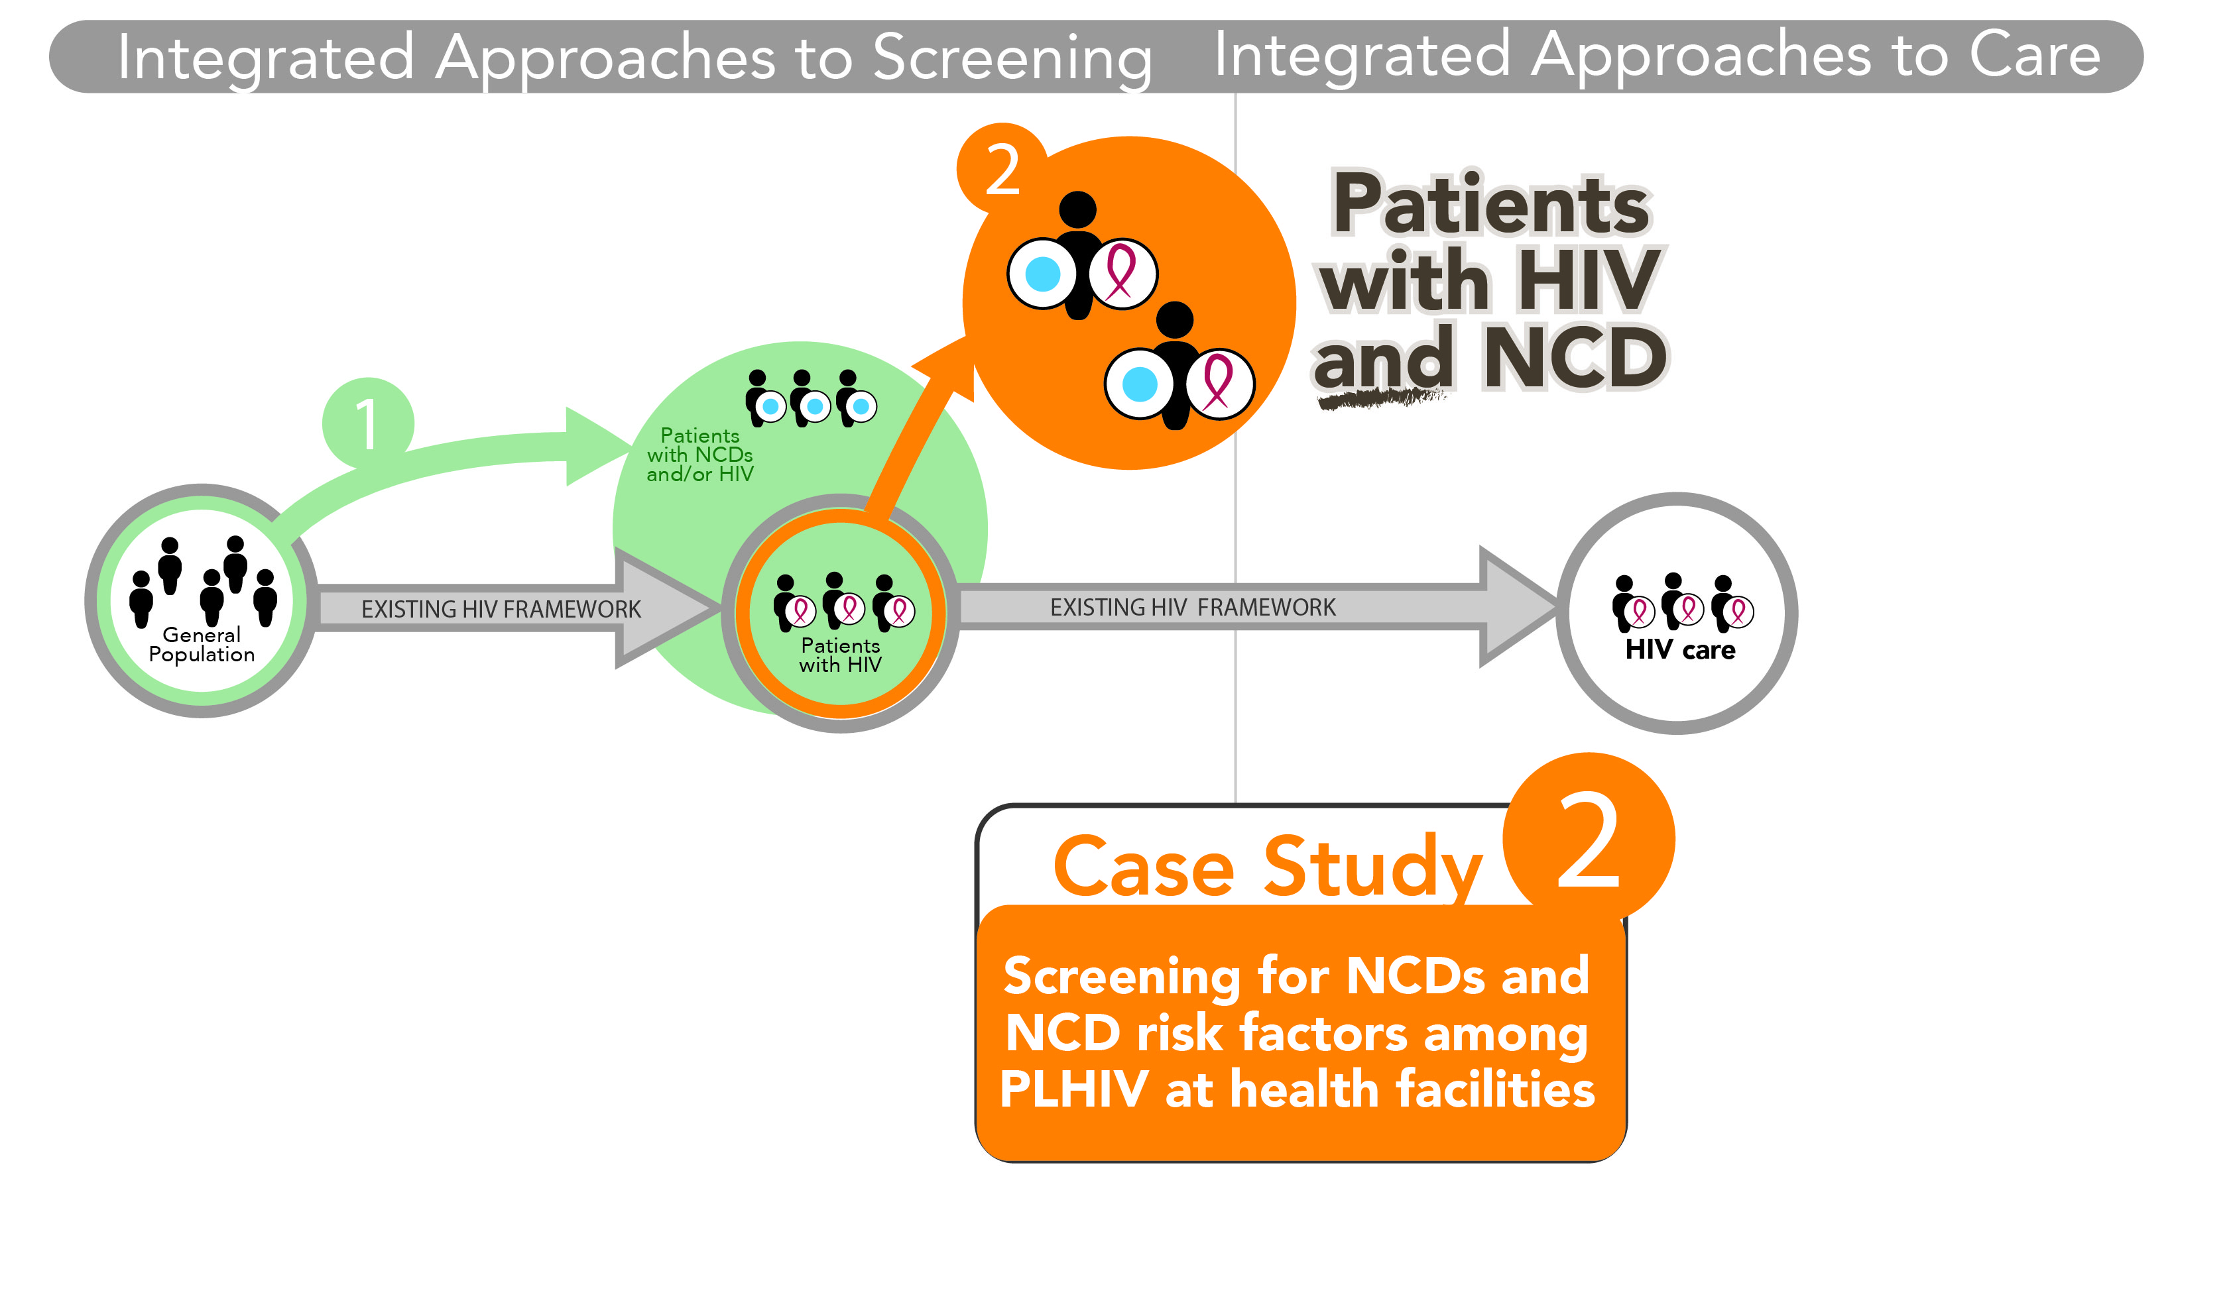

Slide 22
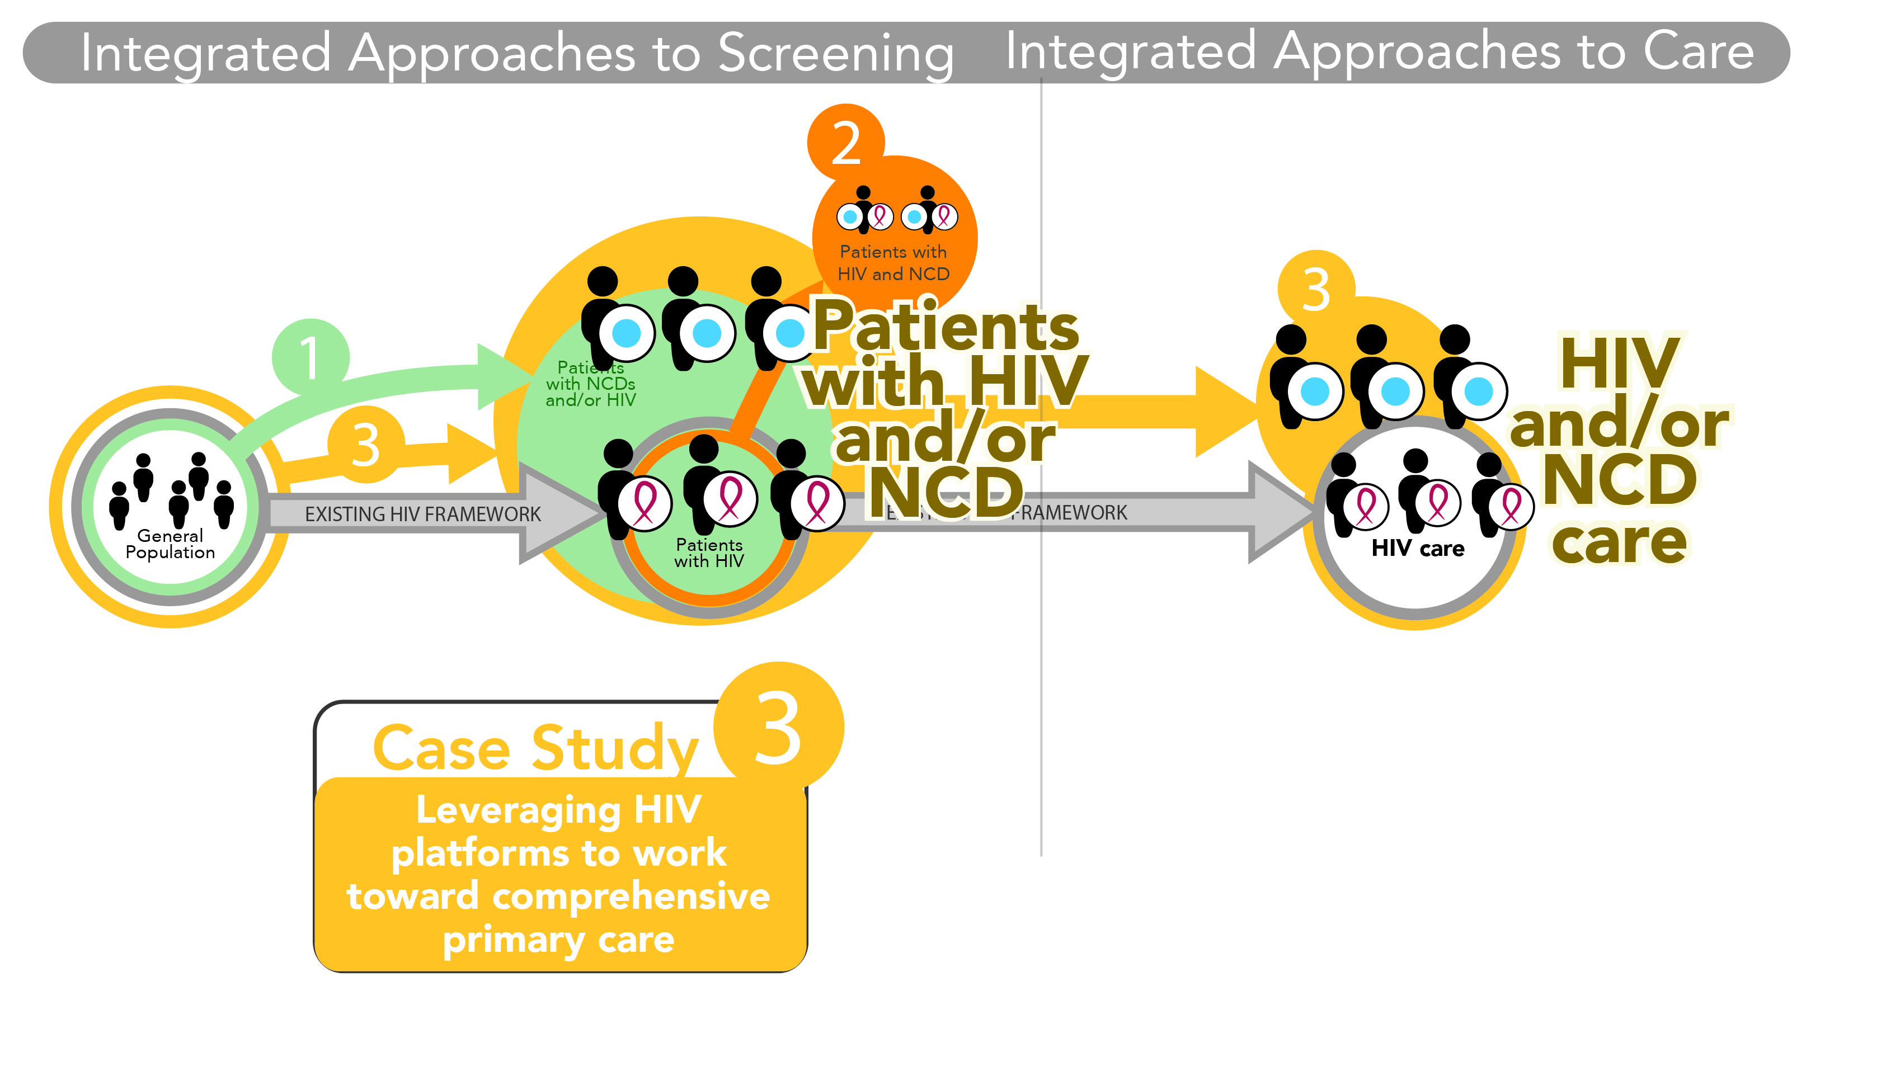

Slide 23
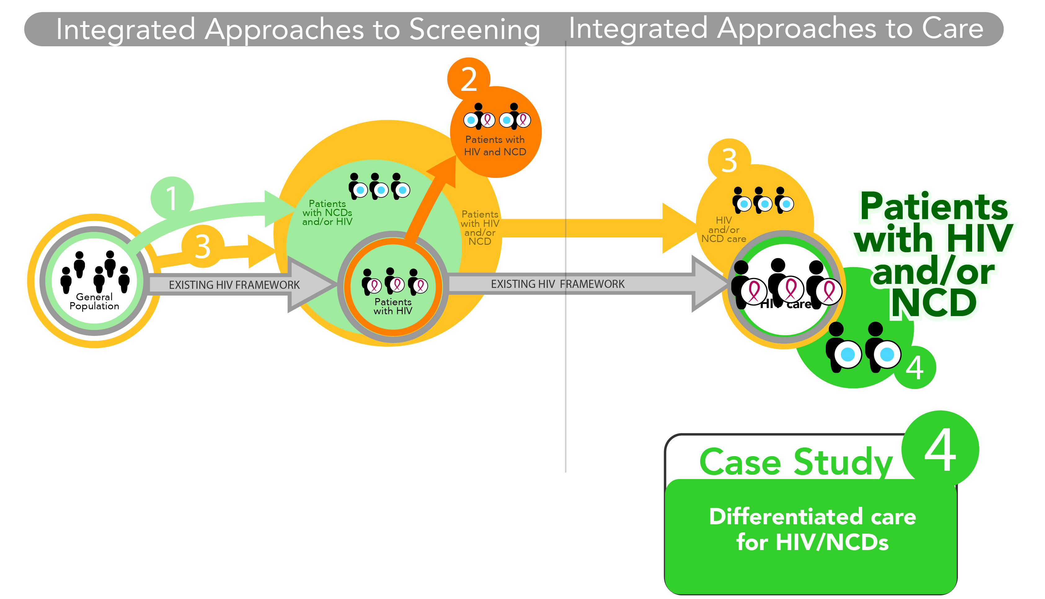

Slide 24
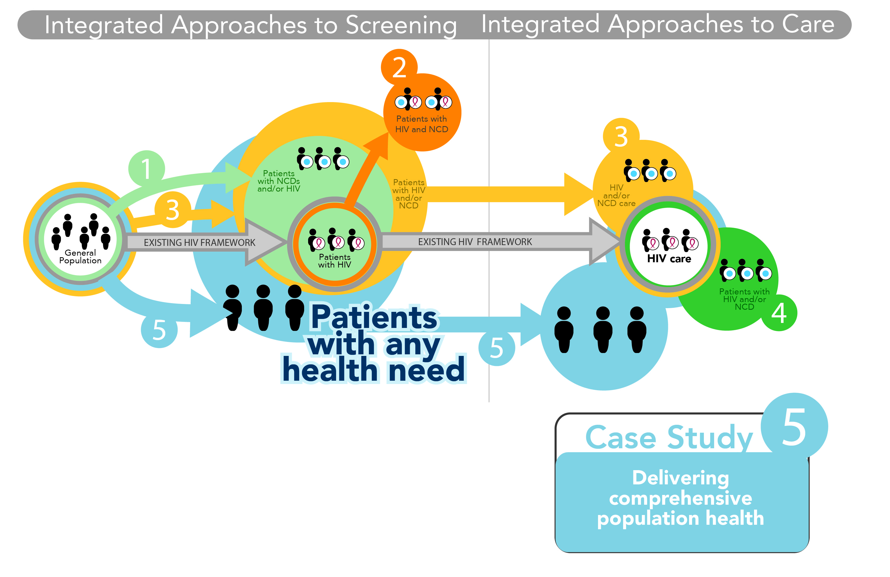

Slide 25
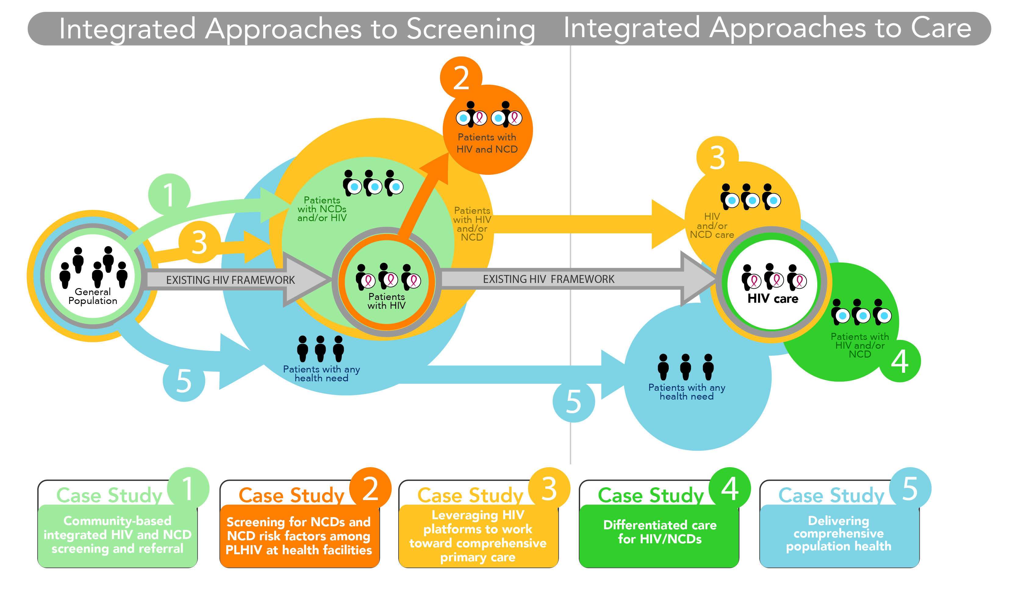

Slide 26
Integrating cardiovascular disease risk factor screening into HIV services in Swaziland: lessons from an implementation science study
Miriam Rabkin
Director for Health Systems Strategies at ICAP Columbia and an Associate Professor of Medicine & Epidemiology at Columbia University's Mailman School of Public Health, NY NY, US
Palma, Anton; McNairy, Margaret L.; Gachuhi, Averie B.; Simelane, Samkelo; Nuwagaba-Biribonwoha, Harriet; Bongomin, Pido; Okello, Velephi J.; Bitchong, Raymond A.; El-Sadr, Wafaa M.

Slide 27
Integrating CVDRF Screening and HIV Care in Eswatini
In Eswatini (formerly Swaziland), the prevalence of both HIV and cardiovascular disease risk factors (CVDRF) is high
CVDRF screening and management are recommended for PLHIV, but not routinely performed
The HEART study explored the feasibility and acceptability of CVDRF screening for PLHIV
HEART included CVDRF screening, time-motion studies, exit interviews, key informant interviews with providers, costing studies; participants with CVDRF were then randomized to two different management strategies
Today’s presentation focuses on findings re: feasibility and yield

Slide 28
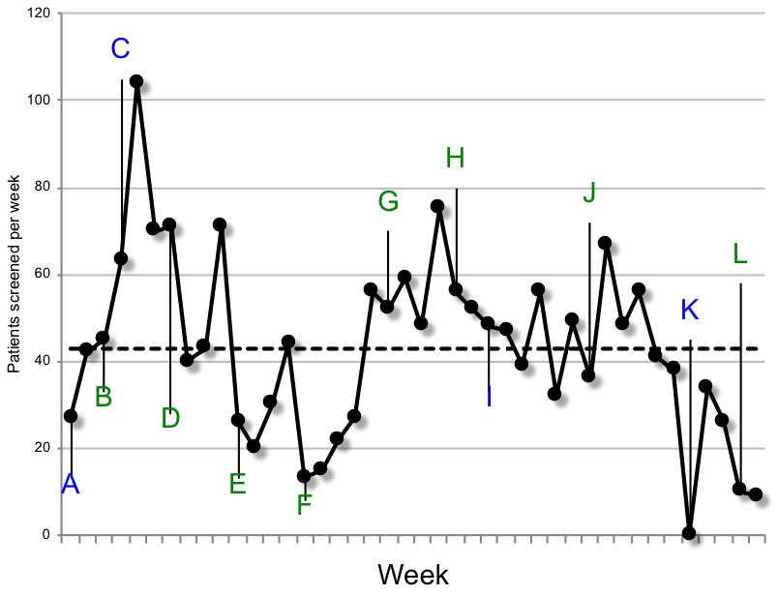
Practical Implementation Barriers
KEY: Timeline of screening activities and clinic events Blue: space, supplies and systems; Green: staffing issues
 | Description
A | 1st screening room opened
B | Additional nurses posted to clinic
C | 2nd screening room opened
D | Kaposi’s Sarcoma clinic opened, staff diverted
E | Baby clinic opened, off-site trainings occurred
F | Clinic short 4 nurses for the holidays
G | Study staff begin to help with screening
H | Clinic nurses reduce screening due to presence of study staff
I | BP machine broke
J | Study staff begin early morning screening and enrollment
K | Point-of-care test kits stock-out
L | No clinic nurses assigned to screening
Mean: 43 screened per week

Slide 29
CVDRF Screening Results (N=1,826)
 | Total | Age (years) |  |  | Sex
Characteristic |  | 40-49 | 50-59 | 60+ | Male | Female
Total, n (%) | 1,826 (100%) | 1,121 (61%) | 462 (25%) | 238 (13%) | 701 (38%) | 1,125 (62%)
At least 1 CVD risk factor | 39% | 32% | 47% | 55% | 45% | 35%
Hypertension (BP > 140/90 mmHg) | 25% | 19% | 31% | 42% | 21% | 27%
Hypercholesterolemia (non-fasting TC > 6.2 mmol/L, POC) | 8% | 6% | 11% | 11% | 6% | 9%
Diabetes (HbA1c > 6.5%, POC) | 5% | 3% | 8% | 10% | 4% | 5%
Smoking in past year (self-report) | 9% | 9% | 10% | 8% | 22% | 2%
Hypertensive emergency (SBP >180 or DBP >110) | 2% | 1% | 3% | 3% | 2% | 2%
≥ 10% 10-year CVD risk | 3% | 1% | 4% | 10% | 3% | 3%

Slide 30
Conclusions re: Screening for CVDRF
High yield; 39% of patients had at least one risk factor
Appreciated by patients and staff
Multiple practical barriers even with point-of-care diagnostics funded by study and provided free of cost
  Space / Staff / Supplies / Systems
Careful planning is required in order to implement integrated HIV/NCD services at scale
This research was supported by the United States President’s Emergency Plan for AIDS Relief (PEPFAR) through the U.S. Centers for Disease Control and Prevention (CDC) under the terms of Cooperative Agreement Number R01AI100059 and by the National Institute of Allergy and Infectious Diseases under grant #T32AI114398. The contents are solely the responsibility of ICAP and do not necessarily reflect the views of the United States Government.

Slide 31
Building reliable supply chains for noncommunicable disease commodities: lessons learned from HIV and evidence needs
Robert Ferris
Chief , HIV Prevention, Care and Treatment Division at the US Agency for International Development (USAID), Washington DC, US
Pastakia, Sonak D.; Tran, Dan N.; Manji, Imran; Wells, Cassia; Kinderknecht, Kyle

Slide 32











End-to-End
Global Supply Chain
Orders
Orders
Registration & Waivers
Clinic
District
Warehouse
Customs
Medicine
Regional Distribution
Center
Central
Medical
Store
Medicine
Medicine
Medicine
Supplier
Medicine

Slide 33
Challenges & Opportunities
Resource mobilization
  Domestic and international
  Infrastructure and human resources
Resource utilization
  Streamlining procurement processes
  Maintaining system integrity
  Capitalizing on data

Slide 34
Moving Forward
Innovative financing
Novel recruitment and training strategies
Better, cost-effective warehouse and transport designs
Simplified standards and technologies across platforms
Data to the site level to improve forecasting and tracking

Slide 35
Opportunities and challenges for evidence-informed HIV-noncommunicable disease integrated care policies and programs: lessons from Malawi, South Africa, Swaziland and Kenya
Beatrice L. Matanje Mwagomba
Medical Director at Lighthouse Trust in Lilongwe, Malawi ,PhD Fellow, Global Health Implementation Program, University of St Andrews, Scotland and College of Medicine, Malawi
Ameh, Soter; Bongomin, Pido; Juma, Pamela A.; MacKenzie, Rachel K.; Kyobutungi, Catherine; Lukhele, Nomthandazo; Mwangi, Kibachio Joseph Muiruri; Amberbir, Alemayehu; Klipstein-Grobusch, Kerstin; Gómez-Olivé, Francesc Xavier; Berman, Josh

Slide 36
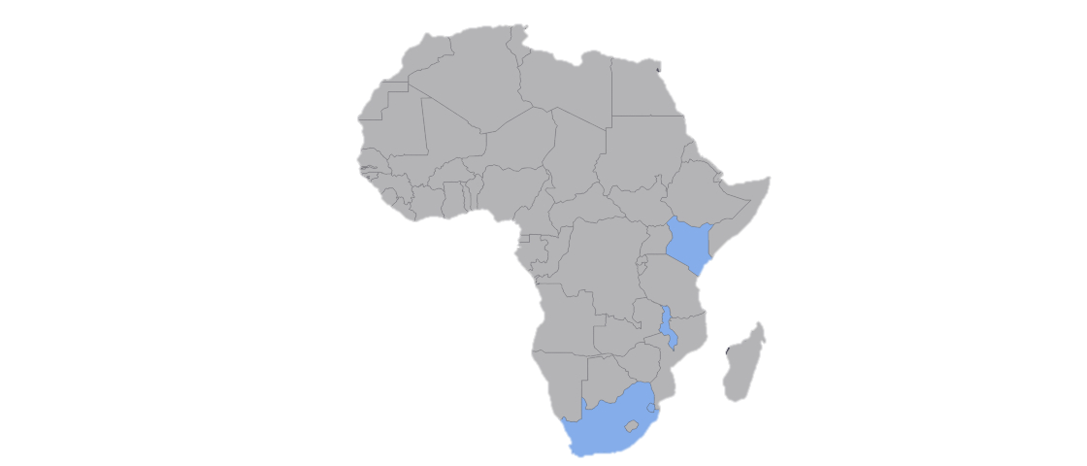
CONTEXT: Integrated HIV-NCD Programs in SSA
Malawi | 2007: Integrated Cervical cancer-HIV screening 2016: national ART guidelines include hypertension screening Only Pilot integrated HIV-NDC management; scale-up awaiting lessons from 4 integration model projects (LHT, DI, PIH, DREAM)
Kenya | Kenya Health Policy (2014 – 2030) promotes integration of NCD prevention into existing infectious disease programs Current ART guidelines include screening and management of hypertension, DM & depression as “Standard Package of Care” for PLHIV; pilot projects by Healthy Heart Africa (PATH) & MSF No Scale-up of integrated programs yet
South Africa | 2011: national-level pilot of Integrated Chronic Disease Management (ICDM) model, includes both CDs (HIV & TB) and NCDs with health promotion, screening & management - health systems strengthening and reform focused Phased scale-up of integrated programs in provinces; not yet nation-wide
Swaziland | Integrated screening, treatment & referral for diabetes, hypertension & cervical cancer into HIV programs; Adapted HIV chronic care models for NCD management & piloted in 6 HFs, in 2014, supported by ICAP and CDC No Scale-up of integrated models yet
Notes:
Location of the 4 countries used with their policy availability or process stages

Slide 37
Over-aching challenges and opportunities for
HIV-NCD Integrated Policies in SSA
1. HIV-NCD integration evidence gaps | Inadequate local evidence available to support HIV-NCD integration Further evidence needed on: supply chains and human resources for effective HIV-NCD integration Costs and cost-effectiveness studies Integration effect on HIV stigma
2. Packaging and disseminating the evidence | Need for congruent research, policy plans, and communication across different audiences, government departments, and sectors to break down health system silos
3. Funding for development process and evaluation of policies | Integrated HIV/NCD pilot program implementation, evaluation & scale up require adequate funding (only SA had national level funding) Large scale international funders can facilitate integration process that offer national MOHs capacity to start pilot research and programming process implementation & evaluation Can be followed by national fiscal and programmatic plans
4. Health system challenges for implementation programs | Continuous critical Health system constraints: infrastructure, human resources, medical supply chain management, and program-monitoring systems Combining the HIV, NCD client cohorts perceived as a threat to gains made in HIV programs Existing infrastructure and personnel that have supported unilateral HIV programs can be leveraged to build NCD care capacity.
Notes:
Chart/flow diagram or side by side table with opportunities and challenges for HIV-NCD integrated policies in SSA

Slide 38
Conclusion and Recommendations
Though several challenges span across the 4 countries, there are opportunities to develop evidence-informed HIV-NCD integrated care policies in SSA
Coordinated planning and lessons learned from pilot programs can support larger scale HIV-NCD integration planning and implementation
Leveraging successful SSA HIV programs with proven monitoring and evaluation systems can also inform HIV-NCD integration program monitoring
Highlighted Best Practices for HIV-NCD Integration Policy Development
  Use of integrated knowledge translation methodologies which engage key stakeholders
  National level pilot HIV-NCD integration programs
  Early development of HIV-NCD integration monitoring and evaluation systems
Funders and health development partners ought to support Ministries of Health’ interventions by providing funding schemes and technical assistance
Notes:
Conclusion and Recommendations

Slide 39
Acknowledgement - NIH FIC, USA; all authors & their institutions:
Lighthouse Trust, Kamuzu Central Hospital, Malawi | African Population and Health Research Center (APHRC), Nairobi, Kenya
College of Medicine, University of Malawi, Malawi | Ministry of Health, Swaziland
School of Medicine, University of St Andrews, Scotland, UK | Division of Non-communicable Diseases, Ministry of Health, Kenya
Dignitas International (DI), Zomba, Malawi & DI Toronto, Canada | Julius Center for Health Sciences and Primary Care, University Medical Center Utrecht, The Netherlands.­­­­­­
College of Medical Sciences, University of Calabar, Nigeria | The International Network for the Demographic Evaluation of Populations and Their Health in Developing Countries (INDEPTH) Accra, Ghana.
University of Witwatersrand Rural Public Health and Health Transitions Research Unit (Agincourt) & Wits School of Public Health (J0hannesburg), South Africa. | Department of Global Health and Population, Harvard T.H. Chan School of Public Health, USA
ICAP, Columbia University, Swaziland | Institute of Global Health; University of Geneva, Switzerland

Slide 40
Costs and cost-effectiveness of HIV/noncommunicable disease integration in Africa: from theory to practice
Ruanne V. Barnabas
Associate Professor of Global Health and Medicine at the University of Washington
Nugent, Rachel; Golovaty, Ilya; Osetinsky, Brianna; Roberts, D. Allen; Bisson, Cristina; Courtney, Lauren; Patel, Pragna; Yonga, Gerald; Watkins, David

Slide 41
Background
Integrated HIV/NCD care has the potential to cost-effectively reduce morbidity and mortality
Potential for cost savings – unit costs may be reduced with increased demand and scale-up of integration – but overall costs could also increase
Cost data are needed for budget impact, affordability, and sustainability analyses
The change in cost must be compared with the change in health to estimate cost-effectiveness
These analyses would support the economic case for HIV/NCD integration
We reviewed economic evidence and assessed the role of health economics in decision making for HIV/NCD integration

Slide 42
Systematic Review
Methods
  Reviewed the economic evidence for integrated HIV/NCD strategies in LMIC (PRISMA and Cochrane guidelines)
  Abstracted cost data → narrative synthesis
Results
  896 abstracts → 12 reports (9 studies in SSA)
  Current evidence limited to screening
  Cervical cancer screening (n=5), cardiometabolic screening (4), depression (1)
  No studies evaluated the costs of integrating NCD care (treatment, adherence, retention)
  Few estimates of cost-effectiveness (CCx)
  NCD screening increased costs by 6-30% (USD 1.14 - 12.31) dependent on the intervention
  15%-20% decrease in number of participants screened per day

Slide 43
Qualitative Interviews
Methods
  11 IDIs with ministry of health (n=2), donors (2), in-country implementers (2), policy advisor (1), and academics (4)
  Settings: Kenya, Malawi, South Africa, Swaziland, and globally
  Understanding about the economic aspects of HIV/NCD integration
Results
  Most informants expected integrated care to be cost-effective
  Challenges identified: vertical funding streams, drug procurement for NCD management, and M&E
  Identified the need to match the integration model with the setting and careful budget planning
  Cost data were necessary to inform HIV/NCD integration decisions

Slide 44
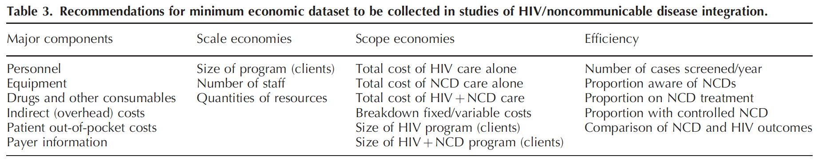
Discussion and next steps
Recommendations for minimum economic dataset
Integrated HIV/NCD care has many potential benefits but the economic justification is unproven
We need better evidence on the cost, cost-effectiveness, and fiscal sustainability of integrated programs to justify this approach in limited-resource countries
Four major research needs:
  Additional economic evaluations including CEAs
  Better longitudinal data on NCD risk and outcomes in PLHIV
  Studies are needed that assess the interactions of multiple NCDs
  Methods, data sources, and assumptions of the HIV and NCD economic modeling communities would benefit from harmonization and standardization

Slide 45
Panel 1 Discussion – Wafaa El-Sadr Moderator
Sonak Pastakia
Miriam Rabkin
Robert Ferris
Beatrice L. Matanje Mwagomba
Ruanne V. Barnabas

Slide 46
Panel 2 – The Science of HIV/NCD Integration
Non-communicable Diseases among HIV-infected persons in low- and middle-income countries: A systematic review and meta-analysis Pragna Patel, Centers for Disease Control and Prevention, United States
From HIV Prevention to non-communicable disease health promotion efforts in sub-Saharan Africa: A narrative review Gerald Yonga, University of Nairobi, Kenya
Implementation science for integration of HIV and non-communicable disease services in sub-Saharan Africa: A systematic review Christopher Kemp, University of Washington, United States
Building on the HIV chronic care platform to address non-communicable diseases in Sub-Saharan Africa: A research agenda Linda E. Kupfer, US National Institutes of Health, United States
Global partnerships to support NCD care in LMICs: Lessons from HIV/AIDS Deborah Von Zinkernagel, UNAIDS, Switzerland
Moderated Discussion – Eric Goosby, UCSF, Moderator - Panel 2 Speakers

Slide 47
Noncommunicable diseases among HIV-infected persons in low-income and middle-income countries: a systematic review and meta-analysis
Pragna Patel
Center for Global Health, Division of HIV & TB, HIV Prevention Branch, US Center for Disease Control and Prevention, Atlanta, Georgia, US
Rose, Charles E.; Collins, Pamela Y.; Nuche-Berenguer, Bernardo; Sahasrabuddhe, Vikrant V.; Peprah, Emmanuel; Vorkoper, Susan; Pastakia, Sonak D.; Rausch, Dianne; Levitt, Naomi S.; for the NIH HIV/NCD Project Disease Condition Technical Operating Group

Slide 48
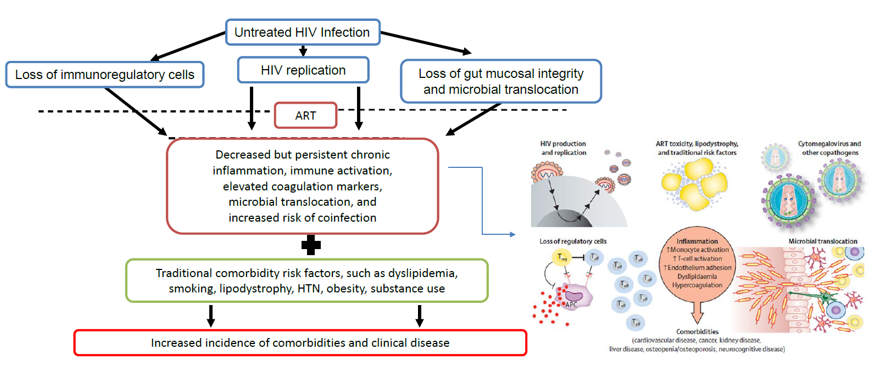
Chronic Inflammation and Increased Risk for Comorbidities
in HIV-Positive Persons
Deeks SG. Annu Rev Med. 2011;62:141-155; Deeks SG et al. Lancet 2013; 382:1525-33

Slide 49
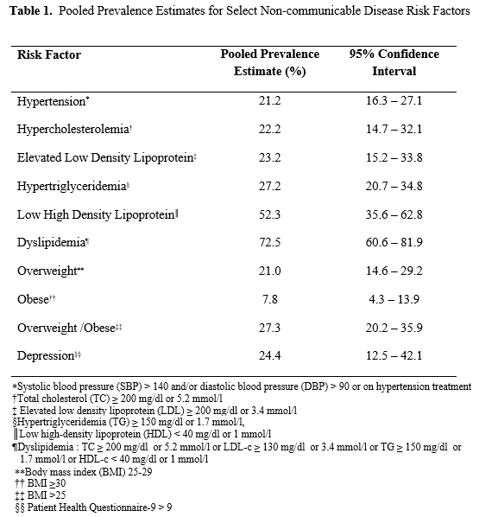
Methods
Results
Examined peer-reviewed literature between January 1, 2010 and December 31, 2016 for papers on HIV and 4 NCDs
6143 abstracts reviewed, from which 377 articles were examined
141 papers were included in the summary
57 were selected for quantitative analysis
Estimates were not generated for invasive cervical cancer and diabetes due to sparse data and heterogeneity of the studies
Invasive cervical cancer: 1.3-1.7%
Diabetes: 1.3-18%

Slide 50
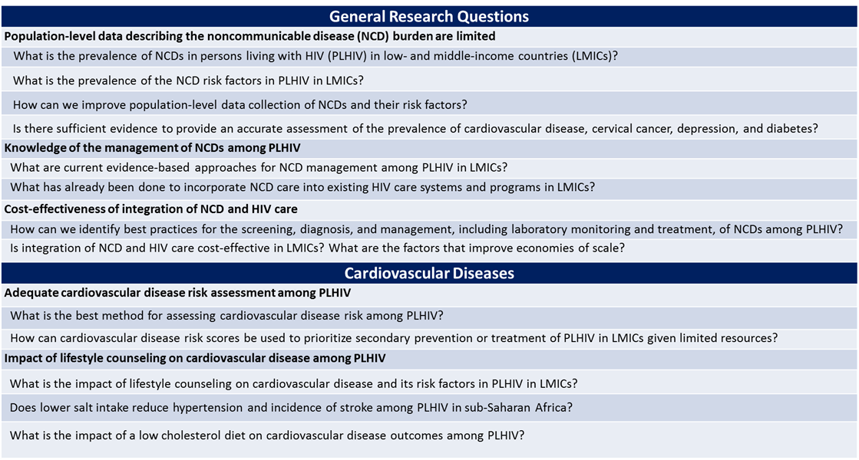

SAMPLE CONTENT for Side By Side Display
Research Agenda
Bullet
  Sub bullet
  Customize chart colors to match your center’s palette
  HINT: Use the eyedropper tool in the FILL menu to sample the colors in the color bar at the bottom of the page

Slide 51
From HIV prevention to non-communicable disease health promotion efforts in sub-Saharan Africa: A Narrative Review
Professor Gerald Yonga
University of Nairobi, Nairobi, Kenya
Kenneth Juma, Reid, Michael; Roy, Monika; Vorkoper, Susan; Temu, Tecla M.; Levitt, Naomi S.; Oladepo, Oladimeji; Zakus, David

Slide 52
Aims and Methods of Review
To synthesize literature on NCD and HIV, that addresses behavior change communication (BCC) interventions in SSA
Reviewed 20 SSA-based studies; focused on NCD BCC interventions, among persons living with HIV (PLHIV), and in general population
In addition;
  Applied RE-AIM framework to assess potential public health impact
  Solicited expert opinions from 10 key informants in 5 SSA

Slide 53
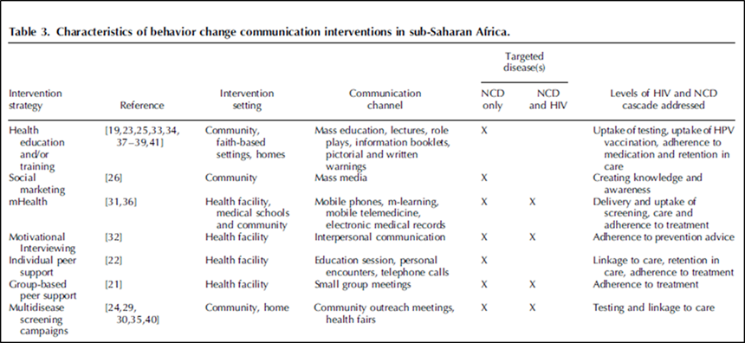
Results
Of the 20 articles, 4 were on dual HIV/NCDs; only 4 specified a behavior change model/theory
BCC interventions targeted multiple parts of disease continuum, from prevention → to treatment/adherence
BCC strategies (health education, social marketing, motivational interviewing, mobile health, and peer support)
Few studies addressed >1 dimension of RE-AIM
Opinions from key informants supported feasibility of integrating HIV and NCD BCC interventions

Slide 54
Discussions and conclusions
In SSA, BCC interventions extensively used in HIV epidemic; are increasingly used in NCD as well
Review highlights BCC strategies utilized for NCD, some e.g mhealth showing feasibility and early effectiveness
Few studies integrated HIV and NCDs
Integrated NCD/HIV BCC could improve effectiveness of preventive services, access, and demand
Public health impact of such approaches unknown, REAIM aspects poorly characterized
Although data on integration of HIV/NCD health promotion efforts is limited, there is a fair amount of evidence to support the feasibility of integration,
Strategies employed in HIV global response (including peer support and mHealth) provide the initial experience, tools, and platforms useful in planning NCD health promotion programs.
Need for research addressing best ways to scale NCD health promotion in high HIV burden settings and characterize important implementation science dimensions

Slide 55
Implementation science for integration of HIV and non-communicable disease services in sub-Saharan Africa: a systematic review
Christopher G. Kemp
Department of Global Health, University of Washington, Seattle, Washington US
Weiner, Bryan J.; Sherr, Kenneth H.; Kupfer, Linda E.; Cherutich, Peter K.; Wilson, David; Geng, Elvin H.; Wasserheit, Judith N.

Slide 56
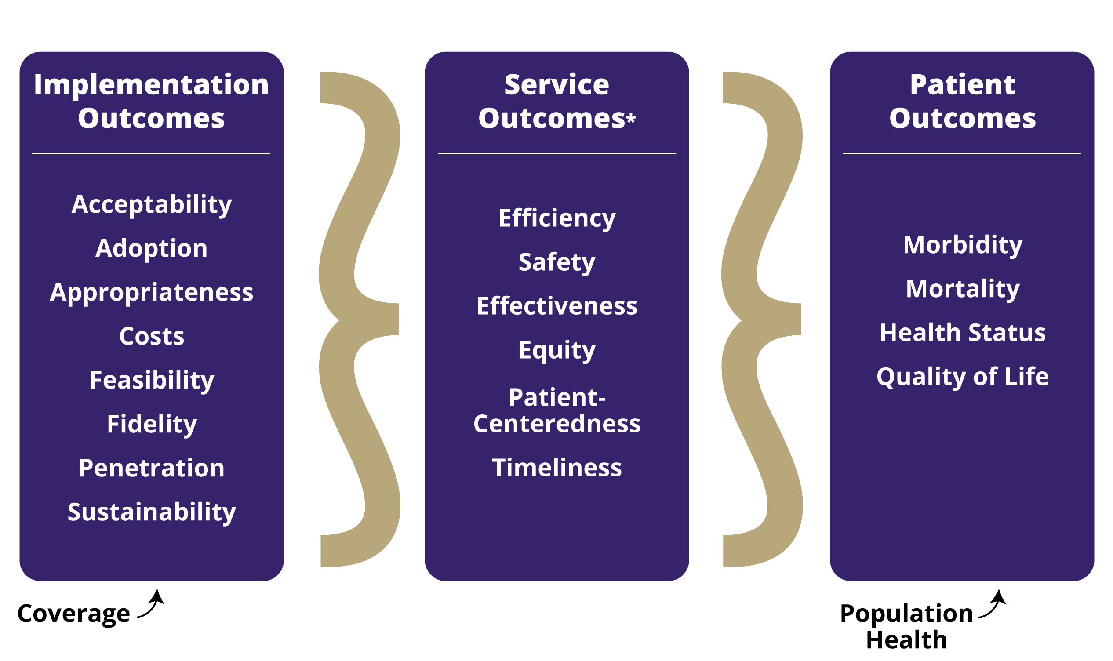
Motivation and Methods
Implementation science (IS) is a systematic, scientific approach to ask and answer questions about how to deliver what works in populations who need it with greater speed, appropriate fidelity, efficiency, and relevant coverage.
Delivery Systems
Impact Evaluation
Economic Evaluation
Qualitative Research
Operations Research
Quality Improvement/ Assurance
Organizational Readiness for Implementing Change
Stakeholder & Policy Analysis
Dissemination Research
Social Marketing
Surveillance & Data Systems
Objectives:
Systematically review how IS has been used to evaluate NCD/HIV integration in Sub-Saharan Africa (SSA)
Identify research questions & capacity building needs to guide future work
Inclusion:
Evaluating integrated NCD/HIV services in SSA
Reporting at least one implementation outcome¹
Exclusion:
Did not explain variation in implementation outcomes
Adapted from Proctor et al, 2011
Notes:
Essential to this definition is a conclusive evidence base establishing intervention efficacy (’what works’) from rigorous efficacy/effectiveness trials, or strong observational data when efficacy trials are not feasible or practical.
Systematic application of methods from diverse disciplines as essential to understand dynamics and processes as we move from intervention development, to implementation, and ultimately scale-up to achieve population-level health benefits.
Implementation science (IS) can inform the efficient and effective integrate HIV and NCD services.
You may want to give an example of an IS problem (HPV vaccine works – how do we make HPV vaccinations for their children acceptable to parents and feasible for the health system to provide?
I agree no one can see the methods picture – and they may find it confusing. I would leave it out.

Slide 57
Results
Studies:
26 (84%) used qualitative methods.
4 (13%) used economic evaluation.
1 (3%) used IS theoretical framework.
Implementation outcomes:
  Acceptability (55%), feasibility (39%), and penetration (26%) most commonly assessed.
  Cost (13%), adoption (3%), fidelity (3%) rare.
  Sustainability never assessed.
Service delivery outcomes:
  Treatment (68%), client satisfaction (52%), and screening (45%) most common.
Patient health outcomes rare (13%).
Programs:
Most targeted cervical cancer (50%) or depression (42%).
Most delivered at clinic (65%) or hospital (54%) level.
Databases
2333
Other sources
22
Non-duplicates
1661
Screened
1661
Excluded
1469
Full-text Review
192
Excluded
161
Not target setting or population: n=5
Not integration of NCD into HIV services: n=85
No IS outcomes: n=22
Not IS: n=12
Not peer reviewed: n=3
>1 of above: n=34
Included
31 studies
26 programs

Slide 58
Discussion
Qualitative acceptability and feasibility studies are common
  Patients feel that integrated services are acceptable
  Providers have concerns related to feasibility: lack of space, workload, etc.
Limited use of IS methods and theories
  Theories may need to be adapted for use in SSA
  Lack of capacity for IS in SSA
Limited range of NCDs and outcomes evaluated
  No programs targeting stroke, myocardial infarction, or substance abuse
  Few evaluations of cost, adoption, or fidelity; none of sustainability
  Few evaluations of patient health outcomes
Future Directions:
Build in-country capacity in IS
Incorporate theoretical frameworks
Explain variation in implementation outcomes
Assess the complete range of implementation outcomes
  Especially cost and sustainability
Evaluate the process of scale-up
Thank you!
  kempc@uw.edu
  bjweiner@uw.edu

Slide 59
Building on the HIV chronic care platform to address noncommunicable diseases in sub-Saharan Africa: a research agenda
Linda E. Kupfer
Center for Global Health Studies
Fogarty International Center
US National Institutes of Health, Bethesda, Maryland, US
Vorkoper, Susan; Anand, Nalini; Patel, Pragna; Beecroft, Blythe; Tierney, William M.; Ferris, Robert; El-Sadr, Wafaa M.; on behalf of the HIV/NCD Project

Slide 60
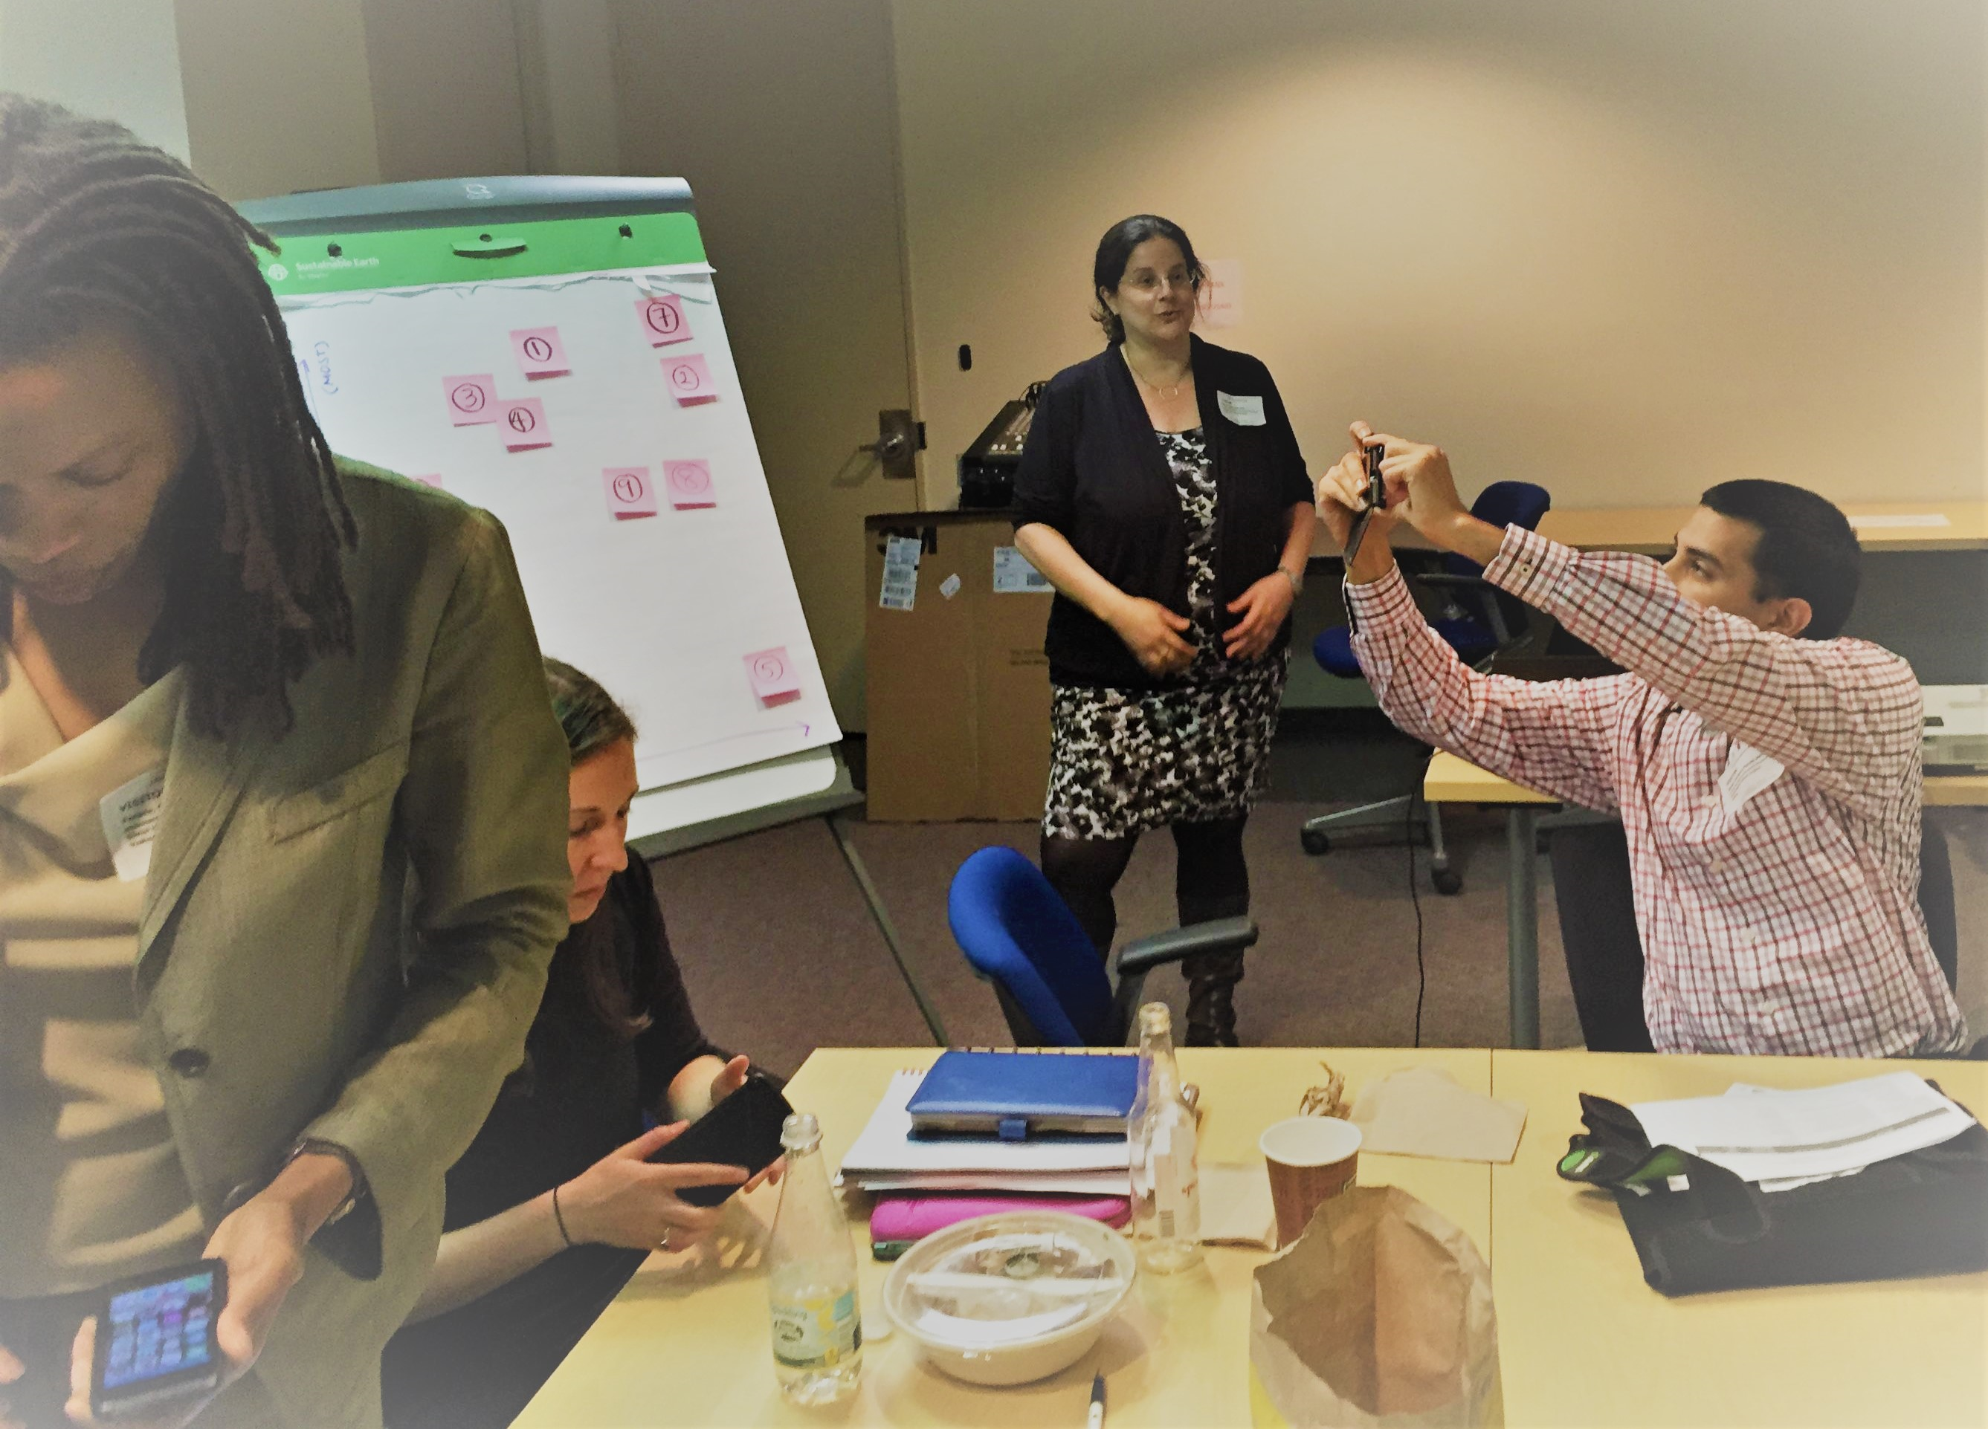
Research to guide practice: enhancing HIV/AIDS platforms to address non-communicable diseases in sub-Saharan Africa
Stage 1 | Project Parameters; Teams. (2014)
Stage 2 | Scoping Reviews; Research Gaps and Priorities
Stage 3 | Models Workshop; Supplement Outline
Stage 4 | Supplement Articles
Stage 5 | Research Agenda
Brought together over 100 stakeholders over 4 years to analyze the landscape and develop a research agenda and produce a supplement to document it all. Led by NIH/FIC with CDC and USAID. Initial funding from PEPFAR.
Prioritize Research Questions from Scoping Reviews
Notes:
Do you want to add here something about Fogarty Leadership of effort and funding support from PEPFAR?

Slide 61
Results from the scoping reviews
HIV management strategies can incorporate NCDs to improve clinical outcomes – how do we do it?
HIV-NCD integrated care programs would need to be rigorously evaluated.
Integrating HIV and NCD services at scale requires leveraging and research on the underlying health system structures and assets. (S110-S111)
Notes:
Maybe say HIV management strategies in first bullet
Second bullet would say: HIV-NCD integrated care programs would need to be rigorously evaluated
Maybe at end of third bullet add: and assets

Slide 62
HIV/NCD Integration
Research Questions
Pg. S110
What impact does HIV/NCD integration have on HIV treatment, in terms of adherence, retention, stigma or immunologic outcomes?
Policy, governance leadership
Human capacity
Health promotion
Finance and economics
What are the evidence needs and evidence generation activities that would support decisions surrounding HIV/NCD policies?
Cross-cutting
Service delivery models
Which HIV clinical cadres should provide screening services, initiate and manage treatment, and distribute medication for NCDs?
How can health management information systems be used to minimize additional data collection burdens arising from integrated care?
What are key challenges and viable approaches to integrated comprehensive care?
How do we enhance health systems to provide integrated HIV/NCD prevention care and treatment?
Information, evaluation, and research
What is the most effective innovative financing for supply chain resource mobilization?
How does the integration of HIV and NCD communication interventions impact service provision and demand?
Supply chain
What is the financial cost of population-level scale up of NCD prevention, screening, care, and treatment programs?
How can sustainable mutually beneficial private public partnerships be established?
Partnerships
Notes:
Thanks to all All active participants in the project over the four years. Special thanks to my co authors
Susan Vorkoper who with
Pragna Patel and Bob Ferris - Secretariat
Bill Tierney.
Wafaa El-Sadr – Steering Committee and FIC AD Board
Nalini Anand – Director of CGHS
Blythe Beecroft
And a shout out to Eric Goosby and Deborah Von Zinkernagel at OGAC at the time of idea conception and supported it throughout.

Slide 63
Global partnerships to support noncommunicable disease care in low and middle-income countries: lessons from HIV/AIDS
Deborah Von Zinkernagel
Coordinator for Policy and Programme at the UN Joint Programme on AIDS and Acting Director for the Department of Community Support, Social Justice and Inclusion at UNAIDS
Johnson, Michael; Wilkinson, Jessica; Gardner, Adrian; Kupfer, Linda E.; Kimaiyo, Sylvester;

Slide 64

HIV Partnerships: Model for NCDs?
Global organizations are a critical factor in the world’s response to the HIV epidemic
Partnerships support countries for:
  Disease-specific service delivery
  Health systems capacity
  Implementation science to improve programs
  Access to critical health products
  Political advocacy
  Planning for shift from global to national support; “sustainability”
This Photo by Unknown Author is licensed under CC BY-NC-SA

Slide 65
Multiple Partnerships Needed
BUT … No one global organization can support the range of needs. Hence, partnerships among the global organizations and with countries are critical.
What are the characteristics of the global organizations, what are their strengths, and what can be learned and/or leveraged for the control of NCDs?

Slide 66
HIV Partners: Coverage
Area of Support | Global Fund to Fight AIDS, TB, Malaria | Joint United Nations Programme on HIV/AIDS (UNAIDS) | President’s Emergency Plan for AIDS Relief (PEPFAR) | UNITAID | Private Sector Partnerships (ex. PRPR, PEPFAR-AZ and PEPFAR-BD)*
HIV/AIDS Service Delivery; Financial or Technical Support | Focus | Focus | Focus | Minimal | Contribute
Comprehensive Health Systems Capacity Support | Contribute | Contribute | Contribute | Contribute | Contribute
Implementation Research to Improve Delivery | Contribute | Contribute | Contribute | Contribute | Contribute
Introduction and Availability of New Health Products | Contribute | Contribute | Contribute | Focus | Focus
Political Advocacy for Accountability, Inclusion, and Resource | Contribute | Focus | Focus | Contribute | Minimal
Enhanced Approaches to Sustainability and Transition | Contribute | Contribute | Contribute | Contribute | Minimal
Green = Plays primary leadership role in utilizing this mode or supporting this activity when addressing HIV/AIDS in LMICs
Yellow = Plays a supporting (but not primary) role in utilizing this mode or supporting this activity when addressing HIV/AIDS in LMICs
Orange= Plays a very small role in utilizing this mode or supporting this activity when addressing HIV/AIDS in LMICs
* PRPR=Pink Ribbon/Red Ribbon, AZ=Astrazeneca, BD=Becton-Dickinson
Notes:
Qualitative analysis of a convenience sample of global organizations in the HIV response:
UNAIDS
Global Fund
UNITAID
PEPFAR
Private Sector Partnerships
On what do they each focus, do they create a “whole” response individually or together?

Slide 67
Global HIV Partnerships: Adapt for NCDs?
Many partnerships needed- Financial and/or Technical
Multilateral, bilateral, public private, national
HIV partnerships focus on immediate disease control (service delivery, commodity delivery, political advocacy) ; limited focus (sustainability, implementation research for improved service delivery, comprehensive health system building)
HIV Partnerships could serve as models and/or be adapted for addressing the global NCD epidemic

Slide 68
Panel 2 Discussion – Moderator Eric Goosby
Pragna Patel
Gerald Yonga
Christopher G. Kemp
Linda E. Kupfer
Deborah Von Zinkernagel

