Slide 1
Community Led PrEP Delivery Getting It Right
Dr. Sushena Reza-Paul
Assistant Professor
University of Manitoba

Slide 2
Community Led PrEP Delivery
A community comes together to gain control over factors that have an impact on their lives and thereby, own the program from its design, inception, implementation and the outcomes. They are also the rightful owners of the risk and response and therefore the resources and results.
In the context of PrEP the community leads all the above processess that includes governance, design, delivery, monitoring and therefore the results

Slide 3
Introduction
Contrasting FSW settings:
Kolkata- Brothel based
Mysore & Mandya- Mixed pattern (street, lodges, houses, etc.)
Bottom-up approach since inception
WHO and BMGF discussed with Ashodaya and DMSC
Ashodaya and DMSC chose University of Manitoba
As the support agency for the community-led research
N

Slide 4
Context
Ashodaya- Dawn of Hope
Initiated in 2005, governed democratically by elected board of directors
Durbar- The Unstoppable
Organization of 60,000 SWs initiated in 1995 expanding all over West Bengal including Kolkata city
7000 members across 4 districts
Proven leadership in integrated health program (HIV/STI, SRH, TB)
Diversified to other social development programs including banking, social security, etc.
Well recognized and acclaimed for Community-led academy, Ashodaya Academy, conducting community based research and capacity building
Runs the largest co-operative bank for SWs in Asia called Usha Co-operative, 40 educational centers, children hostels etc.
Has remained one of the best practices for HIV intervention globally
Democratically governed
Actively active in addressing underlying reasons of poverty, discrimination, alienation from the mainstream society as well as provide holistic healthcare to its members
Runs 49 clinics with >500 staff (80% are sex workers)
for, of, by’ female, male and trans sex workers

Slide 5
Chronology
2012-13
WHO initiated discussion on PrEP
2013-14
2015
2016
Demonstration Project started
Community Consultation and Preparedness
Feasibility Study
Preparation for Demonstration project
Expressed concern but willingness to explore and assess feasibility of PrEP
Discussion with WHO and BMGF
Approval
2018
Demonstration Project Finishes

Slide 6
Outreach team incorporated PrEP in its daily outreach plan
PE/CM responsible for identifying interested FSWs, bringing them to clinic, following up for 16 months, fostering community norm on PrEP & condom use
Contextualized approaches
HIV+ SW promoted PrEP; SW leaders initiated PrEP first (testimonial ambassador)
Follow-up visits to Ashodaya clinic (Static & outreach)
Linked with ART physician at district level & accompanied referral when required
Tailor-made dispensation plan (location, duration etc.)
Integrated design within existing prevention program
Design incorporated findings from FS
Ongoing Community preparedness
External stakeholder management
Determining processes for mobilization, recruitment, delivery, follow-up, adherence support, drug delivery and clinic
Ingredients of Community-led PrEP
Governance
Determining the design
Delivery
Accountability
Monitoring and Quality Control
Phased out follow-up plan on the field by CM/PE
Individualized drug dispensation plan & customized drug intake time
Developed and used simplified tool to monitor adherence at outreach
Self reported questionnaire during quarterly clinic visit
Ashodaya Governing body (management & fiduciary controls)
Community Advisory board for PrEP
Advisory Committee (experts & SWs)
Project management team- 3 SWs & 3 non-community staff
To the Ashodaya Governing Board
Having accountability to the community taking PrEP; community redressal system
Ensuring accountability to the funders, scientific community and others

Slide 7
Results
Status | Ashodaya | Durbar | Total
Total screened | 707 | 843 | 1550
Eligible in screening | 652 | 717 | 1369
Not eligible in screening | 55 | 126 | 181
Enrolled to the study | 647 | 678 | 1325
Refused to enroll | 5 | 39 | 44
Exited without completing 16m | 7 | 79 | 86
Completed 16 month follow-up | 640 | 600 | 1240
# on PrEP (post study till Jul18) | 466 | 504 | 970

Slide 8
Results (N=640)
Sex-work characteristics
Socio-demographic, reproductive
Age: Median 35 (18-48).
Literate: : 268 (41.42%)
Regular partner: 559 (86.4%)
Median monthly income: Rs.5400
# of children: 2 (0 – 6)
# using contraception: 617
Age of entry: 28 (15-44)
Avg of years in sex-work: 6 (1-30)
Place of sex-work: Urban/Rural
Risk perception
Participants were 3.72 times more likely to feel at high risk at baseline when compared to exit visit (p<0.0001)

Slide 9
Results
Sexual Behavior
Percentage of condom usage during last sex during last week
STI Syndrome , HIV, Pregnancy
Visit | N | STI Syndrome n(%) | HIV positive n(%) | Pregnancy n(%)
1M | 637 | 1 (0.16) | 0 (0) | 0 (0)
3M | 642 | 5 (0.78) | 0 (0) | 2 (0.31)
6M | 641 | 2 (0.31) | 0 (0) | 0 (0)
9M | 641 | 0 (0) | 0 (0) | 1 (0.16)
12M | 640 | 0 (0) | 0 (0) | 0 (0)
15M | 640 | 0 (0) | 0 (0) | 0 (0)
Screening:707
Syndromic STI:13 (1.8%)
HIV positive: 9(1.27%)

Slide 10
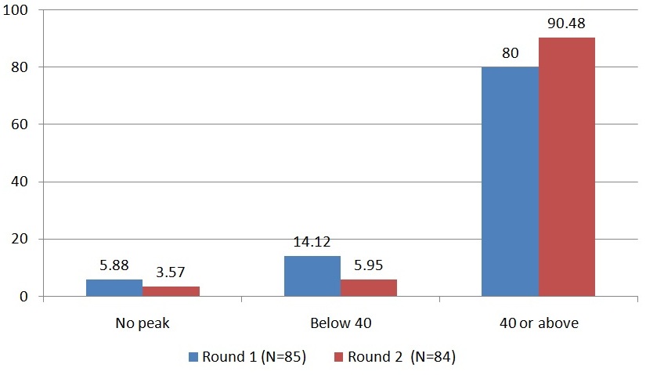
Adherence
Self-reported adherence
Blood Tenofovir level (ng/mL)
R1 = M3 & R2 = M6

Slide 11
PrEP in Zimbabwe
Adherence Sisters Programme
Building Sisterhood & supporting HTC, PrEP, ART uptake & adherence
Women nominate their ‘Buddy/Sister’
ART & PrEP users together without disclosing
Discussion & Action on the issues discussed by the women
General Support
SMS reminders
Active follow-up through phone call & home visits
CM sessions
Testing & linking to care
PrEP & adherence
Insights & Results
500 initiated, 402 came for 1st follow-up
Early adopters, peer support & buddy system helped overcome barriers
FSW on PrEP reported it as empowering

Slide 12
PrEP in South Africa
Performance against Annual target
Supporting
Clients:
Incorporating
PrEP in daily outreach
activities
PrEP Ambassador
PE draw on their
own experience
when
addressing
concerns
Track &
Monitor:
Weekly
microplanning,
SMS, WA, sitevisits
Creative Workshops
to discuss challenges and bring solutions
Lessons Learnt
Multi-disciplinary approach to actively address side-effects
Stigma over mistakenly identified as HIV+ discourages PrEP
Planned follow-up for structured messaging encourages adherence & retention
First 3 months crucial for 'client drop-off'. Hence active intervention
FY18 PrEP New Uptake

Slide 13
Community led process could be time intensive but has assured results
Ongoing community preparedness for both ART & PrEP
Context specific delivery & individualized intake can minimize hurdles & maximise adherence
Integration with existing prevention program that includes outreach plan and PE responsibilities
Maintaining community cohesion
Lessons Learnt
Time taken for community consensus generation and preparedness
Regulatory approvals & drug imports
Working with the existing community systems and ensuring rigor, speed, quality
Ensuring data is reviewed regularly, focus on adherence, condom use, STI, etc.
Leads to ground swell in demand – managing the demand without dampening the spirit
Challenges

Slide 14
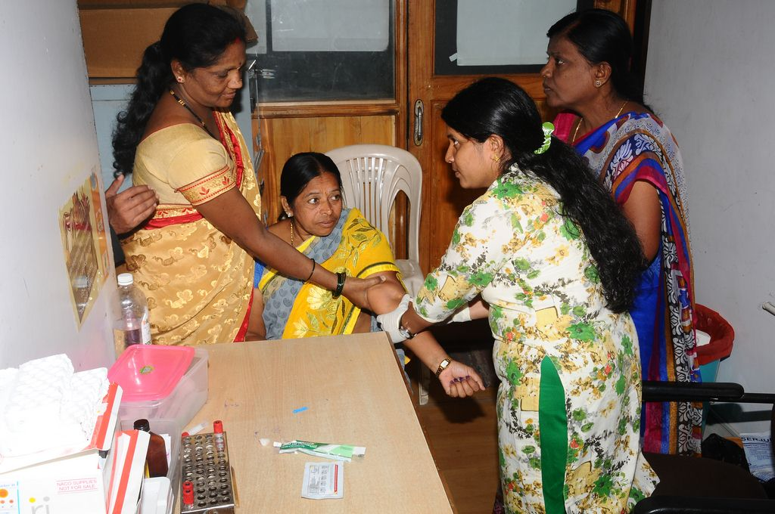
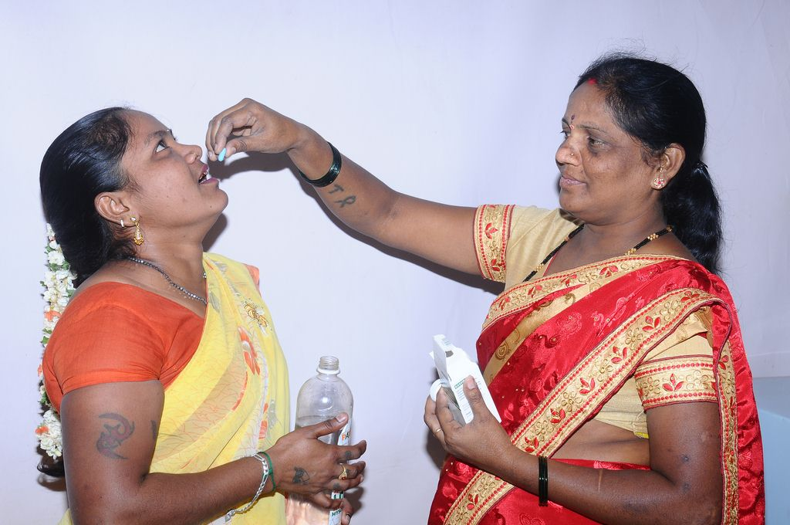
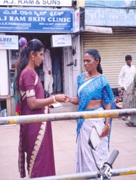
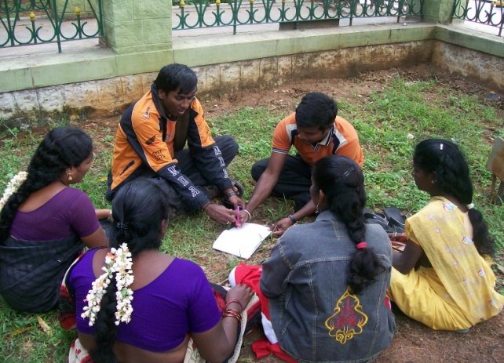
Are we ready to get it right?
Placing the 'trust & faith' in community
Investing in the leadership
Enhancing their capabilities based on 'community intelligence'
Providing fiduciary controls
To stand by the community for them to succeed & not pass judgement

Slide 15
Acknowledgements
All the Sex Workers at Ashodaya and DMSC - My Gurus
Dr. Smarajit Jana, DMSC and STRI
National AIDS Control Organization
Indian Council for Medical Research
National AIDS Research Institute
WHO and UNAIDS, India
Dr. Frances and The Sisters from “Sisters with a Voice”
Ms. Naomi, the team at WITS RHI and the peer educators
Gilead and Mylan
The Bill and Melinda Gates foundation

