Slide 1
LEADERSHIP ON HIV AS PART OF SDG IMPLEMENTATION: Going from Portugal to the World
Founder & President of UNITE
Ricardo Baptista Leite, MP, MD, PhD(c)
Medical Doctor and Member of the Portuguese National Parliament
Health Committee | Foreign Affairs Committee
Head of Public Health | Catholic University of Portugal
Guest Lecturer | Nova University of Lisbon
ricardo.baptistaleite@gmail.com
| @RBaptistaLeite

Slide 2
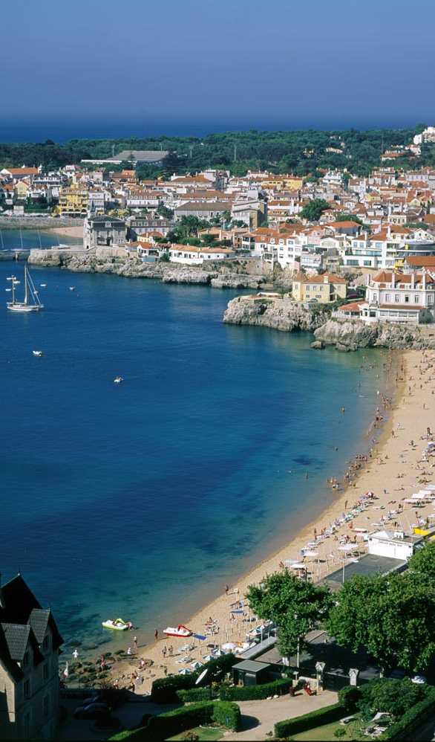
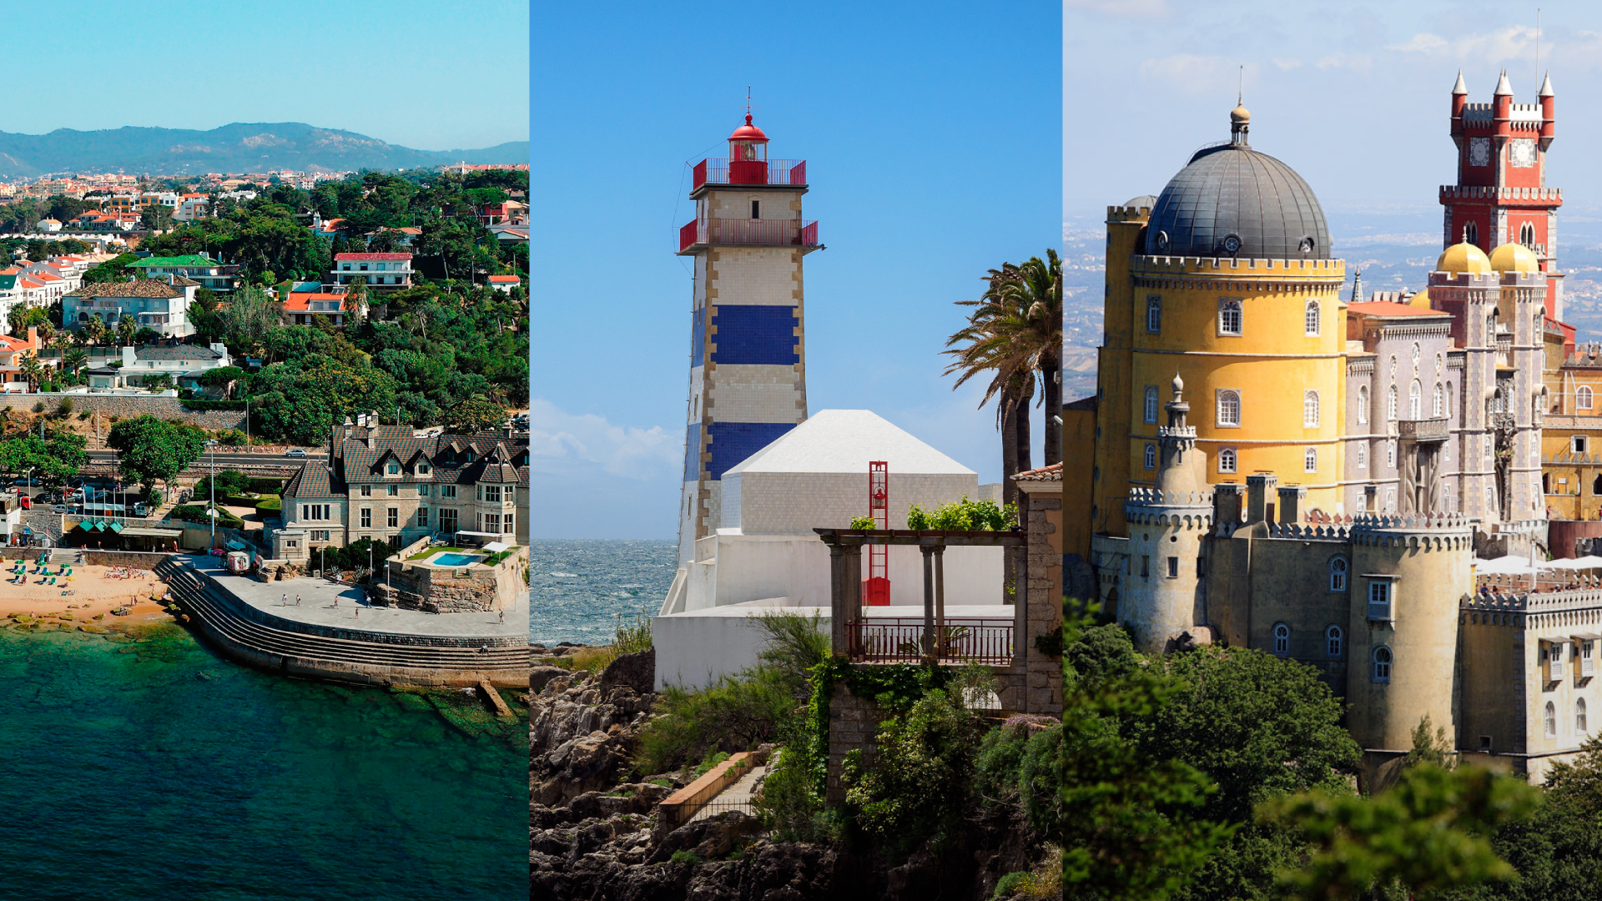
Portugal: Cascais – Sintra – Estoril Coast
| @RBaptistaLeite

Slide 3
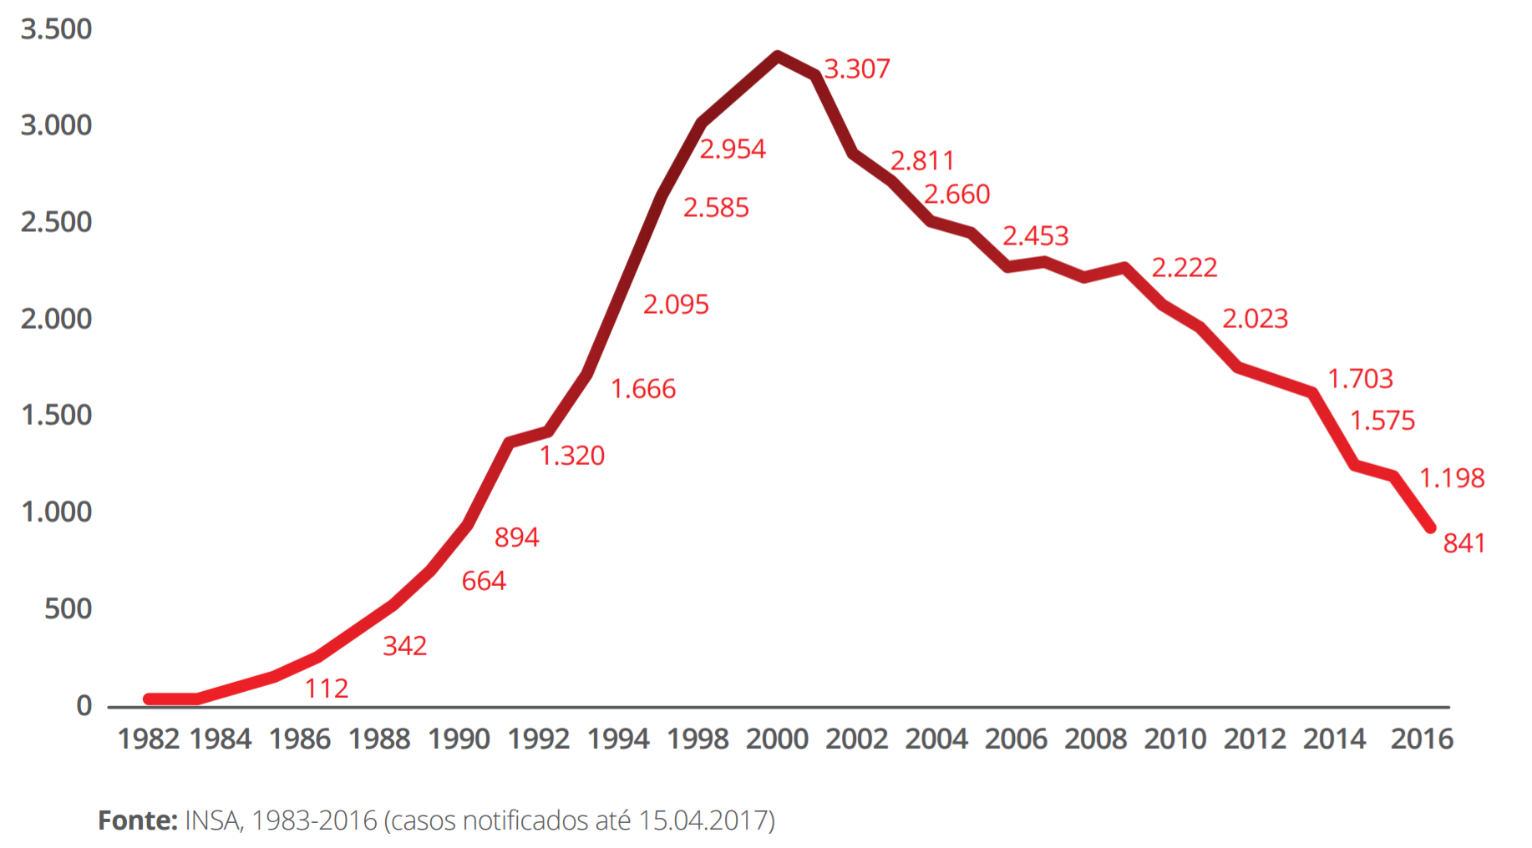
HIV in Portugal
Number of New HIV Infections 1983-2016
REHAB SUCCESS RATES
CRIME
DRUG RELATED IMPRISONMENTS
EU COMPARED CONSUMPTION
1979
1983
1996
2001
2011
DRUG TOURISM
1st Dx HIV
in Portugal
HAART
Decriminalization of Drug Use
TROIKA
| @RBaptistaLeite

Slide 4
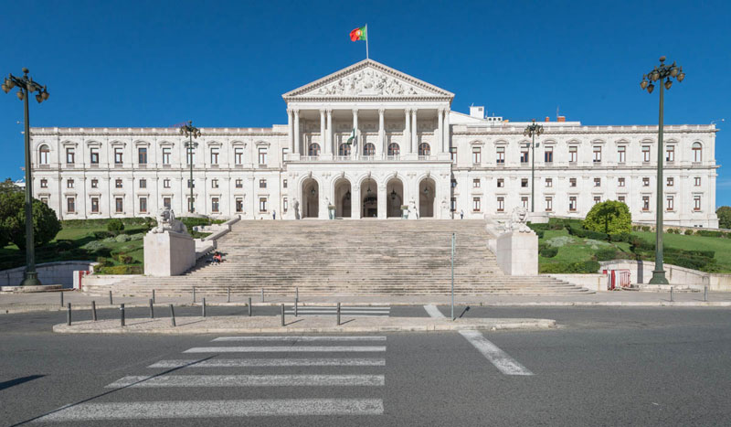
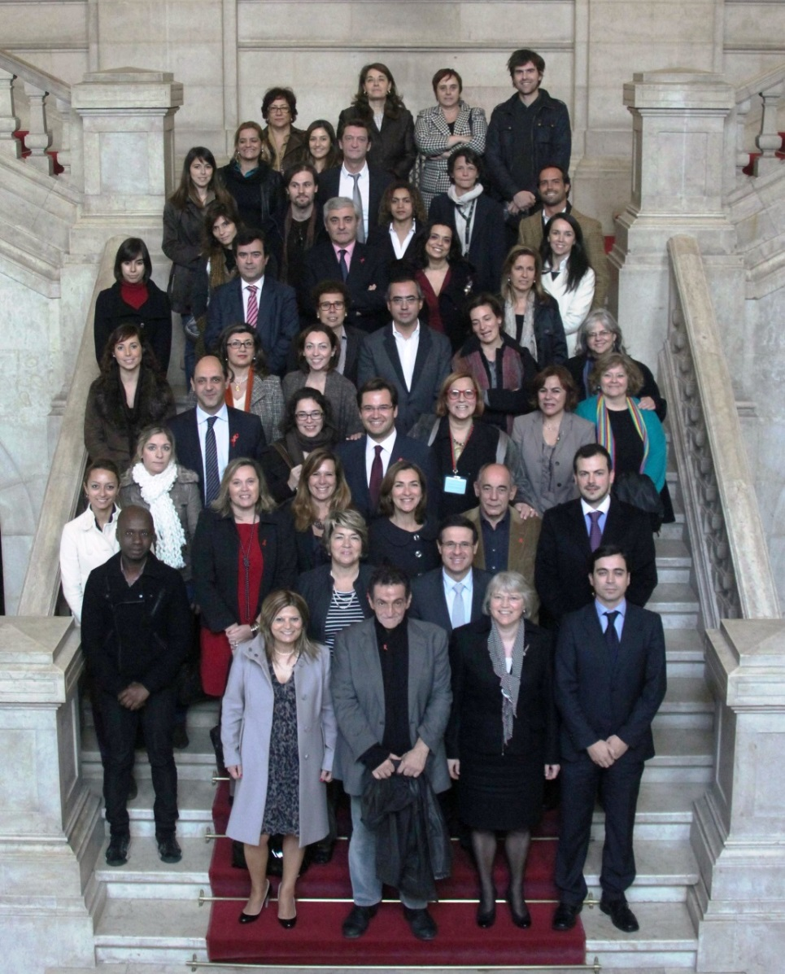
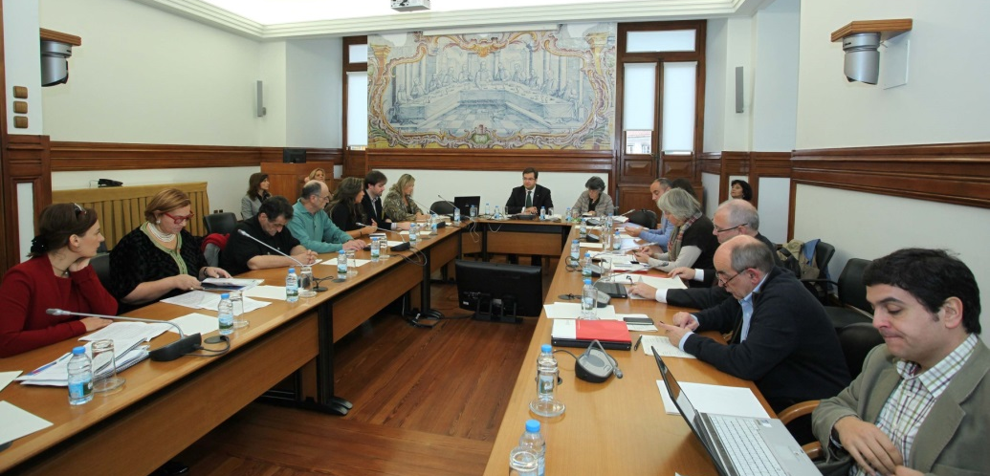
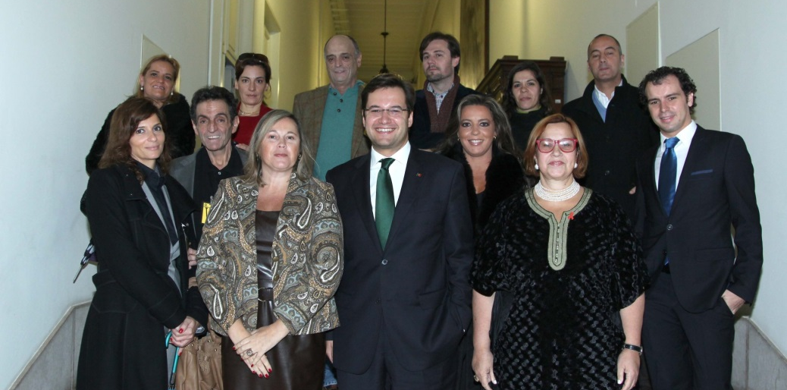
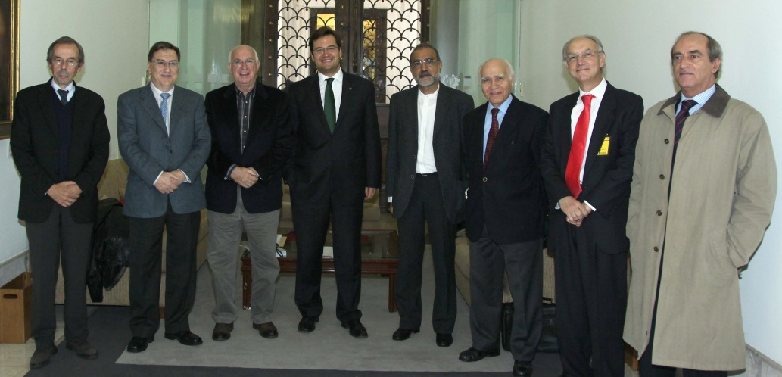
HIV in Portugal
2011 | Parliament HIV Resolution
| @RBaptistaLeite

Slide 5
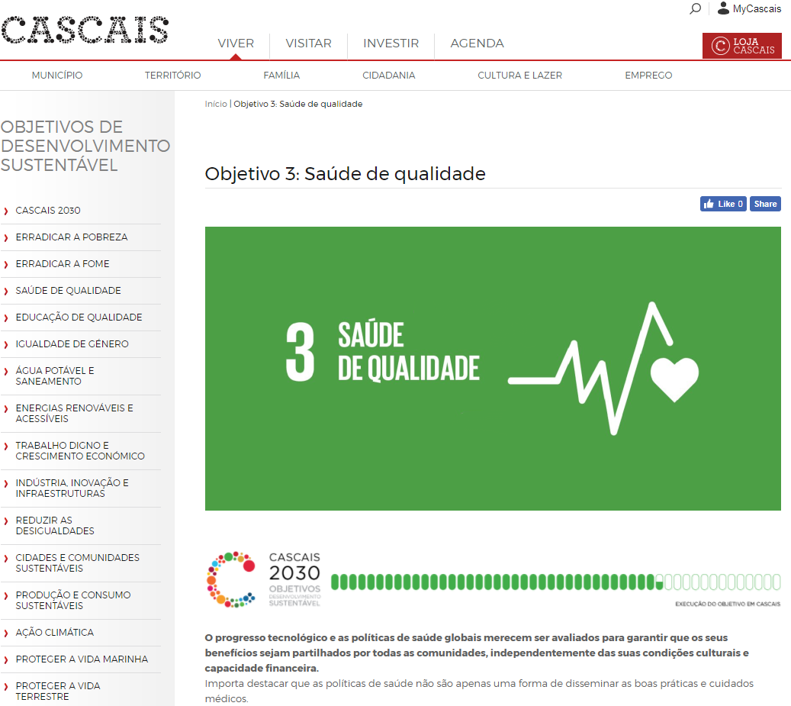
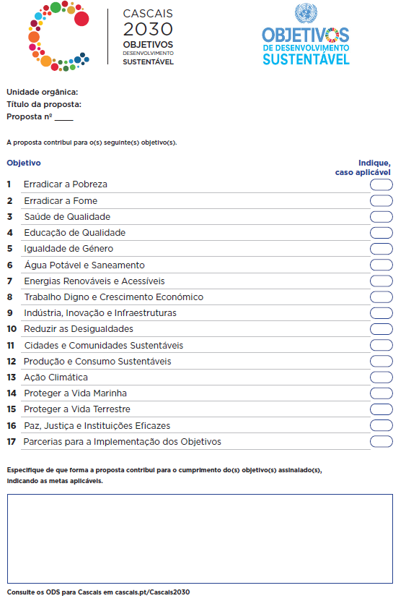
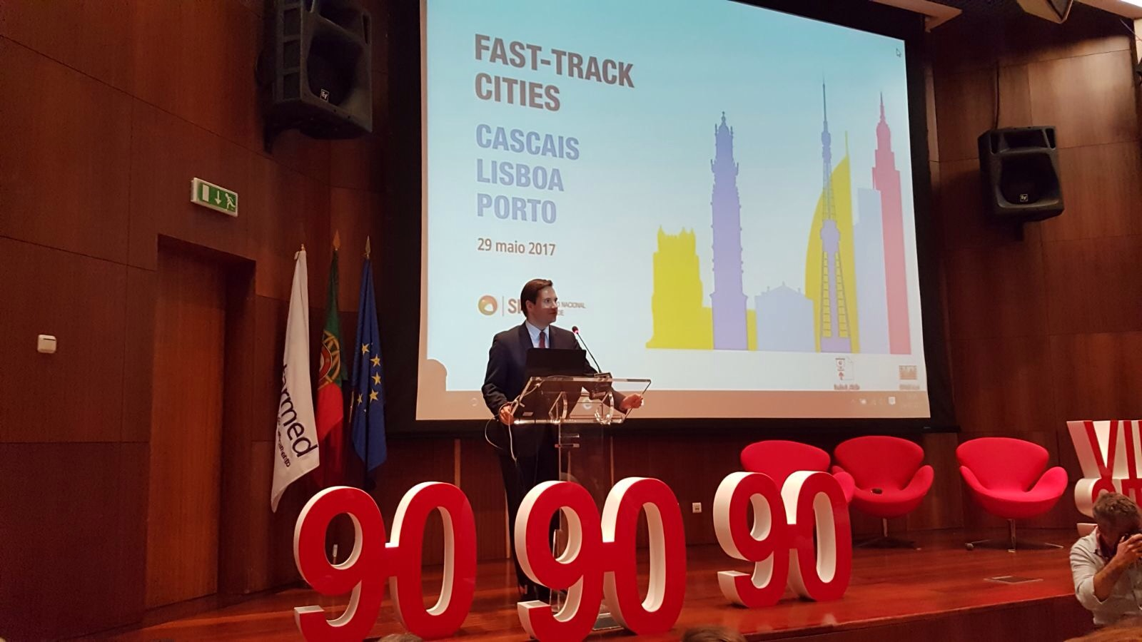
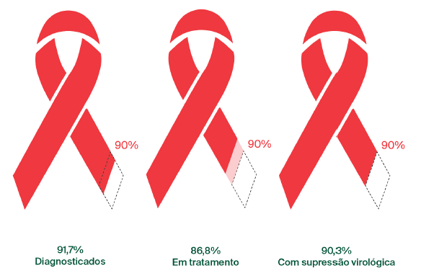
HIV in Portugal
Number of New HIV Infections 1983-2016
90 – 90 – 90 in Portugal
1979
1983
1996
2001
2011
2015
2017
2018
Cascais, Lisbon and Oporto on the Fast Track to end AIDS
Lisbon, 29th May 2017
HEP C
53,5% Late Diagnosis
1st Dx HIV
in Portugal
HAART
Decriminalization of Drug Use
90,3%
Virologically Supressed
Fast Track Cities
91,7%
Diagnosed
86,8%
On Treatment
TROIKA
T&T
PrEP
Source: Ministry of Health, July 2018
| @RBaptistaLeite

Slide 6
| @RBaptistaLeite
Notes:
WE HAVE THE SCIENTIFIC EVIDENCE AND TECHNOLOGICAL MEANS TO END AIDS AS AS PUBLIC HEALTH THREAT BY 2030.
WHAT DOES IT TAKE TO GET THERE?

Slide 7
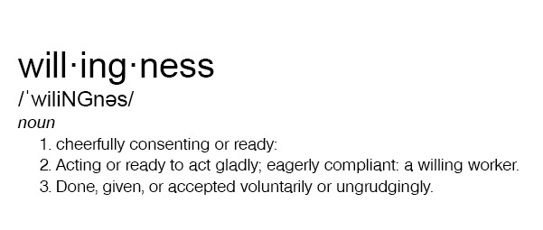
| @RBaptistaLeite

Slide 8
Taking action to deliver on global policy goals
Still MP’s are excluded from most International - Multilateral workgroups and decision processes
Members of Parliament
Approve national budgets
Directly change local and national policies
Interface between Governments and the People
| @RBaptistaLeite

Slide 9
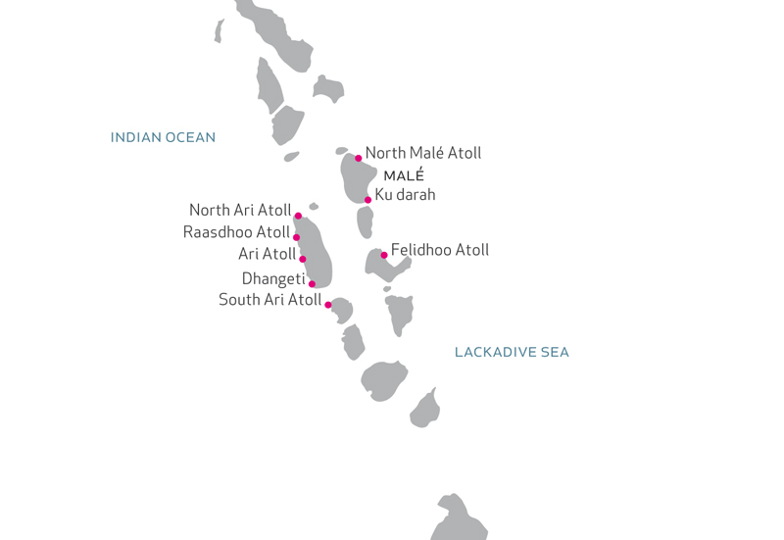
Europe
Chapter
North America Chapter
Western-Pacific Chapter
Central, South America & the Caribbean
Chapter
Africa Chapter
South-East Asia Chapter
Eastern Mediterranean Chapter
UNITE REGIONAL CHAPTERS
| @RBaptistaLeite

Slide 10
MP
Scientific Evidence
Best Policy Practices
Political Analysis and Strategy
Media and PR Support
Data Collection
Community Engagement and Advocacy
| @RBaptistaLeite

Slide 11
| @RBaptistaLeite

Slide 12
It’s time to end HIV/AIDS, viral hepatitis and other infectious diseases
It’s time to UNITE.
www.unitenetwork.org
With the support and under the auspices of
ricardo.baptistaleite@gmail.com | @RBaptistaLeite

