Slide 1
Population Mobility: Challenges for Universal HIV Testing and Treatment
Mobility in Africa: human rights and the HIV care cascade
Joseph Larmarange Institut de Recherche pour le Développement (IRD)
Notes:
Good evening everyone.

Slide 2
Preliminary comment
Increasing concern about restricting the movement of population
Current policy processes have the potential to undermine efforts to improve the global responses to migration and HIV (Vearey JIAS 2018)
Notes:
I would like to start this presentation by the observation that there is globally an increasing concern about restricting the movement of population.
In the special issue, Vearey explains that the current global discussion surrounding population mobility, focused on this security dimension, tend to ignore other crucial dimensions as health. She shows how current policy processes have the potential to undermine efforts to improve the global responses to migration and HIV.

Slide 3
Presentation overview
Context: mobility and migration in Africa
Mobility and HIV acquisition
Mobility and the HIV care cascade
African migrants living in Europe
Key populations and mobility
Notes:
With this issue of human rights in mind, I will present some elements of context regarding mobility and migration in sub-Saharan Africa, before exploring the relationship between mobility and HIV acquisition and between mobility and the HIV care cascade. Then, we will talk about the situation of African migrants living in Europe and the situation of key populations.

Slide 4
Mobility in sub-Saharan Africa
Low transcontinental migration
Intra-sub-Saharan African migration is the largest south-to-south movement
High level of internal mobility
Rural to urban, between rural, rural to semi-urban…
“Household fluidity” (PopART HPTN 071) (Hoddinot et al. JIAS 2018)
Notes:
Forms of mobility in sub-Saharan Africa are diverse and complex.
Transcontinental migration between Africa and other part of the world is low. On the opposite, intra-sub-Saharan African migration represents the largest south to south movement of people in the world. Internal mobility, which means inside a same country, is high. Rural to urban migration flows do not predominate in all settings; we also observe rural to urban, between rural or rural to semi-urban movements.
In their contribution to the special issue, Hoddinot and colleagues used the concept of “household fluidity” to describe the fact that in southern Africa household members seem to move in and out almost continuously.

Slide 5
The HIV care cascade
Population-based and cross-sectional concept
Proportion of HIV+ being
diagnosed,
in care,
on ART,
virally suppressed
Computed
among resident PLWHIV
within a geographical area
at a specific time point
Notes:
What we call the “HIV care cascade” is measured by a population-based and cross-sectional set of indicators estimating the proportion of HIV-positive individuals diagnosed, in care, on ART and virally suppressed among all people living with HIV, residing within a certain geographical area, at a specific time point.

Slide 6
Mobility and HIV acquisition
Increased sexual risk behaviour and HIV prevalence among migrants
in Kenya and Uganda (SEARCH) (Camlin et al. JIAS 2018)
in rural KwaZulu Natal (South Africa) (McGrath et al. Lancet HIV 2015)
Relation between distance of migration and HIV acquisition (Dobra et al. AIDS 2017)
Notes:
As the care cascade is limited to individuals infected by HIV, exploring the relation between mobility and HIV acquisition is key to understanding the relation between mobility and the cascade.
CLIC
Increased sexual risk behaviour and higher HIV prevalence have been reported in migrants in sub-Saharan Africa.
CLIC
In the special issue, Carol Camlin and her colleagues showed, using data from the SEARCH trial, that in rural eastern Africa, both longer-distance/permanent and localized/shorter-term forms of mobility were associated with higher-risk behaviours.
CLIC
Interestingly also, Nuala Mc Grath and her colleagues showed that sexual risk behaviours were significantly more common in non-residents than in residents for both men and women in rural KwaZulu-Natal.
CLIC
Using data of a population cohort in the same area, Adrian Dobra and his colleagues showed a relationship between distance of migration and HIV acquisition. Even on a short-distance, mobile people are more at risk of acquiring HIV.

Slide 7
Population dynamics & the HIV care cascade
Data from ANRS 12249 TasP trial
rural KwaZulu Natal
2012-2016
Individual longitudinal trajectories
residency
HIV status
engagement with HIV care
(Larmarange et al. JIAS 2018)
Notes:
In the paper we published with colleagues in the special issue, we explored the impact of population dynamics on the HIV care cascade.
Data were collected through the ANRS 12249 TasP trial, a universal test and treat trial implemented in rural KwaZulu Natal between 2012 and 2016.
CLIC
We were able to build the individual longitudinal trajectories of the local population in terms of residency, HIV status and engagement with HIV care.

Slide 8
Annual rates
Population dynamics & the HIV care cascade
Data from ANRS 12249 TasP trial
rural KwaZulu Natal
2012-2016
Individual longitudinal trajectories
residency
HIV status
engagement with HIV care
(Larmarange et al. JIAS 2018)
+17.3%
+0.2%
+4.8%
Resident adult population living with HIV
16th birthday
HIV sero-conversion
Death
Out-migration
In-migration
Entries
Exits
-21.0%
-1.6%
Notes:
Over time, the resident adult population living with HIV, which constitutes the denominator of the HIV care cascade, was changing due to several types of events.
CLIC
Individuals already HIV infected when aging into the HIV population cohort were marginals.
CLIC
New HIV infections resulted in an annual increase of 4.8% of the people living HIV population.
CLIC
The annual death rate among people living with HIV was 1.6%.
CLIC
Finally, in-migration and out-migration of HIV infected individuals were very important in this rural area, creating an important turn-over of the resident population living with HIV, around a fifth being replaced every year.

Slide 9
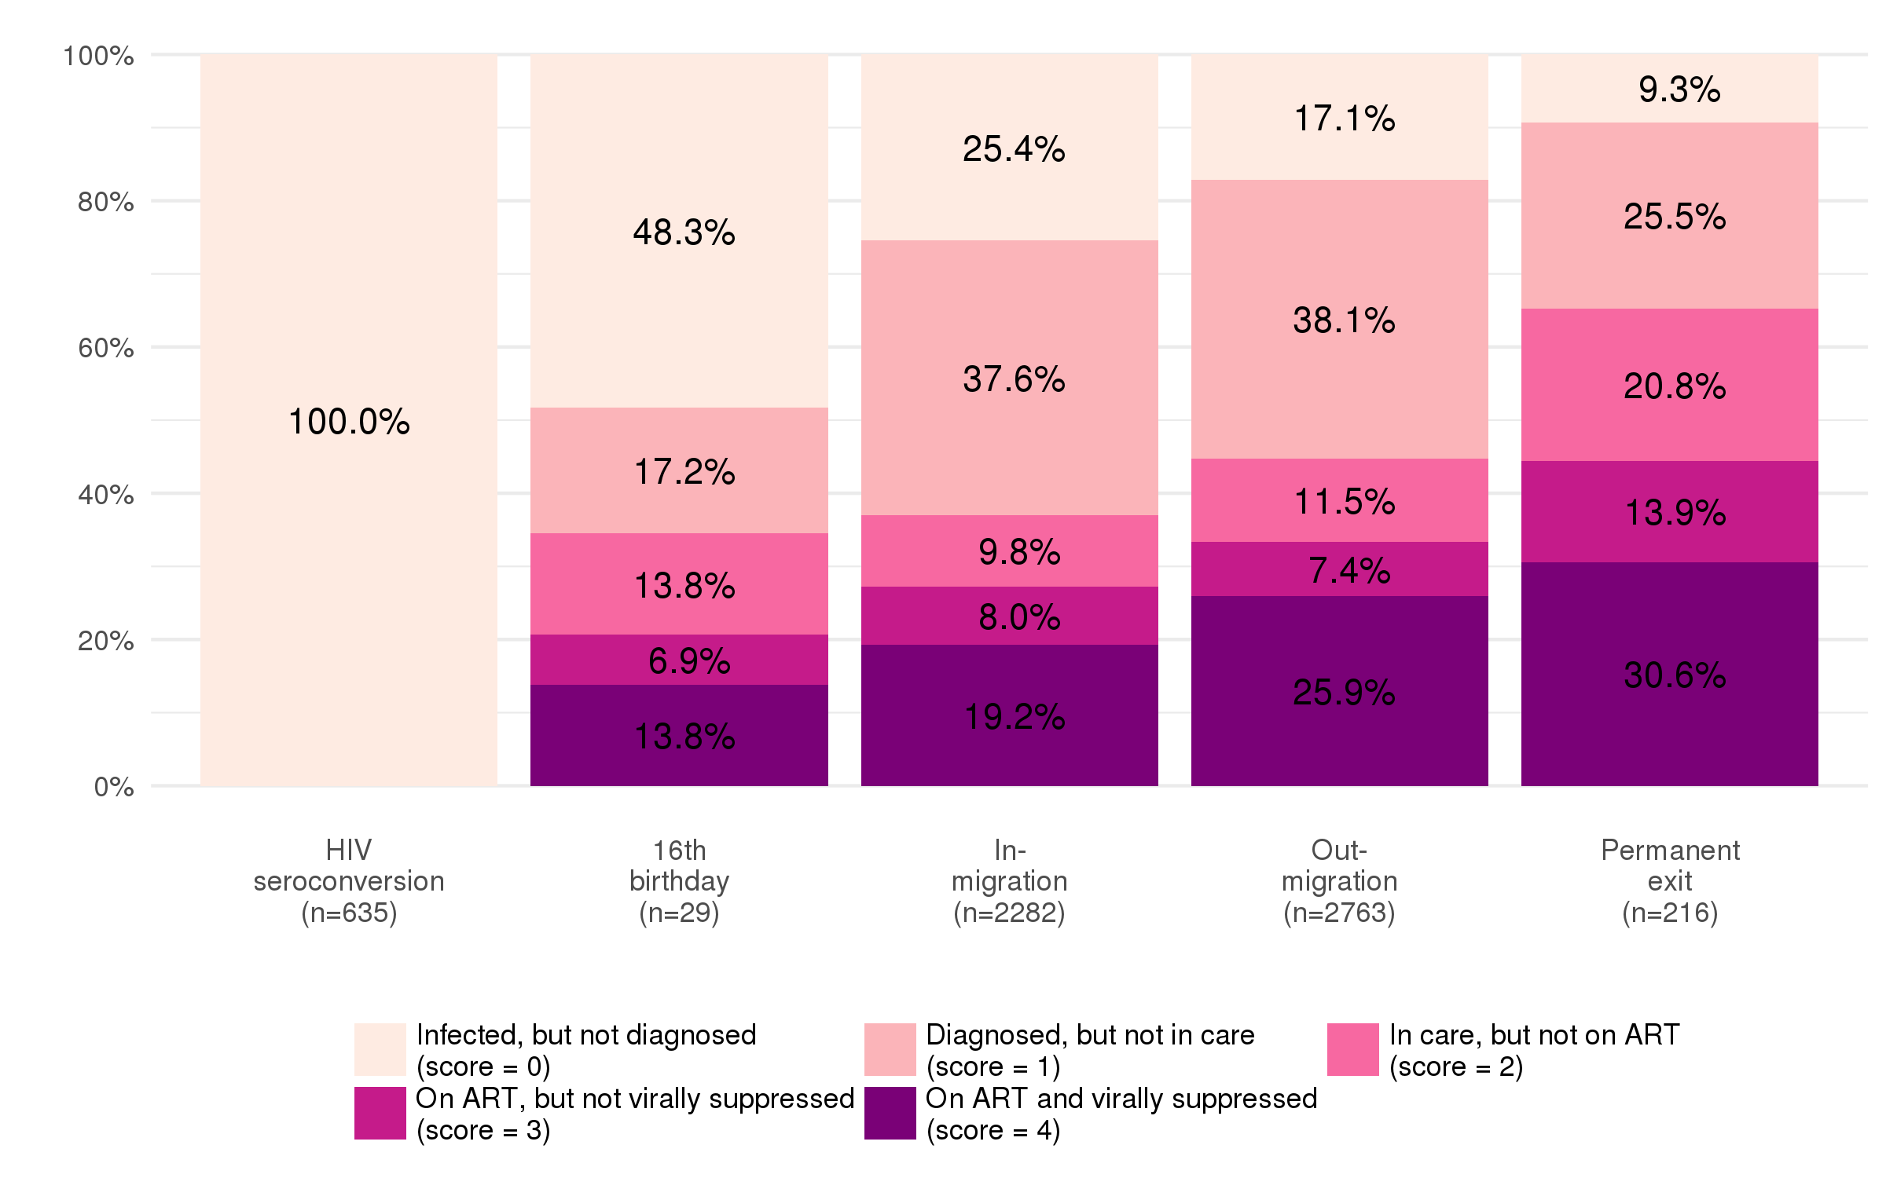
Cascade status at entry/exit
Deaths
ANRS 1229 TasP
(Larmarange et al. JIAS 2018)
Notes:
Our data allow us to identify the cascade position of individuals at the date they entered or exited the HIV population cohort. The different positions within the cascade are, from lighter to darker shades of pink: infected but not diagnosed, diagnosed but not in care, in care but not on ART, on ART but not virally suppressed and finally on ART and virally suppressed.
CLIC
By definition, HIV seroconverters, represented here on the left, were undiagnosed at the estimated date when they acquired HIV.
CLIC
On the opposite, two thirds of individuals who died from HIV, represented here on the right, were engaged in HIV care.
CLIC
The situation of migrants was intermediate. But to contextualize their situation regarding HIV care, they needs to be compared with non migrants.

Slide 10
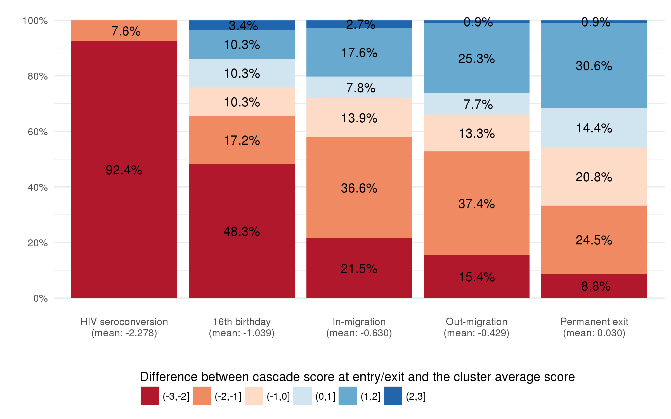
Relative position in the HIV care cascade
Deaths
ANRS 1229 TasP
(Larmarange et al. JIAS 2018)
Notes:
To do that, we considered the position within the HIV care continuum as a score ranging from 0 (undiagnosed) to 4 (virally suppressed). We compared the cascade score of each individual joining or leaving the population of resident adults living with HIV with the average score of their cluster at the time of entry or exit.
Orange to red indicates individuals with a lower score compared to the average score.
CLIC
In-migrants joined the HIV population at lower stages of the cascade and then lowered the global population cascade.
CLIC
Even if out-migrants usually left at a slightly higher position in the cascade than in-migrants, there were also at lower stages compared to the rest of the resident population.
CLIC
In addition, in a context of high HIV incidence, the continuous flow of newly infected individuals, slows down efforts to increase overall ART coverage and population viral suppression, ultimately attenuating any population-level impact on HIV incidence.
CLIC
TasP results show that current service delivery is more adapted for residents. Non-residents would need specific interventions to link and retain into care over time.

Slide 11
Mobility, access to and retention into care
Optimal lifelong engagement with HIV care could be threatened by mobility
Will be detailed in the following presentations, in particular with results from PopART HPTN 071 and MaxART
Migrants face specific vulnerabilities that limit their retention at each step of the cascade
Notes:
Several meta-analysis and systematic reviews of the literature show that optimal lifelong engagement in HIV care can be threatened by a range of factors at the individual, social and structural levels, affected by mobility.
CLIC
Several of the presentations in this session will explore
the challenges of juggling household responsibility, livelihood mobility and HIV management (from PopART data);
how movements in and out households shape HIV services access (from PopART data);
and how relocation could be the first step of a complex chain of events that affect retention into care (from MaxART data).
CLIC
Migrants in sub-Saharan Africa face specific vulnerabilities that limit their retention at each step of the cascade.

Slide 12
African migrants in Europe
Overrepresented in European epidemic
ANRS Parcours study
~ half of African migrants acquired HIV after migration (Desgrées du Lou et al. Eurosurveillance 2015)
Increased exposure to HIV acquisition due to social hardships, including lack of a residence permit (Pannetier et al. Lancet Public Health 2017)
Timing and determinants: tomorrow at 11:00 in Elicium 1 (Gosselin #WEAC0104)
Notes:
African migrants living in Europe also faces specific vulnerabilities. African migrants are overrepresented in European HIV epidemic.
CLIC
Recent results from the ANRS PARCOURS study showed that the epidemic among African migrants living in France was not only an “imported” epidemic: around half of African migrants in France acquired HIV after their arrival. The PARCOURS study also show that the social hardships faced by sub-Saharan African migrant after migration increases their exposure to HIV infection. This is particularly true for women exposed to sexual violence due to a lack of housing or lack of a residence permit. Timing and determinants of post-migration HIV acquisition will be presented tomorrow by Anne Gosselin at 11:00 in Elicium 1.

Slide 13
Migrants in Europe (2)
aMASE study (Fakoya et al. JIAS 2018)
9 European countries / 57 HIV clinics
Median time to diagnosis
5 years (women)
8 years (heterosexual men)
7 years (gay and bisexual men)
Late diagnosis
Despite utilization of health services
Missed opportunities for testing
Migration-specific barriers, including difficulties understanding the legal rights to accessing health care
Notes:
In the special issue, Fakoya and colleagues present the results of a cross sectional study conducted in 9 European countries within 57 HIV clinics.
CLIC
Most respondents were diagnosed post-migration, with median times from acquisition to diagnosis five years for women, eight years for heterosexual men and height years for gay and bisexual men. Late diagnosis was common despite utilization of health services prior to diagnosis, suggesting that opportunities for HIV testing are being missed.
CLIC
Migration-specific barriers were identified, such as language barriers and difficulties understanding the legal rights to accessing healthcare.

Slide 14
Key Populations and mobility
Missed opportunities in terms of prevention among gay and bisexual migrants in Europe (Fakoya et al. JIAS 2018)
Sex workers and men who have sex with men very mobile in southern Africa (Vearey JIAS 2018)
Mobility of female sex workers in Côte d’Ivoire: a challenge for continuity of prevention and care (Becquet et al. ICASA 2017)
Notes:
Fakoya and colleagues noticed that missed opportunities in terms of HIV prevention needs are also likely to shape the HIV epidemic among gay and bisexual migrant men.
CLIC
In southern Africa, Vearey highlights the fact that key populations as sex workers and men who have sex with men are also highly mobile groups. Policies targeting key population groups should integrate the dimension of mobility.
CLIC
In my own work with female sex workers in Côte d’Ivoire, mobility in this population has been identified as one of the main challenges to address to ensure a continuity of prevention and care.

Slide 15
(re)Setting the policy agenda on migration
It is crucial to integrate the dimension of mobility and migrations into our responses to the HIV epidemics
Access to prevention and care is also a fundamental right for mobile populations
“There is an urgent need to develop migration-aware and mobility-competent responses to health globally.” (Vearey JIAS 2018)
Notes:
Taking all of that together, it is crucial to integrate the dimension of mobility and migrations into our responses to the HIV epidemics, and to reset the policy agenda on migration.
CLIC
Access to prevention and care is also a fundamental right for mobile populations.
CLIC
And to quote Vearey: “There is an urgent need to develop migration-aware and mobility-competent responses to health globally”

Slide 16
Thank you for your attention
Notes:
Thank you for your attention

