Slide 1
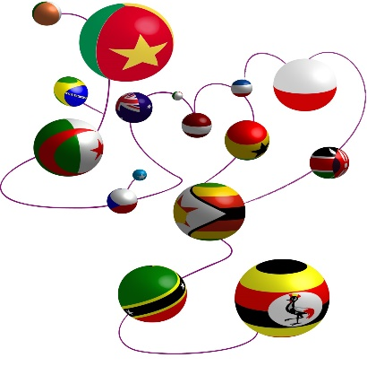
HIV-positive migrants in Europe: policy and health systems challenges
Dr Fiona Burns
UCL Institute for Global Health /
Royal Free Hospital U.K.

Slide 2
Outline
Epidemiology
aMASE study
Challenges for HIV prevention, treatment and care
Disclosures: have received consultancy fees and conference support from Gilead Sciences Ltd.

Slide 3
Proportion HIV diagnoses in migrants* by country of report, EU/EEA 2016
40%
Source: ECDC/WHO (2017). HIV/AIDS Surveillance in Europe 2017– 2016 data
Notes:
Foreign citizens – 7% total populaiton

Slide 4
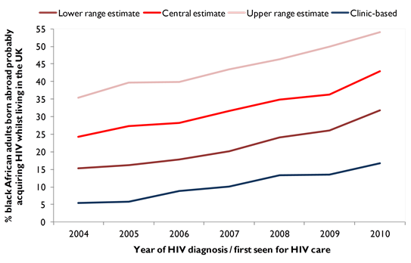
Where do migrants get infected with HIV (prior to or after arrival to the EU)?
Source: Rice BD, Elford J, Yin Z et al (2012). A new method to assign country of HIV infection among heterosexuals born abroad and diagnosed with HIV in the UK. AIDS 26 (15): 1961-6
Clinic-based estimate CD4-based estimate
46%
24%
18%
7%
Source: Rice BD, Elford J, Yin Z et al (2012). A new method to assign country of HIV infection among heterosexuals born abroad and diagnosed with HIV in the UK. AIDS 26 (15): 1961-6

Slide 5
aMASE in EuroCoord
Clinic-based Survey
57 HIV clinics, 9 countries:
Belgium, Germany, Greece, Italy, The Netherlands, Portugal, Spain Switzerland, UK
Eligibility Criteria:
Aged 18 years and over
Foreign born & resident in the country for $≥$6 months
Diagnosed $≤$5 years of study date
Able to complete survey in one of 14 available languages:
Arabic, Amharic, Dutch, English, French, German, Greek, Italian, Polish, Portuguese, Russian, Spanish, Somali, Turkish
Delivery: electronic survey linked to clinical data through unique study number
CD4+, viral load, subtype, serological evidence of seroconversion, ART, AIDS defining illness $≤$ 3 months from diagnosis, HbsAg+, Hep C

Slide 6
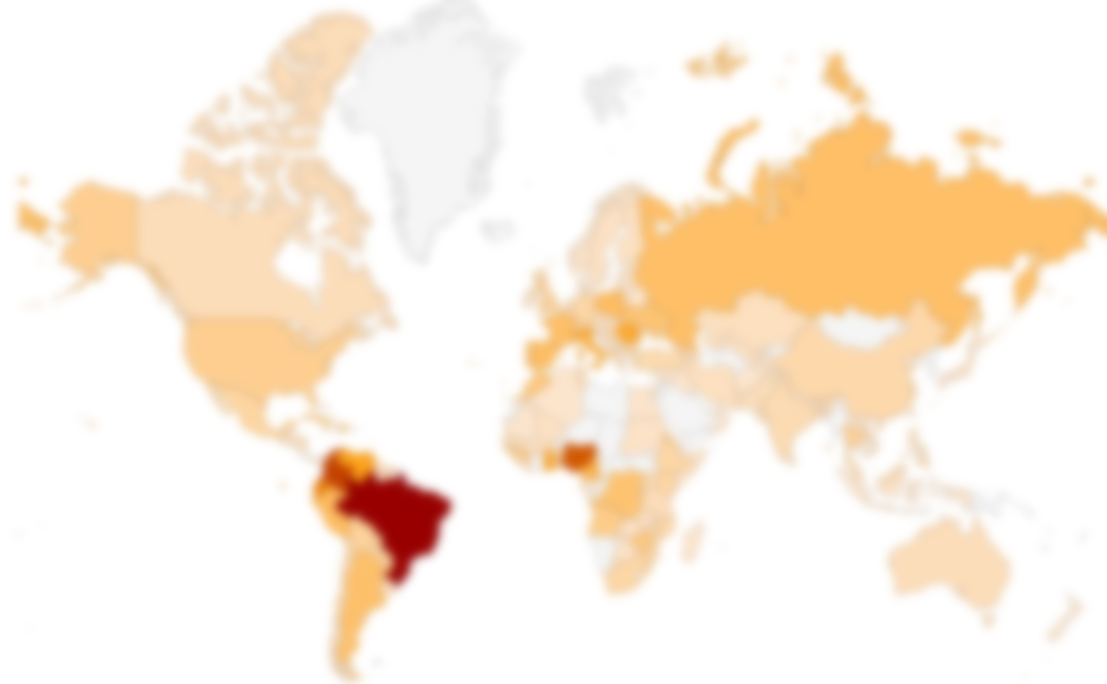
Results –Pre/at diagnosis
 | Women (n=658) | Het Men (n=446) | Gay/bisexual men (n=989)
Age (median years ) | 37 | 41 | 35
Years in CCOR prior to diagnosis (median) | 5 | 8 | 7
Region of birth (%)
Africa | 63.1 | 57.0 | 7.4
Lat America/Caribbean | 18.2 | 16.1 | 46.1
Europe | 13.8 | 18.2 | 31.7
Other | 4.9 | 8.7 | 14.8
Prior negative HIV test (%) | 46.7 | 43.4 | 82.0
Late diagnosis CD4<350 (%) | 50.0 | 56.9 | 29.8
CCOR=current country of residence

Slide 7
Previous negative HIV test
Women (46.7%)
Associated* with Antenatal care in CCOR
Het Men (43.4%)
Associated* with immigration status
Gay/bisexual men (82.0%)
Associated* with CCOR; Age; Number sex partners in CCOR; STI diagnosis ever; Gay vs bisexual
High health service use in 2 years prior to diagnosis (71 to 83% across groups)
HIV testing mentioned at GP 11 to 28%
Registered with GP associated with CCOR & Immigration status across all groups
*Multivariable analysis adj for CCOR, age, region of birth, years since migration, immigration status
Notes:
MSM Factors* associated
CCOR; Immigration status; years since migration, on ART

Slide 8
Social determinants
 | Women % | Het Men % | Gay/bisexual men %
Income min wage or more | 24 | 31 | 63
Mod/severe hunger past 4 wk | 22 | 27 | 13
Missed appointments due to travel expense | 12 | 15 | 7
Delayed/forwent treatment due to cost | 8 | 9 | 5
TasP indicators
On ART | 84 | 91 | 68
Last viral load <50 copies/ml | 77 | 76 | 78
~1/3 Experienced difficulties with health service post migration
Unclear of right to access
No health card/insurance
Language
Notes:
Travel to home country in past yr 29.0%; 28.8%; 50.3%

Slide 9
Policy and health system challenges
Structural factors dominate access to HIV prevention and integration into health system
Migrant women & het men – structural interventions required as well as individual-level behavioural interventions
MSM – many seroconverted within 2 years of last negative HIV test
Many missed opportunities – testing and prevention
Notes:
Why is it important to provide ART to migrants:
From a clinical perspective, treatment reduces morbidity and mortality
From a public health perspective, you are 96% less likely to transmit HIV if you are on treatment and virally suppressed
From a human rights perspective, it is the right thing to do

Slide 10
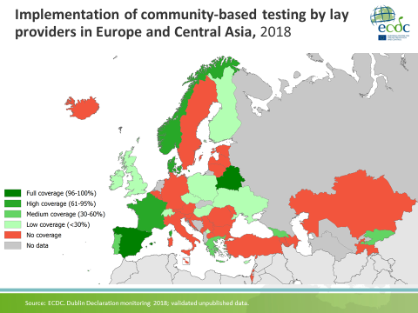
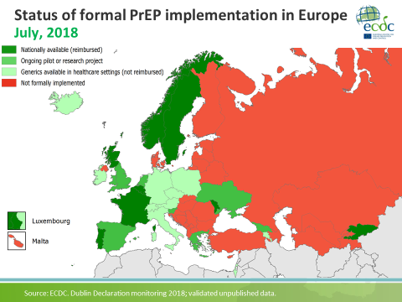

Slide 11
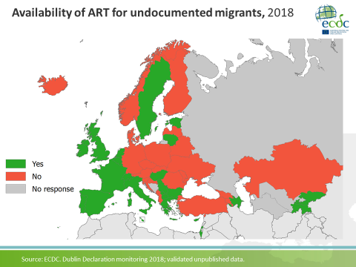

Slide 12
Thank you
Julia del Amo • Ibi Fakoya • Teymur Noori
aMASE Working Group
Débora Álvarez • Anne-Françoise Gennotte • Cécile La Morté • A Barthélemy • Claudia Wengenroth • Giota Touloumi • Gountas Ilias • Koulai Loumpiana • Anagnostou Olga • Gundolf Schüttfort, • Claudia Wengenroth • Henrique Barros • Paula Meireles, • Susana Monge • Bruno Ledergerber • Cornelia Staehelin • Maria Prins • Janneke Bill • Freke Zuure • Tullio Prestileo • Nicolla Petrosillo
Advisory Members of WG
Anne Johnson • Ade Fakoya • Alain Volny-Anne • Kevin Fenton • Ramazan Salman
Community Advisory Group
Bryan Teixeira • Bisi Alimi • Debora Alvarez • Janneke Bil • Anna Colucci • Julia del Amo • Marc Dixneuf • Andy Gregg • Jason Farrell • Anna Maria Luzi • Maureen Louhenapessy • Alberto Martin-Perez • Tatiana Mouhebati • Godwyns Onwuchekwa • Jenifer Rebollo • Ramazan Salman • Diana Silva • Miguel Vazquez • Alain Volny-Anne • Nicky Voudouri • Wim Zuilhof • Freke Zuure • Koen Block
Everyone who participated in and promoted the survey
Funding from the European Union’s Seventh Framework Programme for research, technological development and demonstration under EuroCoord grant agreement n˚ 260694

