Slide 1
Drug use among MSM (overview with focus on chemsex)
Isabelle Giraudon
AIDS 2018, Amsterdam, 23 July 2018

Slide 2
Challenges from a drug monitoring perspective
Challenges in monitoring drug use and drug-related harms among MSM
Definition, prevalence?
‘Trendspotter’/sentinel methodology
Impact of new psychoactive substances
Challenges in reaching out and linking to care
Joining up sexual health and drug services to better meet client needs

Slide 3
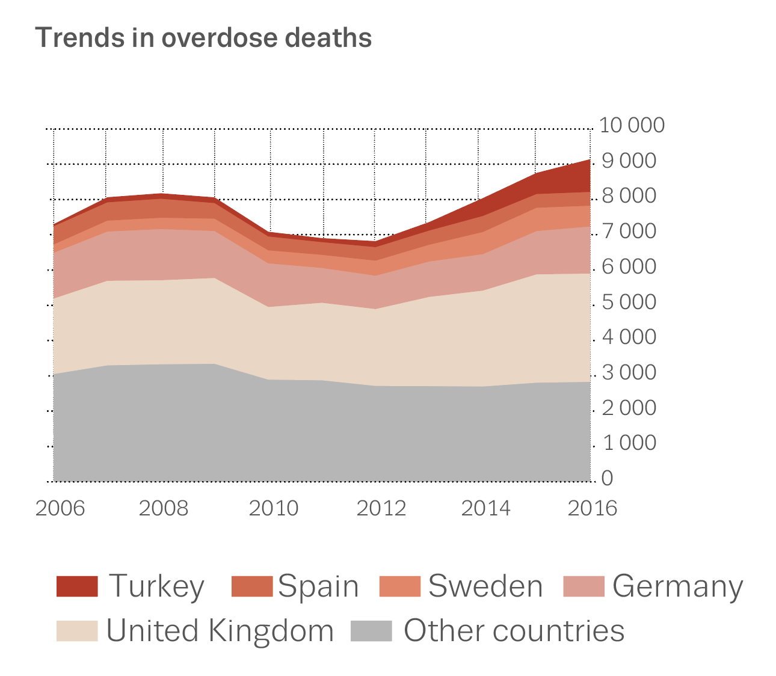
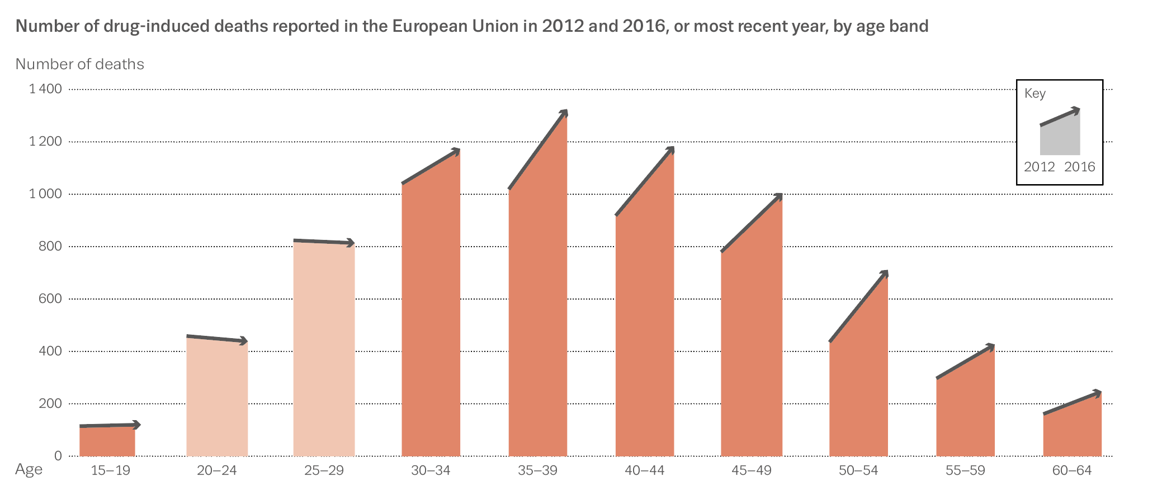
Overall overdose deaths
9 138 deaths in 2016
Heroin and other opioids a concern
Increases in all age categories
Frequency of harm through overdose of typical chemsex drugs? GHB, mephedrone, crystal meth? – limited data

Slide 4
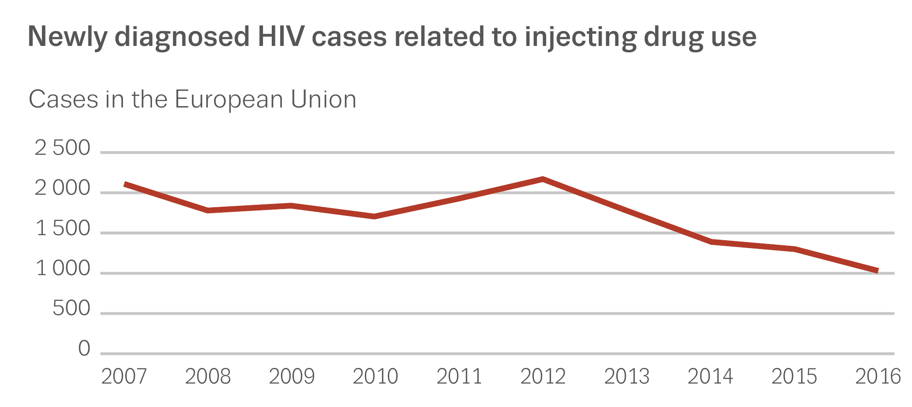
HIV among injecting drug users
Overall decrease of 51 % between 2007 and 2016
1 027 new cases among injecting drug users
Evidence shows needle and syringe programmes are effective in reducing the transmission of HIV
New HIV infections in the context of chemsex/slamming?

Slide 5
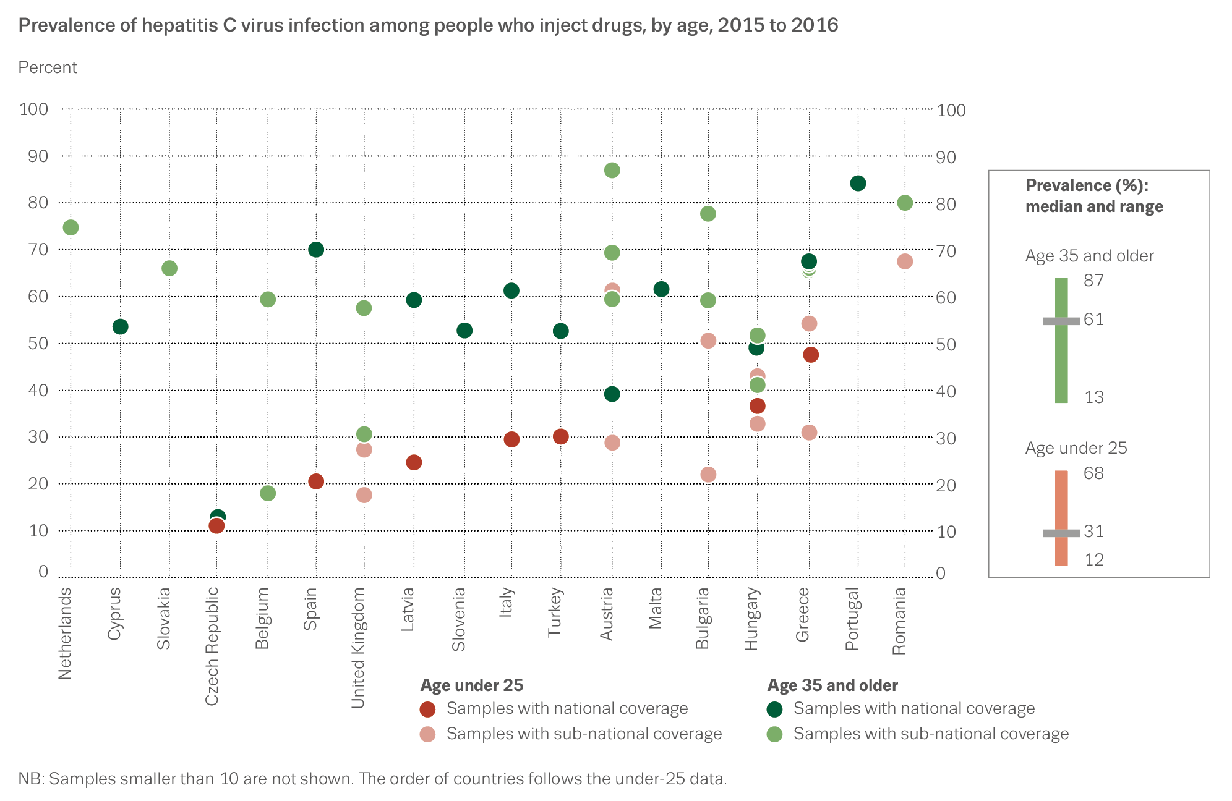
High hepatitis C prevalence
2015-16 prevalence varied from 15 to 82 %
6/13 countries with national data reporting a rate in excess of 50 %
Infections in the context of chemsex/slamming?

Slide 6
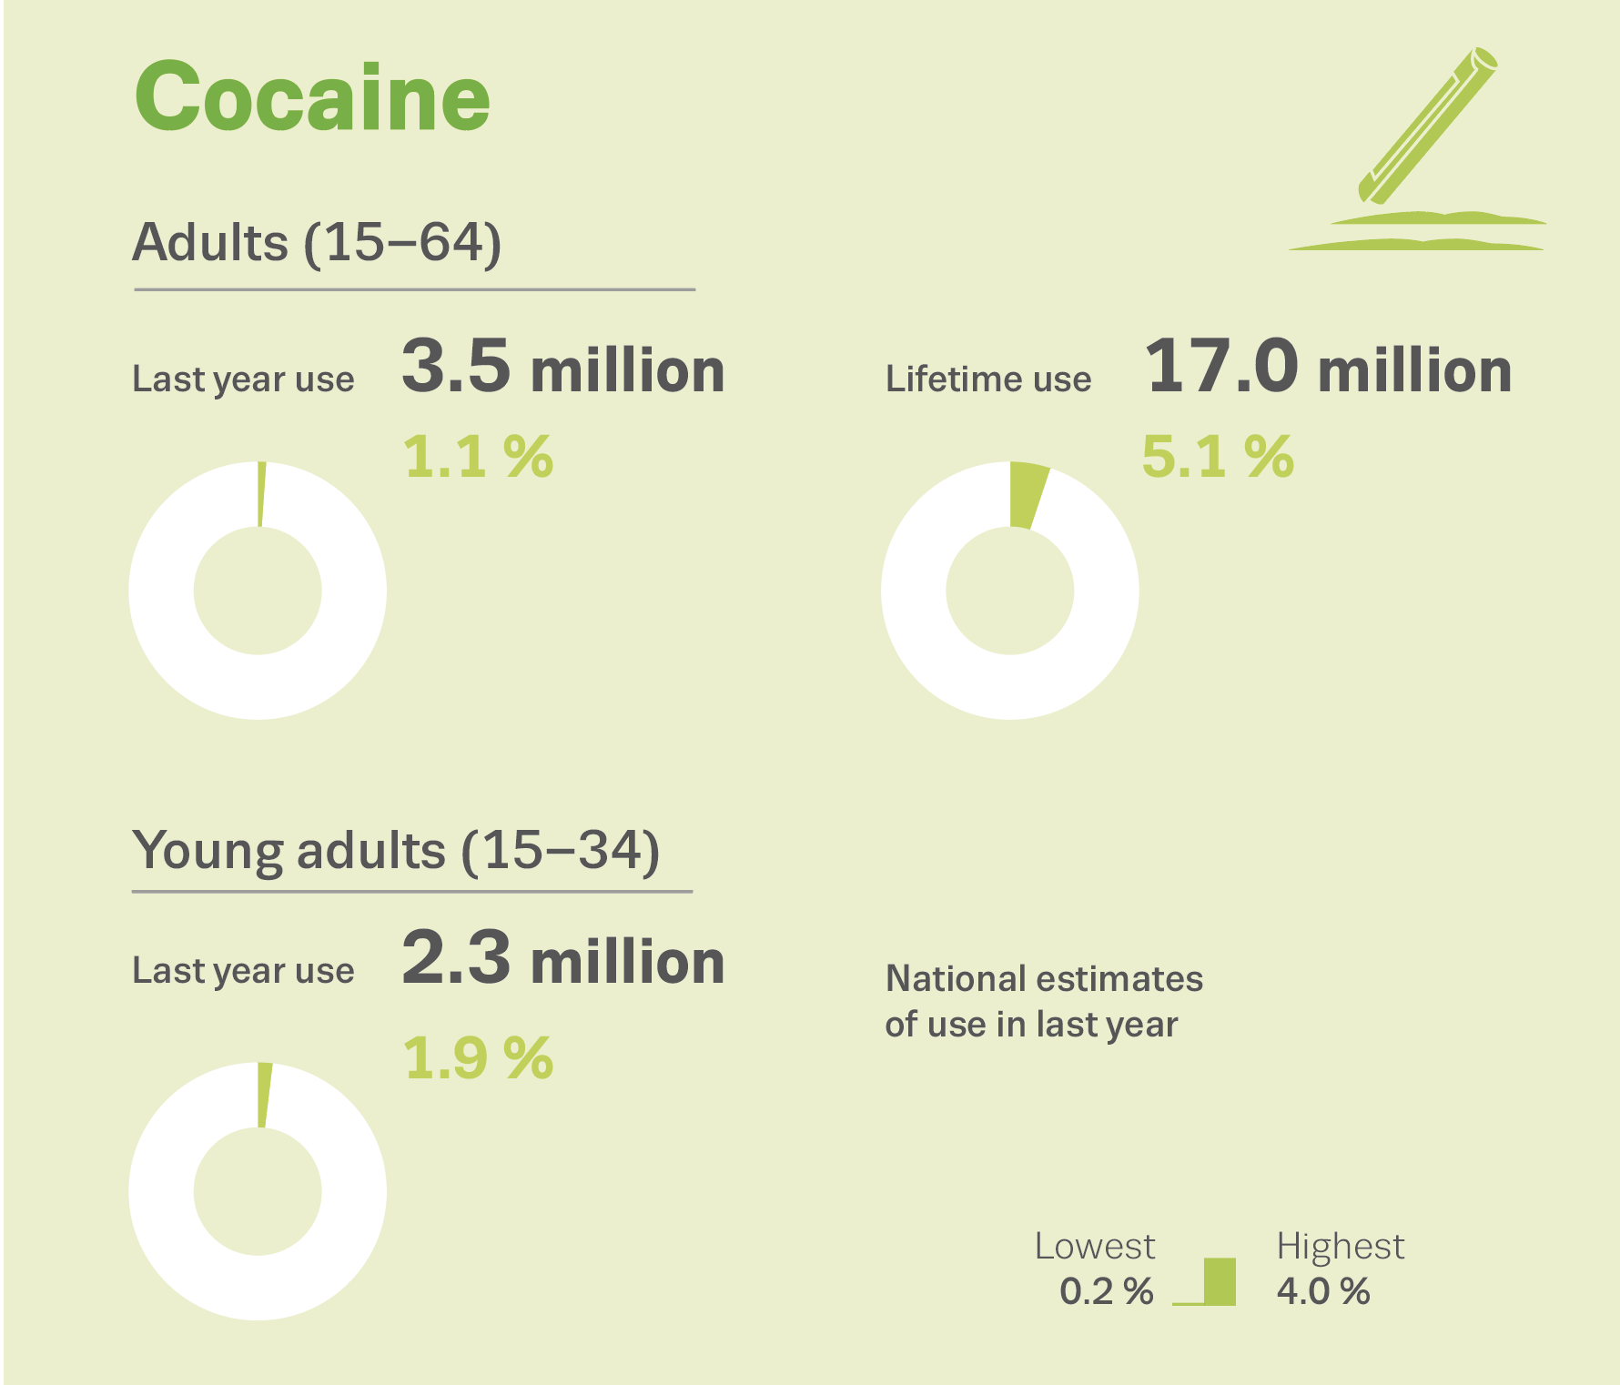
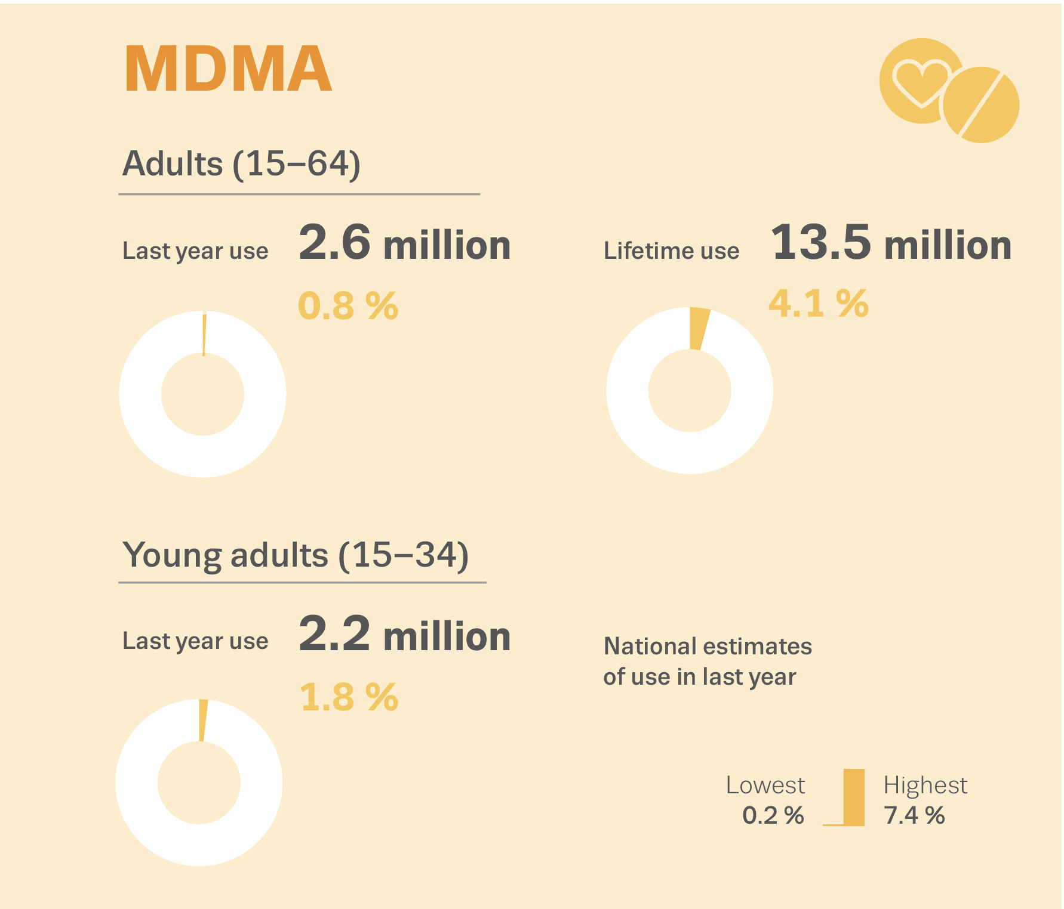
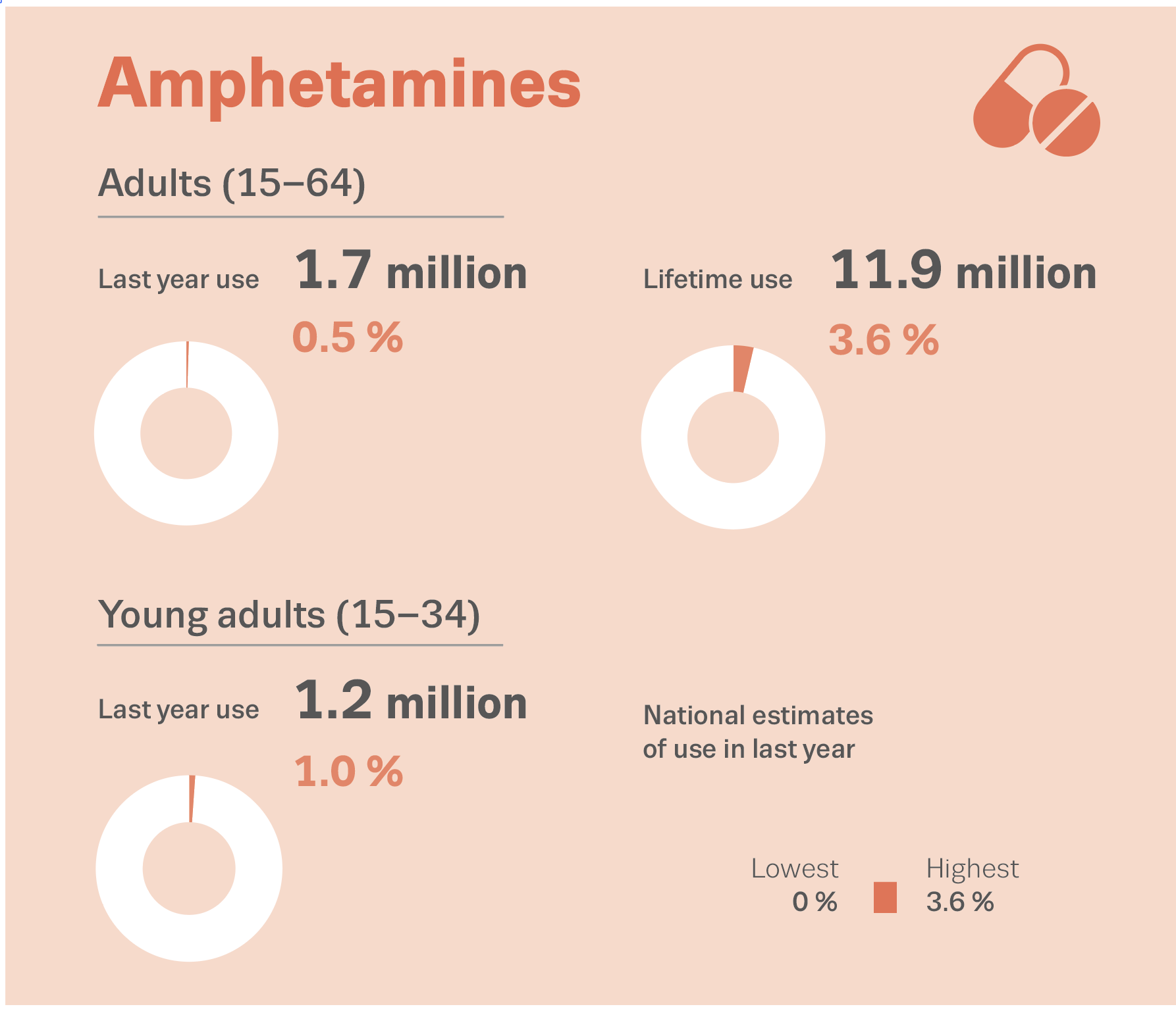
Stimulant use in the general population
Cocaine: 2.3 million young adults (15-34) used it in the last year
MDMA: 2.3 million young adults (15-34) used it in the last year
Amphetamines: 1.3 million young adults (15-34) used it in the last year

Slide 7
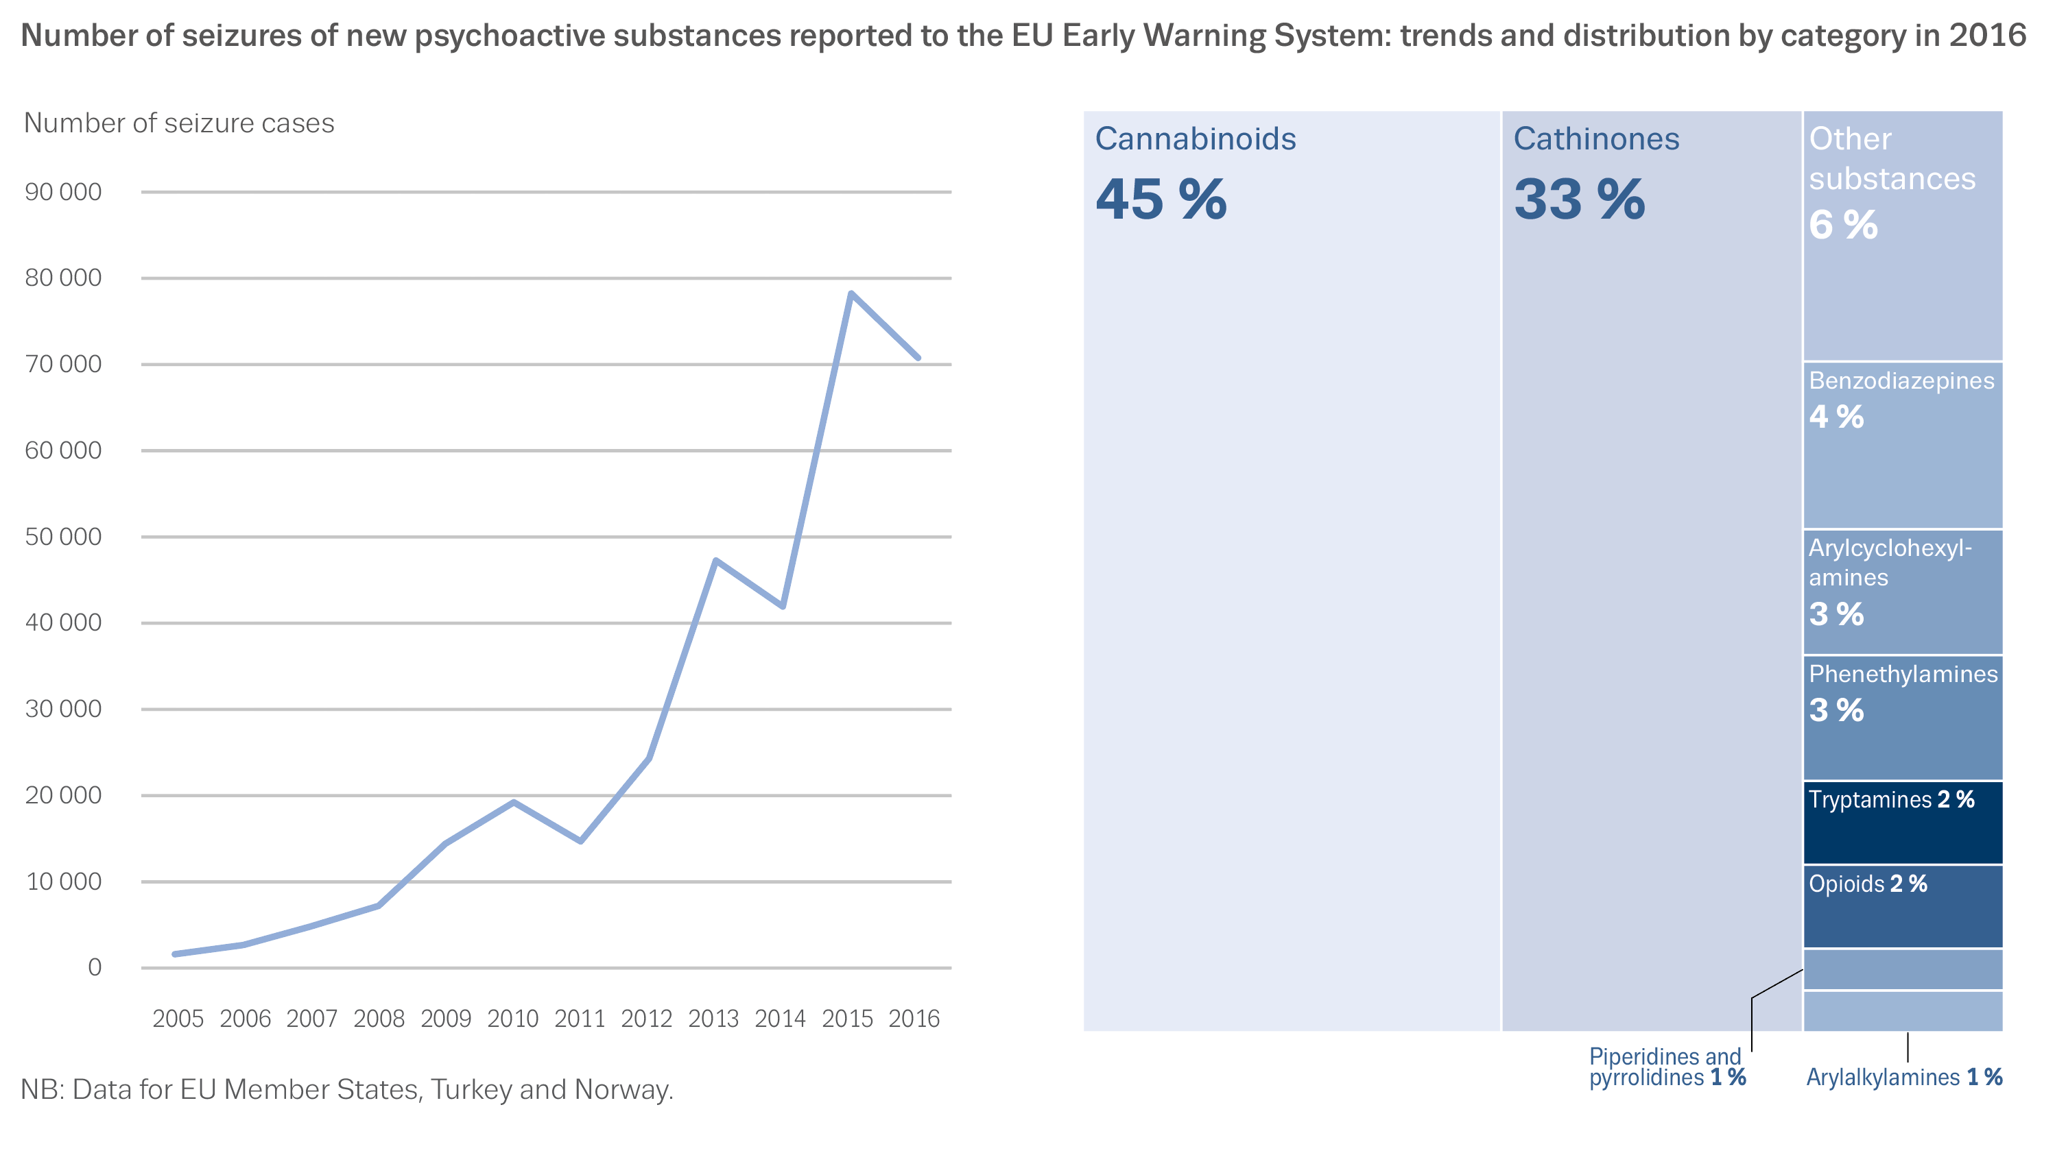
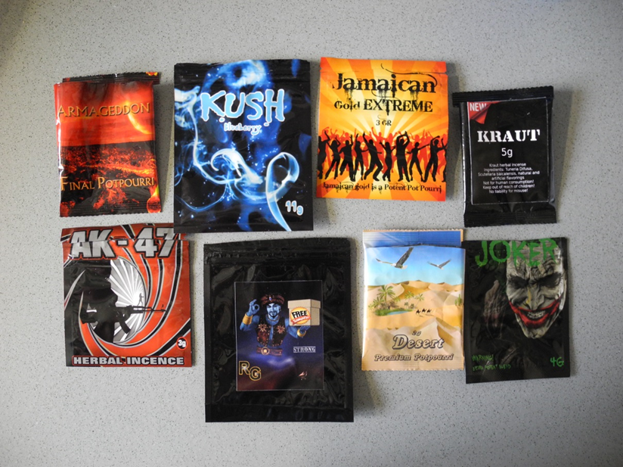
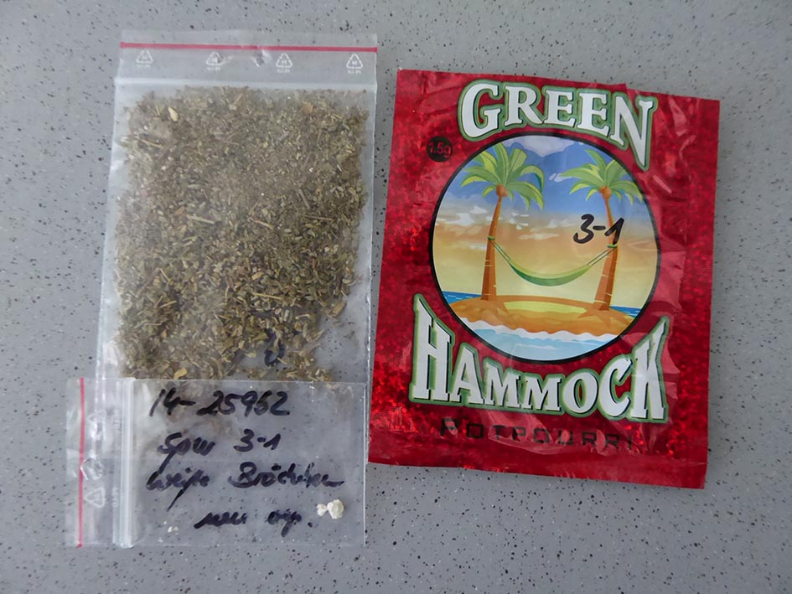
NPS seizures: synthetic cathinones and cannabinoids continue to dominate
^{Copyright: Jan Schäper.}
^{Copyright: Jan Schäper.}

Slide 8
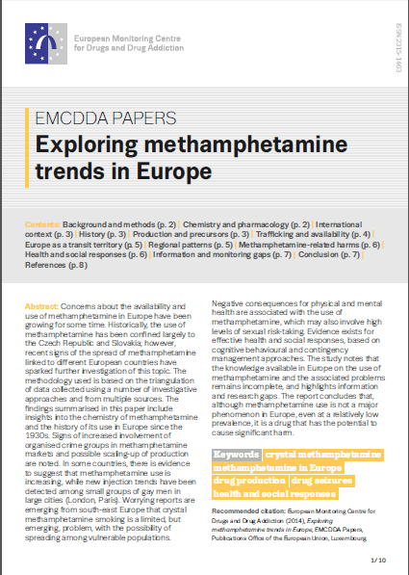
Methamphetamine use and slamming
‘This is a public health concern for gay men participating in slamming parties, with experts reporting poor adherence to HIV medication and increased rates of hepatitis C virus reinfection among this group’.
‘Although the injection of drugs is generally on the decline across Europe, it is particularly worrying that this new phenomenon known as slamming is going against the trend’.
Source: EMCDDA Trendspotter study summer 2013

Slide 9
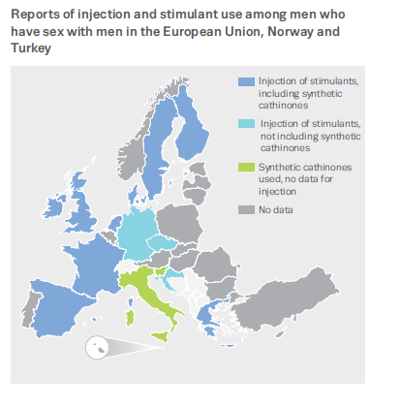
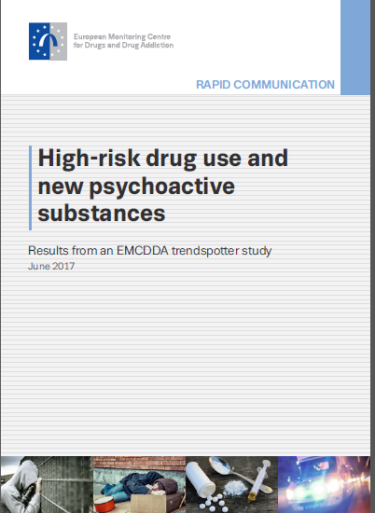
Injection and stimulant use among MSM
Source: Trendspotter study 2017
There are concerns that small groups of men who have sex with men who may be experiencing problems linked with chemsex and slamming seem to be ‘off the radar’ of national drug agencies and communitiy based drug services (Pirona et al 2017)
Notes:
The practice of stimulant drug injection, sometimes including synthetic cathinones, by a subgroup of men who have sex with men has raised public health concerns in recent years. This injection behaviour, generally referred to as ‘slam’ or ‘slamming’, primarily takes place in the context of sex parties (Batisse et al., 2016; Kirby and Thornber-Dunwell 2013a,b; Stuart, 2013). Synthetic cathinones, such as mephedrone, are sometimes used in combination with other drugs such as GHB (gamma-hydroxybutyrate), GBL (gamma-butyrolactone), crystallised methamphetamine, cocaine and sildenafil, with the purpose of reducing inhibition and enhancing sexual experience (Abdulrahim et al., 2016; Bourne et al., 2014). ‘Chemsex’ parties can last from a few hours to several days and participants usually engage in risky sexual practices with multiple partners, sometimes exchanging syringes and not using condoms, with a consequent increase in the risk of contracting sexually transmitted diseases and other blood-/body fluid-borne viral infections (McCall et al., 2015; Peyrière et al., 2013).
At the time of writing, a small number of studies documenting slamming practices have come from France, Spain and the United Kingdom. A recent survey of HIV-positive patients attending 30 HIV clinics in England and Wales found that among the men who have sex with men, nearly a third (29 %) reported engaging in chemsex in the past year and 1 in 10 reported slamming (Bourne et al., 2015; Daskalopoulou et al., 2014; Pufall et al., 2016). Studies have also been conducted in French cities (Batisse et al., 2016; Foureur et al., 2013). In addition, experts involved in this analysis report that the injection of NPS among men who have sex with men also occurred in Ireland, the Netherlands and Sweden.
Reports of slamming practices are also available from other European countries. In both the Czech Republic and Germany, the injection of stimulants among small populations of men who have sex with men is confirmed, but synthetic cathinones do not appear to be part of the cocktail of substances used. In Denmark, Finland and Greece, anecdotal evidence also suggests that some stimulant injection might be occurring among men who have sex with men. In Italy and Slovenia, mephedrone is reportedly available and used in the men who have sex with men scene but there is no clear evidence that it is being injected (see Figure 3).
Evidence suggests that those among this group with drug problems are more likely to be in contact with sexual health clinics or HIV/AIDS checkpoints

Slide 10
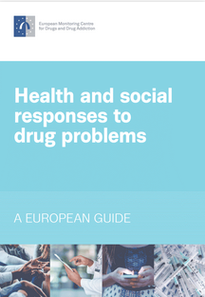
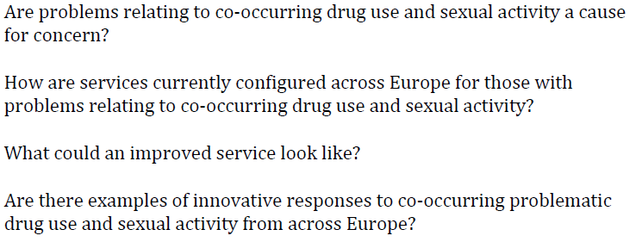
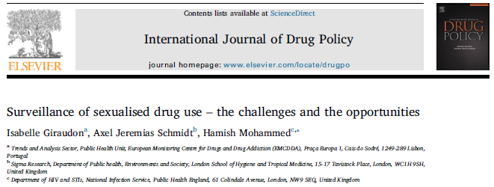
Source O Bowden-Jones, 2017 Background paper commissioned by the EMCDDA

Slide 11
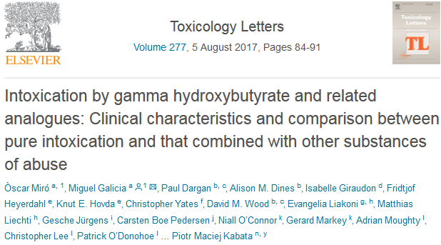
‘Sentinel’ and mixed methods surveillance needed
Source: Euro-DEN European sentinel network of 32 hospital emergency services in 20 countries (network supported by EMCDDA)
Source: OFDT French Focal point for EMCDDA

Slide 12
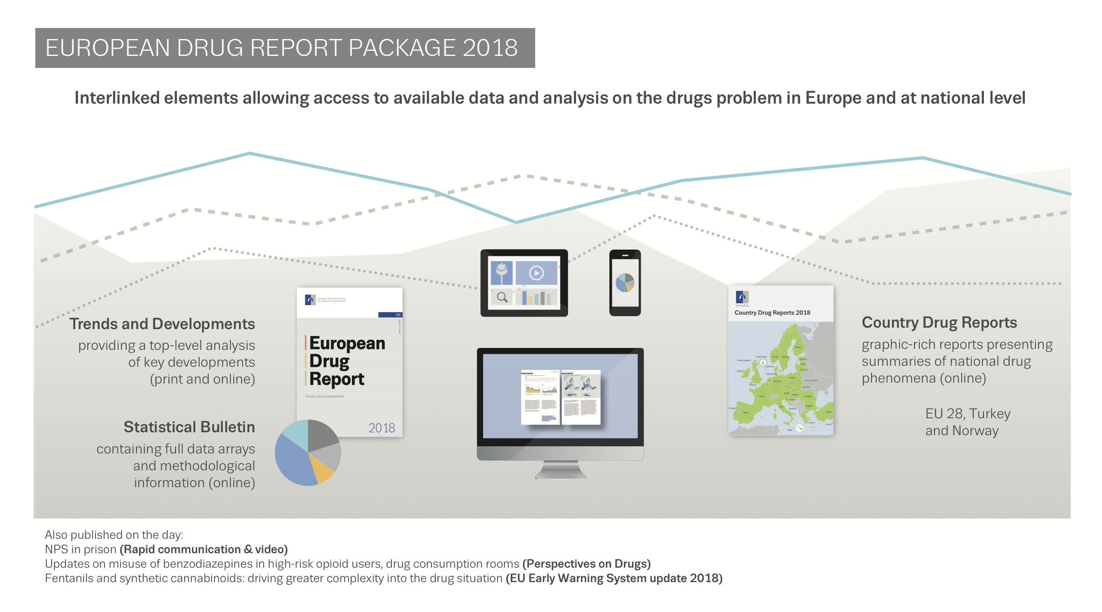
Thank you for your attention
Isabelle.giraudon@emcdda.europa.eu

