Slide 1

Beyond viral suppression – Long term sexual health of people living with HIV
Professor Jeffrey Lazarus
Steering Group Co-Chair
Pre-conference: Understanding and Addressing the HIV and STI Syndemics

Slide 2



Why ‘beyond viral suppression’?
Because living a long and healthy life with HIV is a reality
Over the last three decades HIV/AIDS care has transformed markedly
Understanding the
virus and providing palliative care for those with HIV/AIDS
The advent of
antiretroviral therapy
Now in an era where living a long and healthy life with HIV is a reality
Source: Lazarus JV, Safreed-Harmon K et al. BMC Medicine 2016;14:94.

Slide 3

The HIV Outcomes initiative
Today’s health and social inclusion issues for people living with HIV (PLHIV) receive insufficient attention from policy-makers and healthcare providers
Aims to make these elements central to overall HIV response
Complementary to existing work in prevention, diagnosis, treatment and care
Collaboration, partnership and cross-boundary working
Observer status
Sponsored by Gilead Sciences and ViiV Healthcare

Slide 4
The HIV Outcomes initiative
Works to ensure that PLHIV live long and live well
Viral suppression, although crucial, is not the only outcome that matters for PLHIV
Longer life with HIV brings different challenges that need different approaches
Developing a new paradigm for policy attention and care delivery

Slide 5

HIV Outcomes - Organisation
Study
group
Observers
Steering
group
Presidents
Operations team
Secretariat

Slide 6
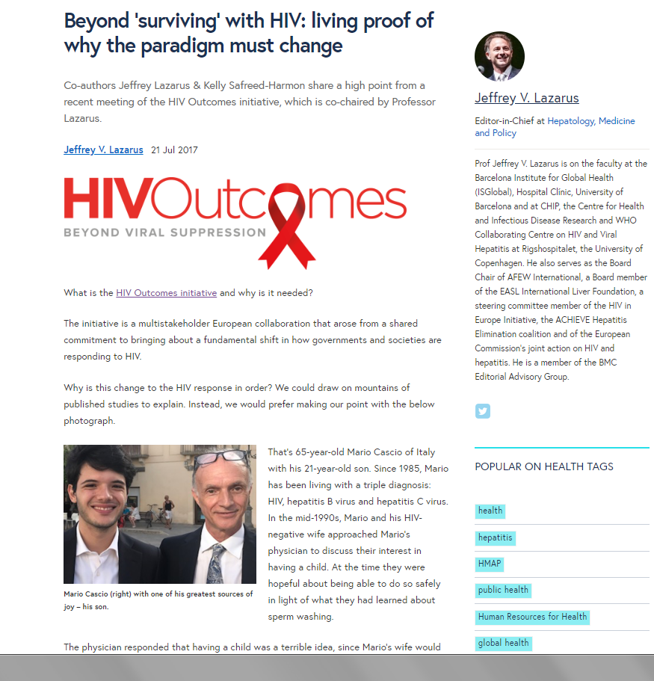
Sexual and reproductive health of PLHIV
“We would like to have a child”.
The physician responded that having a child was a terrible idea, since Mario’s wife would simply end up raising the child alone as a widow.

Slide 7
STI services for PLHIV in your country
Do you think PLHIV are receiving the services they need to prevent and treat STIs in your country?
No, services need to be improved to care for comorbidities in PLHIV
Somewhat, only some areas have suitable services available
Yes, suitable services are available
Do not know

Slide 8
Beyond Viral Suppression: Our research plan
Our Question: How are health systems performing in relation to the changing clinical and psychosocial realities facing people with HIV in Europe as we go ‘beyond viral suppression’?
RETENTION IN CARE
RETENTION IN CARE
RETENTION IN CARE
Notes:
The starting point was concern about poor QoL of virally suppressed PLHIV – led to recognition of the need to investigate health outcomes, including both comorbidities and QoL outcomes, as well as the need to investigate access to services, to see if that is contributing to suboptimal outcomes.

Slide 9
Health outcomes for people living with HIV
Insufficient attention is being paid to
long-term health outcomes and quality of life
Notes:
UNAIDS 90-90-90 sparked the need to address quality and health outcomes in the Beyond VS era.

Slide 10
Methodology

Slide 11
Methodology
18-item English-language survey drawing on 2017 HIV Outcomes Beyond Viral Suppression report
7 sections: HIV clinical management, comorbidities, health-related quality of life, psychosocial services, discrimination, sexual and reproductive health, and general issues
Respondents: HIV monitoring experts in Estonia, Italy, the Netherlands, Slovenia, Sweden and Turkey
Survey administered from 20 April 2018 to 30 June 2018

Slide 12
Findings

Slide 13
Comorbidities and polypharmacy
Service access – comorbidity screening/testing in PLHIV
  Many countries cannot monitor screening/testing for several comorbidities
  High capacity to monitor screening/testing for HBV, HCV and TB

Slide 14
Comorbidities and polypharmacy
Service access – comorbidity diagnosis and treatment in PLHIV
  Monitoring of diagnosis and treatment for comorbidities is also limited
  Again, HBV, HCV and TB more widely monitored

Slide 15
Comorbidities and polypharmacy
National HIV clinical guidelines
  Some guidelines do not include recommendations to screen/test for widespread comorbidities, including STIs and sexual dysfunction
  Three do not include recommendations to screen for polypharmacy

Slide 16
Discrimination within health systems
Few countries can report on this important indicator!
Notes:
Say that the point is not how much discrim there is in Slovenia and Turkey, but rather that so many countries don’t know how much discrim, when there is a great deal of narrative evidence of discrim within health systems in many countries (i.e. Evidence of it happening, but w/o systematic measurment of incidence/prevalence in nationally representative populations).
ALSO – if people ask, explain what the Slovenia and Turkey data are based on. We do not know Slovenia source – have queried and are awaiting response. Turkey wrote, ” This data is taken from an early study (run in 2011) and is the only data from Turkey on stigma. (Gökengin D, Çalık Ş, Öktem P. Analysis of HIV/AIDS-Related Stigma and Discrimination in Turkey: Results of the People Living With HIV Stigma Index. Klimik Dergisi 2017; 30(1): 15-21).”

Slide 17
Desire for children
Desire for children and need for preconception planning among PLHIV
  No countries report on the issue
  Few countries have the capacity to report on our proposed indicators
Notes:
We do not know whether or not this is problematic – research in this area is somewhat limited, and we cannot determine how widespread the interest is among PLHIV in having children.
If there is widespread interest, then it may be important to monitor unmet need for preconception planning services, as research in various countries has indicated that health care providers are not sufficiently attentive to the fertility desires of patients with HIV.

Slide 18
Health-related quality of life
Health-related quality of life
  One country is currently reporting HRQoL
  Two others have the capacity to do so
  Three do not

Slide 19
Conclusions

Slide 20
Conclusions
Study countries have monitoring gaps across key domains:
  Comorbidities including STIs
  Discrimination within health systems
  Desire for children
  Health-related quality of life
Overburdened national monitoring systems cannot be expected to take on more than a few new indicators – what should these be?
Minimise reporting burden by prioritising carefully and aligning with current indicators and monitoring activities

Slide 21
HIV Outcomes recommendations
Year-long multi-stakeholder process focusing on long-term health and well-being of PLHIV
Identified priority issues at two expert roundtables (December 2016; June 2017)
Expert workshop to develop recommendations responding to these issues (September 2017)
Launched at European Parliament event (29 November 2017)

Slide 22
Recommendations
Adopt an integrated, outcomes-focused, and patient-centred approach to long-term care
  Put comorbidity prevention, treatment and management at the centre of long-term HIV care
  Coordinate outcomes-focused care delivery using a personalised care plan
  Integrate services for mental health and neurocognitive impairment
  Ensure an ongoing focus on sexual and reproductive health
  Increase systematic participation of PLHIV in decisions about their care

Slide 23
Recommendations
Expand national monitoring of long-term care and outcomes
Fund studies to provide information on the long-term health of people living with HIV
Combat stigma and discrimination within health systems
Upscale involvement of the HIV community in priority setting at country level

Slide 24
Acknowledgements
Study Group participants include Dr Julia del Amo (National Centre for Epidemiology, Spain), Professor Jane Anderson (Homerton University Hospital NHS Foundation Trust), Yusef Azad (UK National AIDS Trust), Dr Natasha Azzopardi Muscat (European Public Health Association and the University of Malta), Dr Udi Davidovich (Amsterdam Public Health Service), Nikos Dedes (European AIDS Treatment Group), Dr Josep Maria Gatell (University of Barcelona), Meaghan Kall (Public Health England), Konstantinos Lykopoulos (Viiv Healthcare), Dr Annick Manuel (Gilead Sciences), Dr Ellen Nolte (London School of Hygiene and Tropical Medicine), Teymur Noori (ECDC) and Professor Kholoud Porter (University College London).
The HIV indicators study manager is Kelly Safreed-Harmon (ISGlobal, Hospital Clínic, University of Barcelona).

