Slide 1
Monitoring the Accountability Framework-
Community Perspective
Sunday, 22 July, 07:30-20:00
Room Elicium 1, RAI Amsterdam
Blessina Kumar

Slide 2
Disclosure
Relations that could be relevant for the meeting | Company names
Sponsorship or refund funds
Payment or other financial remuneration
Shareholder rights
Other relations | Union Board of Directors Global TB CAB Member Member rGLC SEAR Chair Ethics Committee, NITRD, India
Reference: https://www.cgr.nl/CGR.nl/media/CGR.nl/Gedragscode/Format-of-disclosure-slide-for-speakers-at-refresher-training-meetings.pdf

Slide 3
Outline
Key Asks
Principles of Accountability Framework
Who should be accountable?
Communities – egs. From successful movements
What is needed?- Community Perspective
Conclusion

Slide 4

UNITED TO END TUBERCULOSIS: AN URGENT
GLOBAL RESPONSE TO A GLOBAL EPIDEMIC
Key Asks from TB Stakeholders and Communities
Reach all people by closing the gaps on TB diagnosis,
treatment and prevention
Transform the TB response to be equitable, rights-based,
and people- centered
Accelerate development of essential new tools to end TB
Invest the funds necessary to END TB
Commit to decisive and accountable global leadership, including regular un reporting and review

Slide 5
Principles
Guiding principles of the Accountability framework (supported by TB affected communities and CS)
Effectiveness
Integrity
Inclusive
Accountable and transparent

Slide 6
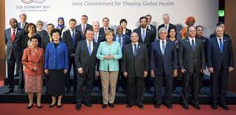
Who should be accountable?
Heads of State
National Programs
Technical Partners
Donors
Civil Society Organisations
Community Based Organisations

Slide 7
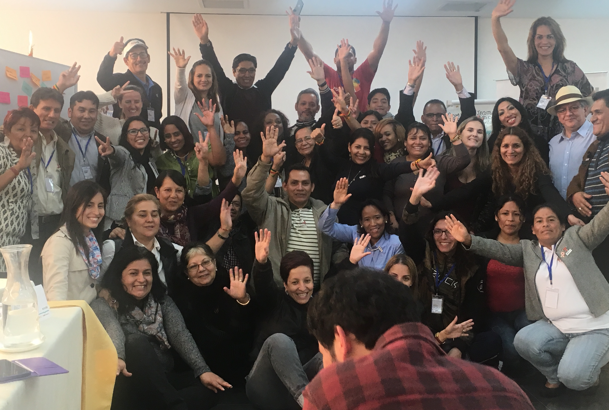

Communties!!!!!
Communities are ideally best placed to realistically monitor and hold entities accountable!!

Slide 8

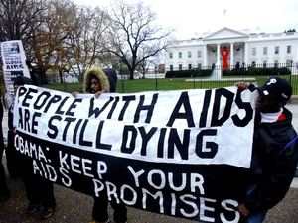
Comparative advantage- Communities
SILENCE=DEATH
USA -50
Australia
London
Paris
India
AIDS Coalition to Unleash Power
“make a demand that’s reasonable and doable, present that demand to the powers that be who can enact it, and when they refuse, you do civil disobedience until they are forced by pressure to take action.”-Sarah Schulman, activist.

Slide 9
Lets look at TB
Present monitoring and Reporting is very medicalised
TB response needs to reflect the urgency and so does our accountability mechanism
Both the response, accountability framework and monitoring of it needs to be about PEOPLE!

Slide 10
What is needed? – Community perspective
Community led independent and fully funded accountability mechanism
  Informed, empowered, science literate, TB survivor/ affected
Inclusive Monitoring mechanisms
  Inclusive would mean that communities can access both information and report into easily. It is more than a global/national community organisation/ CSO making a ‘alternate report’. It has to be the person on the ground having the ease of access. This plug-in is presently missing.

Slide 11
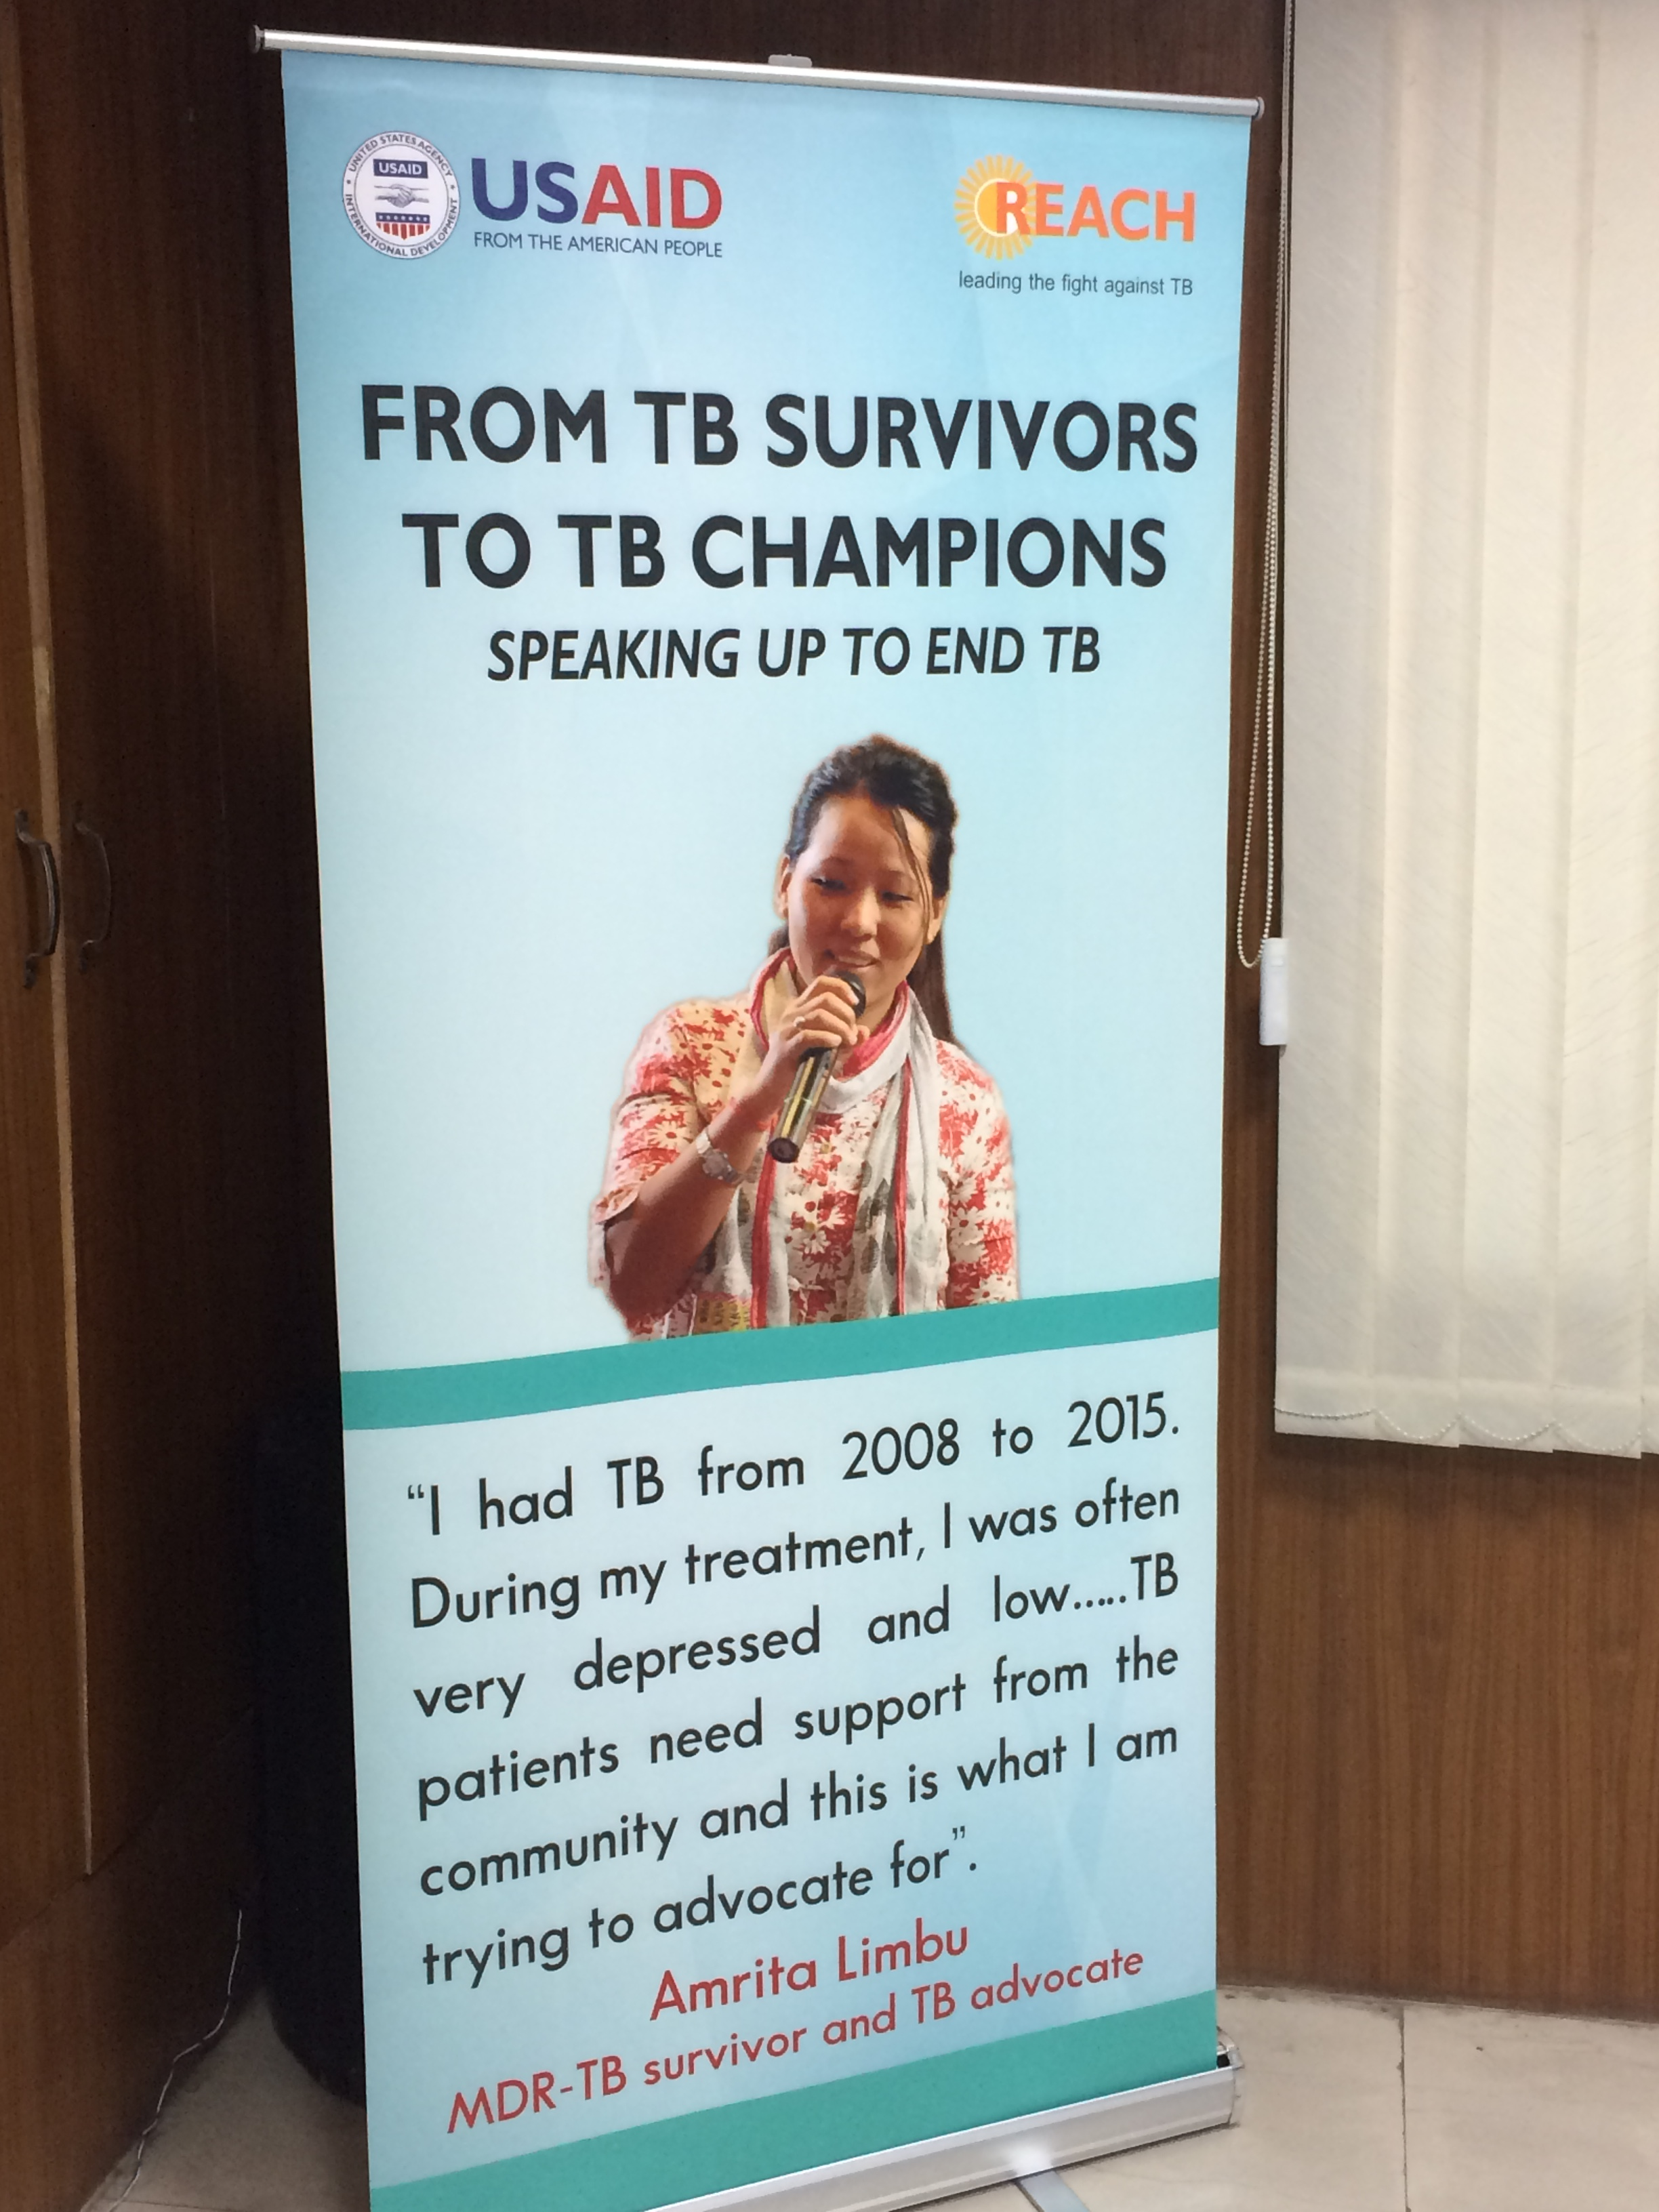
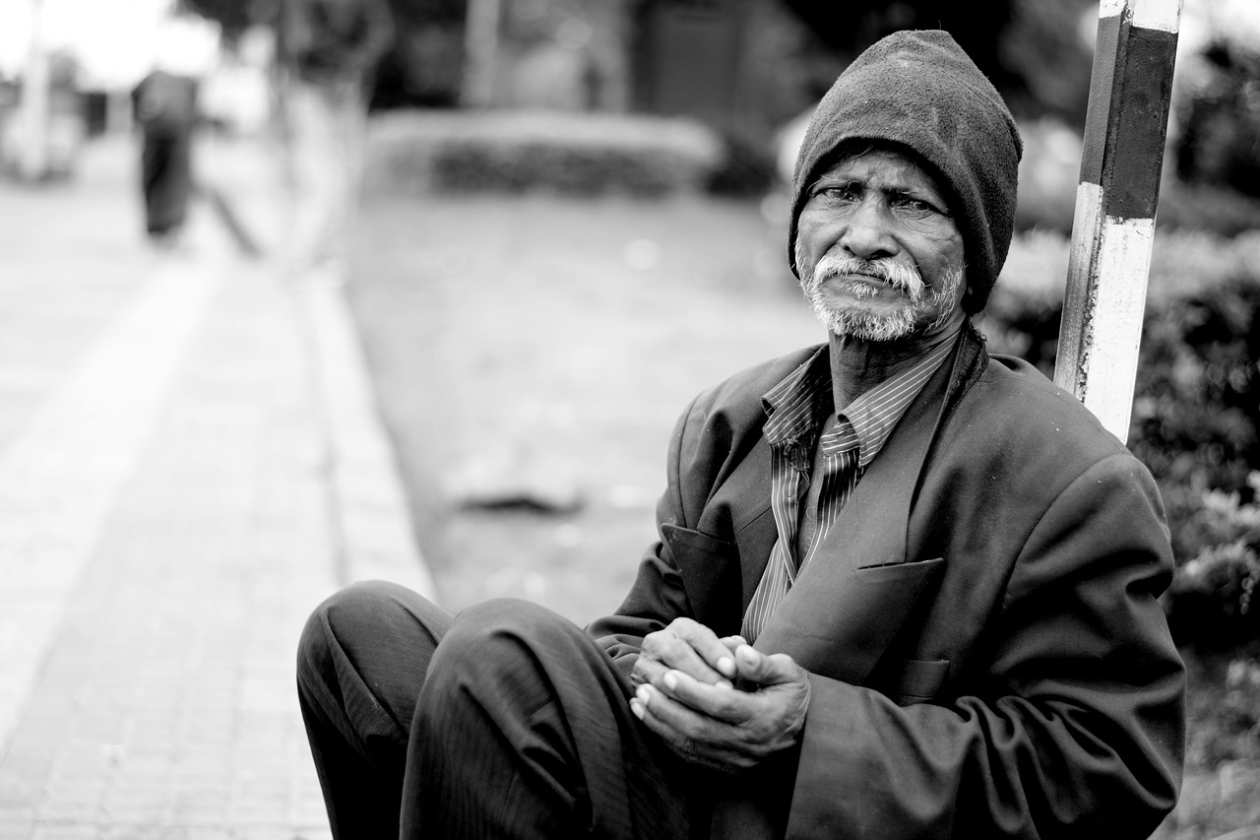

Slide 12
What is needed?
They are members of the community.
The empowered community worker and the poor person.
In the accountability structure, which is inclusive, both of them need to be able to feed into the system their angst or their joy of being cured of TB or having their community free of TB.

Slide 13
What is needed?
Where is the feedback loop?
Where is technological edge?
Where is the disruptive tech that is changing the world?
We need to invest in developing an inclusive monitoring mechanism with clear process indicators.
Best if it was done along side developing the accountability framework.

Slide 14

What next?
We don’t have all the answers but what we can and need to do is together invest in developing an inclusive monitoring mechanism for the accountability frame work with clear process indicators.

Slide 15
Thank you!
Email: communication@gctacommunity.org
Website: www.gctacommunity.org

