Slide 1
Notes:
1. Define syndemics and describe syndemic theory (based on Merrill Singer's seminal book)
2. Provide examples of how syndemics drive HIV in key populations/vulnerable groups (using published literature)
3. Discuss how syndemic theory can be used (and has been used where there's data) to inform development of interventions tailored for key populations.
FOCUS ON EXAMPLES: SPNS PROJECTS for TRANS WOMEN

Slide 2
Syndemic Theory
Tonia Poteat, PhD, MPH, PA-C
Johns Hopkins School of Public Health
Center for Public Health and Human Rights
Notes:
From the session organizers: What they expect-- 3 topics connected—non-technical intro to each. Highlight links with other topics. Ending with me (ethics). Make sure we have enough time for questions. Stick to 15 minutes! Save questions for end. Have 20 minutes for discussion.
Frank: use of spacial analysis for epidemics in rural South Africa—geographic, young females, phylogenetic results also. Shows high risk community leading transmission. How these results feed into design of intervention. Not related to migrants as Christophe mentioned, but will be talking about migration -- its normative, 30% move each year. Fine social science work on how people feel about being labeled high incidence communities. (He said he will send me article.)
Christophe: will present results of Uganda intervention, and fisher folk analysis using phylogenetics as example of it being useful. Related to law and stigma of communities. How much migrants contribute to the epidemic. He will also talk about movement of phylogenetic analysis from central labs to diffusion of sequencing technology to local areas, and potential problems with that in the future
the theory of syndemics (for example, mental health, substance abuse, and sexual risk taking) within key and vulnerable populations and how they may interact with adverse social conditions (for example, migration, political unrest, and financial instability) in different geographical regions to drive the ongoing HIV epidemic
An introduction to syndemic theory, the role of syndemics in driving the HIV epidemic in different key and vulnerable groups, and how this information can be used to support tailored prevention programmes

Slide 3
Disclosures
Research Support
  Gilead Sciences
  Viiv Healthcare
Notes:
Several state-of-the-art methodologies and technologies have been introduced over the past decade, including:
· the theory of syndemics (for example, mental health, substance abuse, and sexual risk taking) within key and vulnerable populations and how they may interact with adverse social conditions (for example, migration, political unrest, and financial instability) in different geographical regions to drive the ongoing HIV epidemic
· real-time molecular epidemiology that can be used to rapidly identify clusters of new infections within geographically or demographically defined groups
· geographical information systems that can be used to understand the social and geographical structure of communities and to identify locations with high HIV prevalence and/or incidence
This session will describe ways in which information from these methodologies and technologies can be incorporated into prevention programmes that are tailored to local populations. The session will also discuss some of the ethical and legal issues that may arise when incorporating these methodologies into prevention programme

Slide 4
Acknowledgement
Thank you to the people living with HIV who have generously shared their time, experiences, and bodies for the purposes of research.
Much of the fight against HIV and AIDS relies upon people living with HIV continuing to put themselves forward and our fight against HIV and AIDS is indebted to those past and present.

Slide 5
What is a syndemic?
Synergistic Epidemic
MEDICAL DEFINITION
“A set of linked health problems involving two or more afflictions, interacting synergistically, and contributing to excess burden of disease in a population.”
--www.medicinenet.com
SOCIAL SCIENCE DEFINITION
“The concentration and deleterious interaction of two or more disease or other health conditions in a population, especially as a consequence of social inequity and the unjust exercise of power.”
  --M. Singer, Introduction to Syndemics
Notes:
An introduction to syndemic theory, the role of syndemics in driving the HIV epidemic in
different key and vulnerable groups, and how this information can be used to support tailored
prevention programmes
Tonia Poteat, Johns Hopkins Bloomberg School of Public Health

Slide 6

Syndemic Theory
Emphasizes role of social and cultural forces in producing epidemics
Differs from
  interacting epidemics (e.g. HIV and TB)
  co-morbid conditions (e.g. depression and substance use)
  multiple risk factors
Singer M. Introduction to Syndemics:A Critical Systems Approach to Public and Community Health. San Francisco, CA: Jossey-Bass; 2009.
Notes:
https://www.ncbi.nlm.nih.gov/pmc/articles/PMC4199444/
Syndemic theory may be the theoretical framework best suited to explain high rates of HIV/AIDS among Black and Latino men in NYC, because it takes into account multiple interrelated systems that contribute to heightened vulnerability to HIV/AIDS within marginalized communities. A syndemic is defined as “two or more afflictions, interacting synergistically, contributing to excess burden of disease in a population.”¹⁵In syndemic theory, individual epidemics are “sustained in a community/population because of harmful social conditions and injurious social connections”.¹⁶ Therefore, syndemics include epidemics both of disease and the social conditions that contribute to the proliferation of disease. Thus, epidemic must be understood in both physiological (i.e., disease) and psycho-sociological (i.e., behavioral, social, and structural) terms.^{16–19} The emphasis on the role of social and cultural forces in producing epidemics is one detail of syndemic theory that sets it apart from similar concepts that address the interactive effects of disease, such as “interacting epidemics” (e.g., HIV/AIDS and tuberculosis), “co-morbid conditions” (e.g., depression and substance use), and clusters of health-related crises.

Slide 7
Key Elements
Disease Concentration
  2 or more diseases concentrate in a particular social context (population, geography, etc.)
Disease Interaction
  Interactions between epidemics at individual and population level amplify disease burden
Large scale social forces
  Harmful social conditions drive the disease concentration and synergistic interaction
Singer et al, Lancet 2017; 389

Slide 8
The Seminal Syndemic
There remain significant methodological and geographical gaps in epidemiological and intervention research on the SAVA syndemic, particularly in low- and middle-income countries.
This global review underscores the need to advance a continuum of multilevel integrated interventions that target salient mechanisms of the SAVA syndemic, especially for adolescent girls, young women, and transgender women who use drugs.
Notes:
Objectives: Multiple pathways link gender-based violence (GBV) to HIV and other sexually transmitted infections among women and girls who use or inject drugs. The aim of this article is to synthesize global literature that examines associations among the synergistic epidemics of substance abuse, violence, and HIV/AIDS, known as the SAVA syndemic. It also aims to identify a continuum of multilevel integrated interventions that target key SAVA syndemic mechanisms. Methods: We conducted a selective search strategy, prioritizing use of meta-analytic epidemiological and intervention studies that address different aspects of the SAVA syndemic among women and girls who use drugs worldwide from 2000 to 2015 using PubMed, MEDLINE, and Google Scholar. Results: Robust evidence from different countries suggests that GBV signiﬁcantly increases the risk of HIV and other sexually transmitted infections among women and girls who use drugs. Multiple structural, biological, and behavioral mechanisms link GBV and HIV among women and girls. Emerging research has identiﬁed a continuum of brief and extended multilevel GBV prevention and treatment interventions that may be integrated into a continuum of HIV prevention, testing, and treatment interventions to target key SAVA syndemic mechanisms among women and girls who use drugs. Conclusions: There remain signiﬁcant methodological and geographical gaps in epidemiological and intervention research on the SAVA syndemic, particularly in low- and middle-income countries. This global review underscores the need to advance a continuum of multilevel integrated interventions that target salient mechanisms of the SAVA syndemic, especially for adolescent girls, young women, and transgender women who use drugs.

Slide 9
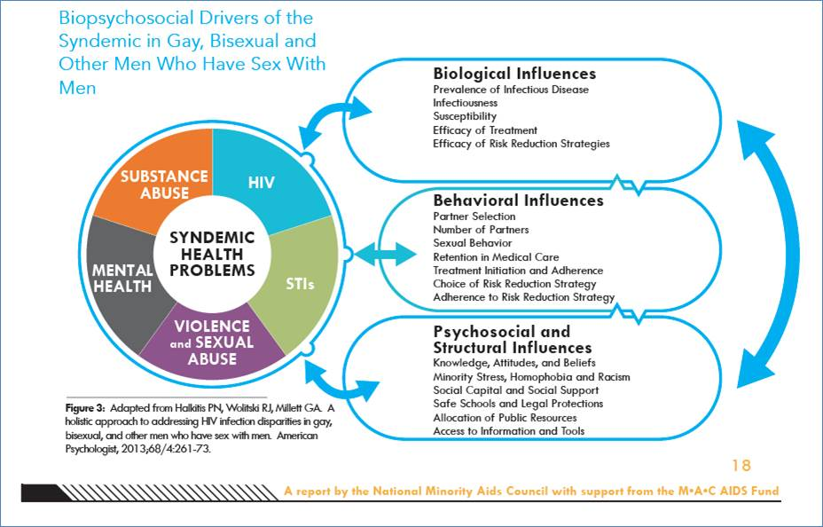

Slide 10
Notes:
Abstract: Transgender communities are among the groups at highest risk for HIV infection in the United States. Using syndemic theory, we examine how HIV risk in transgender communities is embedded in multiple co-occurring public health problems, including poor mental health, substance use, violence and victimization, discrimination, and economic hardship. Although safer sex counseling and testing programs are essential platforms for HIV intervention, these modalities alone may be insufﬁcient in reducing new infections. Multicomponent interventions are necessary to respond to the complex interacting syndemic factors that cumulatively determine HIV vulnerability in transgender individuals.

Slide 11
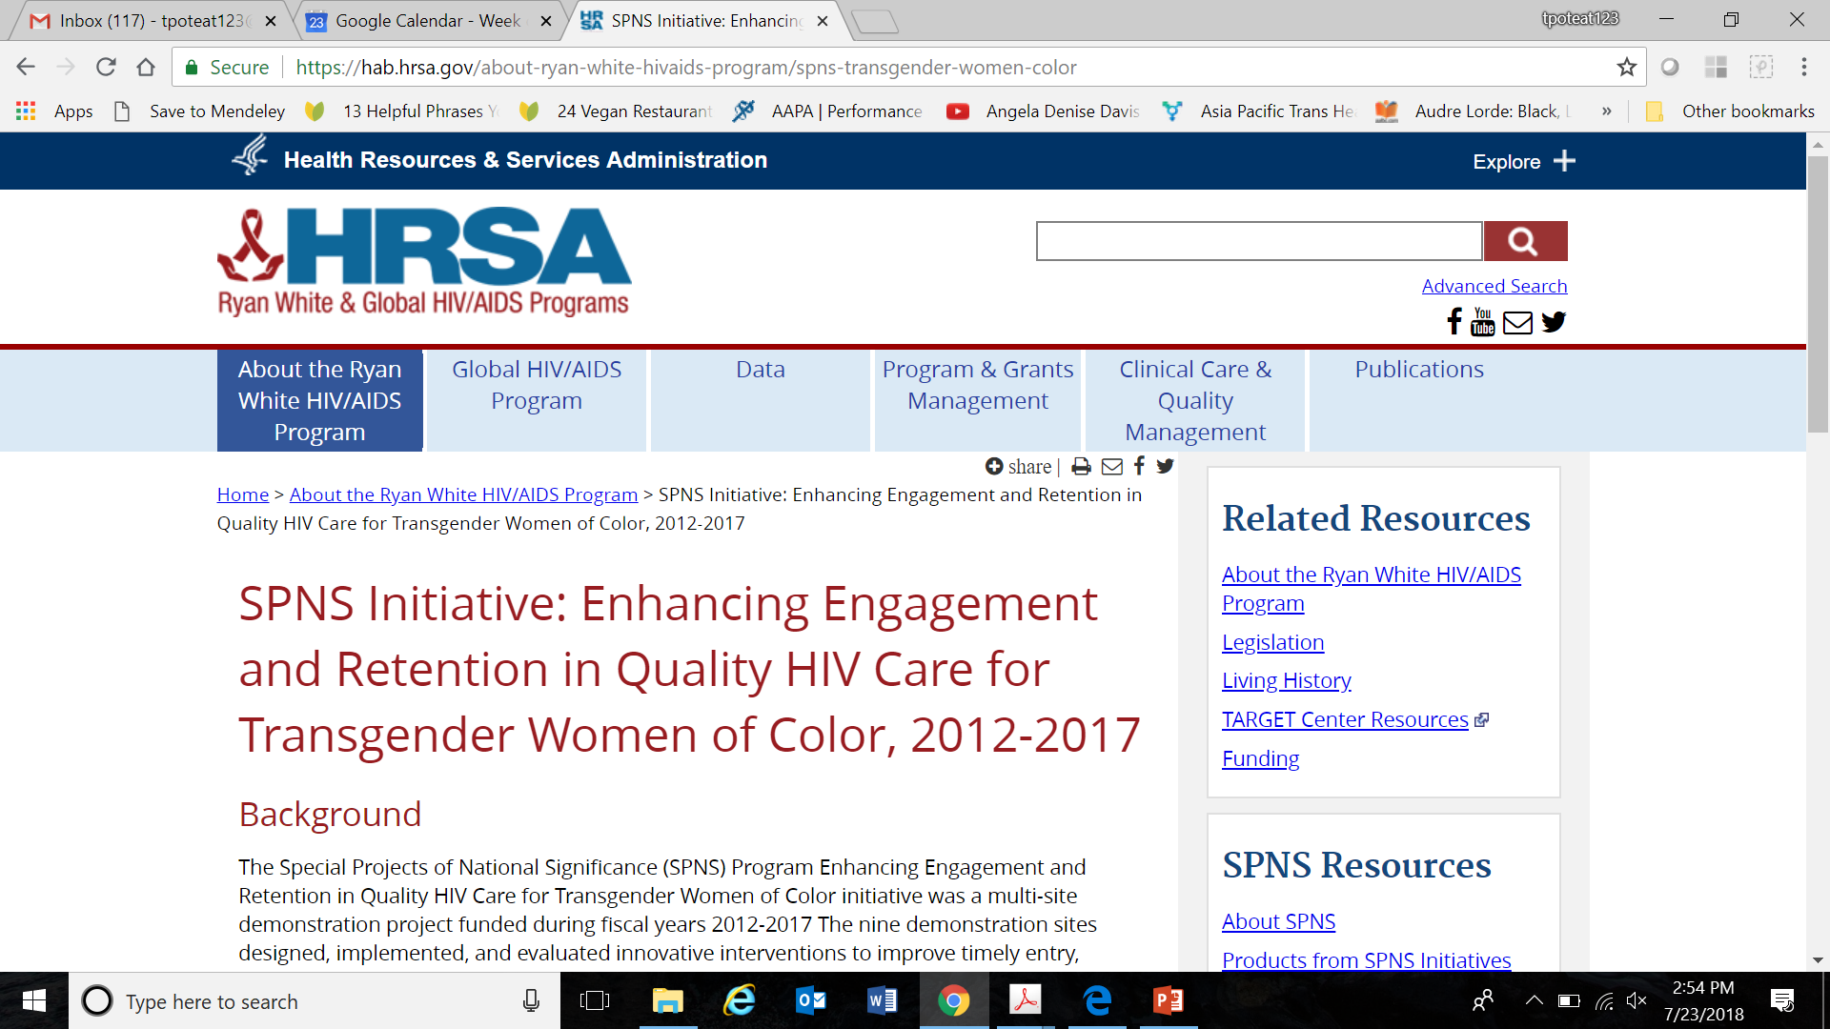

Slide 12
Systematic Review of Syndemic Literature
71 quantitative studies through 2016
  75% in the U.S. (decreasing trend)
  Majority focus on MSM (51%)
Psychosocial conditions (>80%):
  Mental health, substance use, violence
Outcomes: HIV risk behavior (63%)
All analyzed at the individual level
  41% examined additive associations (decreasing trend)
No studies of interventions
  79% cross-sectional, 21% longitudinal
Tsai et al., Lancet 2017; 389: 978–82

Slide 13
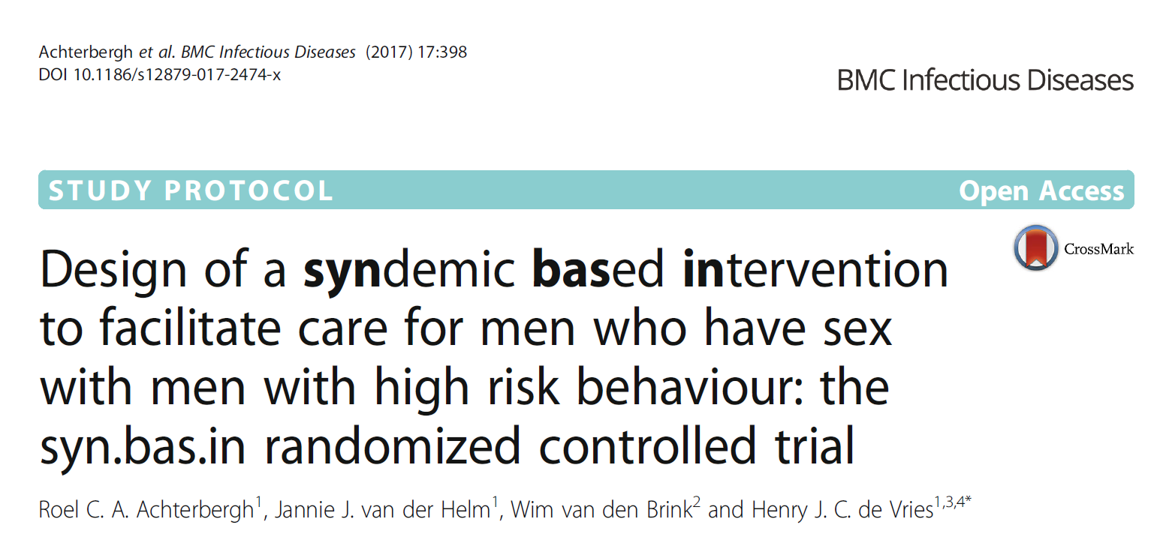
SYNDEMIC DOMAINS
Sex addiction
Alcohol/drug addiction
Anxiety
Depression
ADHD
Aleithymia
Partner violence
Childhood sex abuse
Discrimination
OUTCOMES
Addiction/mental health help-seeking
STI incidence and risk behavior
Notes:
BASED IN AMSTERDAM
Alexithymia /ˌeɪlɛksəˈθaɪmiə/ is a personality construct characterized by the subclinical inability to identify and describe emotions in the self. The core characteristics ofalexithymia are marked dysfunction in emotional awareness, social attachment, and interpersonal relating
Help seeking behaviour for mental health and/or addiction problems among MSM who are at high risk for STIs and HIV. Since care is co-located, we will be able to use both confirmed help seeking behaviour and self-reported help seeking behaviour (i.e. Have you seen a health professional (family doctor, counsellor or psychologist) to get help for mental problems or problems due to substance use or sex in the last year? yes/no).
Secondary outcomes
STI incidence and changes in risky sexual behaviours (i.e. condom use/number of partners/ number of unsafe partners/amount anal sex/recreational drug use/renounce to visit the STI clinic). In addition, we will monitor how care was experienced. If help seeking behaviour took place, information will be collected to know where help was obtained, and how useful the help was on a scale from

Slide 14
Interventions
Incomplete operationalization of syndemics result in failure to implement and test syndemic interventions
Multi-component interventions often fail to address social forces beyond the individual level and are often limited to one disease/condition

Slide 15
Challenges
Requires systems thinking for which there may be limited experience and/or political will
Measuring syndemics and quantifying their impact on synergistic social and biological systems is complex
Notes:
RCTs exclude co-morbid conditions
Funders organized around specific diseases.

Slide 16
Opportunities
Recognize social and political forces that drive structural vulnerabilities
Identifies inequitable distribution of power as a source of inequitable distribution of disease
When fully applied, can promote interventions at the policy as well as clinical and individual levels

