Slide 1
Exploring innovation around
HIV and substance use
Olena Stryzhak
Positive Women, Ukraine

Slide 2
Drug Use has Major Costs:
Health Costs
Socio-economic Costs
14.6x Mortality
>20x HIV infection
>50x Hepatitis C
>6x TB in PWID with HIV
>23x TB in Prison
Treatment
Incarceration
Productivity
Crime

Slide 3
Harm reduction is underfunded
Redirection of just 7.5% of current drug control spending by 2020 would achieve a 94% cut in new HIV infections among people who use drugs by 2030, and a 93% drop in HIV-related deaths.
An estimated US$100 billion is currently spent on global drug enforcement and control, while only US$160 million is spent on harm reduction.
We call on member states to redirect 10% of their annual drug control spending towards harm reduction.

Slide 4
New Psychoactive Substances (NPS)
643 NPS reported by 101 countries by the end of 2015 (348 by the end of 2013)
Current estimate for new NPS emergence is one substance per week.
Use of NPS is mostly concentrated among young men and women aged 16 to 24
Most of NPS are sold via internet (mobile applications, specialized web forums, webs, etc)
NPS have lower price in comparison with ‘natural’ drugs, which can make them accessible for young people.
OST and naloxone provision are not effective in case of NPS. Needle and syringe programs are relevant for NPS, but the number of syringes needed should be considerably higher than in case of opioid use due to intensity of injections.
Common effect of many NPS use is increase in sexual activity, which in its turn may lead to unprotected sex.

Slide 5
Harm Reduction Interventions targeting the use of NPS
Provide PUD and service providers with information about substance available and its side effects
Increase services for experimental users, in nightlife settings as well
Provide drug tests to ensure PUD know what they consume and are empowered to make safer choices.
Secure good coverage of HR services and increase the number of syringes per person for those who inject NPS
Avoid waiting lists and provide sufficient slots in substitution treatment services, avoid drop offs or other sanctions due to the programme’s strict rules
Promote self-help and exchange reliable information between users
Promote drug consumption rooms
Cooperate with toxicological laboratories and medical institutions providing care to PUD in cases of overdose
Train service providers (including ambulance staff) how to communicate with PUD under the influence of NPS

Slide 6
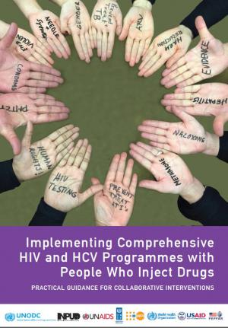
Community Engagement
People who use drugs need to engage in strong, focused advocacy and negotiate with decision-makers to address these significant challenges, as well as to continue to fight for their own right to engage in the planning, implementation, and monitoring of national HIV responses
Implementing Comprehensive HIV and HCV Programmes with People Who Inject Drugs
Notes:
PRACTICAL GUIDANCE FOR COLLABORATIVE INTERVENTIONS

Slide 7
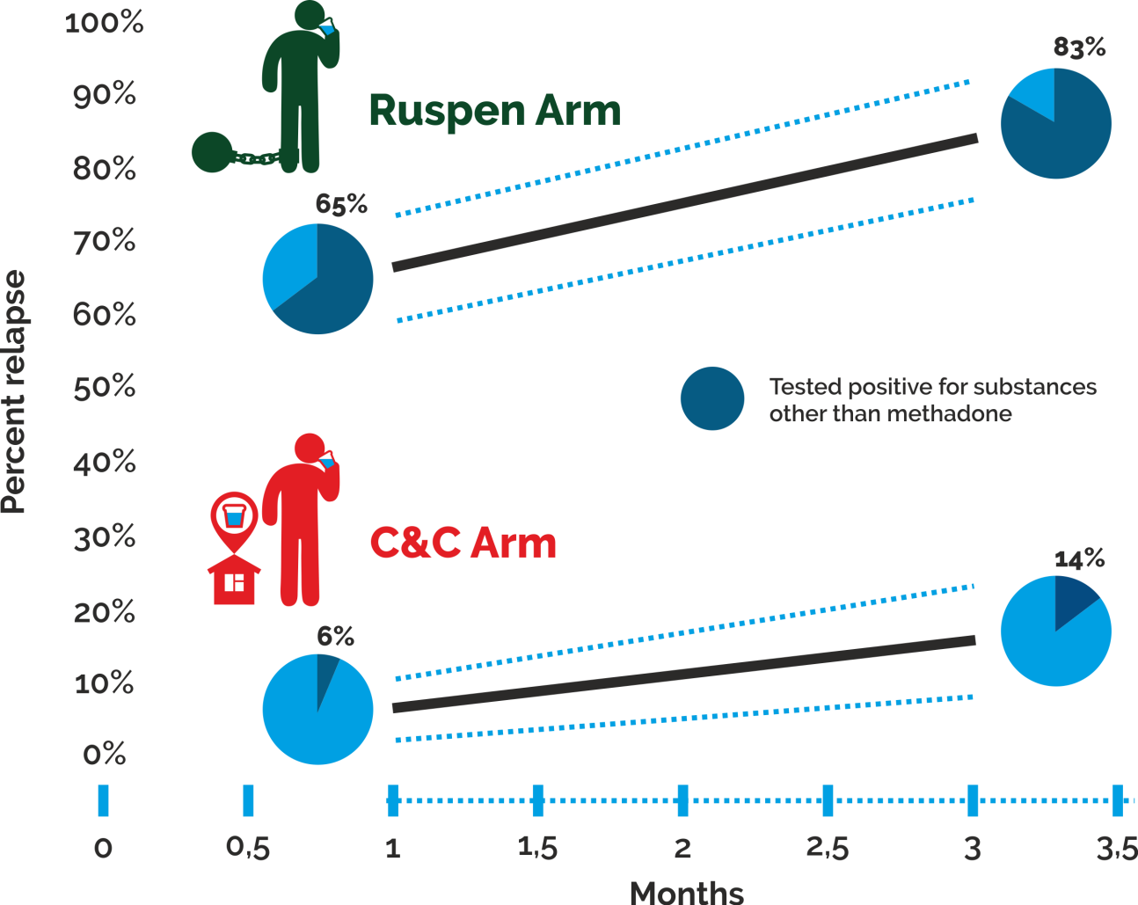
Community based OST versus compulsory detention
Differences in drug relapse rates between patients from compulsory drug detention centers vs voluntary drug treatment centers in Malaysia
Community OST is
6-fold more effective and
12-fold cost-effective as detention

Slide 8
Gender Lens: Women Who Use Drugs
HIV, Violence, Stigma, Discrimination
Punitive Legal Frameworks
Gender Inequality

Slide 9
The realities for Women who use drugs
Women
who used drugs
police and IPV Violence
poor/no access to maternal healthcare
under-represented in clinical trials and research
societal and Self-Stigma
tougher sentences and incarceration
removal of children from their custody
OST is unavailable during pregnancy
poor/no drug treatment and rehabilitation
no voice and legal support

Slide 10
Gender responses in drug policies
Criminalisation impedes women’s human rights and silences the human rights violations of women who use drug including their access to services. Women who use drugs are afraid to advocate for themselves and it is often dangerous to speak on behalf of women who use drugs
In 2016 the UNGASS called for gender mainstreaming in drug policies and emphasised the need to involve women at all stages of development, implementation, monitoring and evaluation of drug policies and programming.
Notes:
rules 13 and 14

Slide 11
Gender responses in drug policies (2)
The UN Rule for the Treatment of Female Prisoners and Non-Custodial rules for female offenders (Bangkok Rules) 2011, reinforce the importance of gender sensitive policies on people who use drugs. As women living with HIV transition from jail they experience greater co-morbidity and worse HIV treatment outcomes than men.
Implementation lags behind with little reform and no consideration to scale up gender-sensitive drug policies.
Notes:
rules 13 and 14

Slide 12
Governments
Provide funding and ensure access to comprehensive health care services, including SRH, HCV, HIV prevention strategies recommended by UNODC, WHO, and UNAIDS, especially in prisons. Future interventions that transition incarcerated women to community-based HIV clinical care should be gender-sensitive
Develop mechanisms that guarantee personal safety that allows women to report incidents of violence without fear
Ensure cases of violence are investigated including those committed by healthcare providers, social workers, law enforcement officials. Provide access to state legal assistance for WUD
Conduct a full review of progress and recommendations (together with women who used drugs) made through UNGASS policy around gender in drug policies.
Improve legal framework to ensure uninterrupted substitution therapy for WUD. Secure access and availability to integrated services including support and OST during and post pregnancy.

Slide 13
Researchers and Donors
Capture the diversity of women who use drugs and that recognises the intersectionality within different populations of women who use drugs. Focus on women who use drugs
, including LGBTI communities, women who are incarcerated, women living with HIV and sex workers, as key considerations in treatment, research and support.
Encourage countries to support human rights and evidence based interventions for women who use drugs
Strengthen the capacity and engagement of women who use drugs in major donors supported programmes.
Support community driven research that collects and explores qualitative data to address and improve the lives of women who use drugs.

Slide 14
Sample slide 3

