Slide 1
DolPHIN-1 : Randomised controlled trial of dolutegravir (DTG)- versus efavirenz (EFV)-based therapy in mothers initiating antiretroviral treatment in late pregnancy
C. Orrell, K. Kintu, J.A. Coombs, A. Amara, L. Myer, J. Kaboggoza, B. Simmons, L. Else, C. Heiberg, C. Waitt, S. Walimbwa, E.M. Hodel, A. Hill, S. Khoo, M. Lamorde, on behalf of the DolPHIN-1 Study Group
** Research funding and drug donation for DolPHIN-1 was provided by ViiV Healthcare

Slide 2
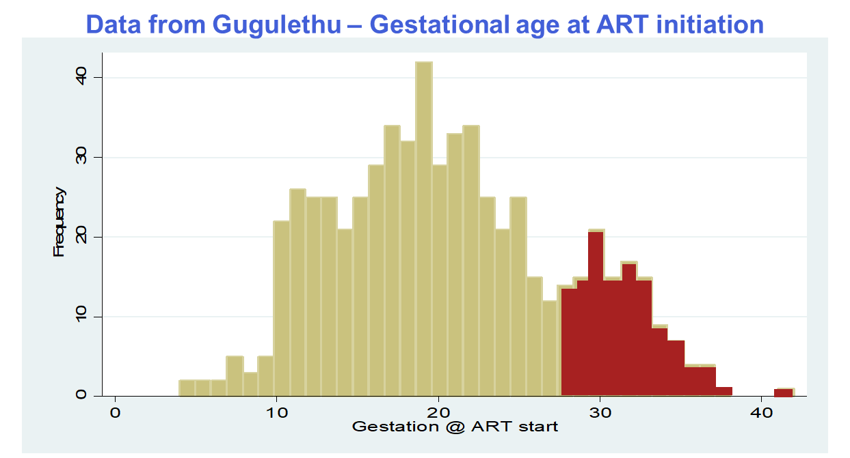
Background
Around 1.5M HIV+ women become pregnant each year
Effective and timely ART has
averted 1.6M infant infections
In S Africa, around a fifth of HIV+
pregnant women initiate ART late,
in 3rd trimester (T3)
Late initiation associated with 7-fold increased risk of MTCT, and doubling of infant mortality in first year
Hypothesis:
Faster VL declines with DTG may reduce MTCT at birth &
during breastfeeding (BF) in HIV+ mothers initiating ART in T3
Meyers et al. PLoS ONE 2015;10(9): e0138104

Slide 3
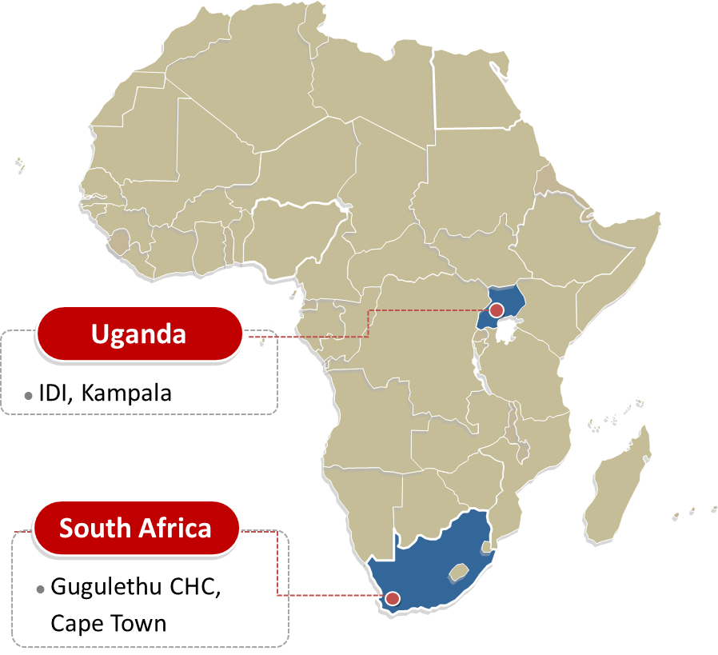
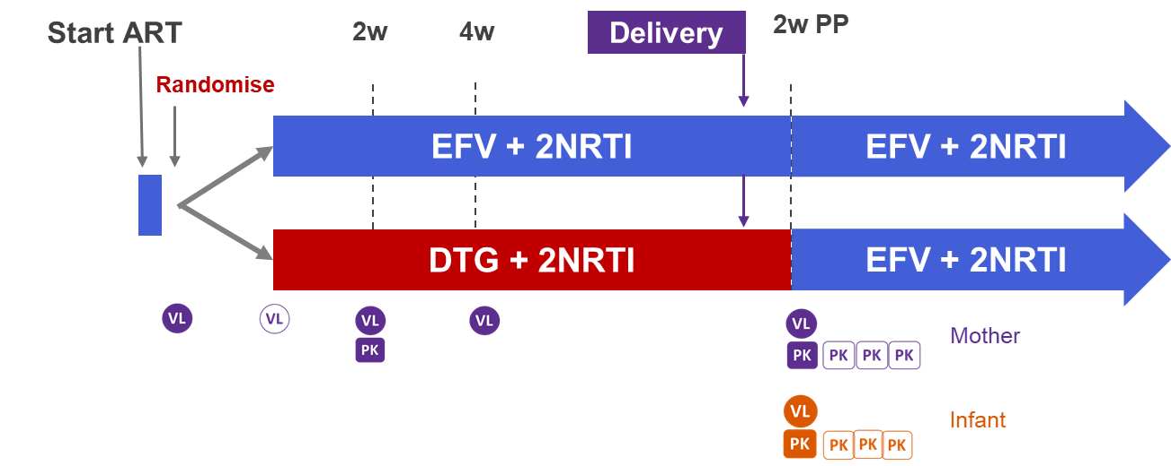
DolPHIN-1: Dolutegravir in Pregnant HIV mothers and their Neonates NCT02245022
1-7d
To comply with guidelines, all subjects start EFV pending randomisation
HIV+ pregnant mums initiating ART in T3 (28-36w gestation)
≥18y, no ARVs in preceding 6m (no previous INSTIs), no depression,
Hb ≥ 8g/dL, eGFR ≥ 50, ALT ≤ 5xULN, no active HBV
Randomised 1:1 to receive DTG vs EFV until 2w PP
plus TDF/3TC (Uganda) or TDF/FTC (S Africa). DTG (50mg/d), EFV (600mg/d)
Primary endpoint: maternal PK of DTG
Secondary endpoints: plasma VL <50 copies (or undetectable) at PP visit (0-2w PP), safety and tolerability, PK in cord blood and BM

Slide 4
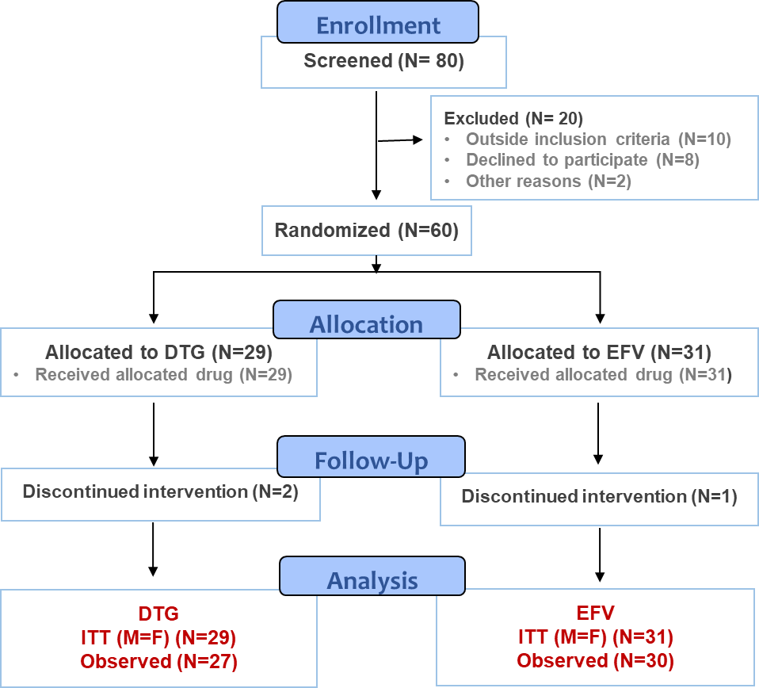
DolPHIN-1 Enrolment & Baseline Demographics
Baseline median (range) | DTG (n=29) | EFV (n=31) | Total (n=60)
Age (y) | 27 (19-42) | 25 (19-35) | 26 (19-42)
Weight (kg) | 68 (45-103) | 65 (48-119) | 66 (45-119)
BMI (kg/m²) | 26 (19-40) | 25 (21-46) | 26 (19-46)
Est gestation (w) | 31 (27-35) | 30 (27-36) | 31 (27-36)
HIV VL log₁₀ copies | 4 (2-5) | 4 (3-6) | 4 (2-6)
CD4 (cells/mm3) | 343 (41-712) | 466 (32-932) | 394 (32-932)
HBsAg +ve * | 0 | 2 (6.5%) | 2 (3.3%)
Herbal/traditional medicines | 5 (17.2%) | 8 (25.8%) | 13 (21.7%)
* missing data DTG (2) EFV (1)
60 HIV+ mothers enrolled : DTG (29), EFV (31)
Equally split across both study sites
Median gestation 31w
No difference in baseline VL, CD4, previous obstetric history, gestation, BMI
High use of traditional medicines noted

Slide 5
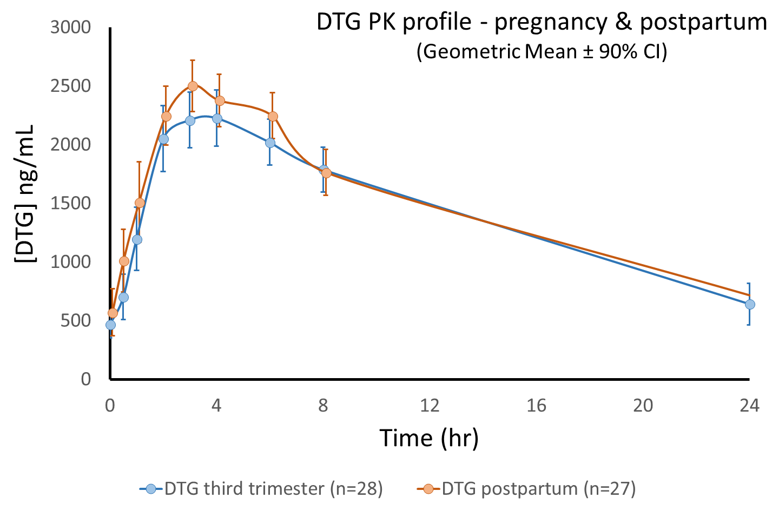
Results – Maternal Plasma PK (T3 versus PP)
 | DTG ng/mL (range)
 | T3 * (n=28) | PP * (n=27) | GMR (90%CI)
AUC_{0-24h} (ng*h/mL) | 35,322 (19,196 – 67,922) | 37,575 (14,933 – 59,633) | 0.95 (0.74 – 1.23)
C_{max} (ng/mL) | 2,534 (1,462 – 3,986) | 2,843 (1,398 – 4,224) | 0.91 (0.82 – 1.01)
C_{trough} (ng/mL) | 642 (188 – 3,088) | 696 (204 – 1,443) | 0.93 (0.76 – 1.14)
DTG ≤ MEC (324ng/mL) | 9/28 (32%) | 6/27 (22%)
324 ng/ml
64 ng/ml
* 1 subject with undetectable levels throughout excluded
Rich PK sampling in T3 and PP
PP sampling (2-18d; median 8d) does not reflect return to normal physiology;
exposures not significantly different from T3
All but one [DTG] above 64 ng/mL (PA-IC₉₀)
In T3, 9/28 (32%) of [DTG] at or below 324 ng/mL (MEC)
Maternal:cord blood ratio = 1.21 (0.51 – 2.11) [median (range)]
Min et al, AIDS 2011;25:1737
Cotterell et al. Clin Pharmacokinet 2013;52:981
Notes:
T3 exposures similar to PANNA, slightly lower than IMPAACT P1026s

Slide 6
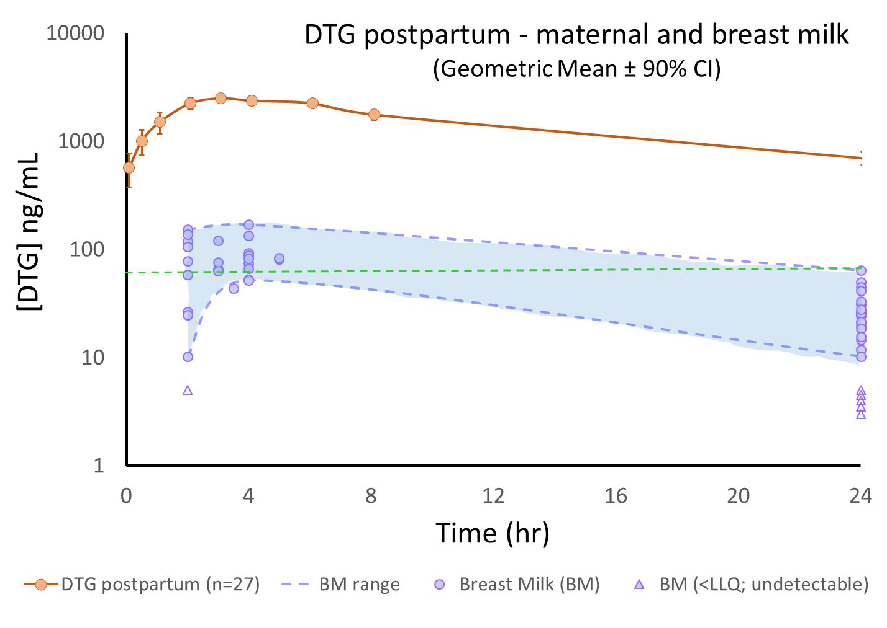
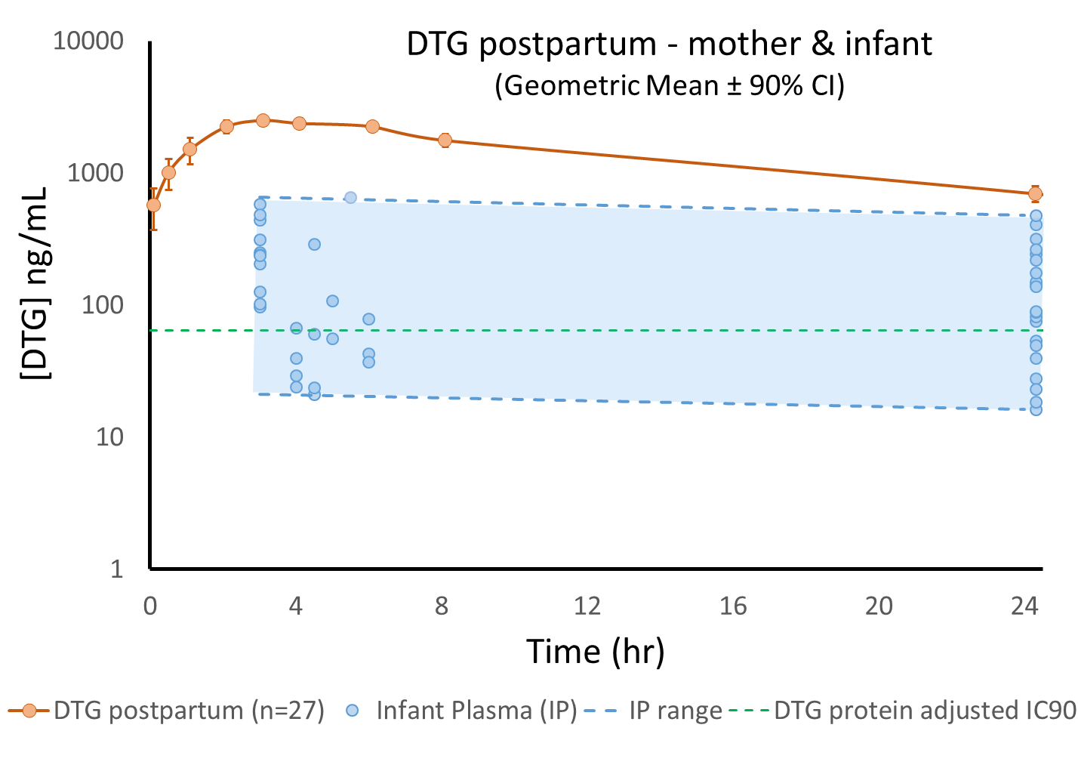
Results – PK in Breast Milk and Breastfeeding Infants
Breast Milk
Infant Plasma
64 ng/mL
64 ng/mL
Breast milk
sampled at maternal plasma C_{max} and C_{trough}
Geometric mean BM_{max} 70 (58 – 83) ng/mL; BM_{trough} 24 (19 – 29) ng/mL
BM:MP at C_{max} and C_{trough} = 0.03 (3%)
Infant plasma
sampled at maternal plasma C_{trough}; feed mandated at C_{max} and infant sampling 1h later
Geometric mean IP_{max} 111 (50 – 172) ng/mL; IP_{trough} 87 (47 – 127) ng/mL
IP:MP_{max} = 0.05 (0.02 – 0.07) ; IP:MP_{trough} = 0.12 (0 – 0.26)

Slide 7
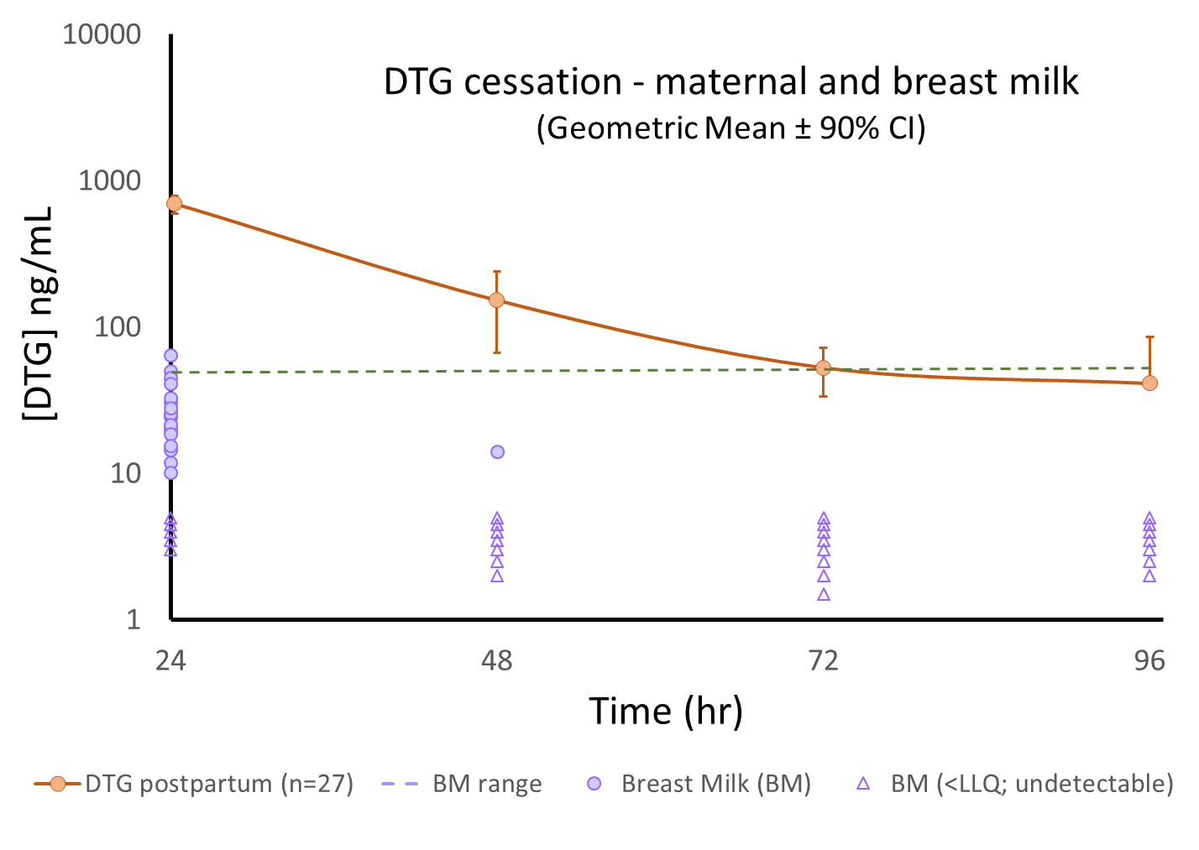
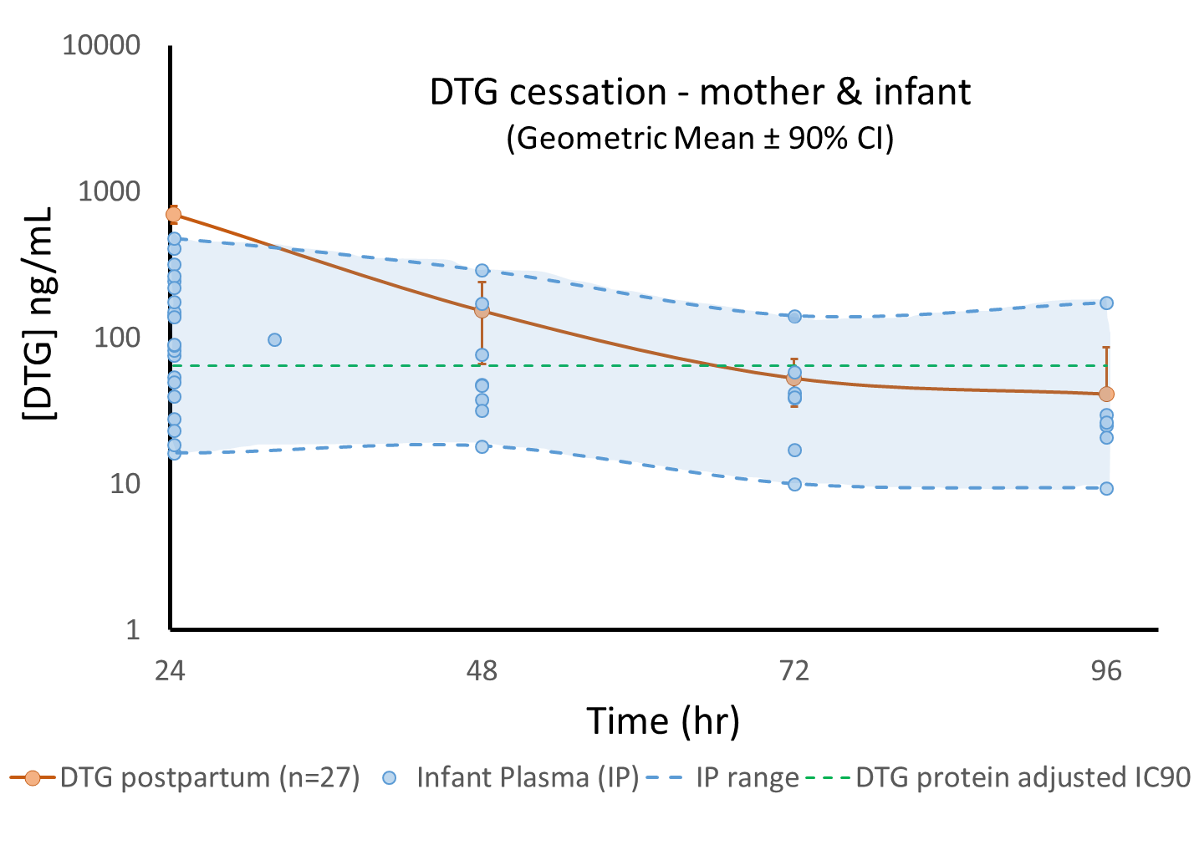
Results : DTG Washout following Cessation
MP vs Breast Milk
MP vs Infant Plasma
64 ng/mL
64 ng/mL
Breast milk
Rapid washout following DTG cessation
Infant plasma
Slow washout of DTG in infants following cessation of DTG in mother
Likely reflects accumulation from BF (+/- residual transplacental accumulation) due to decreased glucuronidation in the neonate

Slide 8
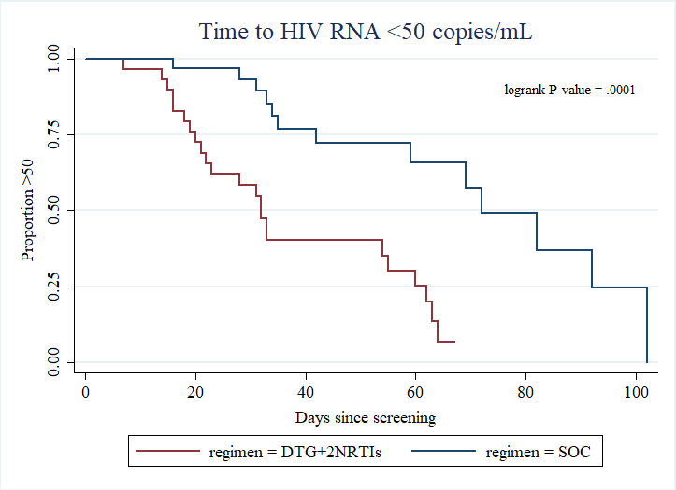
Results – Viral load at Post-partum Visit
ITT (M=F) | DTG (N = 29) | EFV (N = 31) | P value **
HIV-1 RNA level at PP visit
<50 copies/mL * | 20 (69.0%) | 12 (38.7%) | 0.02
≥50 copies/mL | 9 (31%) | 19 (61.3%)
* <50 copies/mL or UD (Roche Ampliprep Cobas Taqman HIV-1 2.0)
** Pearson Chi-squared
Includes individuals missing or discontinued by visit
By ITT, significantly greater proportion of DTG subjects achieved virological suppression at PP (2w) visit
Median time to HIV-1 RNA <50 copies was approximately halved with DTG compared to EFV
1 mother in the DTG arm had UD DTG concentrations, with no VL response; another with [DTG] < 64 ng/mL experienced virological rebound (3 class drug resistance from baseline sample)
NRTI: M41L, L210W, T215Y, M184V
NNRTI: Y188L
PI: M46I, I84V, I54V, V32I, V82A, L33F, K43T

Slide 9
Safety – Maternal outcomes
 | DTG (N = 29) | EFV (N = 31) | Total (N = 60)
Given birth | 29 (100.0%) | 31 (100.0%) | 60 (100.0%)
Mode of delivery, N (%)
Normal | 25 (86.2%) | 21 (67.7%) | 46 (76.7%)
C-section | 4 (13.8%) | 10 (32.3%) | 14 (23.3%)
Experiencing at least 1 adverse event Grade ≥ 3 | 2 (6.9%) | 0 | 2 (3.3%)
Experiencing at least 1 serious adverse event | 2 (6.9%)§ | 1 (3.2%)* | 3 (5.0%)
Maternal AEs and SAEs since starting ART (i.e. includes initial EFV-based ART in mothers subsequently randomised to DTG)
§ 1 case of Haemoglobin decreased (not related);
1 case with Malaria + Urinary tract infection (possibly related), Stillbirth (not related), and ALT+ bilirubin increased +
Hypokalaemia + Hyponatraemia (possibly related)
* 1 case of Hypertension + Pre-eclampsia (unlikely related)

Slide 10
Safety – Infant outcomes
 | DTG (N = 29) | EFV (N = 31) | Total (N = 60)
Outcome of delivery
Normal healthy baby | 28 (96.6%) | 29 (93.5%) | 57 (95.0%)
Stillbirth§ | 1 (3.4%) | - | 1 (1.7%)
Congenital malformation | - | 2 (6.5%) | 2 (3.3%)
of which syndactyly § | - | 1 (3.2%) | 1 (1.7%)
Multiple * | - | 1 (3.2%) | 1 (1.7%)
Gestation age at birth, weeks
median (range) | 39 (35-43) | 38 (34-42) | 38 (34-43)
Length of baby, cm
median (range) | 51 (44-58) | 50 (33-55) | 50 (33-58)
Weight of baby, kg
median (range) | 3 (2-4) | 3 (2-4) | 3 (2-4)
Experiencing at least 1 serious adverse event | - | 3 (9.7%)† | 3 (5.0%)
§ Not related
* Not related.
Multiple skeletal and limb defects (talipes, multiplex arthrogryposis, developmental hip dysplasia, limb hyperextension)
Cardiac defects (Atrial septal defect, Persistent left superior vena cava) + cleft palate, hyporeflexia (? Larsen or TARP syndrome)
Note: The infant was also pre-term/small for gestational age, and had congenital syphilis.
† 2 cases with congenital malformations and 1 case of neonatal sepsis (not related)

Slide 11
DolPHIN-1 Conclusions
In this pilot study, a significantly greater proportion of mothers initiating ART late in pregnancy achieved HIV-1 RNA <50 copies/mL with DTG- compared to EFV- based regimens
DTG exposures in T3 were relatively low. In-utero accumulation of DTG was high (121%).
Breast milk accumulation of DTG was 3% with higher exposures in breastfed infants, likely due to reduced drug clearance
Upon cessation, DTG was rapidly eliminated from breast milk; however infant washout was prolonged.
Safety of DTG and EFV was comparable; however evaluation is limited by small sample size, relatively short follow-up and by prior EFV use in all DTG mothers initiating ART
DolPHIN-2 (NCT03249181) is a randomised comparison of DTG vs EFV initiation in third trimester (28w – labour; N = 250).

Slide 12
Acknowledgements
We are grateful to all the mothers and families who participated in DolPHIN-1
Infectious Diseases Institute
Mohammed Lamorde
Kenneth Kintu
Stephen Walimbwa
Julian Kaboggoza
Eva Laker
Byamugisha Josaphat
Andrew Kambugu
Pauline Byakika
Catriona Waitt
Helen Reynolds
Eva-Maria Hodel
Laura Else
Alieu Amara
Joshua Gini
Sujan Dilly Penchala
Laura Dickinson
Henry Pertinez
Adeniyi Olagunju
David Back
University of Cape Town
Catherine Orrell
Landon Myer
Julie-Anne Coombs
Christie Heiberg
Ushma Mehta
Yashna Singh
Statistical Support
Andrew Hill
Bryony Simons
TSC / IDSMB
Graham Taylor
Mark Mirochnick
Helen McIlleron
Polly Clayden
We are grateful to ViiV Healthcare for project funding and donation of DTG for DolPHIN-1

