Slide 1
Contraception and ART opportunities to expand effective ART and contraceptive choices with Dolutegravir
Chelsea Morroni, MBChB, DFSRH, MPH, MSc, PhD
The Botswana UPenn Partnership and the Liverpool School of Tropical Medicine
Rena Patel, MD, MPH
University of Washington, International Clinical Research Center

Slide 2
No conflicts of interest to declare

Slide 3
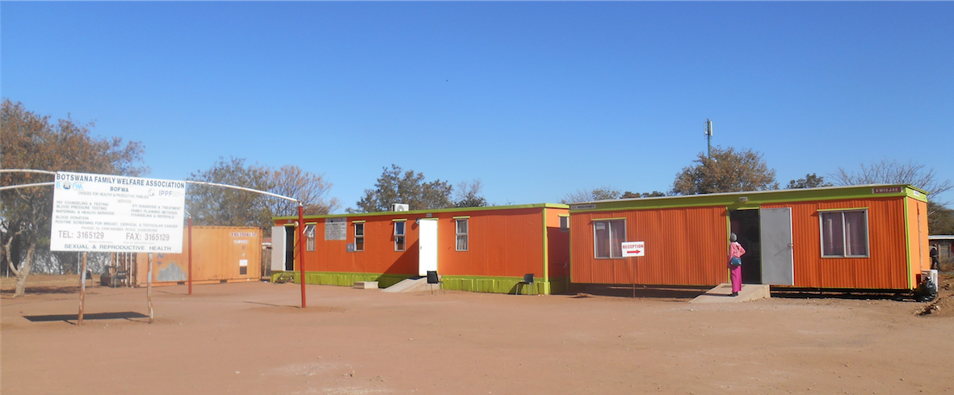

Slide 4
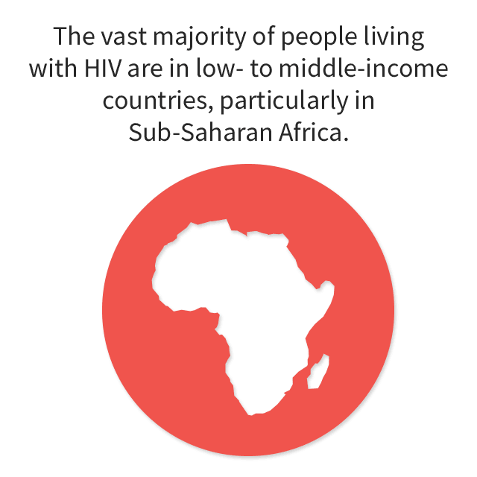
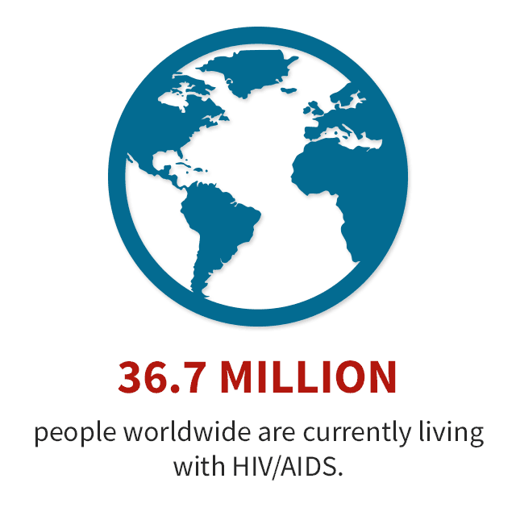
Women and girls account for 59% of the total number of people living with HIV/AIDS in eastern and southern Africa
Six out of 10 people on antiretroviral therapy live in eastern and southern Africa
19.4 MILLION
(or 53%)
in east and southern Africa.
Slide 1

Slide 5
Most women living with HIV/AIDS are of reproductive age
Women living with HIV/AIDS have a range of reproductive desires that change over their life course
Preventing unintended pregnancy + enabling healthy, desired pregnancies = GOOD OUTCOMES for women, children and families and prevention of new HIV infections
19.4 MILLION in east and southern Africa
Women and girls account for 59% of the total number of people living with HIV/AIDS in eastern and southern Africa
67% of adult women (aged 15 years and over) accessing antiretroviral therapy
Six out of 10 people on antiretroviral therapy live in eastern and southern Africa
19.4 MILLION
(or 53%)
in east and southern Africa.
Slide 1

Slide 6
Supporting women living with HIV to achieve their reproductive intentions (whether pregnancy prevention or safe and healthy desired pregnancy) is essential but can also be complex.
Slide 2

Slide 7
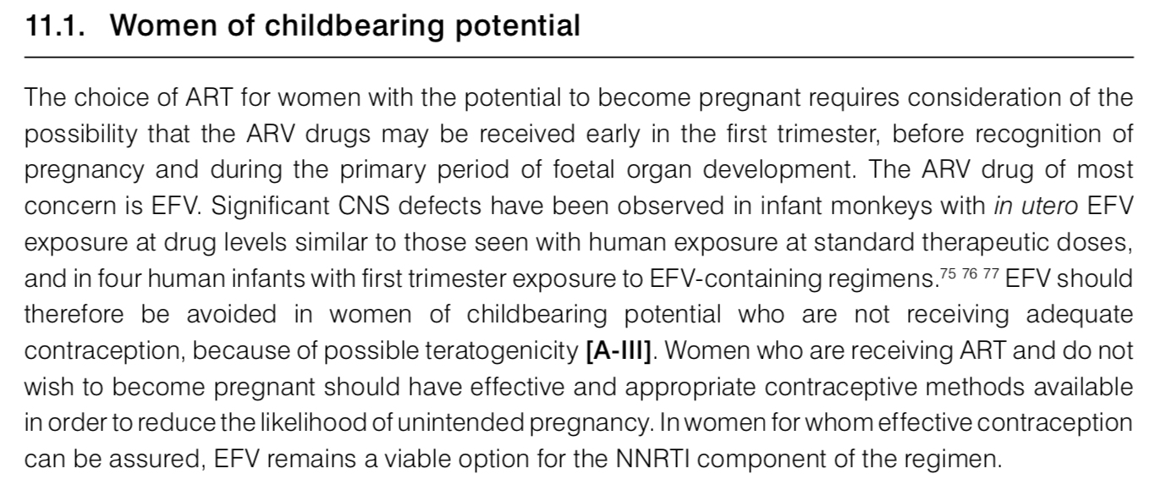
Efavirenz and birth defects
Slide 3

Slide 8
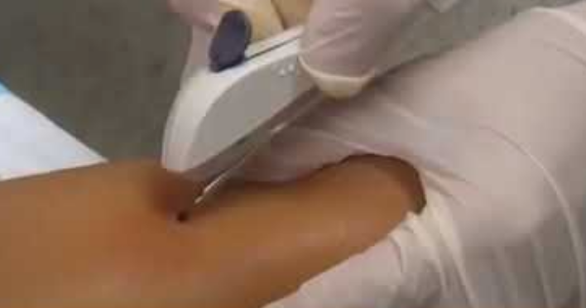
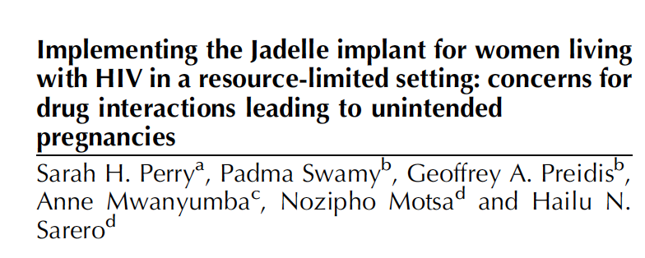
Efavirenz and contraceptive implant
Slide 4

Slide 9
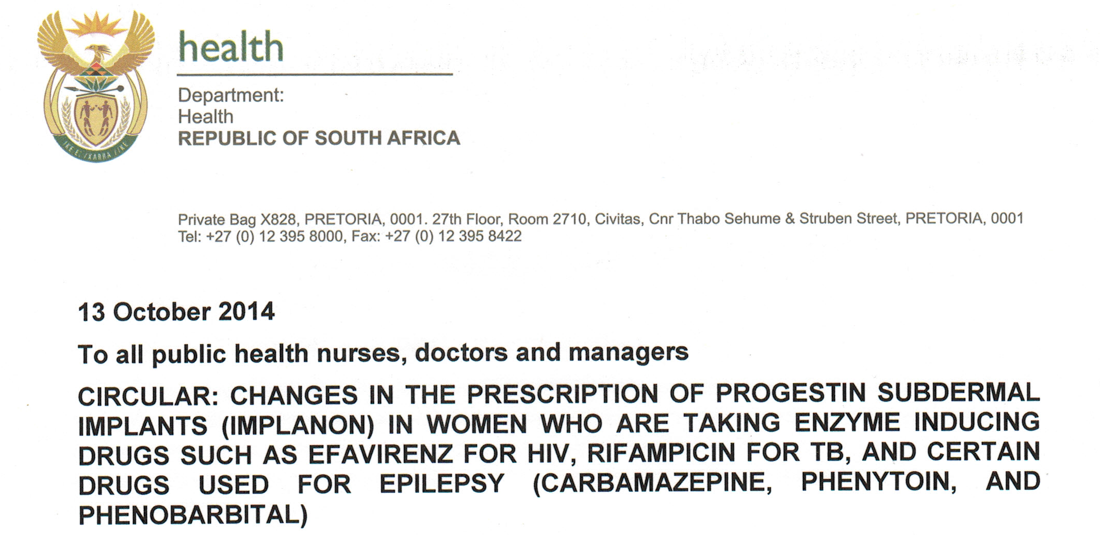
Efavirenz and contraceptive implant
Slide 4

Slide 10
Efavirenz and birth defects
Efavirenz and contraceptive implant
Need to carefully consider risks and benefits before developing guidance that may restrict women’s options
Slide 5

Slide 11
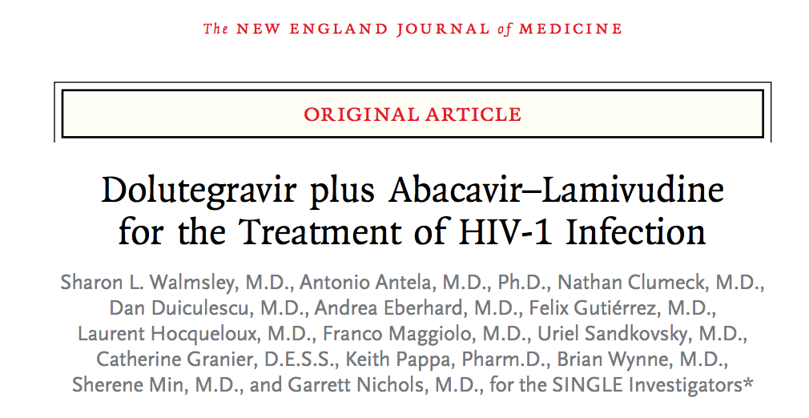
DOLUTEGRAVIR
We identified 5865 citations through database searches and other sources, of which, 126 articles related to 71 unique trials were included in the network analysis, including 34 032 patients randomly assigned to 161 treatment groups. For viral suppression at 48 weeks, compared with efavirenz, the odds ratio (OR) for viral suppression was 1·87 (95% credible interval [CrI] 1·34–2·64) with dolutegravir and 1·40 (1·02–1·96) with raltegravir;
Slide 6

Slide 12
Slide 7

Slide 13
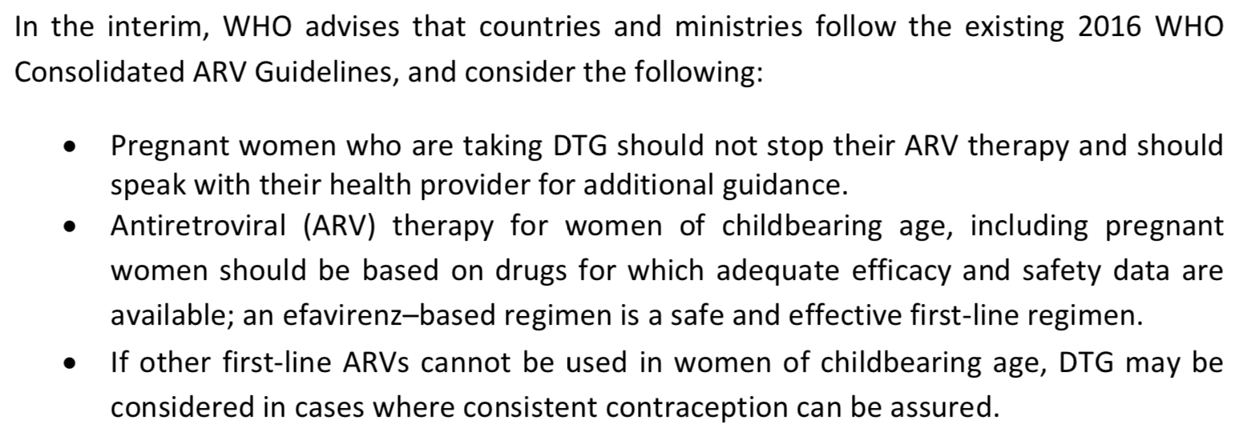
Slide 7

Slide 14
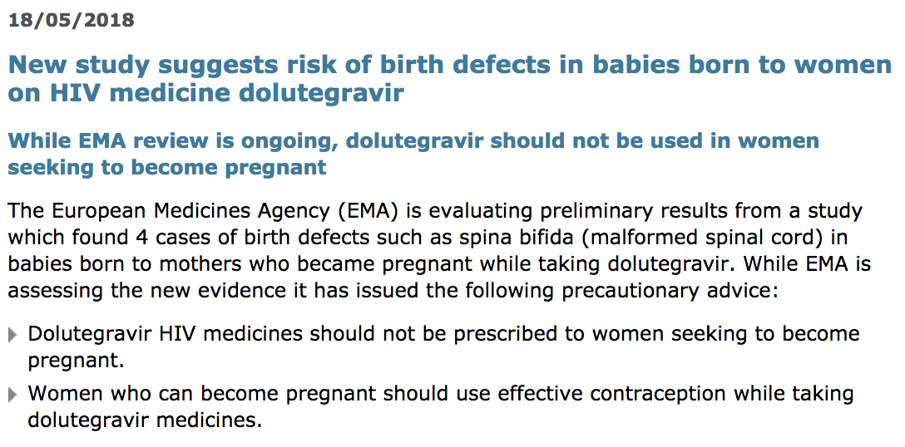
Slide 7

Slide 15
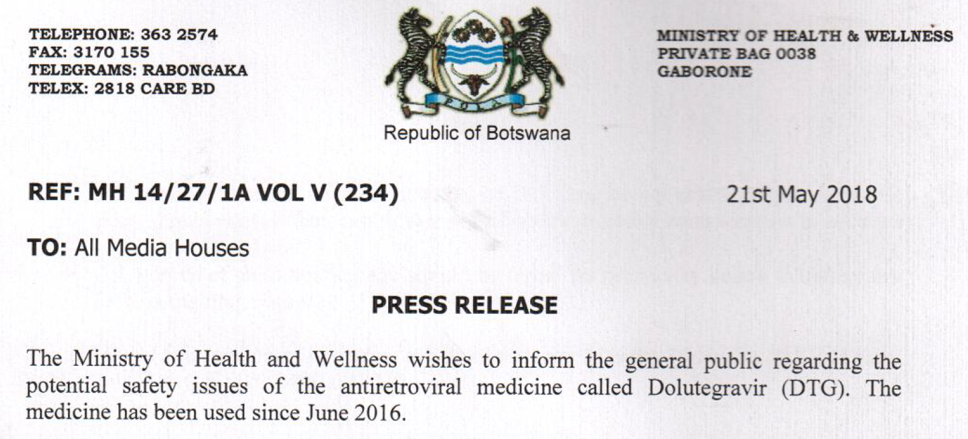
COUNTRY RESPONSES TO THE WHO DOLUTEGRAVIR STATEMENT
BOTSWANA
KENYA
The Ministry recommends:
HIV positive women who are pregnant and have conceived while on DTG, should alert their healthcare providers so they can be counselled and advised appropriately.
HIV positive women who are currently on DTG and who do not desire pregnancy at this time, should take effective contraception in addition to the use of condoms.
HIV POSITIVE WOMEN WHO ARE CURRENTLY ON DTG AND DESIRING PREGNANCY SHOULD ALERT THEIR HEALTHCARE PROVIDERS AND BE SWITCHED TO AN APPROPRIATE ART REGIMEN.
Pregnancy testing should be completed on all women before initiating DTG containing regimens.
The Ministry advises that:
EFAVIRENZ-BASED REGIMEN IS THE PREFERRED FIRST-LINE REGIMEN FOR WOMEN IN CHILD BEARING AGE (15-49) YEARS
As per Dolutegravir indications stated in the June 2017 circular, adolescents and adult men on efavirenz based regimens to be transitioned to DTG based regimens.
Pregnant and breastfeeding women who are currently on DTG based regimens should continue their current regimen until complete cessation of breastfeeding
WOMEN OF CHILD BEARING AGE WHO ARE CURRENTLY ON DTG BASED REGIMENS SHOULD BE TRANSITIONED TO EFAVIRENZ BASED REGIMENS
Slide 8

Slide 16
Restriction of access to the best ART regimen available
Reduced antiviral efficacy
Decreased tolerability
Transmitted drug resistance / acquired drug resistance
Decreased effective contraceptive options
Particularly Long Acting Reversible options with EFV
Diminished sexual and reproductive health rights
Increased risk of neural tube defects
Slide 9

Slide 17
Restriction of access to the best ART regimen available
Reduced antiviral efficacy
Decreased tolerability
Transmitted drug resistance / acquired drug resistance
Decreased effective contraceptive options
Particularly Long Acting Reversible options with EFV
Diminished sexual and reproductive health rights
Increased risk of neural tube defects
Slide 9

Slide 18
“Some governments are now withdrawing dolutegravir from all women of childbearing age, without consulting them, assuming that is dangerous for them all…This blanket approach further limits women’s options. What should always be paramount is…our right to our own choices…to make our own individual decisions about if, what, and when we take antiretroviral therapy and/or contraception. Essentially, we need, and have the right to, fully informed, safe access to comprehensive nonjudgmental SRHR care, including support to navigate adherence and potential consequences, whatever decisions we take.”
Slide 10

Slide 19
A move back to Efavirenz for women of reproductive age may deny women optimal ART and limit options for effective pregnancy prevention
We need to consider what is ‘effective contraception’, based on evidence and risk assessment
The absolute requirement for women to use effective contraception to get DTG needs further consideration
Women’s values and preferences for both ART and contraception need to be considered
Slide 11

Slide 20
The method mix and effectiveness
Slide 12

Slide 21
The method mix and effectiveness
Many effective options
Barriers to access remain
Greater choice leads to better uptake and fewer unintended pregnancies
All methods can potentially be safely used by women living with HIV on ART
Slide 12

Slide 22
The method mix and use of reversible contraception in Africa
Slide 12

Slide 23
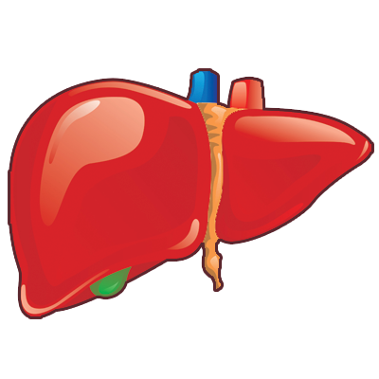
Contraceptive steroid | Contraceptive method | Metabolism
Estrogens
Ethinyl estradiol | COC, patch, ring | Inhibits CYP2C19, CYP3A4, and CYP2B6 Induces UGTs Metabolized by CYP3A4 and CYP 2C9 and UGT
Estradiol cypionate | CIC | Inhibits CYP2C19, CYP3A4, and CYP2B6 Induces UGTs Metabolized by CYP3A4 and CYP2C9 and UGT
Estradiol valerate | COC | Inhibits CYP2C19, CYP3A4. and CYP2B6 Induces UCTs Metabolized by CYP3A4 and CYP 2C9 and UGT
Progestins
Ethynodiol diacetate | COCs | Metabolized to norethindrone
Dienogest | COC | Metabolized by CYP3A4
Nomegestrol acetate | COC | Metabolized by CYP3A3, CYP3A4, and CYP2A6
Drospirenone | COC | Metabolized only to a minor extent, by CYP3A4
Gestodene | COC | Metabolized by CYP3A4
Norgestrel | COC | Metabolized by CYP3A4
Norgestimate | COC | Metabolized by CYP3A4
Desogestrel | COC, POP | Metabolized by CYP2C9 and CYP3A4
Norethindrone | COC, POI, POP | Metabolized by CYP3A4
Levonorgestrel | COC, implant, IUD, ECP | Metabolized by CYP3A4
Norelgestromin | Patch | Metabolized by CYP3A4
Etonogestrel | Ring, implant | Metabolized by CYP3A4
Medroxyprogesterone acetate | CIC, POI | Metabolized by CYP3A4
ART | Metabolism
NNRTIs
Efavirenz (EFV) | Induces CYP3A4, CYP2B6, and UGTs Metabolized by CYP2B6 and CYP3A
IIs
Dolutegravir (DTG) | Not an inducer or inhibitor of CYP enzymes Metabolized by UGTs and CYP3A
PIs
Ritonavir (RTV) | Induces and inhibits CYP3A Induces CYP1A2, CYP2C9, CYP2C19, CYP2B6, and UGTs Inhibits CYP2D6 Metabolized by CYP3A, CYP2D6
Nanda K AIDS 2017
Slide 13

Slide 24
Contraceptive steroid | Contraceptive method | Metabolism
Estrogens
Ethinyl estradiol | COC, patch, ring | Inhibits CYP2C19, CYP3A4, and CYP2B6 Induces UGTs Metabolized by CYP3A4 and CYP 2C9 and UGT
Estradiol cypionate | CIC | Inhibits CYP2C19, CYP3A4, and CYP2B6 Induces UGTs Metabolized by CYP3A4 and CYP2C9 and UGT
Estradiol valerate | COC | Inhibits CYP2C19, CYP3A4. and CYP2B6 Induces UCTs Metabolized by CYP3A4 and CYP 2C9 and UGT
Progestins
Ethynodiol diacetate | COC | Metabolized to norethindrone
Dienogest | COC | Metabolized by CYP3A4
Nomegestrol acetate | COC | Metabolized by CYP3A3, CYP3A4, and CYP2A6
Drospirenone | COC | Metabolized only to a minor extent, by CYP3A4
Gestodene | COC | Metabolized by CYP3A4
Norgestrel | COC | Metabolized by CYP3A4
Norgestimate | COC | Metabolized by CYP3A4
Desogestrel | COC, POP | Metabolized by CYP2C9 and CYP3A4
Norethindrone | COC, POI, POP | Metabolized by CYP3A4
Levonorgestrel | COC, implant, IUD, ECP | Metabolized by CYP3A4
Norelgestromin | Patch | Metabolized by CYP3A4
Etonogestrel | Ring, implant | Metabolized by CYP3A4
Medroxyprogesterone acetate | CIC, POI | Metabolized by CYP3A4
ART | Metabolism
NNRTIs
Efavirenz (EFV) | Induces CYP3A4, CYP2B6, and UGTs Metabolized by CYP2B6 and CYP3A
IIs
Dolutegravir (DTG) | Not an inducer or inhibitor of CYP enzymes Metabolized by UGTs and CYP3A
PIs
Ritonavir (RTV) | Induces and inhibits CYP3A Induces CYP1A2, CYP2C9, CYP2C19, CYP2B6, and UGTs Inhibits CYP2D6 Metabolized by CYP3A, CYP2D6
Nanda K AIDS 2017
Slide 13

Slide 25
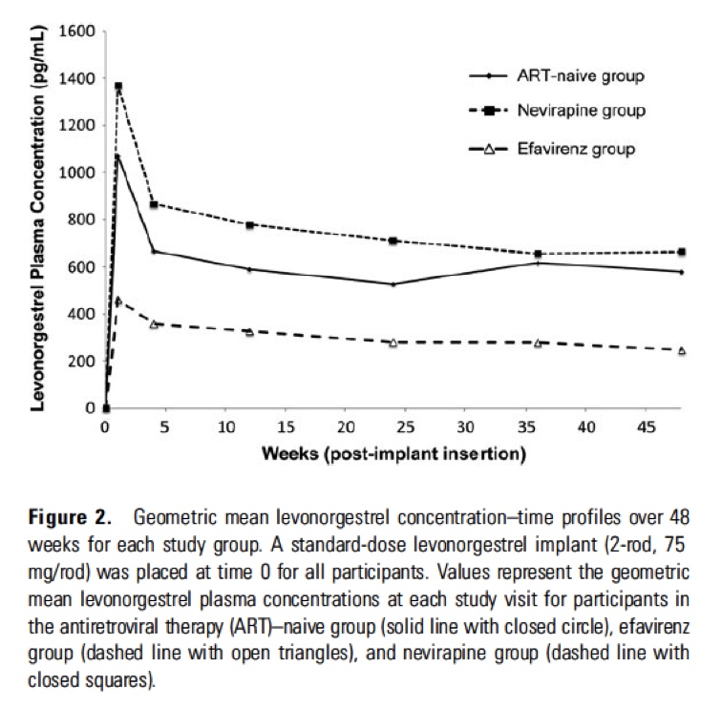
Efavirenz and hormonal contraception
Chappell et al. 2017 UGANDA
Scarsi et al. 2016 UGANDA
Scarsi KK Clinical Infectious Diseases 2016; Perry SH AIDS 2014; Patel RC The Lancet HIV 2015. Chappell CA AIDS 2017
Slide 14

Slide 26
Efavirenz and hormonal contraception
Chappell et al. 2017 UGANDA
Scarsi et al. 2016 UGANDA
Three times higher risk of implant failure with EFV than other ART
Scarsi KK Clinical Infectious Diseases 2016; Perry SH AIDS 2014; Patel RC The Lancet HIV 2015. Chappell CA AIDS 2017
Slide 14

Slide 27
Dolutegravir and hormonal contraception
DTG is primarily metabolised by the enzyme uridine diphosphate glucuronosyl transferase (UGT). DTG does NOT induce CYP450 in vitro. Based on this, interactions with medications metabolised by CYP, such as hormonal contraceptives, are not expected
A small PK study of DTG-COC is reassuring; as are small PK studies with raltegravir and cabotegravir and the COC
Results can probably be extrapolated to other hormonal contraceptives which are eliminated by similar pathways
The US CDC categorises DTG as Category 1 (for use without restriction) with all hormonal
contraceptive methods
Song IH Ann Pharmacother 2015; Anderson MS Br J Clin Pharmacol 2011; Trezza C Br J Clin Pharmacol 2017.
Slide 15

Slide 28
Contraceptive method | Efavirenz | Dolutegravir
Implant (Implanon NXT, Jadelle)
Intrauterine device
Progestin injectables (DMPA, NET-EN)
Combined oral pill
Combined vaginal ring
Combined patch
Progestin-only pill
Condoms
Female sterilisation
Hormonal emergency contraception
IUD emergency contraception
Adapted from Trussell J. Contraceptive failure in the United States. Contraception. 2011; 83 (5): 397-404; Blanchard K, et al. Contraception use and effectiveness among women in a trial of the diaphragm for HIV prevention. Contraception 2011; 83: 556–563.
Slide 16

Slide 29
To ensure that DTG remains an option for women of reproductive age in policy and clinical practice consideration needs to be given to what constitutes effective contraception
Slide 17

Slide 30
An approach with DTG
Routine assessment of reproductive intentions/desires and assessment of pregnancy risk
Ensure availability of Tier 1 LARCs
Wanting to avoid pregnancy:
Informed choice-based counselling towards Tier 1 LARCs
All tier 1 and 2 methods can be very effective
Condom use in addition
Emergency contraception
Consider DTG in women who are using other methods successfully or not at pregnancy risk
Actively desiring pregnancy or trying to conceive:
Counselling, encourage EFV pending further data regarding neural tube defects, and healthy conception support
Avoid overly rigid approaches to defining ‘effective contraception’ and making this a prerequisite for DTG use
This is an opportunity to expand Tier 1 LARC use, but lack of Tier 1 contraceptive availability and use should not be a barrier to DTG use
Slide 18

Slide 31
An approach with EFV
Routine assessment of reproductive intentions/desires and assessment of pregnancy risk
Ensure availability of Tier 1 LARCs
Wanting to avoid pregnancy:
Informed choice-based counselling
IUD and injectable are most effective, due to drug-drug interactions
Condom use in addition
Emergency contraception as IUD or dose adjustments
Actively desiring pregnancy or trying to conceive:
Counselling and healthy conception support
We should offer a range of methods to women on EFV, including the implant with good information
Risk of contraceptive method failure due to drug-drug interactions must be explicitly discussed
Slide 18

Slide 32
Improving holistic sexual and reproductive health for women living with HIV requires an urgent, multifaceted, and multi-level response
Dolutegravir and the integrase era is not a panacea, but is a step in the right direction in terms of expanding effective contraceptive options
Slide 19

Slide 33
Expansion of effective ART & contraception options for women living with HIV and strengthening integrated health services to deliver them must be a priority.
Slide 20

Slide 34
Thanks and acknowledgements
Ava Avalos
Helen Rees
Kim Scarsi
Botswana MoHW SRH Program
Botswana HIV Clinical Care Guidelines Committee
Women who visit our clinics

