Slide 1


Bringing the test to the patient: methods and tools for integrating innovative point-of-care HIV testing into national laboratory networks
Leadership Workshop, 22nd International AIDS Conference
27 July 2018 - 11:00-12:30h, Room E105-108, Amsterdam

Slide 2
Agenda
Results from routine point-of-care testing for early infant diagnosis of HIV (POC EID), including an overview of implementation phases, activities and tools applied (Rebecca Bailey)
Introduction to site and product selection, product approval, site capacity assessments, and placement models for POC testing (Naoko Doi)
Key elements of site enrollment, orientation, planning, training, monitoring and quality assurance, including logistics for a short-haul, hub-and-spoke testing model (Jeff Lemaire)
Special considerations for the procurement and supply chain management of POC HIV diagnostics (Esther Turunga)
Question and answer session (Jennifer Cohn)

Slide 3

Why POC testing for EID of HIV?
Early HIV testing, prompt return of test results, and rapid initiation of treatment are critical for reducing morbidity and mortality among HIV-infected infants
In order to achieve the UNAIDS 90-90-90 targets, the World Health Organization recommends:
  All HIV-exposed infants receive a virological test at 4-6 weeks of age, or at the earliest opportunity thereafter;
  Test results are returned to caregivers quickly (i.e. within 4 weeks); and
  HIV-infected infants are promptly linked to care and treatment services.

Slide 4
In spite of a decade-long effort to scale-up access to conventional EID testing services, which has nearly doubled the number of tests, the coverage of HIV-exposed infants receiving a timely EID test remains below 50%
The proportion of HIV-exposed infants receiving a timely virlogical test for HIV by 2-months of age remained below 50% from 2010-2016.
During the same period the number of EID tests nearly doubled. However long turnaround times (TAT) and a high proportion of results not returned have remained problems.
Only 51% of HIV-infected children are on life-saving ART.

Slide 5





With laboratory-based EID testing, the number of steps from sample collection to return of results to caregiver and clinical action are mired in persistent delays and a high proportion of lost results
Step 1
Specimen collection
at health facility
Step 2
Sample transport
to laboratory
Step 3
Analysis
at the laboratory
Step 4
Result return
to health facility
Step 5
Result return
to caregiver
Timeframe: 30-90 days
Notes:
Practices that contribute to long TAT, such as batching of DBS cards at health facilities and labs.

Slide 6
With funding and support from Unitaid, CHAI/UNICEF and EGPAF are collaborating with the Ministries of Health in 15 African countries to speed up clinical decision making by integrating POC EID testing into national laboratory systems.
Goal: Increase the number of HIV-exposed infants with known HIV status and facilitate early initiation of care and treatment
Purpose: Ensure that at-risk infants have timely access to HIV testing, diagnosis and treatment through the incorporation of POC testing into national EID networks
Scale:
15 countries – 4 overlapping
5 years
  EGPAF 2015-2019
  CHAI/UNICEF 2016 – 2020
$157 million
Senegal
Ethiopia
Cote d’Ivoire
Cameroon
Uganda
Kenya
DRC
Rwanda
Tanzania
Zambia
Malawi
EGPAF
CHAI/UNICEF
Zimbabwe
Mozambique
Overlap
Swaziland
Lesotho

Slide 7
Early results from the routine use of POC EID in nine African countries confirm findings from published studies on reduced TAT for test results, increased rates of results returned, and quicker initiation of ART
Study Results of POC EID Use
Country | Setting | Device/ Sample | # of sites | n (infants) | % result return to caregiver |  | TAT result return | % ART initiation |  | TAT ART Initiation
 |  |  |  |  | ≤ 30# days | Same day |  | ≤ 60 days | Same day
Mozambique (Maputo, Sofala) | Randomized controlled trail (cRCT) | Alere q/ Whole blood | SOC - 8 | 1,876 | 0.32% | 0% | 125 | 12.8% | NA | 127
 |  |  | POC - 8 | 2,034 | 98.7% | 98.2% | 0 | 89.7% |  | 0
Malawi | Observa-tional pre/post | Alere q/ Whole blood | 7 pre POC | 963 | 18.1% | 0% | 56 | 41.9% | 43.8% | 38
 |  |  | 7 post POC | 789 | 100% | 99.5% | 0 | 91.1% | 70.7% | 0
Routine Use of POC EID (monitoring and evaluation [M&E] data)
Nine countries (Dec 2016 – March 2018)* | M&E | Alere q/ Whole blood & Xpert/ Whole blood | SOC – 102 | 2,867 | 19.7% | 0% | 55 | 41.3% | 0% | 50
 |  |  | POC – 339 | 25,102 | 98.3% | 67% | 0 | 91.7% | 65% | 0
NA = not available
#Mozambique SOC: 7.2% within 60 days; Malawi pre: 41% within 60 days
* Cameroon, Côte D’Ivoire, Kenya, Lesotho, Mozambique, Rwanda, Swaziland, Zambia, Zimbabwe (EGPAF)
SOC = Standard of Care (Conventional, lab-based testing) POC = Point-of-Care testing
Notes:
POC EID significantly reduces time from sample collection to result return and to treatment initiation. POC EID increases the ART initiation rate for positive infants.

Slide 8
What inputs were needed to achieve desired outcomes?
Key Inputs
Outcomes
Input 1: Leadership and governance
Compared to conventional, lab-based testing:
Consistent delivery of a larger proportion of test results faster.
Rapid diagnosis of more HIV-positive infants.
Shorter time from sample collection to ART initiation for HIV-positive infants.
Input 2: Site and product selection, product approval, and site capacity assessments
Input 3: Site enrollment, orientation, planning, and training
Input 6: Quality management and assurance (QA)
Input 4: Site monitoring, support, and competency assessments
Input 5: Forecasting, procurement, supply chain and waste management

Slide 9
Gradual and phased implementation approach
Hand-in-hand with the Ministry of Health (MOH) and key stakeholders in each country
Frequent stakeholder consultation and coordination
Gradual and staged selection and enrollment of testing sites
Preparation
Phase
Pilot
Phase
Progressive Site
Enrollment
Routine Testing
and Monitoring
Transitioning
Phase
Stakeholder engagement
Implementation planning
Site and product selection
Product registration
Tools and systems development
M&E system development
Baseline assessments
Procurement agreements
Purchase and ordering
Site enrollment
and trainings
Intensive monitoring & support / mentoring
Continuous improvement
Document and share lessons
Refine site and product selection
Site enrollment
and trainings
Refine systems and tools (include QA and post-market surveillance)
Adapted support monitoring
Improve based on lessons learned
Monitoring and evaluation
Impact assessment
Market dynamics
Engage and prepare for transitioning
Coordinated EID Network Development for Sustainable Impact
Continuous Monitoring, Evaluation, and Improvement using Standardized Frameworks and Tools
Q3 2015
Q4 2016
Q3 2017
Q3 2018
Q2 2019

Slide 10
Activities and tools used to support the approach
Stage 1: Pre-Procurement | Stage 2: Preparation | Stage 3: Implementation | Stage 4: Continuous Monitoring
Engage with relevant MOH Units and/or national technical working groups | Update policies, algorithm, etc. | Print POC EID testing algorithms, SOPs, job aids and distribute to sites | Remote monitoring of stocks and testing
Site selection | Develop training plans and materials | Transport cartridges and other consumables to sites | Remote monitoring and analysis of IQC failures
Platform selection (based on sites selected) | Review and adapt, or develop, standard operating procedures (SOP) and job aids for POC EID, including inventory management | Install POC EID platforms at sites | Post-market surveillance
Product registration Prepare for importation (customs, consignee, warehousing) | For hub and spoke sites, establish: sample transport and/or patient referral network systems; result relay systems; systems to track samples | Performing comprehensive trainings at site: Sample collection, labelling, handling, transport Operating the instrument Equipment maintenance Recording, reporting, and M&E Quality assurance Waste disposal Inventory management | Frequent site monitoring visits (especially soon after enrollment)
Establish a supply chain system | Upgrade physical infrastructure, including procurement of furniture and equipment | Implement M&E system, including connectivity | Use lessons learned to optimize implementation
Identify waste disposal plan | Site preparedness (communication, focal point, patient flow, referral system, etc.) | Community mobilization to create demand | Use testing data to inform procurement and policies
Procurement forecast based on historical demand | Put in place M&E system and tools | Implement sample referral, and supply chain systems | Meet with national stakeholders to share results and lessons
Ordering system and scheduling (accounting for short shelf life of products) | Define minimum package for internal quality control, external quality assurance (EQA) and post-market surveillance (PMS) | Governance and support structure in place | Account for phased enrollment timelines and coordination needs

Slide 11
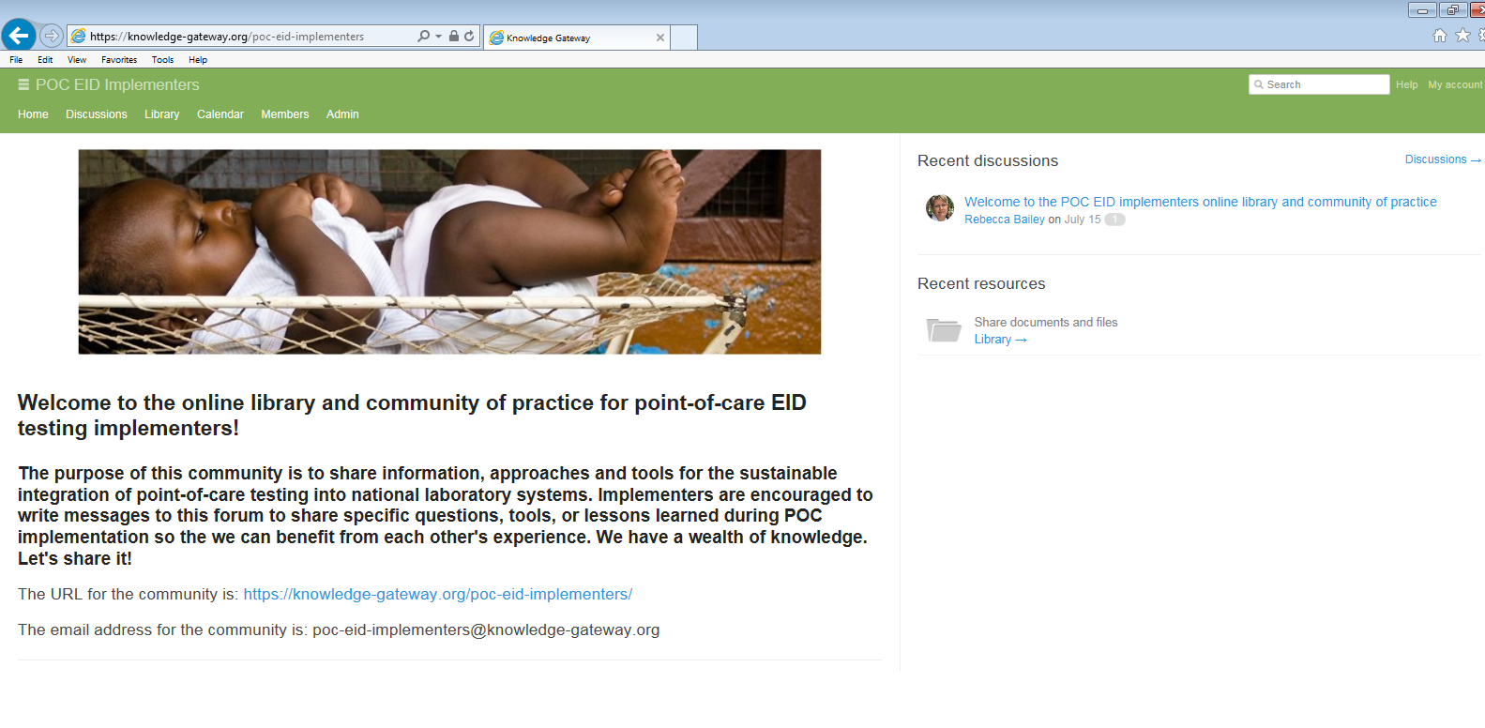
Knowledge Gateway online library and community
URL: https://knowledge-gateway.org/poc-eid-implementers
Email address: poc-eid-implementers@knowledge-gateway.org

Slide 12
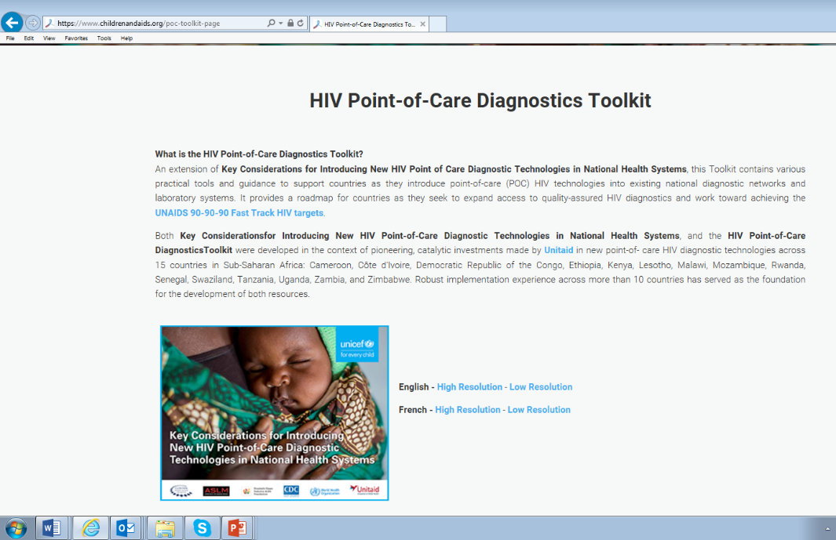
HIV POC diagnostics toolkit (hosted on the UNICEF website)
Tools for:
Product and site selection
Forecasting and supply planning
Regulations
Quality assurance
Others under development
URL: https://www.childrenandaids.org/poc-toolkit-page

Slide 13


Input 1: Leadership and governance
Example activities and outputs:
Criteria for site selection
POC roadmaps, manuals, plans
Product registration
Adapted testing guidelines, algorithms and SOPs
Updated policies, strategies and plants
MOH and technical working groups (e.g. lab, PMTCT, HIV) representing:
MOH units (lab and clinical)
Technical experts and agencies
Implementing partners
Local nongovernment and faith-based organizations
Donors
etc.

Slide 14
Input 2: Site and product selection, product approval, site capacity assessments, and placement models
NAOKO DOI

Slide 15
Input 3: Site enrollment, orientation, planning and training
Assuming the following:
Site and platform selection is completed
All training, planning and monitoring tools developed and available
Instruments and cartridges have been ordered and about to arrive in-country
Ready for POC EID Roll-out?
Not quite….
Testing algorithm, policies, request forms, registers, etc. need to account for POC EID
Site assessment and site improvement plan are required to allow adequate patient flow, HR and infrastructure capacity (secured room, table, storage cabinet, charger-inverter, etc.).
Detailed phased-enrolment plan, as all sites won’t be able to start at the same time
Comprehensive training package (not only instrument training), from sample collection to cartridges disposal, including inventory management, reporting, etc.
Supply chain needs to be adapted to short shelf-life and high-value of commodities
Detailed plan for site monitoring activities with responsible personnel identified

Slide 16
Phased site enrollment

Slide 17









Using hub-and-spoke networks to increase access to POC testing and optimize device utilization rates
Stand-Alone Sites
Receive samples directly from clients and perform POC EID tests on site
Multiple-Entry-Point Sites
Stand-alone or hub testing sites receive samples from different units or wards within the same health facility
POC EID
Nutrition unit
Pediatric ward
POC EID
MCH clinic
Hub-and-Spoke Networks
Hub sites provide testing for patients at that site and for spoke sites. Nearby spoke sites send samples to the hub sites for testing
Integrated Testing Sites
Process different types of POC tests
(e.g. EID, TB, other)
Spoke
POC
Spoke
EID
TB
Hub
Other
POC EID

Slide 18
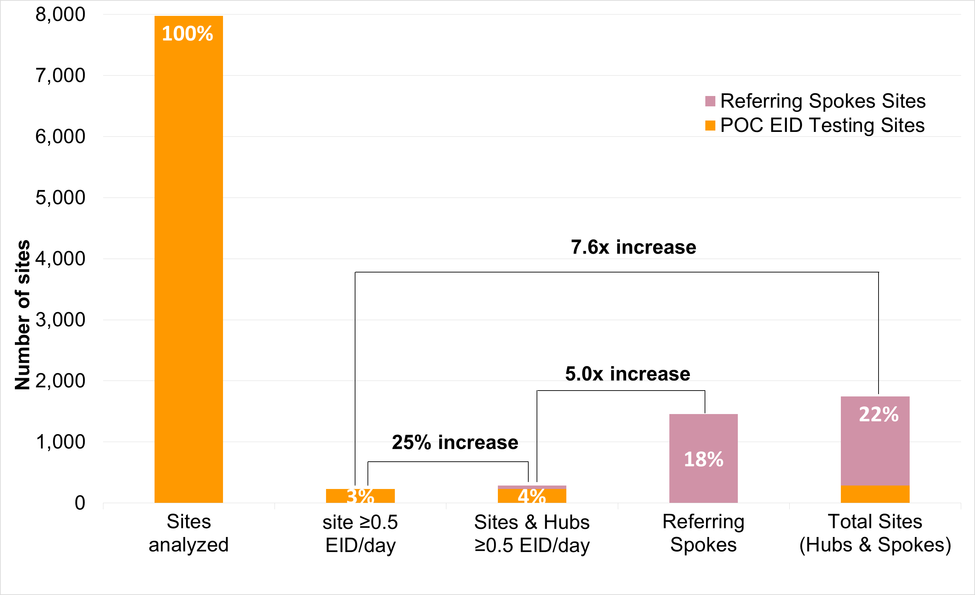
Hub-and-spoke improves access to POC EID for sites with low demand
Number of health facilities identified as
eligible to access POC EID testing

Slide 19
Hub-and-spoke networks: Sample transport
Use of EDTA microtainer tubes (Ethylenediaminetetraacetic acid to avoid blood clotting)
Specimen stable for 24 hours at room temperature or 72 hours at 2 to 8 °C
Uniform guidance on labeling and packaging (i.e. triple packaging)
Various models of transport, for example:
  Kenya: Leverage existing EID sample transport (planned hubs that way)
  Cameroon: Mix of motorcycle couriers, public transport

Slide 20

Orientation, planning and training
Pre-installation orientation and planning:
  Engage with sub-national authority and coordinate with in-country partners
  Plan enrolment with facility in-charge
  Perform infrastructure upgrades, if needed
  Appoint and train support monitoring staff and supervisors
  Conduct trainings of “master trainers”
  Coordinate with manufacturers for planning of instrument end-user trainings
Installation, trainings, and start-up:
  Confirm scheduling of training
  Instrument installation and end-user training
  Orientation session and trainings for all facility staff involved in EID services
  Start testing activities

Slide 21
Comprehensive training plan
Activities | Day 1 | Day 2 | Day 3 | Day 4 | Day 5
Day One: Mentoring and supportive supervision training 1. Training in all relevant content areas (e.g. EID testing form, instrument operation, sample collection, etc.) 2. The site visit process and tools (e.g. frequency, supervisory visit checklist, reporting) 3. Project M&E methods and tools 4. Recommended approaches for mentoring and supportive supervision, including troubleshooting 5. Training on how to perform competency assessment 6. Lines of communications 7. Education for clinicians on implications of same-day testing
Day Two: Orientation and training session for staff in hub and spoke facilities. 1. Training on the use of the EID Testing Form (how to fill the form for each units, its workflow & documentation) 2. Sample collection training 3. Sample labelling, packaging and transportation training
Day Three: Orientation and training session for staff in hub and spoke facilities. 1. Results communication (to caregiver/ patient) training 2. Training on the communication process. 3. Training on collecting treatment initiation data 4. Waste management training (sorting, labelling, disposal, transport, of destruction of waste)
Day Four: Orientation and training session for staff in hub and spoke facilities. 1. Training on storage, inventory tracking, and ordering of POC EID supplies 2. Overview of mentoring and supportive supervision plans 3. Lines of communications
Day Five: Installation of Alere-Q platform. 1. Manufacturer's End-User training, including operations (loading cartridge and operate instrument), preventive maintenance and cartridge disposal 2. Project's related processes related to testing (transfer of specimen from Microvette to cartridge, how to deal/record/report errors, Sample rejection and error logbook, temperature monitoring, etc.) 3. Lines of communications with spokes and with EGPAF supervisor (naming 1 focal person per site)

Slide 22
Examples of training materials, algorithms, SOPs and job aids

Slide 23

Installation and training are complete.
Time to start testing…. with close monitoring and support.

Slide 24
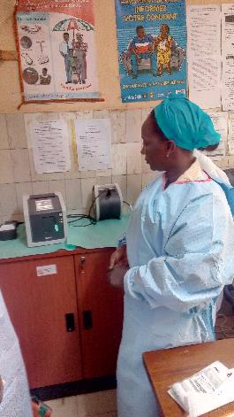
Input 4: Site monitoring, support, and competency assessments
Post-installation monitoring and follow-up
  Ensure close follow-up for each POC EID testing facility and their respective spoke sites
  Data collection, monitoring, and analysis through supportive site monitoring visits, with MOH staff to observe, review data, etc.
  Ensure swift corrective improvement
  Document lessons learned
  Competency assessments of instrument operators and, if possible, certification

Slide 25

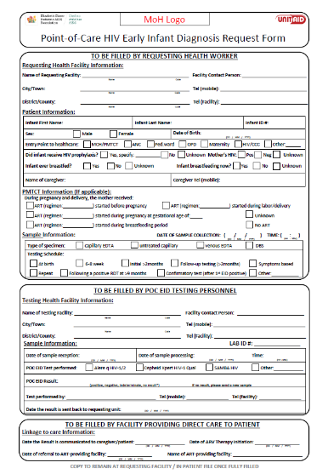
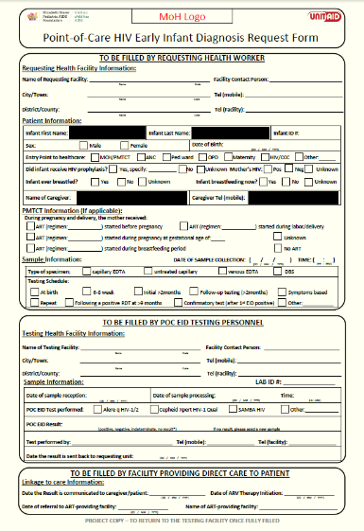
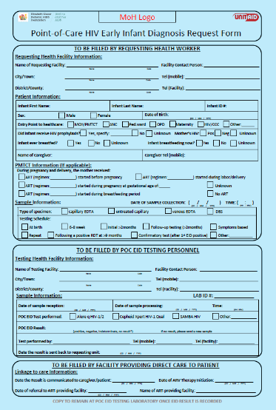
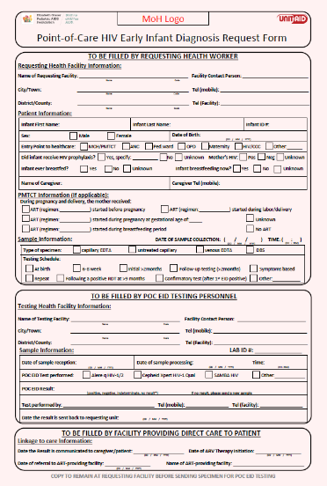
POC EID Testing Form
Single form with carbon copies
Section 1:
Filled by
health worker
Section 2:
Filled by
POC testing staff
Section 3:
Filled by
treating staff

Slide 26
Standardized site monitoring checklist
Site monitoring visits should include review and observation of:
Clinical Integration (i.e. adherence to testing algorithms, patient flow, etc.)
Use of SOPs, job aids, registers, tracking logs, and testing forms
Training and competency of instrument operators, including observation of operators, if possible
Instrument placement and performance
Inventory and waste management
Linkage to care
Trouble shooting
Mentoring, training and information sharing

Slide 27

Frequency of site monitoring visits
Site Enrollment Monitoring Schedule-testing and hub sites
Supportive supervision needs are expected to decrease over time
Site enrollment scheme is planned in a phased manner
The team opted for the following supportive supervision visit scheme for each newly enrolled site:
    2 weeks after each site enrollment
    4 weeks later (6 weeks after enrollment)
    6 weeks later (12 weeks after enrollment)
    If all is going well then move on to the…
Routine Site Monitoring Schedule:
Quarterly supervision to all sites with a POC EID machine
Choose one spoke from each hub to evaluate
Week 1 |  | Week 3 |  |  |  | Week 7 |  |  |  |  |  | Week 13
Week 1 |  | Week 3 |  |  |  | Week 7 |  |  |  |  |  | Week 13
Week 1 |  | Week 3 |  |  |  | Week 7 |  |  |  |  |  | Week 13
Week 1 |  | Week 3 |  |  |  | Week 7
Week 1 |  | Week 3 |  |  |  | Week 7
Week 1 |  | Week 3 |  |  |  | Week 7
Week 1 |  | Week 3 |  |  |  | Week 7
  Human resources for monitoring becomes a key
  consideration as more sites are rolled out.

Slide 28
Remote monitoring of POC EID testing
Investigation and corrective actions
  Good governance and appointed coordinating body is crucial
  Feedback communication with appointed focal points is key
  District-level support is essential for follow-up and corrective action.
  Competency assessment and refresher training might be needed
  Instrument repair might be needed
  Share information with supply chain to avoid stock outs
  Seek technical support from manufacturer if needed
Post-market surveillance
  Know how to identify potential problem in cartridge and instruments
  Similar problems seen across sites should raise a flag and prompt further investigation
  Sudden surge in problem following the use of a new lot should also raise a flag

Slide 29
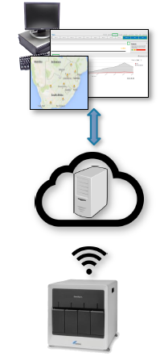
Instrument connectivity
Most instruments are capable of being connected
Partial or complete connectivity solutions sometimes provided by manufacturers
Third-party companies specializing in connectivity exist (SystemOne, Savics, etc.)
Key for overall remote monitoring of implementation
Critical for quality assurance of a decentralized POC network.
Use of dashboard allows rapid visualization of data and network map
Can allow for result transmission to clinicians
Can connect to existing LIMS or electronic registers
Inventory Management
Use of GPS coordinates to map your network
Disease surveillance
Configurable data access permissions

Slide 30
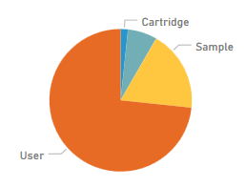
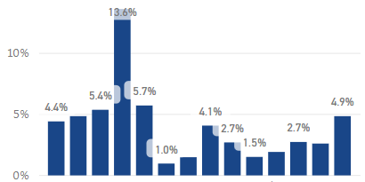
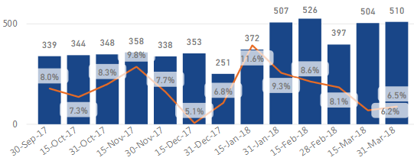
Remote monitoring of POC EID testing
Regular data collection
  Allows to identify trends
  Collected manually (labor intensive) or automatically (seamless and better data quality)
Frequent critical analysis of data
  Site level analysis is essential
  Trends analysis are key
  Require a minimum quantity of data for each site
  Allows to identify outliers (e.g. a facility with higher error rates) when POC EID implementation is at scale
Site 1
Site 2
Site 3
Site 4
Site 5
Site 6
Site 7
Site 8
Site 9
Site 10
Site 11
Site 12
Site 13
Site 14

Slide 31
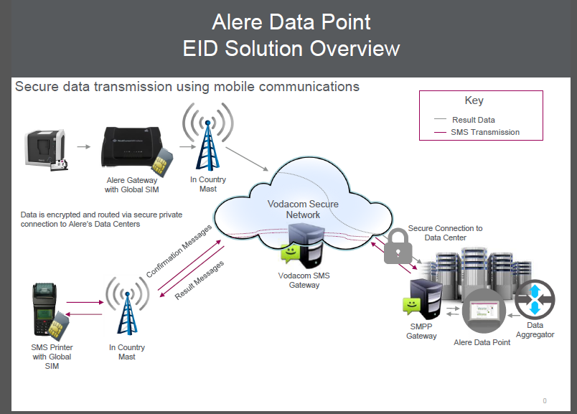
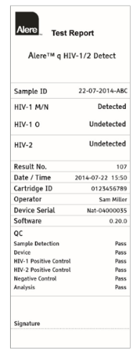
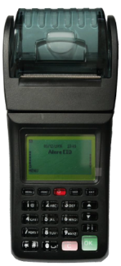
Hub-and-spoke networks: SMS for results return
Linkage-to-care integrated solution developed with ARDx (previously Alere)
Piloted in Côte d’Ivoire, Rwanda, Zimbabwe, and Cameroon (about to start)
DataPoint software, remote data storage, modem, SIM cards and data bundles are provided for FREE by ARDx
Purchasing pre-configured SMS printers for spokes directly from ARDx
Ability for spokes to request reprint
Ability of Alere to remotely push printers’ software update and troubleshoot

Slide 32

Standardized competency assessment tool
Observational checklist assesses three main steps in the testing cascade, namely:
  Sample reception, handling, and labelling
  Cartridge preparation
  Starting and running the assay

Slide 33
Input 6: Quality management and assurance (QM/QA)
Fit-for-purpose quality management/assurance
Site and platform selection (right product at the right place)
Site capacity assessment (infrastructure and HR) and upgrade (right conditions)
Site enrollment steps and activities
Model algorithms for testing and release of results
Comprehensive on-site trainings, and refresher trainings, if needed
(blood collection, packaging, transport, analysis, reporting, waste disposal)
Defined communication lines, for technical support and reporting of issues
Site monitoring and supervision visits
IQC failures monitoring
Use of monitoring logs (temperatures, sample transport, IQC failures, etc.)
Use of connectivity
Competency assessment

Slide 34
Input 5: Forecasting, procurement, supply chain and waste management.
Forecasting
Procurement
Clearing, receipt, and inspection
Inventory management
Storage
Ordering
Delivery
Storage and use at health facility
Consumption reporting
Waste management and reverse logistics
Sample and results transportation

Slide 35
Procurement and supply chain management cycle (1)
1. Forecasting and quantification
  Important to ensure no stock-outs or over-stocks
  Mix of forecasting approaches necessary during introduction and scale up of new devices
  Quarterly supply plan monitoring
  Integrated forecasting of both POC and conventional laboratory-based diagnostics
2. Procurement
  Contracts with manufacturers including service and maintenance agreements
  Frequent orders due to shelf life of test kits
  Lead time consideration of around 3 months from placing the order (i.e. production time + tax waiver process time + shipping time + custom clearance time)

Slide 36
Procurement and supply chain management cycle (2)
3. Shipping and custom clearance
  Identification of incoterm
  Air shipment due to test kit shelf life
  Government tax and duties exemption
  Customs clearance procedure
4. Receipt and inventory management
  Inspection of received commodities
  Inventory control system (FEFO)
  Updated stock-keeping records (whether manual or automated)

Slide 37
Procurement and supply chain management cycle (3)
5. Storage and distribution
  Good storage practices (management; storage facilities; product rotation; storage conditions; and security)
  If possible avoid parallel storage and distribution
  Frequent orders (monthly)
  If possible direct distribution to sites
6. Consumption reporting
  Critical to inform calculations used to forecast and order new supplies
  Monthly reporting recommended

Slide 38
Procurement and supply chain management cycle (4)
7. Waste Management and Reverse Logistics
  Generation of waste should be minimized, as much as possible
  Medical waste should be segregated according to nature of waste
  National SOPs for the storage and transport of medical waste should be followed
  Depending on the type of waste to be treated, disposal can involve autoclaving, incineration, burial in a protected pit, or transfer to a landfill for disposal
  Reverse logistics can be undertaken by health facilities to return waste to a central level facility or warehouse for disposal

Slide 39
Special considerations for POC equipment
Equipment considerations:
  Site upgrades to ensure an appropriate environment (e.g. cooling system, thermometers, locked doors and windows)
  Power considerations (e.g. gel batteries or solar panel and battery system, if not included with the platform)
  Supporting equipment (e.g. printers)
  Routine maintenance
  Long-term service and maintenance agreements

Slide 40
Special considerations for test kits and consumables
Test kits and consumables:
  Shelf life of test kits (currently 9 to 12 months from manufacturing date)
  Sample collection kits – appropriate for the type of sample (e.g. DBS, whole blood)
  Sample transport materials (e.g. EDTA microtainer tubes, triple packaging, cooler boxes)
  Other consumables (e.g. printer paper)
  Waste management or reverse logistics for used and expired cartridges

Slide 41
Monitoring of manufacturer performance
Purpose:
Inform how manufacturer is performing with regards to agreed service levels, quality and cost;
Identify room for improvement; and
Ensure immediate problem-solving and corrective action.
Two types of Key Performance Indicators (KPIs):
Procurement indicators
  On-Time, In-Full principle
  Guaranteed shelf life
  Quality of delivered devices and consumables
  Service and maintenance costs
In-country device performance indicators
  Reported device and module breakdowns
  Response time from receipt of complaint and provision of replacement device
  Repair time

Slide 42
Acknowledgements
Mothers and babies
Ministries of Health
CHAI, UNICEF and EGPAF global and country teams
Other POC EID partners
Unitaid

Slide 43
Questions and Discussion
For more information, please contact: rbailey@pedaids.org

Slide 44
EXTRA SLIDES

Slide 45
MOH-led site and product selection approach
Aims to expand access to POC EID, ensure the proficiency of instrument operators, and optimize previous investments in laboratory networks.
Recommended Steps for Site and Product Selection
Step 1: Analyze the EID Situation | Review the epidemiology and national priorities with respect to PMTCT and to the diagnosis and treatment of pediatric HIV
Step 2: Select POC EID Sites | Identify and assess the capacity of potential POC EID sites. Determine the appropriate operational model(s) based on additional analysis. Finalize site selection.
Step 3: Identify Product Needs | Consider the product needs for each site, such as throughput, infrastructure, portability, ease-of-use and electrical stability requirements, as well as sample type and sample preparation needs.
Step 4: Select POC EID Products | Choose appropriate POC EID products based on which product’s characteristics are the best match for the product needs.

Slide 46
Site capacity assessments
Uses an adapted version of the CDC SPI Point-of-Care Checklist (CDC SPI SPOCT Checklist) to assess the capacity of a site to implement POC EID and also helps to identify what site upgrades might be needed, if any.
Analyzes the ability of each site to:
Integrate point-of-care testing into patient care
Identify and train appropriate staff
Provide the physical facilities required for POC EID testing, such as adequate space and electricity
Ensure the safety of health workers and patients
Implement POC EID tests
Ensure a reliable supply of quality POC EID supplies, reagents and equipment; and
Monitor the quality of testing

Slide 47








A combination of placement models and testing strategies can be used to increase access to POC testing while optimizing device utilization
Stand-Alone Sites
Receive samples directly from clients and perform POC EID tests on site
Multiple-Entry-Point Sites
Receive samples from different units or wards within the same health facility
POC EID
Nutrition unit
Pediatric ward
POC EID
MCH clinic
Hub-and-Spoke Networks
Hub sites provide testing for patients at that site and for spoke sites. Nearby spoke sites send samples to the hub sites for testing
Integrated Testing Sites
Process different types of POC tests
(e.g. EID, TB, other)
Spoke
Spoke
POC
EID
TB
Hub
Other
POC EID

Slide 48
Task shifting: POC EID utilization by lab and non-lab staff
Instrument utilization, various approaches among eight countries:
  Lab sites only: Cameroon, Kenya, Rwanda
  Mix of lab and non-lab sites: Côte d’Ivoire, Zimbabwe, eSwatini (only 1 out of 19 sites is lab)
  Non-lab sites only: Lesotho, Mozambique
103 testing sites reporting (48 lab sites and 55 sites non-lab)
20,209 tests performed (lab: 6,670; non-lab: 13,539)
Both GeneXpert and Alere q instruments were installed across both lab and non-lab staff settings

Slide 49
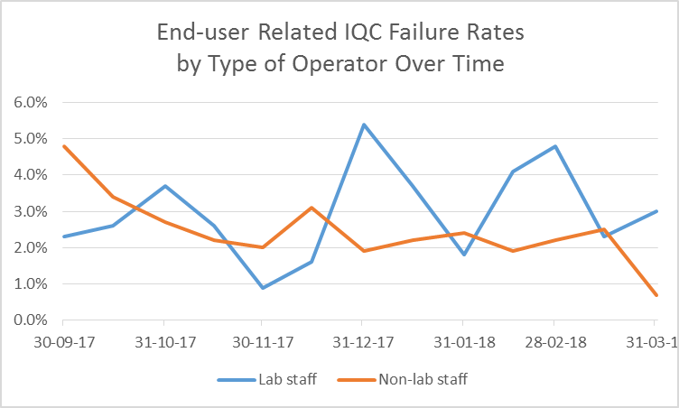
Performance of lab staff compared to non-lab staff
IQC Failure Category | Testing Cadre | % IQC Failure | P-value (95%)
All | Lab Staff | 5.5% | 0.001
 | Non-lab Staff | 6.7%
End-user related | Lab Staff | 3.0% | 0.003
 | Non-lab Staff | 2.3%
*Unpublished data

