Slide 1
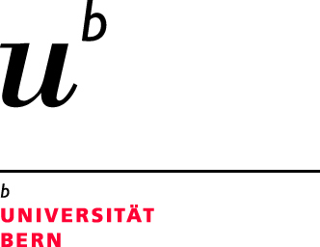
Drug susceptibility testing and mortality in patients treated for tuberculosis in high-burden countries
Kathrin Zürcher, Marie Ballif, Lukas Fenner, Sonia Borrell, Peter M. Keller, Joachim Gnokoro, Olivier Marcy, Marcel Yotebieng, Lameck Diero, E. Jane Carter, Neesha Rockwood, Robert J. Wilkinson, Helen Cox, Nicholas Ezati, Alash’le G. Abimiku, Jimena Collantes, Anchalee Avihingsanon, Kamon Kawkitinarong, Miriam Reinhard, Rico Hömke, Robin Huebner, Sebastien Gagneux, Erik C. Böttger, Matthias Egger, on behalf of the International Epidemiology Databases to Evaluate AIDS (IeDEA)
22nd International AIDS Conference (AIDS 2018), 23-27 July 2018, Amsterdam Netherlands

Slide 2
Background and Aim
Drug resistance and HIV co-infection are challenges for the global control of tuberculosis (TB) (1)
Limited access to drug resistance testing and to appropriate TB treatment (1)
Aim: To assess the impact of discordant anti-TB drug susceptibility testing (local vs reference laboratory) and mortality in HIV-positive and HIV-negative patients in lower and middle income countries
Source: 1, World Health Organization, Global tuberculosis report. 2017

Slide 3
Objectives
To compare drug susceptibility testing (DST) performed at ART programs or TB clinics vs phenotypic DST performed at the Swiss National Center for Mycobacteria
To compare mortality during TB treatment by:
Concordance / discordance of DST results
Degree of drug resistance
TB treatment adequacy

Slide 4
Methods
Patient recruitment and data collection
Clinical data and Mycobacterium tuberculosis isolates from TB patients (≥16 years) stratified by HIV and drug resistance status in 7 countries
International Epidemiology Databases to Evaluate AIDS (IeDEA) and TB clinics
Data collection tool: REDCap (www.project-redcap.org)
Source figure: World Health Organization, Global tuberculosis report. 2017

Slide 5
Methods
Drug susceptibility testing (DST)
ART programs / TB clinics: culture, Xpert MTB/RIF and/or line probe assay
Swiss reference laboratory: liquid culture MGIT with the critical drug concentrations
Drug | mg/L
Isoniazid | 0.1
Rifampicin | 1
Ethambutol | 5
Pyrazinamide | 100
Amikacin | 1
Moxifloxacin | 0.25

Slide 6
Exclusion criteria
Results

Slide 7
Patient characteristics
Results
 | All patients | HIV-negative | HIV-positive | P-value
 | (n=634) | (n=362) | (n=272)
Age, median (IQR), year | 33.2 (26.9-42.5) | 31.7 (25.1-43.3) | 34.7 (29.1-42.0) | 0.49
Sex, n (%) |  |  |  | <0.001
Female | 239 (37.7) | 113 (31.2) | 126 (46.3)
Male | 395 (62.3) | 249 (69.8) | 146 (53.7)
Site of disease |  |  |  | 0.003
Pulmonary TB | 609 (96.1) | 355 (98.1) | 254 (93.4)
Extrapulmonary and pulmonary TB | 25 (3.9) | 7 (1.9) | 18 (6.6)
CD4 count at baseline, median (IQR), cells/µl |  |  | 192 (77.5-369)
No. of observations (%) | - | - | 200
TB drug resistance |  |  |  | <0.001
Pan-susceptible | 394 (62.1) | 200 (55.2) | 194 (71.3)
Any resistance | 240 (37.9) | 162 (44.8) | 78 (28.7) | <0.001
Mono-resistant | 45 (7.1) | 29 (8.0) | 16 (5.9)
MDR | 163 (25.7) | 114 (31.5) | 49 (18.0)
Pre-XDR / XDR | 30 (4.7) | 18 (5.0) | 12 (4.4)
Other | 2 (0.3) | 1 (0.3) | 1 (0.4)
Sputum smear microscopy |  |  |  | <0.001
Negative | 113 (17.8) | 46 (12.7) | 67 (24.6)
Positive | 512 (80.8) | 312 (86.2) | 200 (73.5)
Unknown | 9 (1.4) | 4 (1.1) | 5 (1.8)

Slide 8
Concordance and discordance of DST results
Results
Concordance / discordance of DST results |  | Reference laboratory | Local laboratories
Concordance | 513 (80.9%) | Pan-susceptible | Pan-susceptible
 |  | Mono-resistance | Mono-resistance
 |  | MDR | MDR
 |  | Pre-XDR and XDR | Pre-XDR and XDR
Discordance potentially leading to under treatment | 23 (3.6%) | MDR | Pan-susceptible
 |  | Pre-XDR and XDR | MDR
Discordance potentially leading to over treatment | 67 (10.6%) | Pan-susceptible | Mono-resistance
 |  | Pan-susceptible | MDR
 |  | Mono-resistance | MDR
 |  | MDR | Pre-XDR or XDR
Other discordance | 31 (4.9%) | Pan-susceptible | EMB, SM
 |  | Mono-resistance | Pan-susceptible
 |  | INH, MOX | Mono-resistance
 |  | IHN, PZA | MDR
Treatment was adequate in 96.8% of patients with concordant DST results compared to 77.7% with discordant results

Slide 9
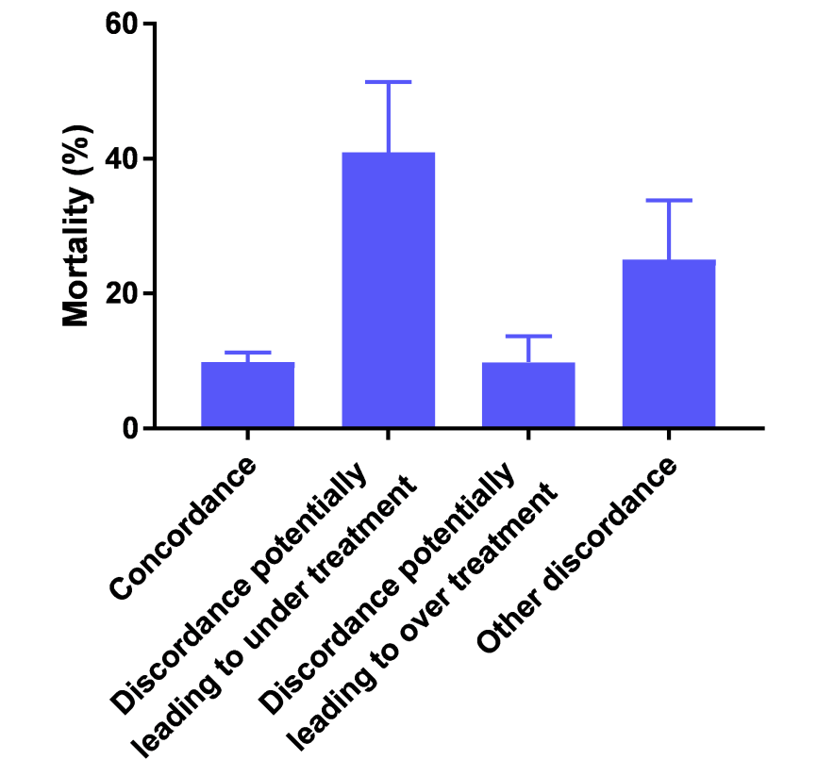
Results
Mortality during TB treatment by concordance / discordance of DST
 | No. of patients | No. of deaths (%) | aOR (95% CI)*
Concordance | 466 | 46 (9.9) | 1
Discordance potentially leading to under treatment | 22 | 9 (40.9) | 9.53 (1.04-87.32)
Discordance potentially leading to over treatment | 61 | 6 (9.8) | 1.01 (0.26-3.88)
Other discordance | 24 | 6 (25.0) | 4.40 (2.14-9.03)
*adjusted for sex, age, sputum microscopy, and HIV status.

Slide 10
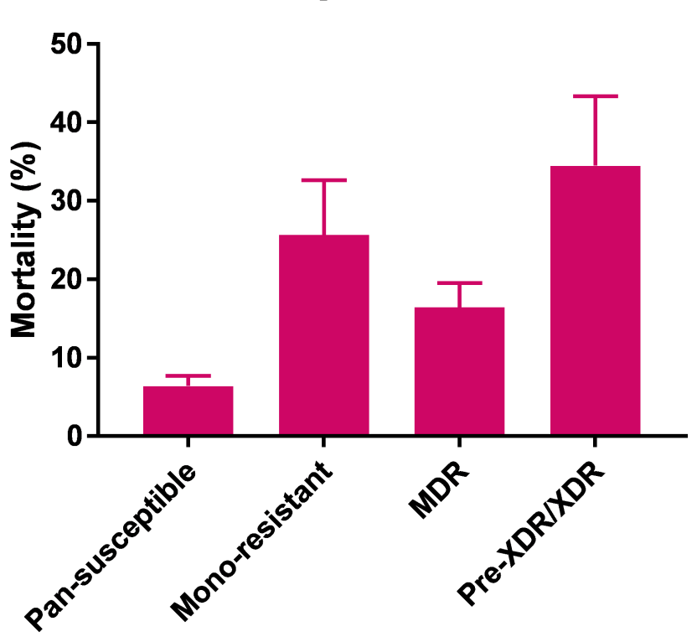
Results
Mortality during TB treatment by degree of drug resistance
 | No. of patients | No. of deaths (%) | aOR (95% CI)*
Pan-susceptible | 359 | 23 (6.4) | 1
Mono-resistance | 39 | 10 (25.6) | 5.38 (2.62-11.04)
MDR | 146 | 24 (16.4) | 3.43 (1.91-6.16)
Pre-XDR/XDR | 29 | 10 (34.5) | 11.33 (2.41-53.3)
*adjusted for sex, age, sputum microscopy, and HIV status.

Slide 11
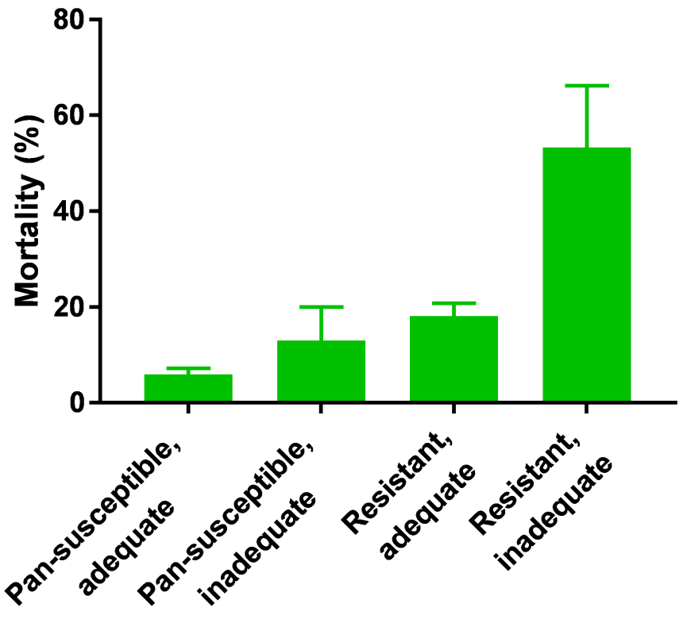
Results
Mortality during TB treatment by treatment adequacy
 | No. of patients | No. of deaths (%) | aOR (95% CI)*
Pan-susceptible, adequate treatment | 336 | 20 (6.0) | 1
Pan-susceptible, inadequate treatment | 23 | 3 (13.0) | 2.81 (0.50-15.81)
Any resistance, adequate treatment | 199 | 36 (18.1) | 4.23 (2.16-8.29)
Any resistance, inadequate treatment | 15 | 8 (53.3) | 21.54 (3.36-138.08)
* adjusted for sex, age, sputum microscopy, and HIV status.

Slide 12
Limitations
Limitations
No incidence or prevalence of drug-resistant TB can be estimated due to sampling strategy
Reduced sample size due to bacterial contamination or missing information
Role of heteroresistance, mixed infections, or minority resistant populations in explaining discordance
Only a selection of common first and second line drugs were tested

Slide 13
Conclusion
Discordant DST results contributed to inadequate treatment and excess mortality
Access to detailed resistance testing at treatment initiation needed to improve treatment outcomes
Understanding factors contributing to discordant DST results necessary to improve diagnostics and treatment outcomes
Preprint copy available on bioRxiv: doi.org/10.1101/370056

Slide 14
Acknowledgements
 | International epidemiology Databases to Evaluate AIDS TB working group and IeDEA team
 | Institute of Social and Preventive Medicine, Berne Prof Matthias Egger and team
 | Swiss Tropical and Public Health Institute, Basel Prof Sébastien Gagneux and team
 | Institute of Medical Microbiology, Zurich Prof Erik C. Böttger and team
Funding:
US National Institutes of Health (NIH)
Swiss National Science Foundation (SNF)

