Slide 1
Polypharmacy and DDIs in an ageing population – European context
Catia Marzolini
University Hospital Basel and University of Basel
University of Liverpool

Slide 2
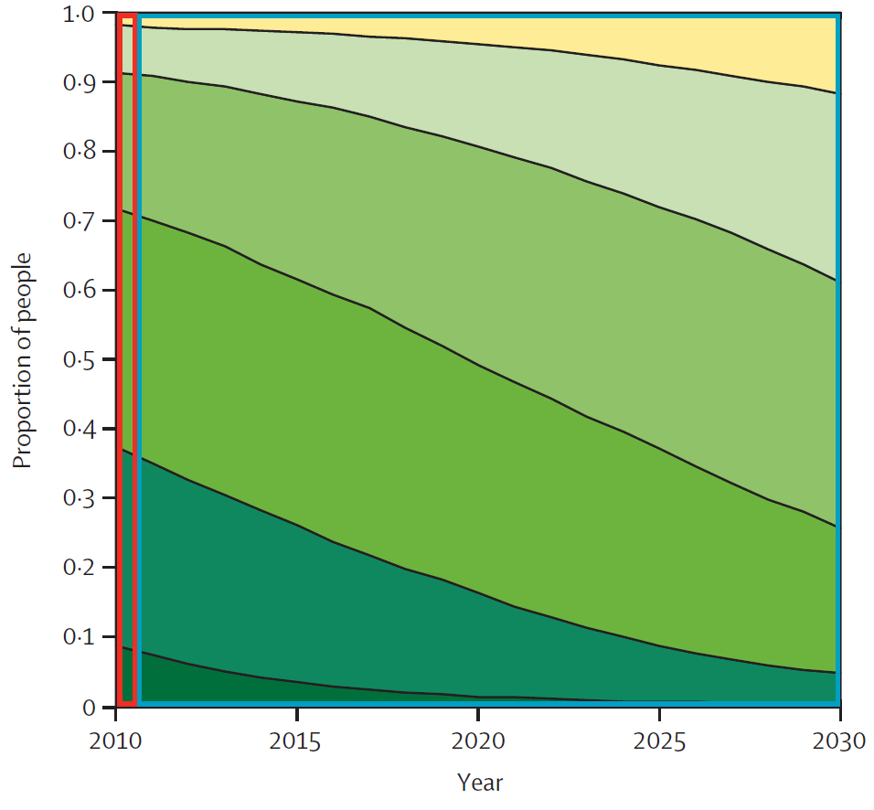
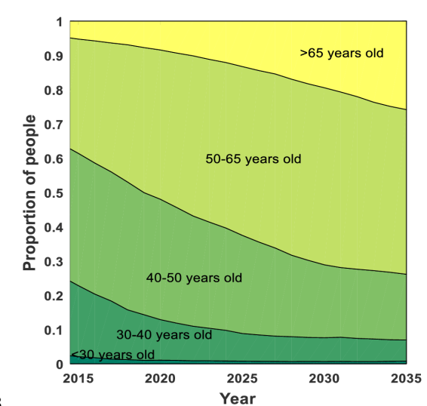
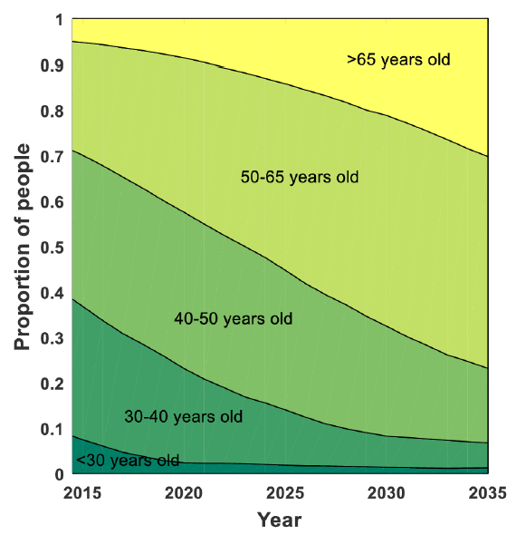
Ageing of HIV population: model projections
Age distribution and number of comorbidities in HIV infected individuals
Netherlands USA Italy
>70 years old
60-70 years old
50-60 years old
40-50 years old
30-40 years old
<30 years old
By 2030
39% pts >60 y
By 2035
27% pts >65 y
By 2035
29% pts >65 y
28% pts > 3 comorbidities
44% pts > 3 comorbidities
29% pts > 3 comorbidities
Comorbidity burden driven by cardiovascular diseases, diabetes and malignancies
Smit M et al. Lancet Infect Dis 2015; Smit M et al. PLoS One 2017

Slide 3
Ageing poses several therapeutic challenges
+
Presence of
comorbidities
Age associated changes in
drug PK and PD
non-HIV/ HIV DDIs
non-HIV/non-HIV DDIs
incorrect drug dosage
drug-diseases interactions
inappropriate drug
adverse drug events
prescribing cascade
inappropriate drugs, DDIs
polypharmacy

Slide 4
Case 1: 68-year old woman
Admitted in September 2016 to emergency room: lost balance, fell and broke arm.
Reports repetitive falls since the summer.
At admission: BP: 102/69 mmHg, heartbeat: normal
eGFR: 71 ml/min/1.73m²
glucose, electrolytes, liver parameters: normal
several recent and old bruises, slight confusion
Medical history Treatment
2010: HIV infection raltegravir (400 mg BID) + FTC (200 mg QD) + TDF (300 mg QD)
VL: undetectable, CD4: 467 cells/mm³
2013: hyperlipidemia rosuvastatin (5 mg QD)
2015: depression amitriptyline (50 mg QD)
Jun 2016: hypertension amlodipine (10 mg QD)
Jul 2016: ankle oedema furosemide (20 mg QD)
Aug 2016: overactive bladder tolterodine (4 mg QD)
Sept 2016: xerostomia, constipation anetholtrithion (25 mg TID) and sterculia (875 mg BID)

Slide 5
Case 1: 68-year old woman
Question: what is the most probable explanation for the recurrent falls?
possible furosemide related hypotension explained by DDI with the patient HIV treatment
possible amlodipine related hypotension explained by DDI with the patient HIV treatment
prescription of several drugs with anticholinergic properties which can impair cognition and may have contributed to the reported recurrent falls
4) likely not drug related

Slide 6
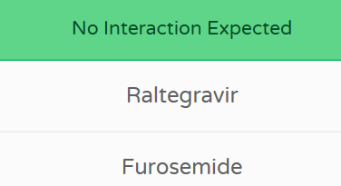
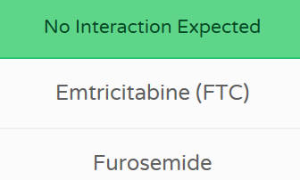
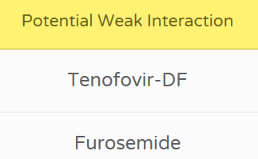
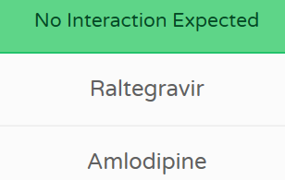
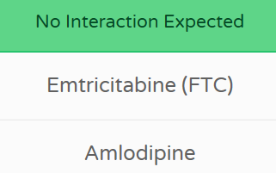
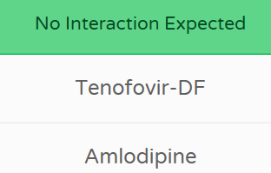
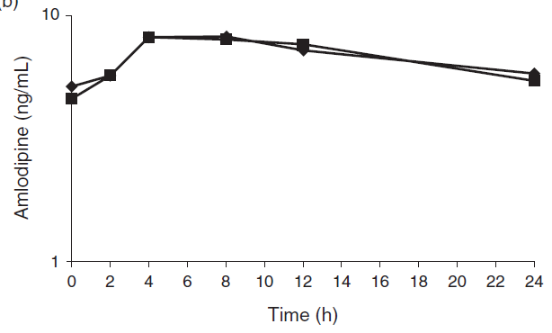
Some answers
DDI between furosemide and raltegravir, FTC, TDF?
Raltegravir metabolized by UGT1A1, no inhibitory effects on CYPs or UGTs
FTC eliminated renally via MATE1 and TDF via OAT1 and MRP4
www.hiv-druginteractions.org
Furosemide is primarily eliminated unchanged renally
and is a weak inhibitor of renal transporter OAT1 ➔
DDI between amlodipine and raltegravir, FTC, TDF?
Amlodipine is primarily metabolized by CYP3A4
➔
www.hiv-druginteractions.org
Amlodipine with/without RAL
Singh G et al. AIDS 2014

Slide 7
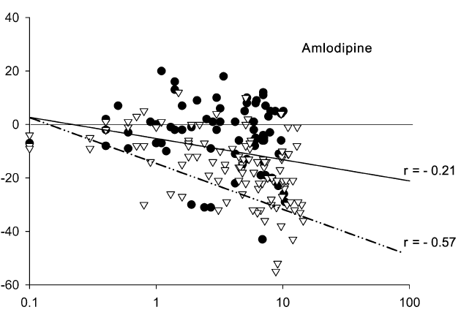
Some answers
Effect of age on amlodipine pharmacodynamics
young
old
Systolic BP (mmHg)
Amlodipine plasma levels (ng/ml)
Amlodipine pharmacodynamics significantly impacted by age: more pronounced decrease in systolic BP in elderly compared to young.
Age affects regulation of physiological processes (arterial baroreflex function), elderly are also more prone to thiazide induced orthostatic changes
there are some other issues….
Leenen FH et al. J Cardiovasc Pharmacol 2010

Slide 8
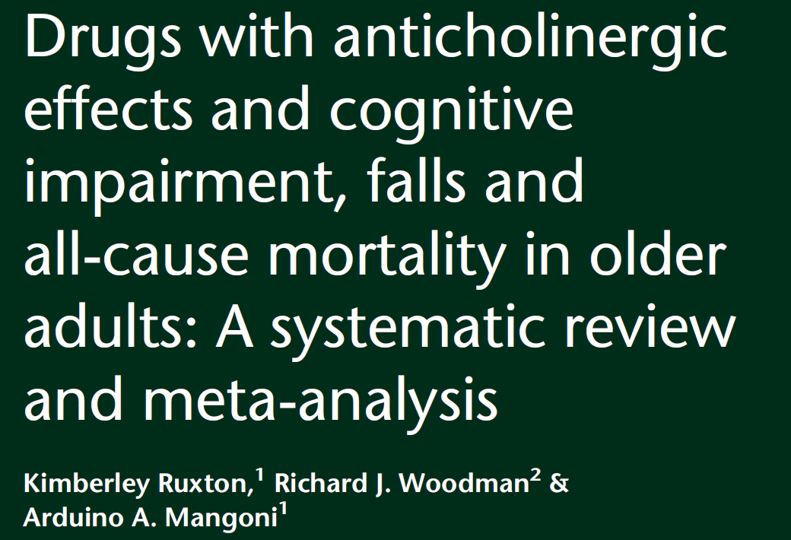
Some answers
… the patient is taking several drugs with anticholinergic properties:
amitriptyline and tolterodine
Anticholinergic drugs are considered as inappropriate for use in elderly
Elderly are more sensitive to adverse anticholinergic effects due to significant decrease in cholinergic receptors in the brain.
Drugs with anticholinergic properties can impair cognition ➔ increase risk of falls, cause constipation, xerostomia, dizziness, blurred vision.
J Am Geriatr Soc 2015
BJCP 2015
BMC Geriatrics 2016

Slide 9
Prescribing
cascade
Jun
Jul
Aug
Sept
admission ER
ankle oedema
urinary incontinence
xerostomia
constipation
amlodipine
furosemide
tolterodine
anetholtrithion + sterculia
Ankle oedema recognized adverse effect of amlodipine (risk higher in women, older patients)
Unlike odema caused by fluid retention, amlodipine induced oedema due to capillary pressure resulting in fluid loss from the capillaries. Does not respond to diuretic treatment.
Sica D et al. J Clin Hypertens 2011
Treatment
Raltegravir + 3TC + TDF
Rosuvastatin
Amitriptyline
Amlodipine
Furosemide
Tolterodine
Anetholtrithion
Sterculia
Patient doing better. Recalls having problems remembering things and notably to take the evening dose while she was on all these medi-cations.
➔ escitalopram
➔ lisinopril
VL measurement: 439’000 copies/ml (Sept 2016)
high resistance: RAL, EVG/c;
intermediate resistance: DTG needs BID dosing
Notes:
Ankle oedema appears to be dose related (frequency about 10%). Of note: ankle oedma are less frequent with lercanidipine.
The pt was diagnosed with HT and was prescribed HT drug. She then experienced CCB adverse event. She had not been diagnosed with any medical cause of oedema such as heart failure, venous insufficiency or hypoalbunemia. Peripheral oedema is the result of vasodilation of peripheral arterioles probably induced by amlodipine since it was not present prior the initiation of the drug. In the present case, oedema were ttt with diuretic which did not help to resolve the oedema but, due to his pharmacological action, increased diuresis and caused urinary incontinence symptoms. Instead of attributing these symptoms to ADR, the physician interpreted as a new health problem and prescribed tolterodine to treat incontinence. Tolterodine has anticholinergic properties. The patient is also taking amitriptyline, an antidepressant with anticholinergic properties . The coadministration of two drugs with anticholinergic properties led to several anticholinergic side effects including impaired cognition which may have contributed to the falls. The patient presents also other anticholinergic side effects: xerostomia and constipation which led to the prescription of more drugs.

Slide 10
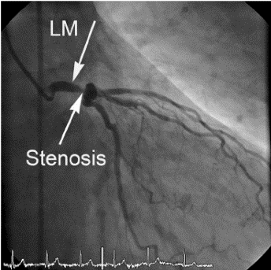
Case 1: 68-year old woman
Patient prefers to have a once daily HIV regimen to prevent the same issue
➔ darunavir/ritonavir (800/100 mg) + TAF (10 mg) + FTC (200 mg)
January 2017: chest and left arm pain, dyspnea
significant stenosis of coronary artery
➔ coronary angiography to place drug-eluting stent
Patient started on:
metoprolol 25 mg QD
aspirin 100 mg QD
clopidogrel 75 mg QD
other comedications:
rosuvastatin
escitalopram
lisinopril
Question: which of the following statement is correct?
1) clopidogrel is an antiplatelet agent of choice in presence of boosted HIV regimens
prasugrel is an antiplatelet agent of choice in presence of boosted HIV regimens
ticagrelor is an antiplatelet agent of choice in presence of boosted HIV regimens
clopidogrel, prasugrel and ticagrelor can all be used with boosted HIV regimens

Slide 11
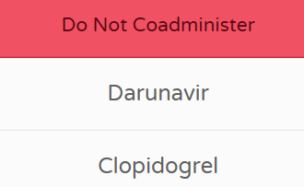
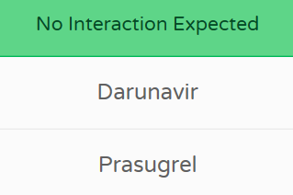
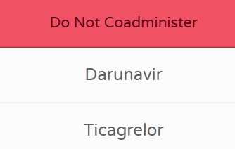
Case 1: 68-year old woman
April 2017: novel episode of chest pain with electrocardiographic signs of acute
anterior myocardial infarction
coronary angiography showed significant intra-stent thrombosis leading
to replacement of drug-eluting stent
➔ patient maintained on same ARV treatment, clopidogrel replaced by prasugrel
and dual antiplatelet treatment (aspirin-prasugrel) maintained for one year
without further occurrence of cardiac events
www.hiv-druginteractions.org

Slide 12
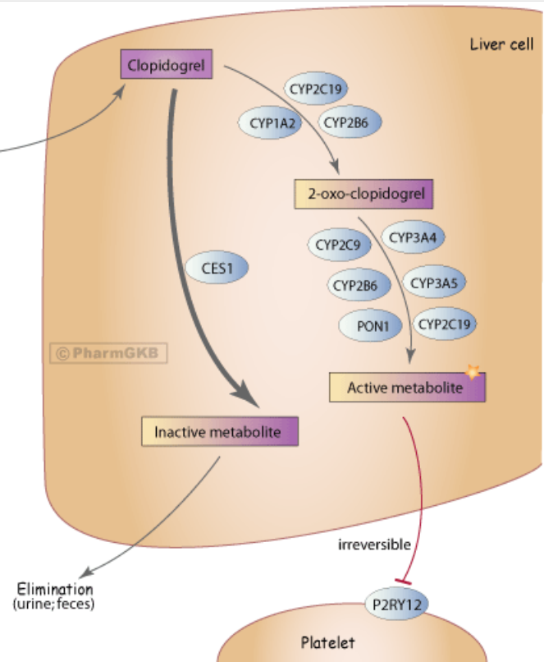
DDI between boosted ARV and antiplatelets
≈15%
Prasugrel
Liver cell
induction
by RTV
CES
Thiolactone int. metabolite
CYP3A4
CYP2C9
inhibition
by RTV, Cobi
CYP2B6
CYP2C19
Active metabolite
what is the net PK/PD effect
of this DDI in patients?
irreversible
P2RYI12
Platelet
Although clopidogrel and prasugrel have comparable platelet inhibition potencies, in clinical trials prasugrel has demonstrated greater platelet inhibition and lower rates of recurrent atherothrombotic events compared to clopidogrel. This might be explained by prasugrel more efficient bioactivation and higher concentrations of the active metabolite.
www.pharmgkb.org, Marsousi N et al. Clin Pharmacokinet 2018

Slide 13
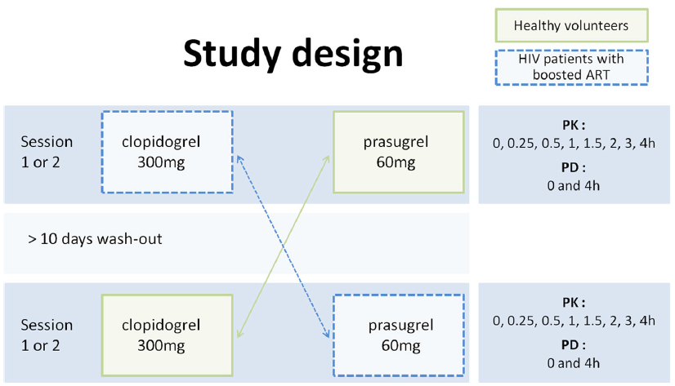
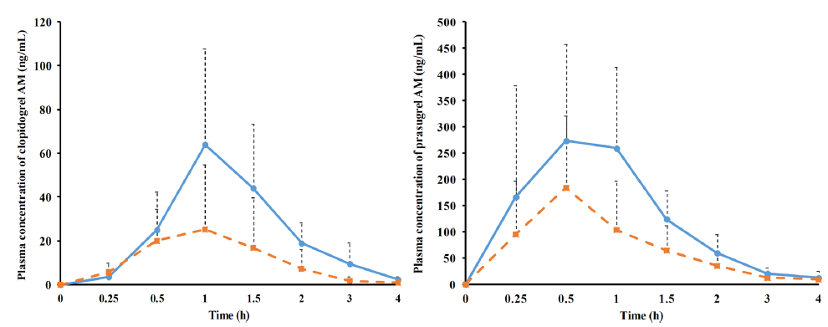
Clopidogrel versus prasugrel and boosted ARV
PK effect
n =12
n= 9
Clopidogrel active metabolite
Prasugrel active metabolite
Second independent clinical
study:
clopidogrel + RTV ➔
clopidogrel active met. AUC -49%
Itkonen MK et al. Clin Pharmacol Ther 2018
AUC -69%
AUC -52%
antiplatelet drug alone
antiplatelet drug + RTV/Cobicistat boosted ARV
Marsousi N et al. Clin Pharmacokinet 2018

Slide 14
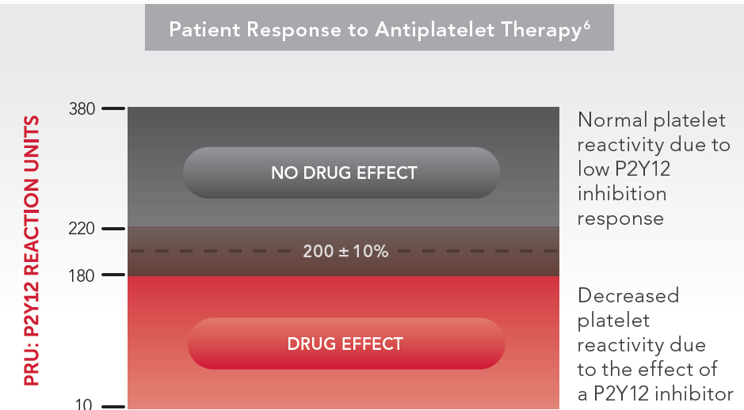
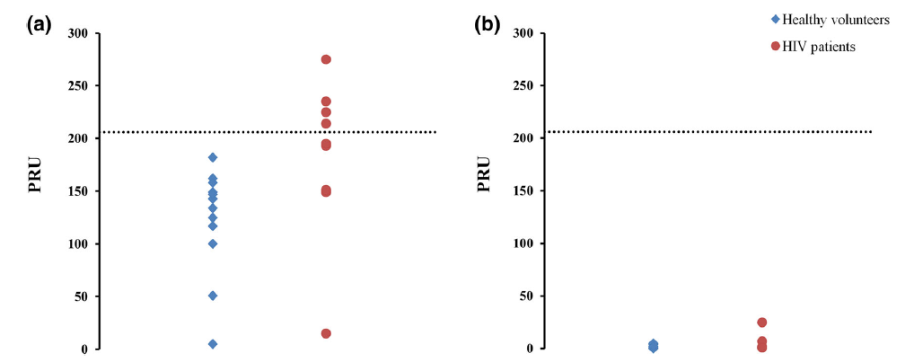
Clopidogrel versus prasugrel and boosted ARV
PD effect
Platelet receptor blockade measured with VerifyNow®
<200 P2Y12 Reaction Units (PRU) suggests P2Y12 inhibition effect
www.accriva.com
Clopidogrel
Prasugrel
44% HIV patients did not
achieve platelet inhibition
all HIV patients prasugrel platelet inhibition remains adequate
Second independent clinical study:
average inhibition of platelet aggregation decreased:
51% (clopidogrel alone) vs 31% (clopidogrel + RTV)
Itkonen MK et al. Clin Pharmacol Ther 2018
healthy volunteers
HIV patients
prasugrel should be preferred over clopidogrel in presence of boosted regimens when possible
Marsousi N et al. Clin Pharmacokinet 2018, Itkonen MK et al. Clin Pharmacol Ther 2018

Slide 15
Learning points
Comorbidities, age-related physiological changes and care by multiple healthcare providers predispose elderly individuals living with HIV to polypharmacy, inappropriate prescribing and DDIs between HIV drugs/non-HIV drugs but also between non-HIV drugs.
=> check drug indication
=> dose carefully (start with low dose and increase dosage slowly when possible,
adapt dosage to renal function)
DDIs with antiretroviral agents are common but are mostly manageable.
Some DDI can be very challenging (i.e. antiplatelets, anticoagulants, cancer drug
immunosuppressants….).

Slide 16
Case 2: 76-year old man
HIV infection in 2010
Patient has been treated over the years with NNRTI and PI based regimens. Currently suppressed with DRV/r (800/100 mg QD) + FTC (200 mg QD) + TDF (300 mg QD)
Current co-medications: lisinopril, vitamin D, calcium, zoledronic acid, tamsulosin,
pitavastatin
Medical history:
Radical left nephrectomy for a renal clear cell carcinoma in 2014
Follow-up negative until March 2018: CT scan revealed multiple metastatic lesions
which cannot be removed by surgery.
First-line treatment options for favorable risk metastatic renal cell carcinoma:
1) sunitinib 50 mg 4 weeks on/2 weeks off
2) bevacizumab + INF alpha 2b bevacizumab 10 mg/kg iv every 2 weeks,
INF 9 mio units sc 3 times/week
3) pazopanib 800 mg daily

Slide 17
Case 2: 76-year old man
Question: what would you advice in this particular situation?
1) maintain of current antiretroviral regimen and treatment with sunitinib
2) maintain of current antiretroviral regimen and treatment with bevacizumab + INF
maintain of current antiretroviral regimen and treatment with pazopanib
change to a dolutegravir, raltegravir or bictegravir containing regimen

Slide 18
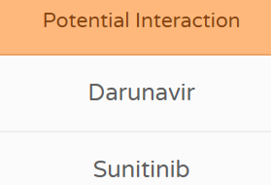
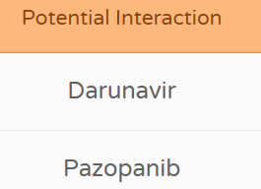
Drug-drug interactions potential
Bevacizumab: proteolytic catabolism ➔ no interaction with patient’s HIV treatment
Interferon alpha 2b: mainly renal elimination ➔ no interaction with patient’s HIV treatment
Sunitinib and pazopanib: metabolism by CYP3A4
www.hiv-druginteractions.org
www.cancer-druginteractions.org
Coadministration with ketoconazole, another strong CYP3A4 inhibitor, increased sunitinib Cmax and AUC by 49% and 51%, respectively, due to inhibition of CYP3A4. Coadministration with potent CYP3A4 inhibitors should be avoided. If this is not possible, the doses of sunitinib may need to be reduced to a minimum of 37.5 mg once daily for gastrointestinal stromal tumor (GIST) and metastatic renal cell carcinoma (MRCC) or 25 mg once daily for pancreatic neuroendocrine tumors (pNET) based on careful monitoring of the tolerability. Sunitinib can cause dose-related QT prolongation. Consider monitoring of sunitinib plasma concentrations if available.
Sunitinib therapeutic range: > 50 ng/ml < 100 ng/ml
Faivre S et al. J Clin Oncol 2006; Mendel DB et al. Clin Cancer Res 2003
Coadministration with ketoconazole, another strong CYP3A4 inhibitor, increased pazotinib Cmax and AUC by 45% and 66%, respectively, due to inhibition of CYP3A4. Concurrent use of CYP3A4 inhibitors should be avoided. If coadministration is necessary, the product label recommends a dose reduction to 400 mg once daily, based on careful monitoring of tolerability. Further dose reduction may be considered if possible drug-related adverse events are observed. QT prolongation and Torsades de pointes have been reported with pazopanib, close monitoring for QT prolongation is recommended if coadministration is necessary. Consider monitoring of pazopanib plasma concentration if available.
Pazopanib minimal effective concentration: > 20 ug/ml
Verheijen RB et al. Clin Cancer Res 2016

Slide 19
Case 2: 76-year old man
HIV treatment is changed to DTG (50 mg) + FTC (200 mg) + TAF (25 mg)
Patient is started on sunitinib 50 mg 4 week on/2 weeks off.
To date, patient completed 3 treatment cycles, treatment is well tolerated
CT performed 3 months after initiation treatment demonstrated inhibition of metastatic
disease progression
Notes:
Bevacizumab binds to endothelial growth factor (VEGF), a key driver of vasculogenesis. Bevacizumab will lead to regression of tumors vascularization. Bevacizumab can cause osteonecrosis of the jar. Cases have been reported in patients who received prior or concomitant treatment with biphosphonate (our patient is currently ttt with zoldedronic acid).

Slide 20
Conclusion
The identification, prevention and management of DDIs remain a key priority in HIV care.
The potential for DDIs needs to be considered systematically when selecting an antiretroviral regimen or when adding any new co-medication to an existing HIV treatment with particular attention to adjust dosage or perform clinical monitoring when needed.

Slide 21
Acknowledgements
Manuel Battegay
Veronika Bättig
Mapi Fleury
David Back
David Burger

