Slide 1
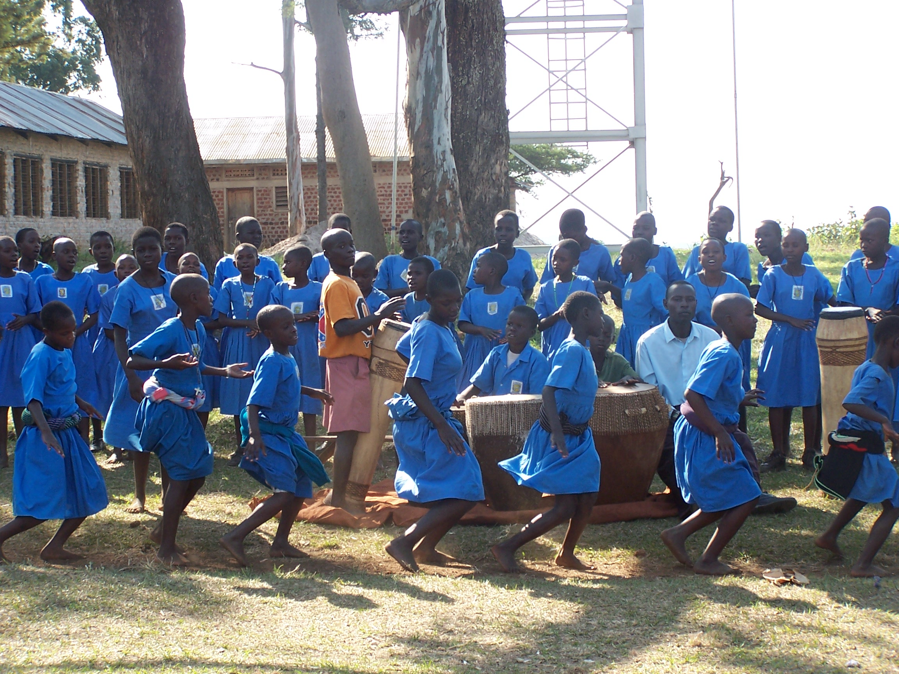
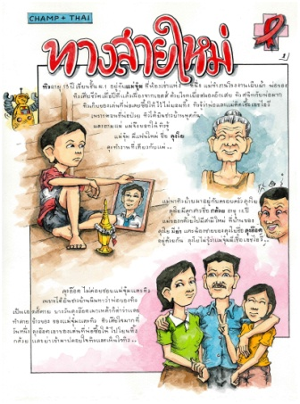
Promoting Mental Health in Adolescents Growing up with HIV
Claude Ann Mellins, Ph.D.
HIV Center for Clinical and Behavioral Studies
New York State Psychiatric Institute & Columbia University
New York, New York, USA
22nd International AIDS Conference, 23-27 July, Amsterdam, The Netherlands
No disclosures to report

Slide 2
Risk Factors for Mental Health Problems in Youth Growing-up with Perinatally-acquired HIV (PHIV)
Adolescence
- Puberty
- Neurocognitive development
- Transition
Medical
- PHIV
- Physical health & CNS outcomes
- Access to care
Socio-economic Factors
- Poverty and social disadvantages
- Housing & food insecurity
- Limited educational/employment opportunities
Mental Health
Family Systems
- Parent-child relationship & communication
- Supervision & monitoring
- Familial mental illness and substance use
- Family disruption
Environment
- Violence
- Substance use
- Racial/ethnic discrimination/marginalization
- HIV-stigma
Peers
- Peer relationships/isolation
- Bullying
- Peer influences (positive/negative)
Stressful Life Events
- Trauma
- Loss & bereavement

Slide 3
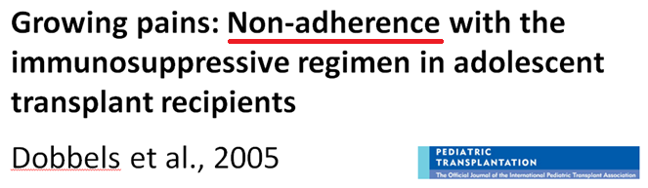
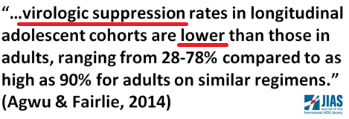
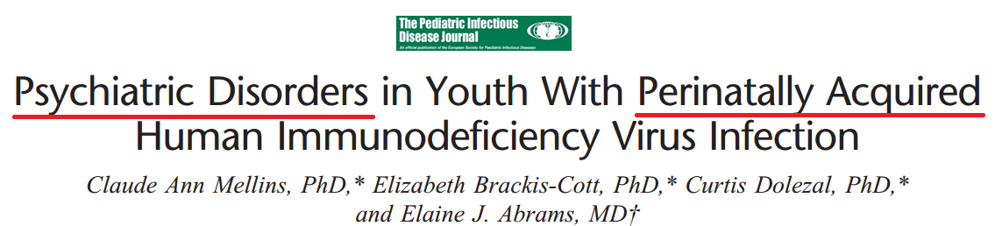
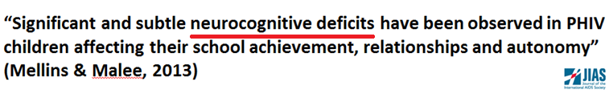

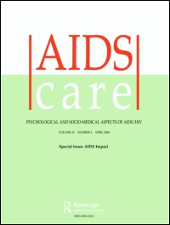


Behavioral Health Outcomes in
Adolescents Living with HIV
“That is why I stopped the ART” (Dahab et al., 2008)
Psychosocial challenges and protective influences for socio-emotional coping of HIV+ adolescents in South Africa: a qualitative investigation
(Petersen et al., 2010. AIDS Care)
Depression among Vertically HIV–Infected Adolescents in Northern Thailand
Benjamin Lee, MD1 , Manik Chhabra, and Peninnah Oberdorfer, 2011. Journal of the International Association of Physicians in AIDS Care
Notes:
In fact- data from across the globe indicate youth are at risk for multiple behavioral health problems- non adherence→ lower rates of viral suppression and actually death rates that have not gone down
CNS effects of HIV→ neuro cog
And mental health problems in the US, South Africa, Thailand and many other contexts
Such that the importance of mental health care as children with hiv reach adolescents young adults was highlighted by a clinician in Africa many years ago

Slide 4
CASAH
(R01 NIMH 069133; Mellins et al., 2009)
    Large cohort study following youth with PHIV
    Youth 9-16 years at enrollment (2003-2008);
    now 18-28 years
    Psychosocial interviews are administered every 12-18 months, including a full validated structured psychiatric interview (DISC)
Notes:
Quick snapshot of what those mental health problems look like using data from
CASAH- one of the few ongoing cohort studies of youth growing up with hIV with full psychiatric interview

Slide 5
CASAH Rates of
Psychiatric Disorders Across Time
 | B 9-16 yrs (x̅=12) | FU1 11-19 yrs (x̅̅=14) | FU2 13-24 yrs (x̅=17) | FU4 15-26 yrs (x̅=20) | FU5 18-28 yrs (x̅=22)
Any Disorder | 35% | 30% | 36% | 44% | 43%
Any psychiatric disorder | 34% | 28% | 27% | 30% | 26%
Any anxiety disorder | 31% | 21% | 19% | 25% | 21%
Any mood disorder | 3% | 6% | 5% | 10% | 11%
Any behavior disorder | 6% | 7% | 9% | 7% | 1%
Any substance use disorder | 2% | 4% | 17% | 23% | 25%
    Prevalence of disorders in CASAH similar to those found in US and international studies in Africa and Asia
    (Vreeman, et al, 2017)
    But these are cross sectional snapshots; do they capture developmental burden of mental health problems?

Slide 6
CASAH: Rates of Psychiatric Disorders in PHIV
Youth Across 5 Time Points Show Greater Burden
We need to be screening for mental health problems across adolescence and young adulthood
69% diagnosed
at least 1x with any non-substance use psychiatric disorder
26% diagnosed
at least 1x with
any mood disorder
83% diagnosed
at least 1x with
any disorder
8% diagnosed
≥ 2x
39% diagnosed
≥ 2x
53% diagnosed
≥ 2x
60% diagnosed
at least 1x with
any anxiety disorder
18% diagnosed
at least 1x with
any behavior disorder
41% diagnosed
at least 1x with
any SUD
31% diagnosed
≥ 2x
21% diagnosed
> 2x
7% diagnosed
≥ 2x
Notes:
in fact- data from CASAH show that cross sectional snapshot signficantly underestimate the impact of mental health on young people during adolecence
Read
End with we need to be asssessing for mental health problems across developmental stages-
Don’t need to give ful psych interviews- but we do need to at least screen across multiple tomains

Slide 7
We Need Treatment Programs
But There are Global Treatment Disparities
90% of children and adolescents live in LMIC
But only 10% of RCTs on child and adolescent mental health treatment done in LMIC
Kieling et al., 2011
Notes:
Data also indicate- that there are substantive mental health needs
But there are Global treatment disparities
Children and adolescents= approximately 1/3 of the world’s population
90% live in Low-income and middle-income countries
While evidence based interventions have been developed and tested in high income countries, limited work where the majority of children live- only 10%

Slide 8
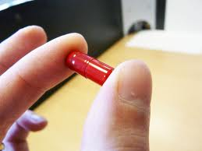


What Do We Know?
There is not one magic pill
Notes:
So to move forward- what do we know
We know from other vulnerable population as well as adults- that there is not one magic pill
Think about HIV treatment as example- need multiple approaches that attack virus across multiple pathways
Mental health is really no different, especially since its also associated with multiple behavioral health outcomes

Slide 9
Multiple Risk Factors for Mental Health Problems
Adolescent
Medical
Socio-economic Factors
Mental Health
Family Systems
Environment
Peers
Stressful Life Events
Notes:
But Rather there re multiple risk factors and multiple domains that may require interventions

Slide 10
Interventions
The National Institutes of Health (2006) noted that effective behavioral interventions:
  Intervene at multiple system levels
  Simultaneously target multiple risk factors
  Integrate behavioral interventions into the environment
We also know early intervention is key
  Prevention of health impairing behaviors before they begin is more effective than intervening after behaviors are established
Notes:
ReAD slide

Slide 11
Model of Psychosocial Service
for HIV-affected Families
In
One stop shopping
  Children, adolescents, and adults treated in the same site
  Mental health services coordinated with medical services
  Multidisciplinary services delivered in a coordinated manner: individual, family and group psychotherapy, psychopharmacology,
  wrap-around services
  Effective and common model in the US for child and adolescent care
  Financially and labor intensive
Notes:
Read slide
Then note – we through it out in LMIC-
Looking for less resource intensive programs – but that still target mutiple behaviors and systems

Slide 12
CHAMP+ based on CHAMP
Collaborative HIV/AIDS Mental Health and Prevention Project
(NIMH: McKay, 2000; Bhana, 2010)
CHAMP is an evidence based intervention, supported in multiple NIH-funded clinical trials (US, South Africa, and Trinidad)
Created by clinicians, researchers, and families using a community-collaborative approach
Originally targeted uninfected inner city early adolescents living in vulnerable communities and their families
Aim: to prevent health risk behaviors and promote mental health
Multiple families (8-10) come together in their communities for 10 sessions to share a meal and participate in separate and combined youth and caregiver groups focused on a semi-structured curriculum

Slide 13
CHAMP:
Collaborative HIV/AIDS Mental Health and Prevention Project
(NIMH: McKay, 2000)
Curriculum focuses on:
  Strengthening parent-child relationships, communication, supervision and decision-making skills
  Strengthening youth mental health, coping, and social problem-solving skills in situations of sex/substance use risk
  Increasing HIV knowledge
  Increasing social support within and between families
Developed for lay staff administration in communities, thus ideal for resource limited settings

Slide 14
CHAMP+ Structure and Curriculum
(NIMH/NINR/NICHD/Victor Daitz/ICAP/TreatAsia; Bhana et, 2013; Mellins 2014; Pardo 2017)
Stakeholders maintained most of the CHAMP structure and curriculum
Lay counselors administer curriculum, but in HIV clinics
Multiple family groups come together
10 session curriculum
  Session 1 Surviving loss and bereavement
  Session 2 What is HIV?
  Session 3 Adherence
  Session 4 Identity, acceptance and coping
  Session 5 Disclosure
  Session 6 Communication
  Session 7 Puberty and adolescent development
  Session 8 Negotiating sexual possibility situations/ peer pressure
  Session 9 Coping with stigma
  Session 10 Family support networks

Slide 15
The Vuka Family
MA’MAFUTHA BAB’VUKA GOGO MUZI NONHLANHLA & NHLANHLA SINDI

Slide 16
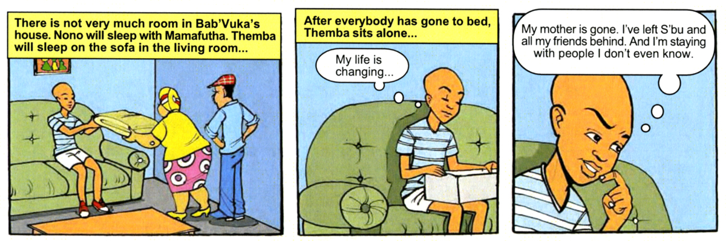
Surviving Loss and Bereavement
Notes:
Themba and his sister go to live with his aunt and uncle. He must struggle with feelings of loss and Bereavement related ot parent death, moving away from home and friends and living with people he doesn’t really know

Slide 17
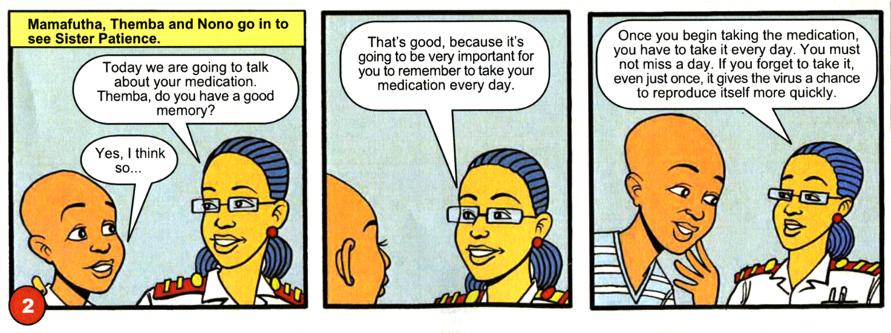
Adherence

Slide 18
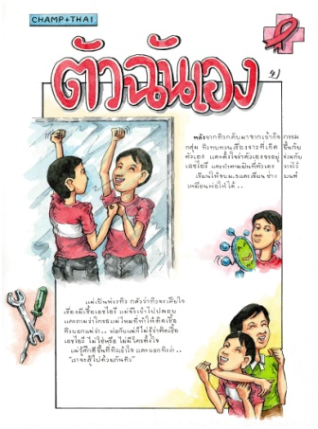
CHAMP+ Asia:
“Walking Together”

Slide 19
Results
Pilot RCTs in South Africa (VUKA) and Thailand (Walking Together) (Bhana, 2013, Mellins, 2014; Pardo, 2017)
    VUKA: N=66 subjects; 2 pediatric clinics
    Walking Together: N=88 subjects; 4 pediatric clinics
At both sites:
    Over 95% attended 9 or 10 (all) sessions
    Intervention participants improved in most areas and
    Compared to standard of care had greater improvement in:
      Self-reported adherence
      HIV knowledge
      Caregiver-child communication
      Perceived stigma
      Mental Health (for Thailand only)

Slide 20

SUUBI+
Economic Empowerment of Adolescents in Sub-Saharan Africa
(Supported by NIMH and NICHD PI: Ssewamala)
Based on SUUBI-Designed for: HIV-uninfected orphans and vulnerable children
Goal: Promote mental health, reduce sexual risk behavior
Method: Improve capacity for economic stability of child, family and community by working with
local banks and families to teach youth about savings and loans, and vocational skills with promotion of education.
Youth open up bank accounts; matching funds
Significant impact on mental health, health, and sexual risk
*Ssewamala, et al. (2009). Social Science and Medicine
Ssewamala, et al. (2012). Journal of Adolescent Health
Notes:
Takes on multiple systems as well to promote adolescent development- similar to champ- goals is to promote health and mental health and reduce risk- but it does this by acknowledgeing the devastating role of poverty on youth and young adult transition. It’s core is an economic empowerment program- improving economic capacity of child, family and community. Grant matches dollar for dollar what is saved. Kids who stay in school get uniforms and books paid for.
Signficant effects on not just helping get families out of poverty- but mental health, and reduced risk

Slide 21
SUUBI+ Adherence
(NICHD; PI: Ssewamala)
SUUBI+adherence developed working with families and community clinics
Goals: To improve ART treatment adherence and mental health and reduce sexual risk behaviors in 9-16 yr olds HIV+ youth
  SUUBI and
  Clinic support using CHAMP+-informed cartoons and groups
Two-arm cluster RCT; 39 clinics in Uganda (702 youth)
First paper (Bermudez et al., AIDS and Behavior, 2018)
Significant impact on rates viral suppression compared to control group at 24 months post baseline
Notes:
RCT with PHIV+ youth (10-16 yrs) in 32 clinics in 3 Districts
At 24-months post intervention initiation, the proportion of virally suppressed participants SUUBI+ increased tenfold (ΔT2−T0 = + 10.0, p = 0.001) relative to the control group (ΔT2−T0 = + 1.1, p = 0.733).
Bermudez, Ssewamala, et al., AIDS and Behavior, 2018

Slide 22
Lessons Learned
Solutions: Need models of care that allow:
  Ongoing screening across development in places where youth are;
  Triage, and;
  Multidisciplinary care models at different stages for those in need
CHAMP+ and SUUBI+ show promise for promoting adolescent well-being by integrating psychosocial interventions into clinical care settings
Both can be tailored to context and delivered by lay staff --
a task-shifting approach critical in resource limited settings
Both highlight the importance of involving stakeholders to promote community trust and ownership, and thus potential for sustainability
Challenge: long term mental health impact unknown; health, mental health and behavioral health risks can co-occur and change over time
Notes:
Last line- bring back image of SNC

Slide 23
It Takes A Village: Collaborators
CASAH
Elaine Abrams, MD
Amelia Bucek, MPH
Cheng-Shiun Leu, PhD
Curtis Dolezal, PhD
Jeannette Raymond
Rehema Korich, MPH
Andrew Wiznia, MD
Mahrukh Bamji, MD
Patricia Warne, PhD
Mary McKay, PhD
Reuben Robins, PhD
CHAMP+/VUKA
Mary McKay, PhD
Elaine Abrams, MD
Arvin Bhana, PhD
Inge Petersen, PhD
Stacey Alicea, MPH
Danielle Friedman-Nestadt, MPH
Sally John, MA
Nonhlashla Myeza, MA
Giselle Pardo, MSW, MPH
Helga Holst, MD
CHAMP+ Asia
Mary McKay, PhD
Elaine Abrams, MD
Jintanat Ananworanich, MD, PhD
Annette Sohn, MD
Gisselle Pardo, LCSW, MPH
Danielle Friedman-Nestadt, MPH, MSW
Cheng Shuin Leu, PhD
Priya Gopalan, LMSW
Torsak Bunupuradah, MD
Chutima Saisaengjan, BS
Sudrak Lakhonpon, RN, MS
SUUBI+ Adherence
Fred Sswemalla, PhD
Mary McKay, PhD
Laura Bermudez, PhD
Others
Kathleen Malee, PhD
Leigh Reardon, MPH
Youth living with HIV and their families who gave us their time and wisdom
    FUNDERS: NIH/NIMH/NICHD/NINR; Victor Daitz Foundation; Waldo Foundation; Columbia University’s MTCT-plus initiative/ICAP; Treat Asia

