Slide 2
Community patient tracking by Lay Community Health Workers (CHWs) is an effective strategy towards the 2nd & 3rd 90
Morapedi Boitumelo M.

Slide 3
GIPA Acknowledgement
“I want to begin by acknowledging and thanking the people living with HIV who have generously participated in the FHI 360, APC project the lessons of which will be shared here today”.

Slide 4
Presentation outline
Background
APC project
Community patient tracing strategies for retention by CHWs
Standard of care before APC project.
Results
Limitations
Conclusions

Slide 5
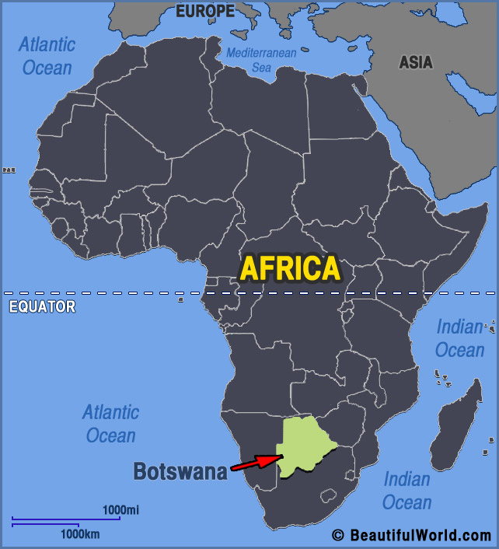
Background
Located in Southern Africa.
Middle income country.
Population 2,5 million
High prevalence of HIV: 18.5% (BIAS IV, 2013).
In June 2016, Botswana introduced 'Treat all’ (To provide ART for all citizens regardless of CD4 count.
Notes:
Sparsely populated, Population 2.5 million, 3rd highest HIV prevalence globally behind Lesotho & Swaziland
In June 2017, Botswana introduced 'Treat all' to provide ART free of charge to Botswana citizens irrespective of CD4 count.

Slide 6
Advancing Partners and communities (APC) project
FHI 360, APC funded by PEPFAR through USAID
Implemented in 8 districts in Botswana
Builds the capacity of communities to contribute to epidemic control.
Trained CHWs support health facilities to trace PLHIV
Not yet initiated on ART but are in the IDCC register
Missed appointments, defaulters and Lost to follow-up (LTFU).
CHWs use standardized tracking tools and SOPs developed by APC project.

Slide 7
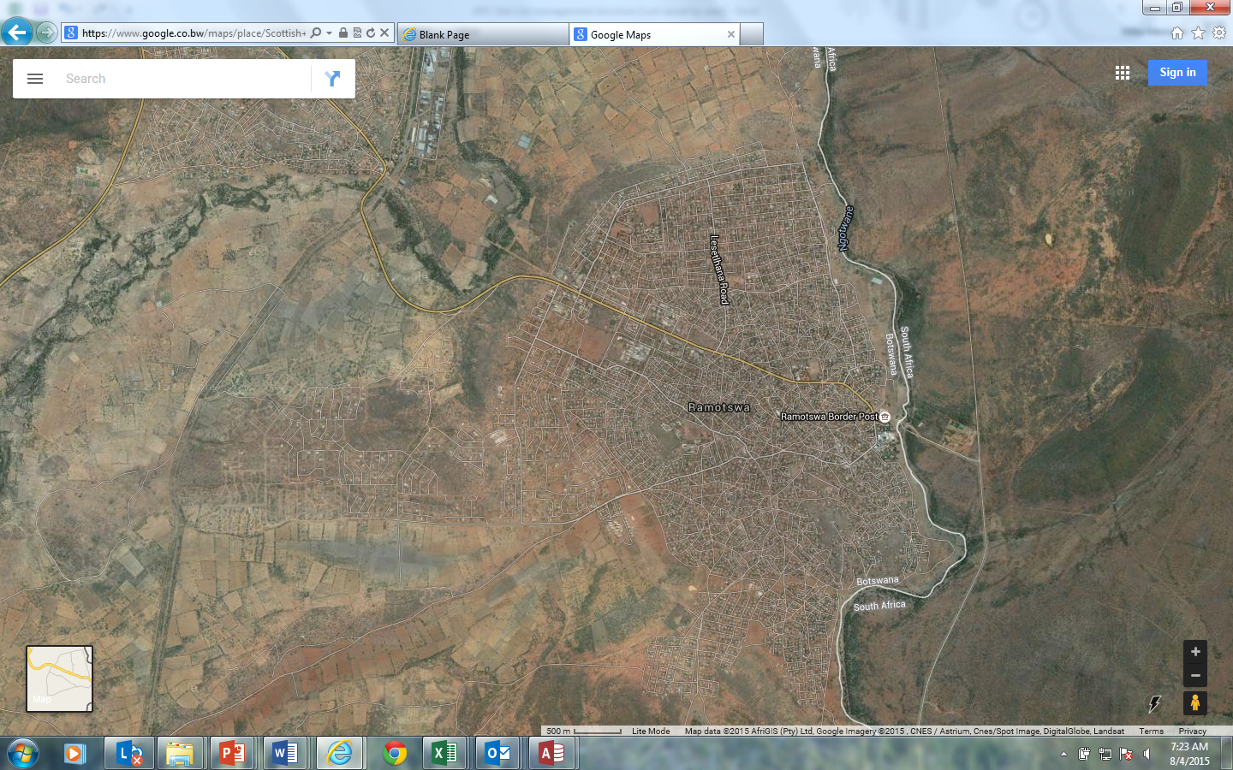
Standard of care before CHWs
IDCC
Nurse
Phone
call
Client
Before CHWs Nurses traced PLHIV lost from care through phone calls.
Notes:
Prior to the APC project, health facility staff traced PLHIV on treatment lost from care through phone calls.

Slide 8
Joint Community facility standard of care
IDCC
Nurse
Phone call
Senior
CHW
CHW
Client

Slide 9
Tracking process
Nurses in the infectious Disease Control Centres (IDCC) issue lists of PLHIV eligible for tracing to senior CHWs.
Senior CHWs verifies if contact information is sufficient to inform community tracing.
Senior CHWs assign CHWs PLHIV to trace based on their coverage area.
CHWs trace PLHIV through phone call and home visit.
Successfully traced patients are linked to facilities.
Clients requiring enhanced support for linkage are accompanied to the health facility.
CHWs provide feedback to facilities regarding unlinked clients (dead, transfer out, declined services, promise to come).
Notes:
FHI 360/APC Project trained CHWs on community HIV care including patient tracking strategies and provided standard operating procedures (SOPs) for guidance. Working in collaboration with the Ministry of Health & Wellness (MoHW) District Health Management Teams (DHMTs). Team leads-Senior Community Health Workers (SCHWs) posted in health facilities and together with nurses in the infectious Disease Control Centres (IDCC) identified
Patients that were in the registers but never started ART
Defaulters
A team of CHWs assigned a caseload of patients to track in the community. Successfully traced patients were linked to facilities through unaccompanied and accompanied referrals. They were also provided information on “Treat All” to support them to opt for ART initiation.

Slide 10
Number of people on Pre-ART, TAP and Legacy positives identified in the community and number linked to clinical care, from Oct 16 - Sep 17
46%
52%
25%
10%
7%
5%
1%
Notes:
584 (46%) had contacts in their clinical file for tracing. 306 (52%) linked back to health facilities and initiated on ART
146 (25%) already on ART, 57 (10%) referred but did not link, 40 (7%) had transferred out of facility, 27 (5%) declined to be linked back , 8 (1%) deceased

Slide 11
Number of people on Pre-ART, TAP and Legacy positives identified in the community and number linked to clinical care by sex, from Oct 16 - Sep 17
Notes:
52% of those linked were females, 48% were males

Slide 12
Number of people LTFU, defaulters, missed appointments tracked in the community and outcomes of tracking, from Oct 16 - Sep 17
61%
51%
26%
8%
6%
6%
3%
Notes:
1273(61%) had contacts in their clinical file for tracing. 651(51%) linked back to health facilities and initiated on ART, 334 (26%) were referred but did not link requiring additional follow-up,
98 (8%) already on ART, 80 (6%) were dead, 74 (6%) transferred out and 36 (3%) declined to be linked back

Slide 13
Number of people LTFU, defaulters, missed appointments linked back to care by CHWs by sex from Oct 16 - Sep 17
Notes:
72% of those linked were females, 28% males-(91% never married, 49% were cohabiting and 138 (21%) of those linked had no adherence partner at the time of linkage to care)

Slide 14
Limitations
No baseline data on the rate of linkage through facility standard of care before CHWs.
Use of paper based and electronic data collection systems leading to data loss for those traced linked but not enrolled in community care.

Slide 15
Conclusions
Implementation of community patient tracking contributes to linkage of PLHIV to ART.
CHWs are critical in filling the human resource gaps within the health system.
CHWs knowledge of their community allows successful tracing of those lost by the health system.
CHWs tracing efforts contributes to updating facility patient records.
Tracing patients that have defaulted from ART or lost from care is resource intensive.
PLHIV that are traced in the community do not always agree to be linked back to care

Slide 16
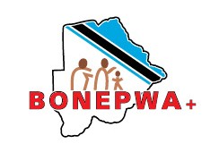
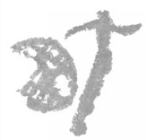
Acknowledgments

