Slide 1
Hidden Opportunities - What Will It Take to Reach 90-90-90 in Eastern Europe?
Vinay P. Saldanha, UNAIDS Regional Director,
Eastern Europe & Central Asia
2018 90-90-90 Targets Workshop
AIDS2018

Slide 2
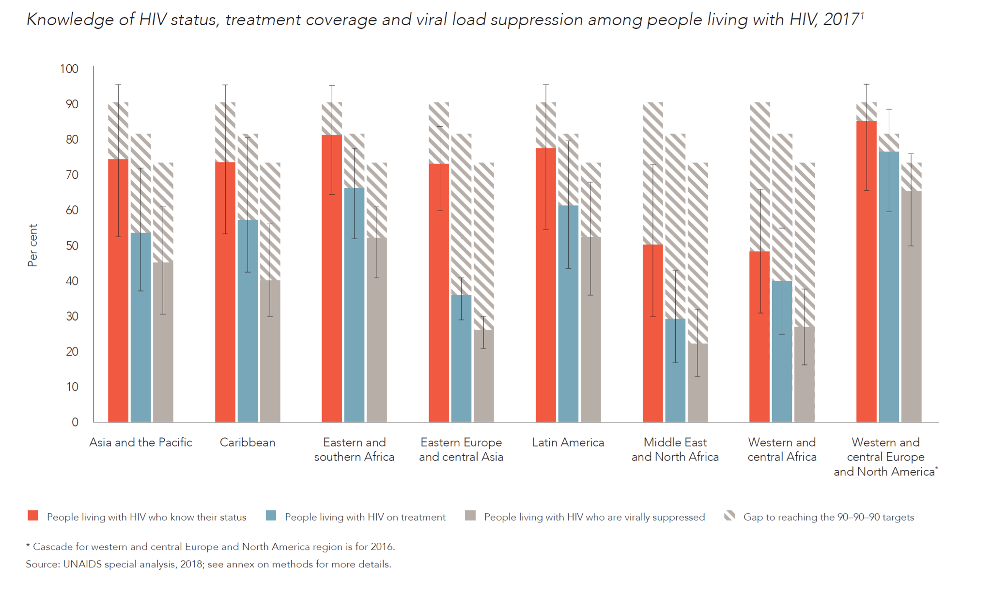
Progress varies by region

Slide 3
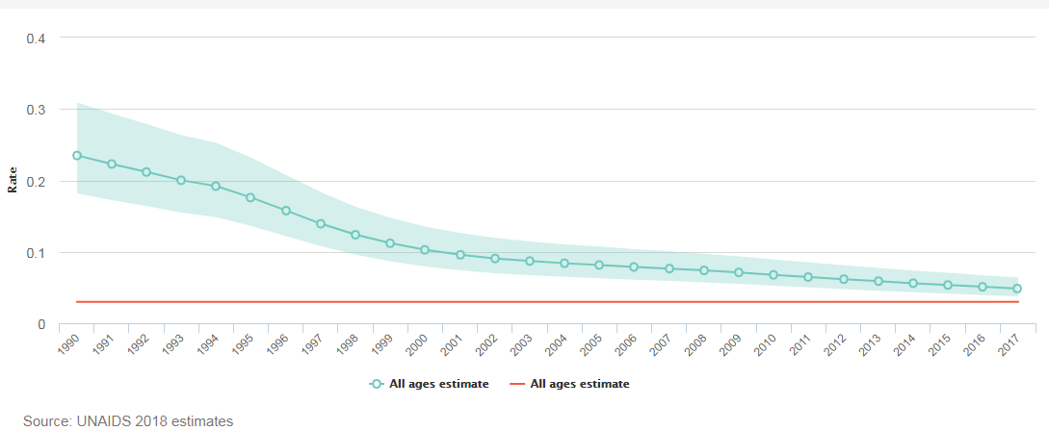
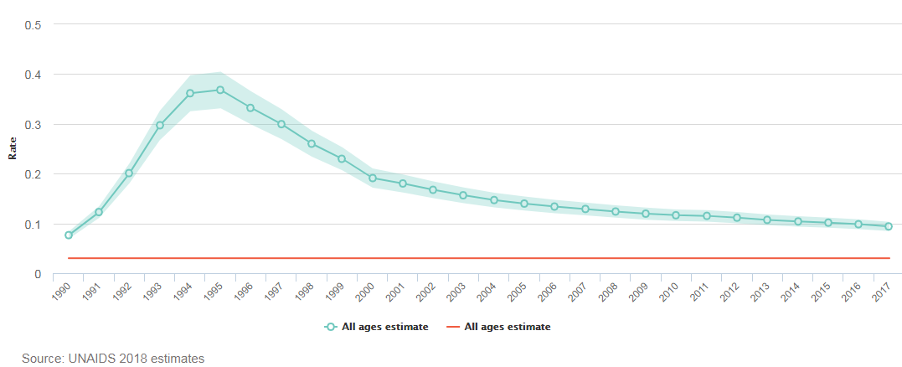
Incidence:prevalence ratio, global and by region, 1990–2017
Global
Eastern Europe and central Asia
Notes:
This ratio of the number of new HIV infections to the number of people living with HIV within a population produces the average duration of time a person lives with HIV in an epidemic that remains stable over many years (prevalence/incidence =duration). If a benchmark is set that corresponds to long life expectancy for people living with HIV, the ratio incorporates both impact-level objectives set by the United Nations General Assembly: preventing HIV infections and ensuring that HIV-positive people live long and healthy lives. UNAIDS has selected an epidemic transition benchmark of 0.03, which corresponds to an average life expectancy after infection of 30 years.

Slide 4
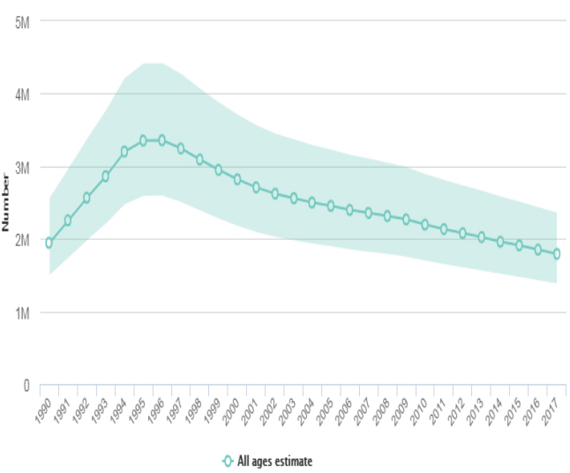
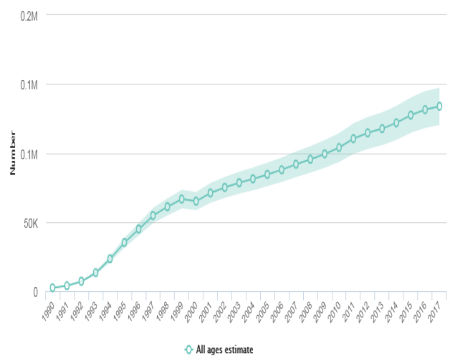
Trend in new HIV infection: global and by region, 1990–2017
Percent change in new HIV infections since 2010 -18 %
Percent change in new HIV infections since 2010 +30 %

Slide 5
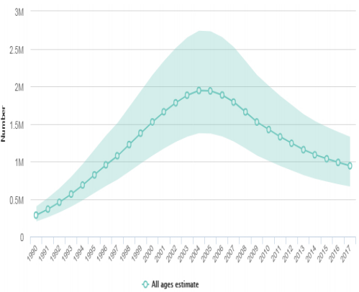
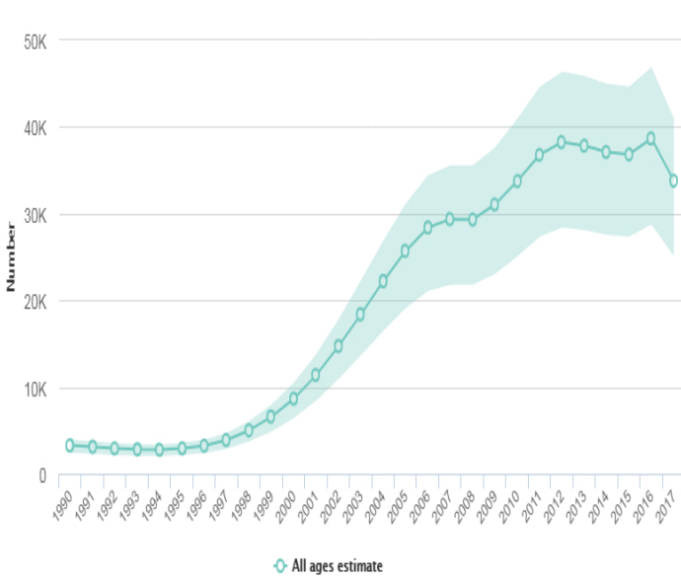
Trend of AIDS-related deaths: global and by region, 1990–2017
Percent change in AIDS-related deaths since 2010 -34 %
Percent change in AIDS-related deaths since 2010 0 %

Slide 6
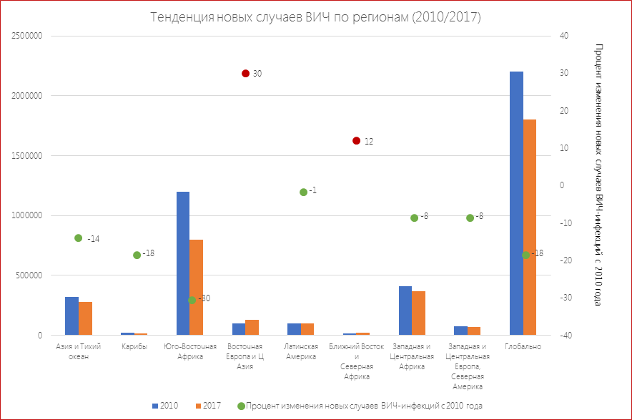
Trend in new HIV cases (2010/2017)
Percent changes in new HIV cases since 2010

Slide 7
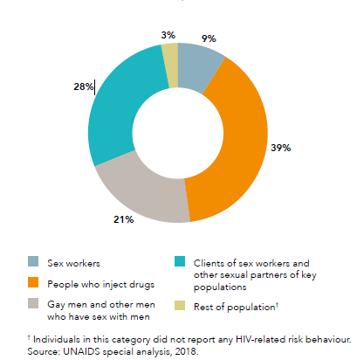
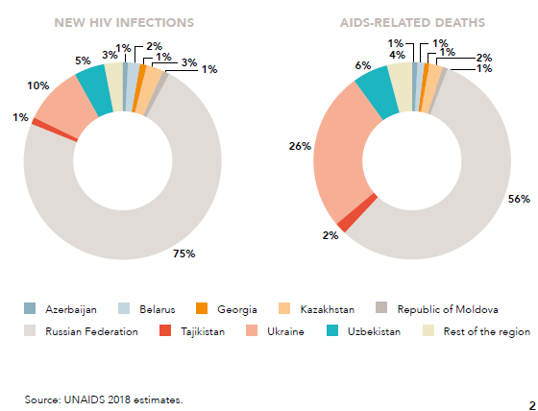
Distribution of new HIV infections and AIDS-related deaths, by population, country, eastern Europe and central Asia, 2017

Slide 8
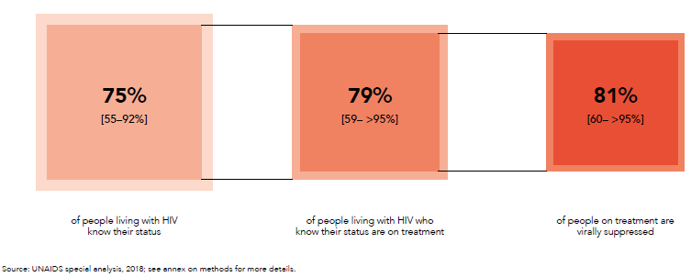
Remarkable progress on HIV testing and treatment: globally and by region, 2017

Slide 9
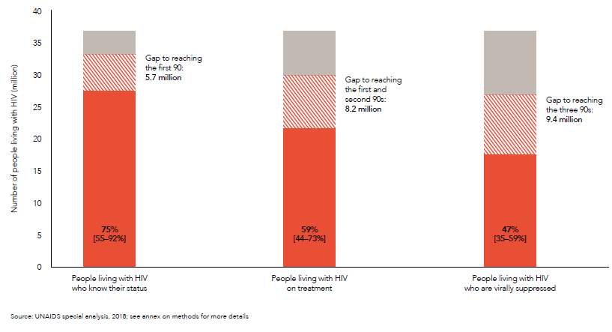
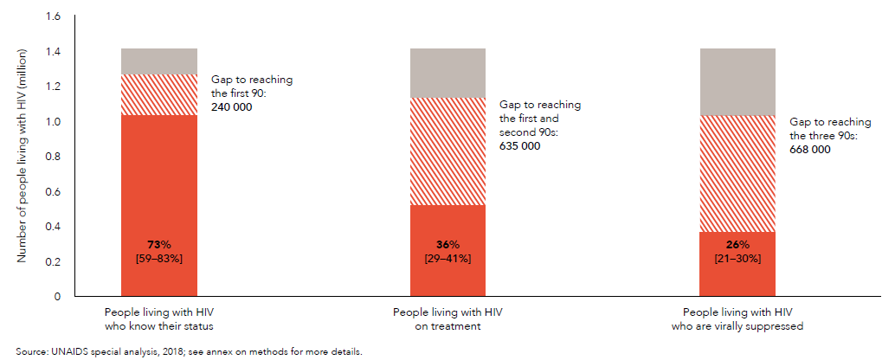
HIV testing and treatment cascade: global and region, 2017

Slide 10
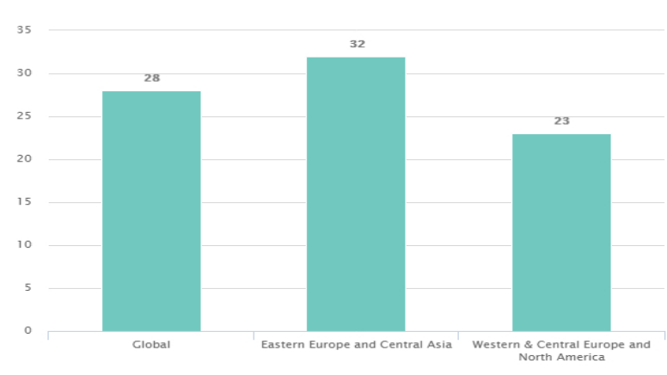
Late HIV diagnosis: All ages with CD4 <200

Slide 11
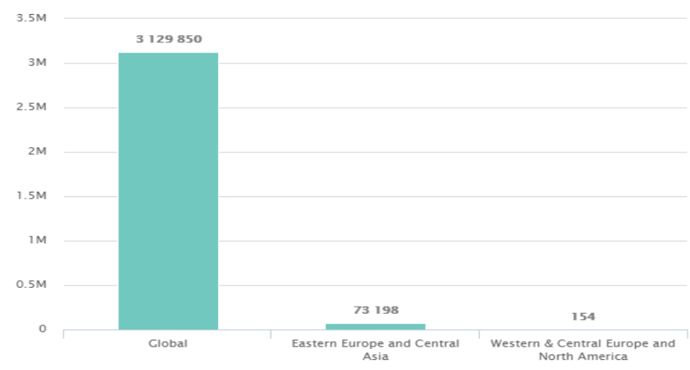
Number of people newly-initiating ART, 2017

Slide 12
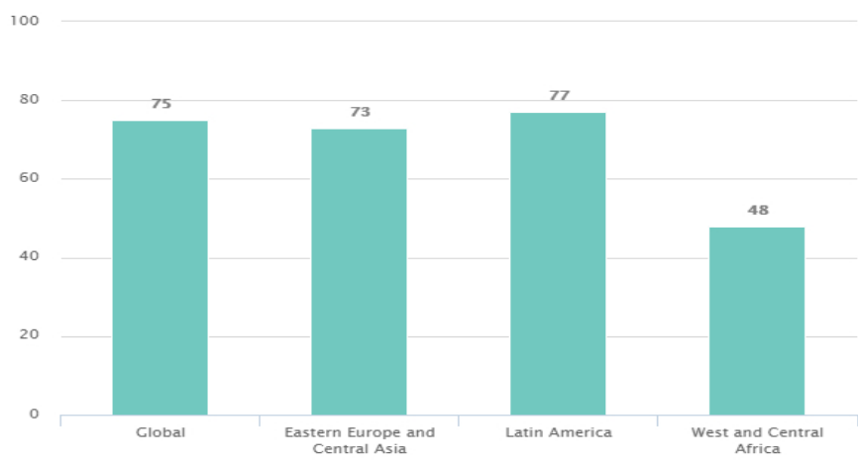
People living with HIV who know their status (%)

Slide 13
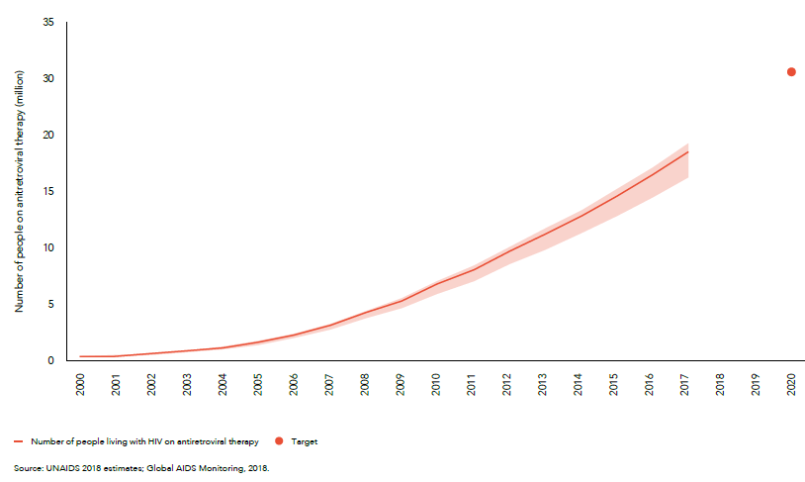
Number of people living with HIV accessing antiretroviral therapy, global, 2000–2017 and 2020 target

Slide 14
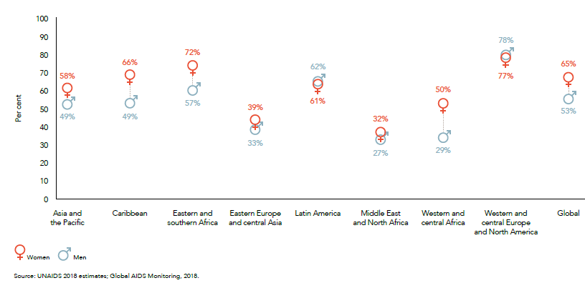
Coverage of antiretroviral therapy by sex, global and regional, 2017

Slide 15
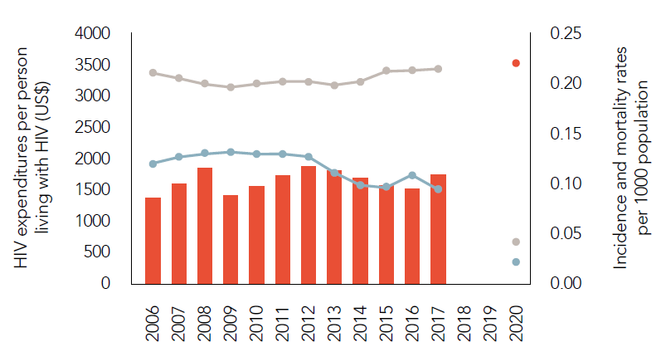
Insufficient investment and impact in the region

Slide 16
Remarkable progress on HIV testing and treatment

