Slide 1
HIV Testing & Human Rights:
Right to Know
&
Right to Privacy
Matthew M. Kavanagh, PhD
Georgetown University
O’Neill Institute for National & Global Health Law

Slide 2
Human Rights & Testing
Right to health
Right to privacy
Effective public helath

Slide 3
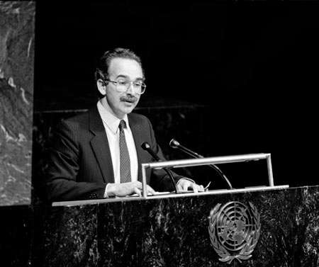
Jonathan Mann
Respect for human rights & public health are inextricably linked, not in opposition.

Slide 4
Right to health
  “Highest attainable standard of health”
    Intl. Convention on Economic, Social, Cultural Rights
  Right to be progressively realized within available resources—with elements that are of immediate effect
  In context of HIV, access to treatment has been interpreted by HR Council & UNHCR to be an immediately effective duty of states.

Slide 5
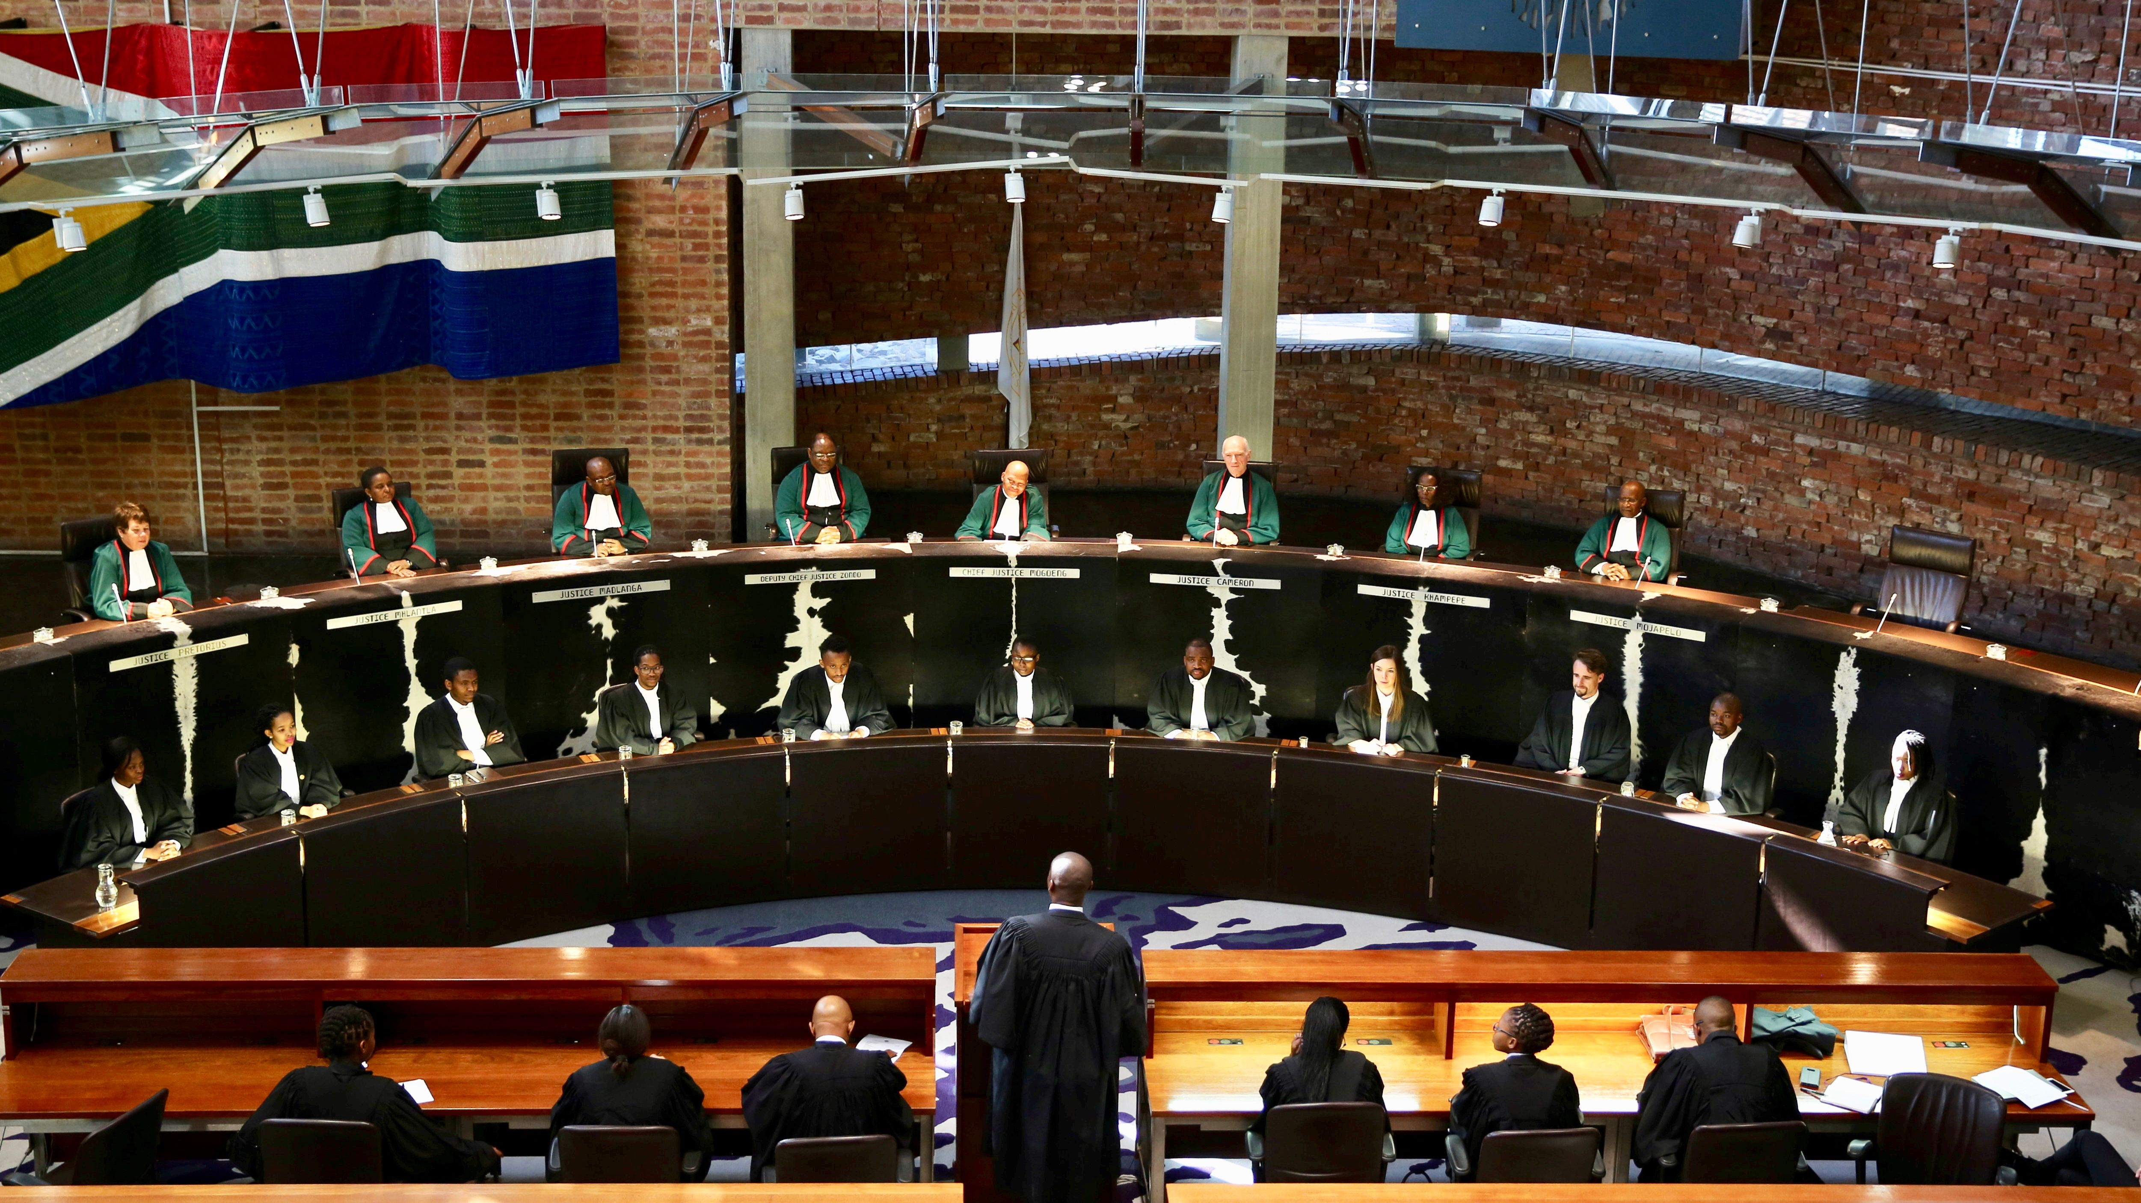
Just over half of countries in the world protect the right to health as a judicially enforceable individual right.
  South Africa: Minister of Health v. Treatment Action Campaign
  India: Sahara House v. Union of India
  Brazil: Rights to generics

Slide 6
Right to Know is Right to Treatment
Testing as entry point to treatment
Can’t realize without it

Slide 7
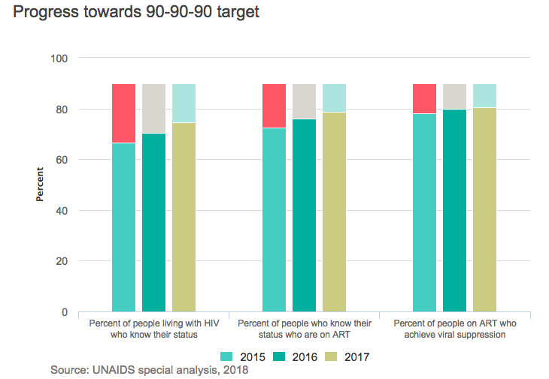
25%

Slide 8
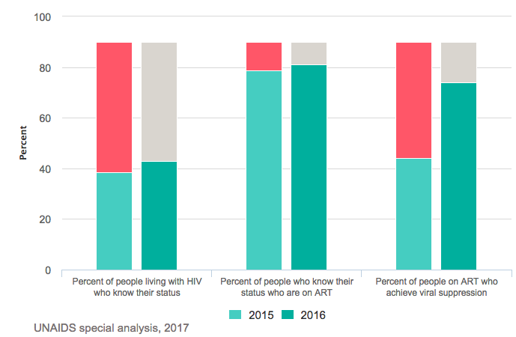
57%
West & Central Africa

Slide 9
What does RtH mean for testing?
Availability: sufficient quantity of functioning public health and health care facilities, goods and services, as well as programs for all.
Accessibility: accessible to everyone: non-discrimination, physical accessibility, economic accessibility, information accessibility.
Acceptability: cater for the specific needs of diverse population groups and in accordance with international standards of medical ethics.
Quality: scientifically and medically sound; safe, effective.

Slide 10
Different modalities have different yield & volume
Botswana

Slide 11
Monitor coverage
PITC in Malawi

Slide 12
Namibia
Consider populations

Slide 13

Rights presume universality…
UNAIDS
Target

Slide 14
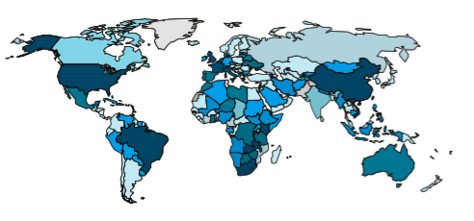
HIV self testing
16 countries 2 years ago
40 countries at last report
But many still “have” a policy but it is not implemented

Slide 15
Right to privacy
Universal declaration of human rights
Intl. Convention on Civil & Political Rights
Part of the right to health under general comment 14 (acceptability)

Slide 16
Stigma is still real

Slide 17
Index texting / partner notification

Slide 18
High Yield
Zimbabwe

Slide 19
Kenya

Slide 20
Haiti

Slide 21
Ukraine

Slide 22
Botswana

Slide 23
Concerns with Index/PN
Coercion
Intimate partner violence
Key populations disclosure
Perception—just one case is enough

Slide 24
What is coercion?
2011 interview study of counselors: “some participants stated that after all attempts to encourage voluntary disclosure failed; they occasionally 'threatened' their patients to make them notify their partners.”
".... if I try other measures and don't succeed, I will tell you that if you don't do it I will do it for you. When you do that many will not want you to be the one to do it. They will rather prefer to do it themselves....." (Female counsellor, 48 years old)
Njozing, Barnabas N., et al. "" If the patients decide not to tell what can we do?"-TB/HIV counsellors' dilemma on partner notification for HIV." BMC international health and human rights 11.1 (2011): 6

Slide 25
Incentives by what we measure

Slide 26
Botswana

Slide 27
Refusal rates
Refusal rate | Refusal Rate
Brown, Lillian B., et al. "HIV partner notification is effective and feasible in sub-Saharan Africa: opportunities for HIV treatment and prevention." Journal of acquired immune deficiency syndromes 56.5 (2012): 437 | 11%
Kamanga, G., et al. "Maximizing HIV partner notification opportunities for index patients and their sexual partners in Malawi." Malawi Medical Journal 27.4 (2015): 140-144. | 10%
Fu, Xiaojing, et al. "Partner notification in cooperation with community-based organizations among HIV-positive men who have sex with men in two Chinese cities." International journal of STD & AIDS 27.10 (2016): 821-831. | 12.1%
Kahabuka, Catherine, et al. "Addressing the first 90: a highly effective partner notification approach reaches previously undiagnosed sexual partners in Tanzania." AIDS and Behavior21.8 (2017): 2551-2560. | 3.9%

Slide 28
Intimate partner violence
Studies | Screened positive for IPV
Henley, Catherine, et al. "Scale-up and case-finding effectiveness of an HIV partner services program in Cameroon: an innovative HIV prevention intervention for developing countries." Sexually transmitted diseases 40.12 (2013): 909. | 7%
Goyette, Marielle S., et al. "Brief Report: HIV Assisted Partner Services Among Those With and Without a History of Intimate Partner Violence in Kenya." JAIDS Journal of Acquired Immune Deficiency Syndromes 78.1 (2018): 16-19. | 7%
Several qualitative studies have failed to find any IPV resulting from PN

Slide 29
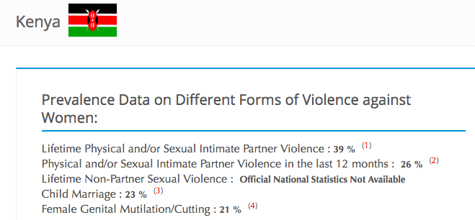
Do our screening tools work?
“all of the included IPV screening tools need additional reliability and validity testing. For example, test retest reliability of the HITS, the WAST, and the PVS has not been studied. No studies reported the internal reliability of the PVS. One study documented the discriminant validity of the WAST, but further validation in other populations would be helpful…. screening tools had sensitivities and specificities that varied widely. For example, the sensitivities of the PVS ranged from 35% to 71%. A reported sensitivity of 35% is concerning because maximum sensitivity should be the goal for IPV screening tools.”
Rabin, Rebecca F., et al. "Intimate partner violence screening tools: a systematic review." American journal of preventive medicine 36.5 (2009): 439-445.

Slide 30
Key Populations: most receive services through public sector and never disclose
Mozambique: KP “reached“ 44,183
Adult population: 17.2 million
Total reached: 0.2%

Slide 31
Perception—just one case

Slide 32
Rights-Based Interventions: prevent violations + respond when (not if) they occur
Clear legal and policy environment
Human rights training
Creation of rights violation reporting
Legal support services
Refusal rates as a measure of respect for right to refuse

