Slide 1


Combination HIV prevention in Rakai, Uganda: Progress, Challenges, and Opportunities
AIDS 2018
MOSA401: Risk heterogeneity across the 90-90-90
M. Kate Grabowski, PhD ScM
Assistant Professor of Pathology and Epidemiology
Johns Hopkins University, Rakai Health Sciences Program
Notes:
Thank you to the conference organizers and session chair for this wonderful opportunity. My name is Kate Grabowski and I am pleased to present these data on behalf of the Rakai Health Sciences Program.

Slide 2
Disclosures
The speaker has no relevant disclosures.

Slide 3
Presentation objectives
Describe Rakai Community Cohort Study (RCCS)
Impact of combination HIV prevention (CHP)
Sub-groups with lower ART coverage
Migration and infection flow: implications for HIV control
Summary and future directions

Slide 4
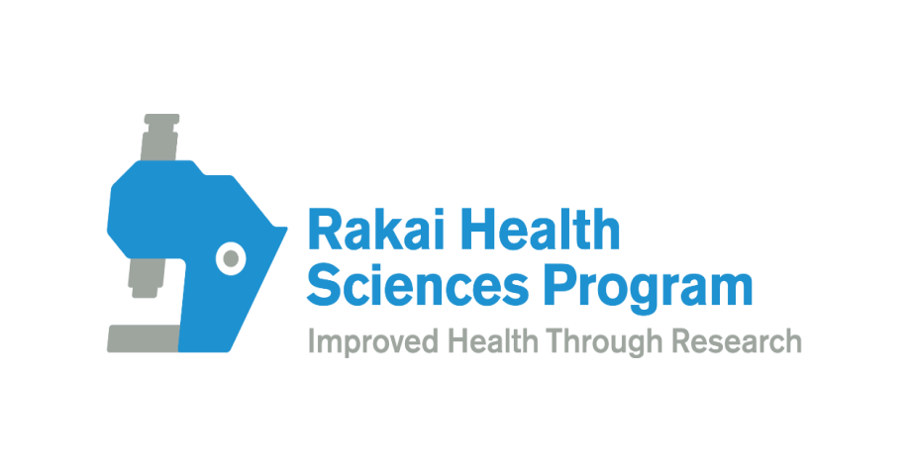
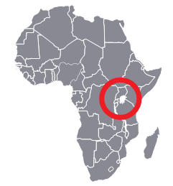
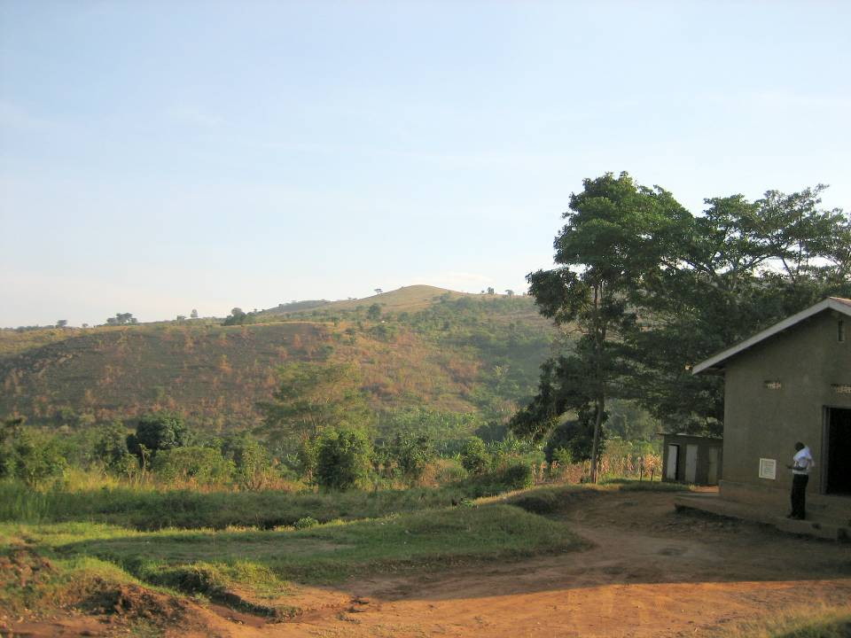
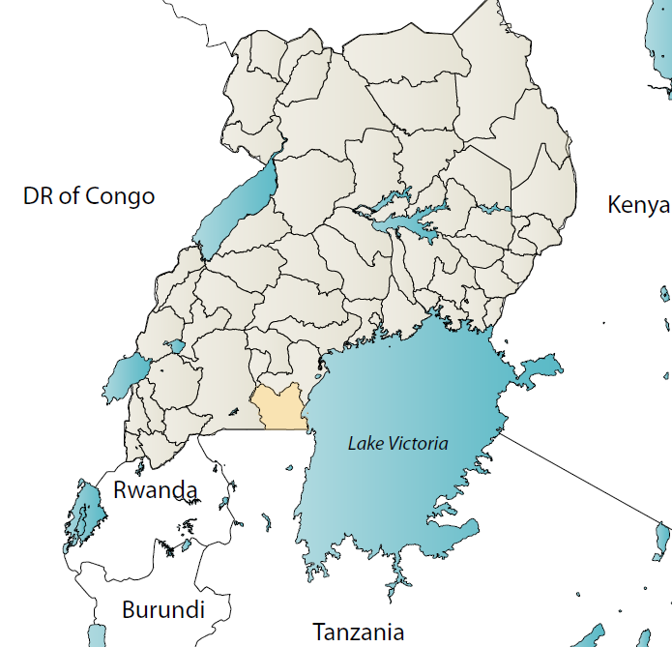
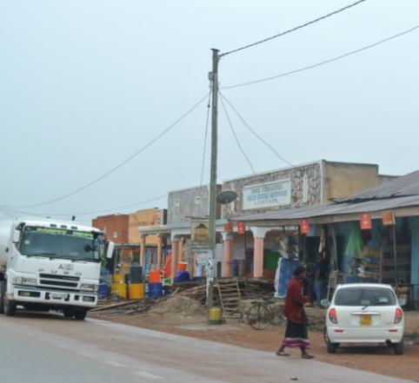
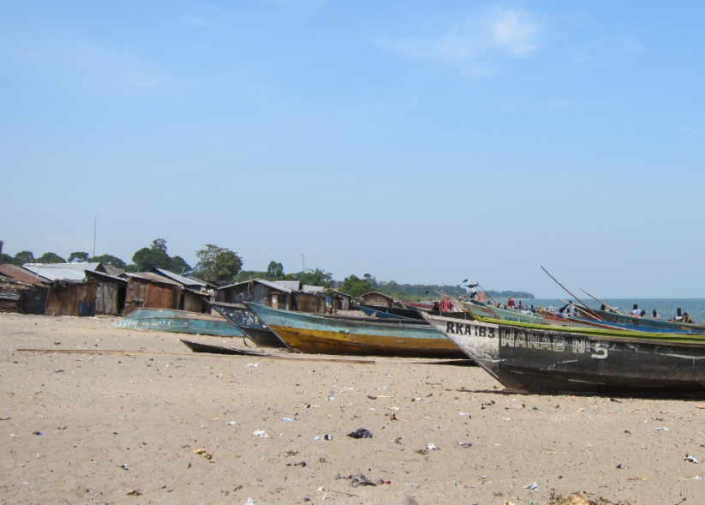
Rakai, Uganda
Population ~500K, HIV prevalence ~13%
Agrarian, semi-urban trading, and fishing communities
Objective 1/5: The Rakai Community Cohort Study

Slide 5
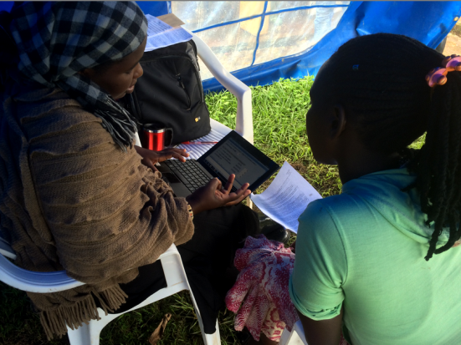
The Rakai Community Cohort Study (RCCS)
Conducted by Rakai Health Sciences Program since 1994
RCCS is an open population-based census and HIV surveillance cohort in 40 communities in Rakai, Uganda.
  Ages 15-49 years
  Survey interval ~ 1.5 year
  ~22,000 study participants
In 2011, RCCS expanded surveillance to four high prevalence fishing communities on Lake Victoria.

Slide 6
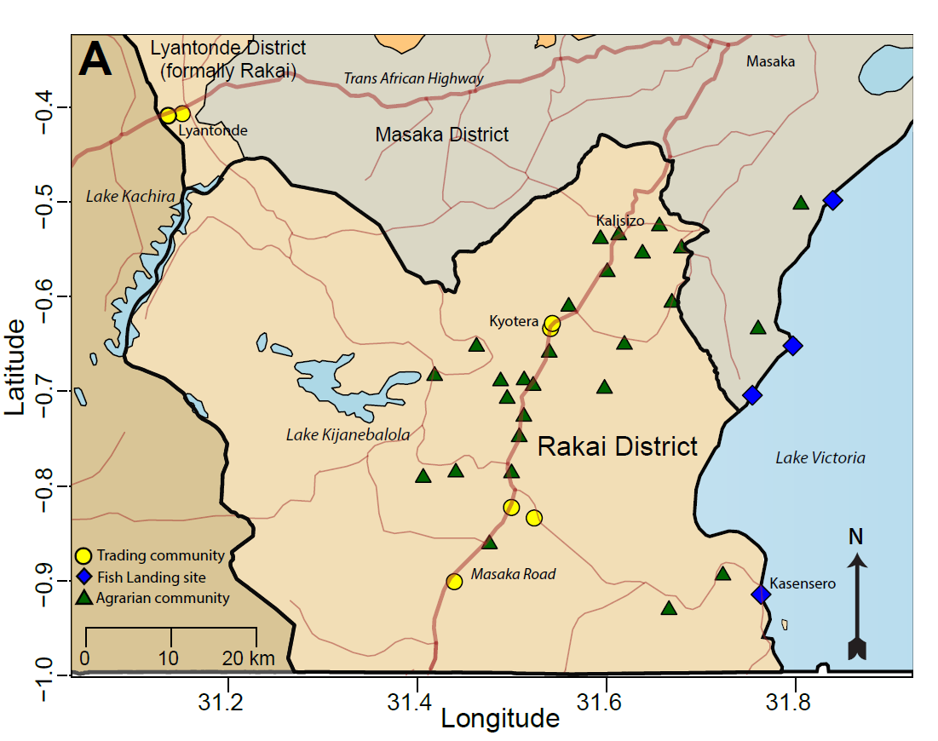
RCCS study communities
Chang, Grabowski et al. Lancet HIV. 2016

Slide 7
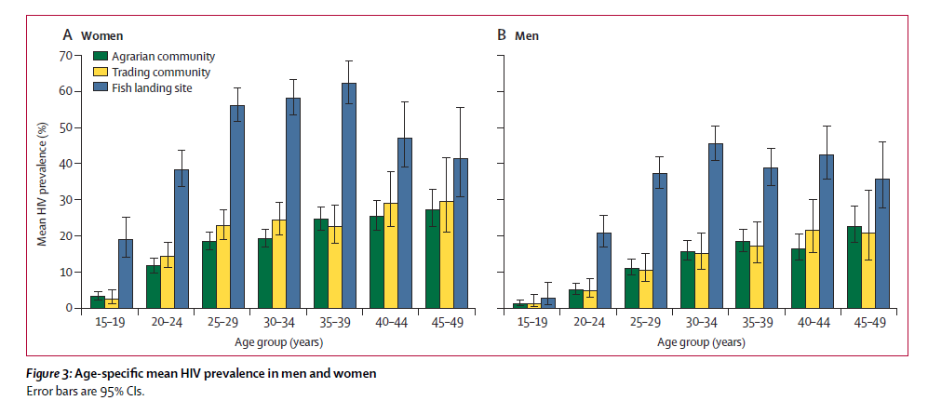
Age-specific HIV prevalence in the RCCS
Chang, Grabowski et al. Lancet HIV. 2016

Slide 8
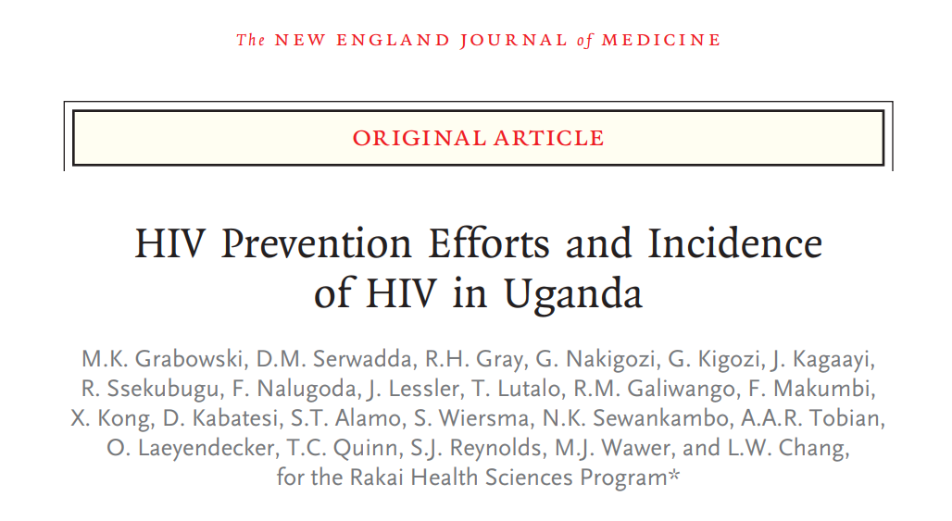
HIV incidence and scale-up of CHP
Population-based study of HIV incidence and scale-up of combination HIV prevention in 30 RCCS agrarian and trading communities, 1999-2016
Scale up of ART began in 2004 and male circumcision in 2007
Grabowski et al. NEJM. 2017

Slide 9
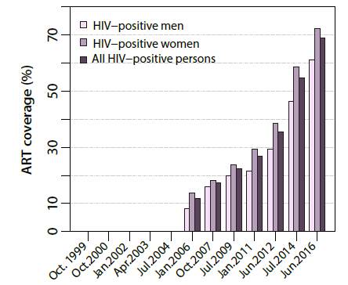
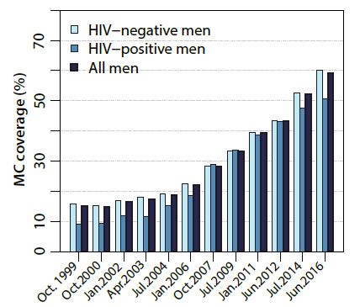
CHP scale-up in agrarian/trading communities
By 2016:
  Self-reported ART use: 69%
  Population viral load suppression: 75%
  Male circumcision: 59%
ART coverage
Male circumcision coverage
* Results obtained prior to Universal Test and Treat in 2017
Grabowski et al. NEJM. 2017

Slide 10
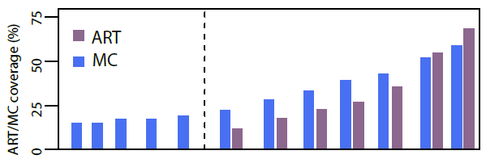
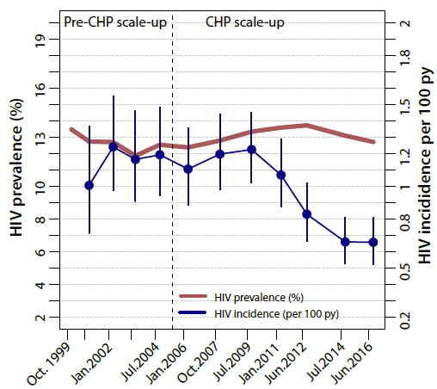
HIV incidence declines with CHP scale-up
HIV incidence stable prior to scale-up of CHP in 2004.
Incidence declined from 1.16/100 py to 0.66/100 py in 2016 (p<0.001).
Relative to period prior to CHP scale up, 42% decline in incidence by 2016 (adjIRR=0.58; 95%CI: 0.45-0.76).
*
**
**
* p<0.05
** p<0.001
Grabowski et al. NEJM. 2017

Slide 11
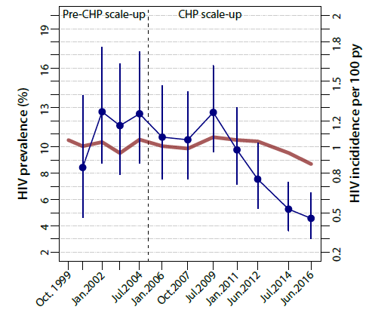
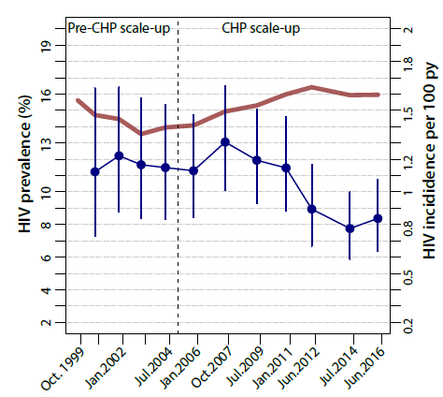
HIV incidence declines among men and women
HIV incidence declined 54% in men (adjIRR=0.46; 95%CI: 0.29-0.73) and 32% in women (adjIRR=0.68, 95%CI: 0.50-0.94).
Men
Women
Grabowski et al. NEJM. 2017

Slide 12
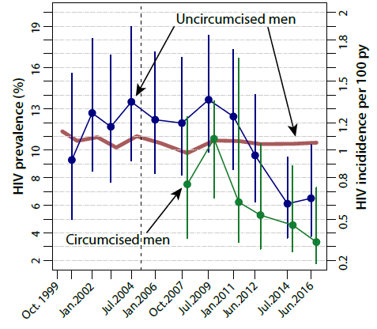
Circumcision and HIV incidence declines among men
HIV incidence per 100 py in 2016:
  Uncircumcised men: 0.65 (95%CI:0.37-1.04)
  Circumcised men: 0.33 (95%CI: 0.18-0.56)
Circumcised men benefitting from indirect effects of higher ART coverage in women and direct effects of circumcision.
Grabowski et al. NEJM. 2017

Slide 13
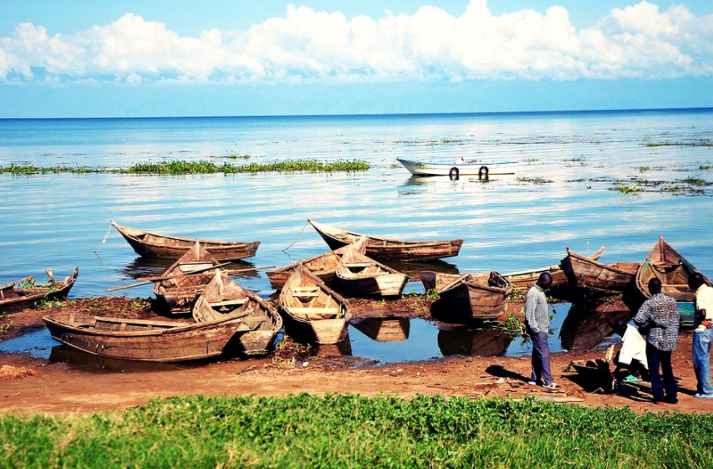
Does combination HIV prevention also reduce HIV incidence in Rakai’s hotspot fishing communities on Lake Victoria?
Notes:
MENTION TEST AND START

Slide 14
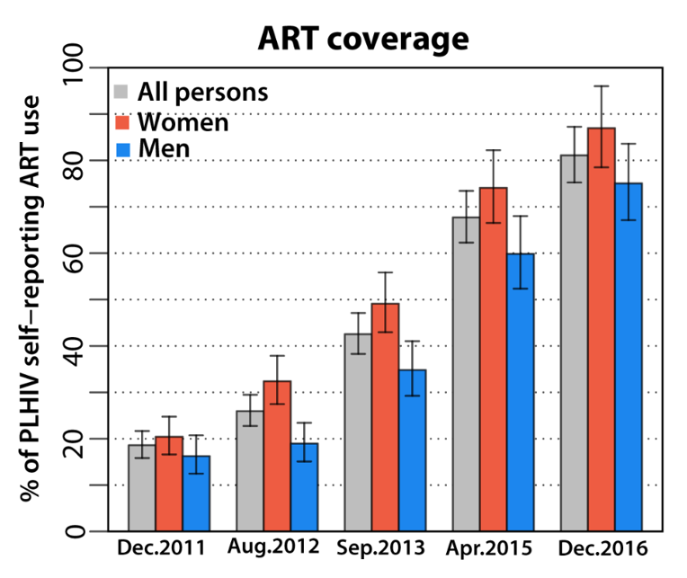
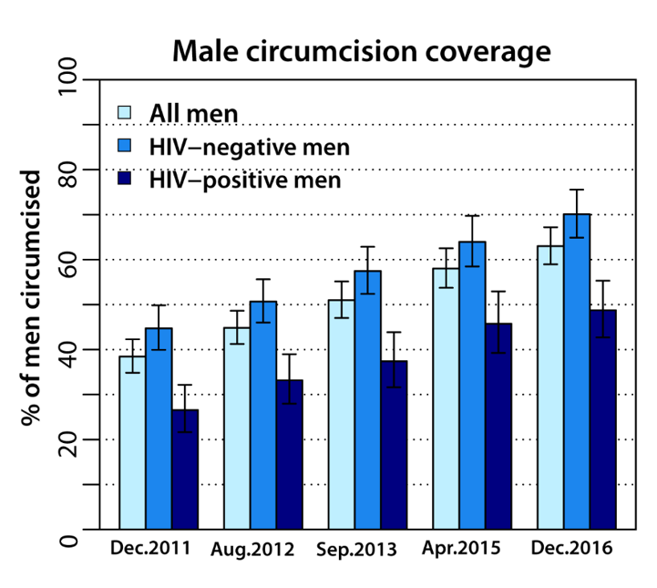
CHP scale-up in Lake Victoria fishing communities
By 2016:
  Self-reported ART use: 81%
  Population viral load suppression: 78%
  Male circumcision: 63%
Universal Test and Treat
Kagaayi et al. CROI. 2018

Slide 15
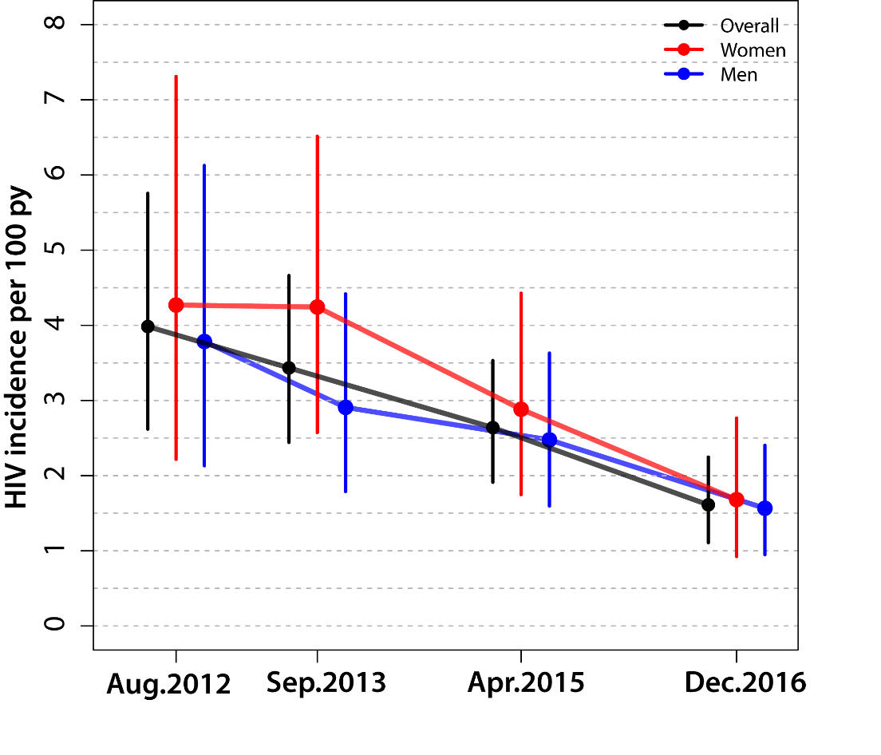
CHP impact in Lake Victoria fishing communities
Universal Test and Treat
By 2016, 58% overall reduction in HIV incidence with Universal Test and Treat (IRR=0.42, 95%CI: 0.25-0.72).
Similar reduction among men (55%) and women (62%).
Kagaayi et al. CROI. 2018

Slide 16
Conclusions on CHP impact
HIV has incidence significantly declined with CHP scale-up.
  Impact observed in high and low prevalence communities
  Lowest incidence among circumcised men
However, even at “90-90-90” and circumcision almost 60%, incidence remains well above UNAIDS targets for HIV elimination.
Grabowski et al. NEJM. 2017

Slide 17
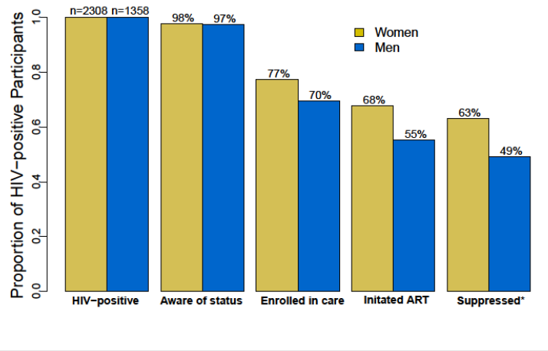
HIV care cascade 2013: Lower ART coverage in men
Billioux et al. JIAS. 2017

Slide 18
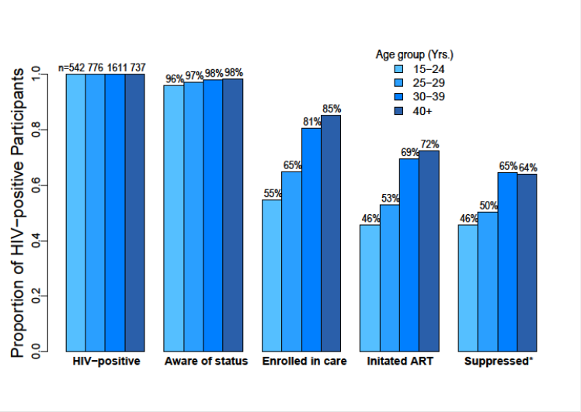
HIV care cascade 2013: Lower ART coverage in younger age groups
Billioux et al. JIAS. 2017

Slide 19
ART use lower among persons under 15-29 years with high risk sexual behaviors
Sexual behavioral risk factor | Men Relative Risk of ART initiation (95%CI) | Women Relative Risk of ART initiation (95%CI)
2 partners in last year* | 0.67 (0.40-1.07) | 0.75 (0.57-0.96)
3+ partners in last year* | 0.70 (0.43-1.11) | 0.86 (0.57-1.24)
Sex with non-marital partner** | 0.63 (0.45-0.90) | 0.77 (0.64-0.92)
Sex with partner outside community*** | 0.77 (0.50-1.15) | 0.76 (0.60-0.95)
* Relative to 1 partner in last year; ** Relative to sex with only marital partners; ***Relative to sex with partner in same community only
Billioux et al. Submitted

Slide 20
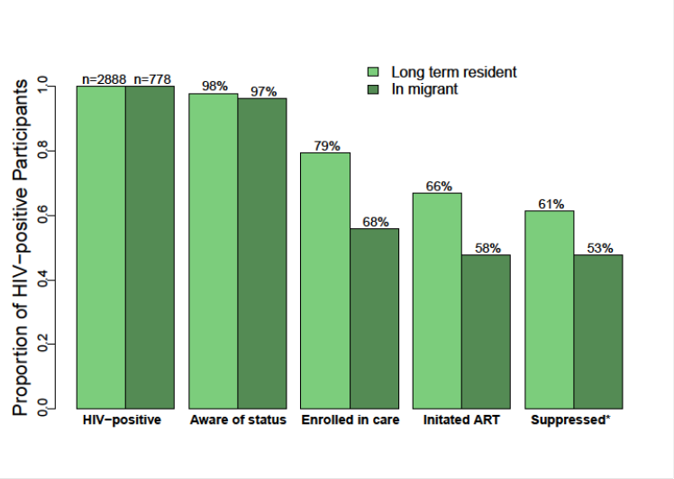
HIV care cascade 2013: Lower ART coverage in recent migrants (arrival < 2 years)
Billioux et al. JIAS. 2017

Slide 21
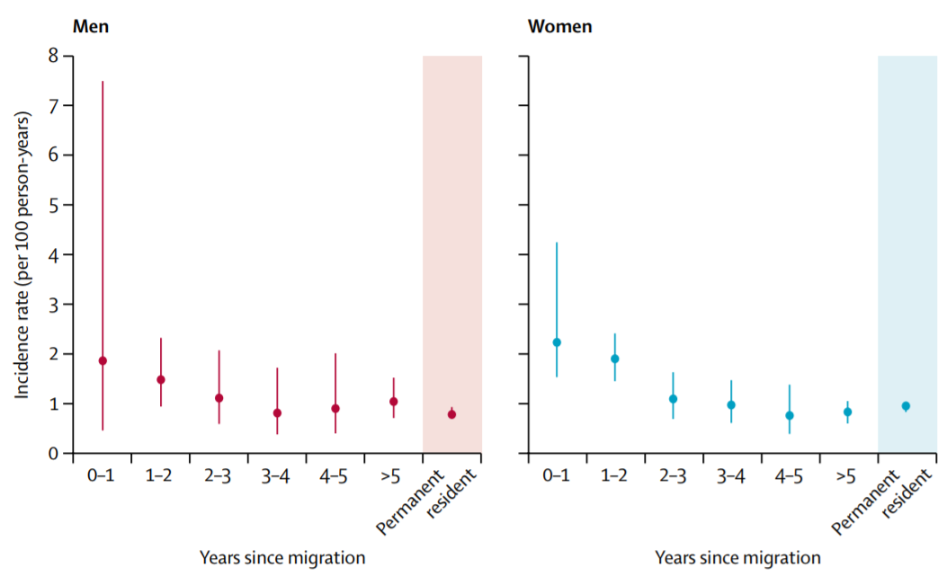
HIV incidence in recent migrants
HIV incidence is significantly higher among migrants who arrived <2 years:
  Women: IRR=1.92 (95%CI:1.52-2.43)
  Men: IRR=1.75 (95%CI: 1.33=2.33)
HIV incidence among recent migrants has NOT declined with scale-up of CHP, despite declines in resident population.
Olawore et al. Lancet HIV. 2018

Slide 22
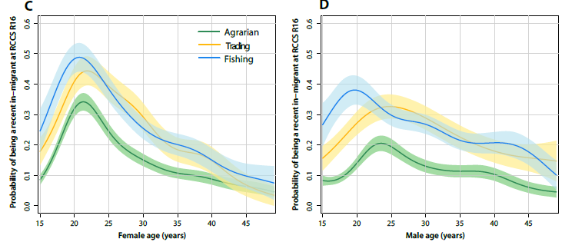
Probability of being a migrant by age
Women
Men
Probability of being a recent migrant
Female age (years)
Male age (years)
Migration more common among women and in fishing and trading communities
Grabowski et al. Submitted

Slide 23
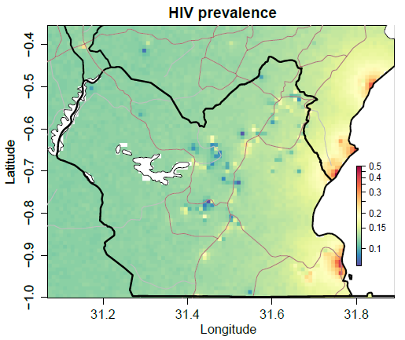
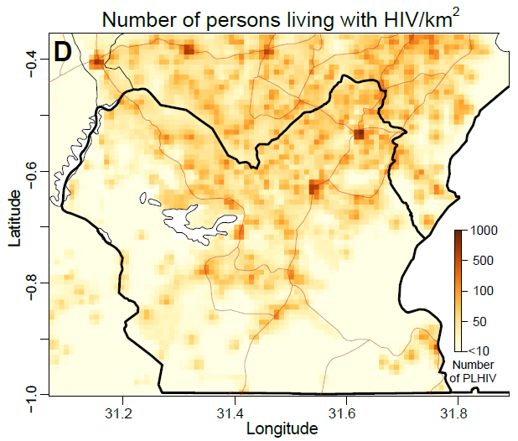
Could geographically targeted control work?
Are high prevalence HIV epidemics in fishing communities (i.e. “hotspots”) driving HIV transmission in the general agrarian and trading population?
High prevalence
Lower case counts
Lower
prevalence
High HIV case
counts
?
?

Slide 24
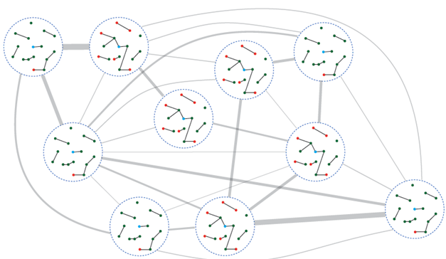
Are Lake Victoria fishing communities sources of HIV transmission?
R01 NIAID, Gates Foundation
Objective: Analyze migration networks and viral infection flows between high and low prevalence communities in the Rakai Community Cohort Study
Data: Census migration data; Deep sequencing viral phylogenetics

Slide 25
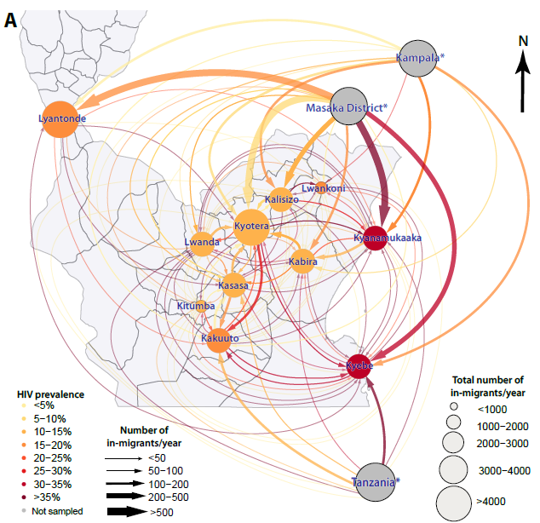
Migration flows and HIV
Preferential migration of HIV positive persons into fishing communities
Phenomenon largely driven by highly infected female populations with low ART coverage
Grabowski et al. Submitted
Notes:
SPLIT THESE

Slide 26
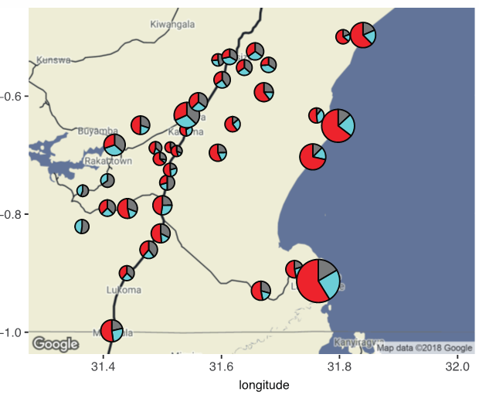
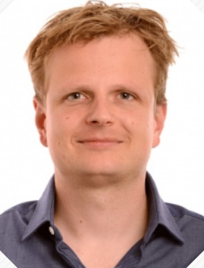
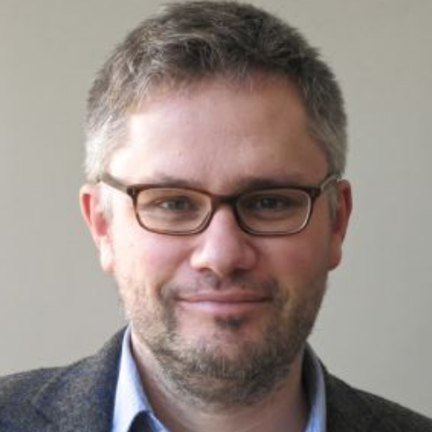
Assessing viral flow between communities
PANGEA-HIV consortium (BMGF funded): 4074 serum samples collected, 2011-2014 for next generation HIV sequencing
Reconstructed HIV transmission networks using viral genomes
Estimated proportion of transmission within and between fishing and inland agrarian and trading populations
Oliver Ratmann
Christophe Fraser

Slide 27
Viral flows between communities
ABSTRACT THAC0102: Thursday, 26 July 2018, 11:15 AM

Slide 28
Conclusions
HIV incidence has declined with scale-up of CHP in settings with and without Universal Test and Treat.
  Lowest incidence among circumcised men.
HIV elimination still not achieved.
  ART coverage remains sub-optimal among men, young people (<30 years) with high risk behaviors, and migrants.
Migrants have high HIV incidence which has not declined with CHP scale-up.
Geographic targeting of CHP to high prevalence hotspots may not reduce HIV transmission in lower risk populations.

Slide 29
Welcome In-coming Neighbor (WIN) Study
NIMH R01
Goals: to decrease HIV incidence and viral load among new in-migrants through rapid linkage to combined HIV prevention/care.
Design: Community randomized implementation science trial
Intervention arm:
  WIN scouts contact all in-migrants to welcome them
  Provide information on health care resources
Control arm: Standard access to care
Endpoint: CHP coverage and incidence by arm
Low tech, low cost, replicable

Slide 30
Acknowledgements
Rakai Health Sciences Program
David Serwadda
Fred Nalugoda
Joseph Kagaayi
Godfrey Kigozi
Gertrude Nakigozi
Tom Lutalo
Robert Ssekubugu
Grace Kigozi
Jeremiah Bazaale
Johns Hopkins Bloomberg School of Public Health
Ronald Gray
Maria Wawer
Justin Lessler
Caitlin Kennedy
Joseph Ssekasanvu
Johns Hopkins School of Medicine
Aaron Tobian
Larry Chang
National Institute of Allergy and Infectious Diseases
Thomas Quinn
Andrew Redd
Oliver Laeyendecker
Steve Reynolds
Oxford University
Christophe Fraser
Matthew Hall
Chris Wymant
Lucie Abeler-Dorner
Tanya Golubcick
Rakai Health Science Program Staff and Study participants
Johns Hopkins Center For AIDS Research
National Institutes of Health
Centers for Disease Control
Bill and Melinda Gates Foundation
Imperial College
Oliver Ratmann

